Slide 1
BIOE 498 / BIOE 599 Advanced Biological Control Systems Lecture 8: Analysis Using Block Diagrams
Joseph L. Hellerstein
eScience Institute, Computer Science & Engineering
Allen School of Computer Science
BioEngineering
Notes:
Diverse students. Some with bio-backgrounds; some without. Some with CS background; some with very limited. Two separate courses combined because of a substantial shared curriculum.

Slide 2
Agenda
Constructing block diagrams
Laplace Transforms and Transfer Functions
From block diagram to transfer functions
From transfer functions to block diagrams

Slide 3
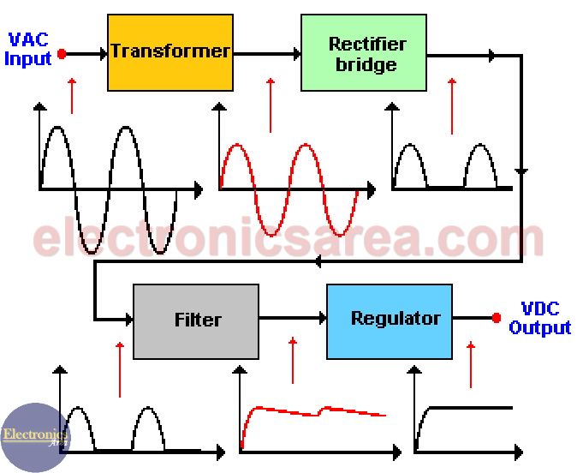
Motivating Example
How does a DC power supply convert AC power?

Slide 4
Why Diagrams?
Abstraction that allows for seeing relationships without excessive details
A way to do incremental refinement
A means of communication
Requires consistent rules

Slide 5

From Reactions to Block Diagrams
Reaction Network
S1
J1
S2
$$J2$$
S3
Block Diagrams
S1
S2
S3
S1
S2
S3
S1 is outside by the system
S1 is part of the system
Block diagram terminology
Lines (S1, S2, S3) are signals (values over time).
Blocks (J1, J2) are systems that transform signals
The relationship between reactions and systems is complex since reactants are not traditional inputs since reactants can be transformed by reactions.

Slide 6


Creating Block Diagram
S1
S2
S3
$$G_{1}(s)$$
$$G_{2}(s)$$
Rules for block diagrams
Arrows are drawn between systems and/or connectors to indicate signal transmission
A connections between systems indicates convolution.
Scalar signals are thin arrows; vector signals are thick arrows
Systems are annotated with their transfer functions (may be multivariate)

Slide 7
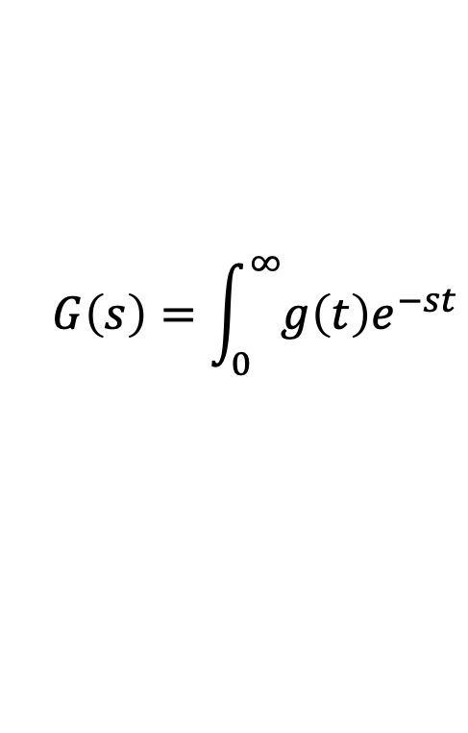
Laplace Transforms
The Laplace transform of a signal describes how it varies over time.
The Laplace transform of a system describes how the system transforms input signals to output signals.
Called a transfer function
Mathematical definition
$$G\left(s\right)=\int_{0}^{∞}{g\left(t\right)e^{−st}}$$

Slide 8
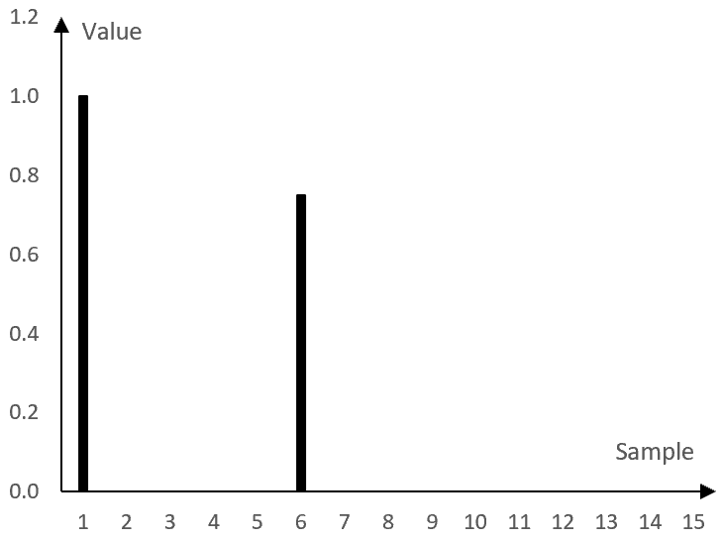






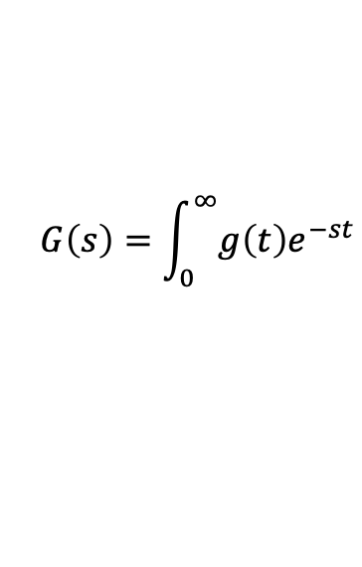


A First Laplace Transform
$$G\left(s\right)=\int_{0}^{∞}{g\left(t\right)e^{−st}}$$
Impulse signal at time $τ$: $δ_{τ}\left(t\right)=1, τ=t;0, τ≠t$
Laplace Transform
$${L[δ}_{τ}\left(t\right){]=e}^{−sτ}$$
$${L[δ}_{0}\left(t\right)]=$$
$$1$$
$$δ_{1}$$
$${L[δ}_{1}]=e^{−s}$$
$${L[δ}_{1}]=e^{−st}+\left(0.8\right)e^{−6s}$$
$${(0.8)δ}_{6}$$
$${L[δ}_{6}]={(0.8)e}^{−6s}$$
Signals and systems can be described using combinations of more Laplace Transforms.
Notes:
Show how can encode a discrete signal with a sum of e^-st terms. Show time shifts and scale by constant.

Slide 9
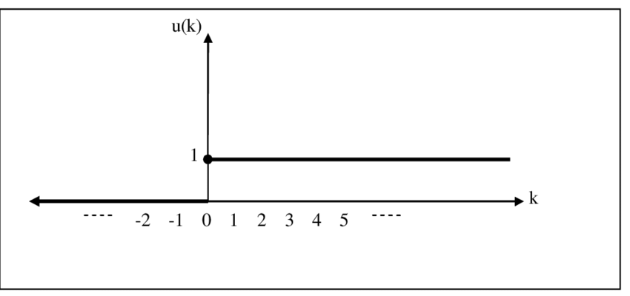
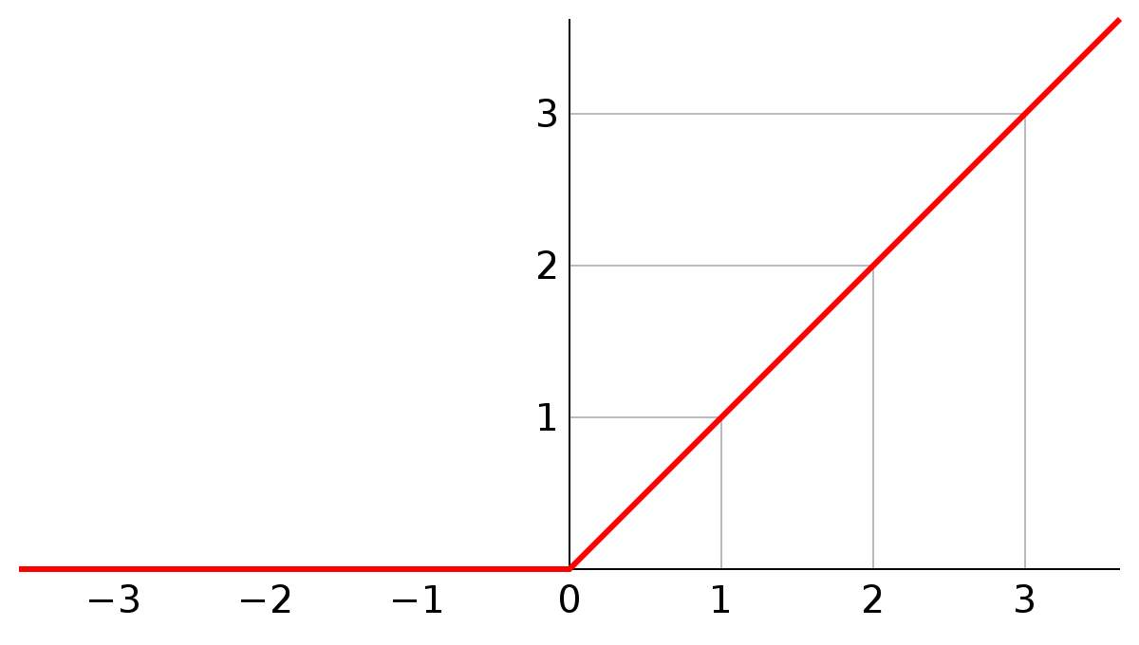

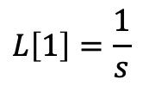


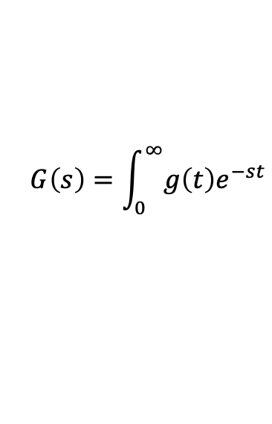

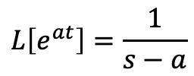



More Laplace Transforms
$$G\left(s\right)=\int_{0}^{∞}{g\left(t\right)e^{−st}}$$
Unit step at time 0: g$\left(t\right)=1, t≥0;0, t<0.$
Ramp: g$\left(t\right)=t, t≥0;0, t<0.$
$$g\left(t\right)$$
$$g\left(t\right)$$
Laplace Transform
$$L\left[1\right]=\frac{1}{s}$$
Laplace Transform
$$L\left[t\right]=\frac{1}{s^{2}}$$
Laplace Transform of transcendentals:
$$L\left[e^{at}\right]=\frac{1}{s−a}$$
$$L\left[cos⁡(ωt)\right]=\frac{s}{s^{2}+ω^{2}}$$
$$L\left[sin⁡(αt)\right]=\frac{ω}{s^{2}+ω^{2}}$$

Slide 10
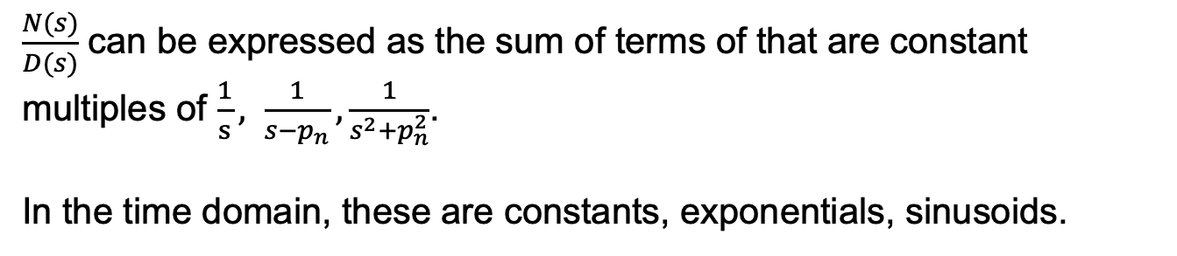

Inverse of a Laplace Function
$$G\left(s\right)=\int_{0}^{∞}{g\left(t\right)e^{−st}}$$
General form for a T.F.: $G\left(s\right)=\frac{N(s)}{D(s)}=\frac{s^{M}+b_{1}s^{M−1 }+⋯+b_{M}}{s^{N}+a_{1}s^{N−1 }+⋯+a_{N}}=\frac{\left(s−z_{1}\right)⋯(s−z_{M})}{\left(s−p_{1}\right)⋯(s−p_{N})}$
$z_{m}$ are the zeroes, $p_{n}$ are the poles.
$\frac{N(s)}{D(s)}$ can be expressed as the sum of terms of that are constant multiples of $\frac{1}{s}, \frac{1}{s−p_{n}}, \frac{1}{s^{2}+p_{n}^{2}}$.
In the time domain, these are constants, exponentials, sinusoids.
Poles indicate stability, oscillations

Slide 11

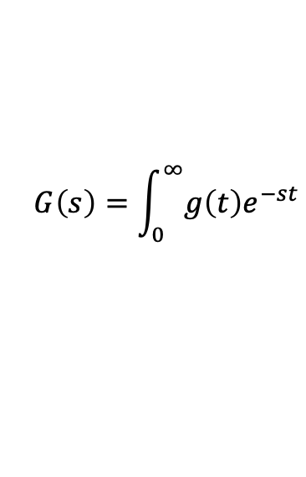
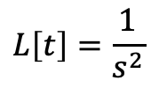

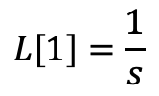
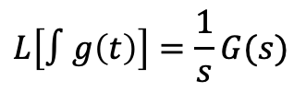



LaPlace Transform Properties
$$G\left(s\right)=\int_{0}^{∞}{g\left(t\right)e^{−st}}$$
Constant multiplication
Derivative
Integral
$$L[ag\left(t\right)]=aG(s)$$
$$L[\dot{g}\left(t\right)]=sG(s)$$
$$L\left[∫g\left(t\right)\right]=\frac{1}{s}G(s)$$
$${(0.8)δ}_{6}$$
${L[δ}_{0}]=$1
$$L\left[1\right]=\frac{1}{s}$$
$$L\left[t\right]=\frac{1}{s^{2}}$$
$$δ_{1}$$
Notes:
How do the last 3 LT relate to each other?

Slide 12
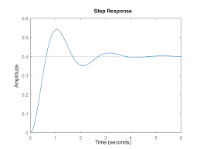
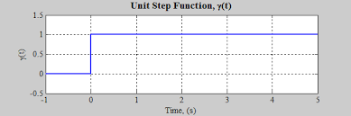

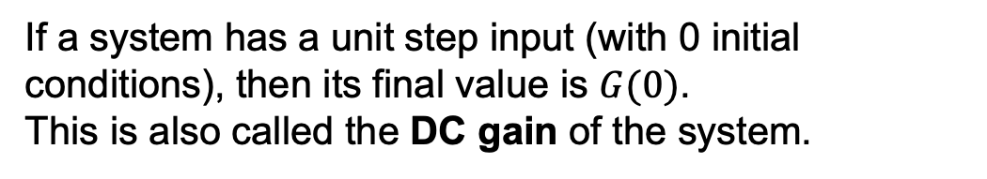


Step Response of a System
Transfer Function: The Laplace transform of a system
$$y(∞)$$
$$G(s)$$
$$G(0)=y(∞)$$
If a system has a unit step input (with 0 initial conditions), then its final value is $G(0)$.
This is also called the DC gain of the system.

Slide 13

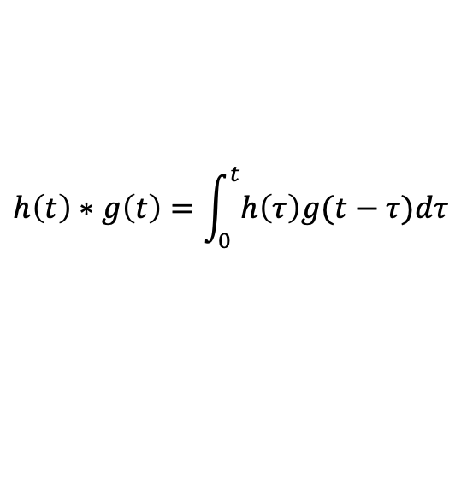
Convolution of Transfer Functions
Convolution
$$h\left(t\right)∗g\left(t\right)=\int_{0}^{t}{h\left(τ\right)g(t−τ})dτ$$
$$L[h\left(t\right)∗g\left(t\right)]=H\left(s\right)G(s)$$

Slide 14

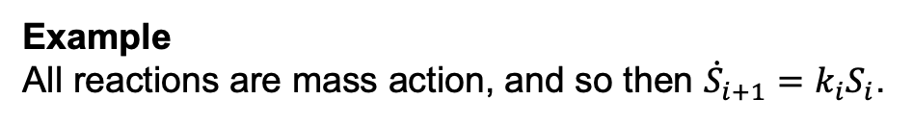

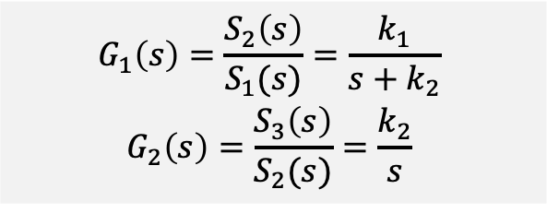
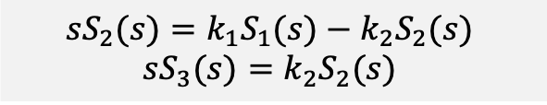
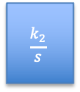
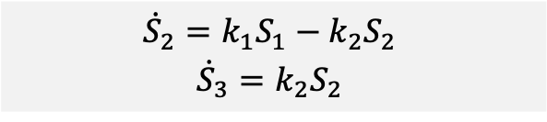

Calculating Transfer Functions From Block Diagrams S1 is outside the system (fixed species)
Finding Transfer Functions
Write state equations in terms of the inputs
Calculate the ratios for each system. Signals other than the input to and output from the system are set to 0.
Example
All reactions are mass action, and so then ${\dot{S}}_{i+1}=k_{i}S_{i}$.
S1
S2
$$G_{2}(s)$$
S3
$$G_{1}(s)$$
$${{\dot{S}}_{2}=k_{1}S_{1}−k_{2}S_{2}}_{ }$$
$${{\dot{S}}_{3}=k_{2}S_{2}}_{ }$$
$$G_{1}\left(s\right)={\frac{S_{2}\left(s\right)}{S_{1}(s)}=\frac{k_{1}}{s+k_{2}}}_{ }$$
$${G_{2}\left(s\right)=\frac{S_{3}\left(s\right)}{S_{2}(s)}=\frac{k_{2}}{s}}_{ }$$
$${{sS}_{2}(s)=k_{1}S_{1}(s)−k_{2}S_{2}(s)}_{ }$$
$${sS_{3}(s)=k_{2}S_{2}(s)}_{ }$$
S1
S2
$$\frac{k_{2}}{s}$$
S3
$$\frac{k_{1}}{s+k_{2}}$$
Notes:
Possibilities for the input signal

Slide 15
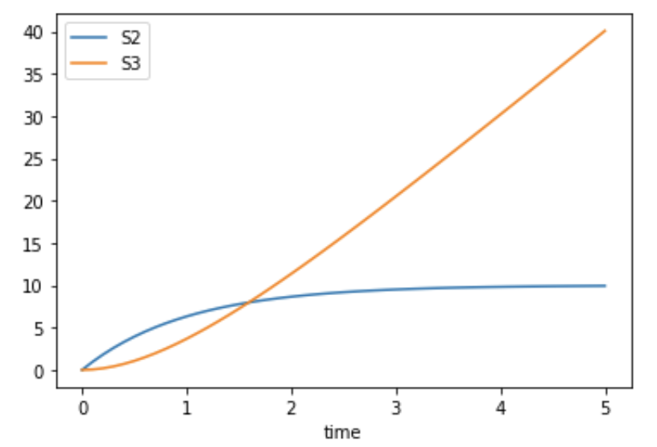

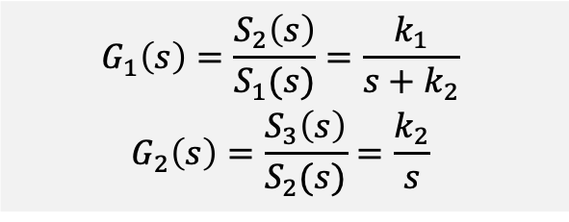
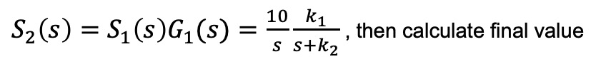
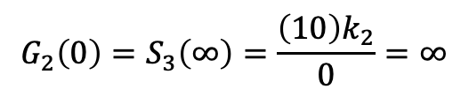



Analysis S1 is outside by the system
$$G_{1}\left(s\right)={\frac{S_{2}\left(s\right)}{S_{1}(s)}=\frac{k_{1}}{s+k_{2}}}_{ }$$
$${G_{2}\left(s\right)=\frac{S_{3}\left(s\right)}{S_{2}(s)}=\frac{k_{2}}{s}}_{ }$$
S1
S2
$$G_{2}(s)$$
S3
$$G_{1}(s)$$
What is the response of $G_{1}\left(s\right)$ to a step of size 10?
$S_{2}\left(s\right)={{S_{1}\left(s\right)G}_{1}(s)=\frac{10}{s}\frac{k_{1}}{s+k_{2}}}_{ }$, then calculate final value
$$k_{1}=1=k_{2}$$
$$G_{1}\left(0\right)=S_{2}\left(∞\right)={(10)k}_{1}/k_{2}$$
What is the response of $G_{2}\left(s\right)$ to a step of size 10?
$$G_{2}\left(0\right)=S_{3}\left(∞\right)=\frac{{\left(10\right)k}_{2}}{0}=∞$$
Notes:
Possibilities for the input signal

Slide 16
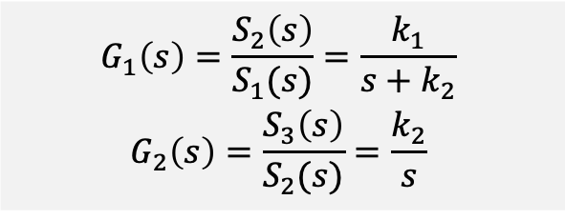
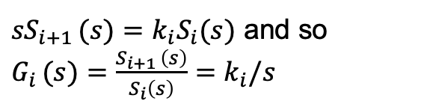
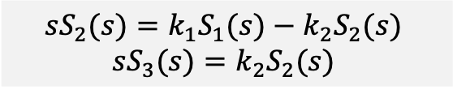
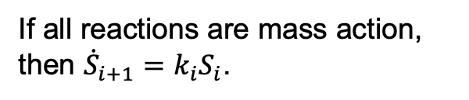
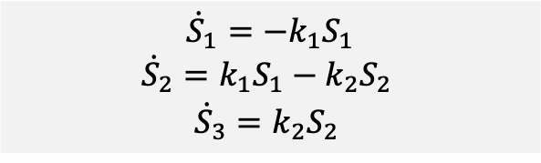



System 2: S1 is part of the system
If all reactions are mass action, then ${\dot{S}}_{i+1}=k_{i}S_{i}$.
S1
S2
S3
${sS}_{i+1 }(s)=k_{i}S_{i}(s)$ and so $G_{i }(s)={\frac{S_{i+1 }\left(s\right)}{S_{i}\left(s\right)}=k}_{i}/s$
$$G_{1}(s)$$
$$G_{2}(s)$$
$$G_{1}\left(s\right)={\frac{S_{2}\left(s\right)}{S_{1}(s)}=\frac{k_{1}}{s+k_{2}}}_{ }$$
$${G_{2}\left(s\right)=\frac{S_{3}\left(s\right)}{S_{2}(s)}=\frac{k_{2}}{s}}_{ }$$
$${\dot{S}}_{1}={−k}_{1}S_{1}$$
$${{\dot{S}}_{2}=k_{1}S_{1}−k_{2}S_{2}}_{ }$$
$${{\dot{S}}_{3}=k_{2}S_{2}}_{ }$$
$${{sS}_{2}(s)=k_{1}S_{1}(s)−k_{2}S_{2}(s)}_{ }$$
$${sS_{3}(s)=k_{2}S_{2}(s)}_{ }$$
$S_{1}\left(s\right)=\frac{1}{s+k_{1}}$, since exponential decay.

Slide 17
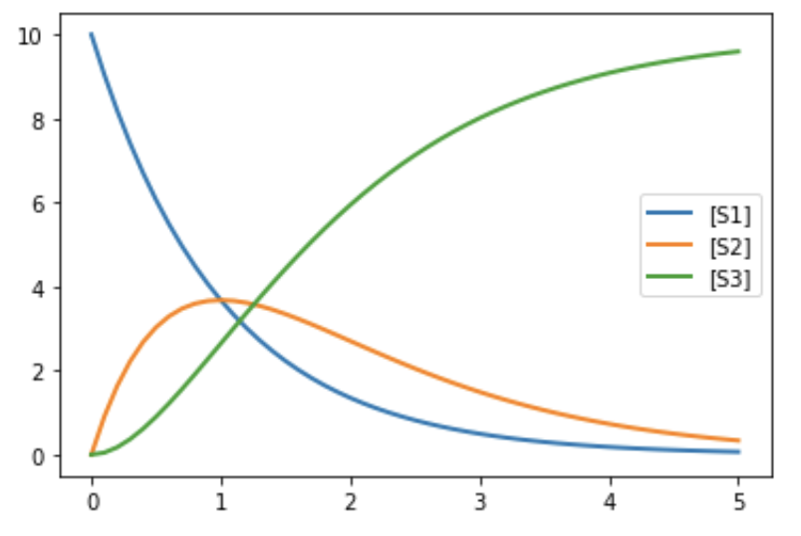


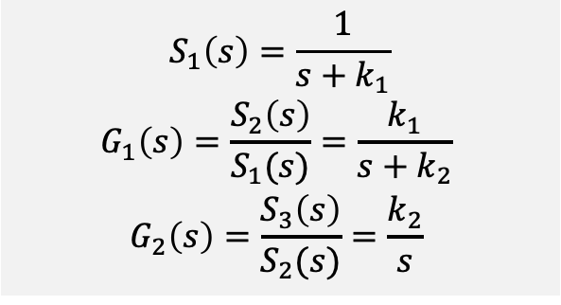
Analysis of System 2
$$S_{1}\left(s\right)=\frac{1}{s+k_{1}}$$
$$G_{1}\left(s\right)={\frac{S_{2}\left(s\right)}{S_{1}(s)}=\frac{k_{1}}{s+k_{2}}}_{ }$$
$${G_{2}\left(s\right)=\frac{S_{3}\left(s\right)}{S_{2}(s)}=\frac{k_{2}}{s}}_{ }$$
S1
S2
$$G_{2}(s)$$
S3
$$G_{1}(s)$$

Slide 18
Block Diagram of Linear Systems
Elements
Systems: TF, input, output
Connectors
Line from system to system: Signal
Line from system to add-connector: Signal addition
Example

Slide 19
From Block Diagram to System TF
Series connection of system
Addition connector
Feedback
Strategy of block reduction

Slide 20
From System TF to Block Diagram
Series connection of system
Addition connector
Feedback

Slide 21
BACKUP

Slide 22


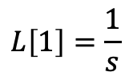
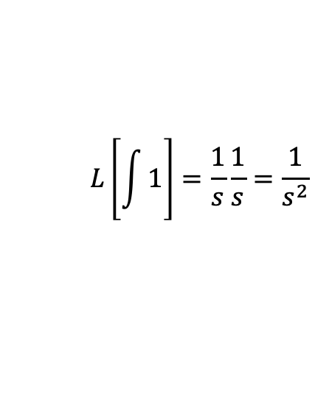
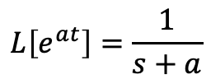
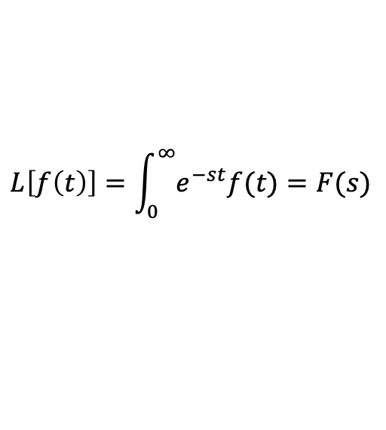


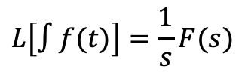

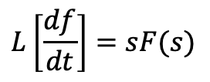
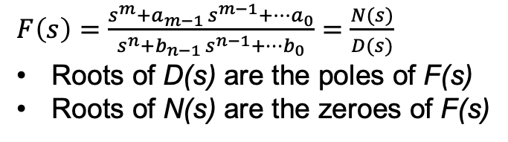
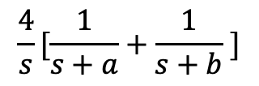
LaPlace Transform Essentials
Definition
$$L\left[f\left(t\right)\right]=\int_{0}^{∞}{e^{−st}f(t)}=F(s)$$
(0 initial conditions)
Properties`
Calculating LaPlace Transforms
$$L\left[∫f(t)\right]=\frac{1}{s}F(s)$$
$$L\left[1\right]=\frac{1}{s}$$
$$L\left[e^{at}\right]=\frac{1}{s+a}$$
$$L\left[\frac{df}{dt}\right]=sF(s)$$
$$L\left[\int{1}\right]=\frac{1}{s}\frac{1}{s}=\frac{1}{s^{2}}$$
$$L\left[∫af\left(t\right)\right]=aF\left(s\right)$$
$$L\left[t\right]=$$
$$L\left[∫f\left(t\right)g(t)\right]=F\left(s\right)G(s)$$
$$L\left[∫f\left(t\right)+g(t)\right]=F\left(s\right)+G(s)$$
$$\frac{4}{s}[\frac{1}{s+a}+\frac{1}{s+b} ]$$
$$L\left[{4∫(e}^{at}+e^{bt} )\right]=$$
$F\left(s\right)=\frac{s^{m}+a_{m−1 }s^{m−1}+⋯a_{0}}{s^{n}+b_{n−1 }s^{n−1}+⋯b_{0}}=\frac{N(s)}{D(s)}$
Roots of D(s) are the poles of F(s)
Roots of N(s) are the zeroes of F(s)

Slide 23


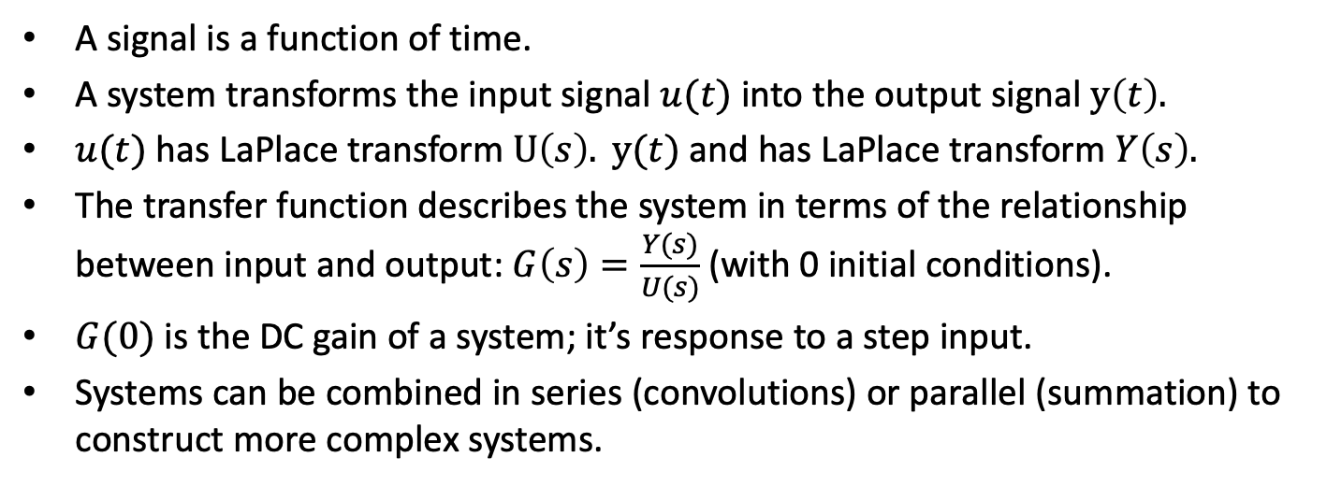



Signals and Transfer Functions
$$G(s)$$
$$u(t)$$
System
$$y(t)$$
$$U(s)$$
$$Y(s)$$
A signal is a function of time.
A system transforms the input signal $u(t)$ into the output signal $y\left(t\right).$
$u(t)$ has LaPlace transform $U\left(s\right). y(t)$ and has LaPlace transform $Y\left(s\right).$
The transfer function describes the system in terms of the relationship between input and output: $G\left(s\right)=\frac{Y(s)}{U(s)}$ (with 0 initial conditions).
$G(0)$ is the DC gain of a system; it’s response to a step input.
Systems can be combined in series (convolutions) or parallel (summation) to construct more complex systems.
A Laplace Transform can represent a signal or a system.

Slide 24
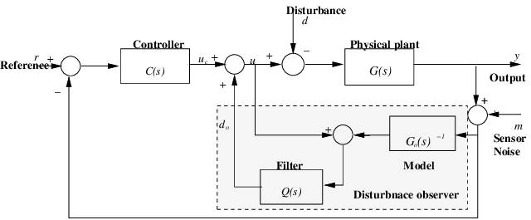
Example of Interconnected Systems

Slide 25
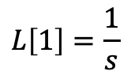


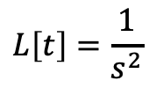


Laplace Properties
$$G\left(s\right)=\int_{0}^{∞}{g\left(t\right)e^{−st}}$$
Unit step at time 0: g$\left(t\right)=1, t≥0;0, t<0.$
Ramp: g$\left(t\right)=t, t≥0;0, t<0.$
$$g\left(t\right)$$
$$g\left(t\right)$$
$$L\left[1\right]=\frac{1}{s}$$
LaPlace Transform
$$L\left[t\right]=\frac{1}{s^{2}}$$
LaPlace Transform

Slide 26
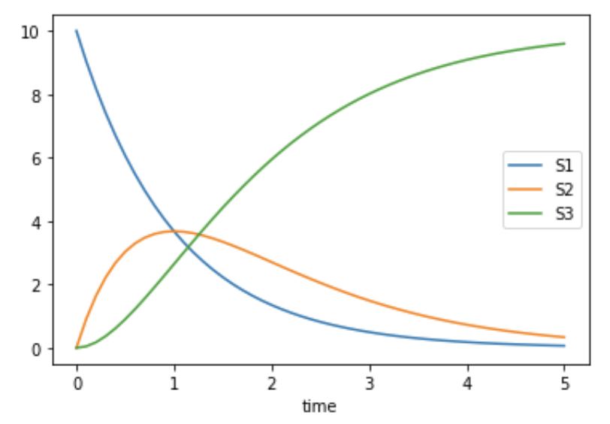


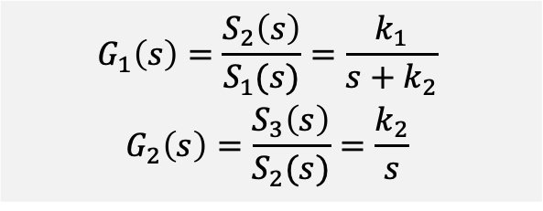


Finding Transfer Functions S1 is unaffected by the system
Finding Transfer Functions
Write state equations in terms of the inputs
Calculate the ratios for each system. Signals other than the input to and output from the system are set to 0.
Example
All reactions are mass action, and so then ${\dot{S}}_{i+1}=k_{i}S_{i}$.
$${{\dot{S}}_{2}=k_{1}S_{1}−k_{2}S_{2}}_{ }$$
$${{\dot{S}}_{3}=k_{2}S_{2}}_{ }$$
$$G_{1}\left(s\right)={\frac{S_{2}\left(s\right)}{S_{1}(s)}=\frac{k_{1}}{s+k_{2}}}_{ }$$
$${G_{2}\left(s\right)=\frac{S_{3}\left(s\right)}{S_{2}(s)}=\frac{k_{2}}{s}}_{ }$$
$${{sS}_{2}(s)=k_{1}S_{1}(s)−k_{2}S_{2}(s)}_{ }$$
$${sS_{3}(s)=k_{2}S_{2}(s)}_{ }$$
S1
S2
$$\frac{k_{2}}{s}$$
S3
$$\frac{k_{1}}{s+k_{2}}$$
Notes:
Possibilities for the input signal

Slide 27











Properties of LaPlace Transforms
Definition
Impulse at 0
$$G\left(s\right)=\int_{0}^{∞}{g\left(t\right)e^{st}}$$
${L[δ}_{0}]=$1
Step response
Constant multiplication
$$G(0)=g(∞)$$
$$L[(a)g\left(t\right)]=aG(s)$$
Derivative
$$L[\dot{g}\left(t\right)]=sG(s)$$
Integral
$$L\left[∫g\left(t\right)\right]=\frac{1}{s}G(s)$$
Specific Functions
$$L\left[1\right]=L\left[∫δ_{0}\right]=\frac{1}{s}$$
$$L\left[t\right]=L\left[∫t\right]=\frac{1}{s^{2}}$$
$$L\left[e^{at}\right]=\frac{1}{s+a}$$

Slide 28


Analyzing The Transfer S1 is unaffected by the system
Finding Transfer Functions
Write state equations in terms of the inputs
Calculate the ratios for each system. Signals other than the input to and output from the system are set to 0.
Example
All reactions are mass action, and so then ${\dot{S}}_{i+1}=k_{i}S_{i}$.
S1
S2
$$G_{2}(s)$$
S3
$$G_{1}(s)$$
$${{\dot{S}}_{2}=k_{1}S_{1}−k_{2}S_{2}}_{ }$$
$${{\dot{S}}_{3}=k_{2}S_{2}}_{ }$$
$$G_{1}\left(s\right)={\frac{S_{2}\left(s\right)}{S_{1}(s)}=\frac{k_{1}}{s+k_{2}}}_{ }$$
$${G_{2}\left(s\right)=\frac{S_{3}\left(s\right)}{S_{2}(s)}=\frac{k_{2}}{s}}_{ }$$
$${{sS}_{2}(s)=k_{1}S_{1}(s)−k_{2}S_{2}(s)}_{ }$$
$${sS_{3}(s)=k_{2}S_{2}(s)}_{ }$$
S1
S2
$$\frac{k_{2}}{s}$$
S3
$$\frac{k_{1}}{s+k_{2}}$$
Notes:
Possibilities for the input signal

Slide 29
Notes
Objective
Know elements of a block diagram, rules for MIMO and SISO
Construct TF from block diagram
Construct block diagram from TF
State space vs. TF representation of systems
Construct TF from block diagram
Construct block diagram from TF
Applyication Reaction networks
Reactions are systems with 0 state: input is reactants; output is products
Apply to a sequential network with TF for each reaction
Construct merged network
See how merged network compares with Tellurium simulation
Add sequestered products
Add feedback (non-linear)

