Slide 1
BIOE 498 / BIOE 599 Advanced Biological Control Systems Lecture 5: Geometric Linear Algebra
Joseph L. Hellerstein
eScience Institute, Computer Science & Engineering
Allen School of Computer Science
BioEngineering
Notes:
Diverse students. Some with bio-backgrounds; some without. Some with CS background; some with very limited. Two separate courses combined because of a substantial shared curriculum.

Slide 2
Objective
Review of key concepts from linear algebra with a geometric twist to promote intuition
Introduce python capabilities for computational linear algebra

Slide 3
Roadmap
Vectors
Vector addition, constant multiplication
Dimensions, linear combinations of vectors
Vector space
Linear independence. Dependence means that can sum to one vectors from the others. One or more vector is superfluous.
Dimension of a vector space. Null space.
Dot product, angle interpretation. Orthogonal vectors. Orthogonal vs. linearly independent.
Matrices. Matrix multiplication as dot products. Represent matrix as a vector of vectors.
Matrix spaces: range, null space. Also for transpose. Dimensions of spaces. Relate to rows/columns.
Similar matrices and changing coordinate systems.
Some types of matrices
Square vs. rectangular: same or different dimensions
Invertible. Only square. Implications for range and null space
Orthogonal columns.
Unitary. Rotate only.
Diagonal. Stretch only.
Eigenvalues and eigenvectors.
Characteristic polynomial
0 eigenvalues implies singularity
Eigenvector decomposition. Not assured that eigenvectors are orthogonal.
Computational linear algebra in python

Slide 4
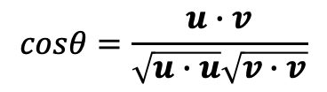






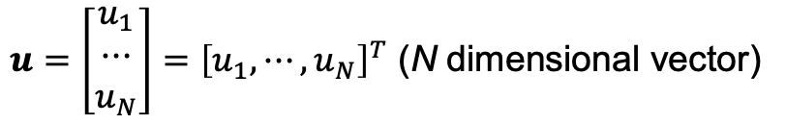
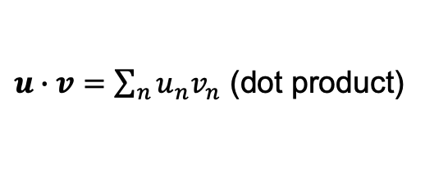
Vectors
{
$$2u$$
$$u$$
$$θ$$
$$w=u−v$$
$u∙v=\sum_{n}{u_{n}v_{n}}$ (dot product)
$$v$$
$$cosθ=\frac{u∙v}{\sqrt{u∙u}\sqrt{v∙v}}$$
$u=\left[\begin{matrix}u_{1} \\ ⋯ \\ u_{N}\end{matrix}\right]={\left[u_{1},⋯,u_{N}\right]}^{T}$ (N dimensional vector)
$u∙v=0≡θ=90°$ (orthogonal)
Can add and dot product vectors if they have the same dimension.
Can scalar multiply vectors. (No change in dimension.)
Notes:
Multi by a constant, positive or negative
Vectors are a convenient abstraction for multidimensional data.

Slide 5

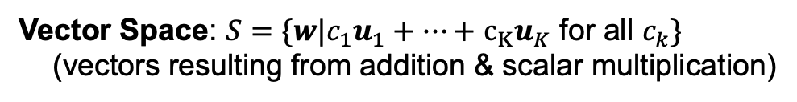
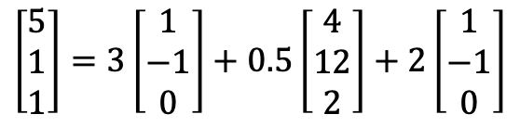
Vector Spaces
Linear Combination: $w={c_{1}u}_{1}+⋯+$ $c_{K}u_{K}$
$$\left[\begin{matrix}5 \\ 1 \\ 1\end{matrix}\right]=3\left[\begin{matrix}1 \\ −1 \\ 0\end{matrix}\right]+0.5\left[\begin{matrix}4 \\ 12 \\ 2\end{matrix}\right]+2\left[\begin{matrix}1 \\ −1 \\ 0\end{matrix}\right]$$
Vector Space: $S=\{w|{c_{1}u}_{1}+⋯+$ $c_{K}u_{K}$ for all $c_{k}\}$
(vectors resulting from addition & scalar multiplication)
Linearly independent vectors: ${c_{1}u}_{1}+⋯+$ $c_{K}u_{K}≠0$ for all $c_{k}$, $c≠0$
$$\dim\left(S\right)=\min_{|\left\{u_{1},⋯\text{,}u_{K}\right\}|}{\{S={c_{1}u}_{1}+⋯+ c_{K}u_{K} \text{for} \text{all} c_{k}\}}$$
Basis: If $u_{1},⋯\text{,}u_{K}$ generate $S$ and $\dim\left(S\right)=K$, then $u_{1},⋯\text{,}u_{K}$ is a basis for $S$.
Notes:
Why must a basis be linearly independent?
Is there only one basis?

Slide 6
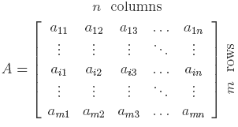

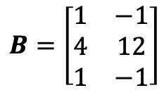


Matrices
Represent a set of vectors
..as columns
..as rows
Transpose
$$B=\left[\begin{matrix}1 & −1 \\ 4 & 12 \\ 1 & −1\end{matrix}\right]$$
$$B=A^{T}$$
$$\left[\begin{matrix}1 \\ −1\end{matrix}\right],\left[\begin{matrix}4 \\ 12\end{matrix}\right],\left[\begin{matrix}1 \\ −1\end{matrix}\right]$$
$$A=\left[\begin{matrix}1 & 4 & 1 \\ −1 & 12 & −1\end{matrix}\right]$$
Notes:
Row space.
Column space.
Null space.
Rank of a matrix.
Transpose.
Matrix multiplication
Coordinate representation

Slide 7
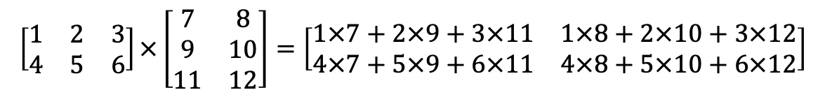
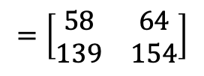

Matrix Multiplication: Mechanics
$$\left[\begin{matrix}1 & 2 & 3 \\ 4 & 5 & 6\end{matrix}\right]×\left[\begin{matrix}7 & 8 \\ 9 & 10 \\ 11 & 12\end{matrix}\right]=\left[\begin{matrix}1×7+2×9+3×11 & 1×8+2×10+3×12 \\ 4×7+5×9+6×11 & 4×8+5×10+6×12\end{matrix}\right]$$
$$=\left[\begin{matrix}1×7 & 1×8 \\ 4×7 & 4×8\end{matrix}\right]+\left[\begin{matrix}2×9 & 2×10 \\ 5×9 & 5×10\end{matrix}\right]+\left[\begin{matrix}3×11 & 3×12 \\ 6×11 & 6×12\end{matrix}\right]$$
$$=\left[\begin{matrix}58 & 64 \\ 139 & 154\end{matrix}\right]$$
Notes:
Note that decomposition is all rank one matrices

Slide 8
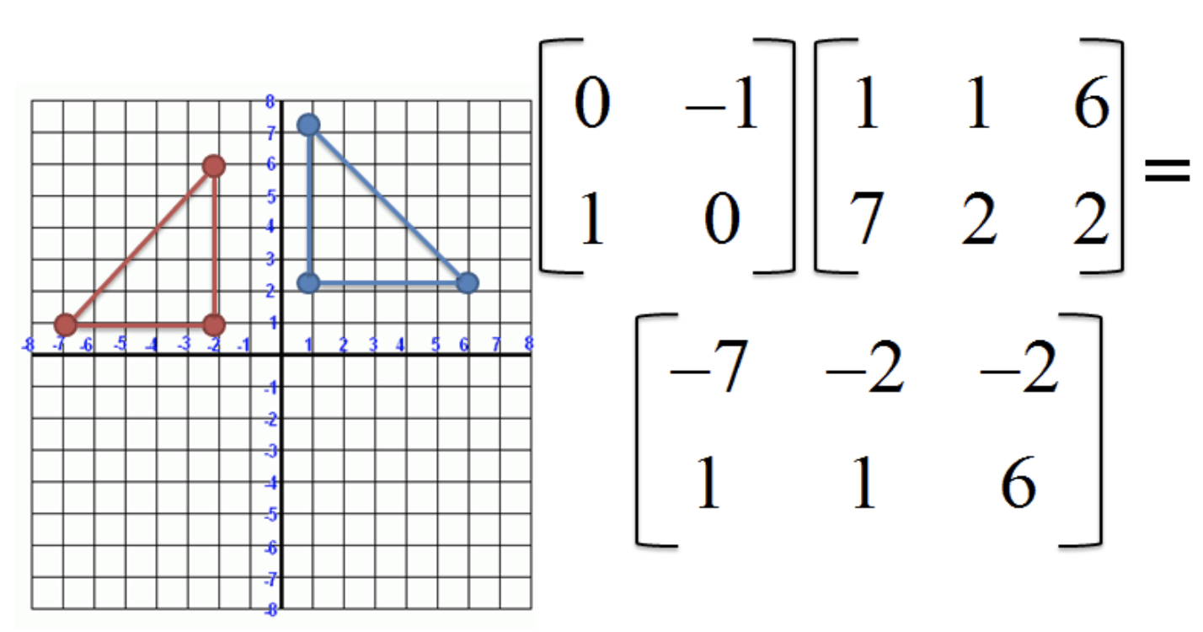
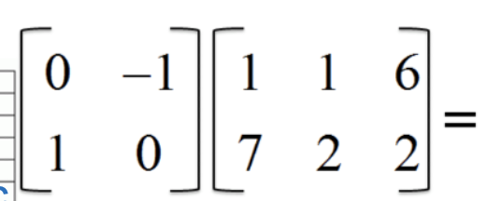
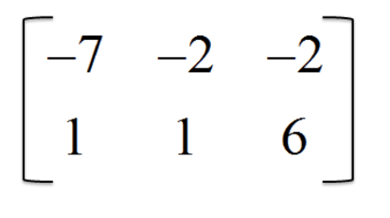
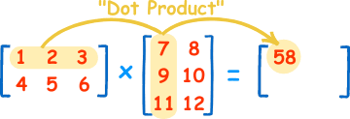


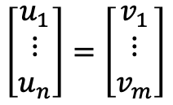








Matrix Multiplication: Interpretations
Rotates a vector.
c
a
a
b
c
b
Compute angles between vectors.
Translates from $R^{n}$ (# col) to $R^{m}$ (# row).
$$w_{1}$$
$$w_{2}$$
$$u_{1}^{T}$$
$$u_{1}^{T}∙w_{1}$$
$$u_{1}^{T}∙w_{2}$$
$$\left[\begin{matrix}u_{1} \\ ⋮ \\ u_{n}\end{matrix}\right]=\left[\begin{matrix}v_{1} \\ ⋮ \\ v_{m}\end{matrix}\right]$$
$$u_{1}^{T}$$
$$u_{2}^{T}∙w_{1}$$
$$u_{2}^{T}∙w_{2}$$
Notes:
Row space.
Column space.
Null space.
Rank of a matrix.
Transpose.
Matrix multiplication
Coordinate representation

Slide 9



Matrix Range Space & Null Space
Translates a vector to a new space, the range of the matrix.
$$Au=\left[\begin{matrix}1 & 1 \\ 2 & 2\end{matrix}\right]\left[\begin{matrix}u_{1} \\ u_{2}\end{matrix}\right]=(u_{1}+u_{2})\left[\begin{matrix}1 \\ 2\end{matrix}\right]$$
The range of $A$ is a 1-d subspace of $R^{2}$.
If you “lose” a dimension, it gets mapped to 0.
The null space of the matrix consists of all vectors that map to 0.
Solve for null space.
$$\left[\begin{matrix}1 & 1 \\ 2 & 2\end{matrix}\right]\left[\begin{matrix}u_{1} \\ u_{2}\end{matrix}\right]=\left[\begin{matrix}0 \\ 0\end{matrix}\right]=0≡u_{1}=u_{2}$$
The rank of the matrix is the dimension of its range.
The dimension of the null space is the dimension of the vectors in the null space.
The number of rows of a matrix is the sum of its rank & dim. of its null space.

Slide 10
Matrix Inverse

Slide 11
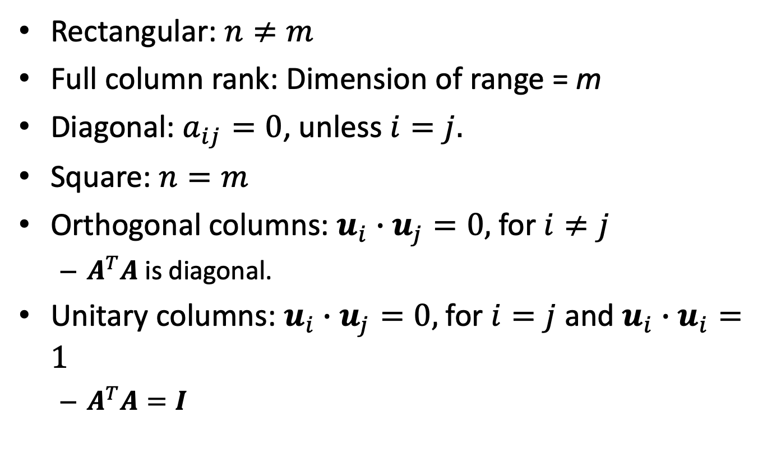

Classifications of $n×m$Matrices
Rectangular: $n≠m$
Full column rank: Dimension of range = m
Diagonal: $a_{ij}=0$, unless $i=j.$
Square: $n=m$
Orthogonal columns: $u_{i}∙u_{j}=0,$for $i≠j$
$A^{T}A$ is diagonal.
Unitary columns: $u_{i}∙u_{j}=0,$for $i=j$ and $u_{i}∙u_{i}=1$
$A^{T}A=I$

Slide 12
Similarity and Changing Coordinate Systems

Slide 13
Determinant

Slide 14
Eigenvalues & Eigenvectors

Slide 15
BACKUP

Slide 16
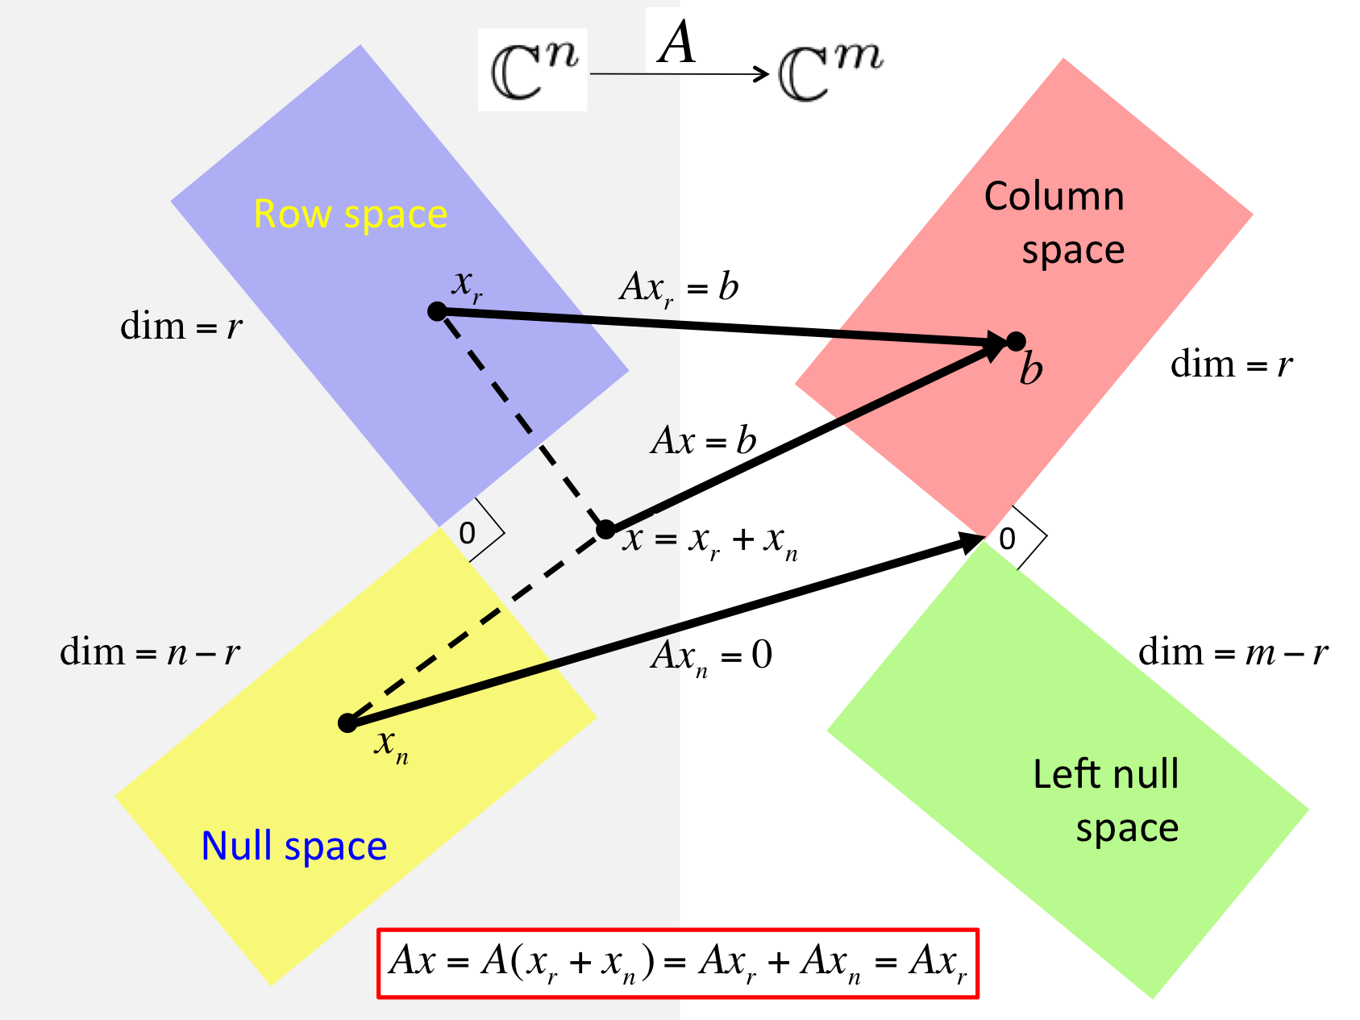

Slide 17
Notes
Fundamental subspaces and orthogonality relationships. Relationship between dim of null space, range, and number of rows. Relationship between singularity and size of null space.
Learning objectives
Visual interpretation of linear algebra
New representations of linear operations
Some key results: SVD, Cayley Hamilton
Definition of linearity
Multi-dimensional modeling with dimensions, angles, lengths.
Transformations of vectors: rotations, stretching, dimension change.
Interpreting linear algebra in terms of transformations
Cross product: angle between two vectors
Summation: decomposed effect of parts
Matrix multiplication: rotation, stretch, dimension change
Basis, characteristic polynomial, eigenvalues, independence, orthogonality, unitary matrices, Jordan form, Cayley Hamilton, SVD, computations, orthogonal decomposition from singular values, A*A is PSD, pseudo inverse.
Submatrices, column stacking
Diagonal representation of a square matrix with distinct non-zero eigenvalues.
Transformations resulting from a unitary and diagonal matrix

