Slide 1
BIOE 498 / BIOE 599 Advanced Biological Control Systems Lecture 13: Control Systems
Joseph L. Hellerstein
eScience Institute, Computer Science & Engineering
Allen School of Computer Science
BioEngineering
Notes:
Diverse students. Some with bio-backgrounds; some without. Some with CS background; some with very limited. Two separate courses combined because of a substantial shared curriculum.

Slide 2
Agenda
Block diagrams
Properties of Laplace transforms
Building more complex systems

Slide 3
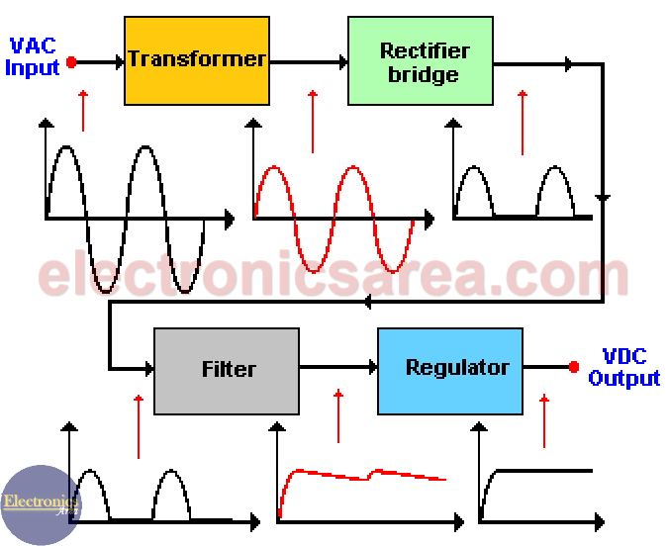
The ”System” Abstraction
How does a DC power supply convert AC power?

Slide 4

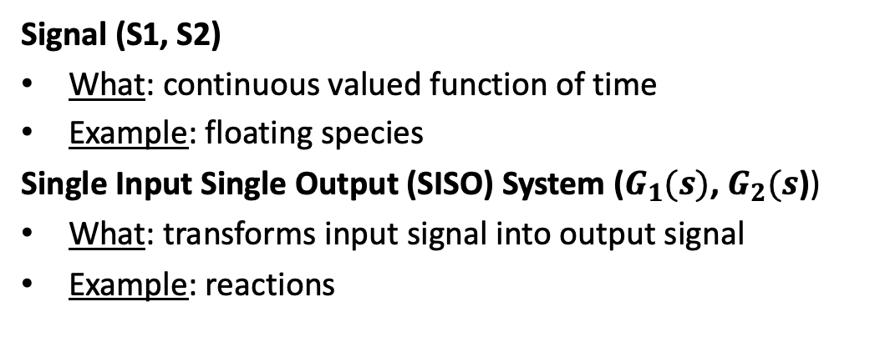


System Abstraction for Reaction Networks
System abstraction of reaction network
Reaction Network
J1: S1→ S2; k1*S1
J2: S2 -> S3; k2*S2
S1
S2
S3
$$G_{1}(s)$$
$$G_{2}(s)$$
S1
J1
S2
$$J2$$
S3
Signal (S1, S2)
What: continuous valued function of time
Example: floating species
Single Input Single Output (SISO) System ($G_{1}(s)$, $G_{2}(s$))
What: transforms input signal into output signal
Example: reactions

Slide 5

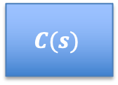

Box Diagrams
Controller
Reference: R3
$$C(s)$$
S1
S2
S3
+
$$G_{1}(s)$$
$$G_{2}(s)$$
$$−$$
Changing System Behavior With Control
Rules for drawing block diagrams
Arrows are directional signals
May be labelled with the name of the signal
Boxes are SISO (single input single output) systems
Internal label is the transfer function
External label (if any) is the name of the system
Filled circles are connectors that add signals
Can derive the transfer function of the composed system from the block diagram.

Slide 6

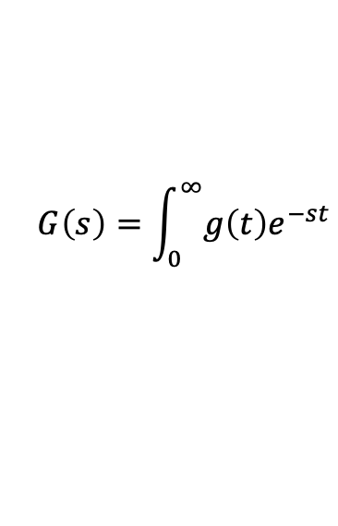

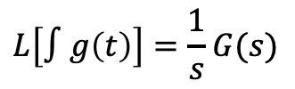


Properties of Laplace Transforms
$$G\left(s\right)=\int_{0}^{∞}{g\left(t\right)e^{−st}}$$
These properties are used to construct the Laplace transform of a complex system.
Constant multiplication
Derivative
Integral
$$L[\dot{g}\left(t\right)]=sG(s)$$
$$L\left[∫g\left(t\right)\right]=\frac{1}{s}G(s)$$
$$L[ag\left(t\right)]=aG(s)$$
Summation (Systems in parallel)
$$L\left[g\left(t\right)+h\left(t\right)\right]=G\left(s\right)+H(s)$$
$L\left[⋅\right]$ is a linear operator.
Notes:
How do the last 3 LT relate to each other?

Slide 7
Convolution of a Signal With a System
Input History
Function
Operation (Convolution)
Put input in history
Calculate output
$$y\left(t\right)=\int_{0}^{t}{u\left(τ\right)g\left(t−τ\right)dτ}$$
$$u$$
$$τ$$ | $$u(τ)$$
0 | 0
1 | 0
2 | 0
$$τ$$ | $$g(τ)$$
0 | 1.0
1 | 0.8
2 | 0.3
$$y$$
$$t=2$$
$$t=0$$
Input History
Function
Input History
Function
$$10.0$$
$$y$$
$$5$$
$$y$$
$$u$$
$$τ$$ | $$u(τ)$$
0 | 10
1 | 0
2 | 0
$$τ$$ | $$g(τ)$$
0 | 1.0
1 | 0.8
2 | 0.3
$$τ$$ | $$u(τ)$$
0 | 10
1 | 6
2 | 5
$$τ$$ | $$g(τ)$$
0 | 1.0
1 | 0.8
2 | 0.3
$$u$$
$$y\left(t\right)=u\left(0\right)g\left(t−0\right)=10∗1=10$$
$$y\left(t\right)=u\left(0\right)g\left(t−0\right)+u\left(1\right)g\left(t−1\right)$$
+ $u\left(2\right)g\left(t−2\right)=12.8$
$$t=1$$
Input History
Function
$$6$$
$$y$$
$$u$$
$$τ$$ | $$u(τ)$$
0 | 10
1 | 6
2 | 0
$$τ$$ | $$g(τ)$$
0 | 1.0
1 | 0.8
2 | 0.3
$$y\left(t\right)=u\left(0\right)g\left(t−0\right)+u\left(1\right)g\left(t−1\right)$$
$=10∗0.8+6∗10=14$

Slide 8





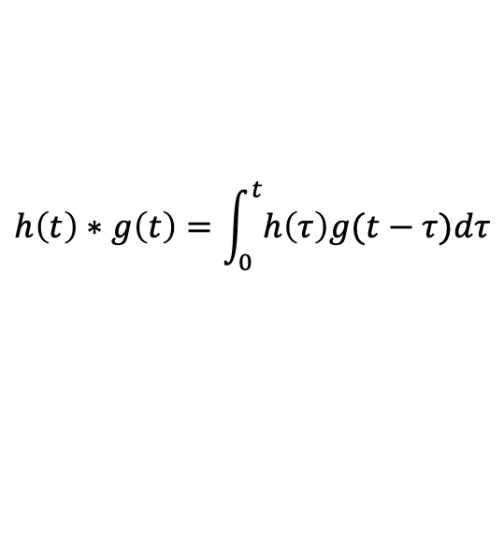

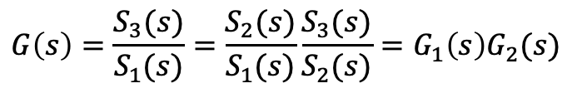
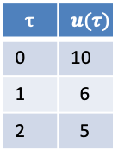

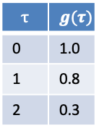

Systems in Series
Convolution definition
Input History
Function
$$h\left(t\right)∗g\left(t\right)=\int_{0}^{t}{h\left(τ\right)g(t−τ})dτ$$
$$y$$
$$u$$
$$τ$$ | $$u(τ)$$
0 | 10
1 | 6
2 | 5
$$τ$$ | $$g(τ)$$
0 | 1.0
1 | 0.8
2 | 0.3
Convolution Laplace Transform
$$L[h\left(t\right)∗g\left(t\right)]=H\left(s\right)G(s)$$
Systems/signals in series are a convolution.
S1
S2
$$G_{2}(s)$$
S3
$$S_{3}\left(s\right)=S_{1}\left(s\right)G(s)$$
$$G_{1}(s)$$
$$G(s)$$
$$G\left(s\right)=\frac{S_{3}(s)}{S_{1}(s)}=\frac{S_{2}(s)}{S_{1}(s)}\frac{S_{3}(s)}{S_{2}(s)}=G_{1}\left(s\right)G_{2}(s)$$
$$G\left(s\right)=\frac{S_{3}(s)}{S_{1}(s)}$$

Slide 9
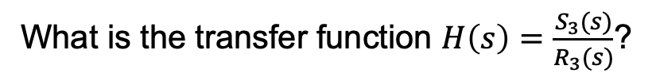

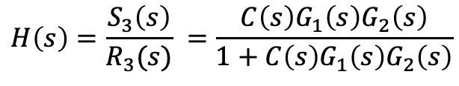


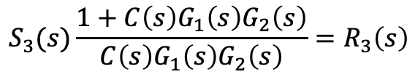
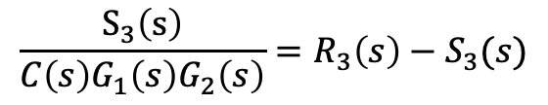
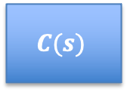



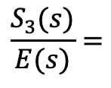


Calcuating Transfer Functions In Diagrams
Controller
R3
E
$$C(s)$$
S1
S2
S3
+
$$G_{1}(s)$$
$$G_{2}(s)$$
$$−$$
What is the transfer function $H\left(s\right)=\frac{S_{3}(s)}{R_{3}(s)}$?
$C\left(s\right), G_{1}\left(s\right), G_{2}(s)$ are in series, a convolution.
$$\frac{S_{3}(s)}{E(s)}=$$
$C\left(s\right)G_{1}\left(s\right)G_{2}\left(s\right)$
Or, $S_{3}\left(s\right)=C\left(s\right)G_{1}\left(s\right)G_{2}\left(s\right)E(s)$
$E\left(s\right)$ is the difference between R3 and S3.
$$E\left(s\right)=$$
$$R_{3}\left(s\right)−S_{3}(s)$$
$$\frac{S_{3}\left(s\right)}{C\left(s\right)G_{1}\left(s\right)G_{2}\left(s\right)}=R_{3}\left(s\right)−S_{3}(s)$$
$$S_{3}(s)\frac{1+C\left(s\right)G_{1}\left(s\right)G_{2}\left(s\right)}{C\left(s\right)G_{1}\left(s\right)G_{2}\left(s\right)}=R_{3}\left(s\right)$$
$$H\left(s\right)=\frac{S_{3}\left(s\right)}{R_{3}(s)} =\frac{C\left(s\right)G_{1}\left(s\right)G_{2}\left(s\right)}{1+C\left(s\right)G_{1}\left(s\right)G_{2}\left(s\right)}$$

Slide 10
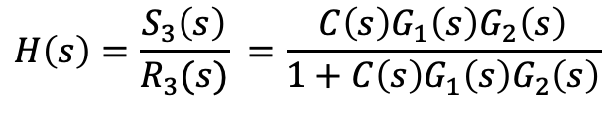


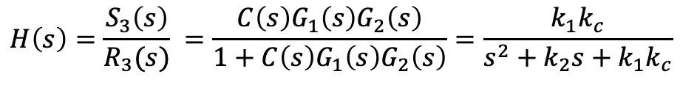


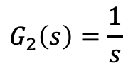
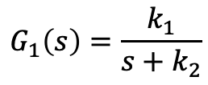

Interpreting the Transfer Function
Controller
R3
E
$$C(s)$$
S1
S2
S3
+
$$G_{1}(s)$$
$$G_{2}(s)$$
$$−$$
$$H\left(s\right)=\frac{S_{3}\left(s\right)}{R_{3}(s)} =\frac{C\left(s\right)G_{1}\left(s\right)G_{2}\left(s\right)}{1+C\left(s\right)G_{1}\left(s\right)G_{2}\left(s\right)}$$
$$G_{1}\left(s\right)=\frac{k_{1}}{s+k_{2}}$$
$$G_{2}\left(s\right)=\frac{1}{s}$$
$$C\left(s\right)=k_{c}$$
$$H\left(s\right)=\frac{S_{3}\left(s\right)}{R_{3}(s)} =\frac{C\left(s\right)G_{1}\left(s\right)G_{2}\left(s\right)}{1+C\left(s\right)G_{1}\left(s\right)G_{2}\left(s\right)}=\frac{k_{1}k_{c}}{s^{2}+k_{2}s+k_{1}k_{c}}$$
What are the poles of $G_{1}\left(s\right)?$
What are the poles of $G_{2}\left(s\right)?$
What are the poles of $G_{1}(s)G_{2}\left(s\right)?$
What are the poles of $H\left(s\right)?$
What is the DC gain of $H\left(s\right)?$ Why is this important?

Slide 11

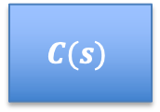





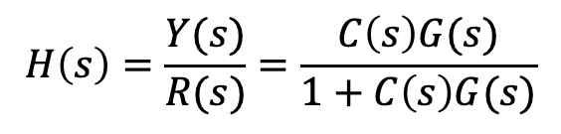
Feedback Control System
Reference
Input
Control
Error
Control
Input
Measured
Output
$$R(s)$$
$$E(s)$$
$$U(s)$$
$$Y(s)$$
$$C(s)$$
$$G(s)$$
+
$$−$$
Controller
System
Under
Control
$$H\left(s\right)=\frac{Y(s)}{R(s)}=\frac{C\left(s\right)G(s)}{1+C\left(s\right)G(s)}$$
We will use this terminology and notation.

Slide 12

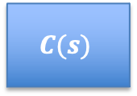







Measurement Noise
Measurement
Noise
$$N(s)$$
$$R(s)$$
$$E(s)$$
$$U(s)$$
$$Y(s)$$
$$C(s)$$
$$G(s)$$
+
+
$$−$$
$\frac{E(s)}{N(s)}=$?

Slide 13

Solving for $\frac{E(s)}{N(s)}$

Slide 14

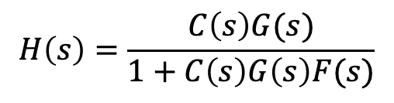
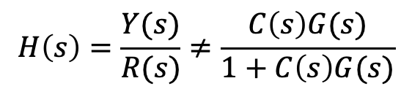
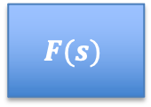
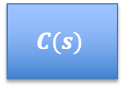
Adding a Filter
Reference
Input
Control
Error
Control
Input
Measured
Output
$$R(s)$$
$$E(s)$$
$$U(s)$$
$$Y(s)$$
$$C(s)$$
$$G(s)$$
+
$$−$$
Controller
System
Under
Control
$$F(s)$$
Filter
A filter smoothes noisy measurements.
$$H\left(s\right)=\frac{Y(s)}{R(s)}≠\frac{C\left(s\right)G(s)}{1+C\left(s\right)G(s)}$$
$$H\left(s\right)=\frac{C\left(s\right)G(s)}{1+C\left(s\right)G\left(s\right)F(s)}$$
Notes:
Add noise input

Slide 15
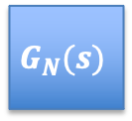


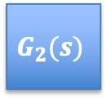




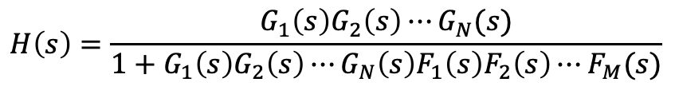






General Solution
+
$$C(s)$$
$$G(s)$$
$$−$$
$$F(s)$$
$$H\left(s\right)=\frac{C\left(s\right)G(s)}{1+C\left(s\right)G\left(s\right)F(s)}$$
$$R(s)$$
$$G_{1}(s)$$
$$G_{2}(s)$$
$$G_{N}(s)$$
$$Y(s)$$
+
$$−$$
$$F_{1}(s)$$
$$F_{2}(s)$$
$$F_{M}(s)$$
$$H\left(s\right)=\frac{Y (s)}{R(s)}$$
$$H\left(s\right)=\frac{G_{1}\left(s\right)G_{2}\left(s\right)⋯G_{N}(s)}{1+G_{1}\left(s\right)G_{2}\left(s\right)⋯G_{N}\left(s\right)F_{1}\left(s\right)F_{2}\left(s\right)⋯F_{M}(s)}$$
Why?

Slide 16
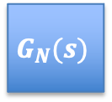


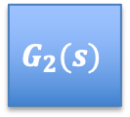





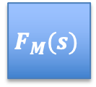
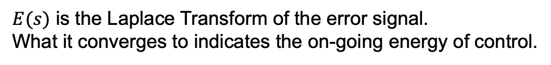
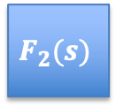
Laplace Transfor of Control Error
$$R(s)$$
$$E(s)$$
$$Y(s)$$
$$G_{1}(s)$$
$$G_{2}(s)$$
$$G_{N}(s)$$
+
$$−$$
$$F_{1}(s)$$
$$F_{2}(s)$$
$$F_{M}(s)$$
$E(s)$ is the Laplace Transform of the error signal.
What it converges to indicates the on-going energy of control.
$$E\left(s\right)=R\left(s\right)H\left(s\right)−R\left(s\right)=R(s)(H\left(s\right)−1)$$
If $H\left(s\right)=\frac{k_{1}k_{c}}{s^{2}+k_{2}s+k_{1}k_{c}}$, what is $e(∞)$ for a step input?
Hint: $e\left(∞\right)=\lim_{s→0}{sE(s)}$

Slide 17
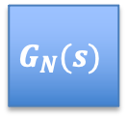



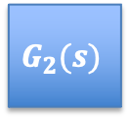

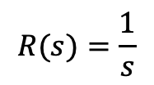








Finding $e(∞)$
$$R(s)$$
$$E(s)$$
$$Y(s)$$
$$G_{1}(s)$$
$$G_{2}(s)$$
$$G_{N}(s)$$
+
$$−$$
$$F_{1}(s)$$
$$F_{2}(s)$$
$$F_{M}(s)$$
$$E\left(s\right)=R\left(s\right)H\left(s\right)−R\left(s\right)=R(s)(H\left(s\right)−1)$$
If $H\left(s\right)=\frac{k_{1}k_{c}}{s^{2}+k_{2}s+k_{1}k_{c}}$, what is $e(∞)$ for a step input?
Hint: $e\left(∞\right)=\lim_{s→0}{sE(s)}$
1. What is $U\left(s\right)$?
$$R(s)=\frac{1}{s}$$
2. What is$R(s)(H\left(s\right)−1)$?
R$(s)(H\left(s\right)−1)\text{=}\frac{1}{s}$ $\frac{−s^{2}−k_{2}s}{s^{2}+k_{2}s+k_{1}k_{c}}$
3. What is$e\left(∞\right)=lim_{s→0}sR(s)(H\left(s\right)−1)$?
$$e\left(∞\right)=0$$
4. What does this tell us about the need for control action once we’re at steady state?

Slide 18
Sensor Noise
Reference
Input
Control
Error
Control
Input
Measured
Output
$$R(s)$$
$$E(s)$$
$$U(s)$$
$$Y(s)$$
$$C(s)$$
$$G(s)$$
+
$$−$$
Controller
System
Under
Control
$$F(s)$$
Filter

Slide 19
Noise

