Slide 1
BIOE 498 / BIOE 599 Advanced Biological Control Systems How Filters Work
Joseph L. Hellerstein
eScience Institute, Computer Science & Engineering
Allen School of Computer Science
BioEngineering
Notes:
Diverse students. Some with bio-backgrounds; some without. Some with CS background; some with very limited. Two separate courses combined because of a substantial shared curriculum.

Slide 2


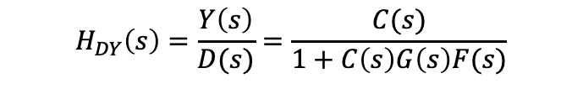


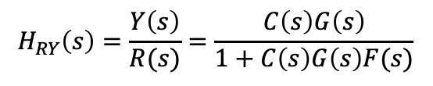


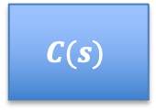
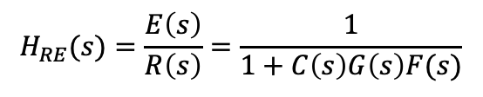



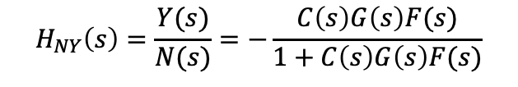
Closed Loop System
Actuator
Disturbance
Measurement
Noise
$$D(s)$$
$$N(s)$$
$$R(s)$$
$$E(s)$$
$$U(s)$$
$$Y(s)$$
$$C(s)$$
$$G(s)$$
+
+
+
$$−$$
$$F(s)$$
$$H_{RY}\left(s\right)=\frac{Y\left(s\right)}{R(s)}=\frac{C\left(s\right)G\left(s\right)}{1+C\left(s\right)G\left(s\right)F(s)}$$
$$H_{RE}(s)=\frac{E\left(s\right)}{R\left(s\right)}=\frac{1}{1+C\left(s\right)G\left(s\right)F(s)}$$
$$H_{NY}\left(s\right)=\frac{Y(s)}{N(s)}=−\frac{C\left(s\right)G\left(s\right)F(s)}{1+C\left(s\right)G\left(s\right)F(s)}$$
$$H_{DY}\left(s\right)=\frac{Y\left(s\right)}{D(s)}=\frac{C(s)}{1+C\left(s\right)G\left(s\right)F(s)}$$
Notes:
Why doesn’t a filter help with measurement noise? Verify transfer functions.

Slide 3
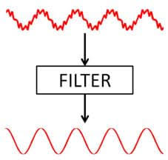
Why Filter
We filter to remove noise and disturbances.

Slide 4
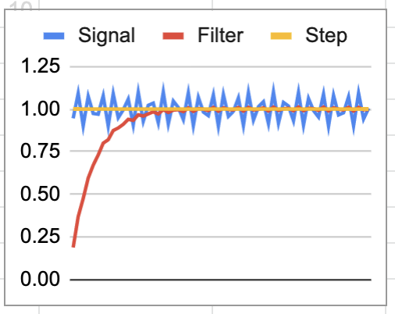
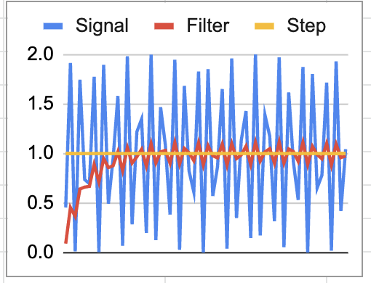


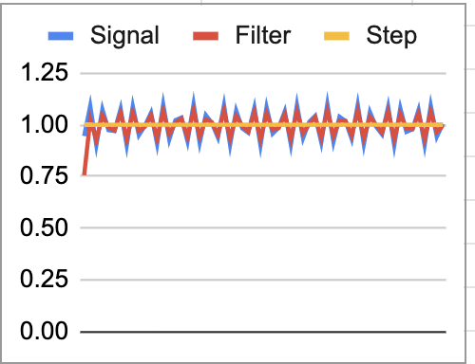
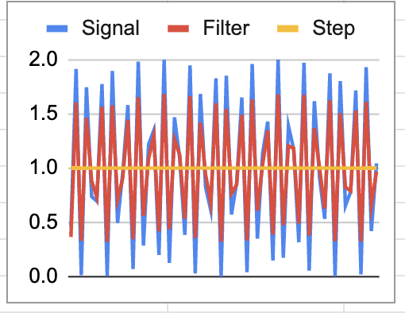






Filter In Discrete Time
$f$ – fraction of current value
$u_{n}$ – n-th input
$y_{n}$ – n-th output
$$y_{n}=f{∗u}_{n}+\left(1−f\right){∗y}_{n−1}$$
Filter response to a noisy step
low noise
high noise
Noise
Noise
Slow convergence, low output noise
small $f$
Noise
Noise
Fast convergence, high output noise
large $f$

Slide 5
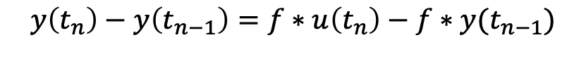
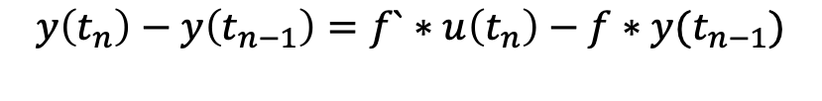
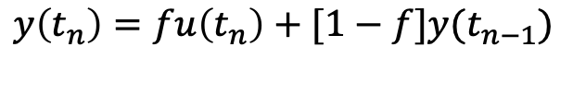

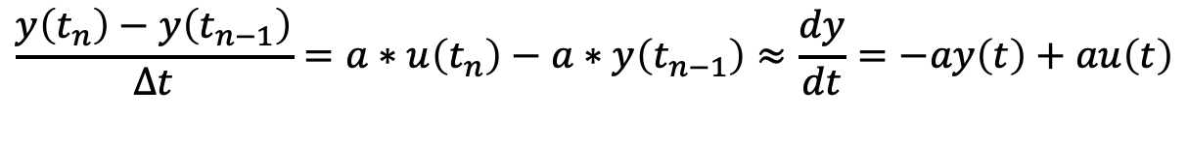
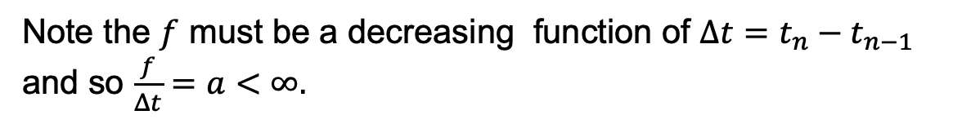
From Discrete Time to Continuous Time
$f$ – fraction of current value
$u_{n}$ – n-th input
$y_{n}$ – n-th output
$$y_{n}=f∗u_{n}+\left(1−f\right){∗y}_{n−1}$$
$$y\left(t_{n}\right)=fu\left(t_{n}\right)+[1−f]y(t_{n−1})$$
$$y\left(t_{n}\right)−y\left(t_{n−1}\right)=f`∗u\left(t_{n}\right)−f∗y(t_{n−1})$$
$$y\left(t_{n}\right)−y\left(t_{n−1}\right)=f∗u\left(t_{n}\right)−f∗y(t_{n−1})$$
Note the $f$ must be a decreasing function of $Δt=t_{n}−t_{n−1}$ and so $\frac{f}{Δt}=a<∞.$
$$\frac{y\left(t_{n}\right)−y\left(t_{n−1}\right)}{Δt}=a∗u\left(t_{n}\right)−a∗y\left(t_{n−1}\right)≈\frac{dy}{dt}=−ay\left(t\right)+au\left(t\right)$$

