Slide 1
BIOE 498 / BIOE 599 Advanced Biological Control Systems Lecture 7-8: Laplace Transform Theory
Joseph L. Hellerstein
eScience Institute, Computer Science & Engineering
Allen School of Computer Science
BioEngineering
Notes:
Diverse students. Some with bio-backgrounds; some without. Some with CS background; some with very limited. Two separate courses combined because of a substantial shared curriculum.

Slide 2
Agenda
Why Laplace Transforms?
Basic Laplace Transforms
Properties
Applying Laplace Transforms

Slide 3
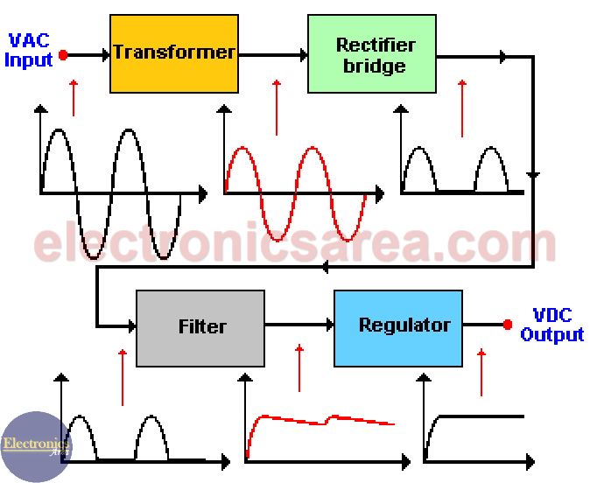
The ”System” Abstraction
How does a DC power supply convert AC power?

Slide 4

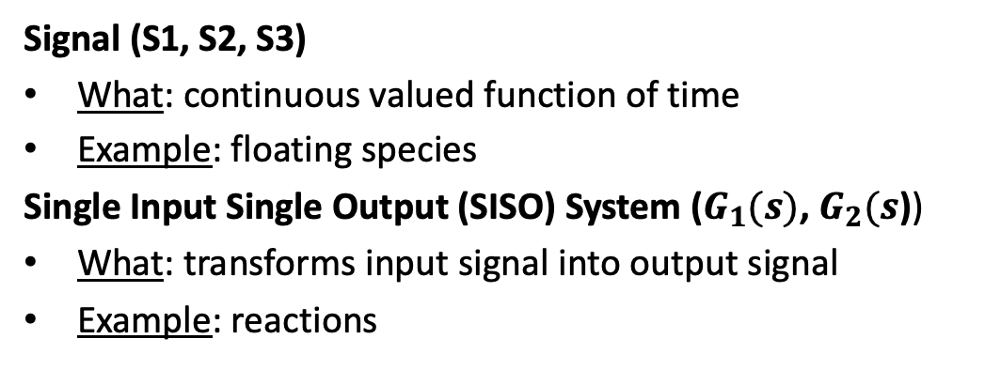


System Abstraction for Reaction Networks
System abstraction of reaction network
Reaction Network
J1: S1→ S2; k1*S1
J2: S2 -> S3; k2*S2
S1
S2
S3
$$G_{1}(s)$$
$$G_{2}(s)$$
S1
J1
S2
$$J2$$
S3
Signal (S1, S2, S3)
What: continuous valued function of time
Example: floating species
Single Input Single Output (SISO) System ($G_{1}(s)$, $G_{2}(s$))
What: transforms input signal into output signal
Example: reactions

Slide 5
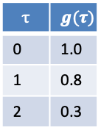



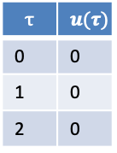
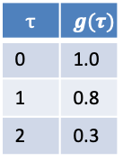




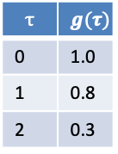










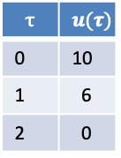
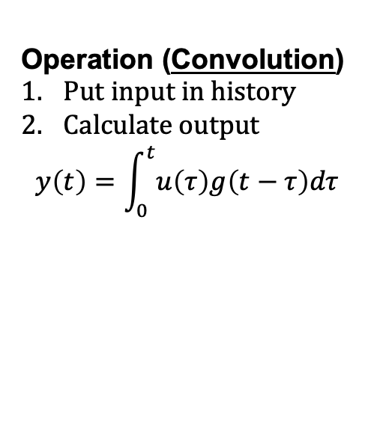
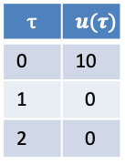
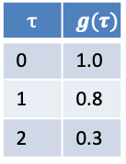
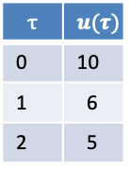

Operation of Linear Time Invariant (LTI) System
Input History
Function
Operation (Convolution)
Put input in history
Calculate output
$$y\left(t\right)=\int_{0}^{t}{u\left(τ\right)g\left(t−τ\right)dτ}$$
$$u$$
$$τ$$ | $$u(τ)$$
0 | 0
1 | 0
2 | 0
$$τ$$ | $$g(τ)$$
0 | 1.0
1 | 0.8
2 | 0.3
$$y$$
$$t=2$$
$$t=0$$
Input History
Function
Input History
Function
$$10.0$$
$$y$$
$$5$$
$$y$$
$$u$$
$$τ$$ | $$u(τ)$$
0 | 10
1 | 0
2 | 0
$$τ$$ | $$g(τ)$$
0 | 1.0
1 | 0.8
2 | 0.3
$$τ$$ | $$u(τ)$$
0 | 10
1 | 6
2 | 5
$$τ$$ | $$g(τ)$$
0 | 1.0
1 | 0.8
2 | 0.3
$$u$$
$$y\left(t\right)=u\left(0\right)g\left(t−0\right)=10∗1=10$$
$$y\left(t\right)=u\left(0\right)g\left(t−0\right)+u\left(1\right)g\left(t−1\right)$$
+ $u\left(2\right)g\left(t−2\right)=12.8$
$$t=1$$
Input History
Function
$$6$$
$$y$$
$$u$$
$$τ$$ | $$u(τ)$$
0 | 10
1 | 6
2 | 0
$$τ$$ | $$g(τ)$$
0 | 1.0
1 | 0.8
2 | 0.3
$$y\left(t\right)=u\left(0\right)g\left(t−0\right)+u\left(1\right)g\left(t−1\right)$$
$=10∗0.8+6∗10=14$

Slide 6


We Describe Signals and Systems Using Laplace Transforms
S1
S2
S3
$$G_{1}(s)$$
$$G_{2}(s)$$
The LT for a system is called a Transfer Function.
Appeal
Describe the dynamics of a system by identifying its poles
Calculate the step response of a system (if it converges)
Can combine LTs of systems to infer the dynamics of the combined systems
Important tool for control design (e.g., choosing the poles of the controlled system)

Slide 7
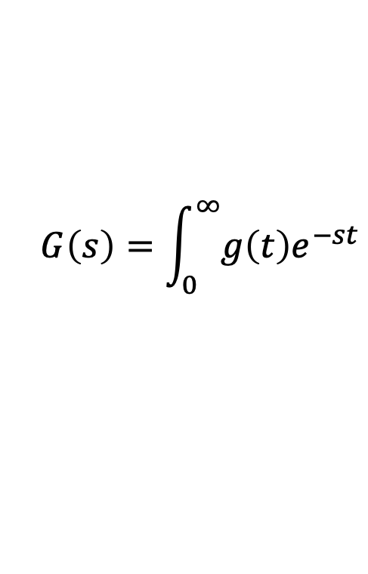
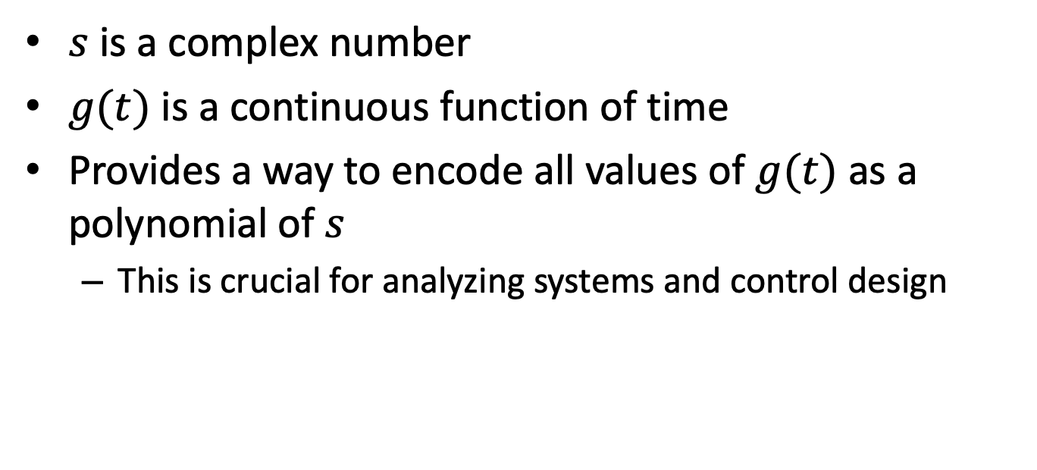
LT Definition
$$G\left(s\right)=\int_{0}^{∞}{g\left(t\right)e^{−st}}$$
$s$ is a complex number
$g(t)$ is a continuous function of time
Provides a way to encode all values of $g(t)$ as a polynomial of $s$
This is crucial for analyzing systems and control design

Slide 8
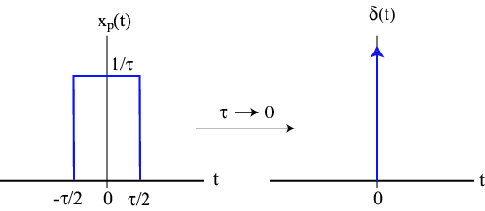

Impulse Signal
Impulse: Instantaneous value.
$$δ_{0}\left(t\right)$$
Impulse signal at time $τ$: $δ_{τ}\left(t\right)=1, τ=t;0, τ≠t$

Slide 9
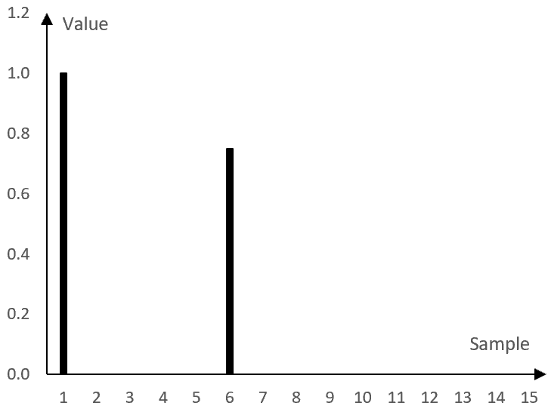






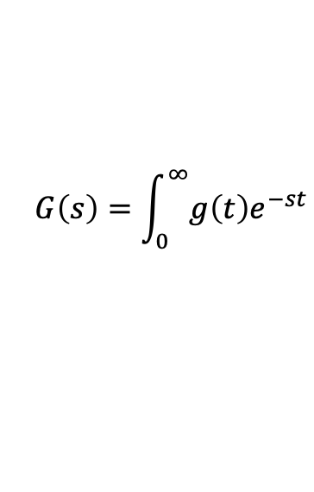
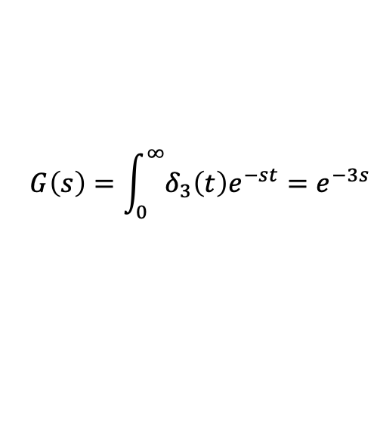



LT of an Impulse
$$G\left(s\right)=\int_{0}^{∞}{g\left(t\right)e^{−st}}$$
Laplace Transform
$${L[δ}_{τ}\left(t\right){]=e}^{−sτ}$$
$${L[δ}_{0}\left(t\right)]=$$
$$1$$
$$δ_{1}$$
$$G\left(s\right)=\int_{0}^{∞}{δ_{3}\left(t\right)e^{−st}}=e^{−3s}$$
$${L[δ}_{1}]=e^{−s}$$
$$L[g(t)]=e^{−s}+\left(0.8\right)e^{−6s}$$
$${(0.8)δ}_{6}$$
$$g(t)$$
$${L[δ}_{6}]={(0.8)e}^{−6s}$$
Signals and systems can be described using combinations of more Laplace Transforms.
Notes:
Show how can encode a discrete signal with a sum of e^-st terms. Show time shifts and scale by constant.

Slide 10
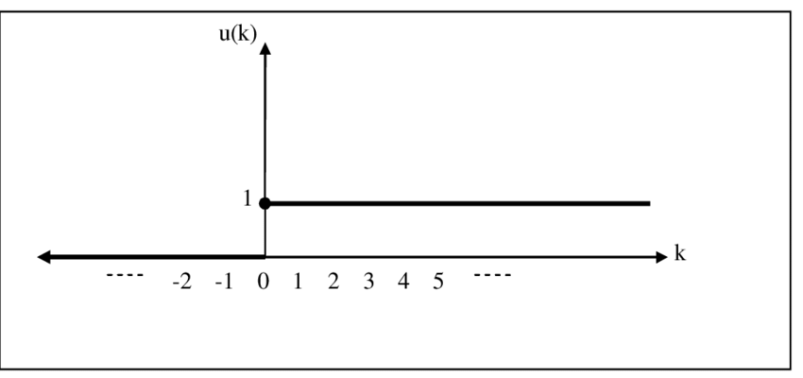
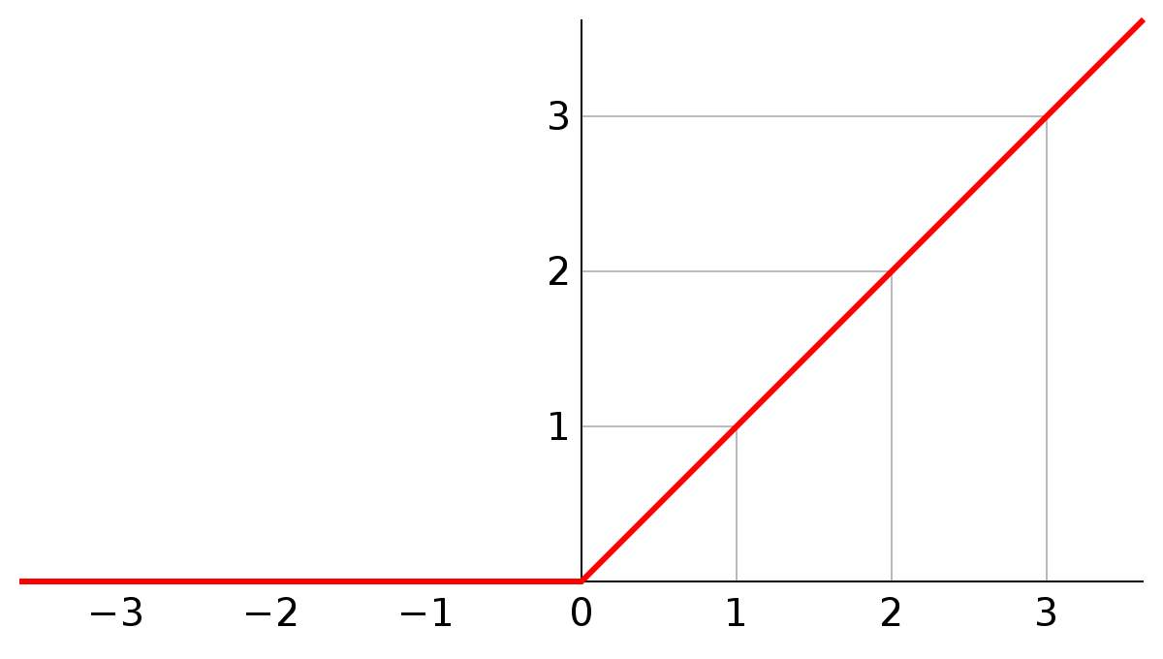

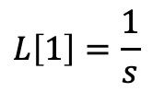


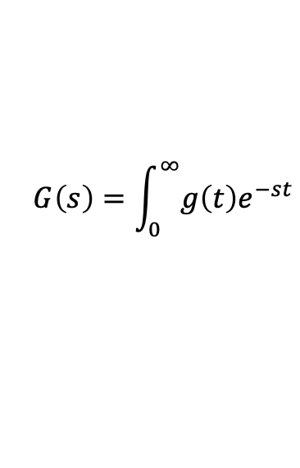

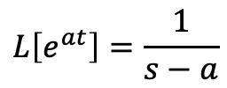



More Laplace Transforms
$$G\left(s\right)=\int_{0}^{∞}{g\left(t\right)e^{−st}}$$
Unit step at time 0: g$\left(t\right)=1, t≥0;0, t<0.$
Ramp: g$\left(t\right)=t, t≥0;0, t<0.$
$$g\left(t\right)$$
$$g\left(t\right)$$
Laplace Transform
$$L\left[1\right]=\frac{1}{s}$$
Laplace Transform
$$L\left[t\right]=\frac{1}{s^{2}}$$
Laplace Transform of transcendentals:
$$L\left[e^{at}\right]=\frac{1}{s−a}$$
$$L\left[cos⁡(ωt)\right]=\frac{s}{s^{2}+ω^{2}}$$
$$L\left[sin⁡(αt)\right]=\frac{ω}{s^{2}+ω^{2}}$$

Slide 11






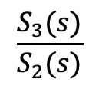
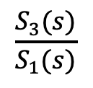
Transfer Function
S1
S2
S3
$$G_{1}(s)$$
$$G_{2}(s)$$
$$G\left(s\right)$$
A transfer function is the ratio of the Laplace transform of the output to the Laplace transform of the input.
$$G_{1}\left(s\right)=\frac{S_{2}(s)}{S_{1}(s)}$$
$$\frac{S_{3}(s)}{S_{2}(s)}$$
$$\frac{S_{3}(s)}{S_{1}(s)}$$
$$G_{2}\left(s\right)=$$
$$G\left(s\right)=$$

Slide 12



An Important Property of L.T.s
$$L\left[g(t)\right]=G(s)$$
The derivative of $g(t)$ is denoted by$\dot{g}(t)$.
$$L\left[\dot{g}(t)\right]=sG(s)$$

Slide 13
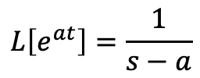
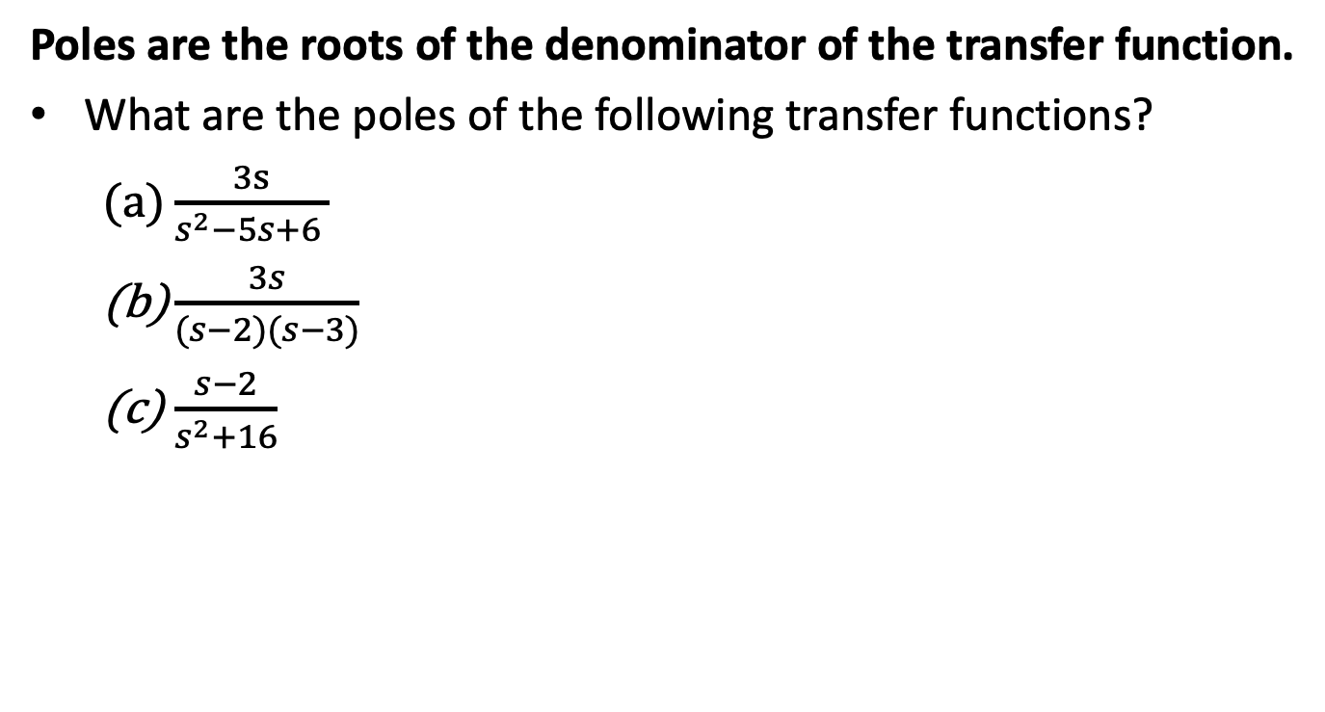


The Poles of a System
$$L\left[e^{at}\right]=\frac{1}{s−a}$$
$$L\left[cos⁡(ωt)\right]=\frac{s}{s^{2}+ω^{2}}$$
$$L\left[sin⁡(αt)\right]=\frac{ω}{s^{2}+ω^{2}}$$
Poles are the roots of the denominator of the transfer function.
What are the poles of the following transfer functions?
$\frac{3s}{s^{2}−5s+6 }$
$\frac{3s}{(s−2)(s−3)}$
$\frac{s−2}{s^{2}+16}$

Slide 14
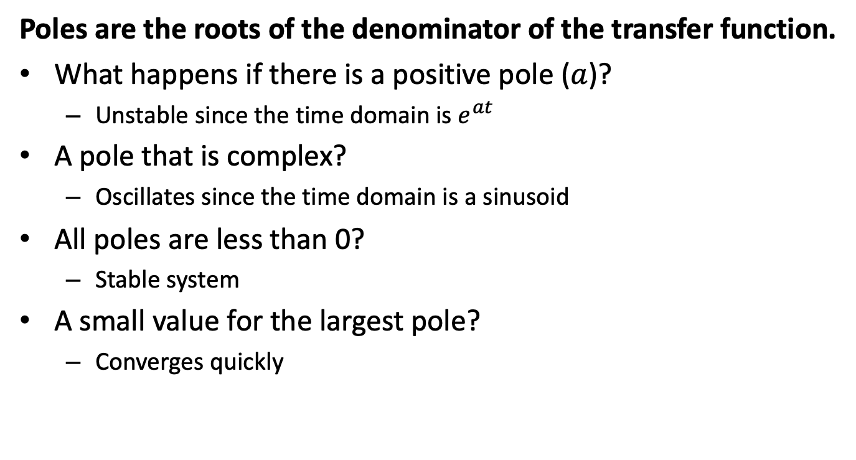
Why Poles?
$$L\left[e^{at}\right]=\frac{1}{s−a}$$
$$L\left[cos⁡(ωt)\right]=\frac{s}{s^{2}+ω^{2}}$$
$$L\left[sin⁡(αt)\right]=\frac{ω}{s^{2}+ω^{2}}$$
Poles are the roots of the denominator of the transfer function.
What happens if there is a positive pole ($a$)?
Unstable since the time domain is $e^{at}$
A pole that is complex?
Oscillates since the time domain is a sinusoid
All poles are less than 0?
Stable system
A small value for the largest pole?
Converges quickly

Slide 15
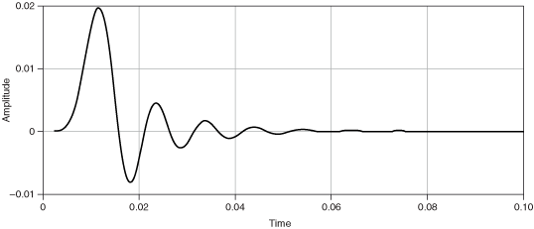


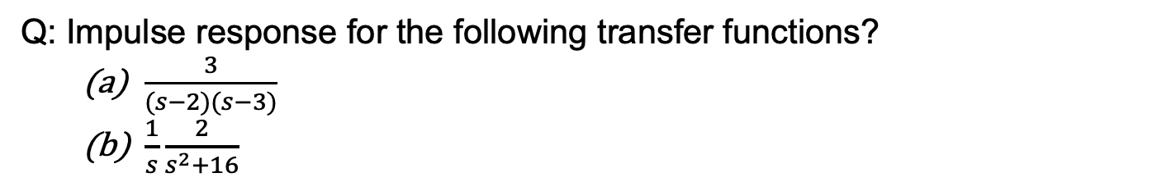

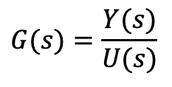


Impulse Response (IR) of a System
$$G\left(s\right)=\int_{0}^{∞}{g\left(t\right)e^{−st}}$$
Defn: Final value of output after a unit impulse at t=0.
Impulse
Response
$$G(s)$$
$$U(s)$$
$$Y(s)$$
$$y\left(∞\right)$$
$$G(s)=\frac{Y(s)}{U(s)}$$
Calculating impulse response
$$\lim_{s→0}{sG\left(s\right)}=y\left(∞\right)$$
Q: Impulse response for the following transfer functions?
$\frac{3}{(s−2)(s−3)}$
$\frac{1}{s}\frac{2}{s^{2}+16}$
IR Indicates how the system responds to an initial condition.

Slide 16
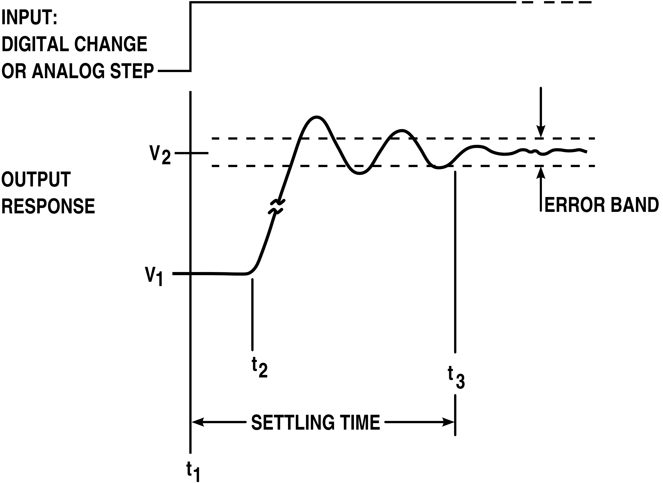
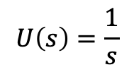
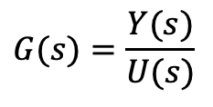


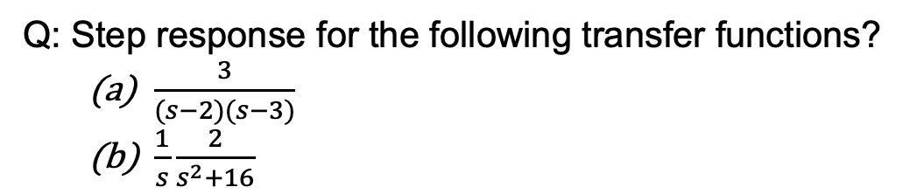

Step Response of a System (DC Gain)
Defn: Final value of output after a unit step at t=0.
$$U\left(s\right)=\frac{1}{s}$$
Step Input
$$G(s)$$
$$y(∞)$$
$$U(s)$$
$$Y(s)$$
Output Response
$$G(s)=\frac{Y(s)}{U(s)}$$
Calculating step response.
$$\lim_{s→0}{G\left(s\right)}=y\left(∞\right)$$
Q: Step response for the following transfer functions?
$\frac{3}{(s−2)(s−3)}$
$\frac{1}{s}\frac{2}{s^{2}+16}$
DC Gain indicates how the input affects the output.

Slide 17

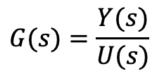
Interpreting DC Gain
$$G(s)$$
$$U(s)$$
$$Y(s)$$
DC Gain = 0
The input does not affect the output
DC Gain > 0
The output increases as the input increases
DC Gain < 0
The output decreases as the input increases
Magnitude of DC Gain is large (small)
Increasing the input has a large (small) effect on the output
$$G(s)=\frac{Y(s)}{U(s)}$$
DC Gain: $G(0)$

Slide 18
Workflow for System Analysis
Calculate the the transfer function.
Calculate poles and determine whether the system is stable/unstable, oscillatory.
Calculate impulse response.
Calculate DC gain.

Slide 19

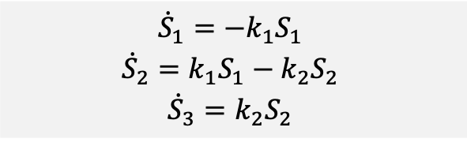

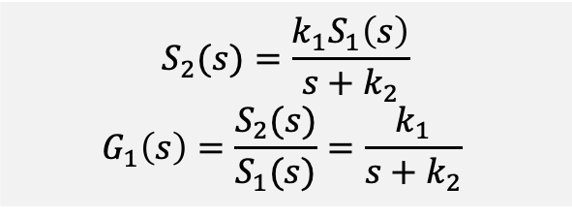
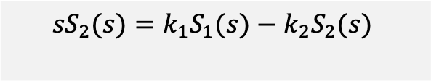

Transfer Functions for Reaction Networks
Reaction Network
Steps for constructing TF of a system:
Define the system in terms of its input and output.
Write the state equations.
Convert state equations to Laplace Transforms.
Solve for the output in terms of the input and calculate the ratio.
J1: S1→ S2; k1*S1
J2: S2 -> ; k2*S2
S1
S2
$$G_{2}(s)$$
S3
$$G_{1}(s)$$
3. Convert to LTs.
1. Define the system
$$G_{1}\left(s\right)={\frac{S_{2}\left(s\right)}{S_{1}(s)}}_{ }$$
$${{sS}_{2}(s)=k_{1}S_{1}(s)−k_{2}S_{2}(s)}_{ }$$
2. Write state equations.
4. Solve for transfer functions.
$${{\dot{S}}_{1}={−k}_{1}S_{1}}_{ }$$
$${{\dot{S}}_{2}=k_{1}S_{1}−k_{2}S_{2}}_{ }$$
$${{\dot{S}}_{3}=k_{2}S_{2}}_{ }$$
$$S_{2}(s)=\frac{k_{1}S_{1}\left(s\right)}{s+k_{2}}$$
$$G_{1}\left(s\right)=\frac{S_{2}(s)}{S_{1}(s)}={\frac{k_{1}}{s+k_{2}}}_{ }$$
Notes:
Possibilities for the input signal

Slide 20


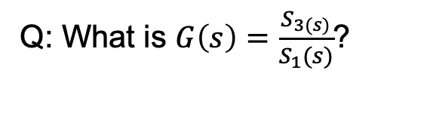
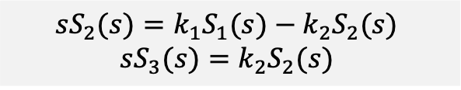

A Second Example
Reaction Network
S1
S2
$$G_{2}(s)$$
S3
J1: S1→ S2; k1*S1
J2: S2 -> S3; k2*S2
$$G_{1}(s)$$
1. Define the system
3. Convert to Laplace Transforms.
$${G_{2}\left(s\right)=\frac{S_{3}\left(s\right)}{S_{2}(s)}}_{ }$$
$${{sS}_{2}(s)=k_{1}S_{1}(s)−k_{2}S_{2}(s)}_{ }$$
$${sS_{3}(s)=k_{2}S_{2}(s)}_{ }$$
2. Write state equations.
4. Solve for transfer functions.
$${{\dot{S}}_{2}=k_{1}S_{1}−k_{2}S_{2}}_{ }$$
$${{\dot{S}}_{3}=k_{2}S_{2}}_{ }$$
$${G_{2}\left(s\right)=\frac{k_{2}}{s}}_{ }$$
Q: What is $G\left(s\right)=\frac{S_{3(s)}}{S_{1}(s)}$?
Notes:
Possibilities for the input signal

Slide 21

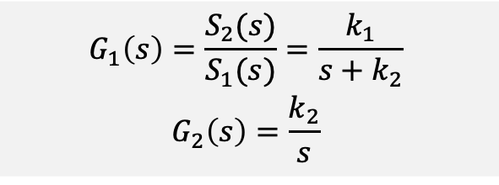

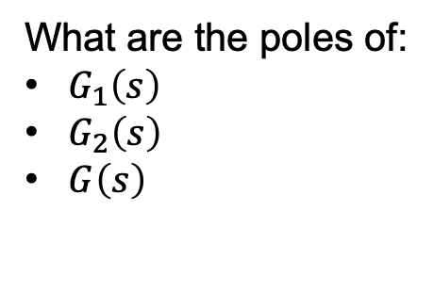

Poles of the System
$$G_{1}\left(s\right)=\frac{S_{2}(s)}{S_{1}(s)}={\frac{k_{1}}{s+k_{2}}}_{ }$$
$${G_{2}\left(s\right)=\frac{k_{2}}{s}}_{ }$$
S1
S2
$$\frac{k_{2}}{s}$$
S3
$$\frac{k_{1}}{s+k_{2}}$$
$$G\left(s\right)$$
What are the poles of:
$G_{1}\left(s\right)$
$G_{2}\left(s\right)$
$G\left(s\right)$
Notes:
Possibilities for the input signal

Slide 22
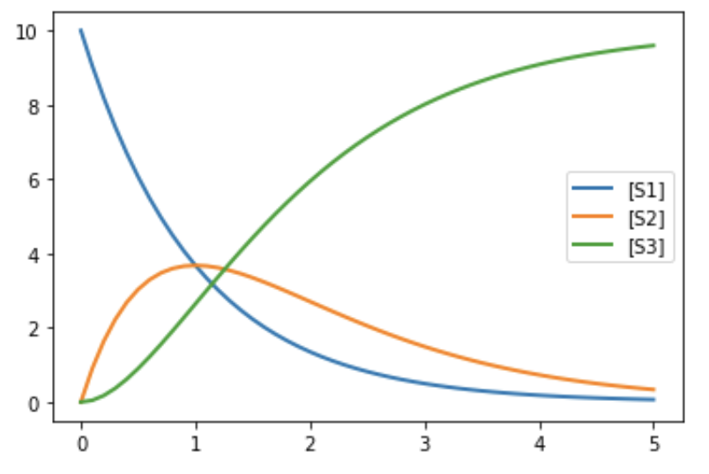


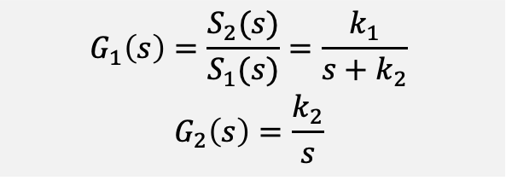




Impulse Response
$$G_{1}\left(s\right)=\frac{S_{2}(s)}{S_{1}(s)}={\frac{k_{1}}{s+k_{2}}}_{ }$$
$${G_{2}\left(s\right)=\frac{k_{2}}{s}}_{ }$$
S1
S2
$$\frac{k_{2}}{s}$$
S3
$$\frac{k_{1}}{s+k_{2}}$$
$$G\left(s\right)$$
Impulse response
$$k_{1}=1=k_{2}$$
$$\lim_{s→0}{sG\left(s\right)}=y\left(∞\right)$$
Response to ${(10)δ}_{0}(t)$:
$G_{1}\left(s\right)→0$
$G_{2}\left(s\right)→{(10)k}_{2}=10$
$G\left(s\right)→\lim_{s→0}{(10)s\frac{k_{1}}{s+k_{2}}}\frac{k_{2}}{s}=\left(10\right)k_{1}=10$

Slide 23
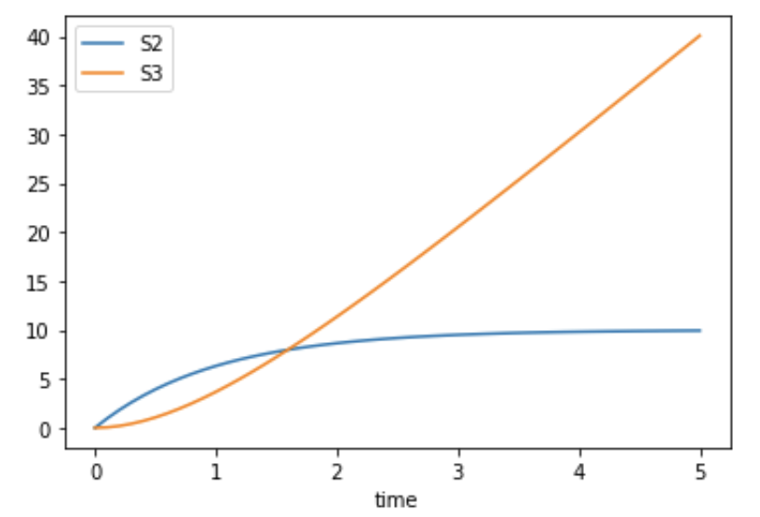



DC Gain (Step Response)
$$G_{1}\left(s\right)=\frac{S_{2}(s)}{S_{1}(s)}={\frac{k_{1}}{s+k_{2}}}_{ }$$
$${G_{2}\left(s\right)=\frac{k_{2}}{s}}_{ }$$
S1
S2
$$\frac{k_{2}}{s}$$
S3
$$\frac{k_{1}}{s+k_{2}}$$
$$G\left(s\right)$$
Calculating step response
$$k_{1}=1=k_{2}$$
$$\lim_{s→0}{G\left(s\right)}=y\left(∞\right)$$
Response to ${(10)δ}_{0}(t)$:
$G_{1}\left(s\right)→\left(10\right)\frac{k_{1}}{k_{2}}=10$
$G_{2}\left(s\right)→\frac{{\left(10\right)k}_{2}}{0}=∞$
$G\left(s\right)→\lim_{s→0}{(10)\frac{k_{1}}{s+k_{2}}}\frac{k_{2}}{s}=∞$

Slide 24
What You Need to Know
How to construct the state equations for a chemical network.
Solve for the Laplace transforms of the states.
Construct transfer functions for systems defined by ratios of state.
Find the poles of a system.
Find the impulse response of a system.
Find the step response of a system.

Slide 25
BACKUP

Slide 26


Inverse of a Laplace Function
$$G\left(s\right)=\int_{0}^{∞}{g\left(t\right)e^{−st}}$$
General form for a T.F.: $G\left(s\right)=\frac{N(s)}{D(s)}=\frac{s^{M}+b_{1}s^{M−1 }+⋯+b_{M}}{s^{N}+a_{1}s^{N−1 }+⋯+a_{N}}=\frac{\left(s−z_{1}\right)⋯(s−z_{M})}{\left(s−p_{1}\right)⋯(s−p_{N})}$
$z_{m}$ are the zeroes, $p_{n}$ are the poles.
$\frac{N(s)}{D(s)}$ can be expressed as the sum of terms of that are constant multiples of $\frac{1}{s}, \frac{1}{s−p_{n}}, \frac{1}{s^{2}+p_{n}^{2}}$.
In the time domain, these are constants, exponentials, sinusoids.

