Slide 1
BIOE 498 / BIOE 599 Advanced Biological Control Systems Lecture 9: Linearizing Reaction Networks
Joseph L. Hellerstein
eScience Institute, Computer Science & Engineering
Allen School of Computer Science
BioEngineering
Notes:
Diverse students. Some with bio-backgrounds; some without. Some with CS background; some with very limited. Two separate courses combined because of a substantial shared curriculum.

Slide 2
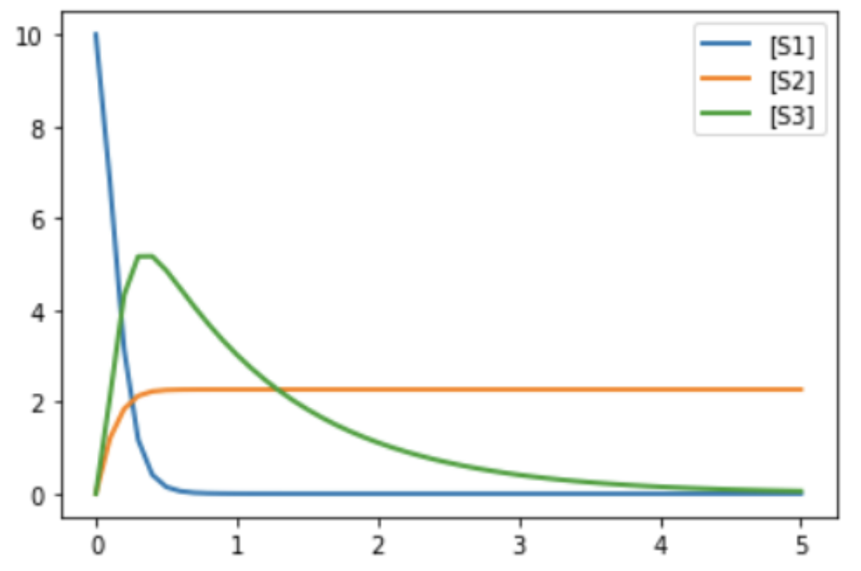


















Running Example
$${=J}_{1}$$
J1: S1 -> S2; k1*S1 J2: S1 + S2 -> 3 S3; k2*S1*S2 J3: S3 -> ; k3*S3 J4: 2 S1 + S3 -> S2; k4*S1*S3 k1 = 2 k2 = 1.5 k3 = 1 k4 = 0.5 S1 = 10 S2 = 0 S3 = 0
State Variables:
$$S_{1}, S_{2}, S_{3}$$
$${= J}_{2}$$
$${= J}_{3}$$
$${= J}_{4}$$
System Equations
${\dot{S}}_{n}$as a function of $J_{m}$
$$\dot{S_{1}}=$$
$$−J_{1}− J_{2}+\left(0\right)J_{3}−2J_{4}$$
$$\dot{S_{2}}=$$
$${ J}_{1}−{ J}_{2} + \left(0\right)J_{3}+ J_{4}$$
$$\dot{S_{3}}=$$
$${(0)J}_{1}+\left(3\right)J_{2} − { J}_{3} − { J}_{4}$$
Substitute reaction kinetics
$$\dot{S_{1}}=$$
$$−k_{1}S_{1}−k_{2}S_{1}S_{2}−{\left(2\right)k}_{4}S_{1}S_{3}$$
$$\dot{S_{2}}=$$
$$k_{1}S_{1}−k_{2}S_{1}S_{2}−k_{4}S_{1}S_{3}$$
$$\dot{S_{3}}=$$
$$(3)k_{2}S_{1}S_{2}−k_{3}S_{3}−k_{4}S_{1}S_{3}$$
Notes:
Note that J4 is not mass action

Slide 3


Linearizing the System Equations
J1: S1 -> S2; k1*S1 J2: S1 + S2 -> 3 S3; k2*S1*S2 J3: S3 -> ; k3*S3 J4: 2 S1 + S3 -> S2; k4*S1*S3
1. Choose an operating point $\overline{x}$, and calculate nominal values $\tilde{x}(t)=x(t)−\overline{x}$.
2. Calculate, $A,$ the Jacobian of the system equations.
3. Solve $\dot{\tilde{x}} =A \tilde{x}$ to obtain $\tilde{x}\left(t\right).$
4. $x\left(t\right)≈\overline{x}+\tilde{x}(t)$.

Slide 4
Agenda
System equations in matrix form
Operating point
Linearization of system equations

Slide 5














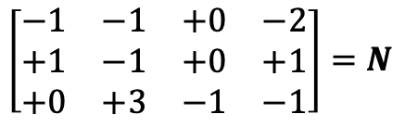


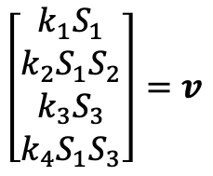




Matrix Representations
J1: S1 -> S2; k1*S1 J2: S1 + S2 -> 3 S3; k2*S1*S2 J3: S3 -> ; k3*S3 J4: 2 S1 + S3 -> S2; k4*S1*S3
System Equations
Stoichiometry Matrix
${\dot{S}}_{n}$as a function of $J_{m}$
J1
J2
J3
J4
$$\dot{S_{1}}=$$
$$−J_{1}− J_{2}+\left(0\right)J_{3}−2J_{4}$$
$$S_{1}$$
$$\left[\begin{matrix}\begin{matrix}\begin{matrix}−1 & −1\end{matrix} & \begin{matrix}+0 & −2\end{matrix}\end{matrix} \\ \begin{matrix}\begin{matrix}+1 & −1\end{matrix} & \begin{matrix}+0 & +1\end{matrix}\end{matrix} \\ \begin{matrix}\begin{matrix}+0 & +3\end{matrix} & \begin{matrix}−1 & −1\end{matrix}\end{matrix}\end{matrix}\right]=N$$
$$\dot{S_{2}}=$$
$$S_{2}$$
$${ J}_{1}−{ J}_{2} + \left(0\right)J_{3}+ J_{4}$$
$$S_{3}$$
$$\dot{S_{3}}=$$
$${(0)J}_{1}+\left(3\right)J_{2} − { J}_{3} − { J}_{4}$$
Substitute reaction kinetics
Flux Vector
$$\dot{S_{1}}=$$
$$−k_{1}S_{1}−k_{2}S_{1}S_{2}−{\left(2\right)k}_{4}S_{1}S_{3}$$
$$J_{1}$$
$$\left[\begin{matrix}\begin{matrix}k_{1}S_{1} \\ k_{2}S_{1}S_{2}\end{matrix} \\ \begin{matrix}k_{3}S_{3} \\ k_{4}S_{1}S_{3}\end{matrix}\end{matrix}\right]=v$$
$$\dot{S_{2}}=$$
$$k_{1}S_{1}−k_{2}S_{1}S_{2}+k_{4}S_{1}S_{3}$$
$$J_{2}$$
$$(3)k_{2}S_{1}S_{2}−k_{3}S_{3}−k_{4}S_{1}S_{3}$$
$$J_{3}$$
$$\dot{S_{3}}=$$
$$J_{4}$$

Slide 6
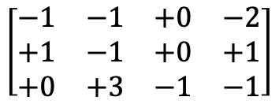




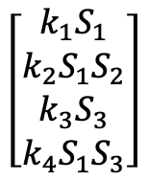
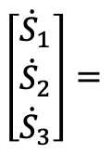


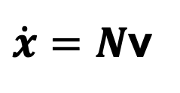





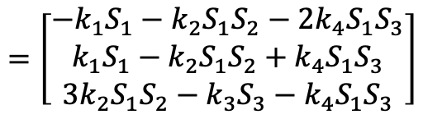




System Equations in Matrices
System Equations
$$\dot{S_{1}}=$$
$$−k_{1}S_{1}−k_{2}S_{1}S_{2}−{2k}_{4}S_{1}S_{3}$$
$$\dot{S_{2}}=$$
$$k_{1}S_{1}−k_{2}S_{1}S_{2}+k_{4}S_{1}S_{3}$$
$$\dot{S_{3}}=$$
$$3k_{2}S_{1}S_{2}−k_{3}S_{3}−k_{4}S_{1}S_{3}$$
$$\dot{x}$$
$$N$$
v
State Derivatives
Stoichiometry Matrix
Flux Vector
J1
J2
J3
J4
$$J_{1}$$
$$\left[\begin{matrix}\begin{matrix}{\dot{S}}_{1} \\ {\dot{S}}_{2}\end{matrix} \\ {\dot{S}}_{3}\end{matrix}\right]=$$
$$J_{2}$$
$$\left[\begin{matrix}\begin{matrix}k_{1}S_{1} \\ k_{2}S_{1}S_{2}\end{matrix} \\ \begin{matrix}k_{3}S_{3} \\ k_{4}S_{1}S_{3}\end{matrix}\end{matrix}\right]$$
$$S_{1}$$
$$\left[\begin{matrix}\begin{matrix}\begin{matrix}−1 & −1\end{matrix} & \begin{matrix}+0 & −2\end{matrix}\end{matrix} \\ \begin{matrix}\begin{matrix}+1 & −1\end{matrix} & \begin{matrix}+0 & +1\end{matrix}\end{matrix} \\ \begin{matrix}\begin{matrix}+0 & +3\end{matrix} & \begin{matrix}−1 & −1\end{matrix}\end{matrix}\end{matrix}\right]$$
$$×$$
$$S_{2}$$
$$J_{3}$$
$$S_{3}$$
$$J_{4}$$
$$=\left[\begin{matrix}\begin{matrix}−k_{1}S_{1}−k_{2}S_{1}S_{2}−2k_{4}S_{1}S_{3} \\ k_{1}S_{1}−k_{2}S_{1}S_{2}+k_{4}S_{1}S_{3}\end{matrix} \\ 3k_{2}S_{1}S_{2}−k_{3}S_{3}−k_{4}S_{1}S_{3}\end{matrix}\right]$$
$\dot{x}=N$v

Slide 7


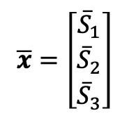

Operating Point
$$t=0, {\overline{S}}_{1}=10,{\overline{S}}_{2}=0,{\overline{S}}_{3}=0$$
$${t=1, \overline{S}}_{1}=0,{\overline{S}}_{2}=2,{\overline{S}}_{3}=3.5$$
$$\overline{x}=\left[\begin{matrix}{\overline{S}}_{1} \\ {\overline{S}}_{2} \\ {\overline{S}}_{3}\end{matrix}\right]$$
An overbar (e.g., ${\overline{S}}_{1})$ is used to indicate the value at an operating point.
An operating point is the values of state variables at which the system is evaluated.
This is often indicated by the time evolution of the system.
$\overline{x}$ is a constant.

Slide 8






Linearization
System Equations
$$\dot{S_{1}}=$$
$$−k_{1}S_{1}−k_{2}S_{1}S_{2}−{2k}_{4}S_{1}S_{3}$$
$$\dot{S_{2}}=$$
$$k_{1}S_{1}−k_{2}S_{1}S_{2}−k_{4}S_{1}S_{3}$$
$$\dot{S_{3}}=$$
$$3k_{2}S_{1}S_{2}−k_{3}S_{3}−k_{4}S_{1}S_{3}$$
Want each equation to be a linear function of $S_{1},S_{2},S_{3}$.
Each equation is a function to linearize.

Slide 9
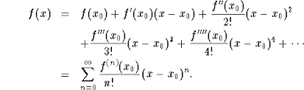
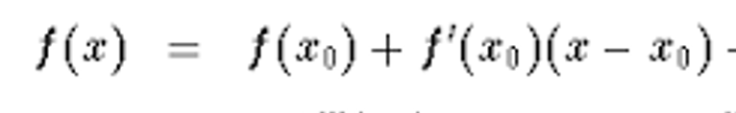

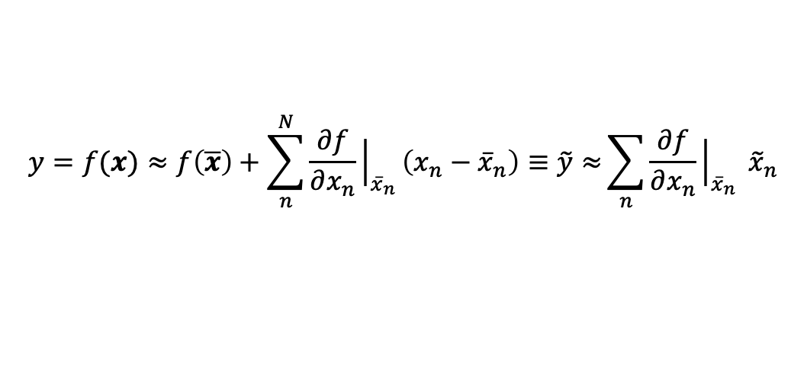


First Order Taylor Series Approximation
Given an operating point $x_{0}$for an analytic function, then
We can approximate the function by:
$$≈$$
If $x$ is a vector with N elements and we have the operating point $\overline{x}$, then
$$y=f(x)≈f\left(\overline{x}\right)+\sum_{n}^{N}{\frac{∂f}{∂x_{n}}{\left.​\right|}_{{\overline{x}}_{n}}\left(x_{n}−{\overline{x}}_{n}\right)≡\tilde{y}≈}\sum_{n}{\frac{∂f}{∂x_{n}}{\left.​\right|}_{{\overline{x}}_{n}} {\tilde{x}}_{n}}$$
Nominal values
$${\tilde{x}}_{n}=x_{n}−\overline{x_{n}}$$
$$\tilde{y}=f(x)−f(\overline{x})$$

Slide 10
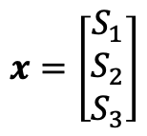
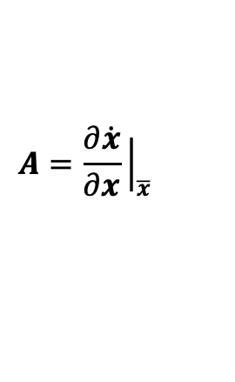


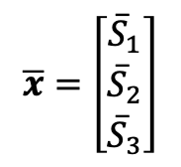



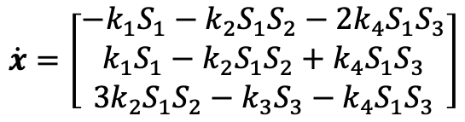

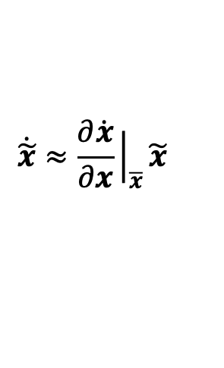

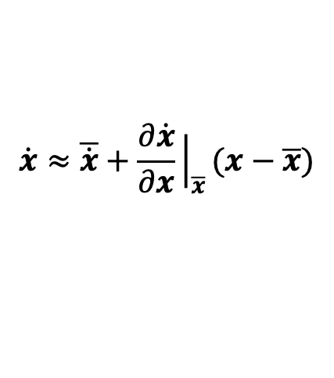

First Order Linearization
System Equations
$$\dot{S_{1}}=$$
$$−k_{1}S_{1}−k_{2}S_{1}S_{2}−{2k}_{4}S_{1}S_{3}$$
$$\dot{S_{2}}=$$
$$k_{1}S_{1}−k_{2}S_{1}S_{2}+k_{4}S_{1}S_{3}$$
$$\dot{S_{3}}=$$
$$3k_{2}S_{1}S_{2}−k_{3}S_{3}−k_{4}S_{1}S_{3}$$
$$x=\left[\begin{matrix}\begin{matrix}S_{1} \\ S_{2}\end{matrix} \\ S_{3}\end{matrix}\right]$$
$$\overline{x}=\left[\begin{matrix}{\overline{S}}_{1} \\ {\overline{S}}_{2} \\ {\overline{S}}_{3}\end{matrix}\right]$$
$$\dot{x}=\left[\begin{matrix}\begin{matrix}−k_{1}S_{1}−k_{2}S_{1}S_{2}−2k_{4}S_{1}S_{3} \\ k_{1}S_{1}−k_{2}S_{1}S_{2}+k_{4}S_{1}S_{3}\end{matrix} \\ 3k_{2}S_{1}S_{2}−k_{3}S_{3}−k_{4}S_{1}S_{3}\end{matrix}\right]$$
$$\dot{x}≈\overline{\dot{x}}+\frac{∂\dot{x}}{∂x}{\left.​\right|}_{\overline{x}}(x−\overline{x})$$
$$\dot{\tilde{x}}≈\frac{∂\dot{x}}{∂x}{\left.​\right|}_{\overline{x}}\tilde{x}$$
Linear System
$$\dot{\tilde{x}}=A \tilde{x}$$
$$A=\frac{∂\dot{x}}{∂x}{\left.​\right|}_{\overline{x}}$$
Jacobian
Remember: $x=\tilde{x}+\overline{x}$

Slide 11

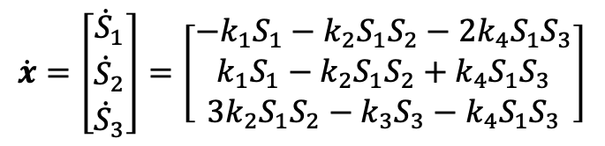
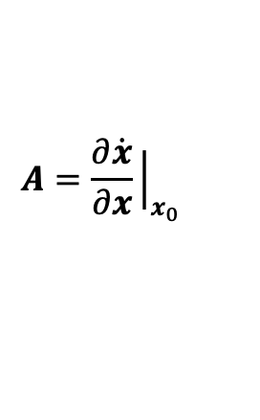
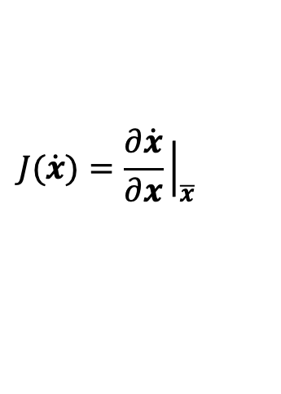
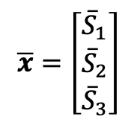
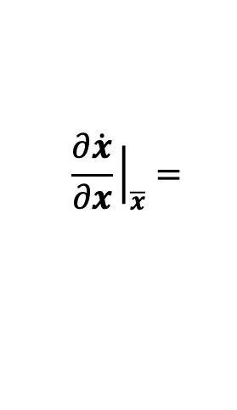
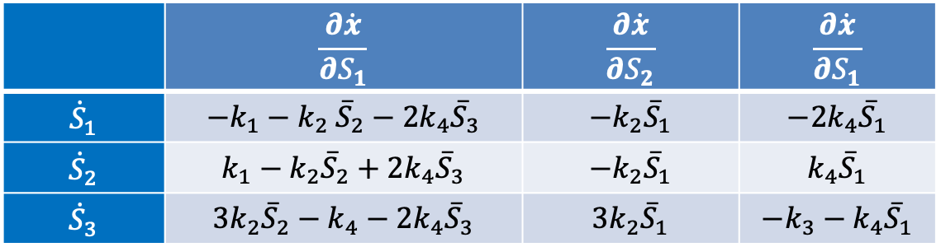
Calculate Jacobian
J1: S1 -> S2; k1*S1 J2: S1 + S2 -> 3 S3; k2*S1*S2 J3: S3 -> ; k3*S3 J4: 2 S1 + S3 -> S2; k4*S1*S3
$$\dot{x}=\left[\begin{matrix}\begin{matrix}{\dot{S}}_{1} \\ {\dot{S}}_{2}\end{matrix} \\ {\dot{S}}_{3}\end{matrix}\right]=\left[\begin{matrix}\begin{matrix}−k_{1}S_{1}−k_{2}S_{1}S_{2}−2k_{4}S_{1}S_{3} \\ k_{1}S_{1}−k_{2}S_{1}S_{2}+k_{4}S_{1}S_{3}\end{matrix} \\ 3k_{2}S_{1}S_{2}−k_{3}S_{3}−k_{4}S_{1}S_{3}\end{matrix}\right]$$
$$\overline{x}=\left[\begin{matrix}{\overline{S}}_{1} \\ {\overline{S}}_{2} \\ {\overline{S}}_{3}\end{matrix}\right]$$
$$J(\dot{x})=\frac{∂\dot{x}}{∂x}{\left.​\right|}_{\overline{x}}$$
 | $$\frac{∂\dot{x}}{∂S_{1}}$$ | $$\frac{∂\dot{x}}{∂S_{2}}$$ | $$\frac{∂\dot{x}}{∂S_{1}}$$
$${\dot{S}}_{1}$$ | $$−k_{1}−k_{2} {\overline{S}}_{2}−2k_{4}{\overline{S}}_{3}$$ | $$−k_{2}{\overline{S}}_{1}$$ | $$−2k_{4}{\overline{S}}_{1}$$
$${\dot{S}}_{2}$$ | $$k_{1}−k_{2}{\overline{S}}_{2}+{2k}_{4}{\overline{S}}_{3}$$ | $$−k_{2}{\overline{S}}_{1}$$ | $$k_{4}{\overline{S}}_{1}$$
$${\dot{S}}_{3}$$ | $$3k_{2}{\overline{S}}_{2}−k_{4}−2k_{4}{\overline{S}}_{3}$$ | $$3k_{2}{\overline{S}}_{1}$$ | $${−k_{3}−k}_{4}{\overline{S}}_{1}$$
$$\frac{∂\dot{x}}{∂x}{\left.​\right|}_{\overline{x}}=$$
Linear System
$$\dot{\tilde{x}}=A \tilde{x}$$
$$A=\frac{∂\dot{x}}{∂x}{\left.​\right|}_{x_{0}}$$

