Slide 1
BIOE 498 / BIOE 599 Advanced Biological Control Systems Lecture 7: Advanced Linear Algebra
Joseph L. Hellerstein
eScience Institute, Computer Science & Engineering
Allen School of Computer Science
BioEngineering
Notes:
Diverse students. Some with bio-backgrounds; some without. Some with CS background; some with very limited. Two separate courses combined because of a substantial shared curriculum.

Slide 2
Agenda
Matrix exponential
Cayley Hamilton Theorem (CHT)
Singular Value Decomposition

Slide 3



Why Matrix Exponential?
Matrix exponential solves: $\dot{x}\left(t\right)=Ax\left(t\right), x\left(0\right)=x_{0}$
$x\left(t\right)=e^{At}x_{0}$
Same as the univariate case! ($x\left(t\right)=e^{at}x_{0}$)
But what is $e^{At}$?
How do we calculate $e^{At}$?
Notes:
Why did I leave out “first order”? Can solve high order systems with more variables.

Slide 4
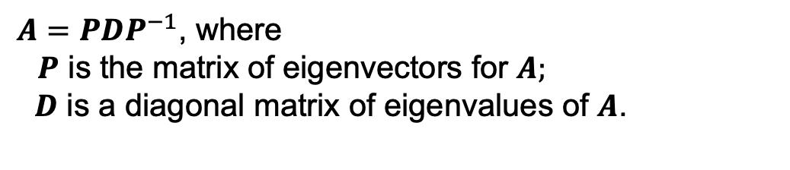
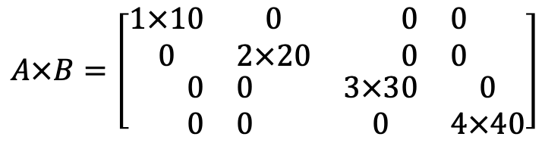
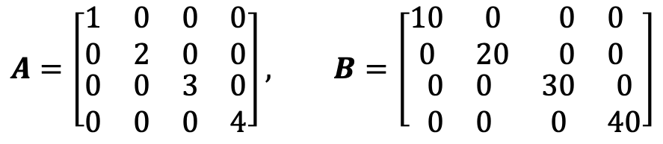
Remember…
Eigenvector decomposition of A (for distinct, non-zero eigenvalues) .
$A=PDP^{−1}$, where
$P$ is the matrix of eigenvectors for $A;$
$D$ is a diagonal matrix of eigenvalues of $A$.
Multiplying diagonal matrices (stretching/shrinking).
$$A=\left[\begin{matrix}\begin{matrix}1 & 0 \\ 0 & 2\end{matrix} & \begin{matrix}0 & 0 \\ 0 & 0\end{matrix} \\ \begin{matrix}0 & 0 \\ 0 & 0\end{matrix} & \begin{matrix}3 & 0 \\ 0 & 4\end{matrix}\end{matrix}\right], B=\left[\begin{matrix}\begin{matrix}10 & 0 \\ 0 & 20\end{matrix} & \begin{matrix}0 & 0 \\ 0 & 0\end{matrix} \\ \begin{matrix}0 & 0 \\ 0 & 0\end{matrix} & \begin{matrix}30 & 0 \\ 0 & 40\end{matrix}\end{matrix}\right]$$
$$A×B=\left[\begin{matrix}\begin{matrix}1×10 & 0 \\ 0 & 2×20\end{matrix} & \begin{matrix}0 & 0 \\ 0 & 0\end{matrix} \\ \begin{matrix}0 & 0 \\ 0 & 0\end{matrix} & \begin{matrix}3×30 & 0 \\ 0 & 4×40\end{matrix}\end{matrix}\right]$$
Just multiply corresponding elements in the diagonals.
Notes:
Show D_e explicitly.

Slide 5
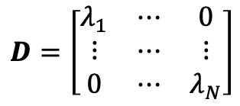

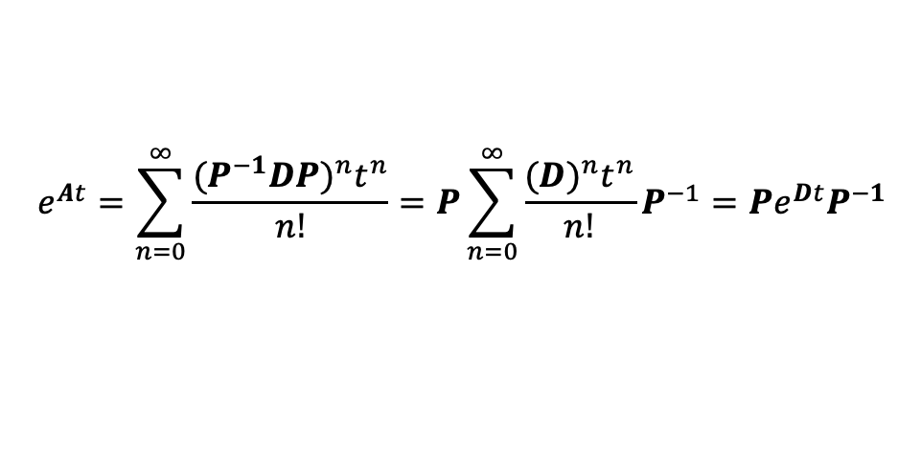
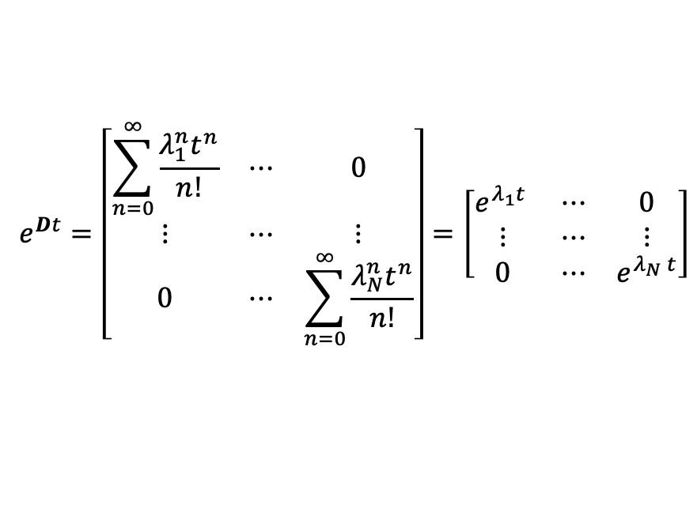
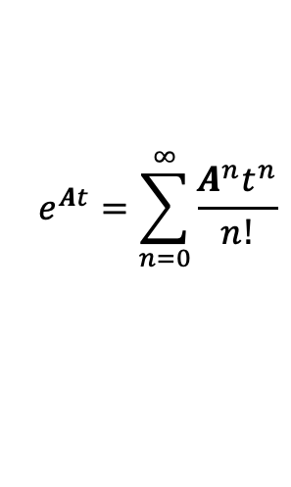

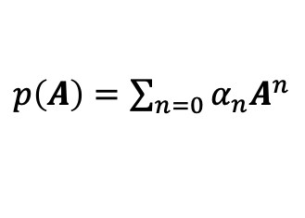

Matrix Exponential ($e^{At}$) as a Polynomial
Let $A$ be a $n×n$ matrix. A polynomial function of $A$ is well defined.
$p\left(A\right)=\sum_{n=0}{α_{n}A^{n}}$
Consider the case of distinct, eigenvalues. (Simpler to illustrate.)
$$e^{At}=\sum_{n=0}^{∞}{\frac{A^{n}t^{n}}{n!}}$$
$$e^{Dt}=\left[\begin{matrix}\sum_{n=0}^{∞}{\frac{λ_{1}^{n}t^{n}}{n!}} & ⋯ & 0 \\ ⋮ & ⋯ & ⋮ \\ 0 & ⋯ & \sum_{n=0}^{∞}{\frac{λ_{N}^{n}t^{n}}{n!}}\end{matrix}\right]=\left[\begin{matrix}e^{λ_{1}t } & ⋯ & 0 \\ ⋮ & ⋯ & ⋮ \\ 0 & ⋯ & e^{λ_{N} t}\end{matrix}\right]$$
$$D=\left[\begin{matrix}λ_{1} & ⋯ & 0 \\ ⋮ & ⋯ & ⋮ \\ 0 & ⋯ & λ_{N}\end{matrix}\right]$$
$$A=PDP^{−1}$$
$$n$$
$$A^{n}=\left(PDP^{−1}\right)⋯\left(PDP^{−1}\right)=PD^{n}P^{−1}$$
$$e^{At}=\sum_{n=0}^{∞}{\frac{{(P^{−1}DP)}^{n}t^{n}}{n!}}=P\sum_{n=0}^{∞}{\frac{{(D)}^{n}t^{n}}{n!}}P^{−1}=Pe^{Dt}P^{−1}$$
Notes:
Show D_e explicitly.

Slide 6
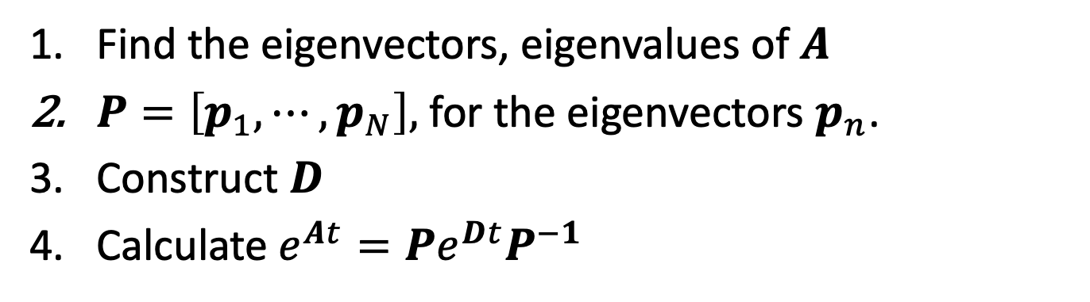

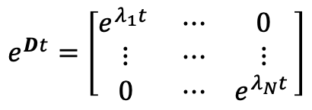
Calculating $e^{At}$
$$e^{Dt}=\left[\begin{matrix}e^{λ_{1}t } & ⋯ & 0 \\ ⋮ & ⋯ & ⋮ \\ 0 & ⋯ & e^{λ_{N}t }\end{matrix}\right]$$
Find the eigenvectors, eigenvalues of $A$
$P=\left[p_{1},⋯,p_{N}\right],$ for the eigenvectors $p_{n}$.
Construct $D$
Calculate $e^{At}=Pe^{Dt}P^{−1}$

Slide 7

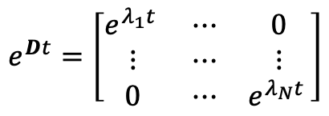

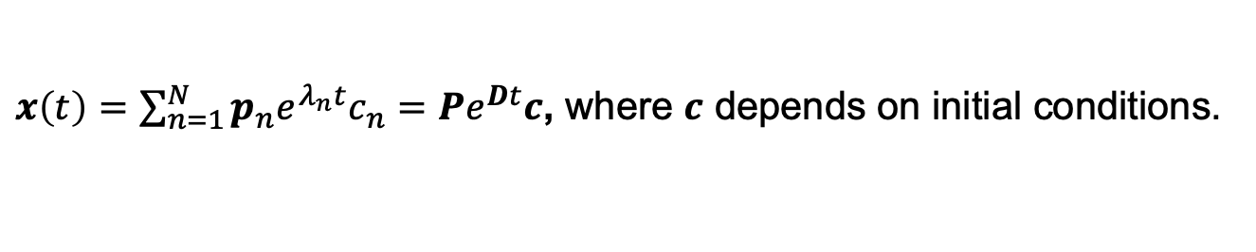

Matrix Exponential Solution to ODEs
Matrix exponential solution.
$$e^{Dt}=\left[\begin{matrix}e^{λ_{1}t } & ⋯ & 0 \\ ⋮ & ⋯ & ⋮ \\ 0 & ⋯ & e^{λ_{N}t }\end{matrix}\right]$$
$$x\left(t\right)=e^{At}x_{0}=Pe^{Dt}P^{−1}x_{0}$$
Solution to ODE using eigenvalues and eigenvectors.
$x\left(t\right)=\sum_{n=1}^{N}{p_{n}e^{λ_{n}t}c_{n}}=Pe^{Dt}c$, where $c$ depends on initial conditions.
$$x_{0}=x\left(0\right)=PIc$$
$${P^{−1}x}_{0}=c$$
$$x\left(t\right)=Pe^{Dt}P^{−1}x_{0}=e^{At}x_{0}$$

Slide 8

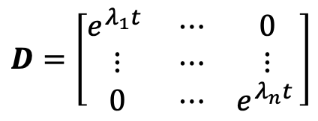
The Matrix Exponential is Nonsingular
$$D=\left[\begin{matrix}e^{λ_{1}t } & ⋯ & 0 \\ ⋮ & ⋯ & ⋮ \\ 0 & ⋯ & e^{λ_{n}t }\end{matrix}\right]$$
$$e^{At}=PDP^{−1}$$
The diagonal is always non-zero. So, $D$is invertible.
$P, P^{−1},D$ are non-singular. So, their product is non-singular.
$e^{At}$ is the product of non-singular matrices, and so $e^{−At}$ always exists.

Slide 9
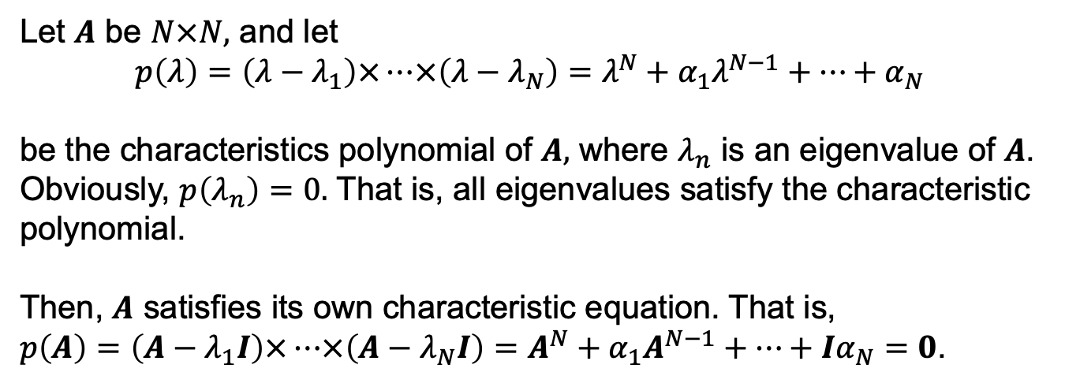
Cayley Hamilton Theorem (CHT)
Theorem
Let $A$ be $N×N,$ and let
$$p\left(λ\right)=\left(λ−λ_{1}\right)×⋯×\left(λ−λ_{N}\right)=λ^{N}+α_{1}λ^{N−1}+⋯+α_{N}$$
be the characteristics polynomial of $A,$ where $λ_{n}$ is an eigenvalue of $A$. Obviously, $p\left(λ_{n}\right)=0.$ That is, all eigenvalues satisfy the characteristic polynomial.
Then, $A$ satisfies its own characteristic equation. That is,
$p\left(A\right)=\left(A−λ_{1}I\right)×⋯×\left(A−λ_{N}I\right)=A^{N}+α_{1}A^{N−1}+⋯+{Iα}_{N}=0$.
Notes:
Show that this makes sense since we’re multiplying square matrices.
Transition from a polynomial of scalars to a polynomial of matrices.

Slide 10
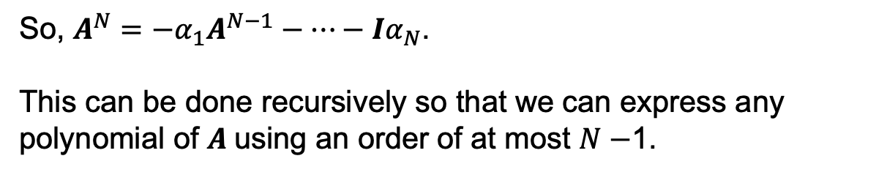

Why Do We Care About CHT? CHT reduces an infinite sum to a finite sum.
CHT: $A^{N}+α_{1}A^{N−1}+⋯+{Iα}_{N}=0$.
So, $A^{N}=−α_{1}A^{N−1}−⋯−{Iα}_{N}$.
This can be done recursively so that we can express any polynomial of $A$using an order of at most $N−$1.
This means that $\sum_{n=0}^{∞}{{α_{n}A}^{n}}=\sum_{n=0}^{N−1 }{α_{n}^{′}A^{n}}$.
Notes:
Show that this makes sense since we’re multiplying square matrices.
Transition from a polynomial of scalars to a polynomial of matrices.

Slide 11
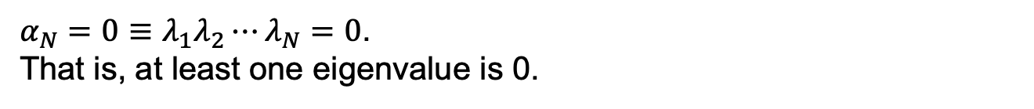


Why Do We Care About CHT? CHT provides a way to calculate an inverse, if it exists.
CHT: $A^{N}+α_{1}A^{N−1}+⋯+{Iα}_{N}=0$.
${\frac{−1}{α_{N}}(A}^{N}+α_{1}A^{N−1}+⋯+α_{N−1}A)=I,$ if $α_{N}≠0.$
$$A{\frac{−1}{α_{N}}(A}^{N−1}+α_{1}A^{N−2}+⋯+α_{N−1}I)=I$$
$$A^{−1}={\frac{−1}{α_{N}}(A}^{N−1}+α_{1}A^{N−2}+⋯+α_{N−1}I)$$
When does the inverse NOT exist?
$α_{N}=0≡λ_{1}λ_{2}⋯λ_{N}=0$.
That is, at least one eigenvalue is 0.
Notes:
Show that this makes sense since we’re multiplying square matrices.
Transition from a polynomial of scalars to a polynomial of matrices.

Slide 12

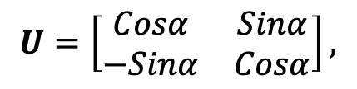
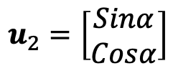
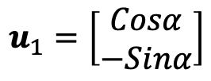
Reminder: Unitary Matrix
$U=[u_{1},⋯,u_{N}]$ ($N×N$) is unitary iff $u_{i}⋅u_{j}=1$ if $i=j$ and 0 otherwise.
$$U=\left[\begin{matrix}Cosα & Sinα \\ −Sinα & Cosα\end{matrix}\right],$$
$$u_{1}=\left[\begin{matrix}Cosα \\ −Sinα\end{matrix}\right]$$
$$u_{2}=\left[\begin{matrix}Sinα \\ Cosα\end{matrix}\right]$$
$$u_{1}⋅u_{1}=Cosα×Cosα+(−Sinα)×(−Sinα)=Cos^{2}α+Sin^{2}α=1$$
$$u_{1}⋅u_{2}=u_{2}⋅u_{1}=Cosα×Sinα−Cosα×Sinα=0$$
$$u_{2}⋅u_{2}=Cosα×Cosα+Sinα×Sinα=Cos^{2}α+Sin^{2}α=1$$
$$U×U^{T}=U^{T}×U=I$$
A unitary matrix is a rotation.

Slide 13
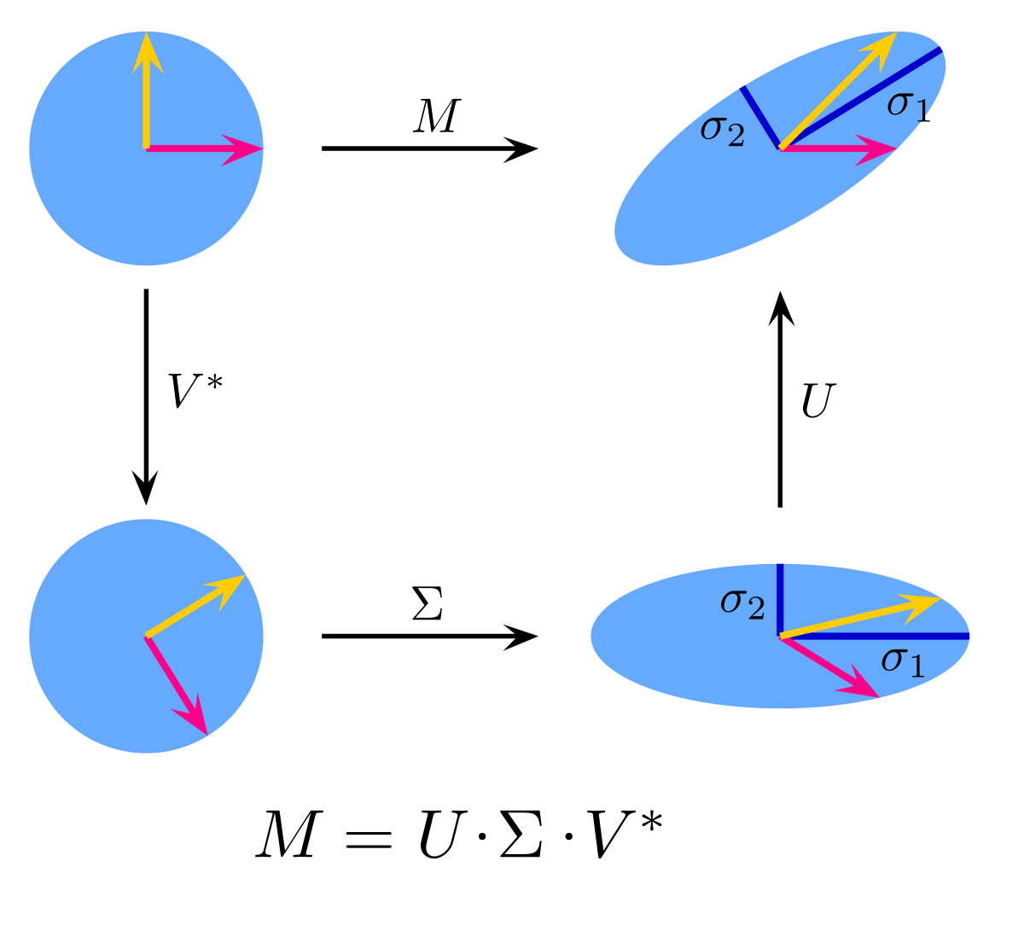

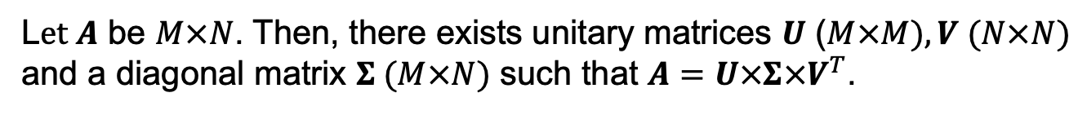



Singular Value Decomposition (SVD)
Probably the most important result in linear algebra.
L$et A$ be $M×N$. Then, there exists unitary matrices $U$ ($M×M), V (N×N)$ and a diagonal matrix $Σ (M×N)$ such that $A=U×Σ×V^{T}$.
$$A=U×Σ×V^{T}$$
Rotation in 2-d
$$U$$
$$V^{T}$$
Rotation in 3-d
Stretch and
translate to 3-d
$$Σ$$
Notes:
Give example. Prove.

Slide 14

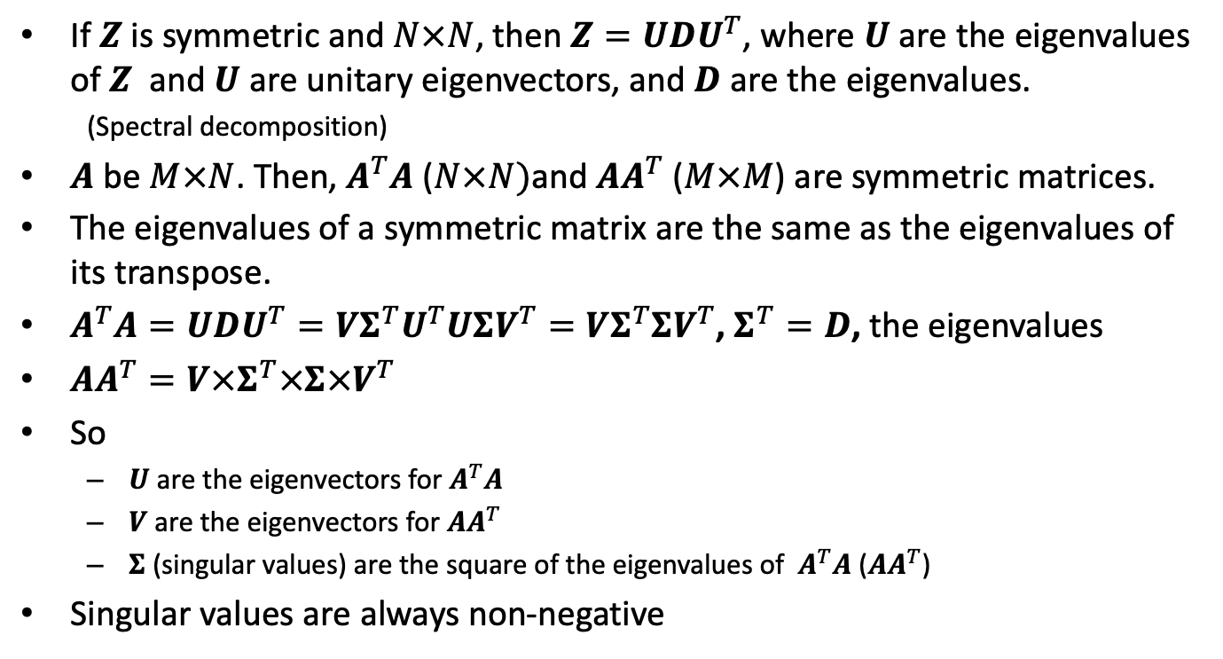



Justification for SVD
$$A=U×Σ×V^{T}$$
$$M×N$$
$$M×M$$
$$M×N$$
$$N×N$$
If $Z$ is symmetric and $N×N$, then $Z=UDU^{T}$, where $U$ are the eigenvalues of $Z$ and $U$ are unitary eigenvectors, and $D$ are the eigenvalues.
(Spectral decomposition)
$A$ be $M×N$. Then, $A^{T}A$ ($N×N)$and $AA^{T}$ ($M×M$) are symmetric matrices.
The eigenvalues of a symmetric matrix are the same as the eigenvalues of its transpose.
$A^{T}A=UDU^{T}=VΣ^{T}U^{T}UΣV^{T}=VΣ^{T}ΣV^{T}$, $Σ^{T}=D$, the eigenvalues
$AA^{T}=V×Σ^{T}×Σ×V^{T}$
So
$U$ are the eigenvectors for $A^{T}A$
$V$ are the eigenvectors for $AA^{T}$
$Σ$ (singular values) are the square of the eigenvalues of $A^{T}A$ ($AA^{T}$)
Singular values are always non-negative

Slide 15
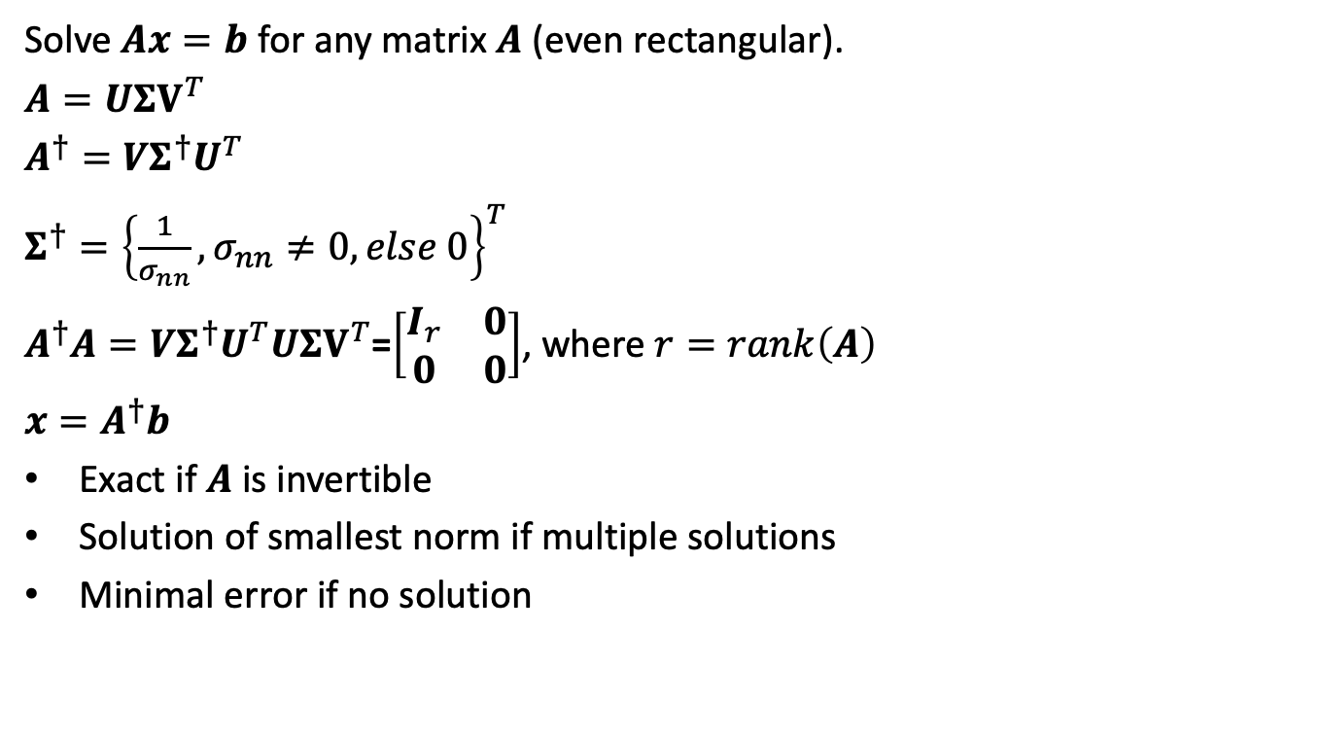
Pseudo Inverse
Solve $Ax=b$ for any matrix $A$ (even rectangular).
$A=UΣV^{T}$
$A^{†}=VΣ^{†}U^{T}$
$Σ^{†}={\left\{\frac{1}{σ_{nn}}, σ_{nn}≠0, else 0\right\}}^{T}$
$A^{†}A=VΣ^{†}U^{T}UΣV^{T}$=$\left[\begin{matrix}I_{r} & 0 \\ 0 & 0\end{matrix}\right]$, where $r=rank\left(A\right)$
$x=A^{†}b$
Exact if $A$ is invertible
Solution of smallest norm if multiple solutions
Minimal error if no solution

