Slide 1
BIOE 498 / BIOE 599 Advanced Biological Control Systems Lecture 4: Modeling Dynamical Systems
Joseph L. Hellerstein
eScience Institute, Computer Science & Engineering
Allen School of Computer Science
BioEngineering
Notes:
Diverse students. Some with bio-backgrounds; some without. Some with CS background; some with very limited. Two separate courses combined because of a substantial shared curriculum.

Slide 2
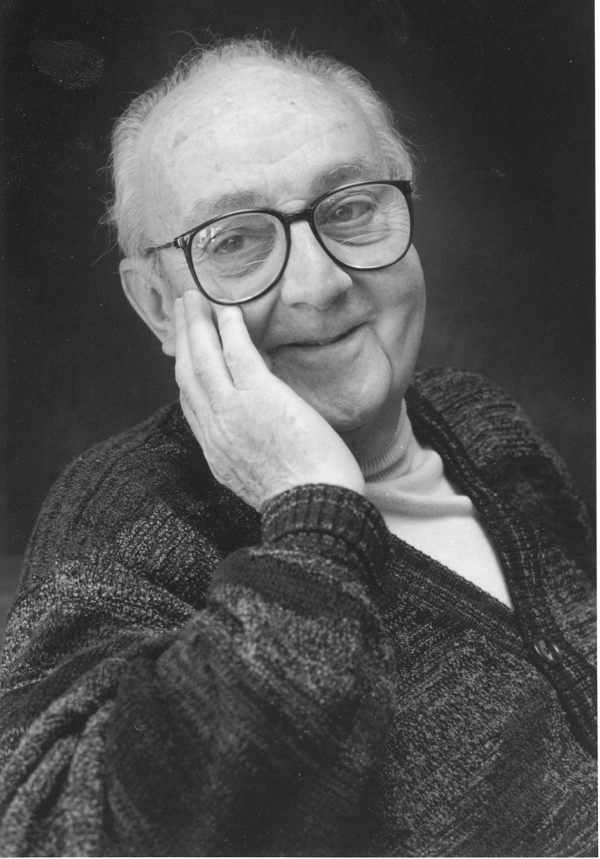
G.P.E. Box (Famous Statistician)
All models are wrong.
But some models are useful.

Slide 3
Agenda
Solving linear ordinary differential equations
Univariate without/with forced input
Multivariate without/with forced input
Matrix exponential solutions, eigenvalue solutions
Non-linear differential equations
Fixed points
Jacobian
Solution strategy

Slide 4
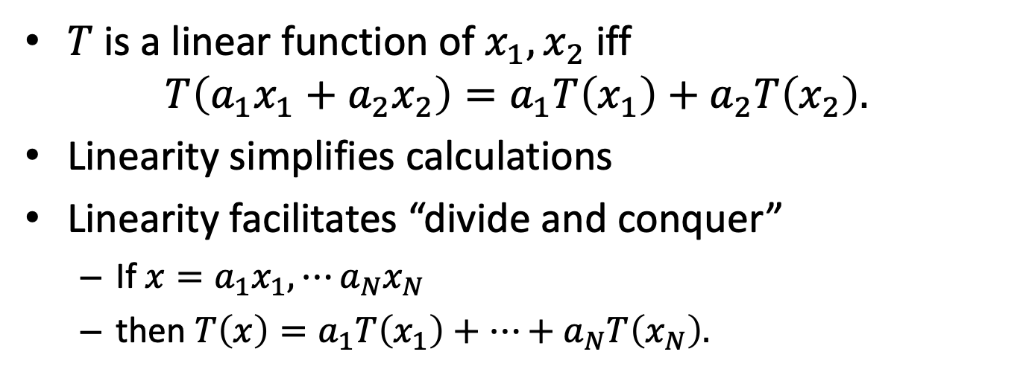
What is Linearity and Why it’s Important
$T$ is a linear function of $x_{1},x_{2}$ iff
$$T\left(a_{1}x_{1}+a_{2}x_{2}\right)=a_{1}T\left(x_{1}\right)+a_{2}T\left(x_{2}\right).$$
Linearity simplifies calculations
Linearity facilitates “divide and conquer”
If $x=a_{1}x_{1},⋯a_{N}x_{N}$
then $T\left(x\right)=a_{1}T\left(x_{1}\right)+⋯+a_{N}T\left(x_{N}\right).$

Slide 5
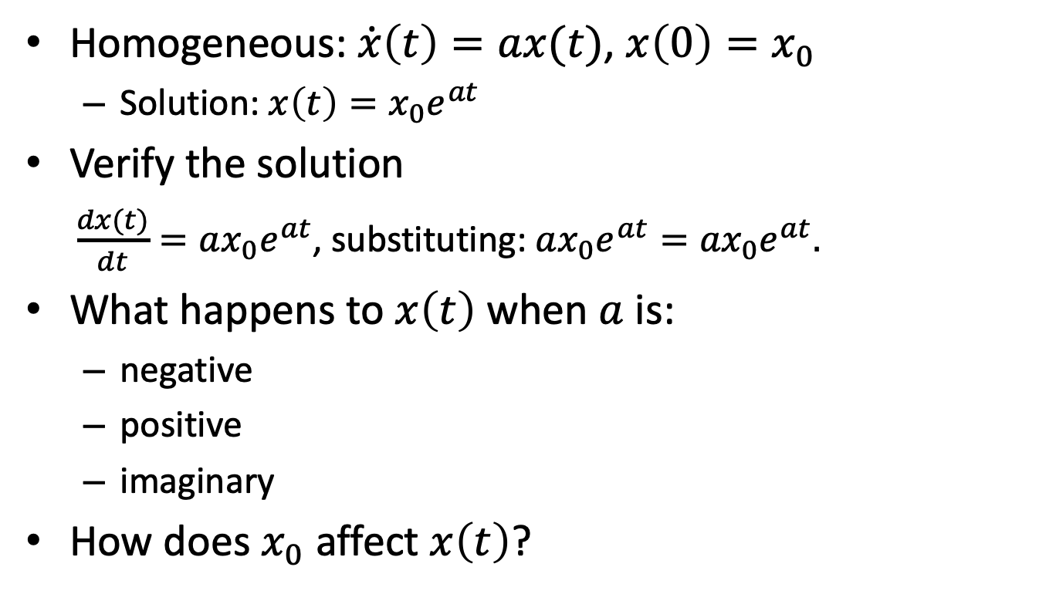
Univariate, First Order, Linear Differential Equations
Homogeneous: $\dot{x}\left(t\right)=ax(t)$, $x\left(0\right)=x_{0}$
Solution: $x\left(t\right)=x_{0}e^{at}$
Verify the solution
$\frac{dx(t)}{dt}=ax_{0}e^{at}$, substituting: $ax_{0}e^{at}={ax}_{0}e^{at}.$
What happens to $x\left(t\right)$ when $a$ is:
negative
positive
imaginary
How does $x_{0}$ affect $x\left(t\right)$?

Slide 6
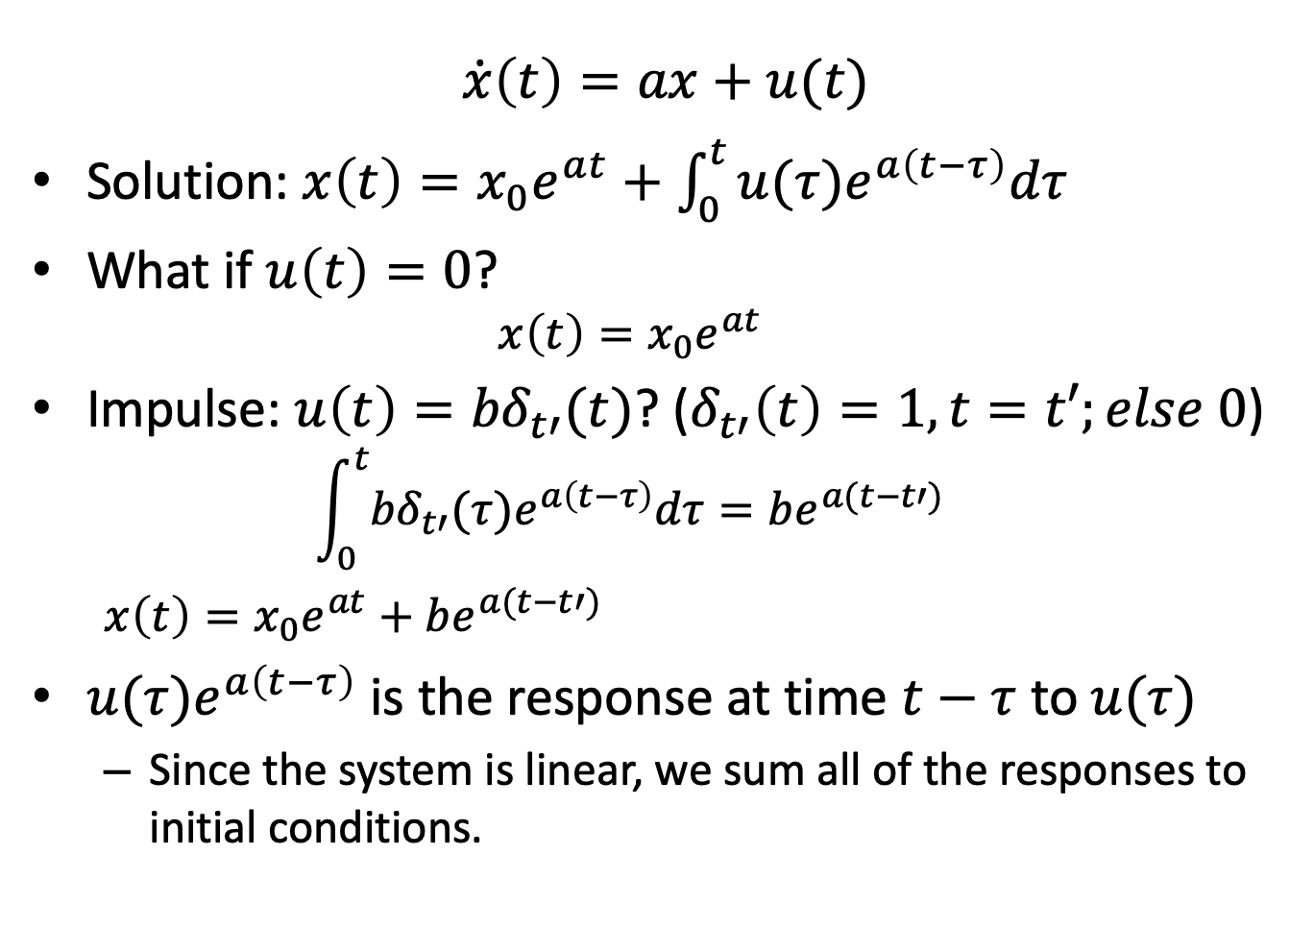
Univariate, First Order With Forced Input
$$\dot{x}\left(t\right)=ax+u(t)$$
Solution: $x\left(t\right)=x_{0}e^{at}+\int_{0}^{t}{{u(τ)e}^{a\left(t−τ\right)}dτ}$
What if $u\left(t\right)=0$?
$$x\left(t\right)=x_{0}e^{at}$$
Impulse: $u\left(t\right)={bδ}_{t′}(t)$? ($δ_{t′}\left(t\right)=1, t=t′;else 0$)
$$\int_{0}^{t}{{{bδ}_{t′}(τ)e}^{a\left(t−τ\right)}dτ}=be^{a(t−t′)}$$
$x\left(t\right)=x_{0}e^{at}+$ $be^{a(t−t′)}$
${u(τ)e}^{a\left(t−τ\right)}$ is the response at time $t−τ$ to$u(τ)$
Since the system is linear, we sum all of the responses to initial conditions.

Slide 7
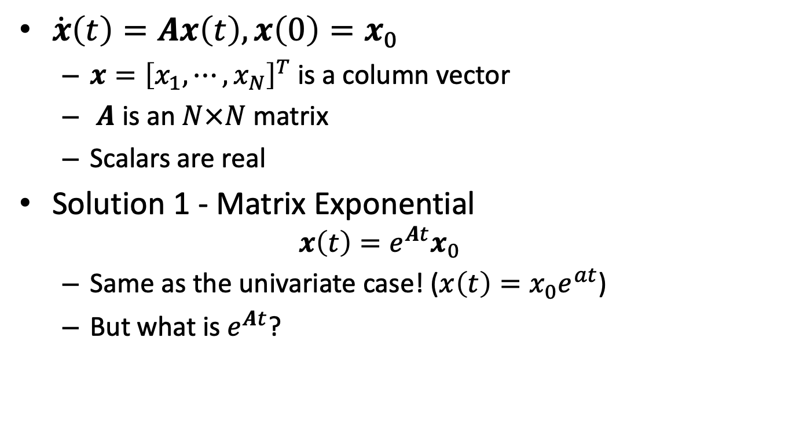
Multivariate, Homogeneous: Matrix Exponential Solution
$\dot{x}\left(t\right)=Ax\left(t\right), x\left(0\right)=x_{0}$
$x={\left[x_{1}, ⋯, x_{N}\right]}^{T}$ is a column vector
$A$ is an $N×N$ matrix
Scalars are real
Solution 1 - Matrix Exponential
$$x\left(t\right)=e^{At}x_{0}$$
Same as the univariate case! ($x\left(t\right)=x_{0}e^{at}$)
But what is $e^{At}$?
Notes:
Why did I leave out “first order”? Can solve high order systems with more variables.

Slide 8
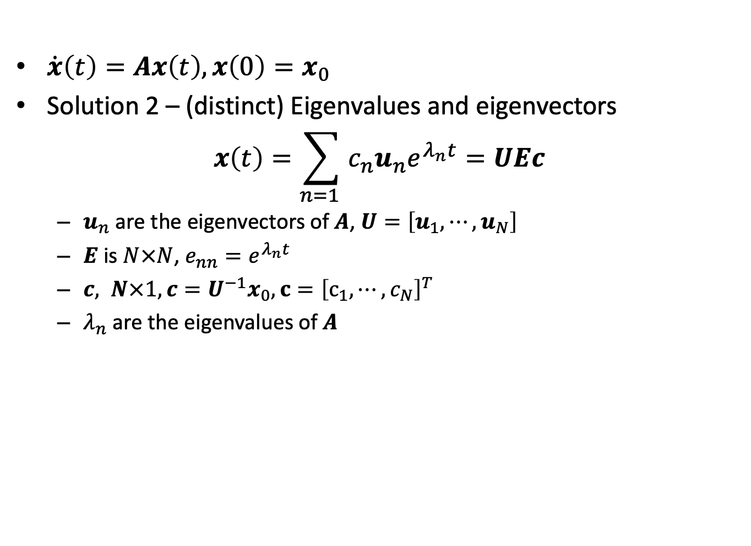
Multivariate, Homogeneous: Eigenvector Solution
$\dot{x}\left(t\right)=Ax\left(t\right), x\left(0\right)=x_{0}$
Solution 2 – (distinct) Eigenvalues and eigenvectors
$$x\left(t\right)=\sum_{n=1 }{c_{n}u_{n}e^{λ_{n}t}}=UEc$$
$u_{n}$ are the eigenvectors of $A$, $U=\left[u_{1},⋯,u_{N}\right]$
$E$ is $N×N$, $e_{nn}=e^{λ_{n}t}$
$c, N×1, c=U^{−1}x_{0}, c={\left[c_{1},⋯,c_{N}\right]}^{T}$
$λ_{n}$ are the eigenvalues of $A$
Notes:
Why did I leave out “first order”? Can solve high order systems with more variables.

Slide 9
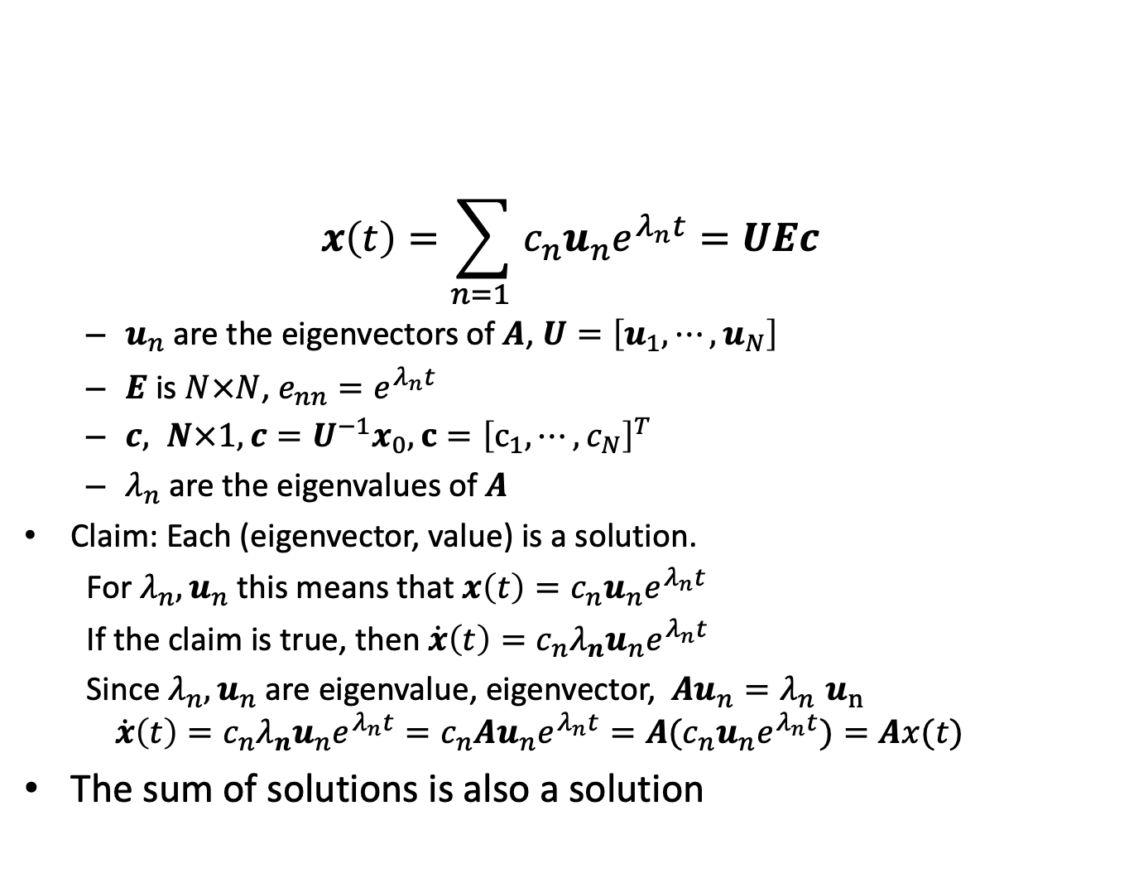
Understanding the Eigenvector Solution
$$x\left(t\right)=\sum_{n=1 }{c_{n}u_{n}e^{λ_{n}t}}=UEc$$
$u_{n}$ are the eigenvectors of $A$, $U=\left[u_{1},⋯,u_{N}\right]$
$E$ is $N×N$, $e_{nn}=e^{λ_{n}t}$
$c, N×1, c=U^{−1}x_{0}, c={\left[c_{1},⋯,c_{N}\right]}^{T}$
$λ_{n}$ are the eigenvalues of $A$
Claim: Each (eigenvector, value) is a solution.
For ${λ_{n},u}_{n}$ this means that ${x\left(t\right)=c_{n}u}_{n}e^{λ_{n}t}$
If the claim is true, then ${\dot{x}\left(t\right)=c_{n}λ_{n}u}_{n}e^{λ_{n}t}$
Since ${λ_{n},u}_{n}$ are eigenvalue, eigenvector, ${Au}_{n}{=λ}_{n}u_{n}$
$${\dot{x}\left(t\right)=c_{n}λ_{n}u}_{n}e^{λ_{n}t}={c_{n}Au}_{n}e^{λ_{n}t}={{A(c}_{n}u}_{n}e^{λ_{n}t})=Ax(t)$$
The sum of solutions is also a solution
Notes:
Why did I leave out “first order”? Can solve high order systems with more variables.

Slide 10
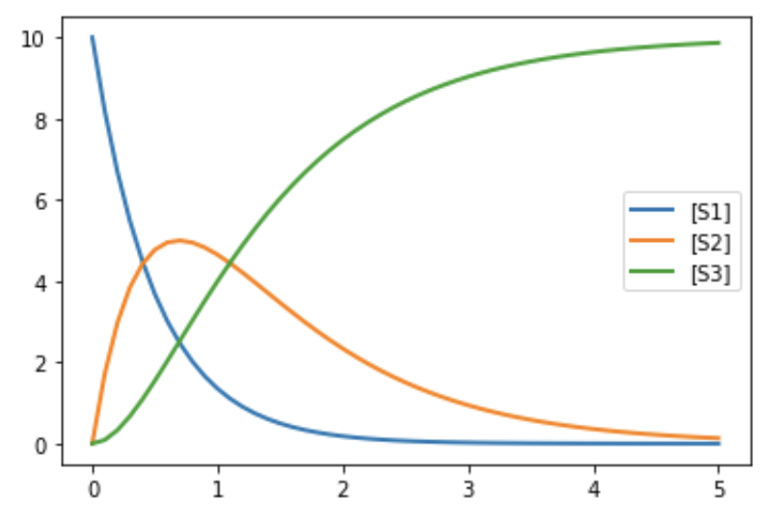


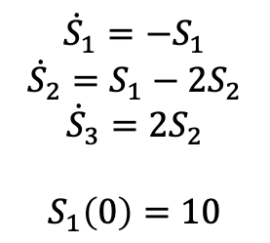
How Eigenvectors Determine Trajectory: 1
$${\dot{S}}_{1}=−S_{1}$$
$${\dot{S}}_{2}=S_{1}−2S_{2}$$
$${\dot{S}}_{3}=2S_{2}$$
$$S_{1}\left(0\right)=10$$
S1
S2
S3
$${v_{1}=S}_{1}$$
$${v_{2}=2S}_{2}$$
Time

Slide 11
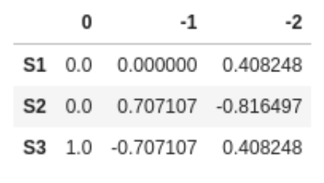


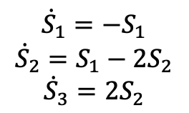
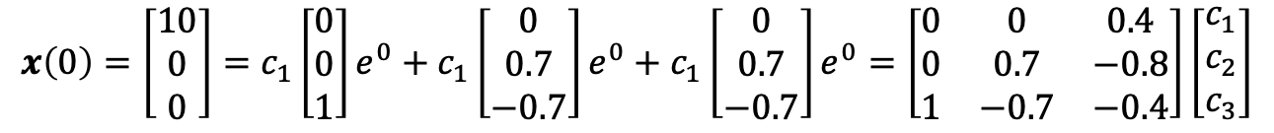
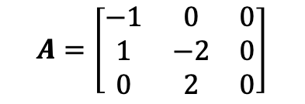
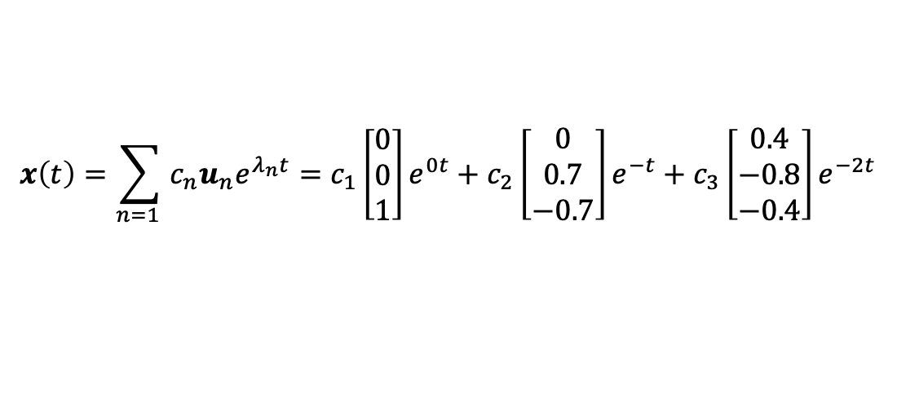
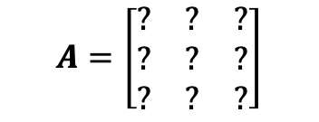
How Eigenvectors Determine Trajectory: 2
$$\dot{x}\left(t\right)=Ax\left(t\right)$$
$$A=\left[\begin{matrix}? & ? & ? \\ ? & ? & ? \\ ? & ? & ?\end{matrix}\right]$$
Eigenvectors for eigenvalues
$${\dot{S}}_{1}=−S_{1}$$
$${\dot{S}}_{2}=S_{1}−2S_{2}$$
$${\dot{S}}_{3}=2S_{2}$$
$$A=\left[\begin{matrix}−1 & 0 & 0 \\ 1 & −2 & 0 \\ 0 & 2 & 0\end{matrix}\right]$$
$$x\left(t\right)=\sum_{n=1 }{c_{n}u_{n}e^{λ_{n}t}=c_{1}\left[\begin{matrix}0 \\ 0 \\ 1\end{matrix}\right]e^{0t}+c_{2}\left[\begin{matrix}0 \\ 0.7 \\ −0.7\end{matrix}\right]e^{−t}+c_{3}\left[\begin{matrix}0.4 \\ −0.8 \\ −0.4\end{matrix}\right]e^{−2t}}$$
Can find the $c_{n}$ by solving:
$$x\left(0\right)=\left[\begin{matrix}10 \\ 0 \\ 0\end{matrix}\right]=c_{1}\left[\begin{matrix}0 \\ 0 \\ 1\end{matrix}\right]e^{0}+c_{1}\left[\begin{matrix}0 \\ 0.7 \\ −0.7\end{matrix}\right]e^{0}+c_{1}\left[\begin{matrix}0 \\ 0.7 \\ −0.7\end{matrix}\right]e^{0}=\left[\begin{matrix}0 & 0 & 0.4 \\ 0 & 0.7 & −0.8 \\ 1 & −0.7 & −0.4\end{matrix}\right]\left[\begin{matrix}c_{1} \\ c_{2} \\ c_{3}\end{matrix}\right]$$

Slide 12
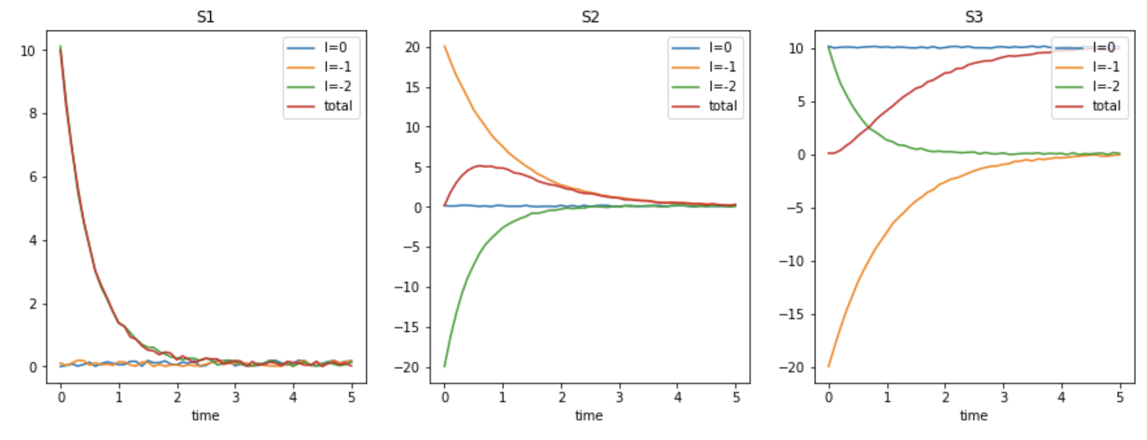
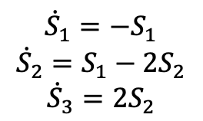

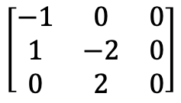
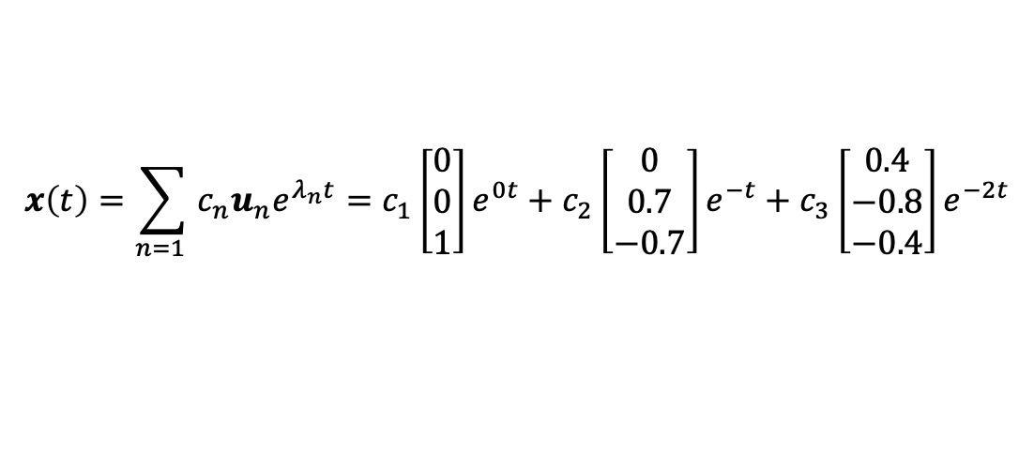
How Eigenvectors Determine Trajectory: 3
$${\dot{S}}_{1}=−S_{1}$$
$${\dot{S}}_{2}=S_{1}−2S_{2}$$
$${\dot{S}}_{3}=2S_{2}$$
$$\left[\begin{matrix}−1 & 0 & 0 \\ 1 & −2 & 0 \\ 0 & 2 & 0\end{matrix}\right]$$
$$A=$$
$$x\left(t\right)=\sum_{n=1 }{c_{n}u_{n}e^{λ_{n}t}=c_{1}\left[\begin{matrix}0 \\ 0 \\ 1\end{matrix}\right]e^{0t}+c_{2}\left[\begin{matrix}0 \\ 0.7 \\ −0.7\end{matrix}\right]e^{−t}+c_{3}\left[\begin{matrix}0.4 \\ −0.8 \\ −0.4\end{matrix}\right]e^{−2t}}$$
Time
(Lines are “fuzzified” so can see overlaps.)

Slide 13
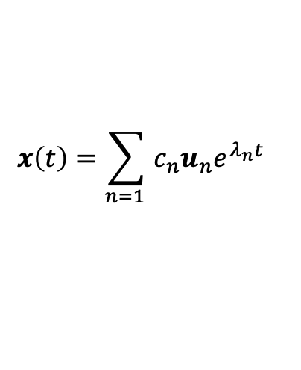
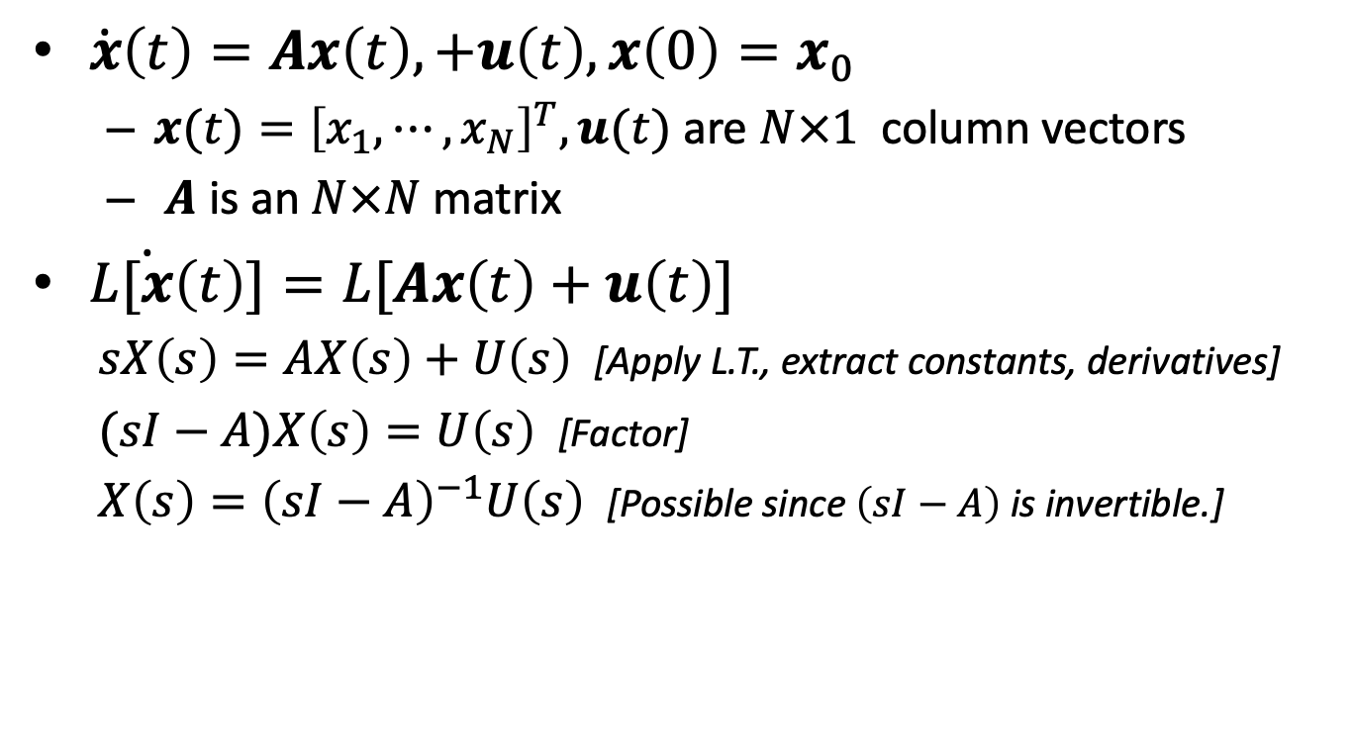
Solution for Multivariate With Forced Input
$\dot{x}\left(t\right)=Ax\left(t\right),+u\left(t\right), x\left(0\right)=x_{0}$
$x(t)={\left[x_{1}, ⋯, x_{N}\right]}^{T}, u(t)$ are $N×1$ column vectors
$A$ is an $N×N$ matrix
$L\dot{[x}\left(t\right)]=L[Ax\left(t\right)+u\left(t\right)]$
$sX\left(s\right)=AX\left(s\right)+U\left(s\right)$ [Apply L.T., extract constants, derivatives]
$(sI−A)X\left(s\right)=U\left(s\right)$ [Factor]
$X\left(s\right)={\left(sI−A\right)}^{−1}U\left(s\right)$ [Possible since $\left(sI−A\right)$ is invertible.]
A system is stable if its poles (eigenvalues) are not positive.
$$x\left(t\right)={\sum_{n=1 }{c_{n}u_{n}e^{λ_{n}t}}}_{}$$

Slide 14
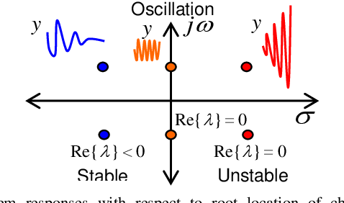
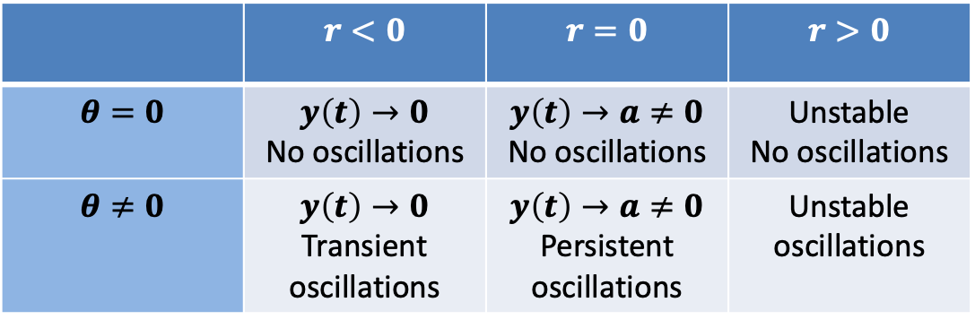



Classification of Systems
Eigenvalues are complex numbers
$$λ=re^{iθ}$$
 | $$r<0$$ | $$r=0$$ | $$r>0$$
$$θ=0$$ | $$y\left(t\right)→0$$ No oscillations | $$y\left(t\right)→a≠0$$ No oscillations | Unstable No oscillations
$$θ≠0$$ | $$y\left(t\right)→0$$ Transient oscillations | $$y\left(t\right)→a≠0$$ Persistent oscillations | Unstable oscillations
$$iθ$$
$$r$$

Slide 15

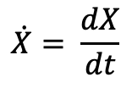
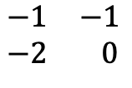


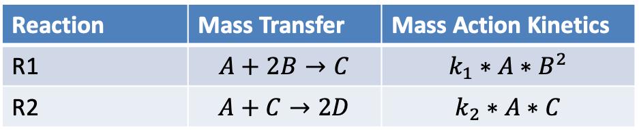




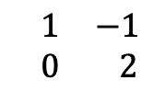

Reaction Network -> Differential Equations
Reaction Network
Reaction | Mass Transfer | Mass Action Kinetics
R1 | $$A+2B→C$$ | $$k_{1}∗A∗B^{2}$$
R2 | $$A+C→2D$$ | $$k_{2}∗A∗C$$
[
]
[
R1
R2
]
$$\dot{A}$$
A
[
]
$$\begin{matrix}−1 & −1 \\ −2 & 0\end{matrix}$$
R1
$$\dot{B}$$
$$=$$
B
$$×$$
$$k_{1}∗A∗B^{2}$$
$$\dot{C}$$
C
$$k_{2}∗A∗C$$
R2
$$\begin{matrix} 1 & −1 \\ 0 & 2\end{matrix}$$
$$\dot{D}$$
D
State Change Vector
Stoichiometry Matrix
Reaction Flux Vector
$$\dot{X}= \frac{dX}{dt}$$
But this is a nonlinear system!

Slide 16
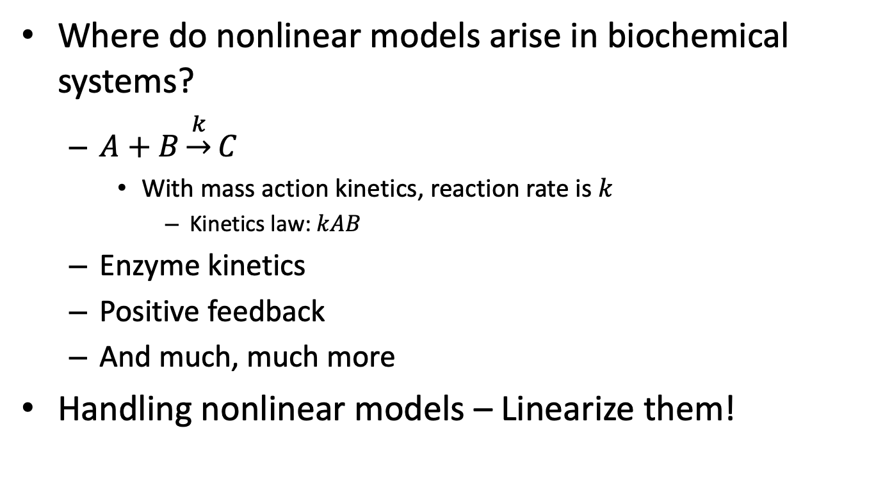
Nonlinear Models
Where do nonlinear models arise in biochemical systems?
$A+B\underset{→}{k}C$
With mass action kinetics, reaction rate is $k$
Kinetics law: $kAB$
Enzyme kinetics
Positive feedback
And much, much more
Handling nonlinear models – Linearize them!

Slide 17
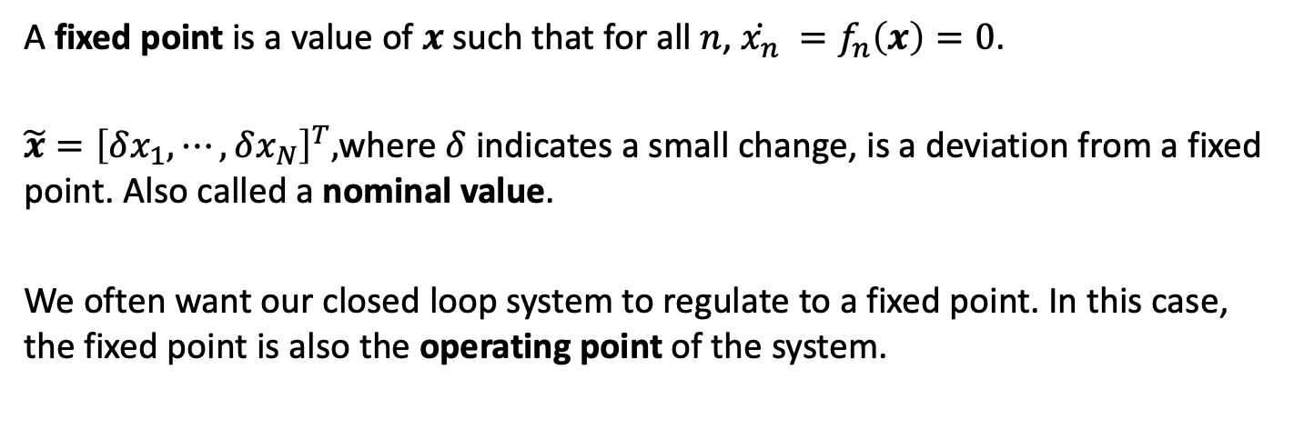
Linearizing the State Change Vector: Fixed Points
A fixed point is a value of $x$such that for all $n$, $\dot{x_{n}} =f_{n}\left(x\right)=0$.
$\tilde{x}={\left[δx_{1},⋯,δx_{N}\right]}^{T},$where $δ$ indicates a small change, is a deviation from a fixed point. Also called a nominal value.
We often want our closed loop system to regulate to a fixed point. In this case, the fixed point is also the operating point of the system.
Notes:
Show the relationship for the approximation and the connection with the Jacobian.

Slide 18


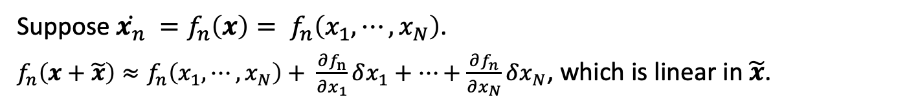








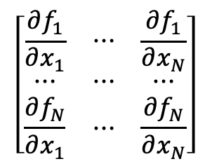
Linearizing the State Change Vector
[
]
[
R1
R2
]
$$\dot{A}$$
A
$$\begin{matrix}−1 & −1 \\ −2 & 0\end{matrix}$$
[
]
$$\dot{B}$$
$$=$$
B
$$×$$
$$k_{1}∗A∗B^{2}$$
R1
$$\dot{C}$$
C
$$\begin{matrix} 1 & −1 \\ 0 & 2\end{matrix}$$
$$k_{2}∗A∗C$$
R2
$$\dot{D}$$
D
State Change Vector
Stoichiometry Matrix
Reaction Flux Vector
Suppose $\dot{x_{n}} =f_{n}\left(x\right)= f_{n}\left(x_{1},⋯,x_{N}\right)$.
$f_{n}\left(x+\tilde{x}\right)≈f_{n}\left(x_{1},⋯,x_{N}\right)+ \frac{∂f_{n}}{∂x_{1}}δx_{1}+⋯+\frac{∂f_{n}}{∂x_{N}}δx_{N}$, which is linear in $\tilde{x}$.
$$\left[\begin{matrix}\frac{∂f_{1}}{∂x_{1}} & ⋯ & \frac{∂f_{1}}{∂x_{N}} \\ ⋯ & ⋯ & ⋯ \\ \frac{∂f_{N}}{∂x_{1}} & ⋯ & \frac{∂f_{N}}{∂x_{N}}\end{matrix}\right]$$
Jacobian of the state change vector
Notes:
Show the relationship for the approximation and the connection with the Jacobian.

Slide 19

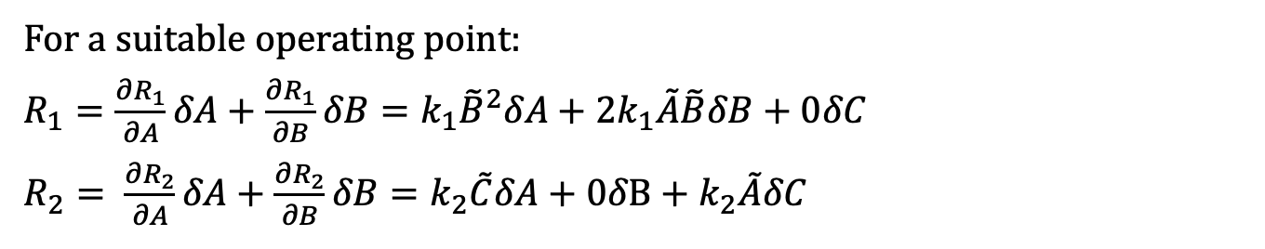



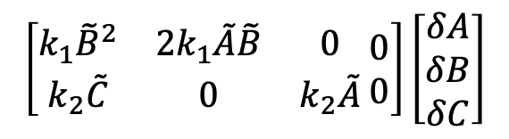


Linearizing a Nonlinear System: Example
[
]
[
R1
R2
]
$$\dot{A}$$
A
$$\begin{matrix}−1 & −1 \\ −2 & 0\end{matrix}$$
[
]
$$\dot{B}$$
$$=$$
B
$$×$$
$$k_{1}∗A∗B^{2}$$
R1
$$\dot{C}$$
C
$$\begin{matrix} 1 & −1 \\ 0 & 2\end{matrix}$$
$$k_{2}∗A∗C$$
R2
$$\dot{D}$$
D
State Change Vector
Stoichiometry Matrix
Reaction Flux Vector
For a suitable operating point:
$R_{1}=\frac{∂R_{1}}{∂A}δA+\frac{∂R_{1}}{∂B}δB={k_{1}\tilde{B}}^{2}δA+2k_{1}\tilde{A}\tilde{B}δB+0δC$
$R_{2}= \frac{∂R_{2}}{∂A}δA+\frac{∂R_{2}}{∂B}δB=k_{2}\tilde{C}δA+0δB+k_{2}\tilde{A}δC$
$$\left[\begin{matrix}\begin{matrix}\dot{\tilde{A}} \\ \dot{\tilde{B}}\end{matrix} \\ \begin{matrix}\dot{\tilde{C}} \\ \dot{\tilde{D}}\end{matrix}\end{matrix}\right]$$
[
]
$$\begin{matrix}−1 & −1 \\ −2 & 0\end{matrix}$$
$$\left[\begin{matrix}k_{1}{\tilde{B}}^{2} & 2k_{1}\tilde{A}\tilde{B} & 0 \\ k_{2}\tilde{C} & 0 & k_{2}\tilde{A}\end{matrix} \begin{matrix}0 \\ 0\end{matrix}\right]\left[\begin{matrix}δA \\ δB \\ δC\end{matrix}\right]$$
$$≈$$
$$×$$
$$\begin{matrix} 1 & −1 \\ 0 & 2\end{matrix}$$
$$δD$$
We generally drop the tildes, and so the use of nominal values is implicit.
Notes:
Show the relationship for the approximation and the connection with the Jacobian.

