Slide 1
BIOE 498 / BIOE 599 Advanced Biological Control Systems Designing Proportional Controllers
Joseph L. Hellerstein
eScience Institute, Computer Science & Engineering
Allen School of Computer Science
BioEngineering
Notes:
Diverse students. Some with bio-backgrounds; some without. Some with CS background; some with very limited. Two separate courses combined because of a substantial shared curriculum.

Slide 2


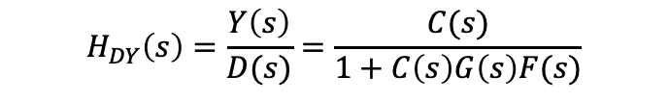


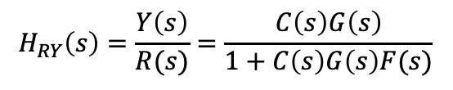



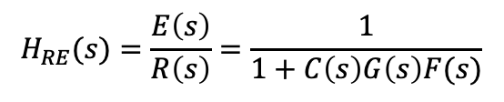



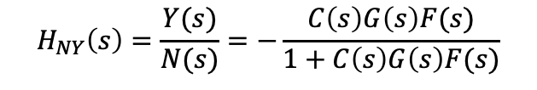
Closed Loop System
Actuator
Disturbance
Measurement
Noise
$$D(s)$$
$$N(s)$$
$$R(s)$$
$$E(s)$$
$$U(s)$$
$$Y(s)$$
$$C(s)$$
$$G(s)$$
+
+
+
$$−$$
$$F(s)$$
$$H_{RY}\left(s\right)=\frac{Y\left(s\right)}{R(s)}=\frac{C\left(s\right)G\left(s\right)}{1+C\left(s\right)G\left(s\right)F(s)}$$
$$H_{RE}(s)=\frac{E\left(s\right)}{R\left(s\right)}=\frac{1}{1+C\left(s\right)G\left(s\right)F(s)}$$
$$H_{NY}\left(s\right)=\frac{Y(s)}{N(s)}=−\frac{C\left(s\right)G\left(s\right)F(s)}{1+C\left(s\right)G\left(s\right)F(s)}$$
$$H_{DY}\left(s\right)=\frac{Y\left(s\right)}{D(s)}=\frac{C(s)}{1+C\left(s\right)G\left(s\right)F(s)}$$
Notes:
Why doesn’t a filter help with measurement noise? Verify transfer functions.

Slide 3













The Design Problem
Suppose that the poles of the System Under Control (SUC) (with transfer function $G(s))$ are too close to 0, or even positive.
$$R(s)$$
$$E(s)$$
$$U(s)$$
$$Y(s)$$
$$C(s)$$
$$G(s)$$
+
$$−$$
Assuming that the controller has full knowledge of SUC state, we want to design a controller so that the closed loop system has more desirable poles.
$$U(s)$$
$$Y(s)$$
$$C(s)$$
$$G(s)$$
X$(s)$
Notes:
Specify the dimensions of the matrices and their products.

Slide 4




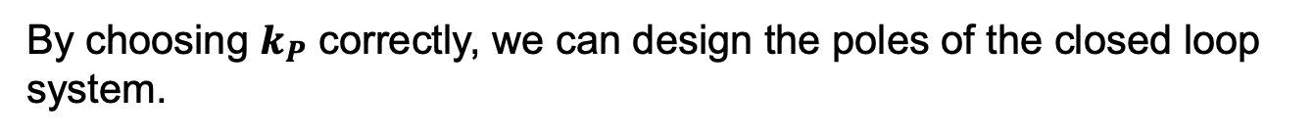






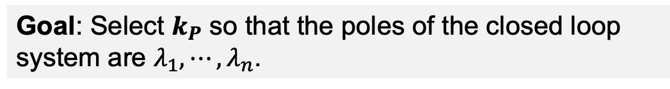
The Design Problem
$$C(s)$$
$$U(s)$$
$$Y(s)$$
$$G(s)$$
X$(s)$
$$\dot{x}\left(t\right)=Ax\left(t\right)+bu(t)$$
Dynamics of SUC in closed loop
$$u\left(t\right)=k_{P}x(t)$$
Controller operation
$$\dot{x}\left(t\right)=Ax\left(t\right)+bk_{P}x\left(t\right)$$
Dynamics of the closed loop system
$$\dot{x}\left(t\right)=(A+bk_{P})x\left(t\right)$$
By choosing $k_{P}$ correctly, we can design the poles of the closed loop system.
This is because the poles of the closed loop system are the eigenvalues of $A+bk_{P}$.
Goal: Select $k_{P}$ so that the poles of the closed loop system are $λ_{1},⋯, λ_{n}$.
Notes:
Specify the dimensions of the matrices and their products.

Slide 5
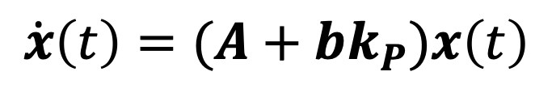




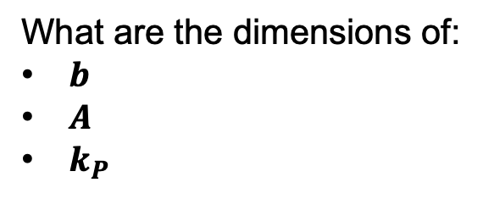


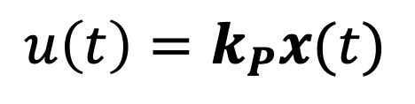

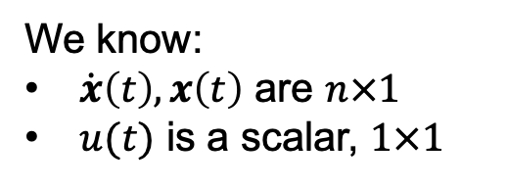









Solving for Closed Loop Poles: Dimensions of Vector & Matrices
$$\dot{x}\left(t\right)=Ax\left(t\right)+bu(t)$$
$$u\left(t\right)=k_{P}x(t)$$
$$\dot{x}\left(t\right)=(A+bk_{P})x\left(t\right)$$
We know:
$\dot{x}\left(t\right), x\left(t\right)$ are $n×1$
$u(t)$ is a scalar, $1×1$
$$u\left(t\right)=k_{P}x(t)$$
What are the dimensions of:
$b$
$A$
$k_{P}$
1$×1$
}
1$×n$
$$n×1$$
$$n×1$$
$$n×n$$
$$n×n$$
1$×n$
$$n×n$$
}
$$\dot{x}\left(t\right)=(A+bk_{P})x\left(t\right)$$
$$n×1$$
$$n×n$$
$$n×1$$
1$×n$
$$n×1$$
Notes:
Specify the dimensions of the matrices and their products.

Slide 6
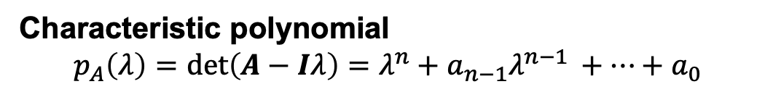
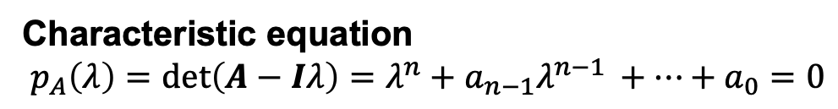
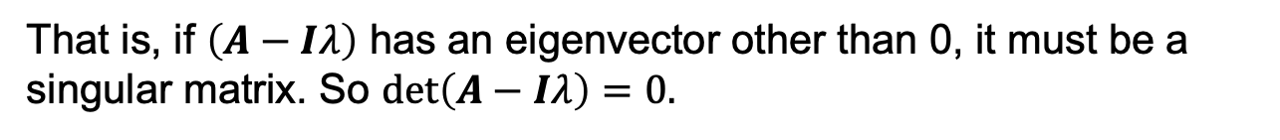
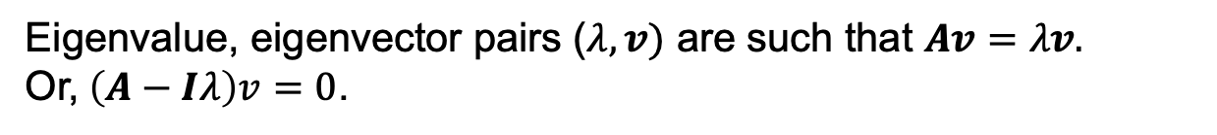
Finding Eigenvalues
Given a matrix $A,$ we want to find its eigenvalues.
Eigenvalue, eigenvector pairs ($λ, v)$ are such that $Av=λv.$
Or,$\left(A−Iλ\right)v=0$.
That is, if $\left(A−Iλ\right)$ has an eigenvector other than 0, it must be a singular matrix. So $det\left(A−Iλ\right)=0.$
Characteristic polynomial
$$p_{A}\left(λ\right)=det\left(A−Iλ\right)=λ^{n}+a_{n−1}λ^{n−1 }+⋯+a_{0}$$
Characteristic equation
$$p_{A}\left(λ\right)=det\left(A−Iλ\right)=λ^{n}+a_{n−1}λ^{n−1 }+⋯+a_{0}=0$$
Notes:
Specify the dimensions of the matrices and their products.

Slide 7
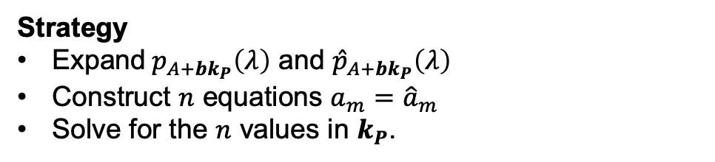


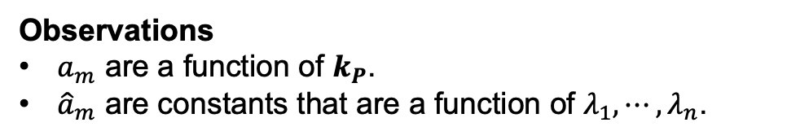
Solving for Closed Loop Poles: Solution Strategy
$$\dot{x}\left(t\right)=(A+bk_{P})x\left(t\right)$$
$$p_{A+bk_{P}}\left(λ\right)=λ^{n}+a_{n−1}λ^{n−1 }+⋯+a_{0}$$
We want the poles to be $λ_{1},⋯,λ_{n}$.
That is, we want the characteristic polynomial to be
$${\hat{p}}_{A+bk_{P}}\left(λ\right)=\left(λ−λ_{1}\right)⋯\left(λ−λ_{n}\right)=λ^{n}+{\hat{a}}_{n−1}λ^{n−1 }+⋯+{\hat{a}}_{0}$$
Observations
$a_{m}$ are a function of $k_{P}$.
${\hat{a}}_{m}$ are constants that are a function of $λ_{1},⋯,λ_{n}$.
Strategy
Expand$p_{A+bk_{P}}\left(λ\right)$ and ${\hat{p}}_{A+bk_{P}}\left(λ\right)$
Construct $n$ equations $a_{m}={\hat{a}}_{m}$
Solve for the $n$ values in $k_{P}$.
Notes:
Specify the dimensions of the matrices and their products.

Slide 8



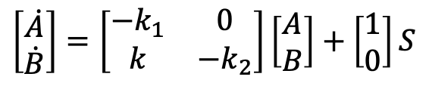
A Simple Example
$S-> A; $S
A->B; k1*A
B-> ; k2*B
$$\dot{A}=−kA+S$$
$$\dot{B}=k_{1}A−k_{2}B$$
$$\left[\begin{matrix}\dot{A} \\ \dot{B}\end{matrix}\right]=\left[\begin{matrix}−k_{1} & 0 \\ k & −k_{2}\end{matrix}\right]\left[\begin{matrix}A \\ B\end{matrix}\right]+\left[\begin{matrix}1 \\ 0\end{matrix}\right]S$$
We want to B to be regulated to $\overline{B}.$

