Slide 1
A Glimpse at BIOE 498 / BIOE 599 Advanced Biological Control Systems
Joseph L. Hellerstein
December 4, 2023
eScience Institute, Computer Science & Engineering
Allen School of Computer Science
Notes:
Diverse students. Some with bio-backgrounds; some without. Some with CS background; some with very limited. Two separate courses combined because of a substantial shared curriculum.

Slide 2
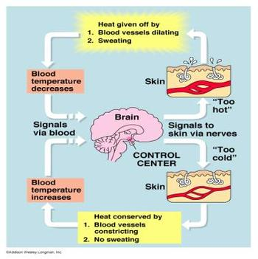
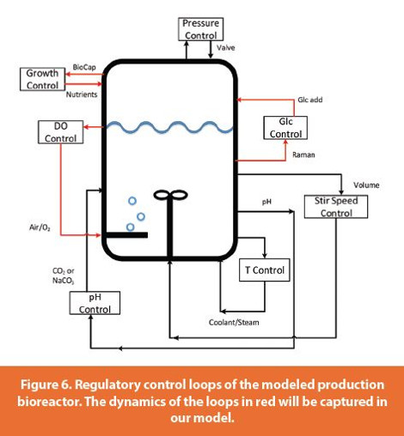
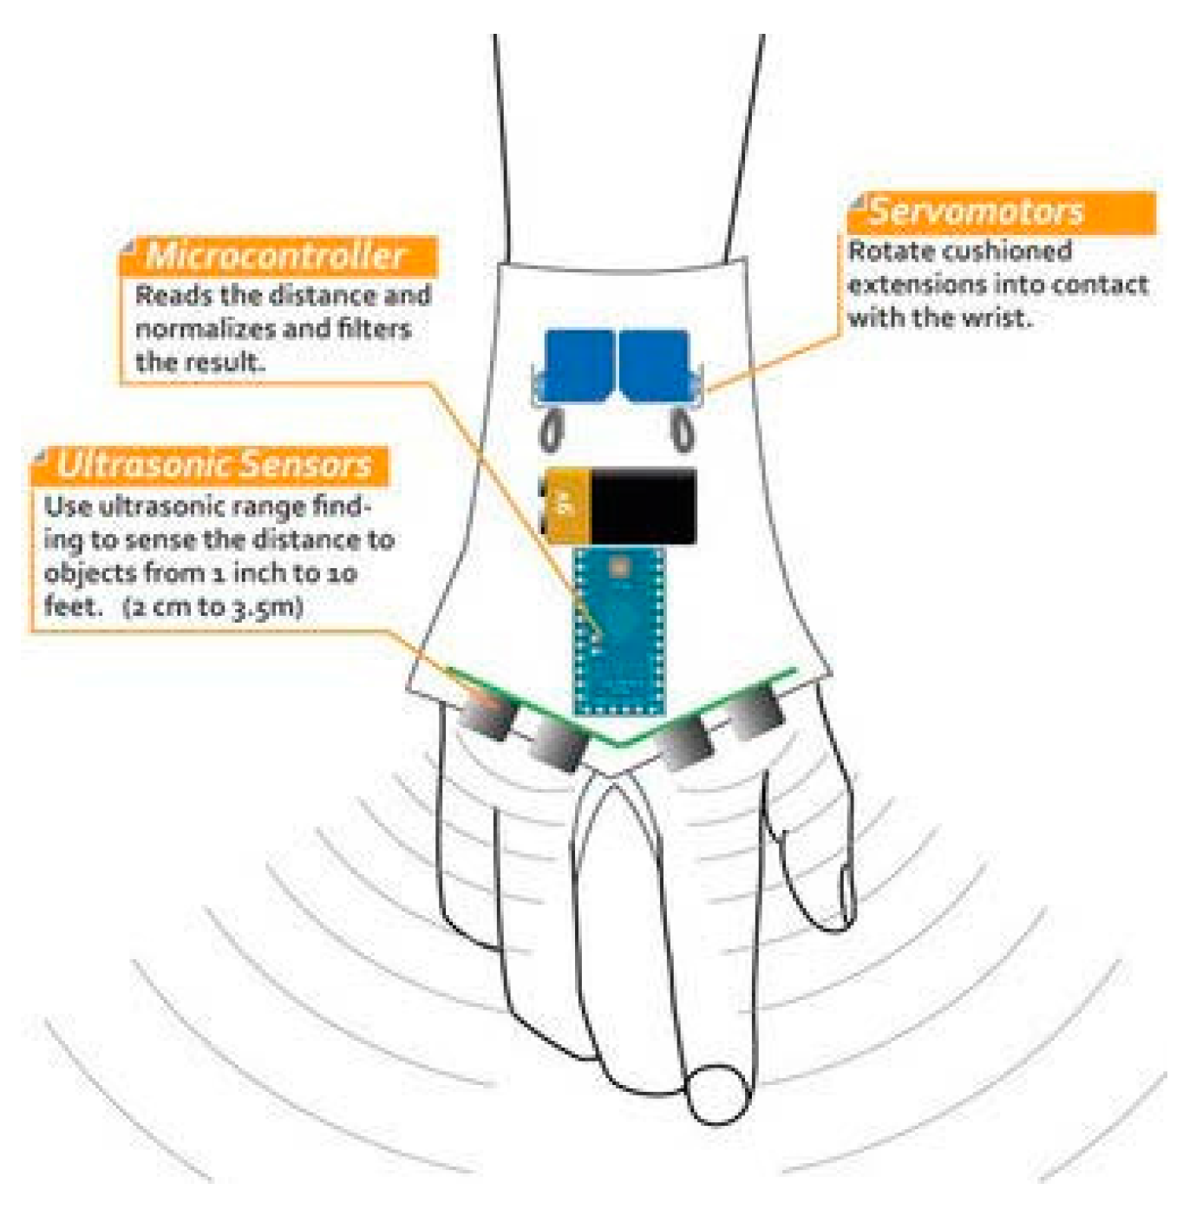
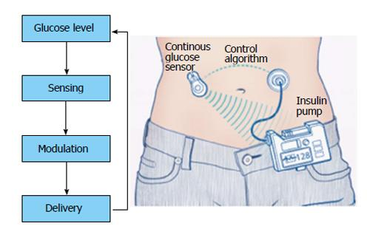
Biology has many closed loop systems.
Regulation objective: Maintain temperature at a constant value in the presence of external and internal disturbances.
Other examples of closed loop systems in biology

Slide 3


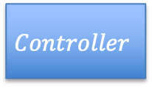



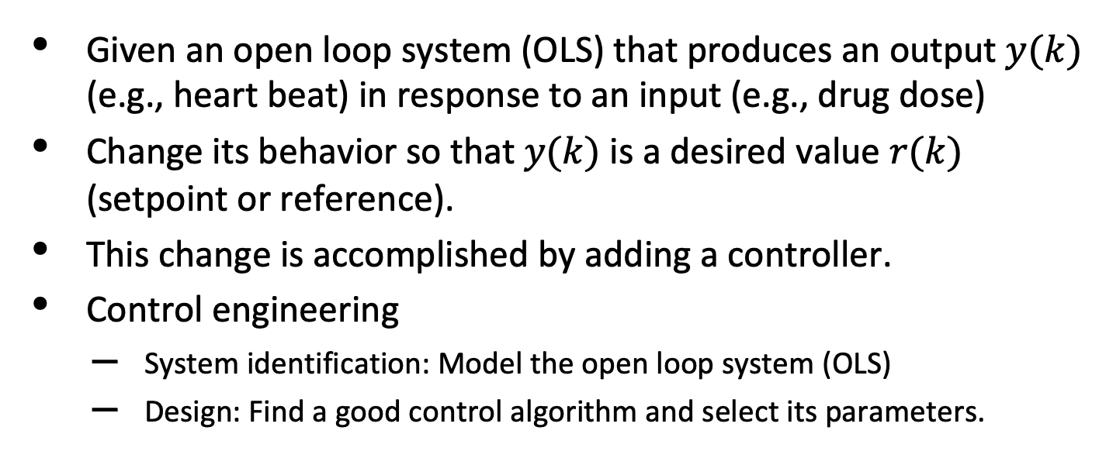

Control Engineering
$$r\left(k\right)$$
$$r\left(k\right)−y(k)$$
$$u\left(k\right)$$
$$y\left(k\right)$$
$$Controller$$
+
$$OLS$$
$$−$$
Given an open loop system (OLS) that produces an output $y(k)$ (e.g., heart beat) in response to an input (e.g., drug dose)
Change its behavior so that $y(k)$ is a desired value $r(k)$ (setpoint or reference).
This change is accomplished by adding a controller.
Control engineering
System identification: Model the open loop system (OLS)
Design: Find a good control algorithm and select its parameters.

Slide 4
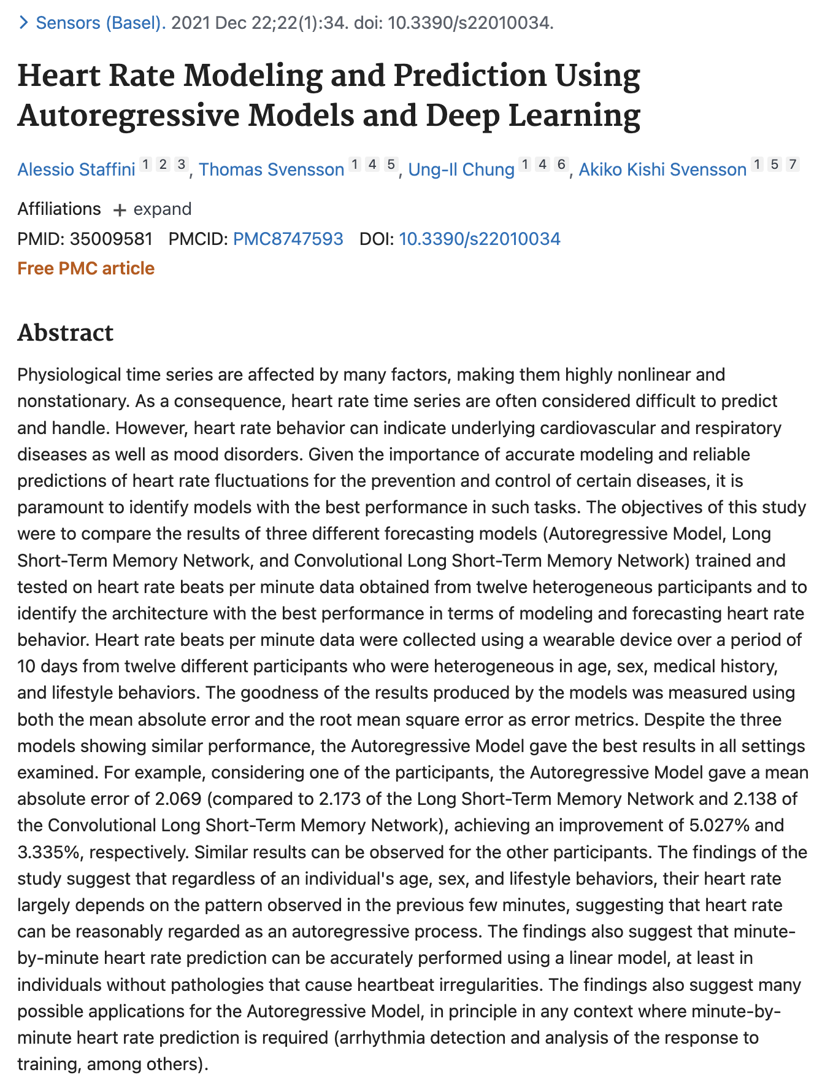
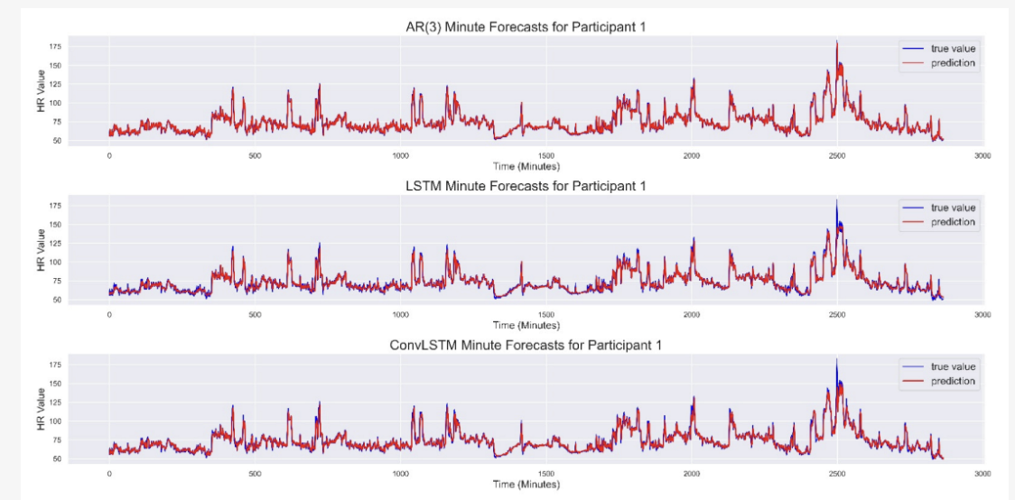
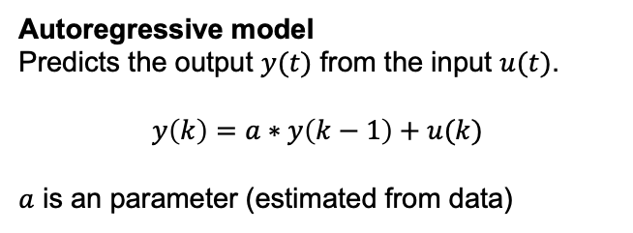
A Simple Model of an Open Loop System
Autoregressive model
Predicts the output $y(t)$ from the input $u(t)$.
$$y\left(k\right)=a∗y\left(k−1\right)+u(k)$$
$a$ is an parameter (estimated from data)
Autoregressive predicts heart beat as well as more complex approaches.

Slide 5

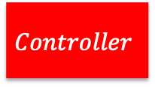



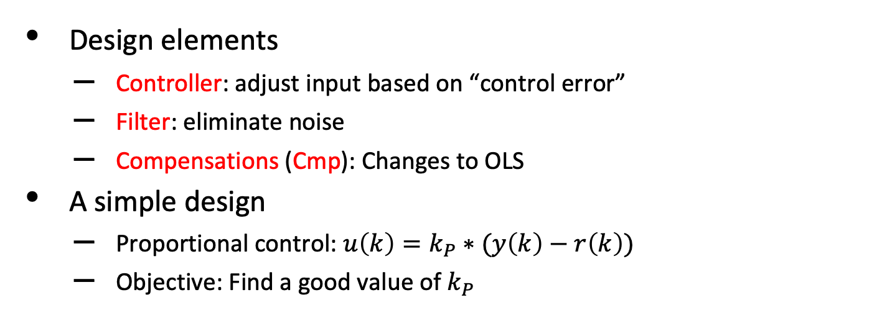
Design
$$r\left(k\right)$$
$$r\left(k\right)−y(k)$$
$$u\left(k\right)$$
$$y\left(k\right)$$
$$Controller$$
Cmp
+
$$OLS$$
$$−$$
$$Filter$$
Design elements
Controller: adjust input based on “control error”
Filter: eliminate noise
Compensations (Cmp): Changes to OLS
A simple design
Proportional control: $u\left(k\right)=k_{P}∗(y\left(k\right)−r\left(k\right))$
Objective: Find a good value of $k_{P}$

Slide 6
DEMO

Slide 7





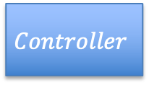

Learning Objectives for BIOEN 498/599: Advanced Biological Control Systems
$$r\left(k\right)$$
$$r\left(k\right)−y(k)$$
$$u\left(k\right)$$
$$y\left(k\right)$$
$$Controller$$
+
$$OLS$$
$$−$$
Analyze controllability
Find an input to the open loop system that controls its outputs
Knowledge of control design
Controllers: proportional, integral, differential control
Lead/lag compensation in biochemical systems
Build testbeds for biochemical closed loop system (using Antimony)
Basics of system identification
Predict stability, accuracy, settling time, overshoot (using LTI theory)
Design closed loop systems (theory-based & ad hoc)

