Slide 1
BIOE 498 / BIOE 599 Advanced Biological Control Systems Lecture 9: Modeling Dynamical Systems
Joseph L. Hellerstein
eScience Institute, Computer Science & Engineering
Allen School of Computer Science
BioEngineering
Notes:
Diverse students. Some with bio-backgrounds; some without. Some with CS background; some with very limited. Two separate courses combined because of a substantial shared curriculum.

Slide 2
Notes
Models as systems of nonlinear differential equations
Modeling signals
Modeling systems
Solutions of linear systems for first order and higher derivatives. Guessing, particular solutions. Answering questions about convergence, oscillations, DC gain.
Laplace transforms
Homogeneous solutions
Sum of solutions
Particular solution
System identification

Slide 3
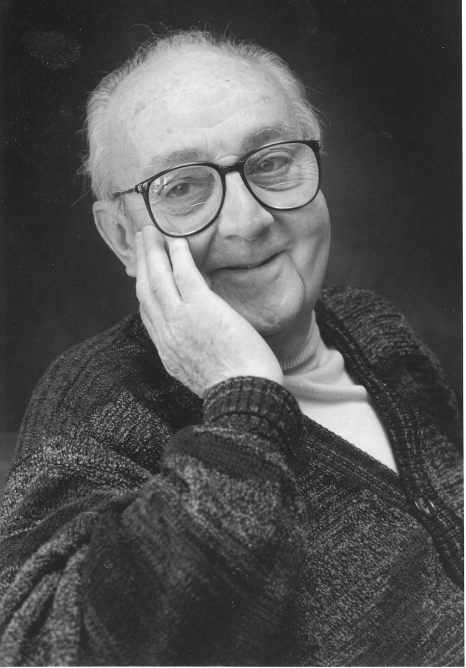
G.P.E. Box (Famous Statistician)
All models are wrong.
But some models are useful.

Slide 4

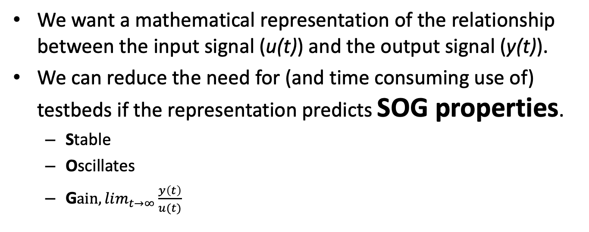

Modeling Dynamical Systems
$$u(t)$$
System
$$y(t)$$
We want a mathematical representation of the relationship between the input signal (u(t)) and the output signal (y(t)).
We can reduce the need for (and time consuming use of) testbeds if the representation predicts SOG properties.
Stable
Oscillates
G$ain, lim_{t→∞}{\frac{y\left(t\right)}{u(t)}}_{}$

Slide 5
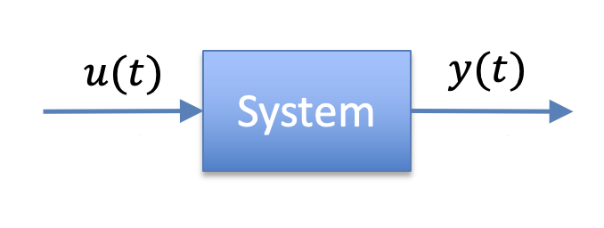
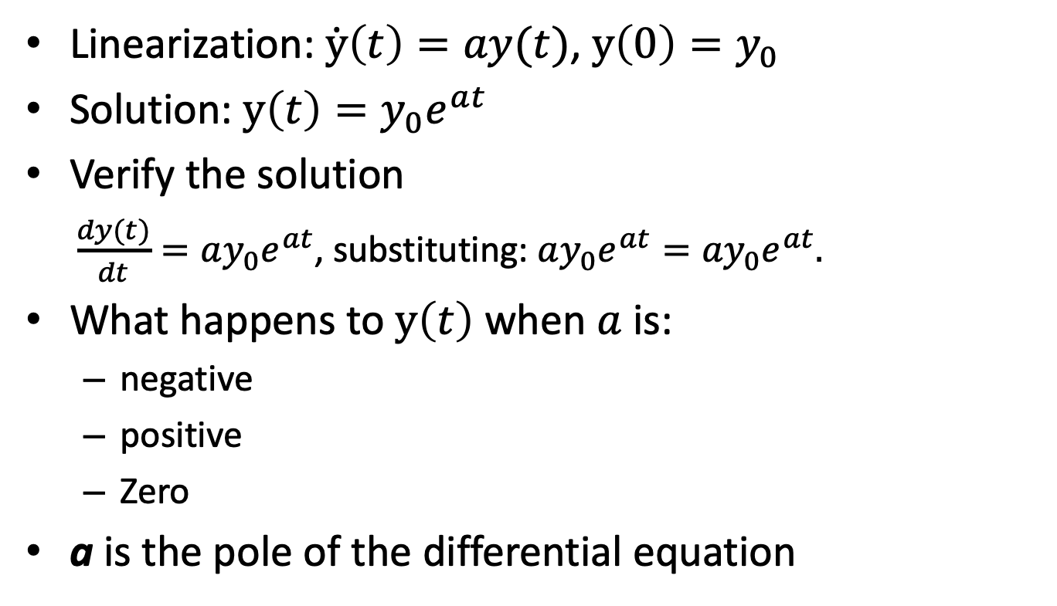
A Simple Linearization of a Signal
X
Linearization: $\dot{y}\left(t\right)=ay(t)$, $y\left(0\right)=y_{0}$
Solution: $y\left(t\right)=y_{0}e^{at}$
Verify the solution
$\frac{dy(t)}{dt}=ay_{0}e^{at}$, substituting: $ay_{0}e^{at}={ay}_{0}e^{at}.$
What happens to $y\left(t\right)$ when $a$ is:
negative
positive
Zero
a is the pole of the differential equation

Slide 6
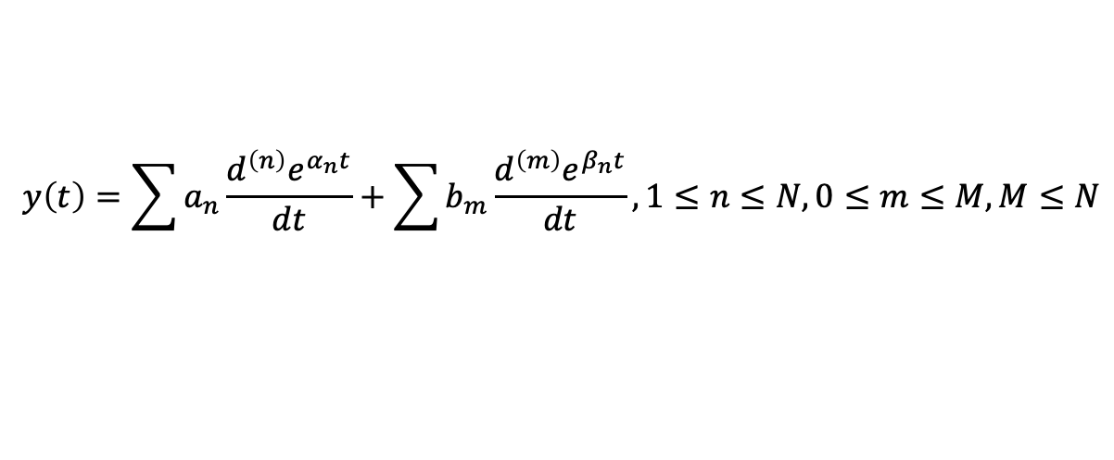
General Approximation
$$u(t)$$
System
$$y(t)$$
Linearization assumption: y(t), u(t) can be approximated by a linear function their derivatives.
$$y\left(t\right)=\sum{a_{n}\frac{d^{\left(n\right)}e^{α_{n}t}}{dt}}+\sum{b_{m}\frac{d^{\left(m\right)}e^{β_{n}t}}{dt}}, 1≤n≤N, 0≤m≤M, M≤N$$

Slide 7
Operating Point for Linearization

Slide 8
Agenda
Solving linear ordinary differential equations
First order, homogeneous
First order, non-homogeneous
High order, non-homogeneous
Non-linear differential equations
Fixed points
Jacobian
Solution strategy

Slide 9

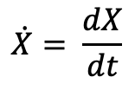
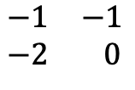


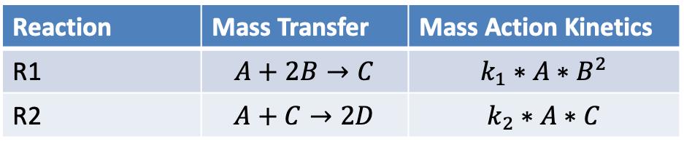




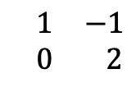

Reaction Network -> Differential Equations
Reaction Network
Reaction | Mass Transfer | Mass Action Kinetics
R1 | $$A+2B→C$$ | $$k_{1}∗A∗B^{2}$$
R2 | $$A+C→2D$$ | $$k_{2}∗A∗C$$
[
]
[
R1
R2
]
$$\dot{A}$$
A
[
]
$$\begin{matrix}−1 & −1 \\ −2 & 0\end{matrix}$$
R1
$$\dot{B}$$
$$=$$
B
$$×$$
$$k_{1}∗A∗B^{2}$$
$$\dot{C}$$
C
$$k_{2}∗A∗C$$
R2
$$\begin{matrix} 1 & −1 \\ 0 & 2\end{matrix}$$
$$\dot{D}$$
D
State Change Vector
Stoichiometry Matrix
Reaction Flux Vector
$$\dot{X}= \frac{dX}{dt}$$
This is a nonlinear system!

Slide 10
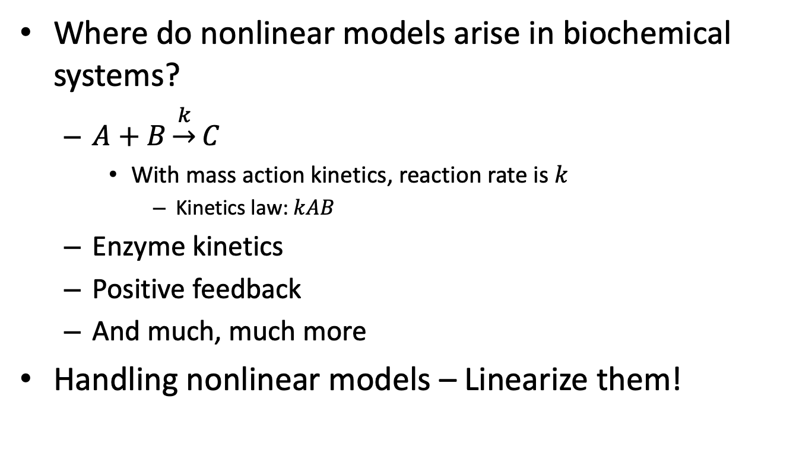
Nonlinear Models
Where do nonlinear models arise in biochemical systems?
$A+B\underset{→}{k}C$
With mass action kinetics, reaction rate is $k$
Kinetics law: $kAB$
Enzyme kinetics
Positive feedback
And much, much more
Handling nonlinear models – Linearize them!

Slide 11
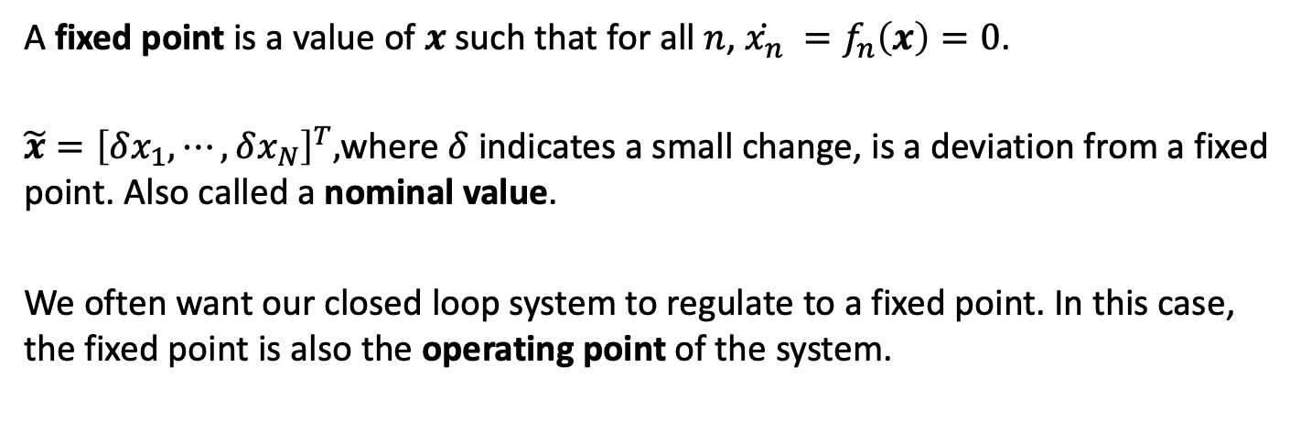
Linearizing the State Change Vector: Fixed Points
A fixed point is a value of $x$such that for all $n$, $\dot{x_{n}} =f_{n}\left(x\right)=0$.
$\tilde{x}={\left[δx_{1},⋯,δx_{N}\right]}^{T},$where $δ$ indicates a small change, is a deviation from a fixed point. Also called a nominal value.
We often want our closed loop system to regulate to a fixed point. In this case, the fixed point is also the operating point of the system.
Notes:
Show the relationship for the approximation and the connection with the Jacobian.

Slide 12


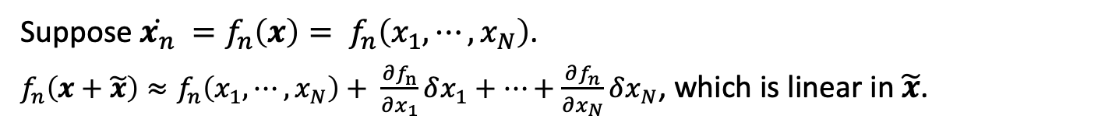








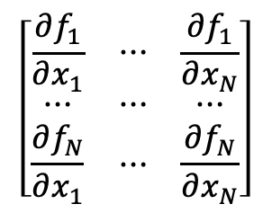
Linearizing the State Change Vector
[
]
[
R1
R2
]
$$\dot{A}$$
A
$$\begin{matrix}−1 & −1 \\ −2 & 0\end{matrix}$$
[
]
$$\dot{B}$$
$$=$$
B
$$×$$
$$k_{1}∗A∗B^{2}$$
R1
$$\dot{C}$$
C
$$\begin{matrix} 1 & −1 \\ 0 & 2\end{matrix}$$
$$k_{2}∗A∗C$$
R2
$$\dot{D}$$
D
State Change Vector
Stoichiometry Matrix
Reaction Flux Vector
Suppose $\dot{x_{n}} =f_{n}\left(x\right)= f_{n}\left(x_{1},⋯,x_{N}\right)$.
$f_{n}\left(x+\tilde{x}\right)≈f_{n}\left(x_{1},⋯,x_{N}\right)+ \frac{∂f_{n}}{∂x_{1}}δx_{1}+⋯+\frac{∂f_{n}}{∂x_{N}}δx_{N}$, which is linear in $\tilde{x}$.
$$\left[\begin{matrix}\frac{∂f_{1}}{∂x_{1}} & ⋯ & \frac{∂f_{1}}{∂x_{N}} \\ ⋯ & ⋯ & ⋯ \\ \frac{∂f_{N}}{∂x_{1}} & ⋯ & \frac{∂f_{N}}{∂x_{N}}\end{matrix}\right]$$
Jacobian of the state change vector
Notes:
Show the relationship for the approximation and the connection with the Jacobian.

Slide 13

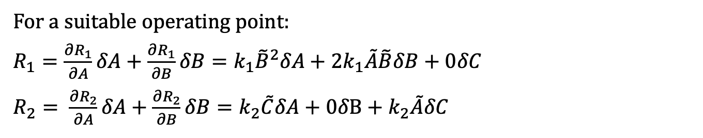



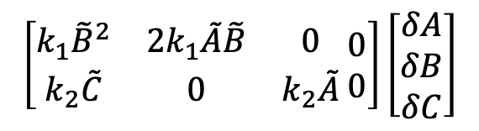


Linearizing a Nonlinear System: Example
[
]
[
R1
R2
]
$$\dot{A}$$
A
$$\begin{matrix}−1 & −1 \\ −2 & 0\end{matrix}$$
[
]
$$\dot{B}$$
$$=$$
B
$$×$$
$$k_{1}∗A∗B^{2}$$
R1
$$\dot{C}$$
C
$$\begin{matrix} 1 & −1 \\ 0 & 2\end{matrix}$$
$$k_{2}∗A∗C$$
R2
$$\dot{D}$$
D
State Change Vector
Stoichiometry Matrix
Reaction Flux Vector
For a suitable operating point:
$R_{1}=\frac{∂R_{1}}{∂A}δA+\frac{∂R_{1}}{∂B}δB={k_{1}\tilde{B}}^{2}δA+2k_{1}\tilde{A}\tilde{B}δB+0δC$
$R_{2}= \frac{∂R_{2}}{∂A}δA+\frac{∂R_{2}}{∂B}δB=k_{2}\tilde{C}δA+0δB+k_{2}\tilde{A}δC$
$$\left[\begin{matrix}\begin{matrix}\dot{\tilde{A}} \\ \dot{\tilde{B}}\end{matrix} \\ \begin{matrix}\dot{\tilde{C}} \\ \dot{\tilde{D}}\end{matrix}\end{matrix}\right]$$
[
]
$$\begin{matrix}−1 & −1 \\ −2 & 0\end{matrix}$$
$$\left[\begin{matrix}k_{1}{\tilde{B}}^{2} & 2k_{1}\tilde{A}\tilde{B} & 0 \\ k_{2}\tilde{C} & 0 & k_{2}\tilde{A}\end{matrix} \begin{matrix}0 \\ 0\end{matrix}\right]\left[\begin{matrix}δA \\ δB \\ δC\end{matrix}\right]$$
$$≈$$
$$×$$
$$\begin{matrix} 1 & −1 \\ 0 & 2\end{matrix}$$
$$δD$$
We generally drop the tildes, and so the use of nominal values is implicit.
Notes:
Show the relationship for the approximation and the connection with the Jacobian.

Slide 14
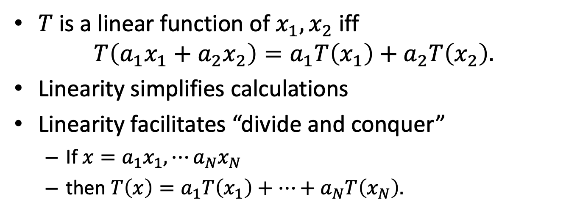
What is Linearity and Why it’s Important
$T$ is a linear function of $x_{1},x_{2}$ iff
$$T\left(a_{1}x_{1}+a_{2}x_{2}\right)=a_{1}T\left(x_{1}\right)+a_{2}T\left(x_{2}\right).$$
Linearity simplifies calculations
Linearity facilitates “divide and conquer”
If $x=a_{1}x_{1},⋯a_{N}x_{N}$
then $T\left(x\right)=a_{1}T\left(x_{1}\right)+⋯+a_{N}T\left(x_{N}\right).$

Slide 15
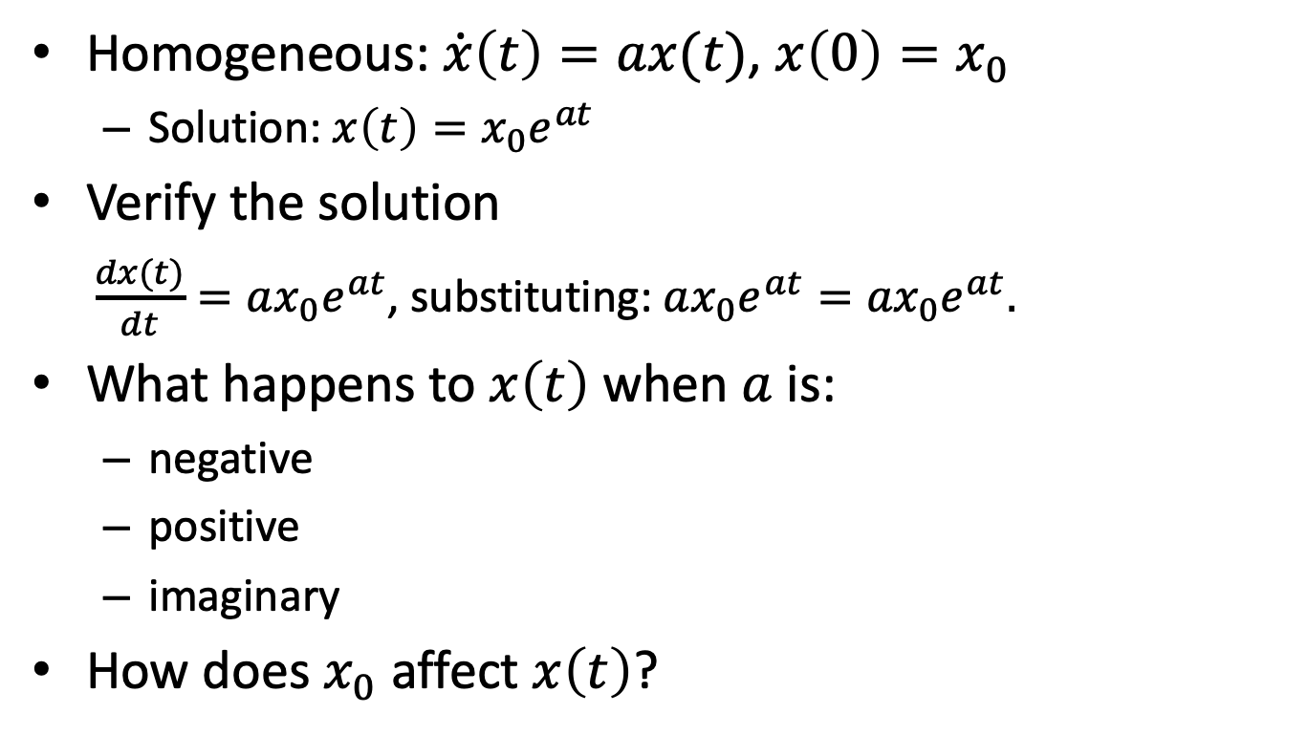
Univariate, First Order, Linear Differential Equations
Homogeneous: $\dot{x}\left(t\right)=ax(t)$, $x\left(0\right)=x_{0}$
Solution: $x\left(t\right)=x_{0}e^{at}$
Verify the solution
$\frac{dx(t)}{dt}=ax_{0}e^{at}$, substituting: $ax_{0}e^{at}={ax}_{0}e^{at}.$
What happens to $x\left(t\right)$ when $a$ is:
negative
positive
imaginary
How does $x_{0}$ affect $x\left(t\right)$?

Slide 16
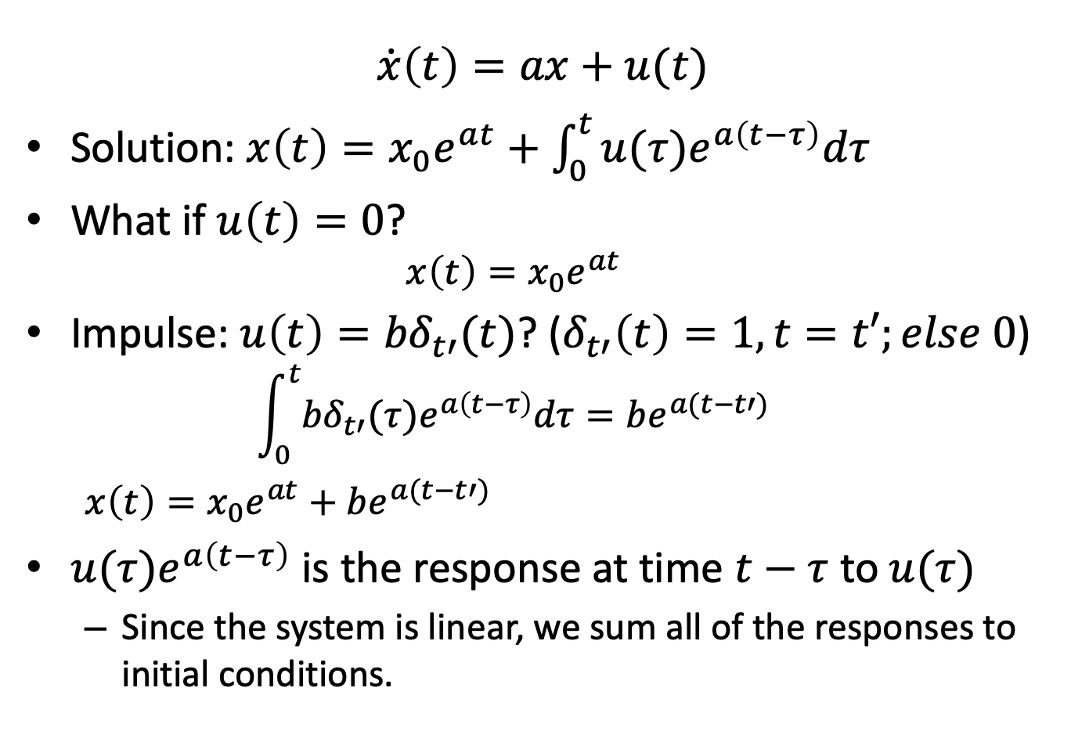
Univariate, First Order With Forced Input
$$\dot{x}\left(t\right)=ax+u(t)$$
Solution: $x\left(t\right)=x_{0}e^{at}+\int_{0}^{t}{{u(τ)e}^{a\left(t−τ\right)}dτ}$
What if $u\left(t\right)=0$?
$$x\left(t\right)=x_{0}e^{at}$$
Impulse: $u\left(t\right)={bδ}_{t′}(t)$? ($δ_{t′}\left(t\right)=1, t=t′;else 0$)
$$\int_{0}^{t}{{{bδ}_{t′}(τ)e}^{a\left(t−τ\right)}dτ}=be^{a(t−t′)}$$
$x\left(t\right)=x_{0}e^{at}+$ $be^{a(t−t′)}$
${u(τ)e}^{a\left(t−τ\right)}$ is the response at time $t−τ$ to$u(τ)$
Since the system is linear, we sum all of the responses to initial conditions.

Slide 17

Multivariate, Homogeneous
$\dot{x}\left(t\right)=Ax\left(t\right), x\left(0\right)=x_{0}$
$x={\left[x_{1}, ⋯, x_{N}\right]}^{T}$ is a column vector
$A$ is an $N×N$ matrix
Scalars are real
Notes:
Why did I leave out “first order”? Can solve high order systems with more variables.

Slide 18
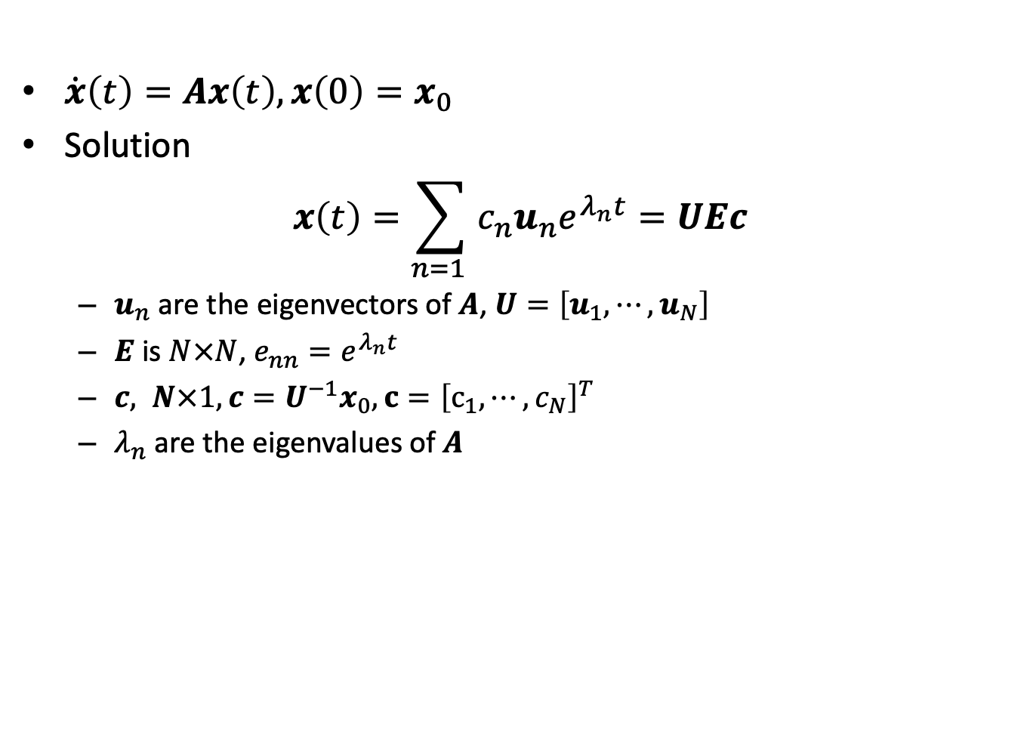
Multivariate, Homogeneous: Eigenvector Solution
$\dot{x}\left(t\right)=Ax\left(t\right), x\left(0\right)=x_{0}$
Solution
$$x\left(t\right)=\sum_{n=1 }{c_{n}u_{n}e^{λ_{n}t}}=UEc$$
$u_{n}$ are the eigenvectors of $A$, $U=\left[u_{1},⋯,u_{N}\right]$
$E$ is $N×N$, $e_{nn}=e^{λ_{n}t}$
$c, N×1, c=U^{−1}x_{0}, c={\left[c_{1},⋯,c_{N}\right]}^{T}$
$λ_{n}$ are the eigenvalues of $A$
Notes:
Why did I leave out “first order”? Can solve high order systems with more variables.

Slide 19
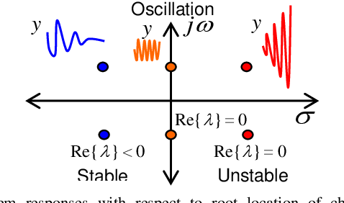
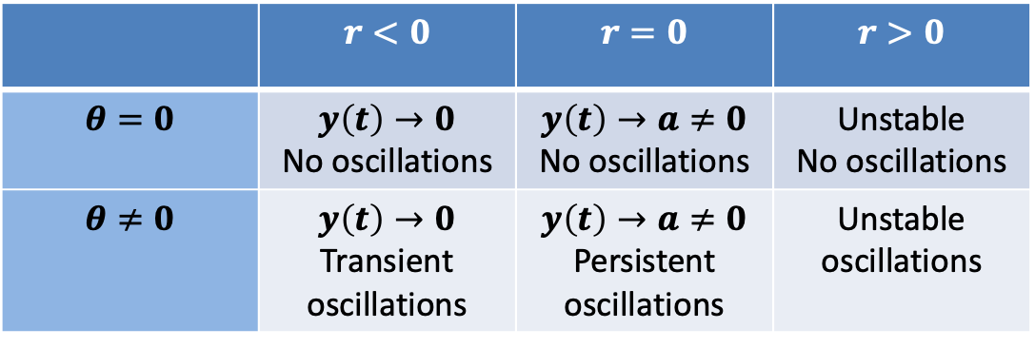



Classification of Systems
Eigenvalues are complex numbers
$$λ=re^{iθ}$$
 | $$r<0$$ | $$r=0$$ | $$r>0$$
$$θ=0$$ | $$y\left(t\right)→0$$ No oscillations | $$y\left(t\right)→a≠0$$ No oscillations | Unstable No oscillations
$$θ≠0$$ | $$y\left(t\right)→0$$ Transient oscillations | $$y\left(t\right)→a≠0$$ Persistent oscillations | Unstable oscillations
$$iθ$$
$$r$$

