Slide 1
BIOE 498 / BIOE 599 Advanced Biological Control Systems Lecture 10: System Identification
Joseph L. Hellerstein
eScience Institute, Computer Science & Engineering
Allen School of Computer Science
BioEngineering
Notes:
Diverse students. Some with bio-backgrounds; some without. Some with CS background; some with very limited. Two separate courses combined because of a substantial shared curriculum.

Slide 2
Notes
Why system identification
Considerations for linear systems
Operating point
Operating region
SysID workflow

Slide 3
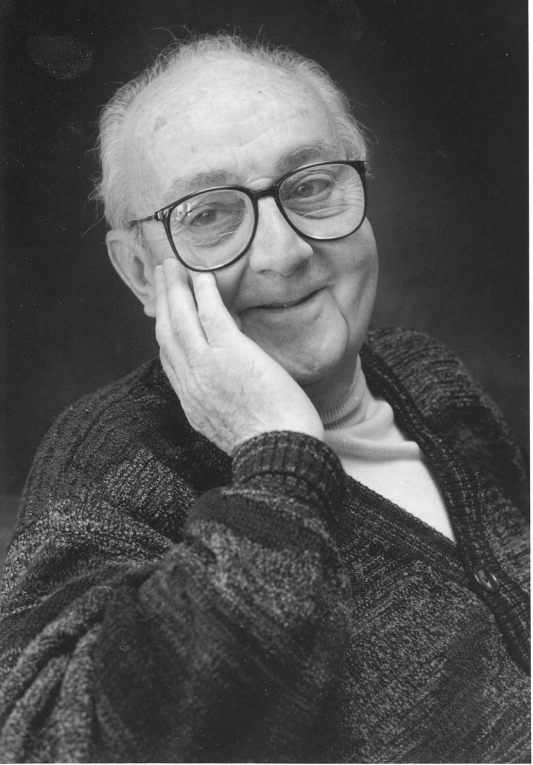
G.P.E. Box (Famous Statistician)
All models are wrong.
But some models are useful.

Slide 4

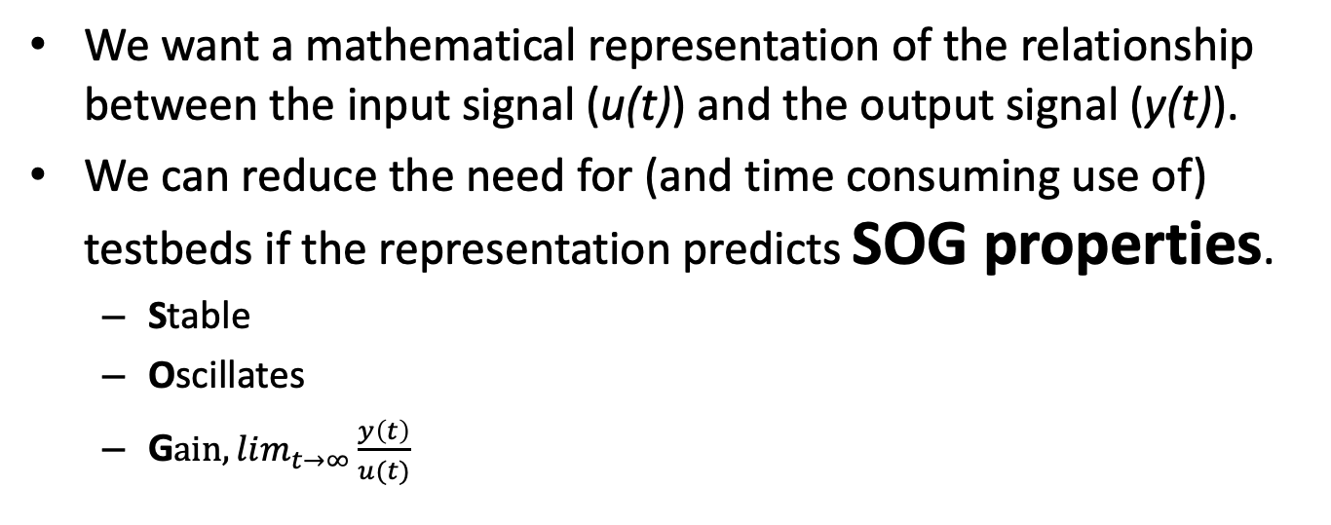

Modeling Dynamical Systems
$$u(t)$$
System
$$y(t)$$
We want a mathematical representation of the relationship between the input signal (u(t)) and the output signal (y(t)).
We can reduce the need for (and time consuming use of) testbeds if the representation predicts SOG properties.
Stable
Oscillates
G$ain, lim_{t→∞}{\frac{y\left(t\right)}{u(t)}}_{}$

Slide 5
Operating Point for Linearization

