Slide 1
BIOE 498 / BIOE 599 Advanced Biological Control Systems Reflections
Joseph L. Hellerstein
eScience Institute, Computer Science & Engineering
Allen School of Computer Science
BioEngineering
Notes:
Diverse students. Some with bio-backgrounds; some without. Some with CS background; some with very limited. Two separate courses combined because of a substantial shared curriculum.

Slide 2
Initial Learning Objectives
Main objective: Learn how to design a controller for a moderately complicated biochemical network.
Evaluate controllability and observability for MIMO systems
Controllability matrix, gramians
Pole placement design
Model predictive control
Issue: Students lacked depth in linear algebra

Slide 3






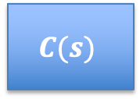



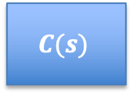


What I Taught
Analysis and design of SISO closed loops for MIMO systems.
$$R(s)$$
$$E(s)$$
$$U(s)$$
$$Y(s)$$
$$C(s)$$
$$G(s)$$
+
$$−$$
$$R(s)$$
$$U(s)$$
$$Y(s)$$
$$C(s)$$
$$G(s)$$
X$(s)$

Slide 4
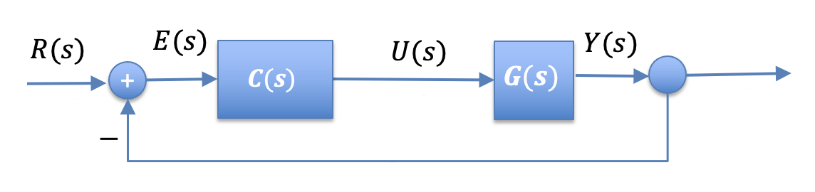
Syllabus Summary
Transfer functions and their composition
DC gain, step response, poles
Theory & application to SBML models
Controllability analysis for SBML models (via DC gain)
Building testbeds for closed loop systems using the CalTech controls package
Iterative design workflow to achieve control objectives in the presence of noise and disturbances
Systematic design using full state feedback

Slide 5
New Syllabus
Changes from 2022
Do control design early on, without theory
Only transfer function analysis: step response, poles
More on filter design to address noise, disturbances

Slide 6
controlSBML
Interface SBML models with CalTech controls package for control analysis, design, and simulation
Controllability analysis
Create standard closed loop architectures
Analysis of closed loop architectures for bias, noise, disturbance
Futures
Readthedocs
Refinements on analysis of closed loop architectures
Requirements for BIOEN 336

