Slide 1
BIOE 498 / BIOE 599 Advanced Biological Control Systems Lecture 8: Analysis Using Block Diagrams
Joseph L. Hellerstein
eScience Institute, Computer Science & Engineering
Allen School of Computer Science
BioEngineering
Notes:
Diverse students. Some with bio-backgrounds; some without. Some with CS background; some with very limited. Two separate courses combined because of a substantial shared curriculum.

Slide 2
Notes
Objective
Know elements of a block diagram, rules for MIMO and SISO
Construct TF from block diagram
Construct block diagram from TF
State space vs. TF representation of systems
Construct TF from block diagram
Construct block diagram from TF
Applyication Reaction networks
Reactions are systems with 0 state: input is reactants; output is products
Apply to a sequential network with TF for each reaction
Construct merged network
See how merged network compares with Tellurium simulation
Add sequestered products
Add feedback (non-linear)

Slide 3
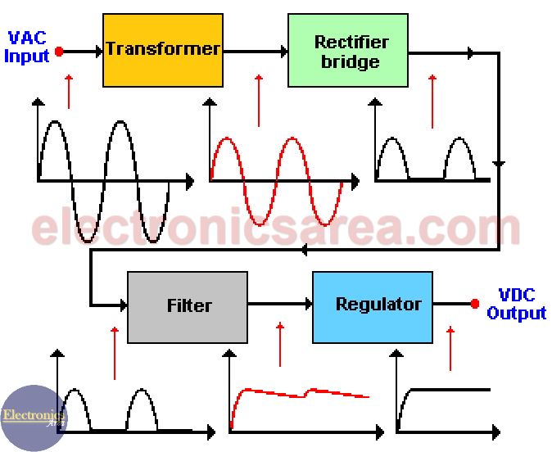
Motivating Example
How does a DC power supply convert AC power?

Slide 4
Why Diagrams?
Abstraction that allows for seeing relationships without excessive details
A way to do incremental refinement
A means of communication
Requires consistent rules

Slide 5

From Reactions to Block Diagrams
Reaction Network
S1
J1
S2
$$J2$$
S3
Block Diagrams
S1
S2
S3
S1
S2
S3
S1 is unaffected by the system
S1 is part of the system
Block diagram terminology
Lines (S1, S2, S3) are signals (values over time).
Blocks (J1, J2) are systems that transform signals
The relationship between reactions and systems is complex since reactants are not traditional inputs since reactants can be transformed by reactions.

Slide 6


Creating Block Diagram
S1
S2
S3
$$G_{1}(s)$$
$$G_{2}(s)$$
Rules for block diagrams
Arrows are drawn between systems and/or connectors to indicate signal transmission
A connections between systems indicates convolution.
Scalar signals are thin arrows; vector signals are thick arrows
Systems are annotated with their transfer functions (may be multivariate)

Slide 7
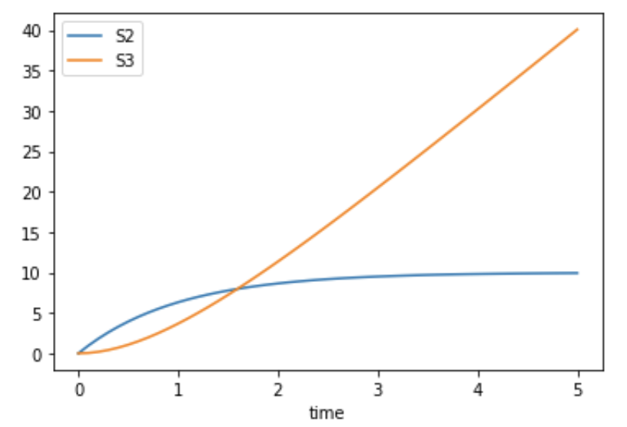
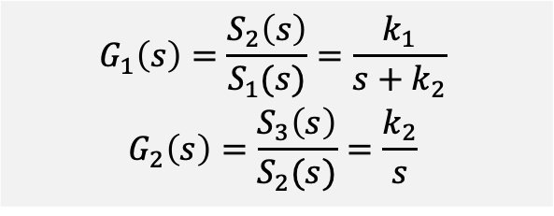
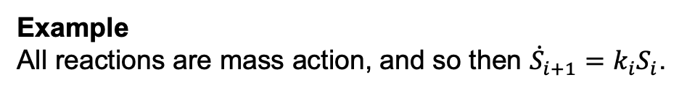
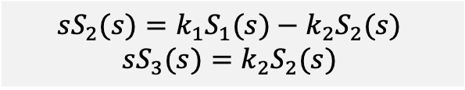



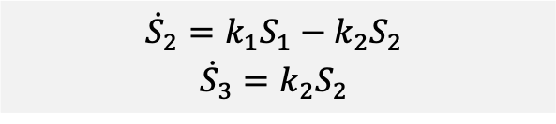

Finding Transfer Functions S1 is unaffected by the system
Finding Transfer Functions
Write state equations in terms of the inputs
Calculate the ratios for each system. Signals other than the input to and output from the system are set to 0.
Example
All reactions are mass action, and so then ${\dot{S}}_{i+1}=k_{i}S_{i}$.
S1
S2
$$G_{2}(s)$$
S3
$$G_{1}(s)$$
$${{\dot{S}}_{2}=k_{1}S_{1}−k_{2}S_{2}}_{ }$$
$${{\dot{S}}_{3}=k_{2}S_{2}}_{ }$$
$$G_{1}\left(s\right)={\frac{S_{2}\left(s\right)}{S_{1}(s)}=\frac{k_{1}}{s+k_{2}}}_{ }$$
$${G_{2}\left(s\right)=\frac{S_{3}\left(s\right)}{S_{2}(s)}=\frac{k_{2}}{s}}_{ }$$
$${{sS}_{2}(s)=k_{1}S_{1}(s)−k_{2}S_{2}(s)}_{ }$$
$${sS_{3}(s)=k_{2}S_{2}(s)}_{ }$$
S1
S2
$$\frac{k_{2}}{s}$$
S3
$$\frac{k_{1}}{s+k_{2}}$$
Notes:
Possibilities for the input signal

Slide 8
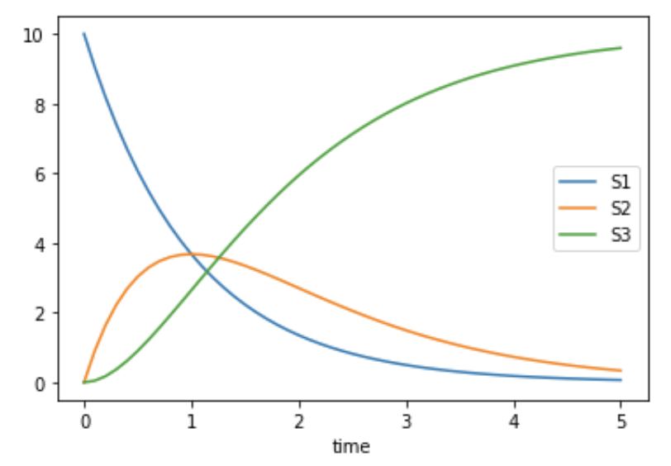
Finding Transfer Functions S1 is unaffected by the system
Finding Transfer Functions
Write state equations in terms of the inputs
Calculate the ratios for each system. Signals other than the input to and output from the system are set to 0.
Example
All reactions are mass action, and so then ${\dot{S}}_{i+1}=k_{i}S_{i}$.
S1
S2
$$G_{2}(s)$$
S3
$$G_{1}(s)$$
$${{\dot{S}}_{2}=k_{1}S_{1}−k_{2}S_{2}}_{ }$$
$${{\dot{S}}_{3}=k_{2}S_{2}}_{ }$$
$$G_{1}\left(s\right)={\frac{S_{2}\left(s\right)}{S_{1}(s)}=\frac{k_{1}}{s+k_{2}}}_{ }$$
$${G_{2}\left(s\right)=\frac{S_{3}\left(s\right)}{S_{2}(s)}=\frac{k_{2}}{s}}_{ }$$
$${{sS}_{2}(s)=k_{1}S_{1}(s)−k_{2}S_{2}(s)}_{ }$$
$${sS_{3}(s)=k_{2}S_{2}(s)}_{ }$$
S1
S2
$$\frac{k_{2}}{s}$$
S3
$$\frac{k_{1}}{s+k_{2}}$$
Notes:
Possibilities for the input signal

Slide 9

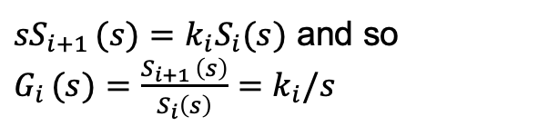

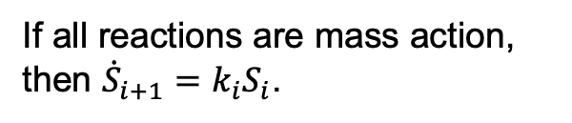


From Reactions to Block Diagram: II S1 is part of the system
If all reactions are mass action, then ${\dot{S}}_{i+1}=k_{i}S_{i}$.
S1
S2
S3
$$G_{1}(s)$$
$$G_{2}(s)$$
${sS}_{i+1 }(s)=k_{i}S_{i}(s)$ and so $G_{i }(s)={\frac{S_{i+1 }\left(s\right)}{S_{i}\left(s\right)}=k}_{i}/s$
J1
J2
$$G_{1}\left(s\right)=\frac{S_{2}(s)}{S_{1}(s)}$$
$$G_{2}\left(s\right)=\frac{S_{3}(s)}{S_{2}(s)}$$
Rules for block diagrams
Arrows are drawn between systems and/or connectors to indicate signal transmission
Scalar signals are thin arrows; vector signals are thick arrows
Systems are annotated with their transfer functions (may be multivariate)

Slide 10
Agenda
Constructing block diagrams
From block diagram to transfer functions
From transfer functions to block diagrams

Slide 11
Block Diagram of Linear Systems
Elements
Systems: TF, input, output
Connectors
Line from system to system: Signal
Line from system to add-connector: Signal addition
Example

Slide 12
From Block Diagram to System TF
Series connection of system
Addition connector
Feedback
Strategy of block reduction

Slide 13
From System TF to Block Diagram
Series connection of system
Addition connector
Feedback

Slide 14
Block Diagram Representation of Reaction Networks
?

