Slide 1
BIOE 498 / BIOE 599 Advanced Biological Control Systems Lecture 9: Linear Time Invariant Systems
Joseph L. Hellerstein
eScience Institute, Computer Science & Engineering
Allen School of Computer Science
BioEngineering
Notes:
Diverse students. Some with bio-backgrounds; some without. Some with CS background; some with very limited. Two separate courses combined because of a substantial shared curriculum.

Slide 2
Agenda
Linear time invariant (LTI) systems
Laplace transforms
Definition, calculation, poles
Solving high order approximations
Poles determine stability and oscillations.
Definition of transfer function.
Calculating DC gain.

Slide 3
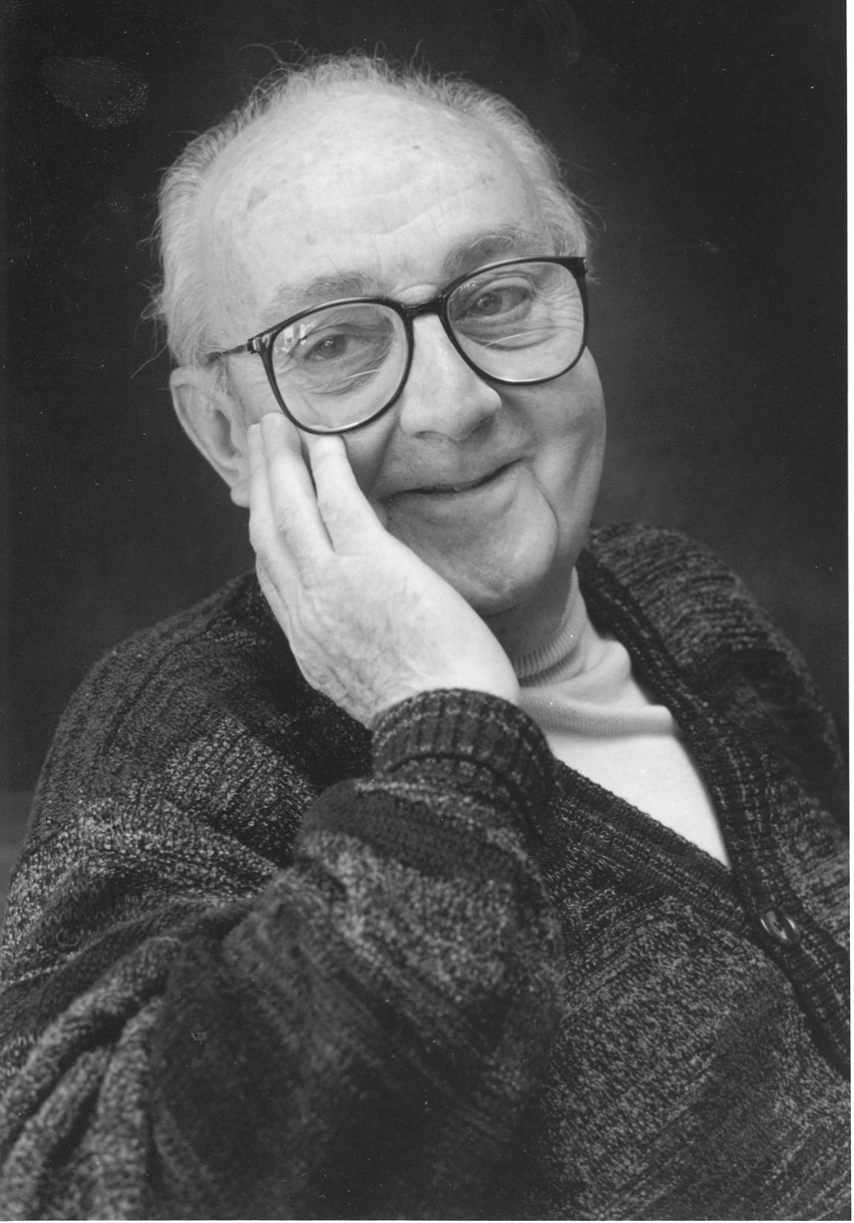
G.P.E. Box (Famous Statistician)
All models are wrong.
But some models are useful.

Slide 4

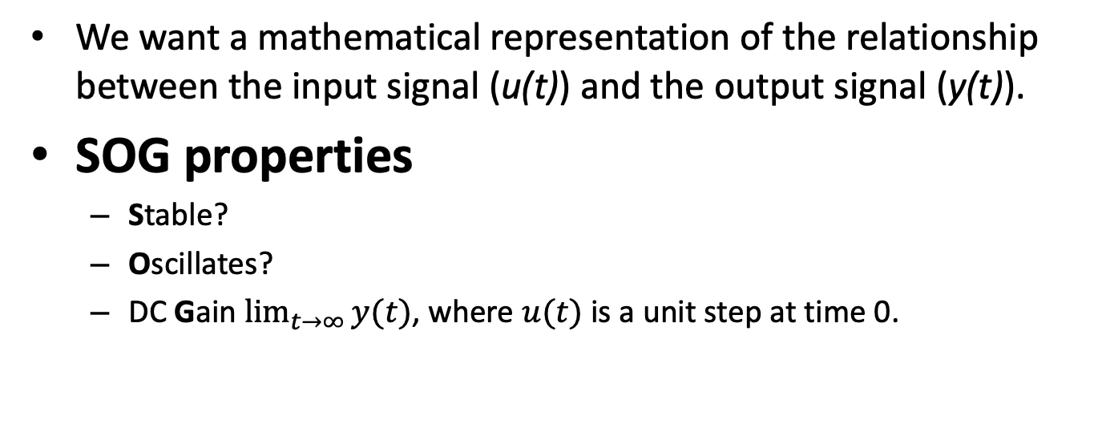

Modeling Signals & Systems
$$u(t)$$
System
$$y(t)$$
We want a mathematical representation of the relationship between the input signal (u(t)) and the output signal (y(t)).
SOG properties
Stable?
Oscillates?
DC Gain $\lim_{t→∞}{y(t)}$, where $u(t)$ is a unit step at time 0.

Slide 5
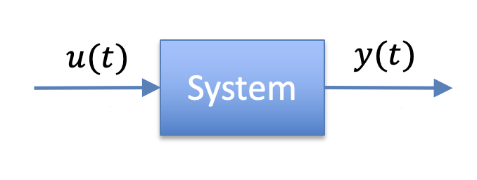
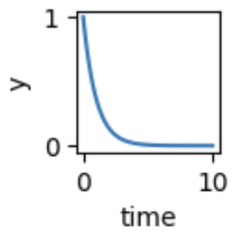
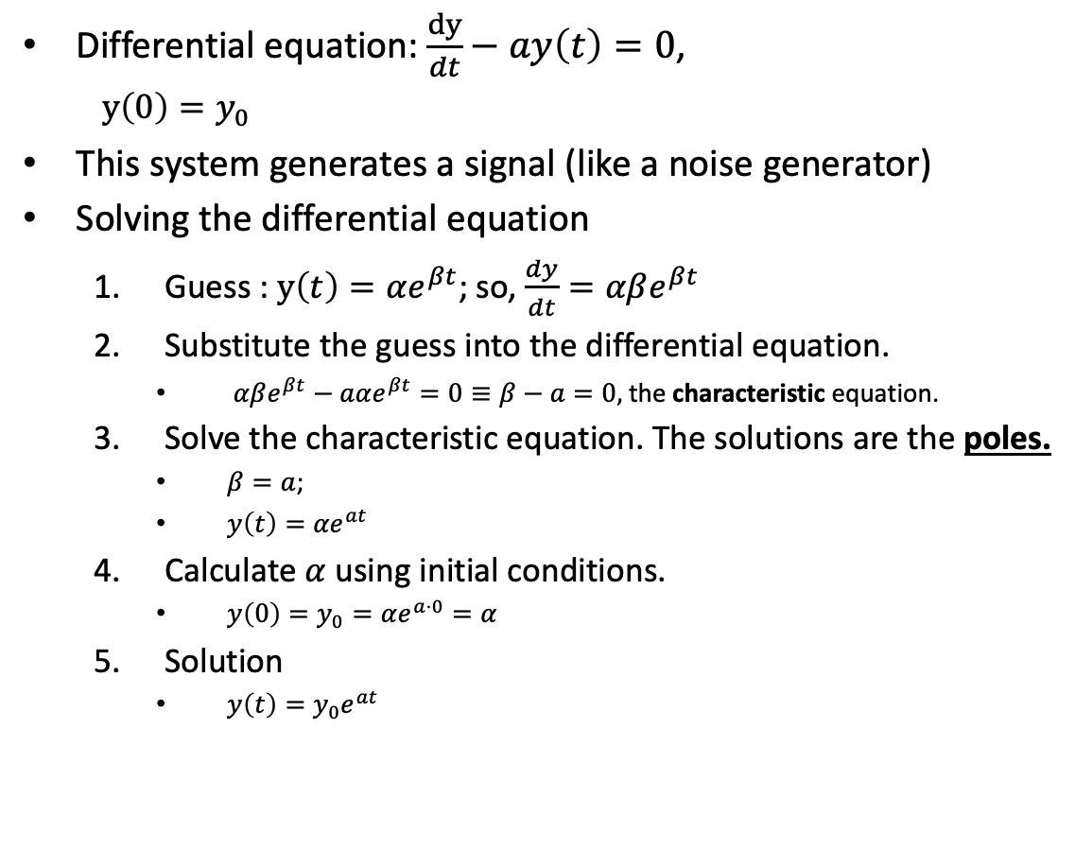
First Order Linear Time Invariant (LTI) System
X
Differential equation: $\frac{dy}{dt}−ay\left(t\right)=0$,
$y\left(0\right)=y_{0}$
This system generates a signal (like a noise generator)
Solving the differential equation
Guess : $y\left(t\right)=αe^{βt}$; so, $\frac{dy}{dt}=αβe^{βt}$
Substitute the guess into the differential equation.
$αβe^{βt}−aαe^{βt}=0≡β−a=0,$ the characteristic equation.
Solve the characteristic equation. The solutions are the poles.
$β=a$;
$y\left(t\right)={αe}^{at}$
Calculate $α$ using initial conditions.
$y\left(0\right)=y_{0}=αe^{a⋅0}=α$
Solution
$y\left(t\right)=y_{0}e^{at}$

Slide 6
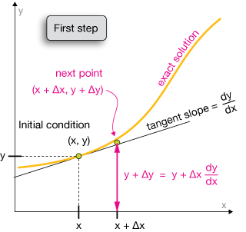


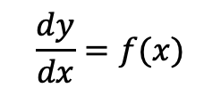


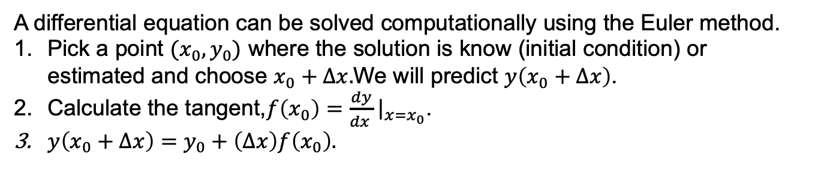






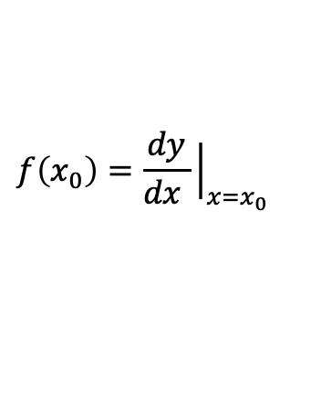

Computational Solutions to Differential Equations
$$\frac{dy}{dx}=f(x)$$
$$\frac{dy}{dx}$$
$$\frac{dy}{dx}$$
$$f\left(x_{0}\right)=\frac{dy}{dx }{\left.​\right|}_{x=x_{0}}$$
$$\frac{dy}{dx}$$
$$y_{0}+\left(Δx\right)f\left(x_{0}\right)$$
$$\frac{dy}{dx}$$
$$y_{0}$$
$$\frac{dy}{dx}$$
$$\frac{dy}{dx}$$
$$\frac{dy}{dx}$$
$$x_{0}$$
$$x_{0}+Δx$$
A differential equation can be solved computationally using the Euler method.
Pick a point $(x_{0},y_{0})$ where the solution is know (initial condition) or estimated and choose $x_{0}+Δx.$We will predict $y\left(x_{0}+Δx\right)$.
Calculate the tangent,$f\left(x_{0}\right)=\frac{dy}{dx }{\left.​\right|}_{x=x_{0}}$.
$y\left(x_{0}+Δx\right)=y_{0}+\left(Δx\right)f\left(x_{0}\right).$

Slide 7
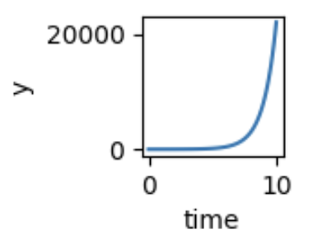
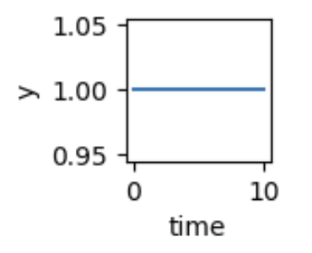


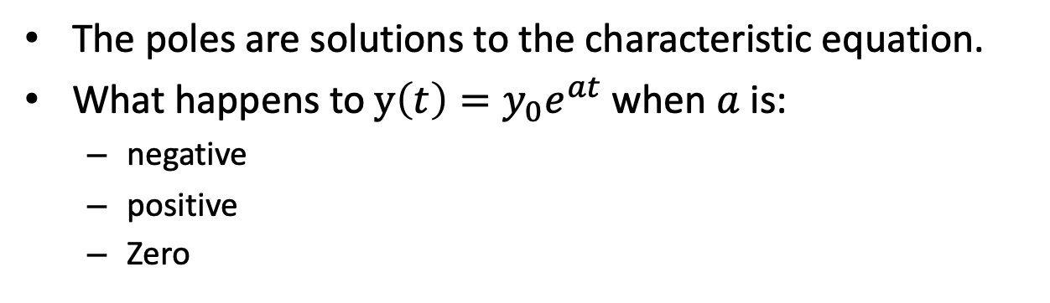

Poles
X
The poles are solutions to the characteristic equation.
What happens to $y\left(t\right)=y_{0}e^{at}$ when $a$ is:
negative
positive
Zero
$$a>0$$
$$a=0$$
$$a<0$$

Slide 8
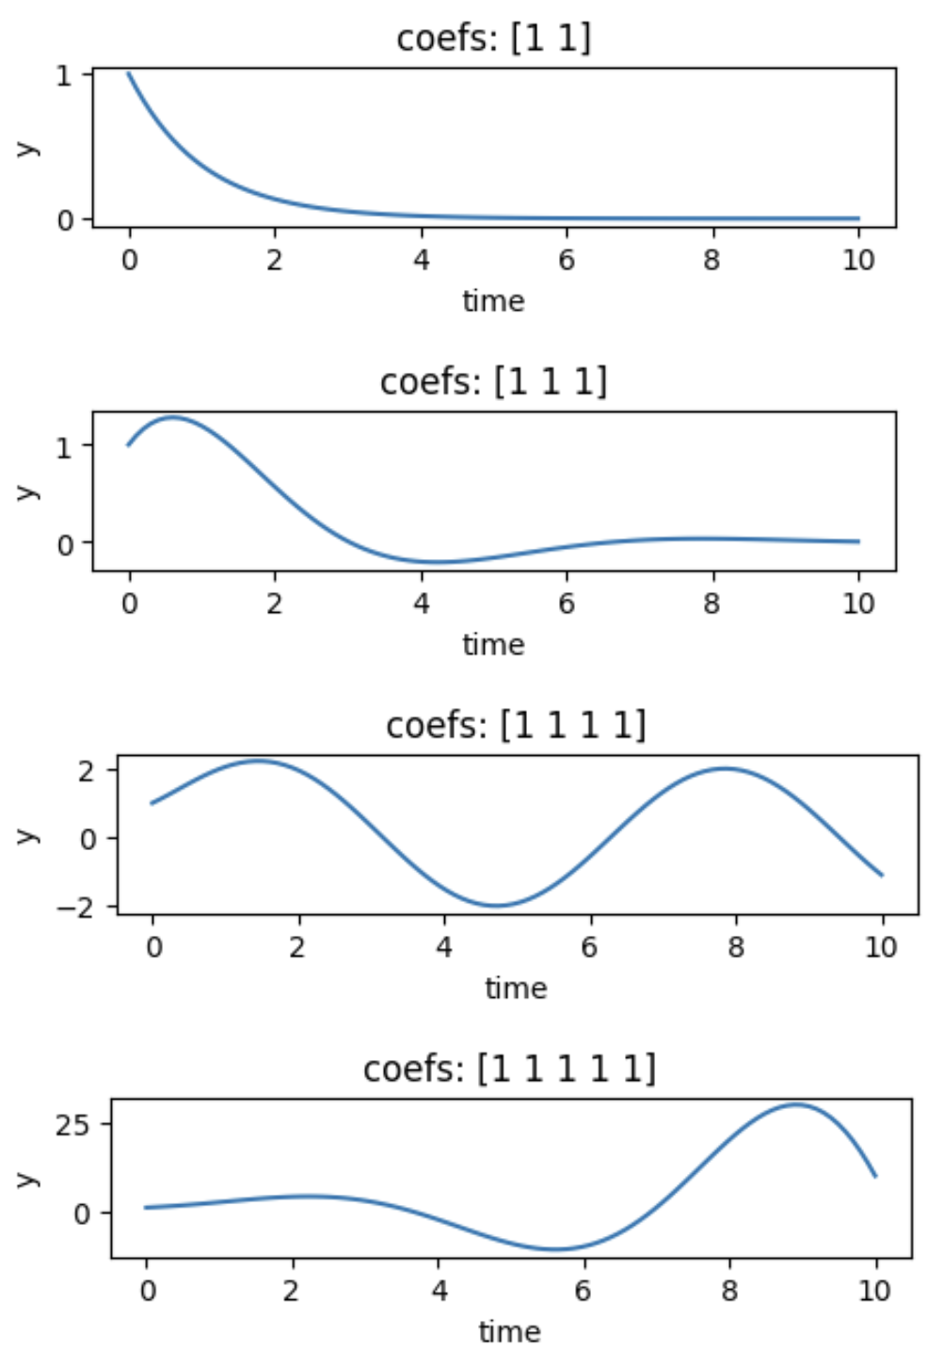
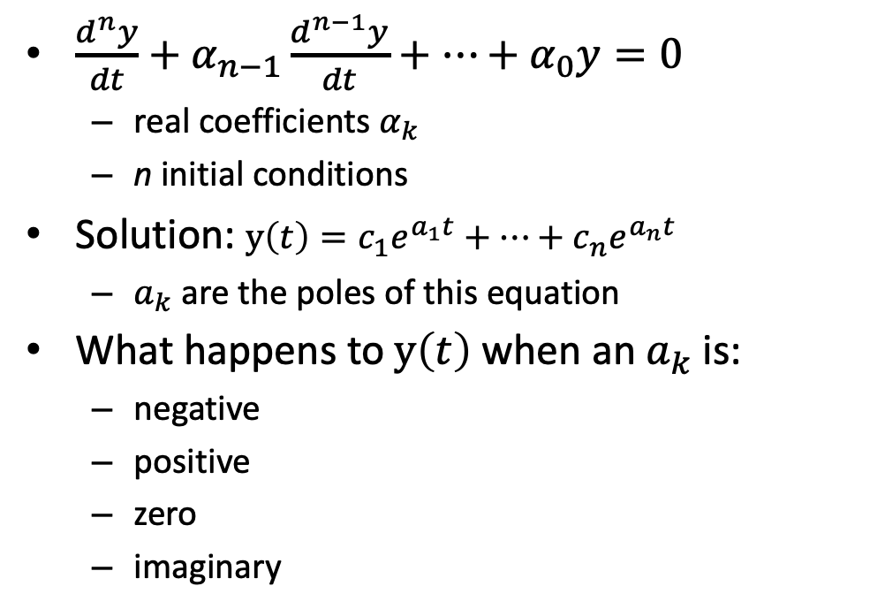

High Order Differential Equations
X
$\frac{d^{n}y}{dt}+α_{n−1}\frac{d^{n−1}y}{dt}+⋯+α_{0}y=0$
real coefficients $α_{k}$
n initial conditions
Solution: $y\left(t\right)=c_{1}e^{a_{1}t}+⋯+c_{n}e^{a_{n}t}$
$a_{k}$ are the poles of this equation
What happens to $y\left(t\right)$ when an${ a}_{k}$ is:
negative
positive
zero
imaginary
1st order
2nd order
3rd order
4th order
$$α_{k}=1$$

Slide 9
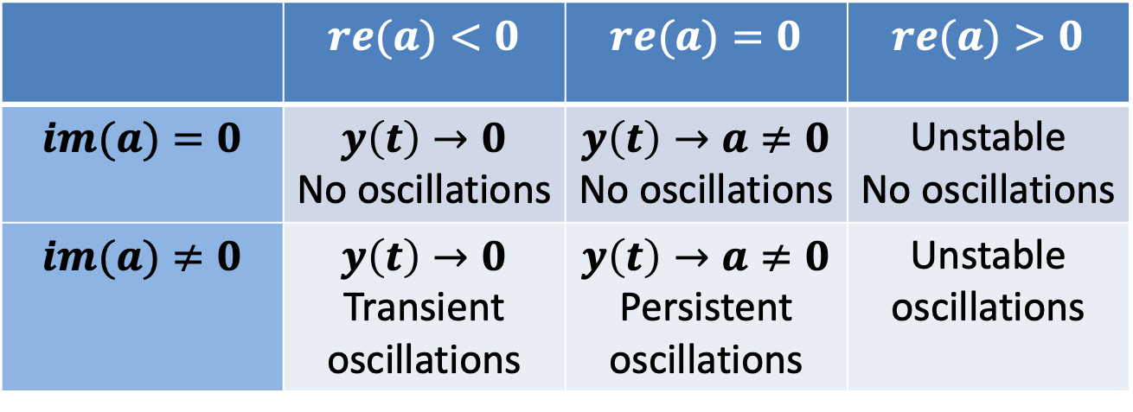
Poles Tell Us About Stability and Oscillations
Consider the (possibly complex) pole $a=(re\left(a\right), im\left(a\right))$
 | $$re(a)<0$$ | $$re(a)=0$$ | $$re(a)>0$$
$$im(a)=0$$ | $$y\left(t\right)→0$$ No oscillations | $$y\left(t\right)→a≠0$$ No oscillations | Unstable No oscillations
$$im(a)≠0$$ | $$y\left(t\right)→0$$ Transient oscillations | $$y\left(t\right)→a≠0$$ Persistent oscillations | Unstable oscillations

Slide 10
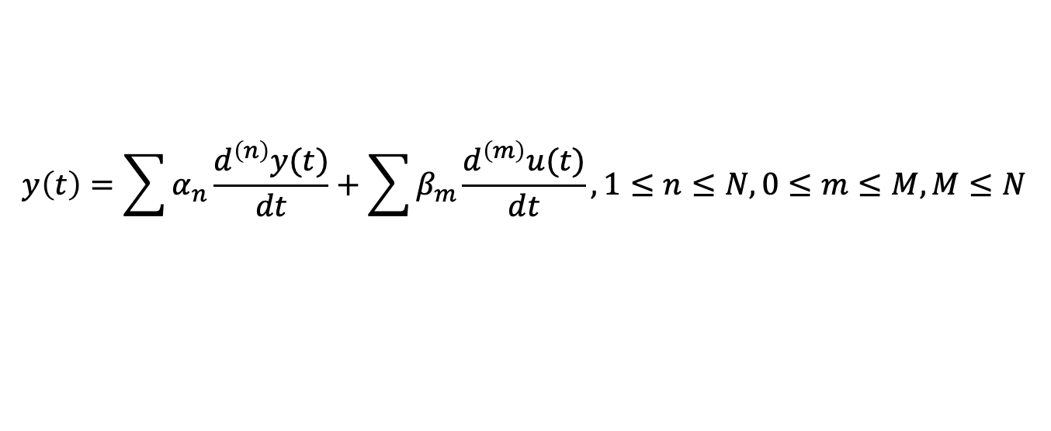
High Order Systems With Inputs
$$y\left(t\right)=\sum{α_{n}\frac{d^{\left(n\right)}y(t)}{dt}}+\sum{β_{m}\frac{d^{\left(m\right)}u(t)}{dt}}, 1≤n≤N, 0≤m≤M, M≤N$$
This is getting complicated!
We need a simpler approach than solving in the time domain.

Slide 11
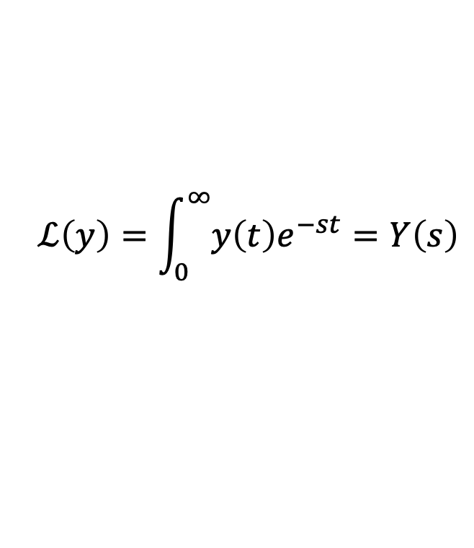
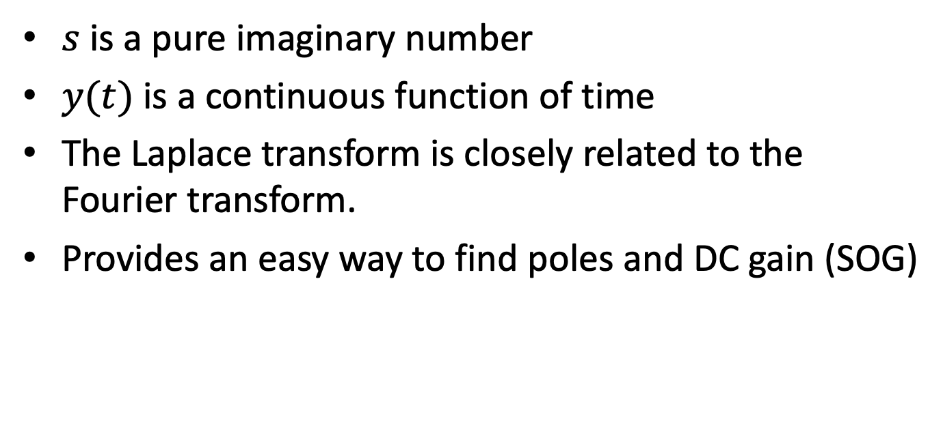
Laplace Transform
$$ℒ\left(y\right)=\int_{0}^{∞}{y\left(t\right)e^{−st}}=Y\left(s\right)$$
$s$ is a pure imaginary number
$y(t)$ is a continuous function of time
The Laplace transform is closely related to the Fourier transform.
Provides an easy way to find poles and DC gain (SOG)

Slide 12
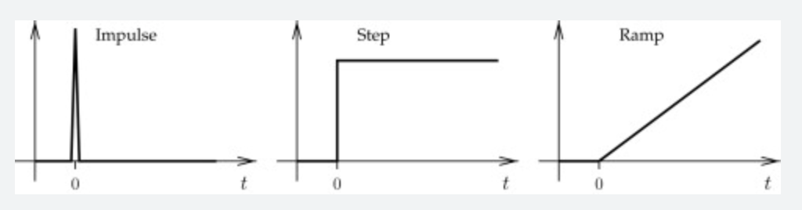



Basic Signals
$${u\left(t\right)=δ}_{0}(t)$$
$${y\left(t\right)= 1}_{0}(t)$$
$$y\left(t\right)=t$$

Slide 13
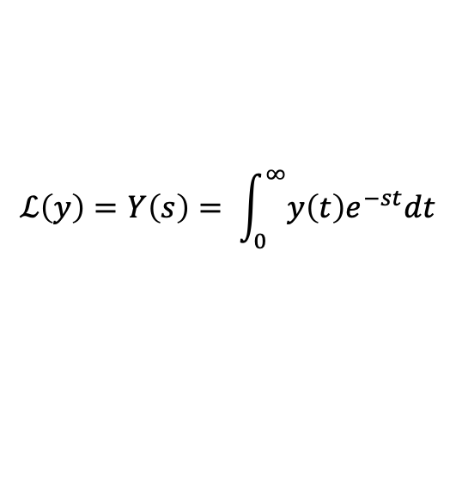
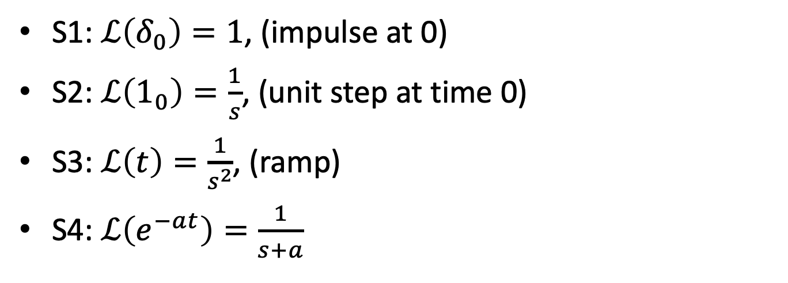
Laplace Transforms of Basic Signals
$$ℒ\left(y\right)=Y\left(s\right)= \int_{0}^{∞}{y\left(t\right)e^{−st}dt}$$
S1: $ℒ\left(δ_{0}\right)=1$, (impulse at 0)
S2: $ℒ\left(1_{0}\right)=\frac{1}{s}$, (unit step at time 0)
S3: $ℒ\left(t\right)=\frac{1}{s^{2}}$, (ramp)
S4: $ℒ\left(e^{−at}\right)=\frac{1}{s+a}$

Slide 14
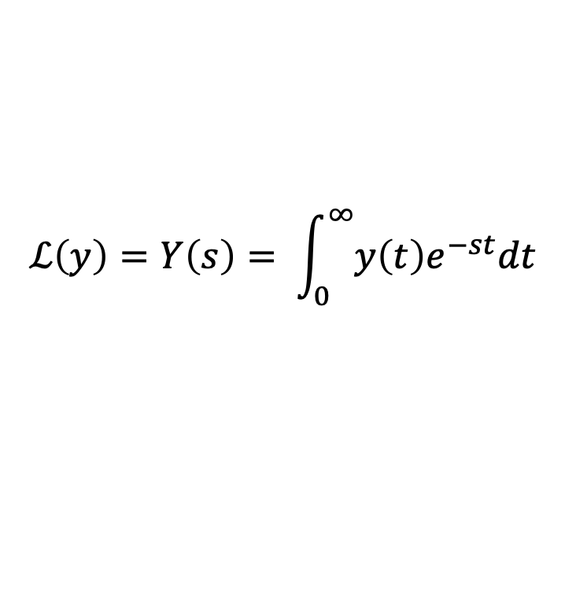
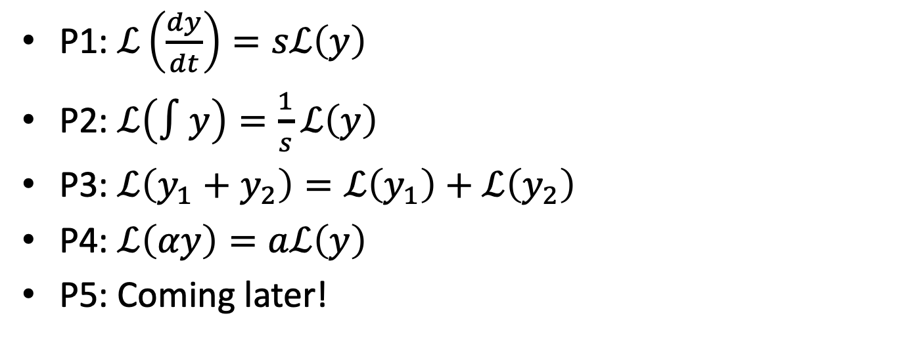
Laplace Transforms Properties
$$ℒ\left(y\right)=Y\left(s\right)= \int_{0}^{∞}{y\left(t\right)e^{−st}dt}$$
P1: $ℒ\left(\frac{dy}{dt}\right)=sℒ\left(y\right)$
P2: $ℒ\left(∫y\right)=\frac{1}{s}ℒ\left(y\right)$
P3: $ℒ\left(y_{1}+y_{2}\right)=ℒ\left(y_{1}\right)+ℒ\left(y_{2}\right)$
P4: $ℒ\left(αy\right)=aℒ\left(y\right)$
P5: Coming later!

Slide 15


Find These Laplace Transforms
$y\left(t\right)=5+3t^{2}+ 100δ$
$\frac{5}{s}+\frac{3}{s^{3}}+100$
$y\left(t\right)={6e}^{−4t }+∫8e^{0.2 t}$
$\frac{6}{s+4}+\frac{8}{s(s−0.2)}$
S1: $ℒ\left(δ_{0}\right)=1$
S2: $ℒ\left(1_{0}\right)=\frac{1}{s}$
S3: $ℒ\left(t\right)=\frac{1}{s^{2}}$
S4: $ℒ\left(e^{−at}\right)=\frac{1}{s+a}$
P1: $ℒ\left(\frac{dy}{dt}\right)=sℒ\left(y\right)$
P2: $ℒ\left(∫y\right)=\frac{1}{s}ℒ\left(y\right)$
P3: $ℒ\left(y_{1}+y_{2}\right)=ℒ\left(y_{1}\right)+ℒ\left(y_{2}\right)$
P4: $ℒ\left(αy\right)=aℒ\left(y\right)$

Slide 16
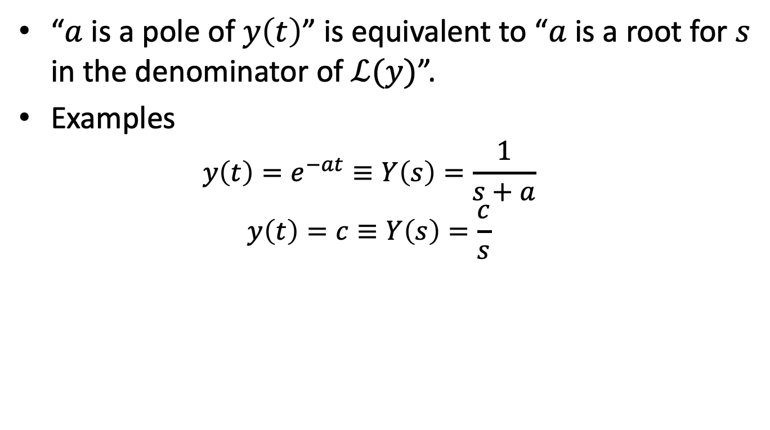
Poles & Laplace Transforms
“$a$ is a pole of $y\left(t\right)$” is equivalent to “$a$ is a root for $s$ in the denominator of $ℒ(y)$”.
Examples
$$y\left(t\right)=e^{−at}≡Y\left(s\right)=\frac{1}{s+a}$$
$$y\left(t\right)=c≡Y\left(s\right)=\frac{c}{s}$$

Slide 17


What are the poles? Are the systems stable?
$\frac{5}{s}+100$
poles at 0. Step + impulse.
$\frac{6}{s+4}+\frac{8}{s(s−0.2)}$
poles at -4, 0, 0.2. unstable.
S1: $ℒ\left(δ_{0}\right)=1$
S2: $ℒ\left(1_{0}\right)=\frac{1}{s}$
S3: $ℒ\left(t\right)=\frac{1}{s^{2}}$
S4: $ℒ\left(e^{at}\right)=\frac{1}{s+a}$
P1: $ℒ\left(\frac{dy}{dt}\right)=sℒ\left(y\right)$
P2: $ℒ\left(∫y\right)=\frac{1}{s}ℒ\left(y\right)$
P3: $ℒ\left(y_{1}+y_{2}\right)=ℒ\left(y_{1}\right)+ℒ\left(y_{2}\right)$
P4: $ℒ\left(αy\right)=aℒ\left(y\right)$

Slide 18





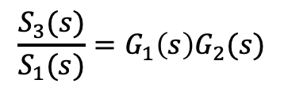


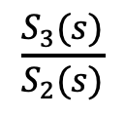
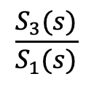
Transfer Function
S1
S2
S3
$$G_{1}(s)$$
$$G_{2}(s)$$
$$G\left(s\right)$$
A transfer function is the ratio of the Laplace transform of the output to the Laplace transform of the input.
$$G_{1}\left(s\right)=\frac{S_{2}(s)}{S_{1}(s)}$$
$$\frac{S_{3}(s)}{S_{2}(s)}$$
$$\frac{S_{3}(s)}{S_{1}(s)}$$
$$G_{2}\left(s\right)=$$
$$G\left(s\right)=$$
A transfer function is a Laplace transform and so has all of its properties.
The transfer function of a system in series is the product of the transfer functions of its constituent systems.
$$\frac{S_{3}(s)}{S_{1}(s)}=G_{1}\left(s\right)G_{2}(s)$$
P5: $G\left(s\right)=$

Slide 19

Final Value Theorem (for Signals)
If $Y\left(s\right)=ℒ\left(y\right)$ and $y\left(t\right)$ converges, then $y\left(∞\right)=\lim_{s→0}{sY(s)}.$
Examples
$Y\left(s\right)=\frac{4}{s}$. $y\left(∞\right)=s\lim_{s→0}{\frac{4}{s}}=4$
$Y\left(s\right)=\frac{1}{s+1}$. $y\left(∞\right)=s\lim_{s→0}{\frac{1}{s+1}}=0$

Slide 20
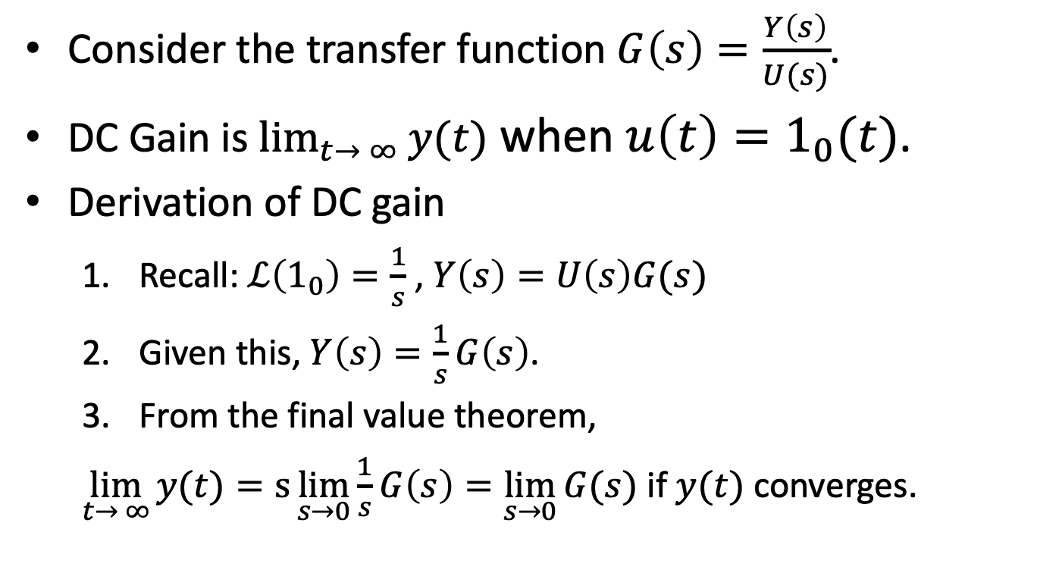
DC Gain For Transfer Functions
Consider the transfer function $G\left(s\right)=\frac{Y\left(s\right)}{U(s)}$.
DC Gain is $\lim_{t→ ∞}{y(t)}$ when $u\left(t\right)=1_{0}(t)$.
Derivation of DC gain
Recall: $ℒ\left(1_{0}\right)=\frac{1}{s}$ , $Y\left(s\right)=U\left(s\right)G(s)$
Given this, $Y\left(s\right)=\frac{1}{s}G\left(s\right)$.
From the final value theorem,
$\lim_{t→ ∞}{y(t)}=s\lim_{s→0}{\frac{1}{s}G\left(s\right)=\lim_{s→0}{G(s)}}$ if $y(t)$ converges.

Slide 21
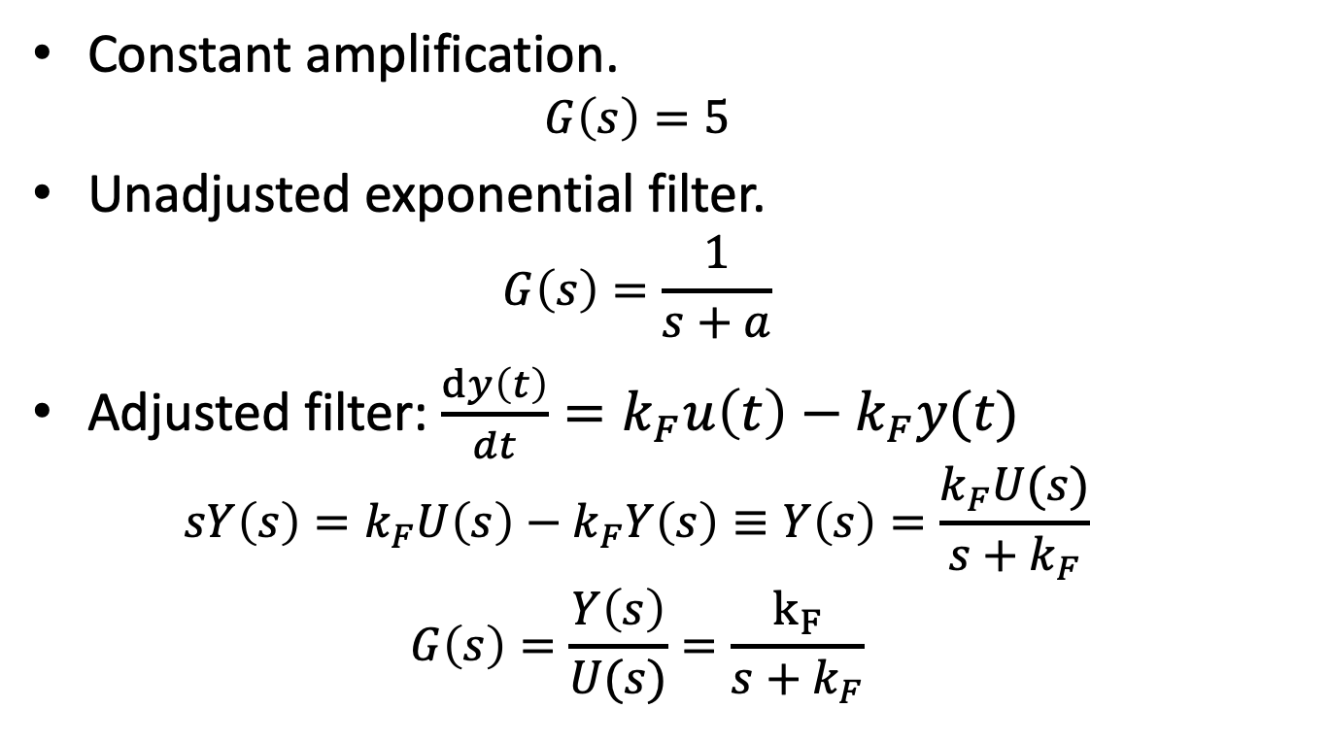

Examples of Calculating DC Gain
DC Gain: ${\lim_{s→0}{G(s)}}$
Constant amplification.
$$G\left(s\right)=5$$
Unadjusted exponential filter.
$$G\left(s\right)=\frac{1}{s+a}$$
Adjusted filter: $\frac{dy\left(t\right)}{dt}=k_{F}u\left(t\right)−k_{F}y(t)$
$$sY\left(s\right)=k_{F}U\left(s\right)−k_{F}Y\left(s\right)≡Y\left(s\right)=\frac{k_{F}U(s)}{s+k_{F}}$$
$$G\left(s\right)=\frac{Y\left(s\right)}{U(s)}=\frac{k_{F}}{s+k_{F}}$$
Notes:
DC gain for constant amplification: 5
DC gain for exponential: 1/a
DC gain for filter: 1

Slide 22
What You Need to Know
Definition of Laplace Transform.
Calculating Laplace Transforms.
LT of signals (S1-S4)
Properties of LTs (P1-P5)
How stability, oscillation are determined by poles.
Definition of Transfer Function.
Calculating DC gain from transfer functions.

