Slide 1
BIOE 498 / BIOE 599 Advanced Biological Control Systems Lecture 9: Linearizing Reaction Networks
Joseph L. Hellerstein
eScience Institute, Computer Science & Engineering
Allen School of Computer Science
BioEngineering
Notes:
Diverse students. Some with bio-backgrounds; some without. Some with CS background; some with very limited. Two separate courses combined because of a substantial shared curriculum.

Slide 2
Agenda
System equations in matrix form
Operating point
Linearization of system equations

Slide 3
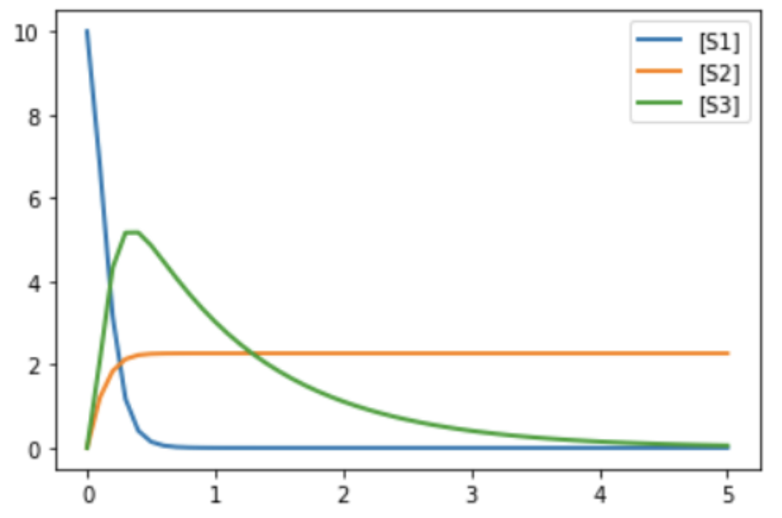














Running Example
J1: S1 -> S2; k1*S1 J2: S1 + S2 -> 3 S3; k2*S1*S2 J3: S3 -> ; k3*S3 J4: 2 S1 + S3 -> S2; k4*S1*S3 k1 = 2 k2 = 1.5 k3 = 1 k4 = 0.5 S1 = 10 S2 = 0 S3 = 0
State Variables:
$$S_{1}, S_{2}, S_{3}$$
System Equations
${\dot{S}}_{n}$as a function of $J_{m}$
$$\dot{S_{1}}=$$
$$−J_{1}− J_{2}+\left(0\right)J_{3}−2J_{4}$$
$$\dot{S_{2}}=$$
$${ J}_{1}−{ J}_{2} + \left(0\right)J_{3}+ J_{4}$$
$$\dot{S_{3}}=$$
$${(0)J}_{1}+\left(3\right)J_{2} − { J}_{3} − { J}_{4}$$
Substitute reaction kinetics
$$\dot{S_{1}}=$$
$$−k_{1}S_{1}−k_{2}S_{1}S_{2}−{\left(2\right)k}_{4}S_{1}S_{3}$$
$$\dot{S_{2}}=$$
$$k_{1}S_{1}−k_{2}S_{1}S_{2}−k_{4}S_{1}S_{3}$$
$$\dot{S_{3}}=$$
$$(3)k_{2}S_{1}S_{2}−k_{3}S_{3}−k_{4}S_{1}S_{3}$$

Slide 4

















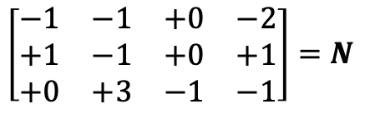
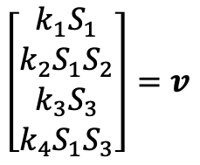







Matrix Representations
J1: S1 -> S2; k1*S1 J2: S1 + S2 -> 3 S3; k2*S1*S2 J3: S3 -> ; k3*S3 J4: 2 S1 + S3 -> S2; k4*S1*S3
System Equations
Stoichiometry Matrix
${\dot{S}}_{n}$as a function of $J_{m}$
$$J_{1}$$
$$J_{2}$$
$$J_{3}$$
$$J_{4}$$
$$\dot{S_{1}}=$$
$$−J_{1}− J_{2}+\left(0\right)J_{3}−2J_{4}$$
$$S_{1}$$
$$\left[\begin{matrix}\begin{matrix}\begin{matrix}−1 & −1\end{matrix} & \begin{matrix}+0 & −2\end{matrix}\end{matrix} \\ \begin{matrix}\begin{matrix}+1 & −1\end{matrix} & \begin{matrix}+0 & +1\end{matrix}\end{matrix} \\ \begin{matrix}\begin{matrix}+0 & +3\end{matrix} & \begin{matrix}−1 & −1\end{matrix}\end{matrix}\end{matrix}\right]=N$$
$$\dot{S_{2}}=$$
$$S_{2}$$
$${ J}_{1}−{ J}_{2} + \left(0\right)J_{3}+ J_{4}$$
$$S_{3}$$
$$\dot{S_{3}}=$$
$${(0)J}_{1}+\left(3\right)J_{2} − { J}_{3} − { J}_{4}$$
Substitute reaction kinetics
Flux Vector
$$\dot{S_{1}}=$$
$$−k_{1}S_{1}−k_{2}S_{1}S_{2}−{\left(2\right)k}_{4}S_{1}S_{3}$$
$$J_{1}$$
$$J_{2}$$
$$\left[\begin{matrix}\begin{matrix}k_{1}S_{1} \\ k_{2}S_{1}S_{2}\end{matrix} \\ \begin{matrix}k_{3}S_{3} \\ k_{4}S_{1}S_{3}\end{matrix}\end{matrix}\right]=v$$
$$\dot{S_{2}}=$$
$$k_{1}S_{1}−k_{2}S_{1}S_{2}+k_{4}S_{1}S_{3}$$
$$J_{3}$$
$$\dot{S_{3}}=$$
$$(3)k_{2}S_{1}S_{2}−k_{3}S_{3}−k_{4}S_{1}S_{3}$$
$$J_{4}$$

Slide 5
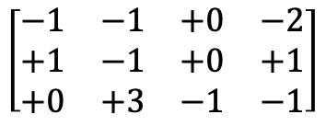








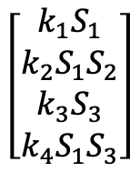
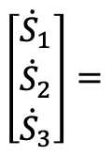









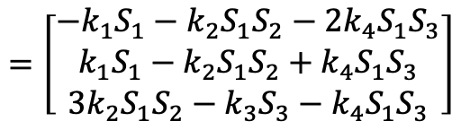
System Equations in Matrices
System Equations
$$\dot{S_{1}}=$$
$$−k_{1}S_{1}−k_{2}S_{1}S_{2}−{2k}_{4}S_{1}S_{3}$$
$$\dot{S_{2}}=$$
$$k_{1}S_{1}−k_{2}S_{1}S_{2}+k_{4}S_{1}S_{3}$$
$$\dot{S_{3}}=$$
$$3k_{2}S_{1}S_{2}−k_{3}S_{3}−k_{4}S_{1}S_{3}$$
State Derivatives
Stoichiometry Matrix
Flux Vector
$$J_{1}$$
$$J_{2}$$
$$J_{3}$$
$$J_{4}$$
$$J_{1}$$
$$\left[\begin{matrix}\begin{matrix}{\dot{S}}_{1} \\ {\dot{S}}_{2}\end{matrix} \\ {\dot{S}}_{3}\end{matrix}\right]=$$
$$J_{2}$$
$$\left[\begin{matrix}\begin{matrix}k_{1}S_{1} \\ k_{2}S_{1}S_{2}\end{matrix} \\ \begin{matrix}k_{3}S_{3} \\ k_{4}S_{1}S_{3}\end{matrix}\end{matrix}\right]$$
$$S_{1}$$
$$\left[\begin{matrix}\begin{matrix}\begin{matrix}−1 & −1\end{matrix} & \begin{matrix}+0 & −2\end{matrix}\end{matrix} \\ \begin{matrix}\begin{matrix}+1 & −1\end{matrix} & \begin{matrix}+0 & +1\end{matrix}\end{matrix} \\ \begin{matrix}\begin{matrix}+0 & +3\end{matrix} & \begin{matrix}−1 & −1\end{matrix}\end{matrix}\end{matrix}\right]$$
$$×$$
$$S_{2}$$
$$J_{3}$$
$$S_{3}$$
$$J_{4}$$
$$=\left[\begin{matrix}\begin{matrix}−k_{1}S_{1}−k_{2}S_{1}S_{2}−2k_{4}S_{1}S_{3} \\ k_{1}S_{1}−k_{2}S_{1}S_{2}+k_{4}S_{1}S_{3}\end{matrix} \\ 3k_{2}S_{1}S_{2}−k_{3}S_{3}−k_{4}S_{1}S_{3}\end{matrix}\right]$$

Slide 6
Linearizing System Equations
System Equations
$$\dot{S_{1}}=$$
$$−k_{1}S_{1}−k_{2}S_{1}S_{2}−{2k}_{4}S_{1}S_{3}$$
$$\dot{S_{2}}=$$
$$k_{1}S_{1}−k_{2}S_{1}S_{2}+k_{4}S_{1}S_{3}$$
$$\dot{S_{3}}=$$
$$3k_{2}S_{1}S_{2}−k_{3}S_{3}−k_{4}S_{1}S_{3}$$
State Derivatives
Stoichiometry Matrix
Flux Vector
$$J_{1}$$
$$J_{2}$$
$$J_{3}$$
$$J_{4}$$
$$J_{1}$$
$$\left[\begin{matrix}\begin{matrix}{\dot{S}}_{1} \\ {\dot{S}}_{2}\end{matrix} \\ {\dot{S}}_{3}\end{matrix}\right]=$$
$$J_{2}$$
$$\left[\begin{matrix}\begin{matrix}k_{1}S_{1} \\ k_{2}S_{1}S_{2}\end{matrix} \\ \begin{matrix}k_{3}S_{3} \\ k_{4}S_{1}S_{3}\end{matrix}\end{matrix}\right]$$
$$S_{1}$$
$$\left[\begin{matrix}\begin{matrix}\begin{matrix}−1 & −1\end{matrix} & \begin{matrix}+0 & −2\end{matrix}\end{matrix} \\ \begin{matrix}\begin{matrix}+1 & −1\end{matrix} & \begin{matrix}+0 & +1\end{matrix}\end{matrix} \\ \begin{matrix}\begin{matrix}+0 & +3\end{matrix} & \begin{matrix}−1 & −1\end{matrix}\end{matrix}\end{matrix}\right]$$
$$×$$
$$S_{2}$$
$$J_{3}$$
$$S_{3}$$
$$J_{4}$$
$$=\left[\begin{matrix}\begin{matrix}−k_{1}S_{1}−k_{2}S_{1}S_{2}−2k_{4}S_{1}S_{3} \\ k_{1}S_{1}−k_{2}S_{1}S_{2}+k_{4}S_{1}S_{3}\end{matrix} \\ 3k_{2}S_{1}S_{2}−k_{3}S_{3}−k_{4}S_{1}S_{3}\end{matrix}\right]$$

Slide 7


Operating Point
$${t=0, S}_{1}=10, S_{2}=0, S_{3}=0$$
$${t=1, S}_{1}=0, S_{2}=2, S_{3}=3.5$$
An operating point is the values of state variables at which the system is evaluated.
This is often determined by the time evolution of the system.

Slide 8






Linearization
System Equations
$$\dot{S_{1}}=$$
$$−k_{1}S_{1}−k_{2}S_{1}S_{2}−{2k}_{4}S_{1}S_{3}$$
$$\dot{S_{2}}=$$
$$k_{1}S_{1}−k_{2}S_{1}S_{2}−k_{4}S_{1}S_{3}$$
$$\dot{S_{3}}=$$
$$3k_{2}S_{1}S_{2}−k_{3}S_{3}−k_{4}S_{1}S_{3}$$
Want each equation to be a linear function of $S_{1},S_{2},S_{3}$.
Each equation is a function to linearize.

Slide 9
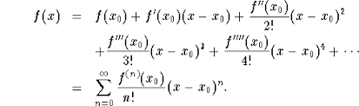
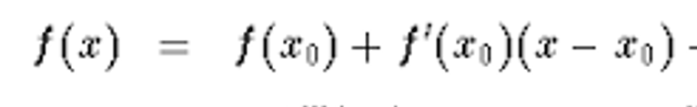

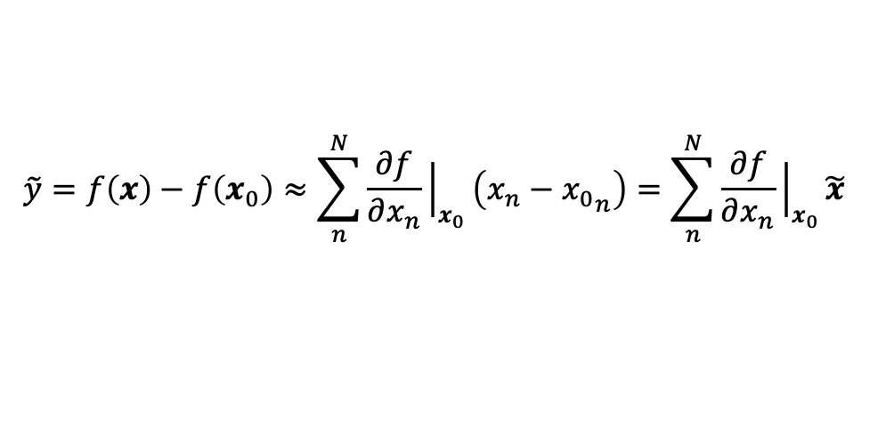


First Order Taylor Series Approximation
Given an operating point $x_{0}$for an analytic function, then
We can approximate the function by:
$$≈$$
If $x$ is a vector with N elements and we have the operating point $x_{0}$, then
$$\tilde{y}=f\left(x\right)−f\left(x_{0}\right)≈\sum_{n}^{N}{\frac{∂f}{∂x_{n}}{\left.​\right|}_{x_{0}}\left(x_{n}−{x_{0}}_{n}\right)=\sum_{n}^{N}{\frac{∂f}{∂x_{n}}{\left.​\right|}_{x_{0}}\tilde{x}}}$$
Nominal values
$$\tilde{x}=x−x_{0}$$
$$\tilde{y}=f(x)−{f(x}_{0})$$

Slide 10



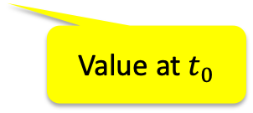

Linearization
System Equations
$$\dot{S_{1}}=$$
$$−k_{1}S_{1}−k_{2}S_{1}S_{2}−{2k}_{4}S_{1}S_{3}$$
$$\dot{S_{2}}=$$
$$k_{1}S_{1}−k_{2}S_{1}S_{2}−k_{4}S_{1}S_{3}$$
$$\dot{S_{3}}=$$
$$3k_{2}S_{1}S_{2}−k_{3}S_{3}−k_{4}S_{1}S_{3}$$
Linearization of $\dot{S_{1}}$ for operating points at time $t_{0}=1$
$$\tilde{{\dot{S}}_{1}}=−k_{1}{\tilde{S}}_{1}−k_{2}S_{2}(t_{0}){\tilde{S}}_{1}−k_{2}S_{1}(t_{0}) {\tilde{S}}_{2}−{{2k}_{4}S_{3}(t_{0}){\tilde{S}}_{1}−{2k}_{4}S_{3}(t_{0}) {\tilde{S}}_{1}}_{}$$
Value at $t_{0}$
$${\tilde{{\dot{S}}_{1}}=\dot{S}}_{1}\left(t\right)−{\dot{S}}_{1}\left(t_{0}\right)$$
$$\tilde{S_{1}}=S_{1}\left(t\right)−S_{1}\left(t_{0}\right)$$
$$\tilde{S_{2}}=S_{2}\left(t\right)−S_{2}\left(t_{0}\right)$$
$$\tilde{S_{3}}=S_{3}\left(t\right)−S_{3}\left(t_{0}\right)$$

Slide 11
Operating Point

Slide 12
BACKUP

