Slide 1
BIOE 498 / BIOE 599
Advanced Biological Control Systems
Linear Time Invariant Systems
Joseph L. Hellerstein
eScience Institute, Computer Science & Engineering
Allen School of Computer Science
BioEngineering
Notes:
Diverse students. Some with bio-backgrounds; some without. Some with CS background; some with very limited. Two separate courses combined because of a substantial shared curriculum.

Slide 2
Agenda
Why model?
Laplace transform, stability, oscillations
Transfer functions and DC gain
Calculating DC gain.

Slide 3
Why Model?
Most control properties are dynamic: stability, oscillations, settling times.
We need a way to easily assess these properties and to manipulate signals and systems (which are dynamical objects).

Slide 4
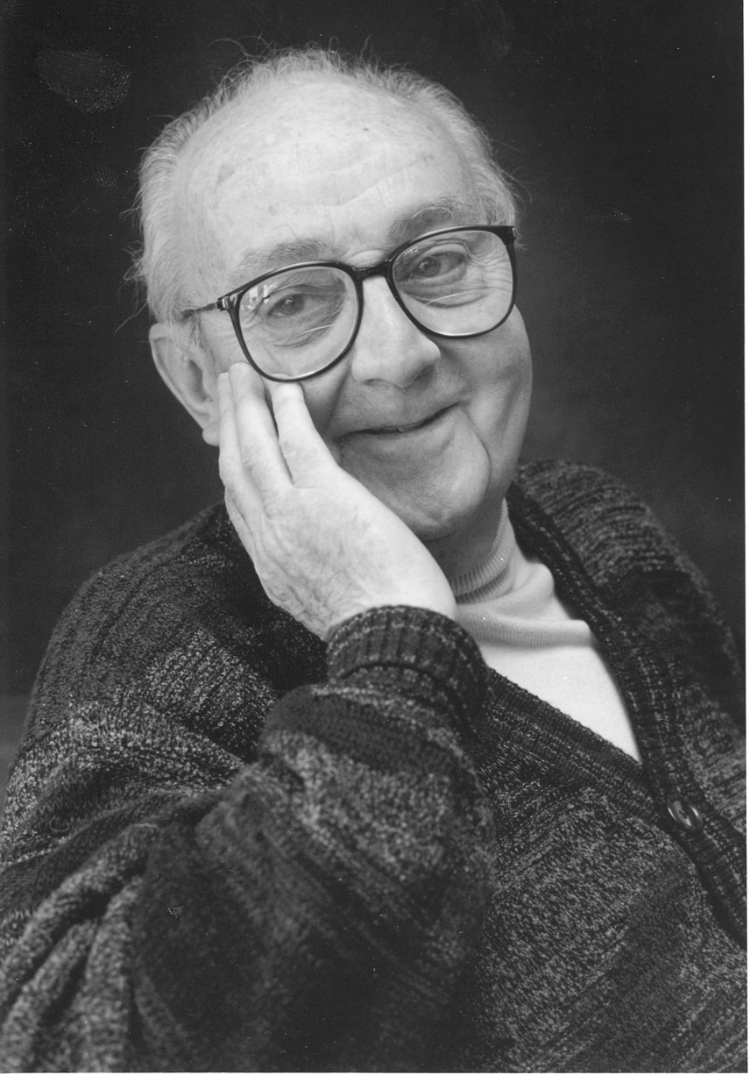
G.P.E. Box (Famous Statistician)
All models are wrong.
But some models are useful.

Slide 5


Modeling signals & systems is about dynamics.
$$u$$
$$y$$
System
We want a mathematical representation of the relationship between the input signal (u) and the output signal (y).
Properties of interest
  Stability
  DC Gain (”final” value of y for a unit step of u)
  Setting times
  Oscillations
Interpreting the mathematical representation
  Interpret it as a “low order” chemical network

Slide 6
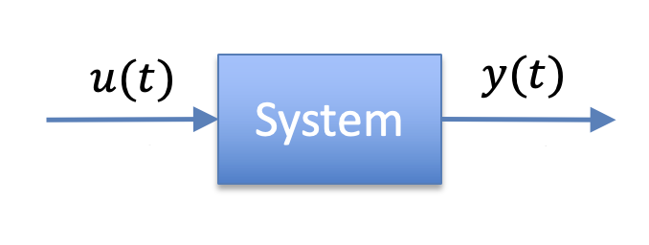
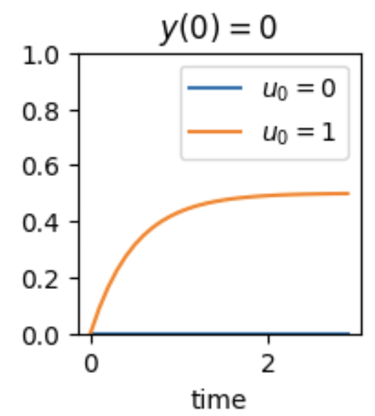
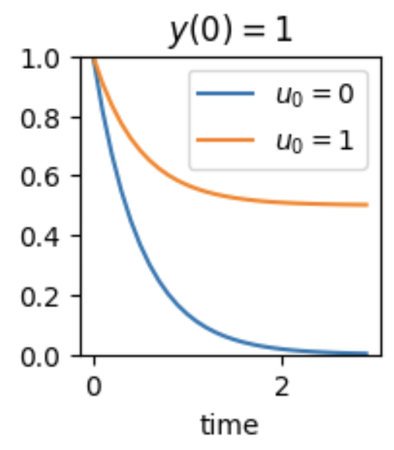
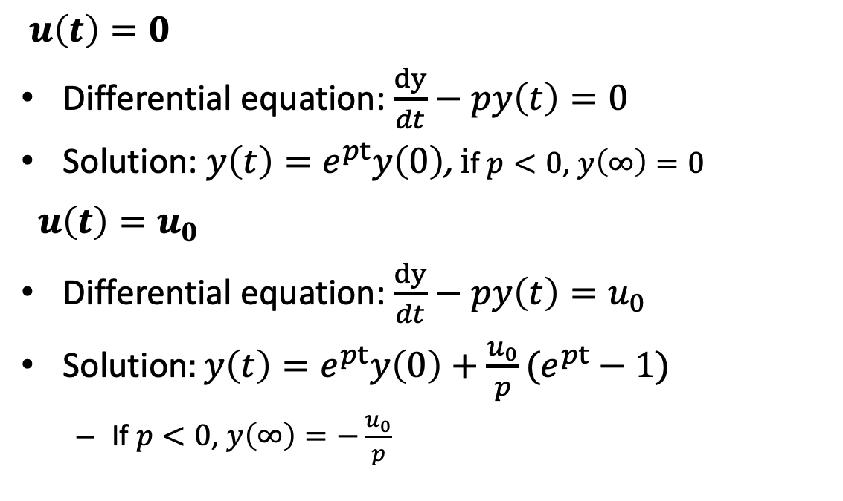

First Order Linear Time Invariant (LTI) System
$u\left(t\right)=0$
Differential equation: $\frac{dy}{dt}−py\left(t\right)=0$
Solution: ${y\left(t\right)=e}^{pt}y\left(0\right)\text{, }\text{i}\text{f} p<0\text{, }y\left(∞\right)=0$
$u\left(t\right)=u_{0}$
Differential equation: $\frac{dy}{dt}−py\left(t\right)=u_{0}$
Solution$:y\left(t\right)=e^{pt}y\left(0\right)+\frac{u_{0}}{p}(e^{pt}−1)$
  If $p<0$, $y\left(∞\right)=−\frac{u_{0}}{p}$
$$p=−1$$

Slide 7
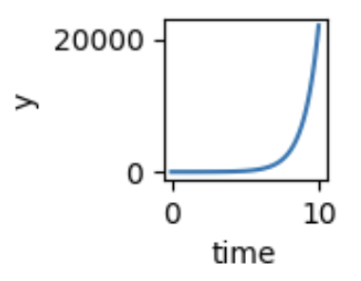
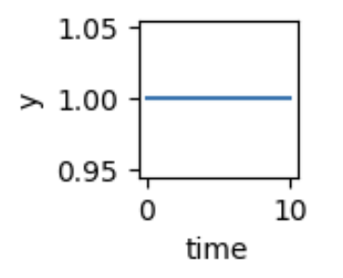
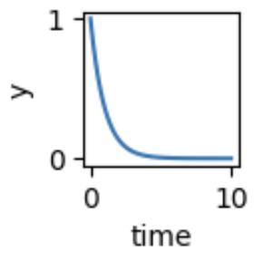


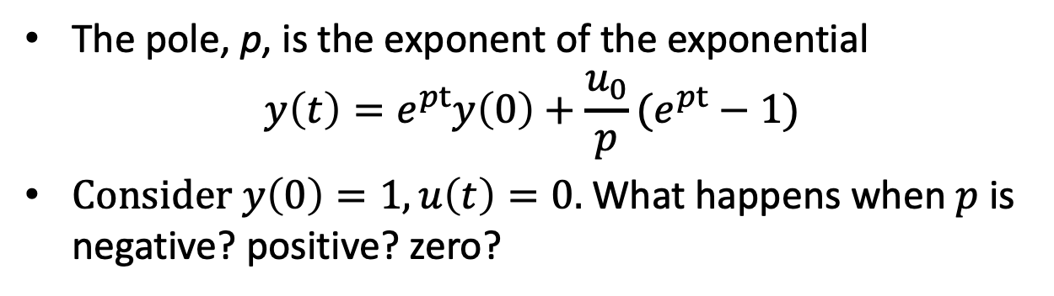

Pole
The pole, p, is the exponent of the exponential
$$y\left(t\right)=e^{pt}y\left(0\right)+\frac{u_{0}}{p}(e^{pt}−1)$$
Consider $y\left(0\right)=1, u\left(t\right)=0.$What happens when $p$ is negative? positive? zero?
$$p>0$$
$$p<0$$
$$p=0$$

Slide 8
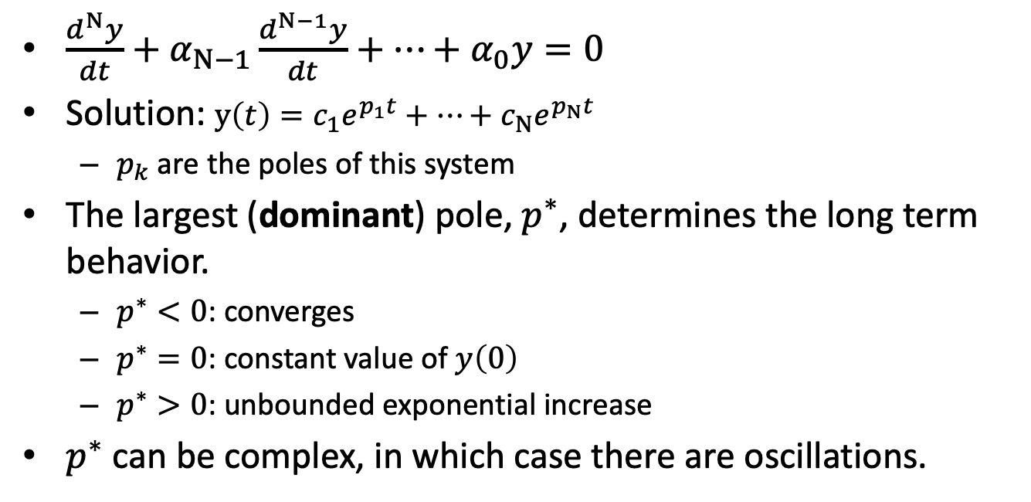
Systems of Differential Equations
$\frac{d^{N}y}{dt}+α_{N−1}\frac{d^{N−1}y}{dt}+⋯+α_{0}y=0$
Solution: $y\left(t\right)=c_{1}e^{p_{1}t}+⋯+c_{N}e^{p_{N}t}$
  $p_{k}$ are the poles of this system
The largest (dominant) pole, $p^{∗}$, determines the long term behavior.
  $p^{∗}<0$: converges
  $p^{∗}=0$: constant value of $y\left(0\right)$
  $p^{∗}>0$: unbounded exponential increase
$p^{∗}$ can be complex, in which case there are oscillations.

Slide 9
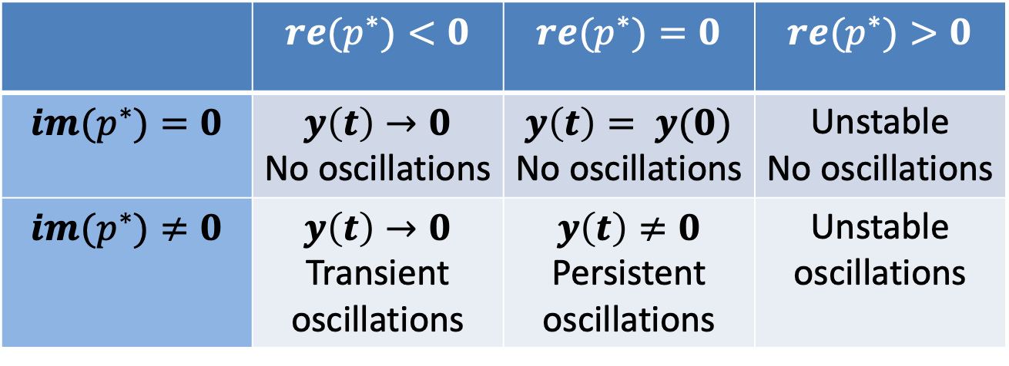
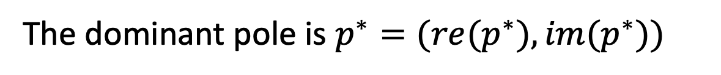


Summary
$$y\left(t\right)=c_{1}e^{p_{1}t}+⋯+c_{N}e^{p_{N}t}$$
The dominant pole is $p^{∗}=(re(p^{∗}), im(p^{∗}))$
$$Re(p^{∗})=max_{n}{Re∗(p}_{n})$$
 | $$re(p^{∗})<0$$ | $$re(p^{∗})=0$$ | $$re(p^{∗})>0$$
$$im(p^{∗})=0$$ | $$y\left(t\right)→0$$ No oscillations | $$y\left(t\right)= y(0)$$ No oscillations | Unstable No oscillations
$$im(p^{∗})≠0$$ | $$y\left(t\right)→0$$ Transient oscillations | $$y\left(t\right)≠0$$ Persistent oscillations | Unstable oscillations
Signals with more negative poles have shorter settling times.

Slide 10
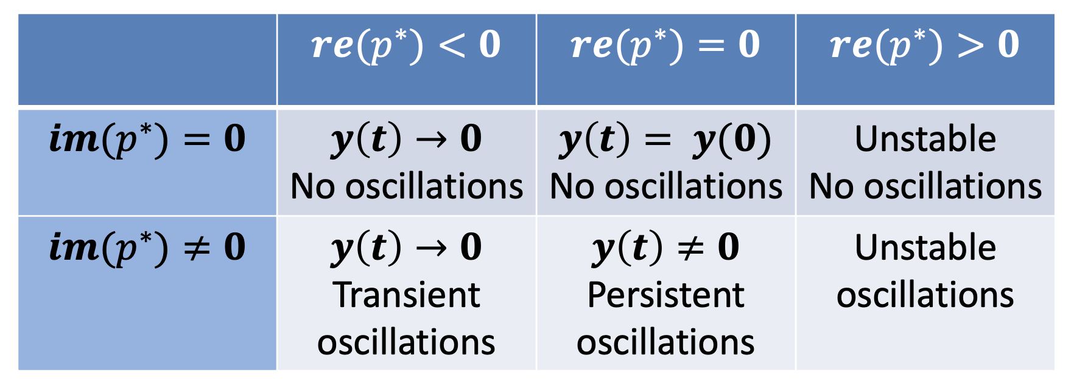
Summary
$$y\left(t\right)=c_{1}e^{p_{1}t}+⋯+c_{N}e^{p_{N}t}$$
The dominant pole is $p^{∗}=(re(p^{∗}), im(p^{∗}))$
$$Re(p^{∗})=max_{n}{Re∗(p}_{n})$$
Signals with more negative poles have shorter settling times.

Slide 11
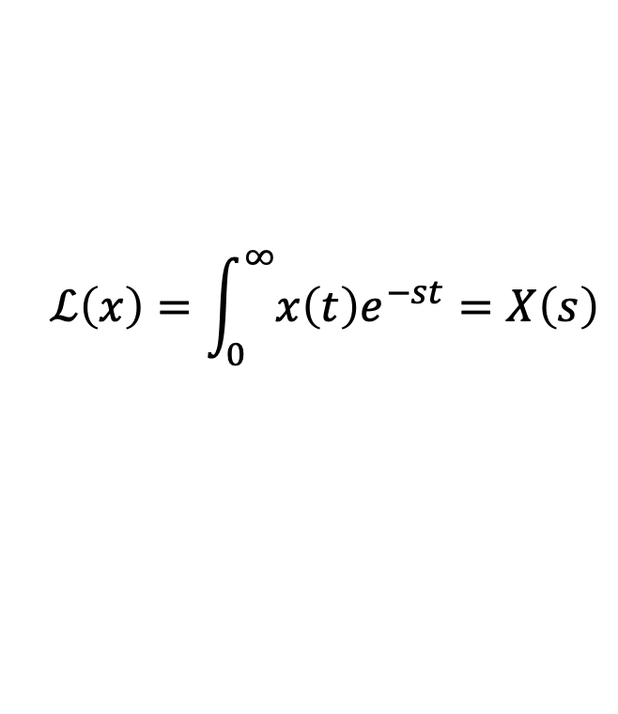
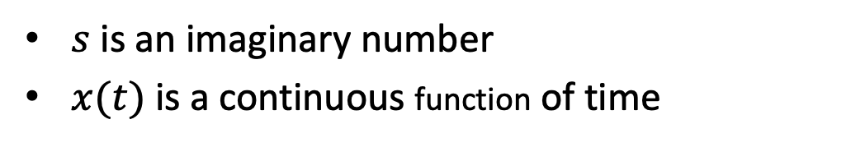
Laplace Transform (LT)
$$ℒ\left(x\right)=\int_{0}^{∞}{x\left(t\right)e^{−st}}=X\left(s\right)$$
$s$ is an imaginary number
$x(t)$ is a continuous function of time
LTs are easy to calculate for a system of linear differential equations.
LTs provide a concise description of dynamic behavior
Poles are easy to find.
Steady state (if it exists) is easy to calculate.

Slide 12
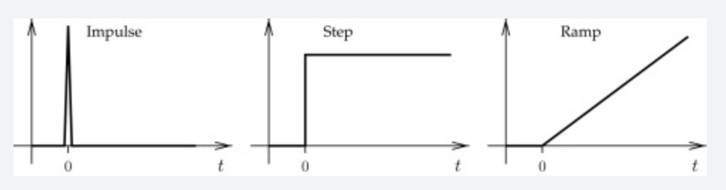
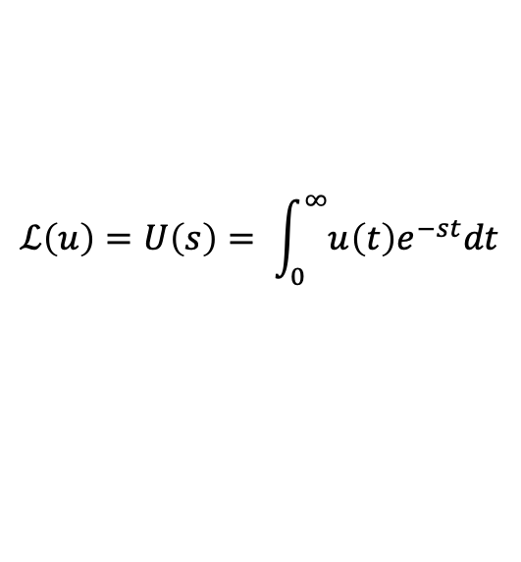
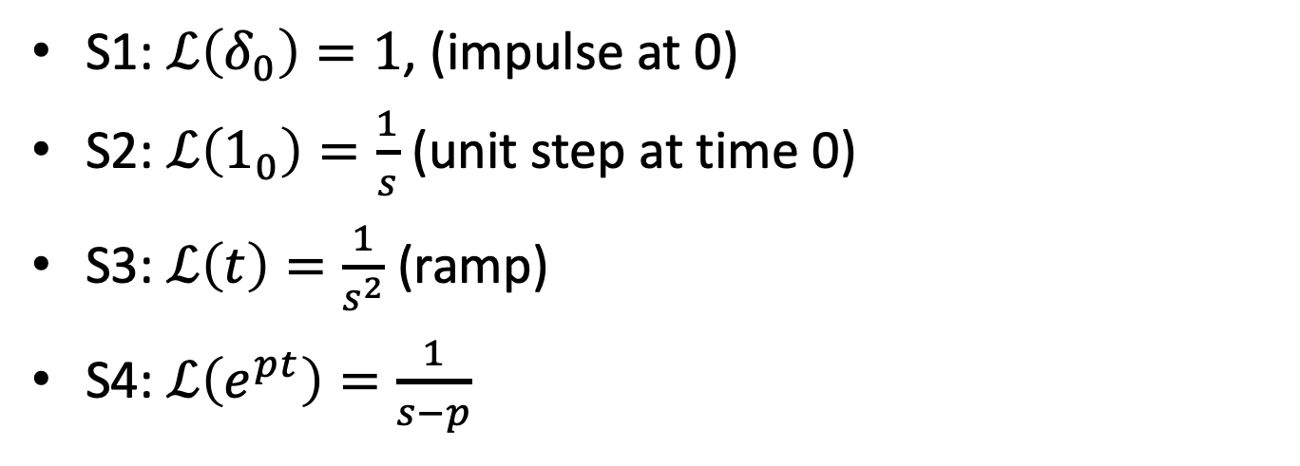


Laplace Transforms of Basic Signals
$$u$$
$$y$$
$$ℒ\left(u\right)=U\left(s\right)= \int_{0}^{∞}{u\left(t\right)e^{−st}dt}$$
S1: $ℒ\left(δ_{0}\right)=1$, (impulse at 0)
S2: $ℒ\left(1_{0}\right)=\frac{1}{s}$ (unit step at time 0)
S3: $ℒ\left(t\right)=\frac{1}{s^{2}}$ (ramp)
S4: $ℒ\left(e^{pt}\right)=\frac{1}{s−p}$

Slide 13
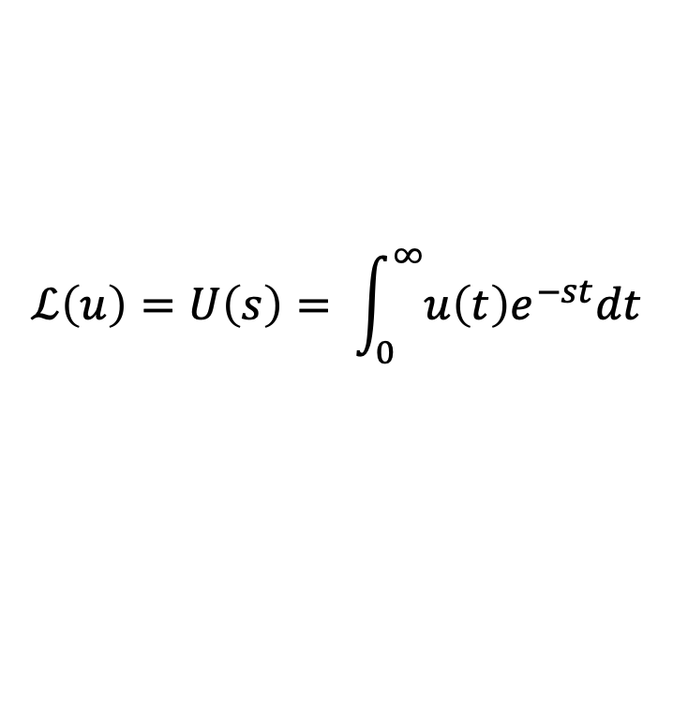
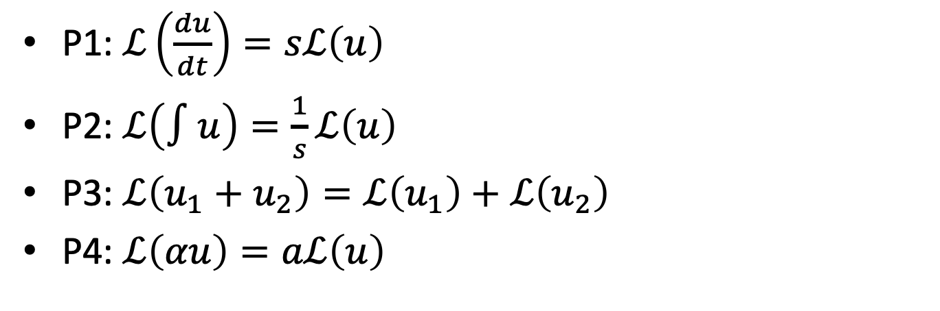
Laplace Transforms Properties
$$u$$
$$y$$
$$ℒ\left(u\right)=U\left(s\right)= \int_{0}^{∞}{u\left(t\right)e^{−st}dt}$$
P1: $ℒ\left(\frac{du}{dt}\right)=sℒ\left(u\right)$
P2: $ℒ\left(∫u\right)=\frac{1}{s}ℒ\left(u\right)$
P3: $ℒ\left(u_{1}+u_{2}\right)=ℒ\left(u_{1}\right)+ℒ\left(u_{2}\right)$
P4: $ℒ\left(αu\right)=aℒ\left(u\right)$

Slide 14
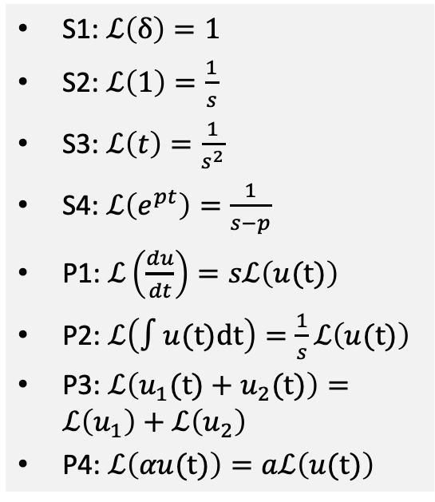
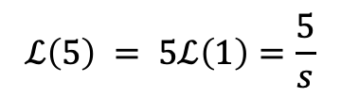

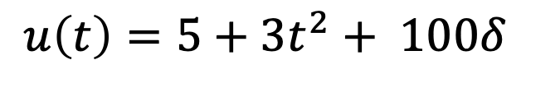

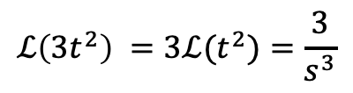
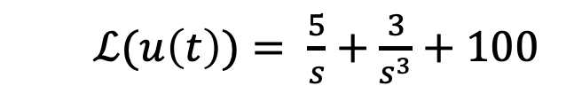
Find The Laplace Transform
$u\left(t\right)=5+3t^{2}+ 100δ$
S1: $ℒ\left(δ\right)=1$
S2: $ℒ\left(1\right)=\frac{1}{s}$
S3: $ℒ\left(t\right)=\frac{1}{s^{2}}$
S4: $ℒ\left(e^{pt}\right)=\frac{1}{s−p}$
P1: $ℒ\left(\frac{du}{dt}\right)=sℒ\left(u(t)\right)$
P2: $ℒ\left(∫u(t)dt\right)=\frac{1}{s}ℒ\left(u(t)\right)$
P3: $ℒ\left(u_{1}(t)+u_{2}(t)\right)=ℒ\left(u_{1}\right)+ℒ\left(u_{2}\right)$
P4: $ℒ\left(αu(t)\right)=aℒ\left(u(t)\right)$
$$ℒ(u\left(t\right))=ℒ(5)+ℒ(3t^{2})+ℒ(100δ)$$
$$ℒ\left(5\right) = 5ℒ\left(1\right)=\frac{5}{s}$$
$$ℒ\left(3t^{2}\right) =3ℒ(t^{2})=\frac{3}{s^{3}}$$
$ℒ\left(100δ\right)=100ℒ\left(δ\right)=100$
  $ℒ(u\left(t\right))= \frac{5}{s}+\frac{3}{s^{3}}+100$

Slide 15
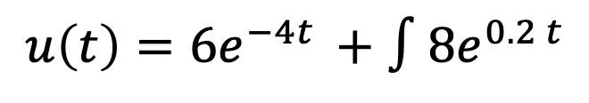
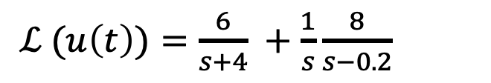
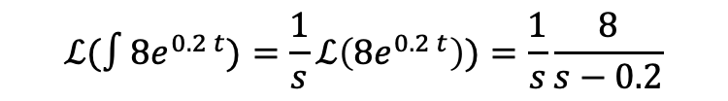
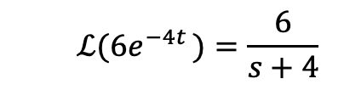
Find The Laplace Transform
$u\left(t\right)={6e}^{−4t }+∫8e^{0.2 t}$
S1: $ℒ\left(δ\right)=1$
S2: $ℒ\left(1\right)=\frac{1}{s}$
S3: $ℒ\left(t\right)=\frac{1}{s^{2}}$
S4: $ℒ\left(e^{pt}\right)=\frac{1}{s−p}$
P1: $ℒ\left(\frac{du}{dt}\right)=sℒ\left(u(t)\right)$
P2: $ℒ\left(∫u(t)dt\right)=\frac{1}{s}ℒ\left(u(t)\right)$
P3: $ℒ\left(u_{1}(t)+u_{2}(t)\right)=ℒ\left(u_{1}\right)+ℒ\left(u_{2}\right)$
P4: $ℒ\left(αu(t)\right)=aℒ\left(u(t)\right)$
  $$ℒ({6e}^{−4t })=\frac{6}{s+4}$$
$$ℒ(∫8e^{0.2 t})=\frac{1}{s}ℒ\left(8e^{0.2 t}\right))=\frac{1}{s}\frac{8}{s−0.2}$$
$ℒ (u\left(t\right))=\frac{6}{s+4} +\frac{1}{s}\frac{8}{s−0.2}$

Slide 16

Poles & Laplace Transforms
“$p$ is a pole of $u(t)$” is equivalent to “$p$ is a root for $s$ in the denominator of $ℒ(u(t))$”.
Examples
  $$u\left(t\right)=e^{pt}≡Y\left(s\right)=\frac{1}{s−p}$$

Slide 17

What are the poles? What are the signals?
$\frac{5}{s}+100$
poles at 0. Step + impulse.
$\frac{6}{s+4}+\frac{8}{s(s−0.2)}$
poles at -4, 0, 0.2. unstable.
S1: $ℒ\left(δ\right)=1$
S2: $ℒ\left(1\right)=\frac{1}{s}$
S3: $ℒ\left(t\right)=\frac{1}{s^{2}}$
S4: $ℒ\left(e^{pt}\right)=\frac{1}{s−p}$
P1: $ℒ\left(\frac{du}{dt}\right)=sℒ\left(u(t)\right)$
P2: $ℒ\left(∫u(t)dt\right)=\frac{1}{s}ℒ\left(u(t)\right)$
P3: $ℒ\left(u_{1}(t)+u_{2}(t)\right)=ℒ\left(u_{1}\right)+ℒ\left(u_{2}\right)$
P4: $ℒ\left(αu(t)\right)=aℒ\left(u(t)\right)$

Slide 18

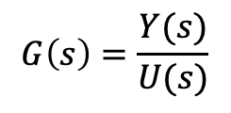


Systems & Transfer Functions
$$U(s)$$
$$Y(s)$$
$$G\left(s\right)$$
Transfer functions describe systems. A system converts the input signal to the output signal.
A transfer function is the ratio of the Laplace transform of the output to the Laplace transform of the input.
$$G\left(s\right)=\frac{Y(s)}{U(s)}$$
A transfer function is a Laplace transform and so has all of its properties.
If the Transfer function is the ratio of two polynomials in s
The roots of the numerator are its zeros
The roots of the denominator are its poles

Slide 19

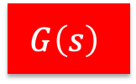






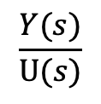



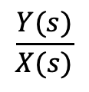


Transfer functions can be composed.
$$U(s)$$
$$G\left(s\right)$$
$$Y(s)$$
$$U(s)$$
$$X(s)$$
$Y(s$)
$$G_{1}(s)$$
$$G_{2}(s)$$
$$G\left(s\right)$$
$$G_{1}\left(s\right)=\frac{X(s)}{U(s)}$$
$$\frac{Y(s)}{X(s)}$$
$$\frac{Y(s)}{U(s)}$$
$$G_{2}\left(s\right)=$$
$$G\left(s\right)=$$
$$G\left(s\right)=G_{1}\left(s\right)G_{2}(s)$$

Slide 20
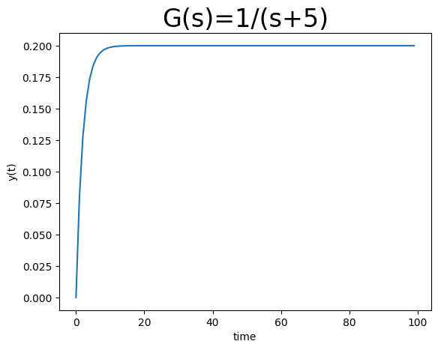
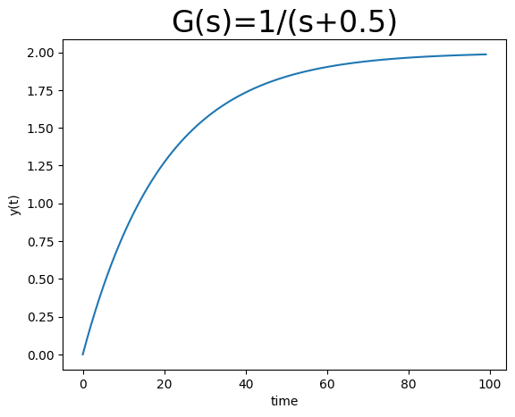
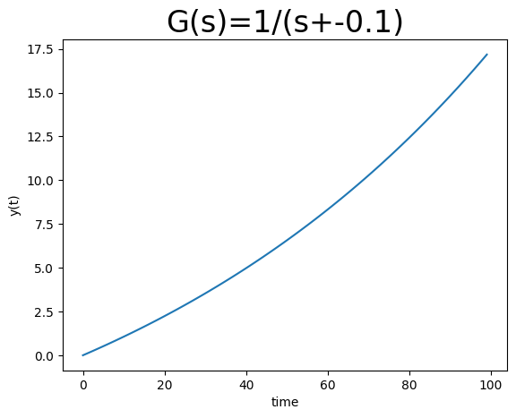


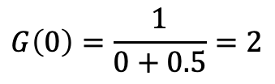

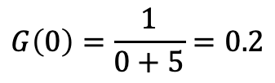
Steady State Step Response (DC Gain)
$$U(s)$$
$$G\left(s\right)$$
$$Y(s)$$
Steady state step response is $G\left(0\right)$ if $G\left(s\right)$ is stable.
X
$$G\left(0\right)=\frac{1}{0+0.5}=2$$
$$G\left(0\right)=\frac{1}{0+5}=0.2$$
unstable

Slide 21
What You Need to Know
Relate poles in transfer functions to stability, oscillations, settling times.
Calculate DC gain from transfer functions.

