Slide 1
BIOE 498 / BIOE 599 Advanced Biological Control Systems Lecture 6: Building Closed Loop Testbeds
Joseph L. Hellerstein
eScience Institute, Computer Science & Engineering
Allen School of Computer Science
BioEngineering
Notes:
Diverse students. Some with bio-backgrounds; some without. Some with CS background; some with very limited. Two separate courses combined because of a substantial shared curriculum.

Slide 2







Control Architecture
$$r(t)$$
$$e(t)$$
$$u(t)$$
$$y(t)$$
Controller
$$OLS$$
+
$$−$$
Signals
$r(t)$: reference input
$e(t)$: control error
y$(t)$: measured output
Systems
Open loop system (OLS)
Controller
Notes:
Why doesn’t a filter help with measurement noise? Verify transfer functions.

Slide 3
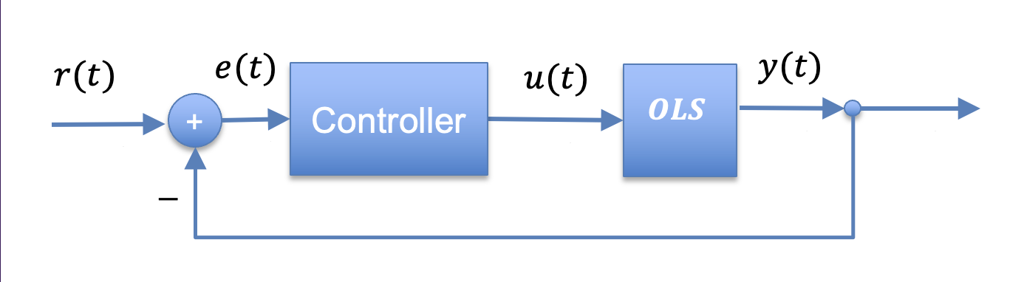


Open Loop System
$$u(t)$$
$$y(t)$$
$$OLS$$
Suppose we have an SBML model LINEAR_MDL.
import controlSBML as ctl
ctlsb = ctl.ControlSBML(LINEAR_MDL,
input_names=["S1"], output_names=["S1", "S2", "S3", "S4"])
linear_sys = ctlsb.makeNonlinearIOSystem("linear_sys")
This creates a NonlinearIOSystem object linear_sys.
linear_sys.S1
linear_sys.S2
linear_sys.S3
linear_sys.S4
linear_sys.S1
linear_sys

Slide 4







PI Controller
$$r(t)$$
$$e(t)$$
Controller
y$(t)$
u$(t)$
+
$$Controller$$
$$−$$
Combine e(t) calculation, constant r(t)
y$(t)$
controller = control.NonlinearIOSystem(
updfcn, # Updates state
outfcn, # Calculates the output
states=1, # States are unnamed and so must give a count
inputs=['in'],
outputs=['out'], name='controller')
This creates a NonlinearIOSystem object controller.
controller.in
controller
controller.out

Slide 5
Interconnect Connections for NonlinearIOSystem Objects
controller.in
controller
controller.out
linear_sys.S1
linear_sys.S2
linear_sys.S3
linear_sys.S1
linear_sys
linear_sys.S4
OUTLIST = ["linear_sys.S1", "linear_sys.S4", "controller.out"]
simple_closed = control.interconnect(
[linear_sys, controller], # systems
connections=[
['linear_sys.S1', 'controller.out'],
['controller.in', 'linear_sys.S4'],
],
inplist=["controller.in"],
outlist=OUTLIST,
)

Slide 6
Wolf Closed Loop System
at
s5
S5_SETPOINT
controller
wolf_sys
Notes:
Why doesn’t a filter help with measurement noise? Verify transfer functions.

Slide 7


Wolf Closed Loop System
at
s5
S5_SETPOINT
controller
wolf_sys
+
$$−$$
S5_SETPOINT
setpoint
differ_sys
+
out
measurement
$$−$$
Notes:
Why doesn’t a filter help with measurement noise? Verify transfer functions.

Slide 8












Homework 1
(a) CLS 1
$$r(t)$$
$$e(t)$$
$$u(t)$$
$$y(t)$$
Controller
$$OLS$$
+
$$−$$
(b) CLS 2
$$r(t)$$
$$e(t)$$
$$u(t)$$
$$u′(t)$$
$$y(t)$$
Controller
Flakifier
$$OLS$$
+
$$−$$
Notes:
Why doesn’t a filter help with measurement noise? Verify transfer functions.

Slide 9



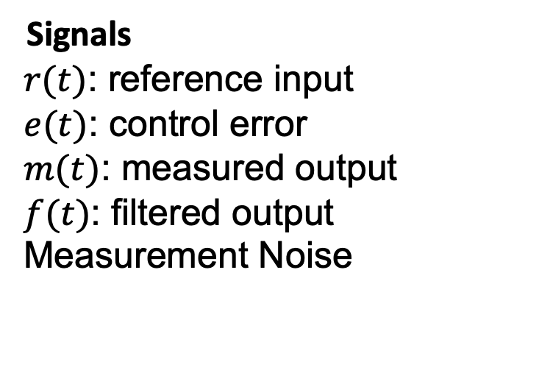






Adding Noise and Filters
Measurement
Noise
$$r(t)$$
$$e(t)$$
$$u(t)$$
$$y(t)$$
m$(t)$
Controller
$$OLS$$
+
+
m$(t)$
$$−$$
f$(t)$
$$Filter$$
Signals
$r(t)$: reference input
$e(t)$: control error
$m(t)$: measured output
$f(t)$: filtered output
Measurement Noise
Systems
Open loop system (OLS)
Controller
Filter
Notes:
Why doesn’t a filter help with measurement noise? Verify transfer functions.

