Slide 1

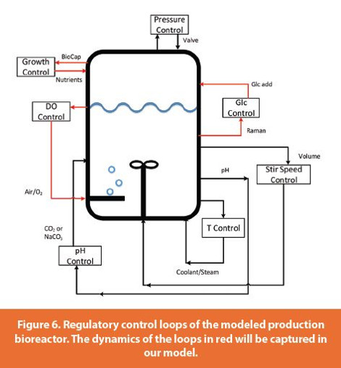
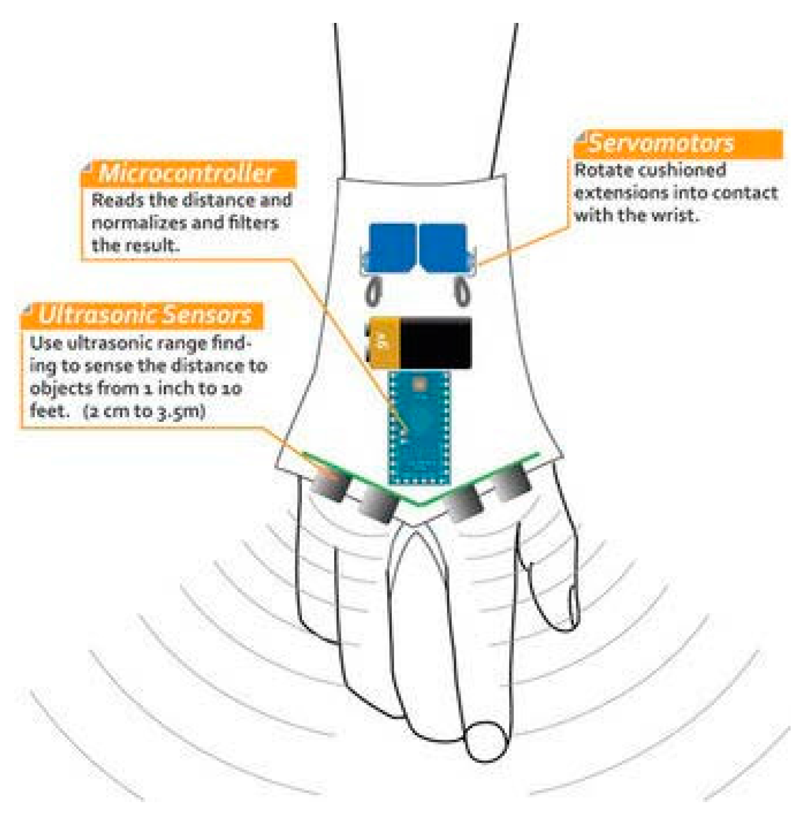
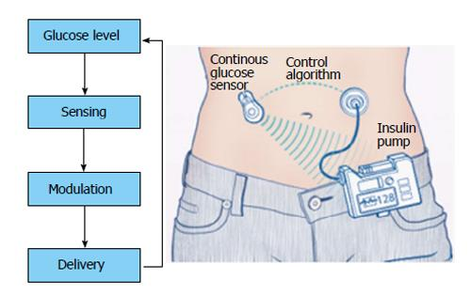



BIOEN 498/599: Biomedical Control Systems Engineering
A practical approach to creating robust biological components.
Winter, 2025. MW 2:30-3:50.
Instructor: Joseph L. Hellerstein, Senior Fellow (eScience Institute), Affiliate Professor (Allen School of Computer Science)
jlheller@uw.edu
Bioreactor Control
Medical Device Control
Insulin Control
Closed loop design (control engineering) is essential to building robust systems from biochemical pathways and other open loop biological components that: regulate outputs to a setpoint; ensure stability; and minimize oscillations. This course teaches the essentials of closed loop design using mechanistic models of biochemical systems. Students will acquire the following skills:
determine appropriate control objectives for a closed loop system;
characterize the time domain behavior of a biological system;
develop closed loop architectures that make use of PID controllers, filters, and techniques for compensating biochemical systems;
computational techniques for finding designs that satisfy control objectives.
Students should have prior experience with programming in python (e.g., BIOEN 336, 437/537).

