Slide 1
BIOE 498 / BIOE 599 Advanced Biological Control Systems Linear Time Invariant Systems
Joseph L. Hellerstein
eScience Institute, Computer Science & Engineering
Allen School of Computer Science
BioEngineering
Notes:
Diverse students. Some with bio-backgrounds; some without. Some with CS background; some with very limited. Two separate courses combined because of a substantial shared curriculum.

Slide 2
Agenda
Why models?
Discrete time analysis
Laplace transforms
Definition, calculation, poles
Solving high order approximations
Poles determine stability and oscillations.
Definition of transfer function.
Calculating DC gain.

Slide 3
The Problem
Most control properties are dynamic: stability, oscillations, settling times.
We need a way to easily assess these properties and to manipulate signals and systems (which are dynamical objects).

Slide 4
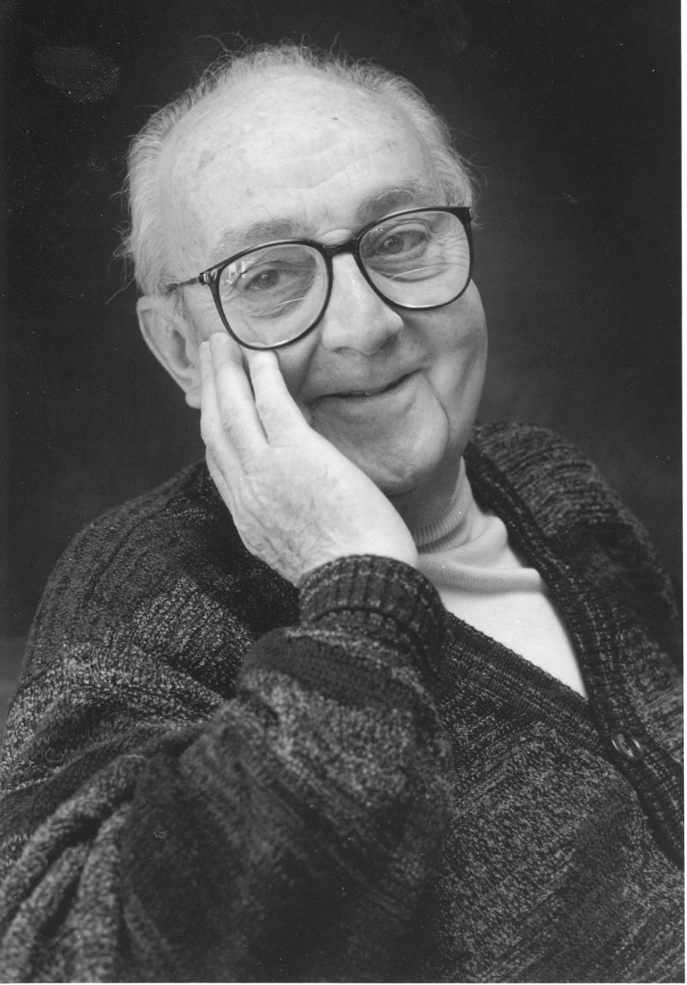
G.P.E. Box (Famous Statistician)
All models are wrong.
But some models are useful.

Slide 5


Modeling Signals & Systems
$$u$$
$$y$$
System
We want a mathematical representation of the relationship between the input signal (u) and the output signal (y).
Properties of interest
Stability
Setting times
DC Gain (”final” value of y for a unit step of u)
Oscillations

Slide 6
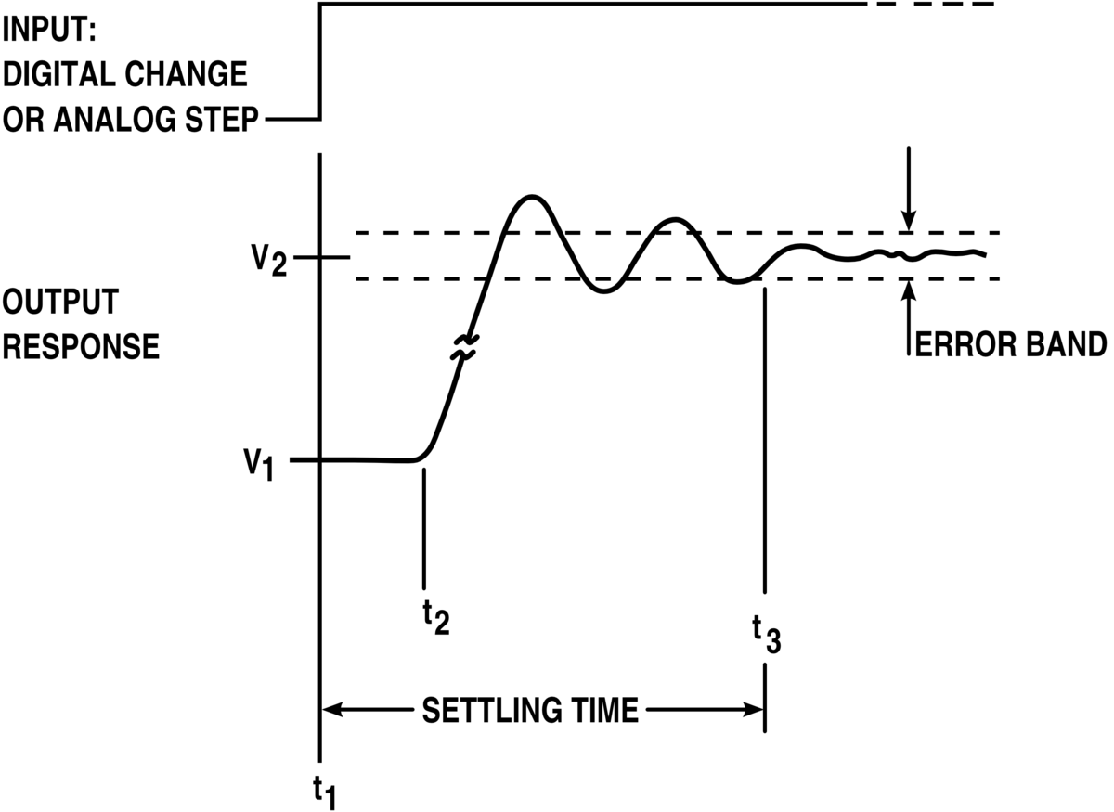
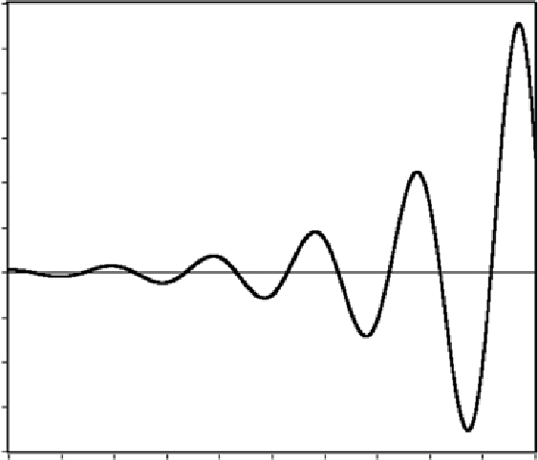
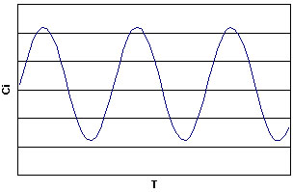

Some System Response
$$u$$
$$y$$
System

Slide 7
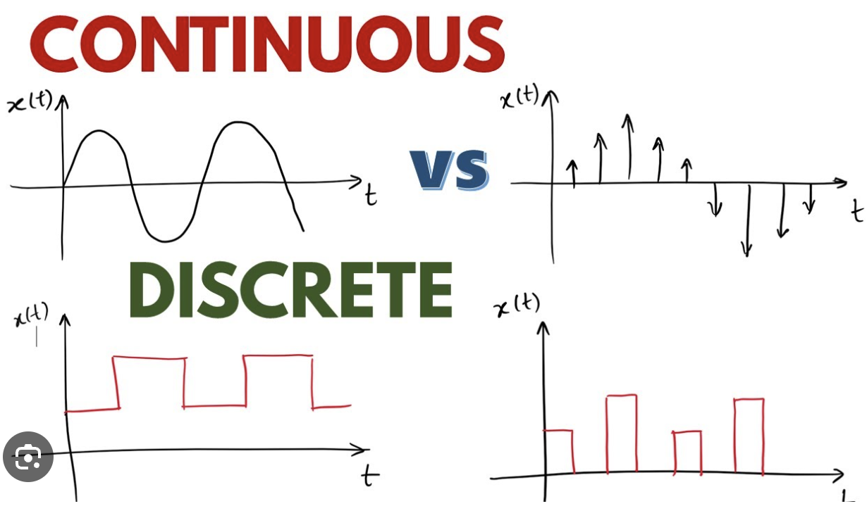




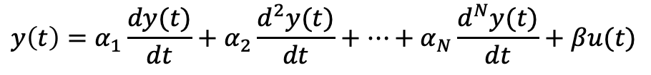

What Models?
$$y(t)$$
$$t$$
We will work with continuous time.
$$y(k)$$
$$k$$
Linear discrete time model (autoregressive time series)
$$y\left(k\right)=a_{1}y\left(k−1\right)+a_{2}y\left(k−2\right)+…+a_{N}y\left(k−N\right)+bu(k)$$
$a_{n}, b$ are constants that do not change over time.
Linear continuous time model (differential equation)
$$y\left(t\right)=α_{1}\frac{dy(t)}{dt}+α_{2}\frac{d^{2}y(t)}{dt}+…+α_{N}\frac{d^{N}y(t)}{dt}+βu(t)$$
$α_{n} ,β$ are constants.

Slide 8
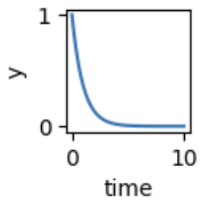
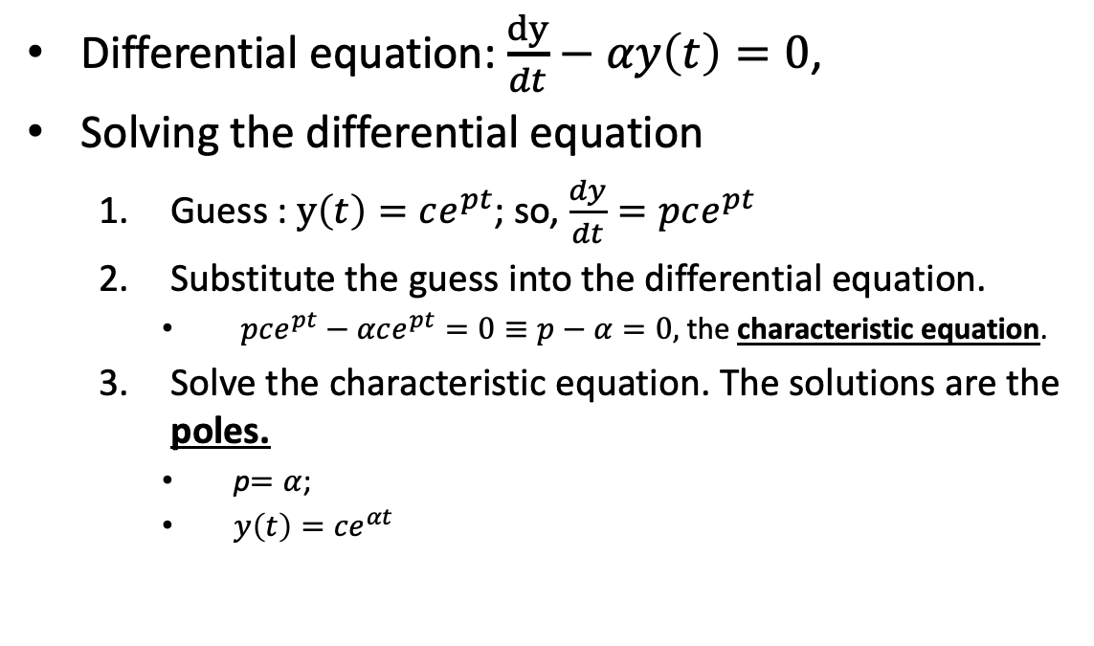
First Order Linear Time Invariant (LTI) System
Differential equation: $\frac{dy}{dt}−αy\left(t\right)=0$,
Solving the differential equation
Guess : $y\left(t\right)=ce^{pt}$; so, $\frac{dy}{dt}=pce^{pt}$
Substitute the guess into the differential equation.
$pce^{pt}−αce^{pt}=0≡p−α=0,$ the characteristic equation.
Solve the characteristic equation. The solutions are the poles.
p$=α$;
$y\left(t\right)={ce}^{αt}$
c is found using the initial conditions.

Slide 9
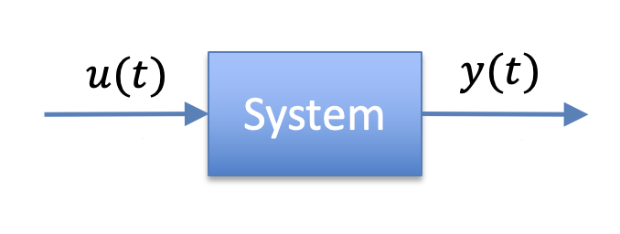
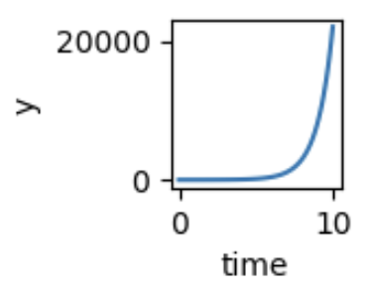
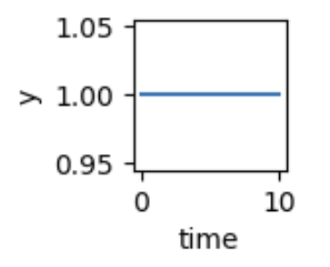


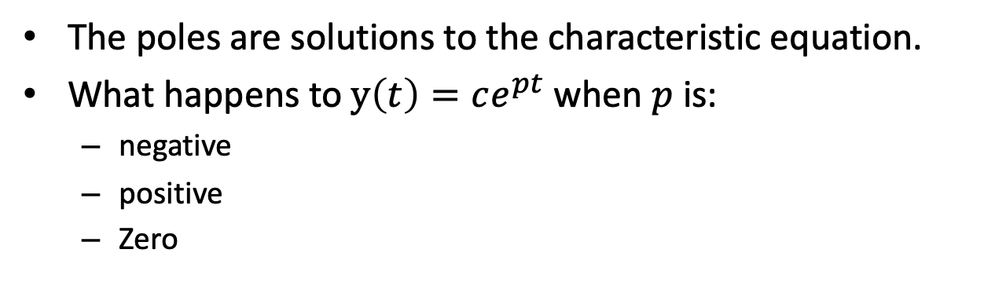

Poles
$\frac{dy}{dt}=pce^{pt}$, $p−α=0,$ the characteristic equation
The poles are solutions to the characteristic equation.
What happens to $y\left(t\right)=ce^{pt}$ when $p$ is:
negative
positive
Zero
$$α>0$$
$$α<0$$
$$α=0$$

Slide 10
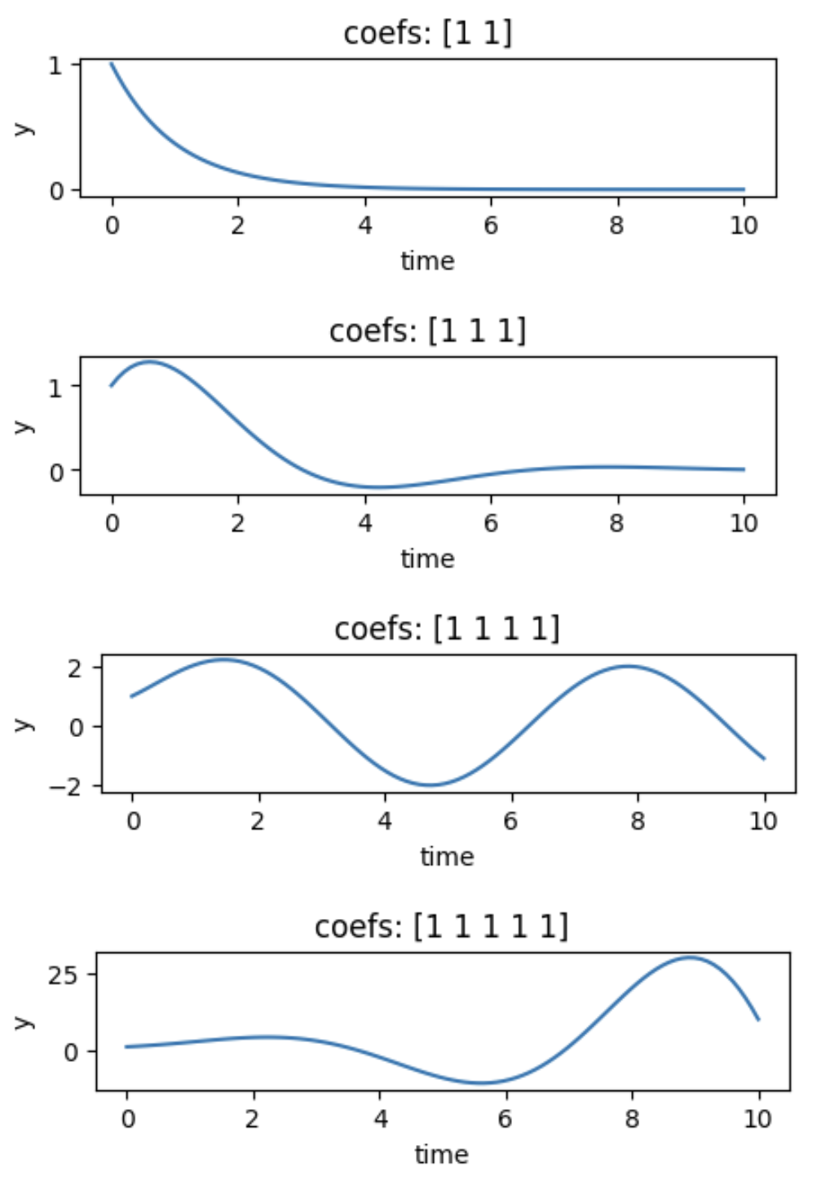
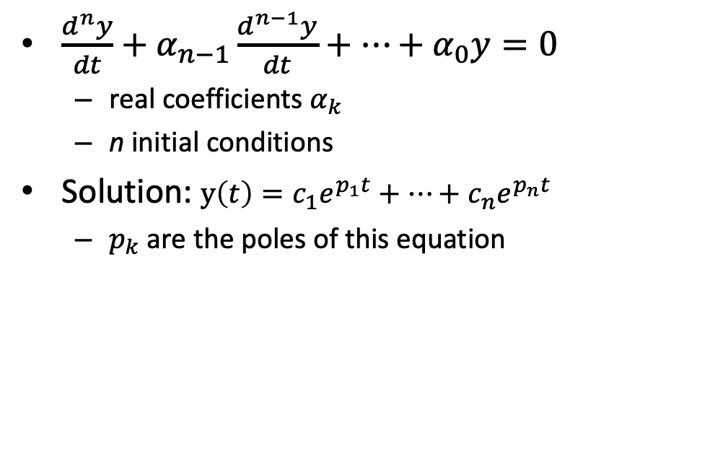

High Order Differential Equations
$\frac{d^{n}y}{dt}+α_{n−1}\frac{d^{n−1}y}{dt}+⋯+α_{0}y=0$
real coefficients $α_{k}$
n initial conditions
Solution: $y\left(t\right)=c_{1}e^{p_{1}t}+⋯+c_{n}e^{p_{n}t}$
$p_{k}$ are the poles of this equation
1st order
2nd order
3rd order
4th order
$$α_{k}=1$$

Slide 11
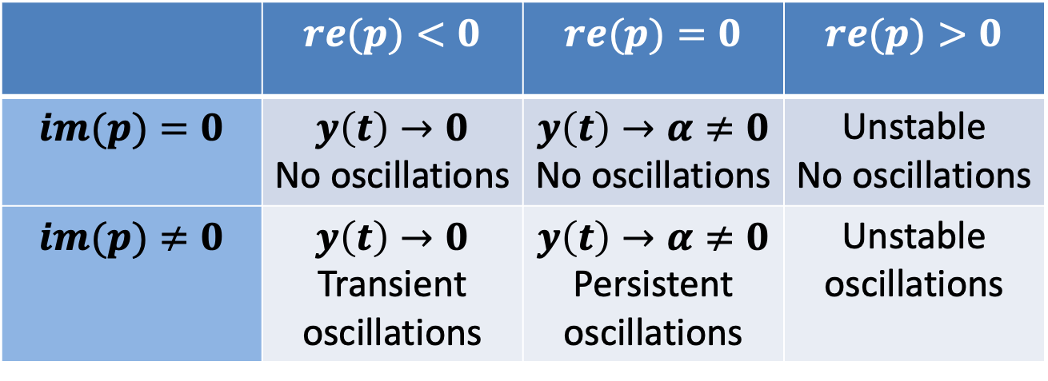
Poles Tell Us About Stability and Oscillations
Consider the (possibly complex) pole $p=(re\left(p\right), im\left(p\right))$
 | $$re(p)<0$$ | $$re(p)=0$$ | $$re(p)>0$$
$$im(p)=0$$ | $$y\left(t\right)→0$$ No oscillations | $$y\left(t\right)→α≠0$$ No oscillations | Unstable No oscillations
$$im(p)≠0$$ | $$y\left(t\right)→0$$ Transient oscillations | $$y\left(t\right)→α≠0$$ Persistent oscillations | Unstable oscillations

Slide 12
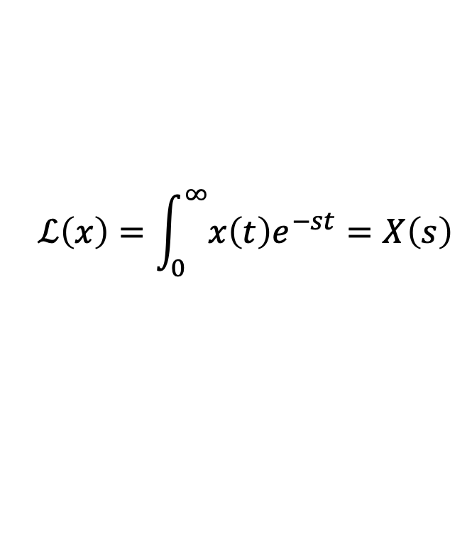

Laplace Transform
$$ℒ\left(x\right)=\int_{0}^{∞}{x\left(t\right)e^{−st}}=X\left(s\right)$$
$s$ is an imaginary number
$x(t)$ is a continuous function of time
Provides an easy way to key properties of systems

Slide 13
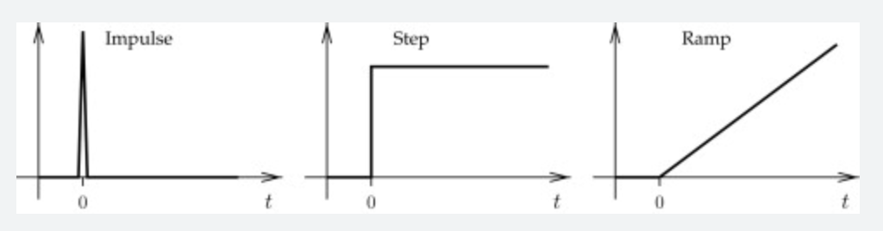





Basic Signals
$$u$$
$$y$$
$${u\left(t\right)=δ}_{0}(t)$$
$${u\left(t\right)= 1}_{0}(t)$$
$$u(t)=t$$

Slide 14
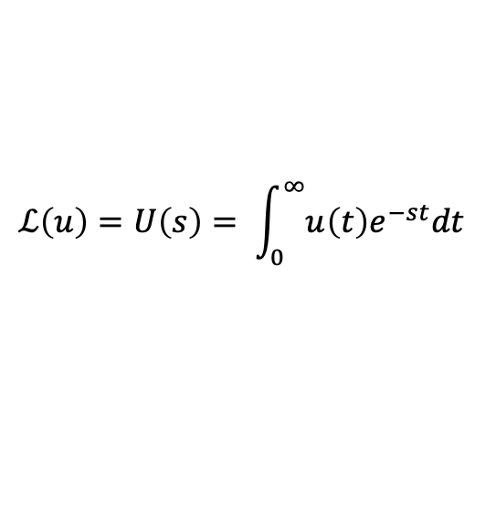
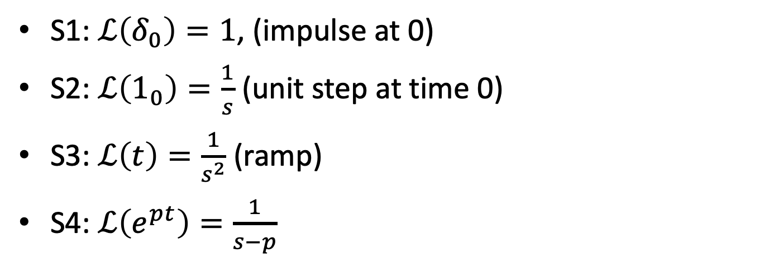
Laplace Transforms of Basic Signals
$$u$$
$$y$$
$$ℒ\left(u\right)=U\left(s\right)= \int_{0}^{∞}{u\left(t\right)e^{−st}dt}$$
S1: $ℒ\left(δ_{0}\right)=1$, (impulse at 0)
S2: $ℒ\left(1_{0}\right)=\frac{1}{s}$ (unit step at time 0)
S3: $ℒ\left(t\right)=\frac{1}{s^{2}}$ (ramp)
S4: $ℒ\left(e^{pt}\right)=\frac{1}{s−p}$

Slide 15
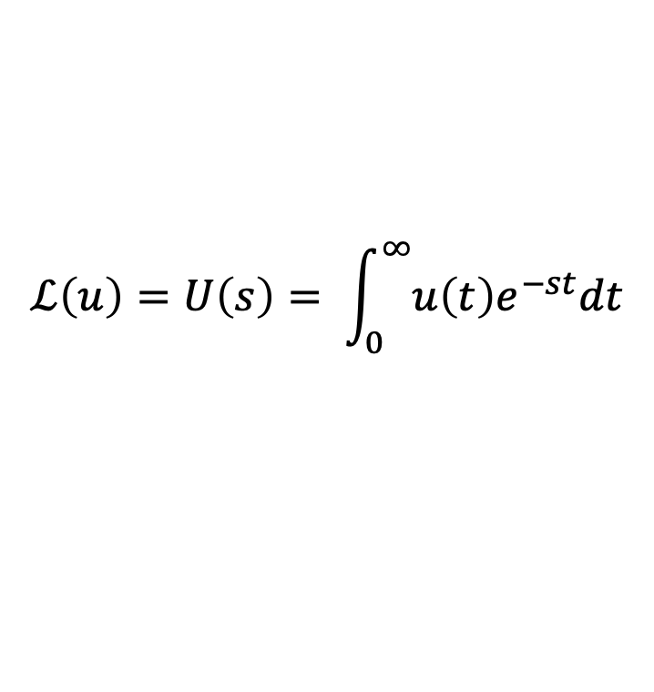
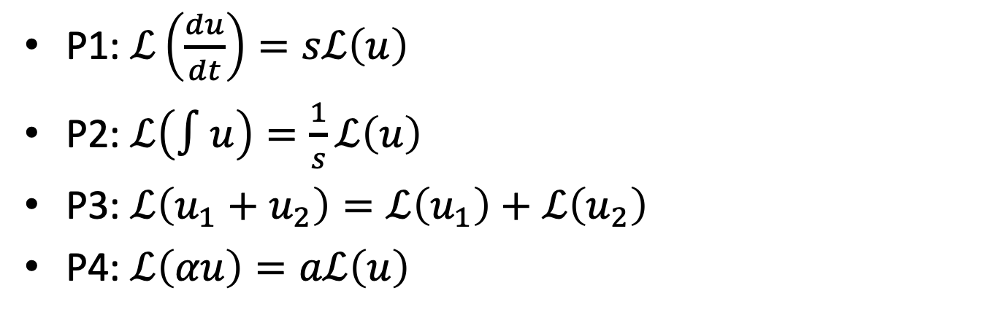
Laplace Transforms Properties
$$u$$
$$y$$
$$ℒ\left(u\right)=U\left(s\right)= \int_{0}^{∞}{u\left(t\right)e^{−st}dt}$$
P1: $ℒ\left(\frac{du}{dt}\right)=sℒ\left(u\right)$
P2: $ℒ\left(∫u\right)=\frac{1}{s}ℒ\left(u\right)$
P3: $ℒ\left(u_{1}+u_{2}\right)=ℒ\left(u_{1}\right)+ℒ\left(u_{2}\right)$
P4: $ℒ\left(αu\right)=aℒ\left(u\right)$

Slide 16


Find These Laplace Transforms
$u\left(t\right)=5+3t^{2}+ 100δ$
$\frac{5}{s}+\frac{3}{s^{3}}+100$
$u\left(t\right)={6e}^{−4t }+∫8e^{0.2 t}$
$\frac{6}{s+4}+\frac{8}{s(s−0.2)}$
S1: $ℒ\left(δ_{0}\right)=1$
S2: $ℒ\left(1_{0}\right)=\frac{1}{s}$
S3: $ℒ\left(t\right)=\frac{1}{s^{2}}$
S4: $ℒ\left(e^{−αt}\right)=\frac{1}{s+α}$
P1: $ℒ\left(\frac{du}{dt}\right)=sℒ\left(u\right)$
P2: $ℒ\left(∫u\right)=\frac{1}{s}ℒ\left(u\right)$
P3: $ℒ\left(u_{1}+u_{2}\right)=ℒ\left(u_{1}\right)+ℒ\left(u_{2}\right)$
P4: $ℒ\left(αu\right)=aℒ\left(u\right)$

Slide 17

Poles & Laplace Transforms
“$p$ is a pole of $u(t)$” is equivalent to “$p$ is a root for $s$ in the denominator of $ℒ(u)$”.
Examples
$$u\left(t\right)=e^{pt}≡Y\left(s\right)=\frac{1}{s−p}$$

Slide 18


What are the poles? What are the signals?
$\frac{5}{s}+100$
poles at 0. Step + impulse.
$\frac{6}{s+4}+\frac{8}{s(s−0.2)}$
poles at -4, 0, 0.2. unstable.
S1: $ℒ\left(δ_{0}\right)=1$
S2: $ℒ\left(1_{0}\right)=\frac{1}{s}$
S3: $ℒ\left(t\right)=\frac{1}{s^{2}}$
S4: $ℒ\left(e^{at}\right)=\frac{1}{s+a}$
P1: $ℒ\left(\frac{dy}{dt}\right)=sℒ\left(y\right)$
P2: $ℒ\left(∫y\right)=\frac{1}{s}ℒ\left(y\right)$
P3: $ℒ\left(y_{1}+y_{2}\right)=ℒ\left(y_{1}\right)+ℒ\left(y_{2}\right)$
P4: $ℒ\left(αy\right)=aℒ\left(y\right)$

Slide 19
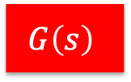
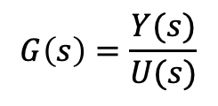


Systems & Transfer Functions
$$U(s)$$
$$Y(s)$$
$$G\left(s\right)$$
Transfer functions describe systems.
A transfer function is the ratio of the Laplace transform of the output to the Laplace transform of the input.
$$G\left(s\right)=\frac{Y(s)}{U(s)}$$
A transfer function is a Laplace transform and so has all of its properties.

Slide 20
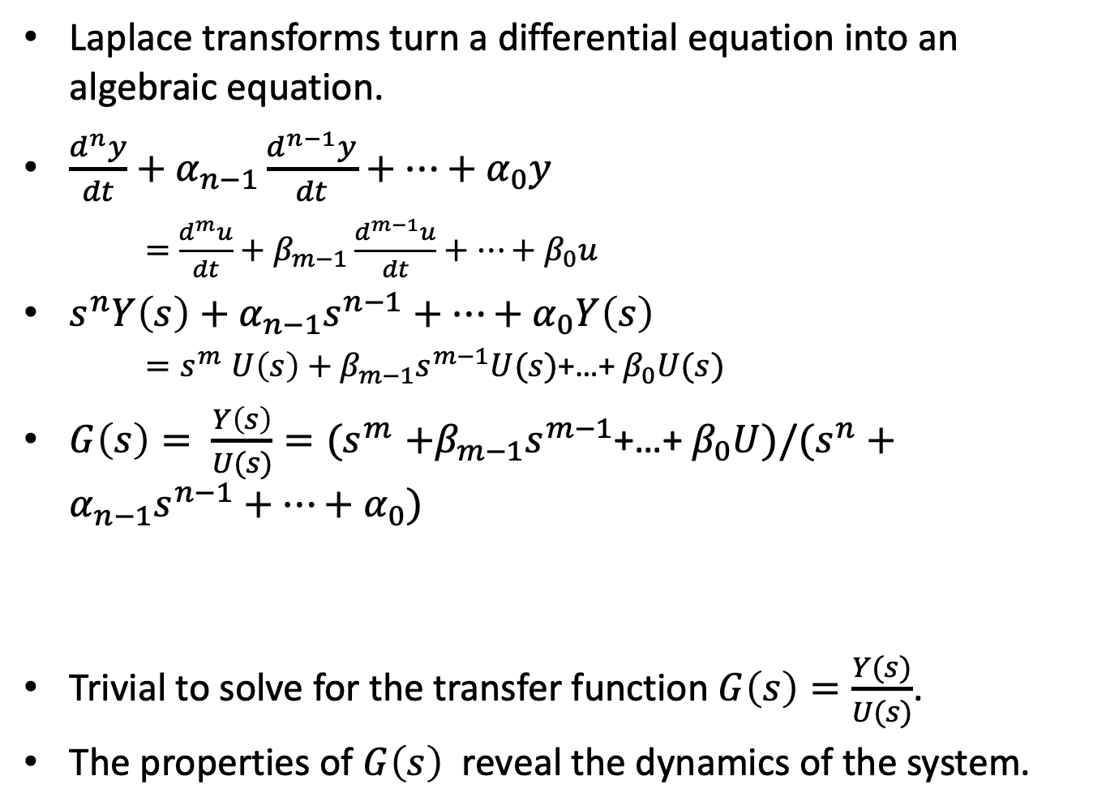
Why Transfer Functions?
Laplace transforms turn a differential equation into an algebraic equation.
$\frac{d^{n}y}{dt}+α_{n−1}\frac{d^{n−1}y}{dt}+⋯+α_{0}y$
$=$ $\frac{d^{m}u}{dt}+β_{m−1}\frac{d^{m−1}u}{dt}+⋯+β_{0}u$
$s^{n}Y\left(s\right)+α_{n−1}s^{n−1}+…+α_{0}Y\left(s\right)$
${=s}^{m}U\left(s\right)+β_{m−1}s^{m−1}U(s)$+…+ $β_{0}U(s)$
$G\left(s\right)= \frac{Y\left(s\right)}{U(s)}{=(s}^{m}+β_{m−1}s^{m−1}\text{+…+ }β_{0}U)/(s^{n}+α_{n−1}s^{n−1}+…+α_{0})$
Trivial to solve for the transfer function $G\left(s\right)=\frac{Y(s)}{U(s)}$.
The properties of $G\left(s\right)$ reveal the dynamics of the system.

Slide 21
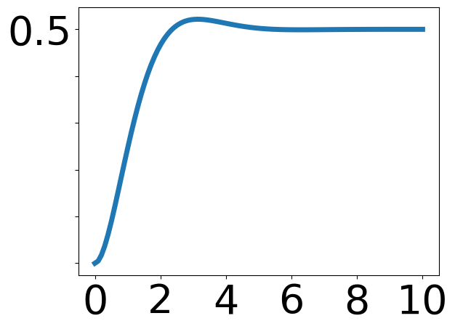
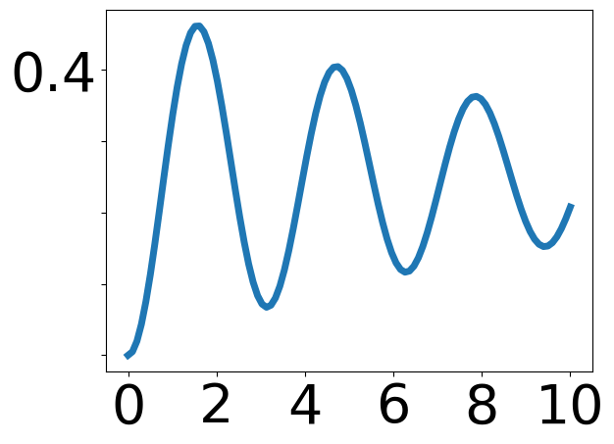
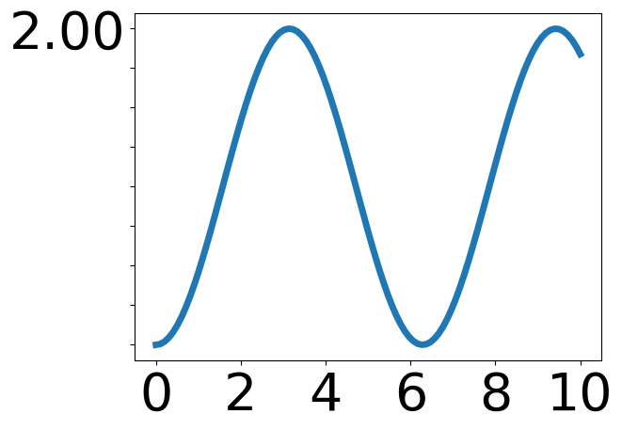
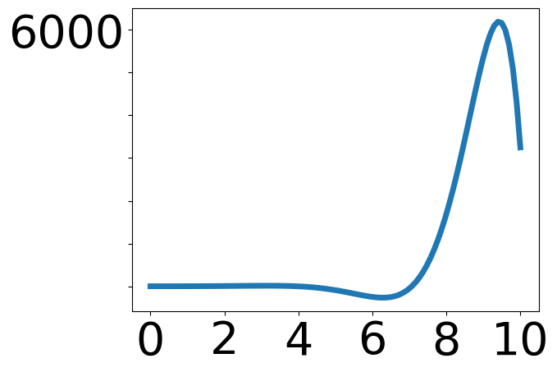
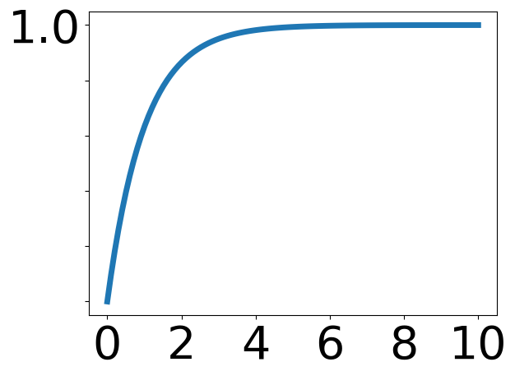
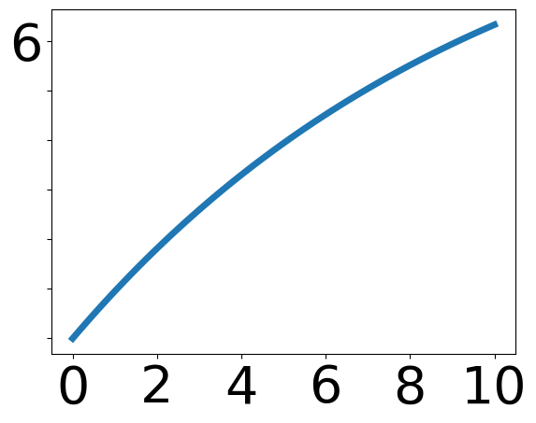
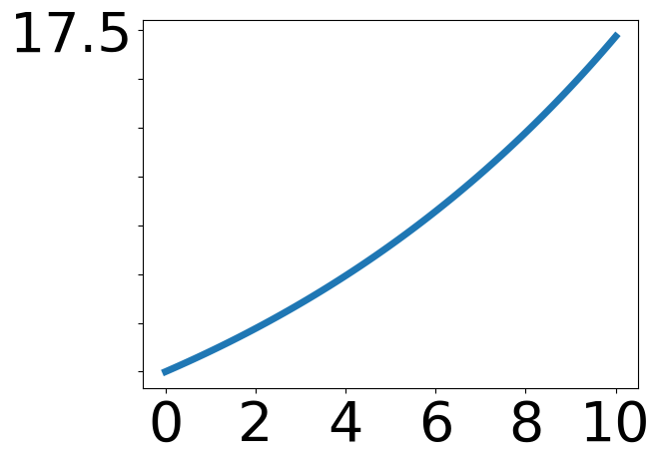
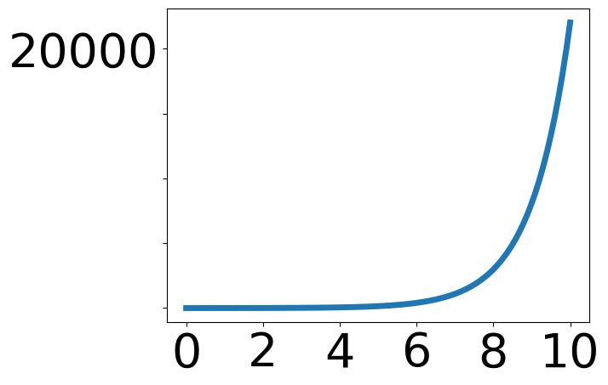


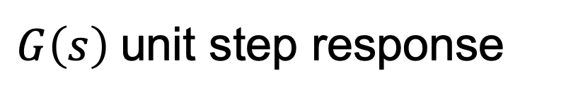


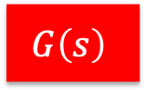
$G\left(s\right)$unit step response
$$U(s)$$
$$G\left(s\right)$$
$$Y(s)$$
Plots are centered on dominant pole
p in “s-plane”.
time
R$e$
I$m$

Slide 22

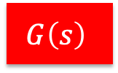






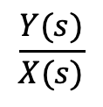



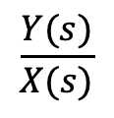


Transfer functions can be composed.
$$U(s)$$
$$G\left(s\right)$$
$$Y(s)$$
$$U(s)$$
$$X(s)$$
$Y(s$)
$$G_{1}(s)$$
$$G_{2}(s)$$
$$G\left(s\right)$$
$$G_{1}\left(s\right)=\frac{X(s)}{U(s)}$$
$$\frac{Y(s)}{X(s)}$$
$$\frac{Y(s)}{X(s)}$$
$$G_{2}\left(s\right)=$$
$$G\left(s\right)=$$
$$G\left(s\right)=G_{1}\left(s\right)G_{2}(s)$$

Slide 23
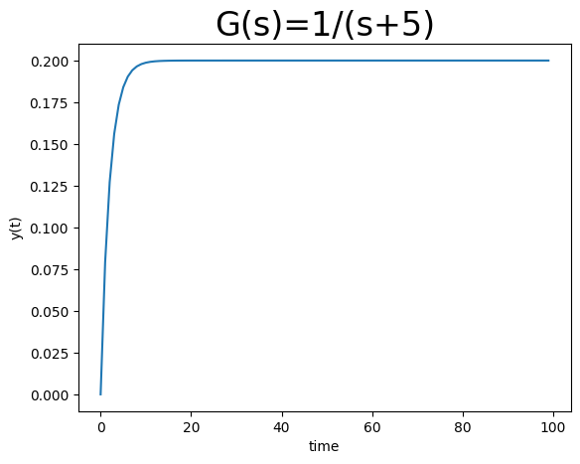
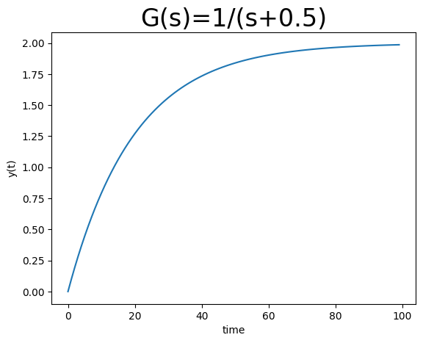
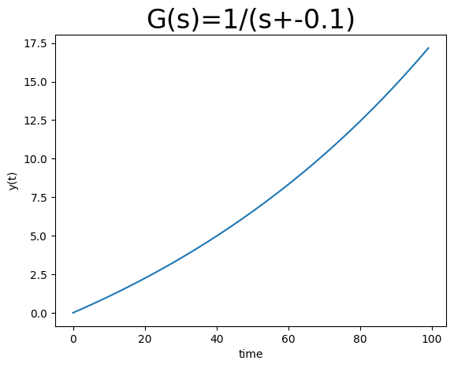


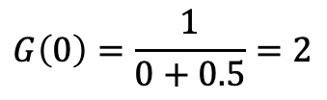

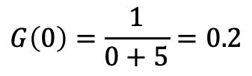
Steady State Step Response (DC Gain)
$$U(s)$$
$$G\left(s\right)$$
$$Y(s)$$
Steady state step response is $G\left(0\right)$ if $G\left(s\right)$ is stable.
X
$$G\left(0\right)=\frac{1}{0+0.5}=2$$
$$G\left(0\right)=\frac{1}{0+5}=0.2$$
unstable

Slide 24
What You Need to Know
Relate the value of poles in system transfer function to stability, oscillations, settling times.
Calculating DC gain from system transfer function.

Slide 25
Exercise 1: Find the Transfer Function for a Sequential Chemical Network

Slide 26
BACKUP

Slide 27



Representing Signals in Discrete Time
k | 0 | 1 | 2 | 3 | 4 | 5
y | 5 | 10.1 | 20.03 | 15 | 30 | 11.11
$$y\left(k\right)=5, 10.1, 20.03, 15, 30, 11.11$$
30
X
$$y(k)$$
20
X
X
10
X
X
X
0
0
1
2
3
4
5
$$k$$
Let $z$ be a complex number. We can encode discrete times as a polynomial, where the exponent indicates the time index. This is called a z-transform.
$$Y\left(z\right)=5z^{0}+10.1z^{−1}+20{.03z}^{−2}+15 z^{−3}+30 z^{−4}+11.11z^{−5}$$

Slide 28



Shifting in time
k | 0 | 1 | 2 | 3 | 4 | 5
y | 5 | 10.1 | 20.03 | 15 | 30 | 11.11
original $Y\left(z\right)$
k | 0 | 1 | 2 | 3 | 4 | 5
y | 0 | 5 | 10.1 | 20.03 | 15 | 30
delay $Y′\left(z\right)$
k | 0 | 1 | 2 | 3 | 4 | 5
y | 10.1 | 20.03 | 15 | 30 | 11.11 | 0
shift $Y′′\left(z\right)$
$$Y\left(z\right)=5z^{0}+10.1z^{−1}+20{.03z}^{−2}+15 z^{−3}+30 z^{−4}+11.11z^{−5}$$
Let $Y^{′}(z)$ the z-transform of $Y\left(z\right)$, delayed by one time unit
$$Y^{′}\left(z\right)=5z^{−1}+10.1z^{−2}+20{.03z}^{−3}+15 z^{−4}+30 z^{−5}+11.11z^{−6}=z^{−1}Y(z)$$
Let $Y^{′}(z)$ the z-transform of $Y\left(z\right)$ shifted by one time unit
$$Y^{′}\left(z\right)=10.1z^{0}+20{.03z}^{−1}+15 z^{−2}+30 z^{−3}+11.11z^{−4}=z^{}Y(z)$$

Slide 29





Adding Signals
$$y_{1}\left(k\right)=5, 10, 0,15$$
$$Y_{1}\left(z\right)=5z^{0}+10z^{−1}+15z^{−3}$$
$$y_{2}\left(k\right)=1, 2, 3, 0$$
$$Y_{2}\left(z\right)=z^{0}+2z^{−1}+{3z}^{−2}$$
$$y_{3}\left(k\right)=6, 12, 3, 15$$
$${Y_{3}\left(z\right)=Y}_{1}\left(z\right)+Y_{2}\left(z\right)={6z}^{0}+12z^{−1}+{3z}^{−2}+15z^{−3}$$
The z-transform of the sum of two time series is the sum of the z-transforms.

Slide 30





Multiplication by a Constant
$$y_{1}\left(k\right)=5, 10, 0, 15$$
$$Y_{1}\left(z\right)=5z^{0}+10z^{−1}+15z^{−3}$$
$$y_{2}\left(k\right)=15, 30, 0, 45$$
$$Y_{2}\left(z\right)=15z^{0}+30z^{−1}+45z^{−3}$$
$Y_{2}\left(z\right)=3Y_{1}(z)$
The z-transform of the product of a constant times a time series is the constant times the z-transform of the time series.

Slide 31




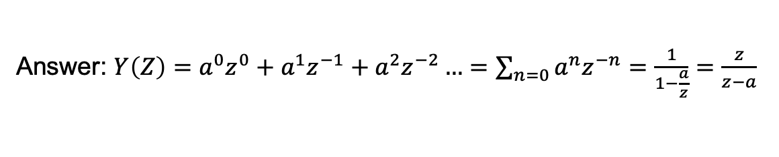
Exercise: Find the z-Transform
A. Find the z-transform of
$$y\left(k\right)=1, a, a^{2}, …$$
$$∞$$
Answer: $Y\left(Z\right)=a^{0}z^{0}+a^{1}z^{−1}+a^{2}z^{−2}…=\sum_{n=0}{a^{n}z^{−n}}=\frac{1}{1−\frac{a}{z}}=\frac{z}{z−a}$
B. For which values of a is this signal bounded (stable)?
Answer: $a<1$
C. Does the signal converge faster when $a→0$ or when $a→1$?
Answer: $a→0$

Slide 32







From Discrete to Continuous Time
$$\frac{dy\left(t\right)}{dt}=αy(t)+βu(t)$$
$$y\left(k\right)=ay\left(k−1\right)+bu(k)$$
$$y\left(k\right)−y\left(k−1\right)=ay\left(k−1\right)−y(k−1)+bu(k)$$
$$y\left(k\right)−y\left(k−1\right)=y\left(k−1\right)[a−1]+bu(k)$$
$$\frac{y\left(k\right)−y\left(k−1\right)}{Δt}=y\left(k−1\right)\frac{a−1}{Δt}+\frac{b}{Δt}u(k)$$
$$\lim_{Δt→0}{}\frac{y\left(t+Δt\right)−y\left(t\right)}{Δt}=y\left(t\right)\lim_{Δt→0}\frac{a−1}{Δt}+\lim_{Δt→0}\frac{b}{Δt}u(t)$$
$$\frac{dy\left(t\right)}{dt}=αy(t)+βu(t)$$
$$α=\lim_{Δt→0}\frac{a−1}{Δt}, β=\lim_{Δt→0}\frac{b}{Δt}$$
When is $y(t)$ bounded? How does this relate to when $y\left(k\right)$ is bounded?
$$α<0$$

Slide 33








Discrete vs. Continuous Time
$$u$$
$$y$$
System
$$y(t)$$
$$t$$
$$y(k)$$
$$y(k)$$
$$k$$

Slide 34

High Order Systems With Inputs
$$y\left(t\right)=\sum{α_{n}\frac{d^{\left(n\right)}y(t)}{dt}}+\sum{β_{m}\frac{d^{\left(m\right)}u(t)}{dt}}, 1≤n≤N, 0≤m≤M, M≤N$$
This is getting complicated!
We need a simpler approach than solving in the time domain.

Slide 35

DC Gain For Transfer Functions
Consider the transfer function $G\left(s\right)=\frac{Y\left(s\right)}{U(s)}$.
DC Gain is $\lim_{t→ ∞}{y(t)}$ when $u\left(t\right)=1_{0}(t)$.
Derivation of DC gain
Recall: $ℒ\left(1_{0}\right)=\frac{1}{s}$ , $Y\left(s\right)=U\left(s\right)G(s)$
Given this, the output signal for a step is $Y\left(s\right)=\frac{1}{s}G\left(s\right)$.
From the final value theorem,
$\lim_{t→ ∞}{y(t)}=s\lim_{s→0}{\frac{1}{s}G\left(s\right)=\lim_{s→0}{G(s)}}$ if $y(t)$ converges.

Slide 36


Examples of Calculating DC Gain
DC Gain: ${\lim_{s→0}{G(s)}}$
Constant amplification.
$$G\left(s\right)=5$$
Unadjusted exponential filter.
$$G\left(s\right)=\frac{1}{s+a}$$
Adjusted filter: $\frac{dy\left(t\right)}{dt}=k_{F}u\left(t\right)−k_{F}y(t)$
$$sY\left(s\right)=k_{F}U\left(s\right)−k_{F}Y\left(s\right)≡Y\left(s\right)=\frac{k_{F}U(s)}{s+k_{F}}$$
$$G\left(s\right)=\frac{Y\left(s\right)}{U(s)}=\frac{k_{F}}{s+k_{F}}$$
Notes:
DC gain for constant amplification: 5
DC gain for exponential: 1/a
DC gain for filter: 1

