Slide 1
BIOE 498 / BIOE 599 Advanced Biological Control Systems System Identification
Joseph L. Hellerstein
eScience Institute, Computer Science & Engineering
Allen School of Computer Science
BioEngineering
Notes:
Diverse students. Some with bio-backgrounds; some without. Some with CS background; some with very limited. Two separate courses combined because of a substantial shared curriculum.

Slide 2


System Identification
$$u(t)$$
System
$$y(t)$$
Constructing a transfer function for the system.
This is data driven.
We are given experimental data and the inputs that produced these data.
From this, we estimate a transfer function that predicts values close to the experimental data.

Slide 3
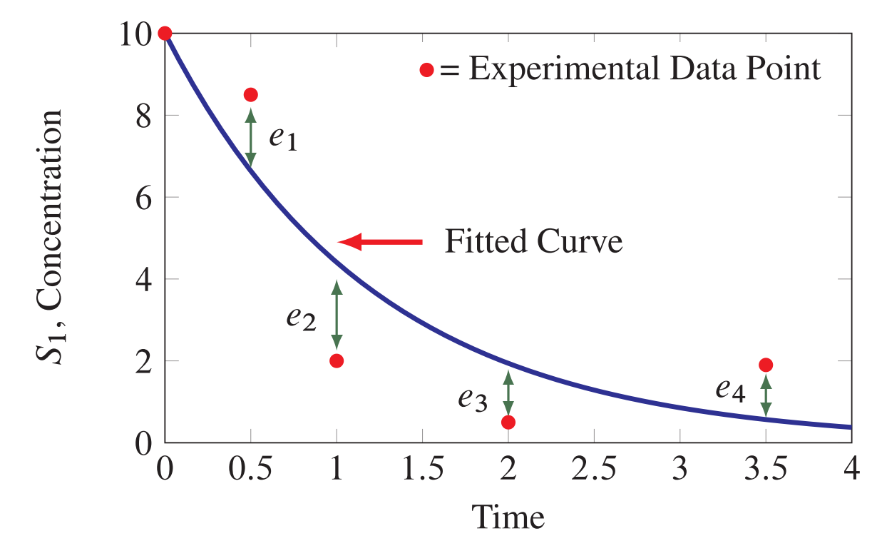
Key Concepts
Residual
Key concepts
Experimental (observational) data – what we want to predict
Fitted curve (predicted values) – predicted from out model
Residuals = Experimental data – fitted curve

Slide 4
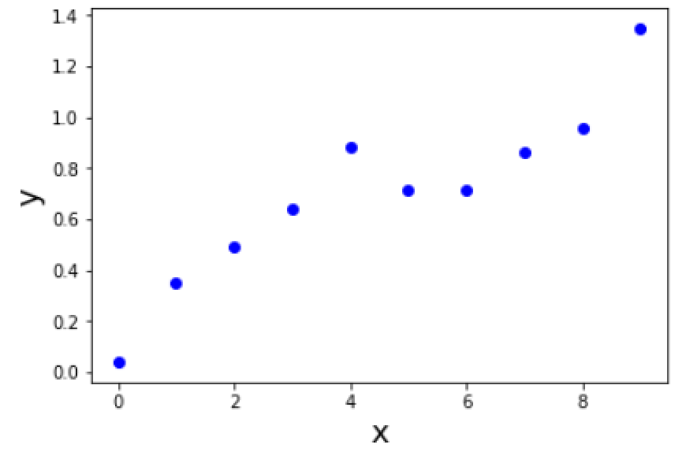
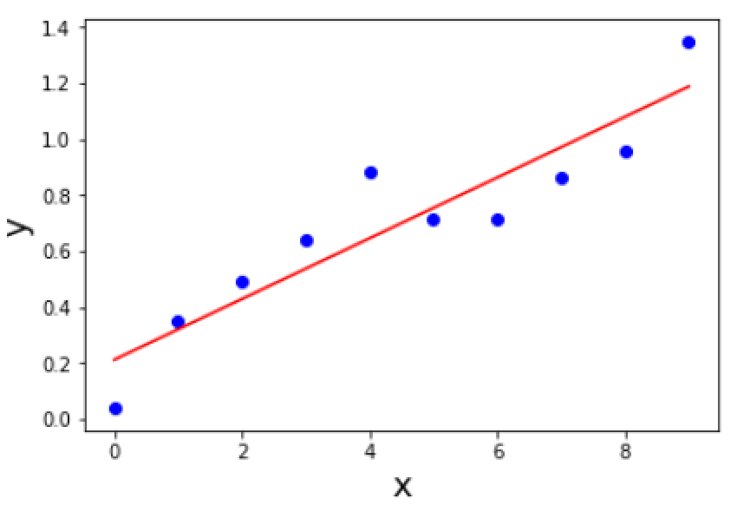
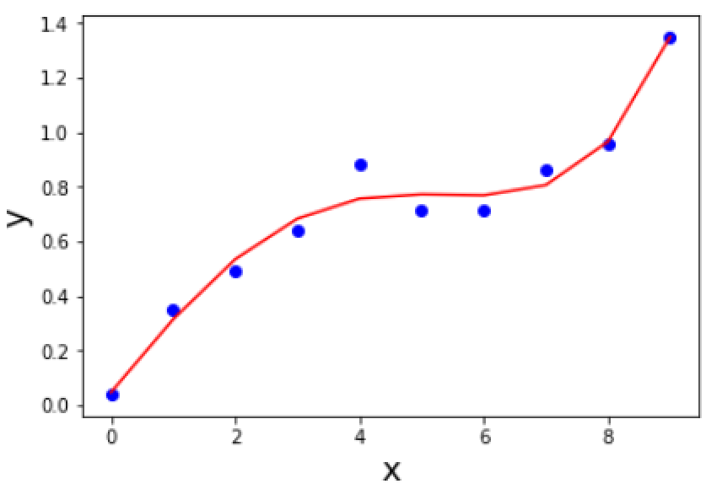


What is A Good Model?
Experimental Data
$$y=ax+b$$
$$y=a_{1}x+a_{2}x^{2}+a_{3}x^{3}+a_{4}x^{4}+b$$
Predictions from a good model have small deviations from the experimental data.

Slide 5
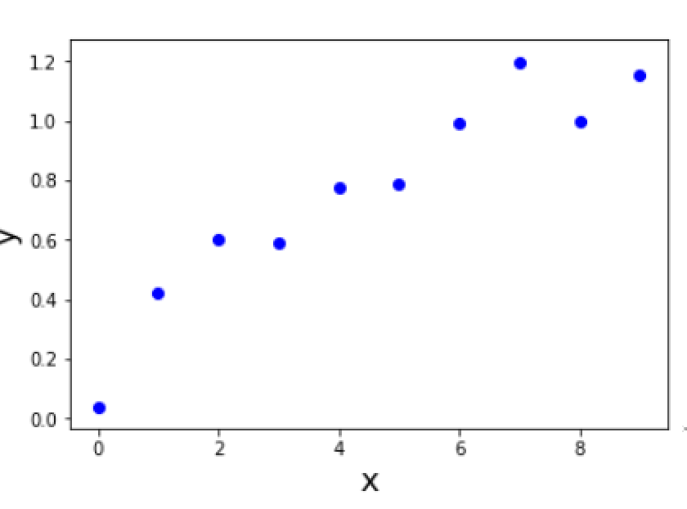
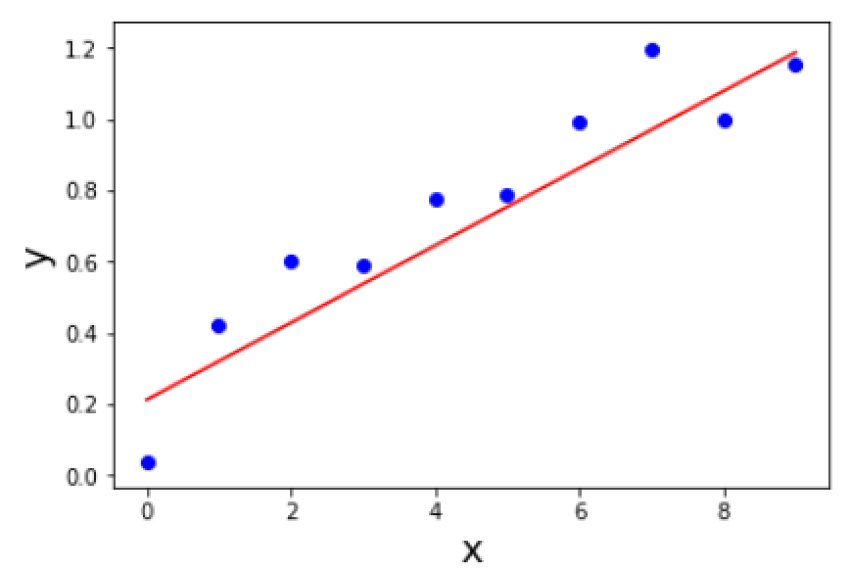
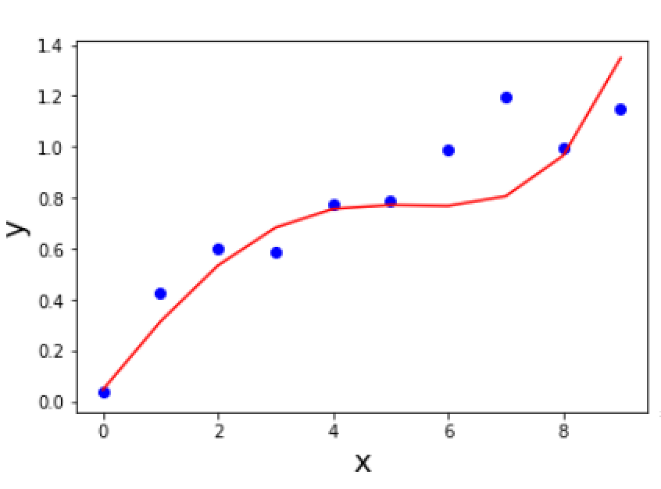
Generalizing Model to New Data
Data 2
Which is the better model now?
A good model provides good fits to many data sets.

Slide 6
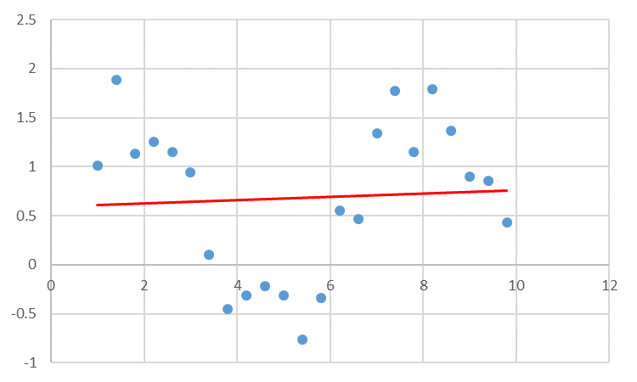
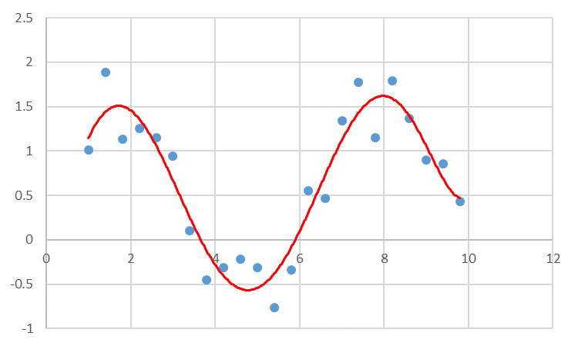
Under fitting
Under fitting
More Realistic

Slide 7
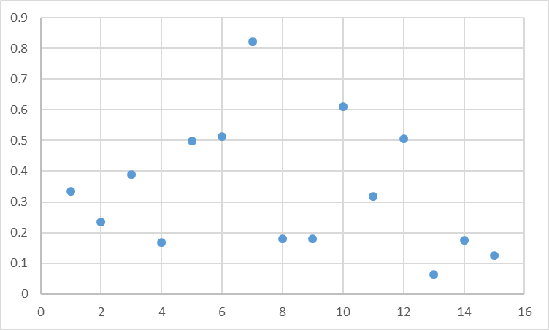
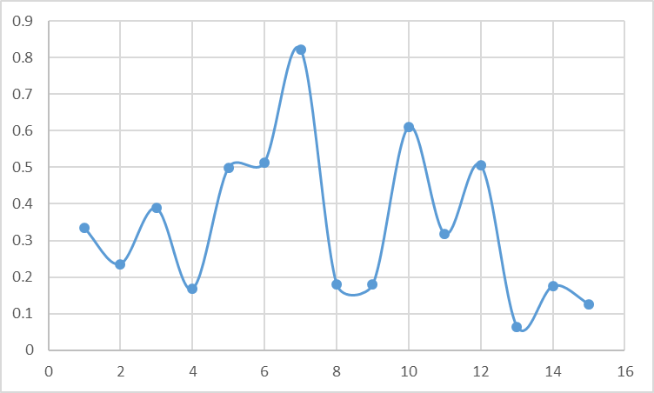
You’ve probably seen this: Someone is a bit too enthusiastic with Excel
Overfitting

Slide 8
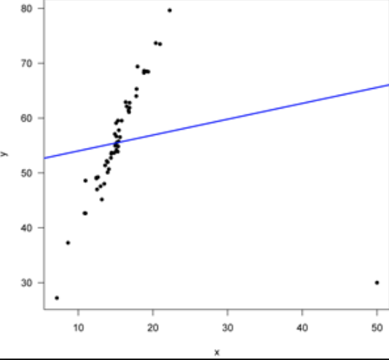
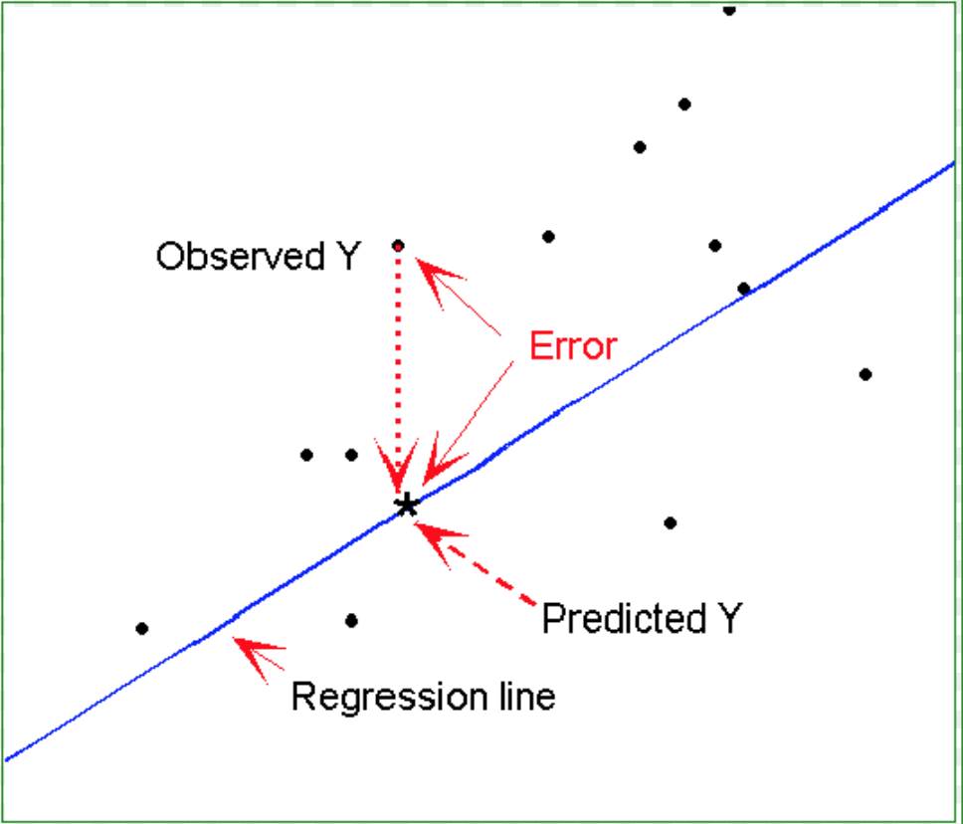
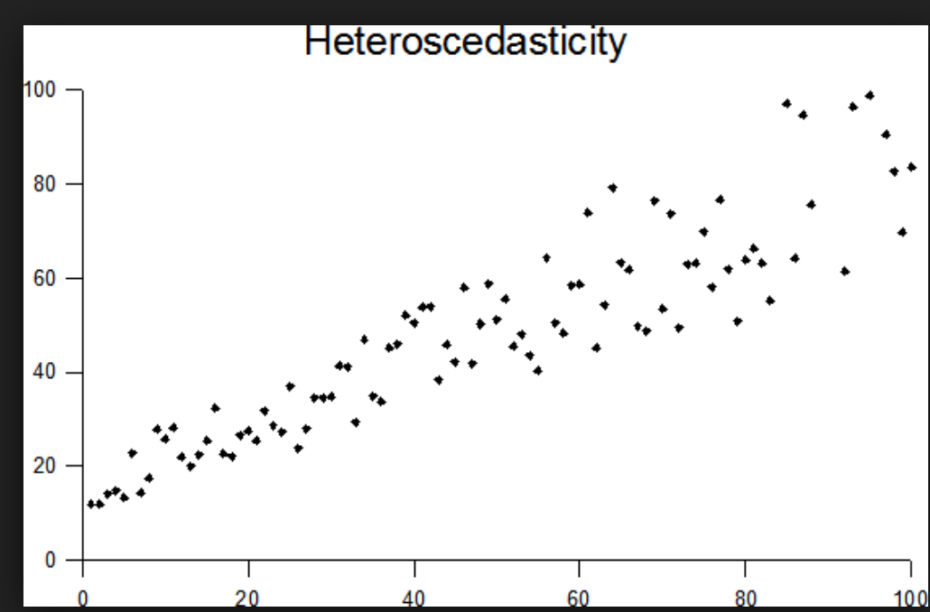
What Residuals Tell Us About Models
Likely Outlier
Functional Bias
Heteroschodasticity

Slide 9

Calculating Residuals
The fitting procedure will attempt to minimize the difference between the model $f$and the data points $y_{i}$, that is minimize:
$$y_{i}−f(x_{i};p_{1}…p_{m})$$

Slide 10
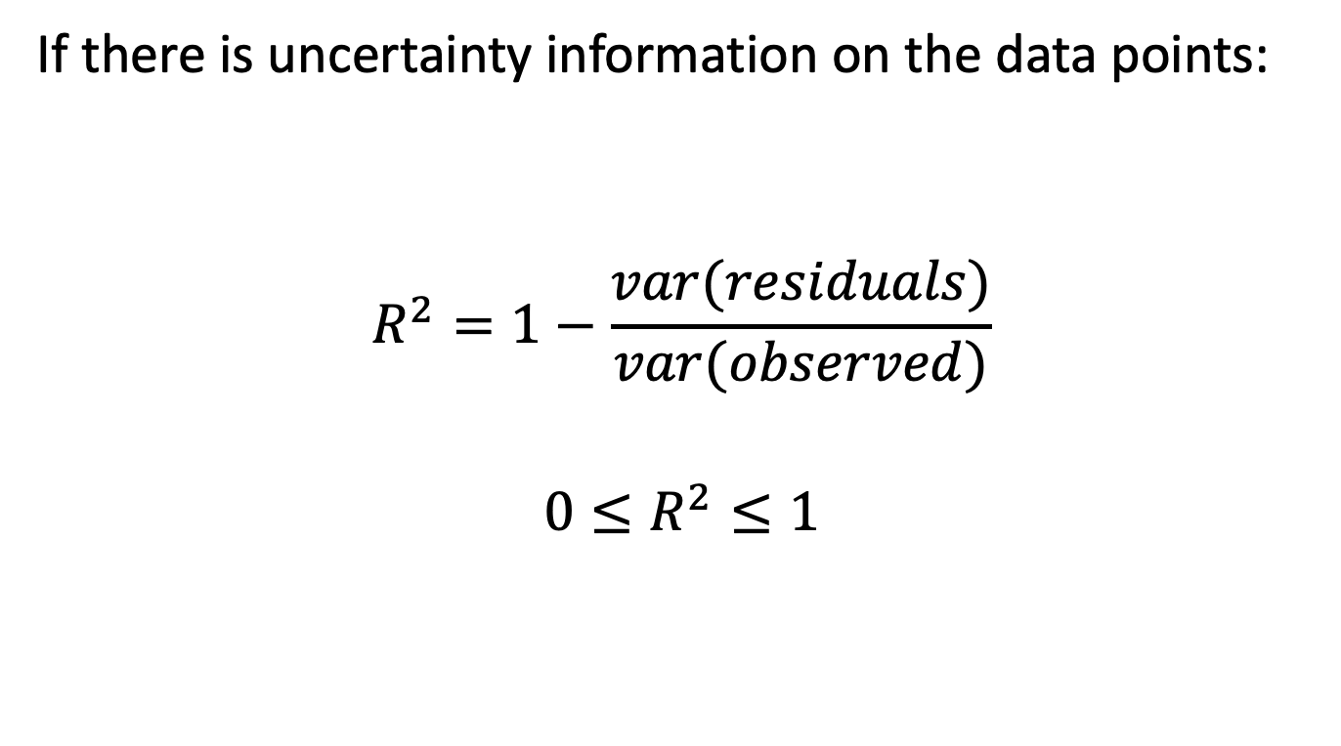
Assessing Model Quality: R²
If there is uncertainty information on the data points:
$$R^{2}=1−\frac{var(residuals)}{var(observed)}$$
$$0≤R^{2}≤1$$
A larger R² indicates a better model.

Slide 11


What is A Good Model?
Data 1
Data 2
$$y=ax+b$$
$$y=a_{1}x+a_{2}x^{2}+a_{3}x^{3}+a_{4}x^{4}+b$$
Fits measurement data
Simple (e.g., few parameters)
Generalizes to new measurement data

Slide 12
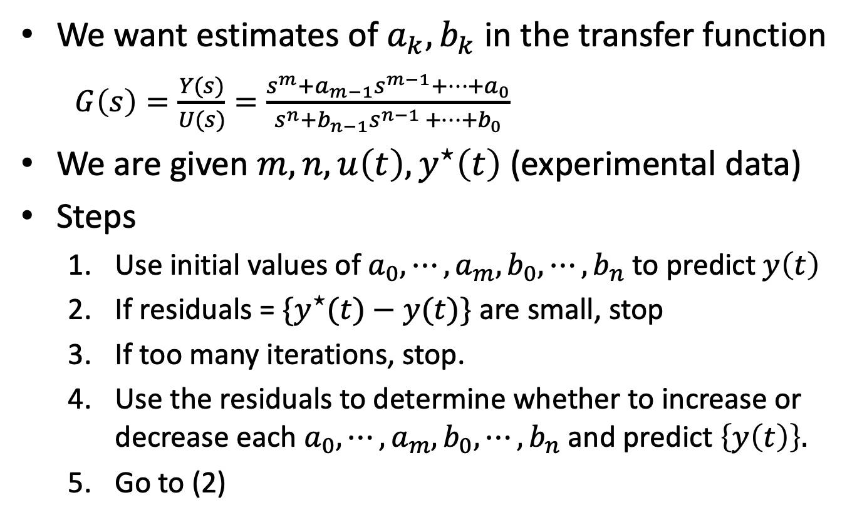
System Identification: Estimating Model Parameters
We want estimates of $a_{k},b_{k}$ in the transfer function
$G\left(s\right)=\frac{Y(s)}{U(s)}=\frac{s^{m}+a_{m−1}s^{m−1}+⋯+a_{0}}{s^{n}+b_{n−1}s^{n−1 }+⋯{+b}_{0}}$
We are given $m, n, u\left(t\right), y^{⋆}\left(t\right)$ (experimental data)
Steps
Use initial values of $a_{0},⋯,a_{m},b_{0},⋯,b_{n}$to predict $y\left(t\right)$
If residuals = ${\{y}^{⋆}(t)−y(t)\}$ are small, stop
If too many iterations, stop.
Use the residuals to determine whether to increase or decrease each $a_{0},⋯,a_{m},b_{0},⋯,b_{n}$and predict $\left\{y\left(t\right)\right\}.$
Go to (2)

