Slide 1
Design Figures

Slide 2
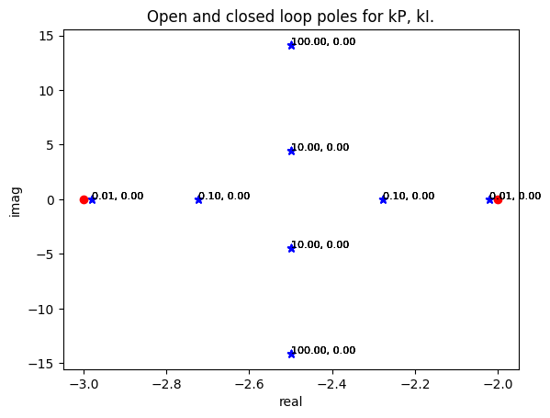
Trajectory of closed loop poles with kP
4
3
1
2
2
1
3
4

