Slide 1
How Linear is BioModels?
Joe Hellerstein
March 12, 2026
Notes:
Diverse students. Some with bio-backgrounds; some without. Some with CS background; some with very limited. Two separate courses combined because of a substantial shared curriculum.

Slide 2
Objectives
Understand how well models can be approximated by linear systems of differential equations.
Identify ”linearity bottlenecks”, reactions that most affect deviations from linearity.
Why?
  Linearity is a key assumption for most quantitative analysis

Slide 3

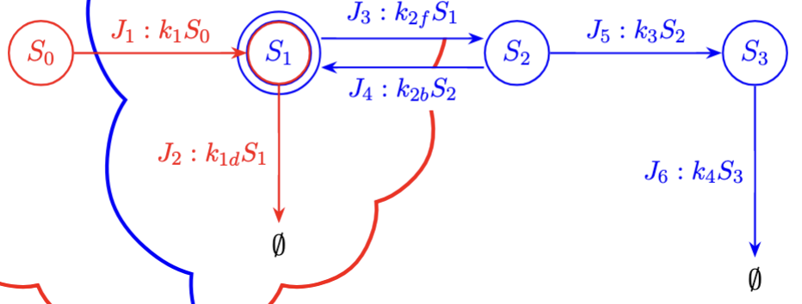
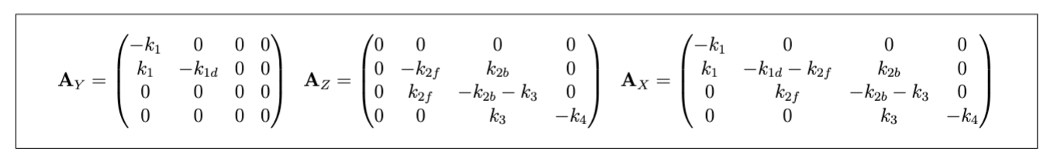
Jacobian of a Subsystem
The dynamics, $ẋ,$ of a subsystem are described by its Jacobian, $A$.
$b$ is the vector of forced inputs (on for each state variable).
The Jacobian of the combined subsystem is the sum of the Jacobians of the individual subsystems if the individual subsystems have no reaction in common.

Slide 4
Step Response
Defn of step response: Change in steady state values change when there is a unit change in one or more values of forced inputs (b).
Objective: Given two subsystems (including their Jacobians), what is the step response of the combined system with the same forced inputs? Assume
  Subsystems are stable
  No reactions in common

Slide 5
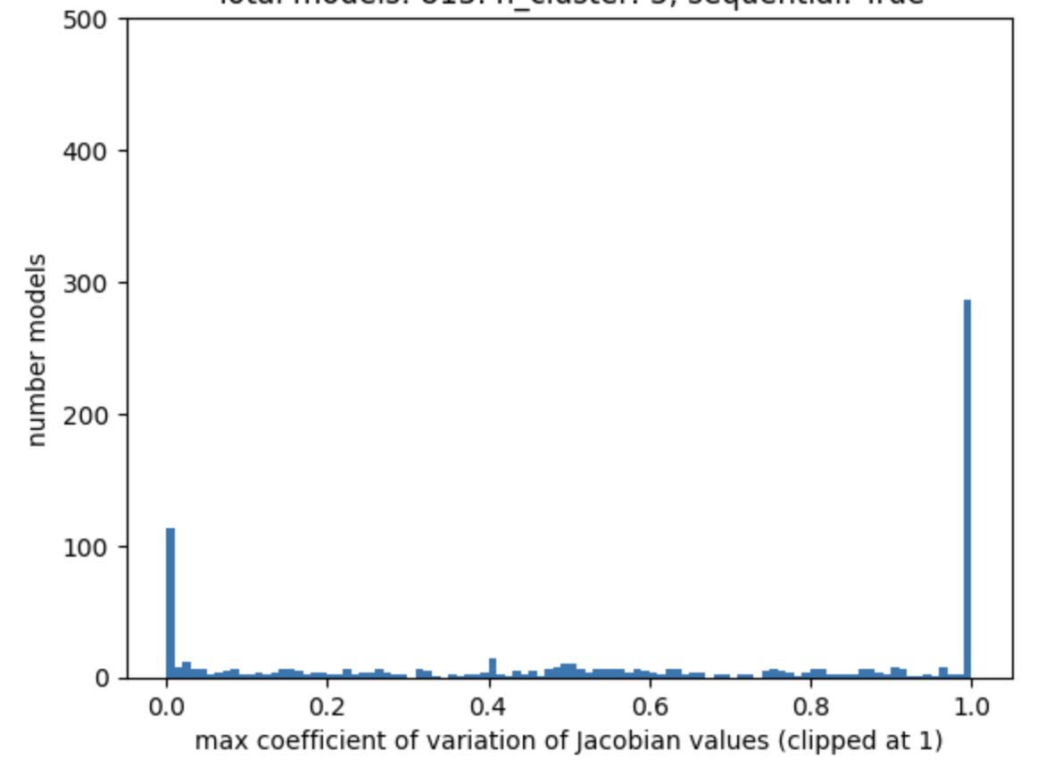
How Good are Linear Approximations in BioModels?
Linear model is a good approximation if the Jacobian does not change over time.
Calculated the maximum coefficient of variant of entries in Jacobians over 100 time points for ~800 models in BioModels
Linear approximation likely works well for ~100 models.

Slide 6
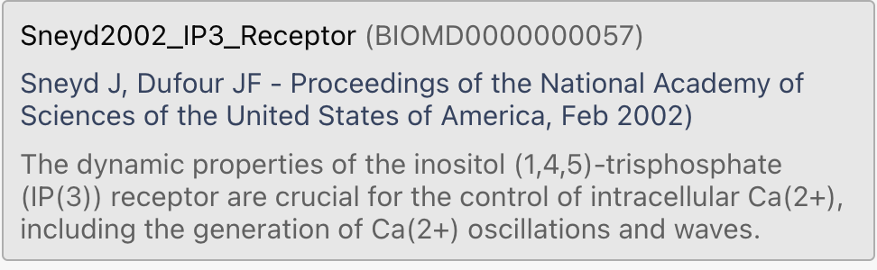
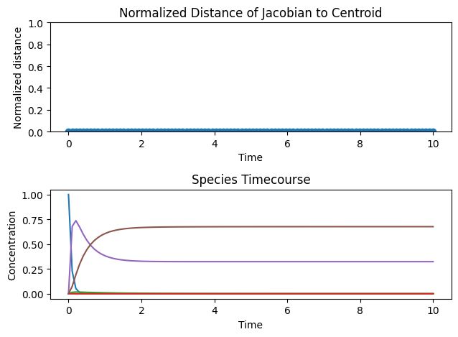
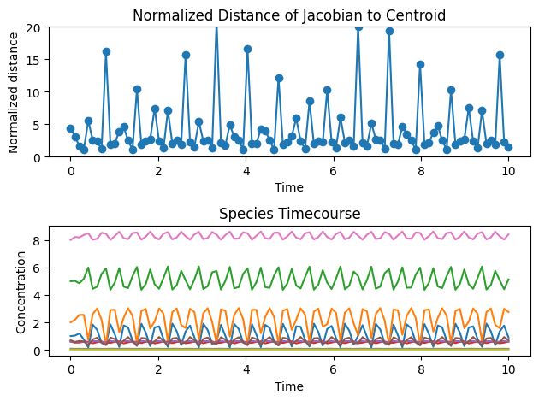
Example: BioModels 57
Jch: CaER => Ca_Cyt; Jch_Fch_0*p1*p2*p3;
Jleak: CaER => Ca_Cyt; Jleak_Fleak;
Jpump: Ca_Cyt => CaER; Jpump_Fpump_0*Ca_Cyt/(Jpump_Kpump + Ca_Cyt);
Wolf Model Counter example

Slide 7
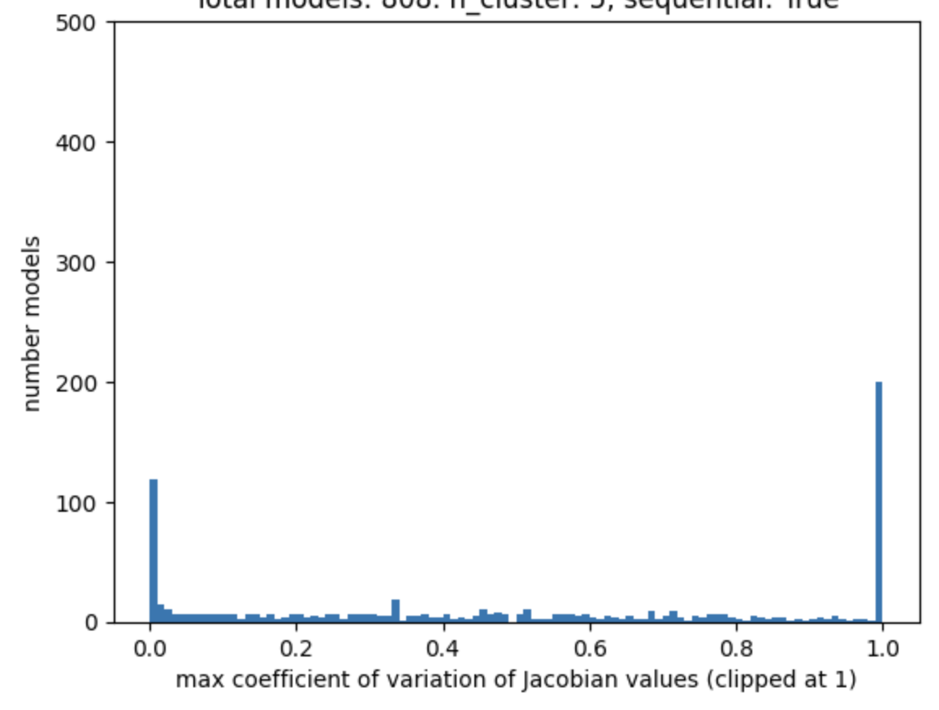
Approximating BioModels With Multiple Jacobians
Linear model is a good approximation if the Jacobian does not change over time.
Calculated the maximum coefficient of variant of entries in Jacobians over 100 time points for ~800 models in BioModels
1 Jacobian
3 Jacobians

Slide 8
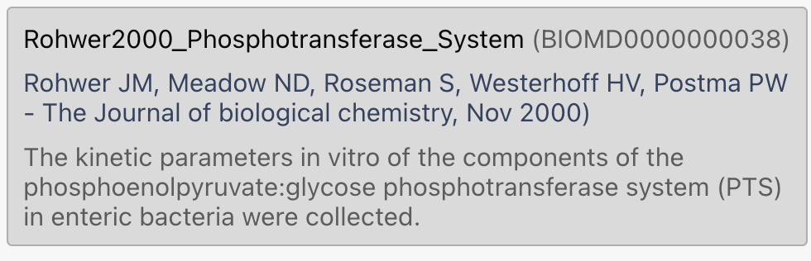
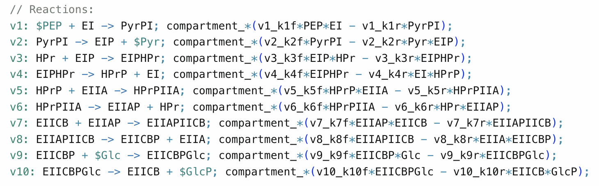
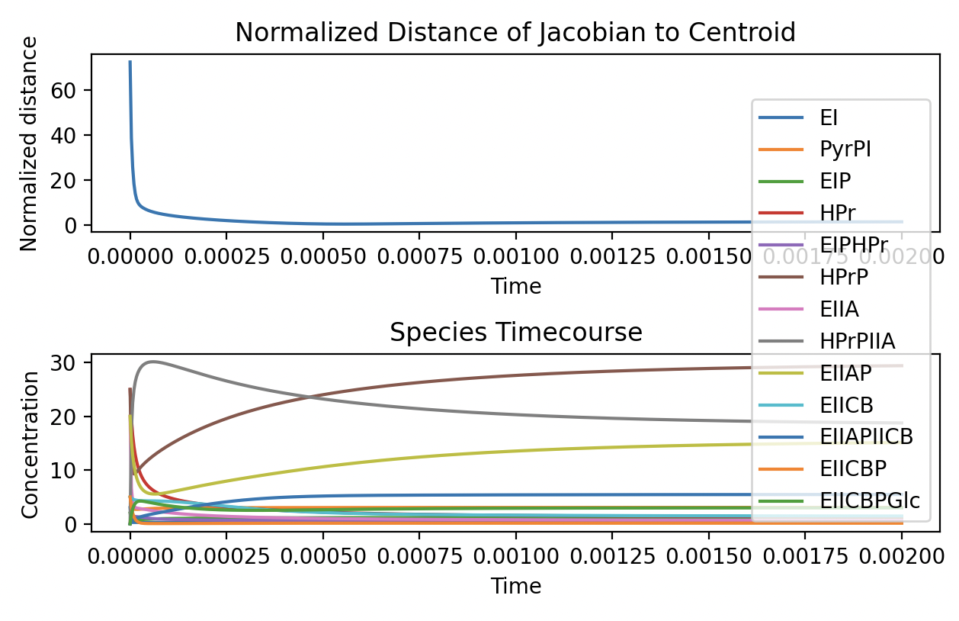
BioModels 38
Lots of nonlinear rate laws: 2 reactants, MM kinetics
Seems like two Jacobians provide a good approximation

Slide 9
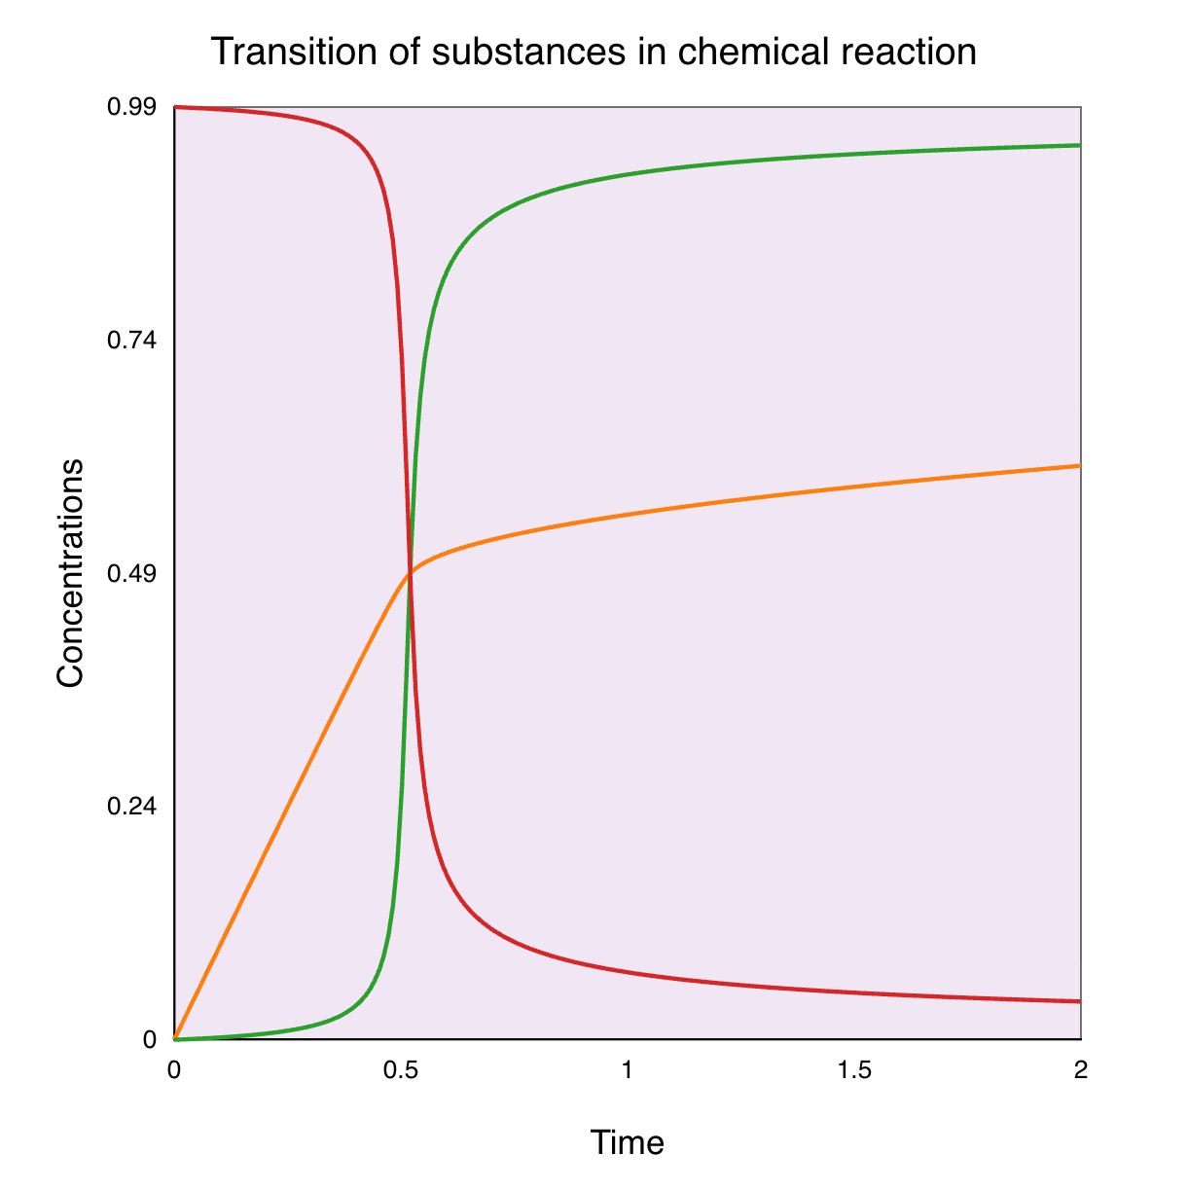
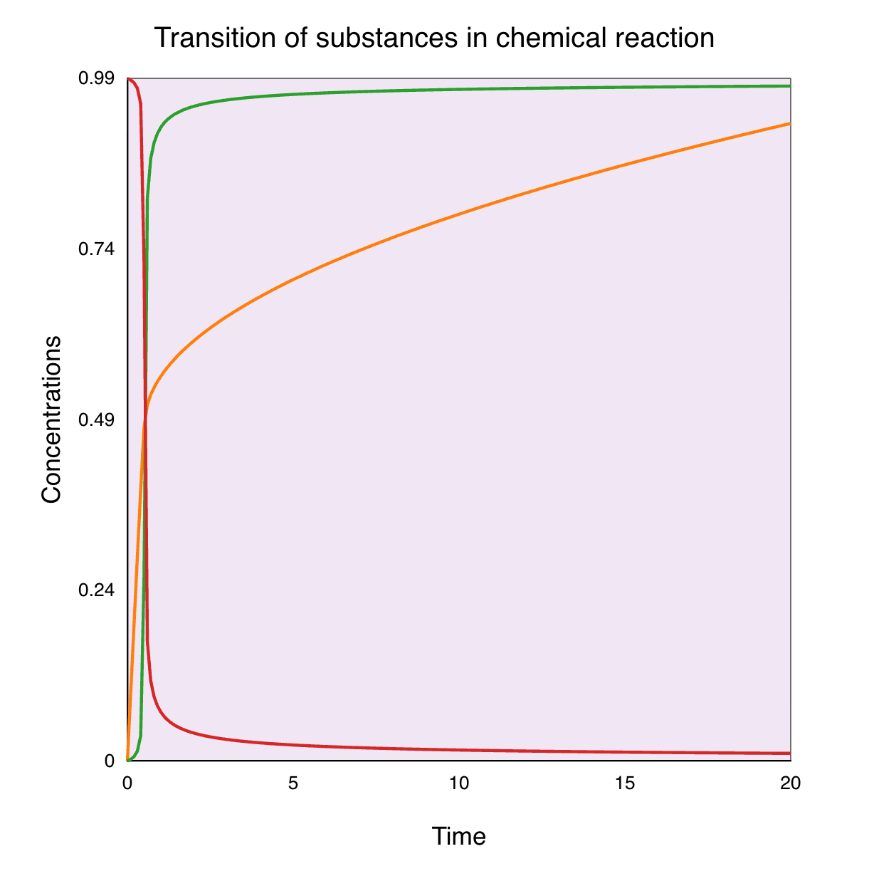
Example of Polylinear Model (BioM 309)
model *Tyson2003_NegFB_Homeostasis()
Ep := Et - E;
E := Et*(2*k3*J4/((k4*R - k3)
+ J3*(k4*R) + J4*k3 + (((k4*R - k3)
+ J3*(k4*R) + J4*k3)^2 –
4*(k4*R - k3)*k3*J4)^(1/2)));
Km3 := J3*Et;
Km4 := J4*Et;
r0: => R; env*k0*E;
r2: R => ; env*k2*R*S;
r3: $Ep => $E; env*k3*Ep/(Km3 + Ep);
r4: $E => $Ep; env*k4*R*E/(Km4 + E);
2
20

Slide 10
PAPER FIGURES

Slide 11
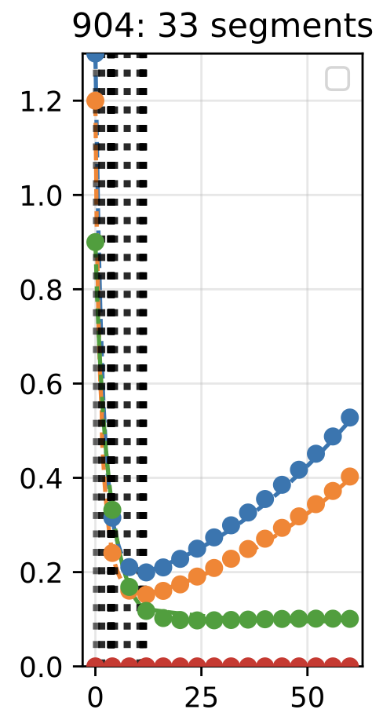
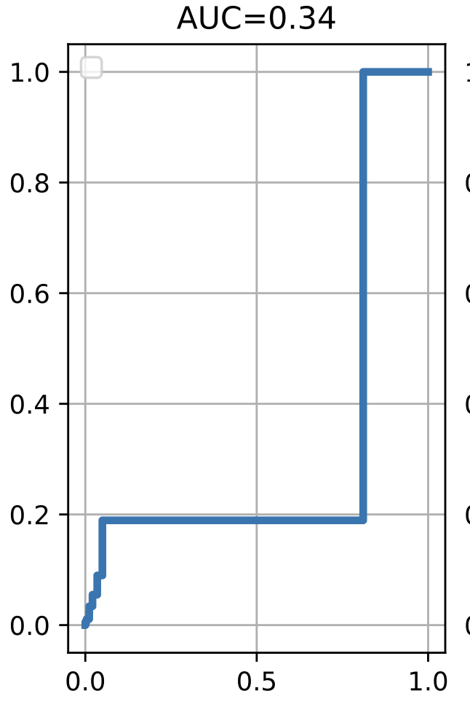
1. Fit an accurate, parsimonious, piecewise linear model.
2. Construct the cumulative curve of normalized segment sizes.
3. Compute, AUC, the area under the cumulative curve of normalized segment sizes.
AUC=0.34
time
normalize segment size
normalize segment size

