Slide 1
Figures for AI Tutorial
April, 2024

Slide 2
MNIST
training
0
1
2
3
4
5
6
7
8
9
testing
0
1
2
3
4
5
6
7
8
9

Slide 3
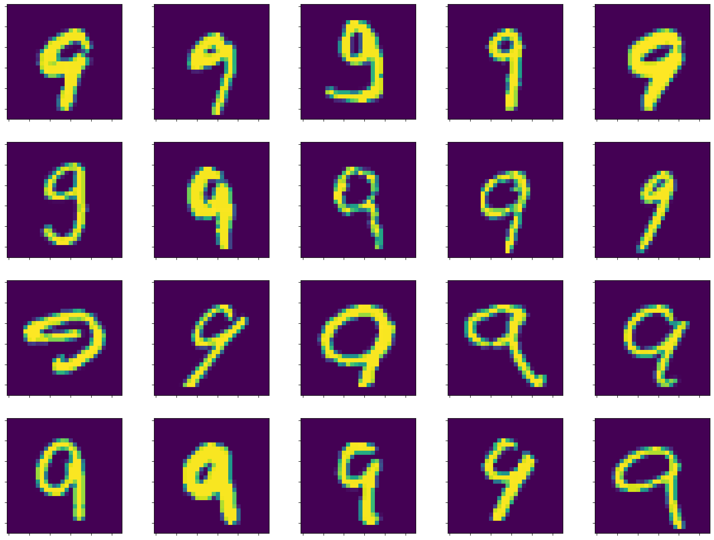
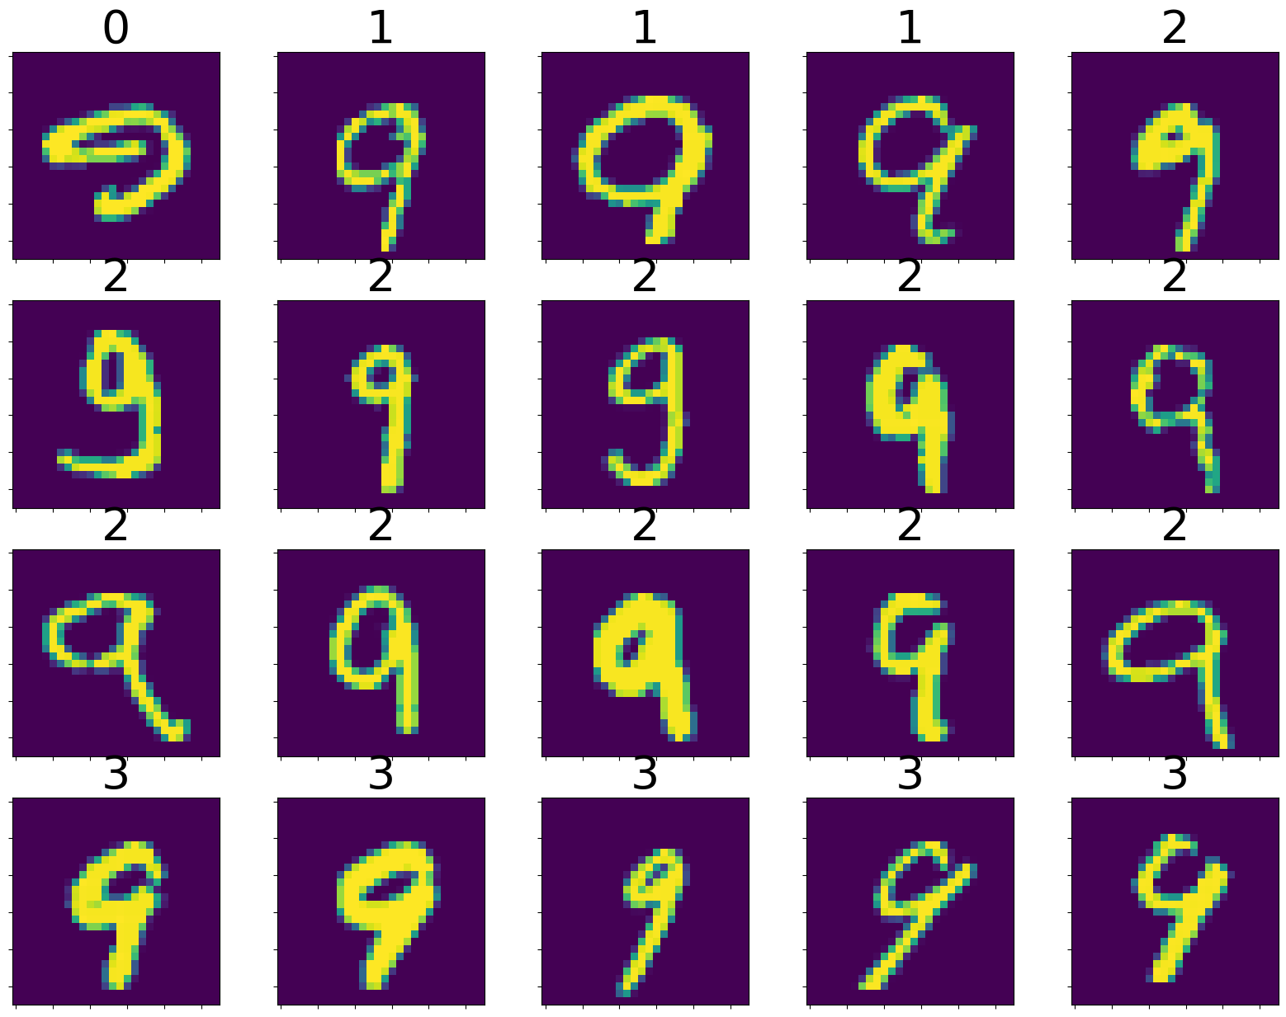
Random Order
Sorted by Cluster

Slide 4



Easy Classification Problem
Feature 2
Feature 1

Slide 5
Easy Classification Problem
Feature 2
Feature 1

Slide 6
Harder Classification Problem
Feature 2
Feature 1

Slide 7
distance
Class average

