Slide 1
Figures for AI Tutorial
April, 2024

Slide 2
MNIST
training
0
1
2
3
4
5
6
7
8
9
testing
0
1
2
3
4
5
6
7
8
9

Slide 3
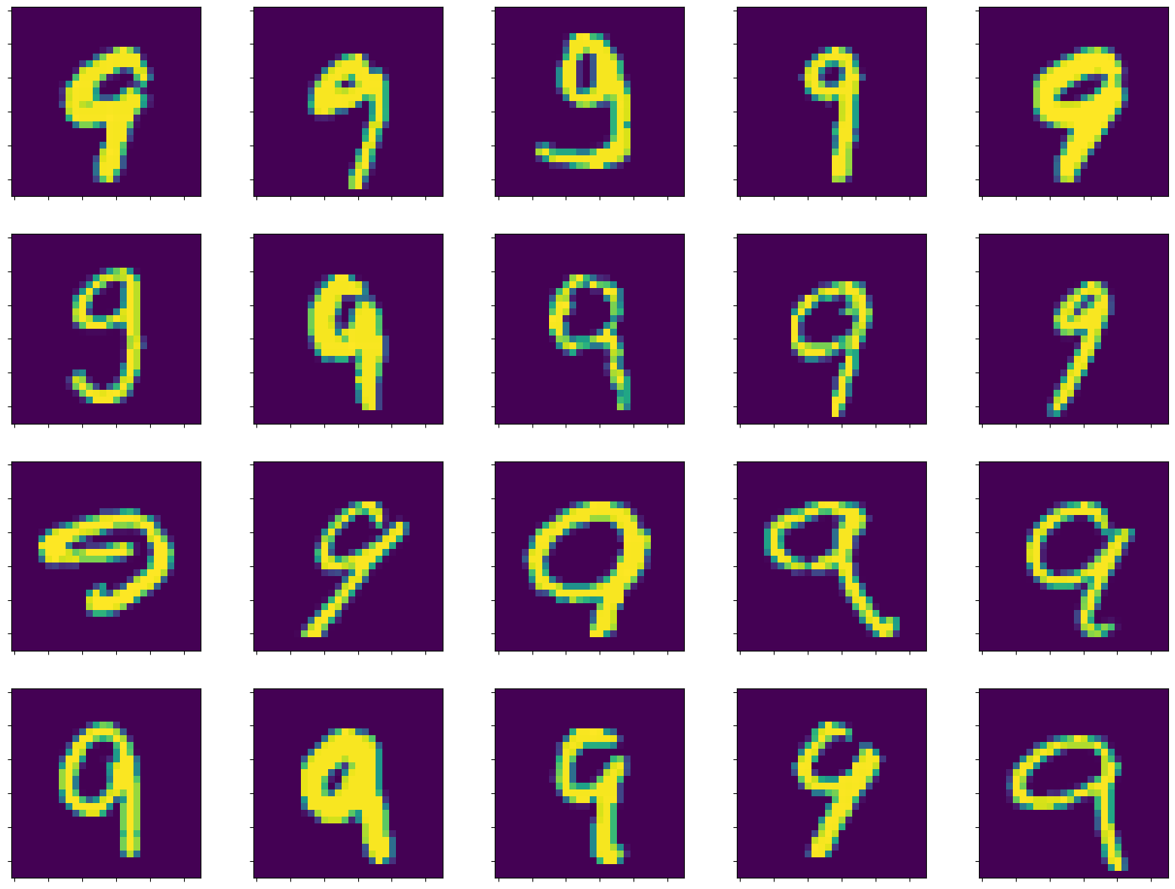
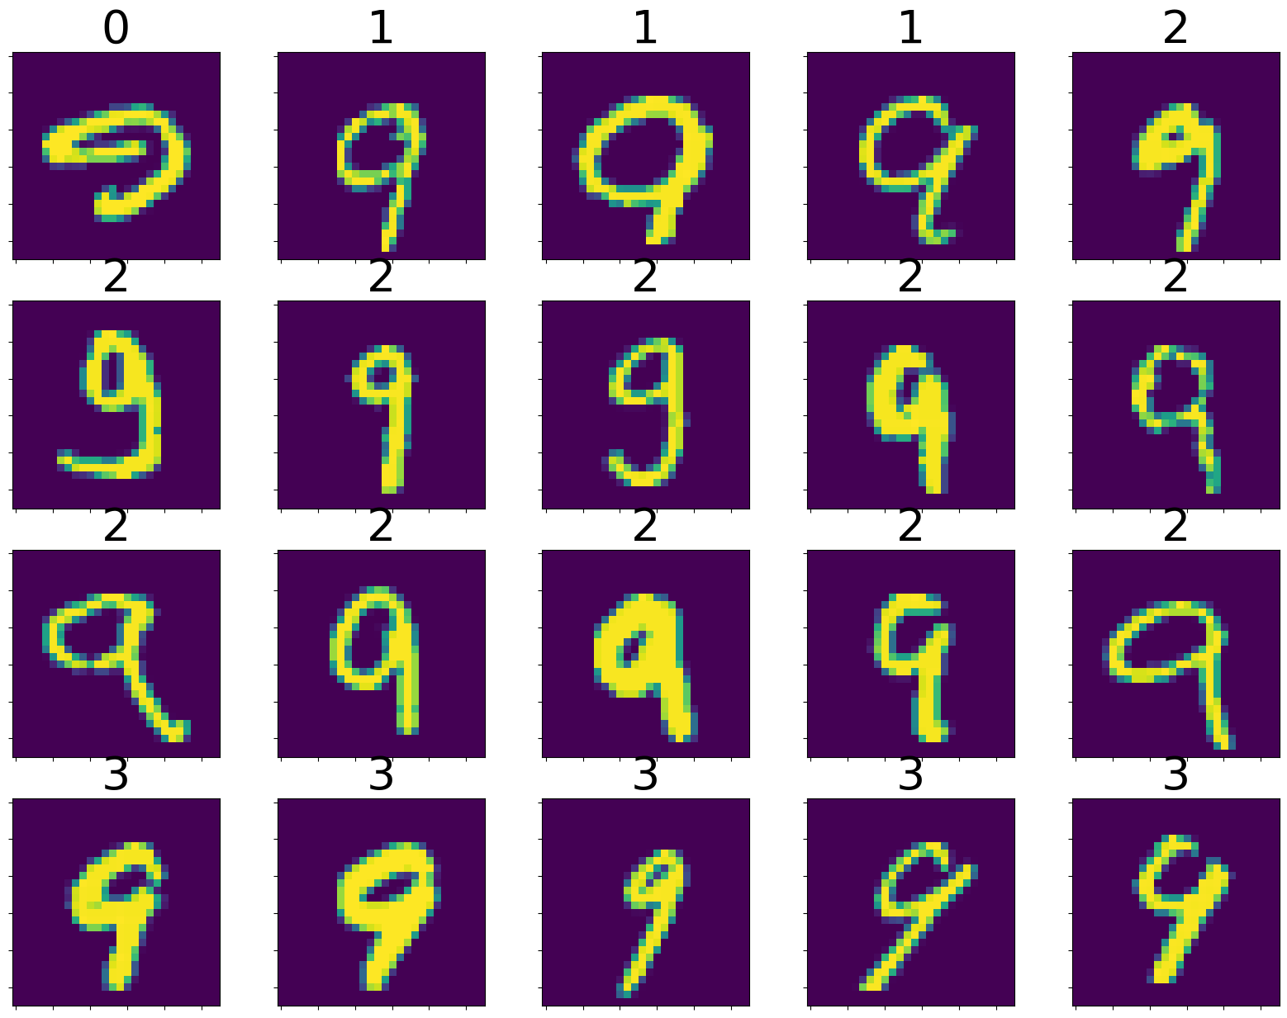
Random Order
Sorted by Cluster

Slide 4



Easy Classification Problem
Feature 2
Feature 1

Slide 5
Easy Classification Problem
Feature 2
Feature 1

Slide 6
Harder Classification Problem
Feature 2
Feature 1

Slide 7
distance
Class average

Slide 8


Real Label
pos
neg
True Positive
(TP)
False Positive
(FP)
pos
Predicted Label
False Negative
(FN)
True Negative
(TN)
neg
$$accuracy=(TP+TN)/(TP+FP+FN+TN)$$
$$recall=TP/(TP+FN)$$
$$pecision=TP/(TP+FP)$$

Slide 9
(ReLU)
(ReLU)
(Softmax)
flatten
image
}
}
0
784
10
9
input
hidden1
hidden2
output

Slide 10
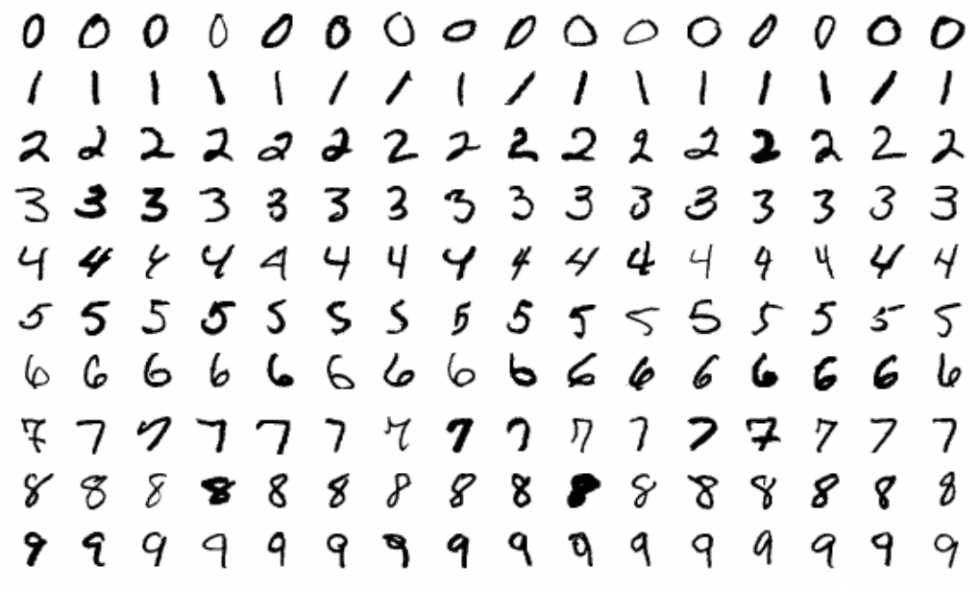





Query: Find all zeroes in this corpus.
Query Result
True positives.
False positives.
False negatives.

