Slide 1
A Mathematical Framework for Modular Biological Networks
JL Hellerstein
Feb, 2024

Slide 2
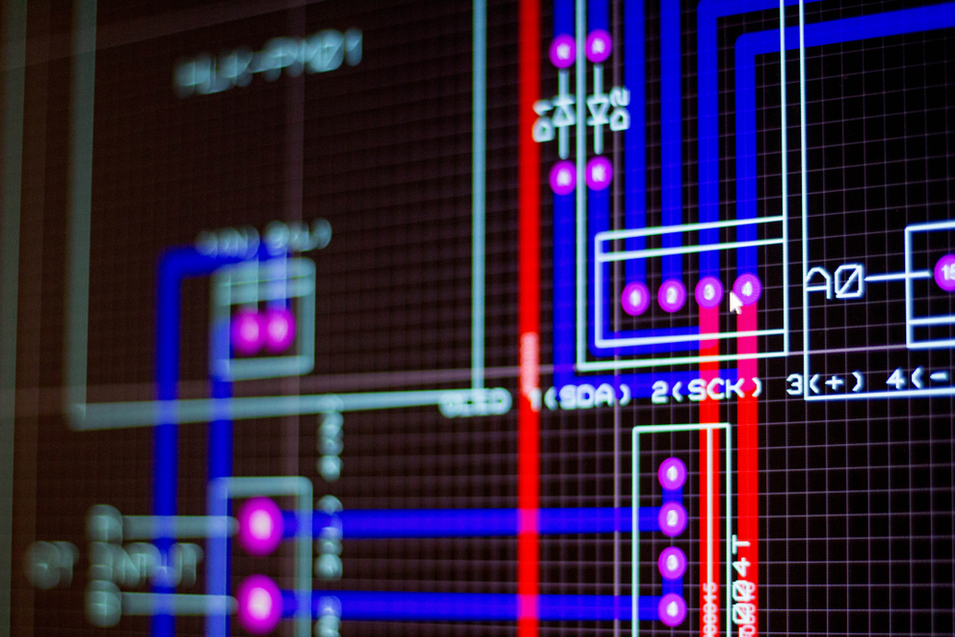
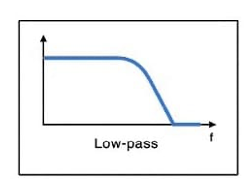
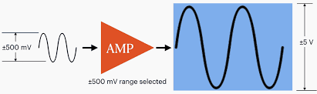
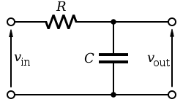
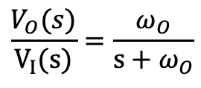
Motivation From Electrical Engineering
SPICE Design System
Vision: Design reaction networks based on desired input/output relationships
Inputs & outputs are species concentrations (signals)
Modules (subnetworks) transform signals in known ways
Given a desired output signal, automatically design the reaction network
Amplifier
Low pass filter
$$\frac{V_{O}(s)}{V_{I}(s)}=\frac{ω_{O}}{s+ω_{O}}$$
frequency

Slide 3
Modules simplify design, testing, reuse
Characteristics of modules
Explicit description of the inputs, outputs, and behaviors.
Modules interact only through their inputs and outputs.
Well-defined ways to compose modules into new modules

Slide 4
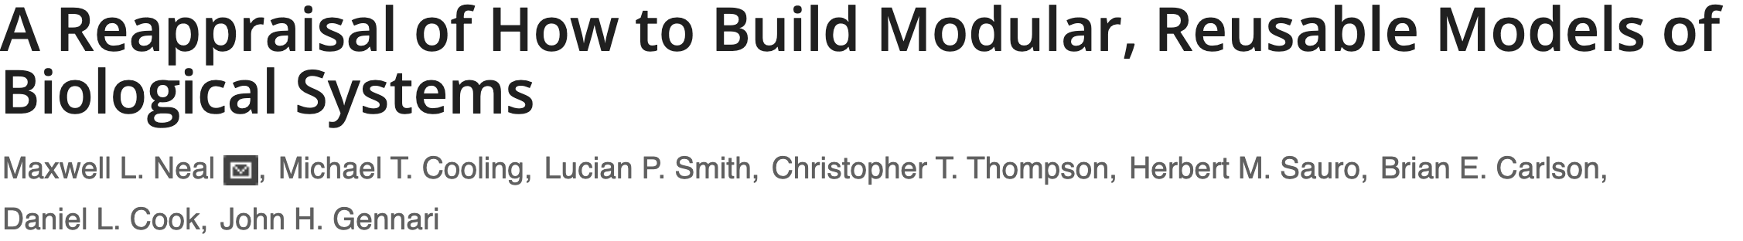
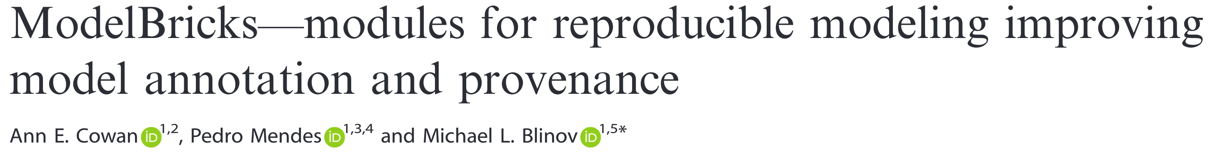
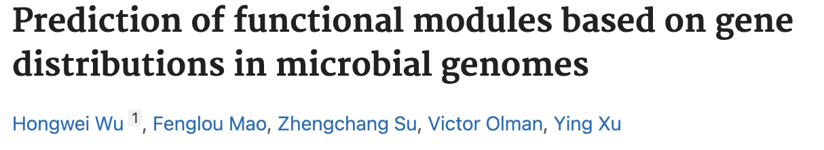
Related Work on Biochemical Modules
Alternatives to information hiding.
Standardized biological parts.
Predicting Gene Ontology annotations.
No formalization of the time course behavior of modules as is needed in a design system.

Slide 5
Scope
Demonstrate
Formal specification of a chemical module that describes its time course behavior
Recursive creation of modules by operations such as: scale, branch-join, concatenate, negative feedback, positive feedback
Automatic creation of a chemical network from a module specification
Limitations: SISO Linear Modules
Single input single output (SISO) modules
Dynamics are described by a system of linear differential equations (e.g., mass action kinetics with at most one reactant)
Time course behavior is described by a transfer function

Slide 6
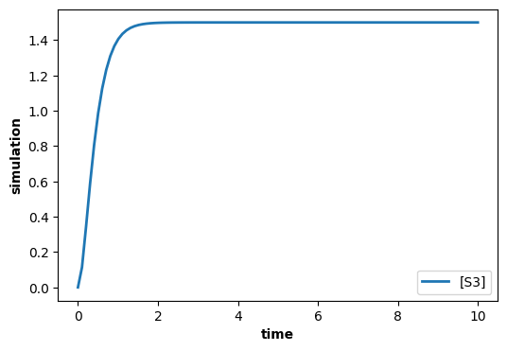
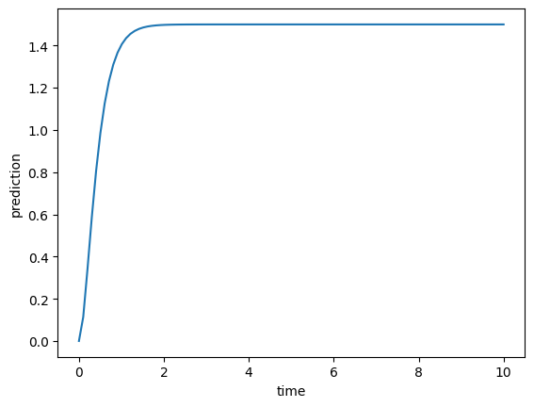
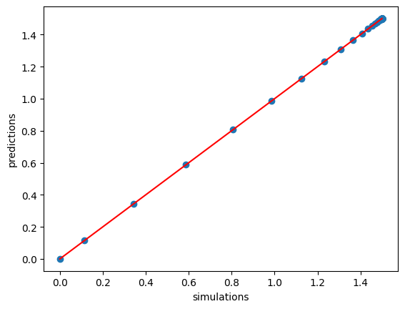





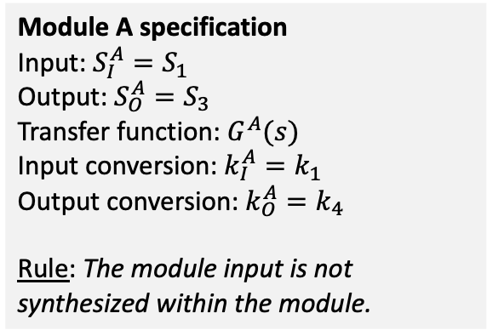



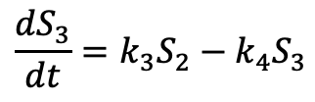

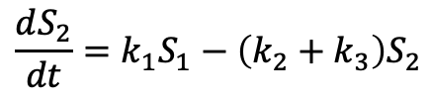
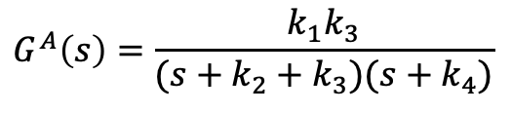
Modules
Transfer function: $G^{A}\left(s\right)=\frac{S_{3}(s)}{S_{1}(s)}$
System equations
$$\frac{dS_{2}}{dt}=k_{1}S_{1}−\left(k_{2}+k_{3}\right)S_{2}$$
$${sS}_{2}\left(s\right)=k_{1}S_{1}\left(s\right)−\left(k_{2}+k_{3}\right)S_{2}(s)$$
Module A
output
$$\frac{dS_{3}}{dt}=k_{3}S_{2}−k_{4}S_{3}$$
$${sS}_{3}\left(s\right)=k_{3}S_{2}\left(s\right)−k_{4}S_{3}(s)$$
input
S1
$$k_{1}S_{1}$$
S2
$$k_{3}S_{2}$$
S3
$$G^{A}\left(s\right)=\frac{k_{1}k_{3}}{(s+k_{2}+k_{3})(s+k_{4})}$$
$$k_{2}S_{2}$$
$$k_{4}S_{3}$$
$$∅$$
$$∅$$
Antimony & control.TransferFunction
Simulation vs. Prediction
Module A specification
Input: ${S_{I}^{A}=S}_{1}$
Output: ${S_{O}^{A}=S}_{3}$
Transfer function: $G^{A}(s)$
Input conversion: $k_{I}^{A}=k_{1}$
Output conversion: $k_{O}^{A}=k_{4}$
Rule: The module input is not synthesized within the module.
$S1 -> S2; kA1*S1
S2 -> ; kA2*S2
S2 -> S3; kA3*S2
S3 -> ; kA4*S3
kA1=1; kA2=2; kA3=3; kA4=4
S1=10; S2=0; S3=0
s = control.TransferFunction.s
tf = kA1*kA3/((s + kA2 + kA3)*(s + kA4))
_, PREDICTIONS_A = control.forced_response(tf,
T=TIMES, U=S1)

Slide 7
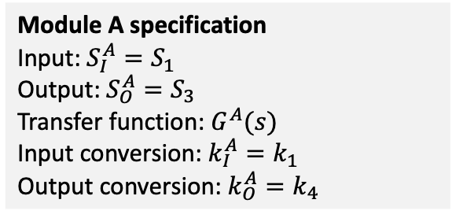
Operations on Modules
Module A specification
Input: ${S_{I}^{A}=S}_{1}$
Output: ${S_{O}^{A}=S}_{3}$
Transfer function: $G^{A}(s)$
Input conversion: $k_{I}^{A}=k_{1}$
Output conversion: $k_{O}^{A}=k_{4}$
The input to an operation is one or more modules and parameter values for the construction of a new module.
The output of an operation is a module.
Non-interacting modules have distinct species.
The concatenation of module A with module B means that the output of A is the same species as the input to B.

Slide 8
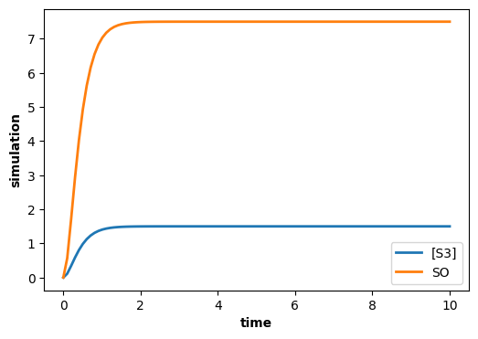






Example of a unary module operation: scale
Module A
output
input
Scale Network
output
input
?
S1
$$k_{1}S_{1}$$
S2
$$k_{3}S_{2}$$
S3
S3
S4
Scale Module
$$k_{2}S_{2}$$
$$k_{4}S_{3}$$
$$∅$$
Module AS
$$∅$$
Objective of the scale operator:
Given module A, construct Module AS whose output is m times the output of module A in isolation.
# Desired behavior using
# an assignment rule.
S1 -> S2; kA1*S1
S2 -> ; kA2*S2
S2 -> S3; kA3*S2
S3 -> ; kA4*S3
S4 ->; SO
kA1=1; kA2=2; kA3=3; kA4=4
$S1=10; S2=0; S3=0; S4=10
# Output of the scale network
m = 5
SO = 0
SO := m*S3
Approach
Create a new module, Scale Module, that scales its input.
Module AS is a new module constructed by concatenating Module A with the Scale Module.

Slide 9
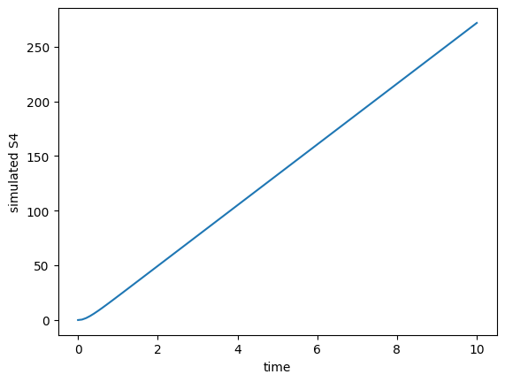








Failed Attempt at Scale Module
Desired behavior
Network A
input
output
input
Scale Network
output
$$k_{1}^{S}S_{3}$$
S1
$$k_{1}S_{1}$$
S2
$$k_{3}S_{2}$$
S3
S3
$$S_{3}→ {m S}_{4}$$
S4
Scale Module
$$k_{2}S_{2}$$
$$k_{4}S_{3}$$
$$∅$$
$$∅$$
Observations:
Did not get the desired output
Output is unstable
Affected the input (retroactivity)
# Failed attempt at scale module.
S1 -> S2; kA1*S1
S2 -> ; kA2*S2
S2 -> S3; kA3*S2
S3 -> ; kA4*S3
S3 -> m S4; kS1*S3 // Scale network
kA1=1; kA2=2; kA3=3; kA4=4; kS1=50
$S1=10; S2=0; S3=0; S4=0
m = 5
Solutions:
Scale Module adjusts for retroactivity
Scale Module degrades the output to ensure stability
$S_{4}$ is not equal to desired.

Slide 10








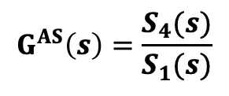





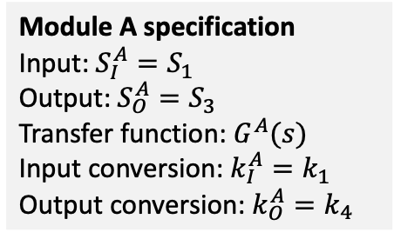


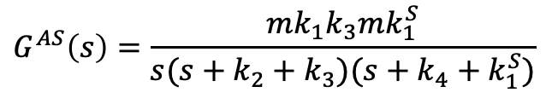


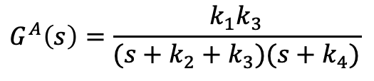
Transfer Function of Scale Module?
Desired behavior
Network A
input
output
input
Scale Network
output
$$k_{1}^{S}S_{3}$$
S1
$$k_{1}S_{1}$$
S2
$$k_{3}S_{2}$$
S3
S3
$$S_{3}→ {m S}_{4}$$
S4
Module A specification
Input: ${S_{I}^{A}=S}_{1}$
Output: ${S_{O}^{A}=S}_{3}$
Transfer function: $G^{A}(s)$
Input conversion: $k_{I}^{A}=k_{1}$
Output conversion: $k_{O}^{A}=k_{4}$
Scale Module
$$k_{2}S_{2}$$
$$k_{4}S_{3}$$
$$∅$$
$$∅$$
Transfer function: $G^{A}\left(s\right)=\frac{S_{3}(s)}{S_{1}(s)}$
$$G^{AS}\left(s\right)=\frac{S_{4}(s)}{S_{1}(s)}$$
$${sS}_{2}\left(s\right)=k_{1}S_{1}\left(s\right)−\left(k_{2}+k_{3}\right)S_{2}(s)$$
$${sS}_{3}\left(s\right)=k_{3}S_{2}\left(s\right)−k_{4}S_{3}(s)$$
$${sS}_{2}\left(s\right)=k_{1}S_{1}\left(s\right)−\left(k_{2}+k_{3}\right)S_{2}(s)$$
$$simulation$$
$${sS}_{3}\left(s\right)=k_{3}S_{2}\left(s\right)−{(k}_{4}+k_{1}^{S})S_{3}(s)$$
$$G^{A}\left(s\right)=\frac{k_{1}k_{3}}{(s+k_{2}+k_{3})(s+k_{4})}$$
$${sS}_{4}\left(s\right)={mk}_{1}^{S}S_{3}\left(s\right)$$
$$G^{AS}\left(s\right)=\frac{mk_{1}k_{3}mk_{1}^{S}}{s(s+k_{2}+k_{3})(s+k_{4}+k_{1}^{S})}$$
$G^{AS}\left(s\right)=G^{A}\left(s\right)\frac{s+k_{O}^{A}}{s+k_{O}^{A}+k_{1}^{S}}$ $\frac{1}{s}mk_{1}^{S}$
$$prediction$$

Slide 11
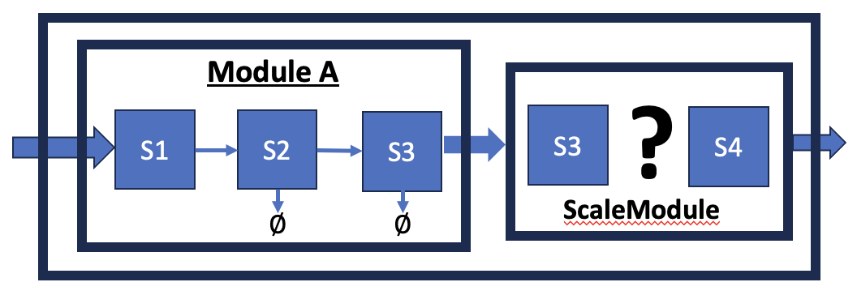
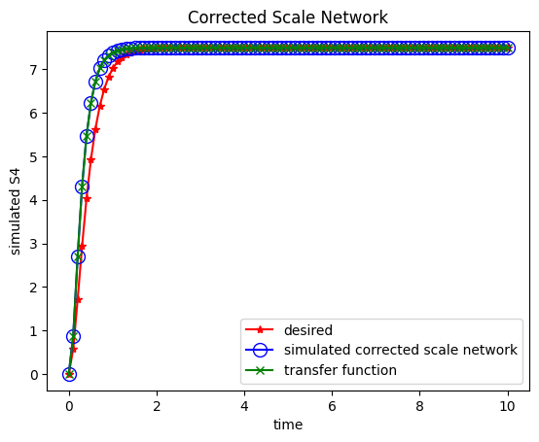


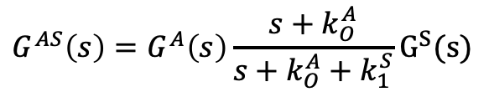



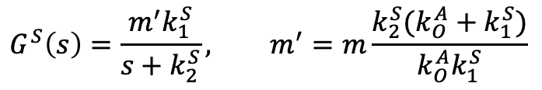


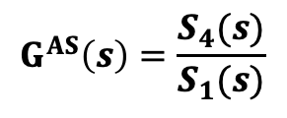
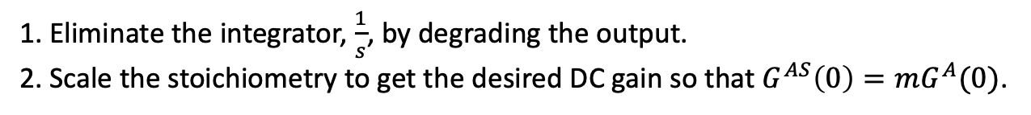




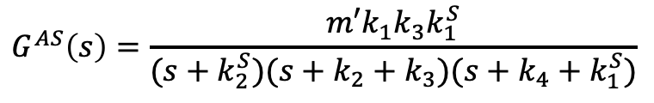
Corrected Scale Module: DC Gain
1. Eliminate the integrator, $\frac{1}{s}$, by degrading the output.
2. Scale the stoichiometry to get the desired DC gain so that $G^{AS}\left(0\right)=mG^{A}(0)$.
input
Scale Network
output
input
Scale Network
output
$$k_{1}^{S}S_{3}$$
$$k_{1}^{S}S_{3}$$
S3
$$S_{3}→ {m S}_{4}$$
S4
S3
$$S_{3}→ {m′ S}_{4}$$
S4
Desired behavior
Old Scale Module
$$k_{2}^{S}S_{4}$$
New Scale Module
$$∅$$
$$G^{AS}\left(s\right)=\frac{S_{4}(s)}{S_{1}(s)}$$
$${sS}_{2}\left(s\right)=k_{1}S_{1}\left(s\right)−\left(k_{2}+k_{3}\right)S_{2}(s)$$
$$G^{S}\left(s\right)=\frac{m^{′}k_{1}^{S}}{s+k_{2}^{S}}, m^{′}=m\frac{k_{2}^{S}(k_{O}^{A}+k_{1}^{S})}{k_{O}^{A}k_{1}^{S}}$$
$${sS}_{3}\left(s\right)=k_{3}S_{2}\left(s\right)−{(k}_{4}+k_{1}^{S})S_{3}(s)$$
${sS}_{4}\left(s\right)={m′k}_{1}^{S}S_{3}\left(s\right)−k_{2}^{S}S_{4}(s)$
$$G^{AS}\left(s\right)=G^{A}\left(s\right)\frac{s+k_{O}^{A}}{s+k_{O}^{A}+k_{1}^{S}}G^{S}(s)$$
$$G^{AS}\left(s\right)=\frac{m′k_{1}k_{3}k_{1}^{S}}{(s+k_{2}^{S})(s+k_{2}+k_{3})(s+k_{4}+k_{1}^{S})}$$
$G^{AS}\left(s\right)=G^{A}\left(s\right)\frac{s+k_{O}^{A}}{s+k_{O}^{A}+k_{1}^{S}}$ $\frac{{m′k}_{1}^{S}}{s+k_{2}^{S}}$
$$G^{AS}\left(0\right)=mG^{A}(0)$$
Notes:
1. The rise time of the scale network is faster than the “desired” network because the dominant pole has a smaller (more negative) value.

Slide 12


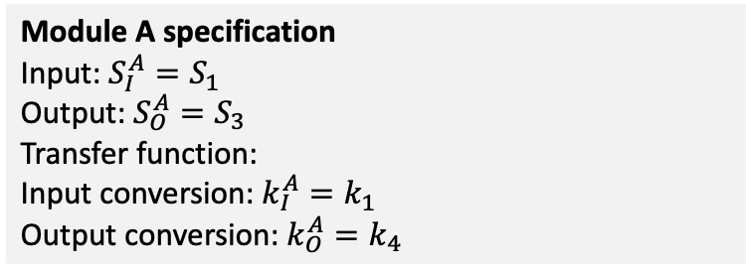


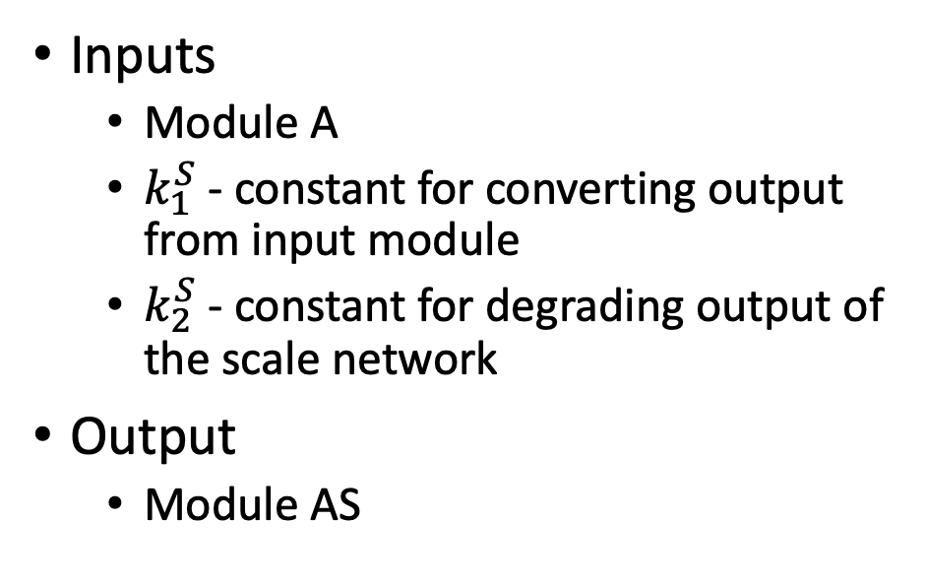



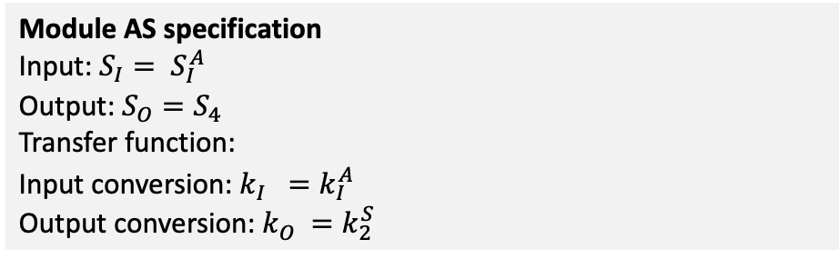



Scale Operator
input
output
input
Scale Network
output
$$k_{1}^{S}S_{3}$$
S1
$$k_{1}S_{1}$$
S2
$$k_{3}S_{2}$$
S3
S3
$$S_{3}→ {m′ S}_{4}$$
S4
$$k_{2}S_{2}$$
$$k_{4}S_{3}$$
$$k_{2}^{S}S_{4}$$
Scale Module
$$∅$$
Module A
$$∅$$
$$∅$$
Module AS
Inputs
Module A
$k_{1}^{S}$ - constant for converting output from input module
$k_{2}^{S}$ - constant for degrading output of the scale network
Output
Module AS
Module A specification
Input: ${S_{I}^{A}=S}_{1}$
Output: ${S_{O}^{A}=S}_{3}$
Transfer function:
Input conversion: $k_{I}^{A}=k_{1}$
Output conversion: $k_{O}^{A}=k_{4}$
$$\frac{k_{1}k_{3}}{(s+k_{2}+k_{3})(s+k_{4})}$$
Module AS specification
Input: ${{S_{I}= S}_{I}^{A}}_{}$
Output: ${S_{O}=S}_{4}$
Transfer function:
Input conversion: $k_{I}^{}=k_{I}^{A}$
Output conversion: $k_{O}^{}=k_{2}^{S}$
$$G^{A}\left(s\right)\frac{s+k_{O}^{A}}{s+k_{O}^{A}+k_{1}^{S}}\frac{m^{′}k_{1}^{S}}{s+k_{2}^{S}}$$
$$m^{′}=m\frac{k_{2}^{S}(k_{O}^{A}+k_{1}^{S})}{k_{O}^{A}k_{1}^{S}}$$

Slide 13














































Operators on Network Modules (A and B)
concatenate
scale
positive feedback
$$GA(s)$$
$$G^{B}(s)$$
$$GA(s)$$
$${k_{1}S}_{O}^{A}$$
$$k_{1}S_{I}$$
$$k_{2}X_{I}$$
$$G(s)$$
$$k_{3}S_{O}^{A}$$
$$S_{I}^{A}$$
$${=S}_{I}^{B}$$
$$S_{O}^{B}$$
$$S_{I}=$$
$$S_{I}^{A}$$
$$S_{O}^{A}=$$
$${m′S}_{O}$$
$$S_{I}$$
$$X_{I}$$
$$S_{I}^{A}$$
$$S_{O}^{A}$$
$$S_{O}$$
$$S_{O}^{A}=$$
$$k_{2}S_{O}$$
$$k_{4}S_{O}$$
$$∅$$
$$k_{5}S_{O}$$
$$∅$$
branchjoin
negative feedback
$$k_{1a}^{}S_{I}$$
$$GA(s)$$
$$S_{I}^{A}$$
$$S_{O}^{A}$$
$$k_{2a}^{}S_{O}^{A}$$
$$k_{1}S_{I}$$
$$k_{2}X_{I}$$
$$G(s)$$
$$k_{3}S_{O}^{A}$$
$$S_{I}$$
$$X_{I}$$
$$S_{I}^{A}$$
$$S_{O}^{A}$$
$$S_{O}$$
$$S_{I}$$
$$S_{O}$$
$$k_{5}S_{O}$$
$$k_{4}S_{O}$$
$$k_{1b }^{}S_{I}$$
$$G^{B}(s)$$
$$k_{2b}^{}S_{O}^{B}$$
$$k_{3}S_{O}$$
$$S_{I}^{B}$$
$$∅$$
$$∅$$
$$∅$$
$$S_{O}^{B}$$

Slide 14
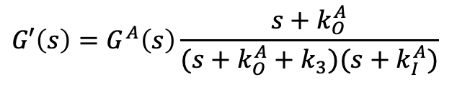
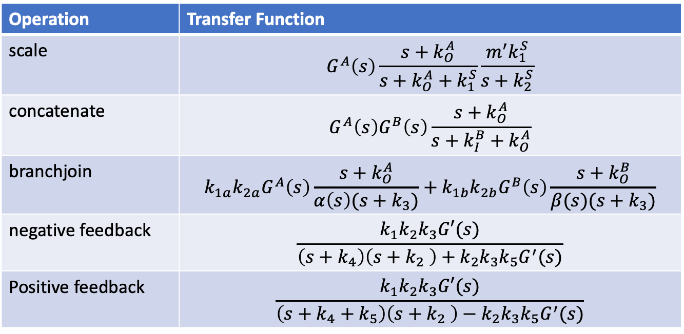
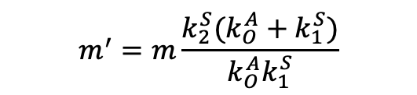


Transfer Functions of Modules Created by Operators
Operation | Transfer Function
scale | $$G^{A}\left(s\right)\frac{s+k_{O}^{A}}{s+k_{O}^{A}+k_{1}^{S}}\frac{m^{′}k_{1}^{S}}{s+k_{2}^{S}}$$
concatenate | $$G^{A}\left(s\right)G^{B}\left(s\right)\frac{s+k_{O}^{A}}{s+k_{I}^{B}+k_{O}^{A}}$$
branchjoin | $$k_{1a}k_{2a}G^{A}\left(s\right)\frac{s+k_{O}^{A}}{α\left(s\right)(s+k_{3})}+k_{1b}k_{2b}G^{B}\left(s\right)\frac{s+k_{O}^{B}}{β(s)(s+k_{3})}$$
negative feedback | $$\frac{k_{1}k_{2}k_{3}G′(s)}{\left(s+k_{4}\right)\left(s+k_{2} \right)+k_{2}k_{3}k_{5}G^{′}(s)}$$
Positive feedback | $$\frac{k_{1}k_{2}k_{3}G′(s)}{\left(s+k_{4}+k_{5}\right)\left(s+k_{2} \right)−k_{2}k_{3}k_{5}G^{′}(s)}$$
$$G′\left(s\right)=G^{A}\left(s\right)\frac{s+k_{O}^{A}}{(s+k_{O}^{A}+k_{3})(s+k_{I}^{A})}$$
$$α\left(s\right)=(s+k_{I}^{A})(s+k_{O}^{A}+k_{2a})$$
$$m^{′}=m\frac{k_{2}^{S}(k_{O}^{A}+k_{1}^{S})}{k_{O}^{A}k_{1}^{S}}$$
$$β\left(s\right)=(s+k_{I}^{B})(s+k_{O}^{B}+k_{2b})$$

Slide 15
Next Steps
Verify operator transfer functions
Do arbitrary operations on network modules
Compare simulation results with transfer functions
Construct design algorithm
Given a transfer function, construct a reaction network with that transfer function
Challenges
Imaginary poles require using negative feedback
Zeroes (non-zero powers of s in the numerator) require branchjoin

Slide 16


Example of a unary module operation: scale
Module A
Scale Network
?
S1
S2
S3
S3
S4
ScaleModule
$$∅$$
$$∅$$

