Slide 1
A Mathematical Framework for Modular Biological Networks
JL Hellerstein
Feb 16, 2024

Slide 2
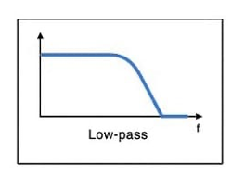
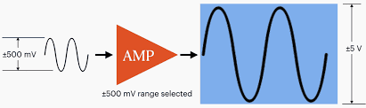
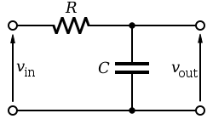
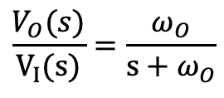
Motivation From Electrical Engineering
Design reaction networks based on desired input/output relationships
Inputs & outputs are “signals” (e.g., species concentrations, fluxes)
Subnetworks transform signals in known ways
Design reaction network by properly assembling well understood subnetworks
Examples from electrical engineering
Amplifier
Low pass filter
$$\frac{V_{O}(s)}{V_{I}(s)}=\frac{ω_{O}}{s+ω_{O}}$$
frequency

Slide 3
Objective
Develop a methodology for constructing modular reaction networks with predictable behaviors
Behaviors are time courses of species concentrations
Initial scope
Single Input Single Output (SISO) networks
Networks have linear dynamics and so can be described by transfer functions

Slide 4
Example: Scale Operation

Slide 5
Modular SISO Reaction Network
Single input species and single output species

Slide 6














Branchjoin
$$GA(s)$$
$$k_{1}^{A}$$
$$S_{I}^{A}$$
$$S_{O}^{A}$$
$$k_{2}^{A}$$
$$S_{I}$$
$$S_{O}$$
$$k_{3}$$
$$k_{1}^{B}$$
$$G^{B}(s)$$
$$k_{2}^{B}$$
$$∅$$
$$S_{I}^{B}$$
$$S_{O}^{B}$$

Slide 7

















Sequential Pathway
$$k_{0}$$
$$k_{1}$$
$$G(s)$$
$$k_{N−1}$$
$$k_{2}$$
$$S_{0}$$
$$S_{1}$$
$${N.S}_{I}$$
$$S_{2}$$
$${N.S}_{O}$$
$$S_{N}$$
$$k_{1}^{′}$$
$$k_{2}^{′}$$
$$k_{N}^{′}$$
$$∅$$
$$∅$$
$$∅$$

Slide 8










Loop
$$k_{1}$$
$$k_{2}$$
$$G(s)$$
$$k_{3}$$
$$k_{4}$$
$$S_{I}$$
$$X_{I}$$
$${N.S}_{I}$$
$${N.S}_{O}$$
$$X_{O}$$
$$S_{O}$$
$$k_{6}$$
$$∅$$
$$k_{5}$$

Slide 9
BACKUP

Slide 10


















Fork-Join
$$GA(s)$$
$${NA.S}_{I}$$
$${NA.S}_{O}$$
$$k_{3}^{A}$$
$$k_{2}^{A}$$
$$k_{1}$$
$$k_{4}$$
$$S_{I}$$
$$X_{I}$$
$$X_{O}$$
$$S_{O}$$
$$k_{6}$$
$$GB(s)$$
$$k_{2}^{B}$$
$${NB.S}_{I}$$
$${NB.S}_{O}$$
$$k_{3}^{B}$$
$$∅$$

