Slide 1
Analysis of Subsystem Interactions in Chemical Reaction Networks
Joe Hellerstein
March 12, 2026
Notes:
Diverse students. Some with bio-backgrounds; some without. Some with CS background; some with very limited. Two separate courses combined because of a substantial shared curriculum.

Slide 2
Objectives
Understand the effect of combining chemical reaction networks (CRNs)
Stability
Step response (DC Gain)

Slide 3
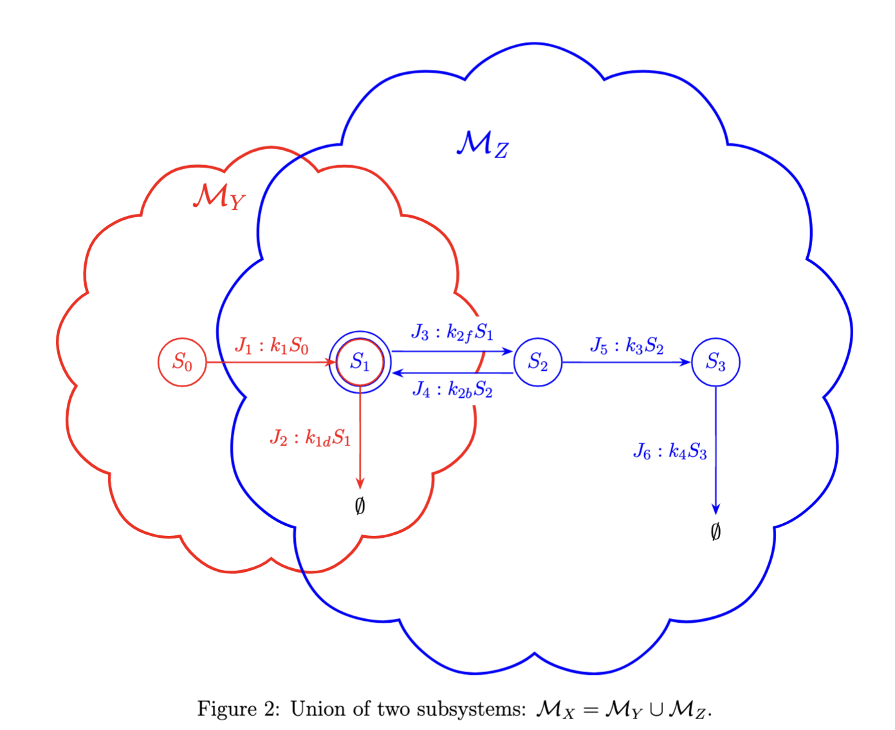
Subsystems
A subsystem of a chemical reaction network (CRN) is a subset of the species and reactions of the CRN.
The subset of species must include all participants of the subset of reactions.
Rate laws are a linear combination of species concentrations (not limited to reactants.

Slide 4

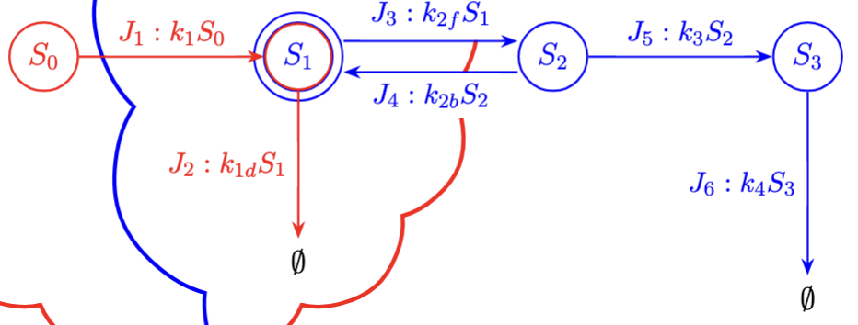
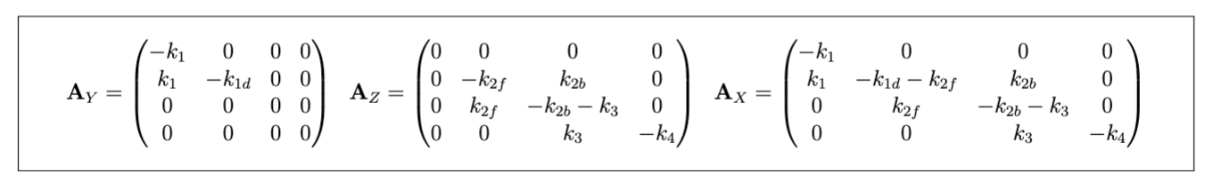
Jacobian of a Subsystem
The dynamics, $ẋ,$ of a subsystem are described by its Jacobian, $A$.
$b$ is the vector of forced inputs (on for each state variable).
The Jacobian of the combined subsystem is the sum of the Jacobians of the individual subsystems if the individual subsystems have no reaction in common.

Slide 5
Stability
Stable if no eigenvalue is positive
How do we assess if the combination of two subsystems is stable if we know the stability of the individual subsystems?
Approach 1: Combine subsystems and then calculate eigenvalues
But this yields no insight into desirable combinations of subsystems

Slide 6
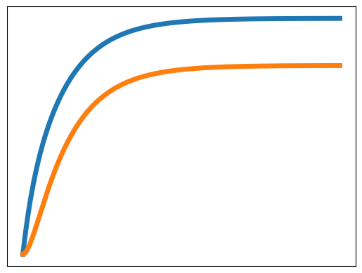
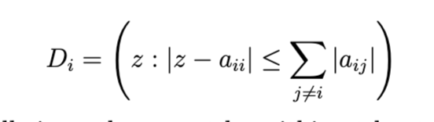


Gershgorin Disks for Stability Analysis
Model
Time course
Jacobian
Eigenvalues
Jacobian
-> S1; 1
S1 -> S2; S1
S2 -> S1; 0.5*S2
S2 -> ; 0.75*S2
$$\left(\begin{matrix}−1 & 0.5 \\ 1 & −1.25\end{matrix}\right)$$
-0.4, -1.8
Gershgorin Disks
Eigenvalues must lie in at least one disk.
Disks for example
$$[−1.5, −0.5], [−2.25, −0.25]$$
Prediction
Stable

Slide 7
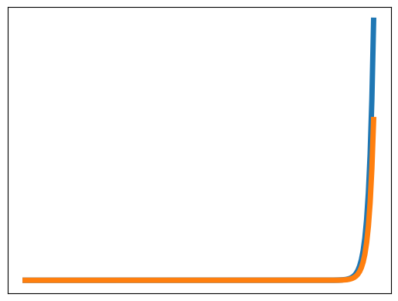
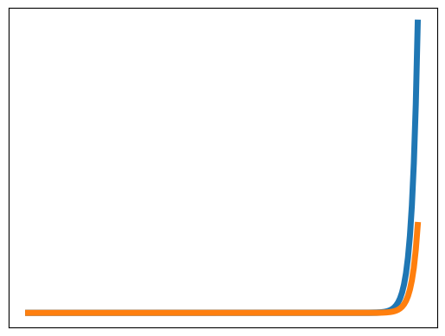
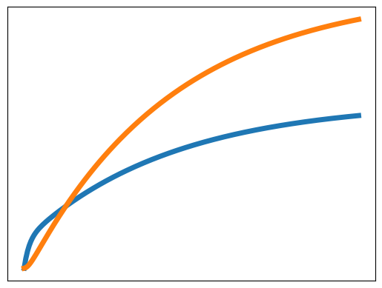








(a)
(b)
(c)
(d)
-> S1; 1
S1 -> S2; S1
S2 -> S1; 0.5*S2
S2 -> ; 0.75*S2
-> S1; 1
S1 -> S1 + S2; S1
S1 -> ; 3*S1
S2 -> S1 + 2 S2; 1.4*S2
S2 -> ; 2*S2
Model
-> S1; 1
S1 -> 4 S1 + S2; S1
S2 -> S1 + 3 S2; S2
-> S1; 1
S1 -> 4 S1 + S2; S1
S2 -> S1 + S2; S2
Time course
Jacobian
$$\left(\begin{matrix}−1 & 0.5 \\ 1 & −1.25\end{matrix}\right)$$
$$\left(\begin{matrix}3 & 1 \\ 1 & 2\end{matrix}\right)$$
$$\left(\begin{matrix}3 & 1 \\ 1 & 0\end{matrix}\right)$$
$$\left(\begin{matrix}−3 & 1.4 \\ 1 & −0.6\end{matrix}\right)$$
Eigenvalues
-0.4, -1.8
3.6, 1.4
3.3, -0.3
-3.5, -0.1
G. disks
$$[−1.5, −0.5], [−2.25, −0.25]$$
$$[2,4], [1, 3]$$
$$[2,4], [−1, 1]$$
$$[−4.4,−1.6], [−0.4, 0.4]$$
Prediction
definitely stable
definitely unstable
indeterminate
indeterminate

Slide 8
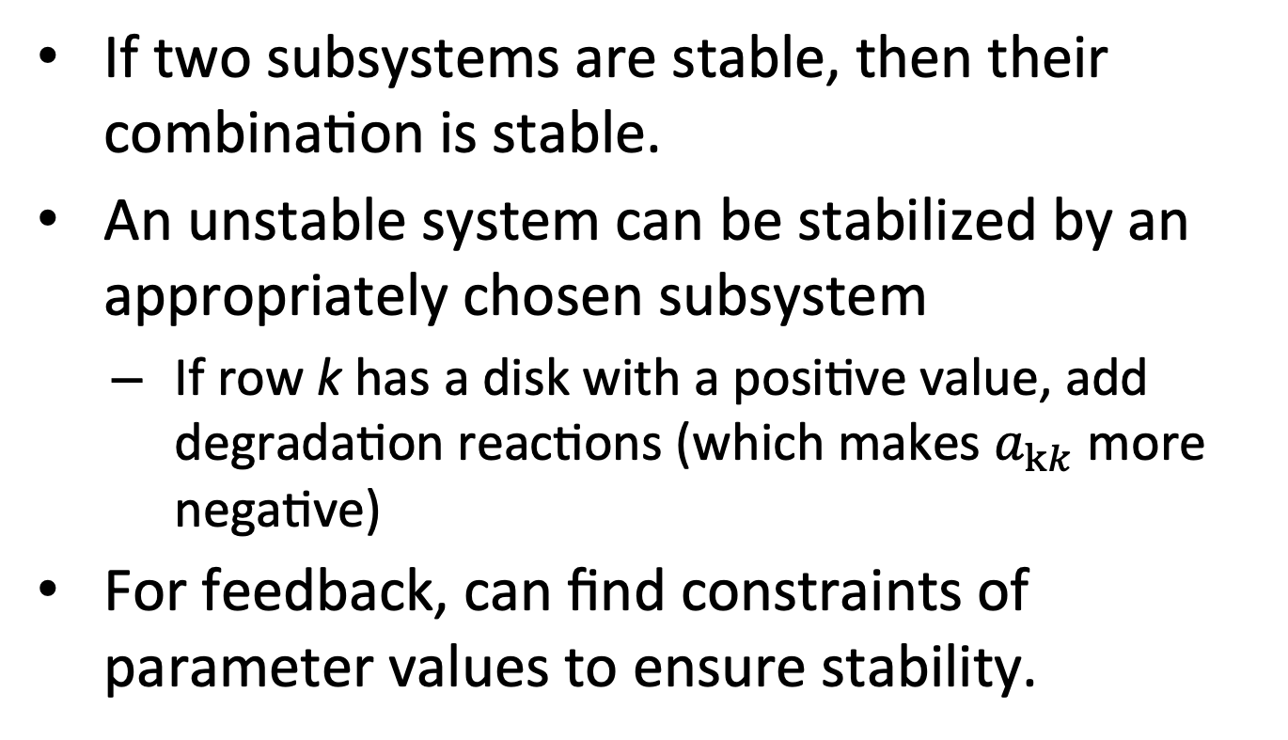
Insights Using GDT
If two subsystems are stable, then their combination is stable.
An unstable system can be stabilized by an appropriately chosen subsystem
If row k has a disk with a positive value, add degradation reactions (which makes $a_{kk}$more negative)
For feedback, can find constraints of parameter values to ensure stability.

Slide 9
Step Response
Defn of step response: Change in steady state values change when there is a unit change in one or more values of forced inputs (b).
Objective: Given two subsystems (including their Jacobians), what is the step response of the combined system with the same forced inputs? Assume
Subsystems are stable
No reactions in common

Slide 10
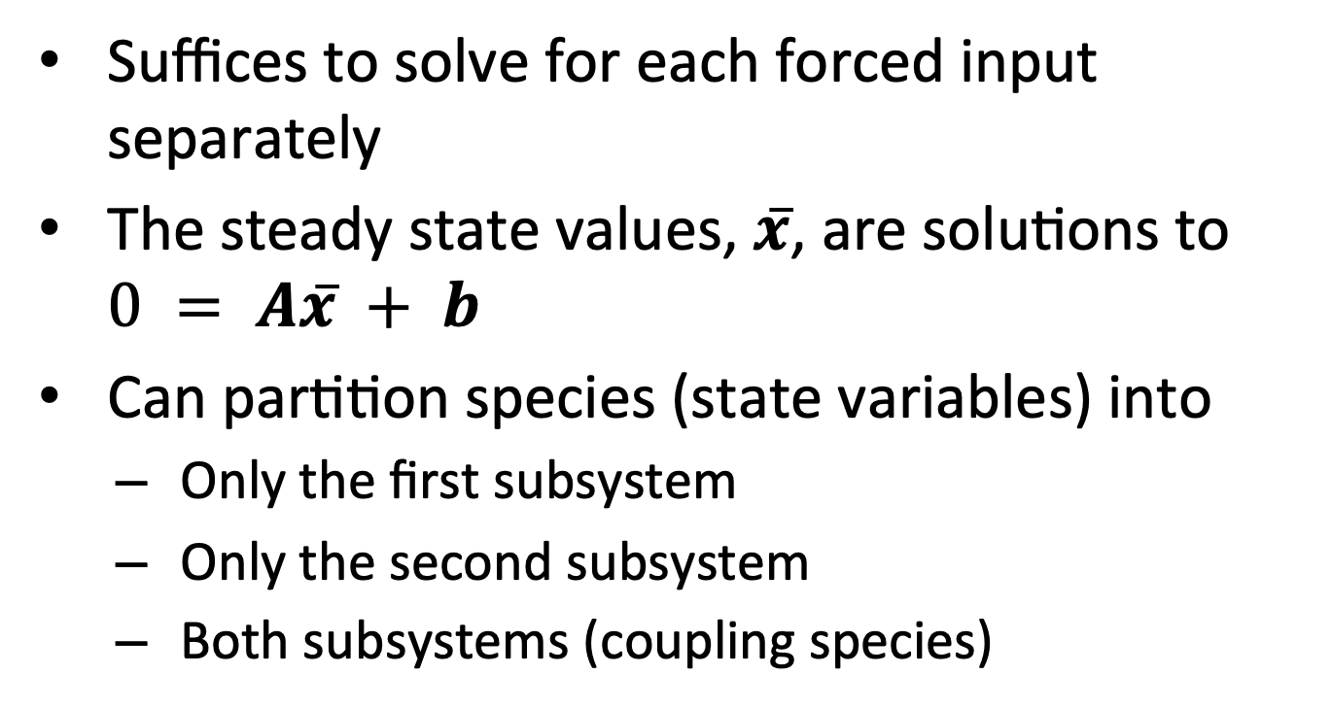
Step Response: Simplifications
Suffices to solve for each forced input separately
The steady state values, $x̅$, are solutions to $0 = Ax̅ + b$
Can partition species (state variables) into
Only the first subsystem
Only the second subsystem
Both subsystems (coupling species)

Slide 11
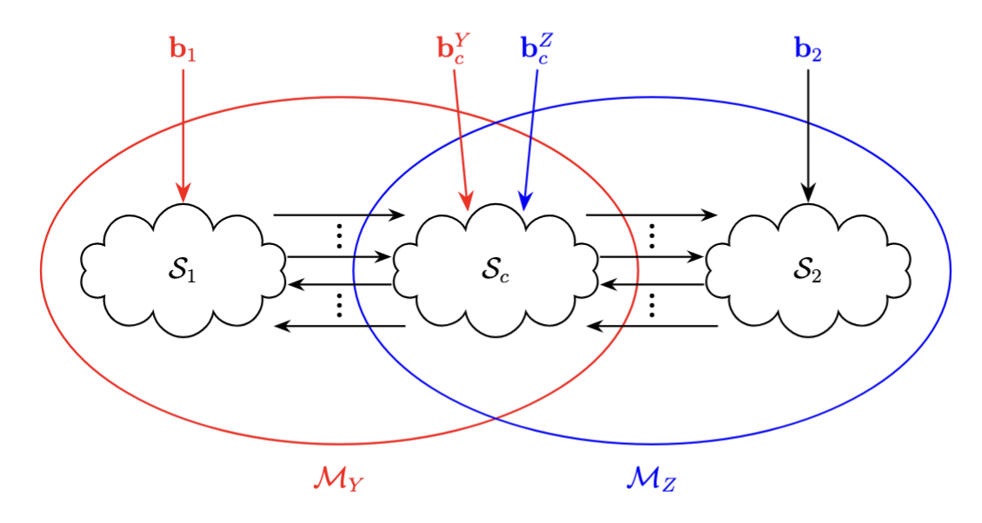
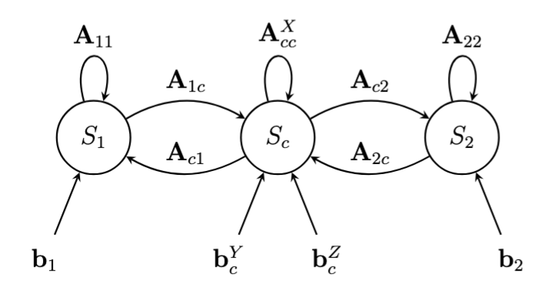
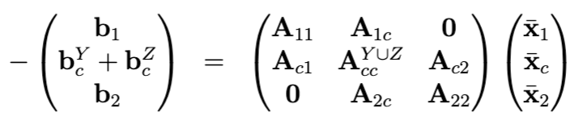

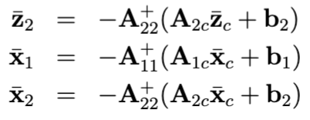
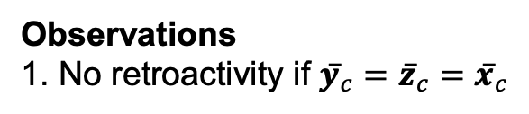
Combining Subsystem Y and Z
Coupling species
Observations
1. No retroactivity if $y̅_{c}=z̅_{c}=x̅_{c}$

Slide 12
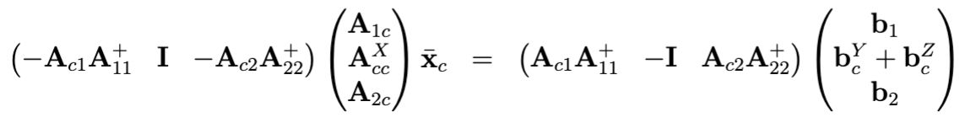
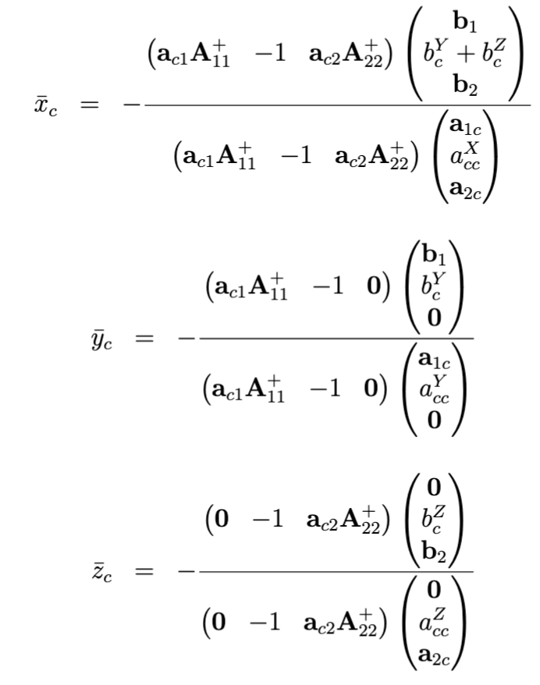
Solving for Coupling Species
Single coupling species

Slide 13
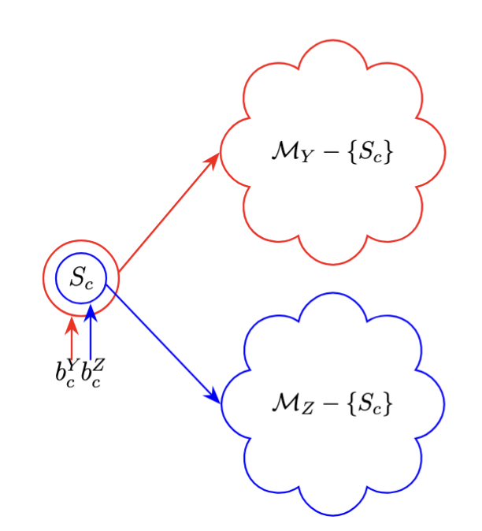
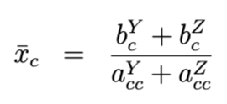
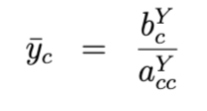
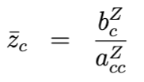

Branch Structure
$$a_{c1}=0=a_{c2}$$
Constraint for eliminating retroactivity ($y̅_{c}=z̅_{c}=x̅_{c}) depend on forced inputs.$

Slide 14
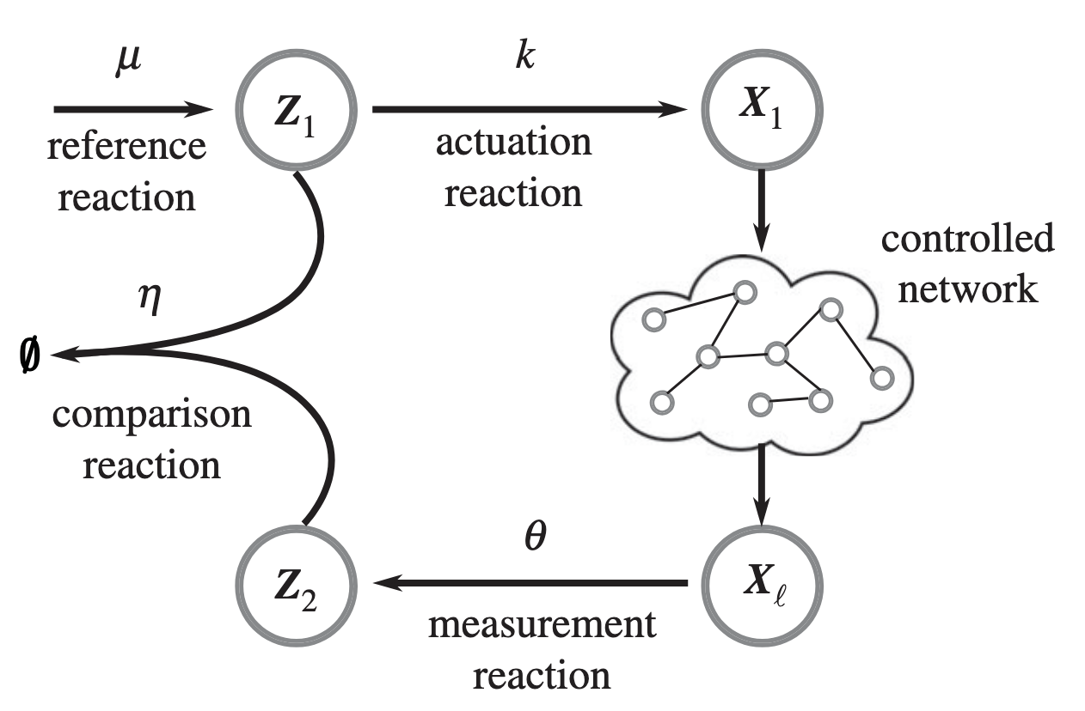
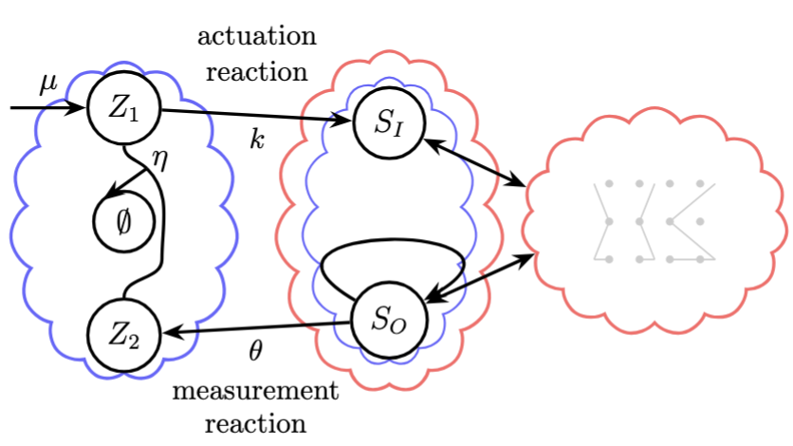
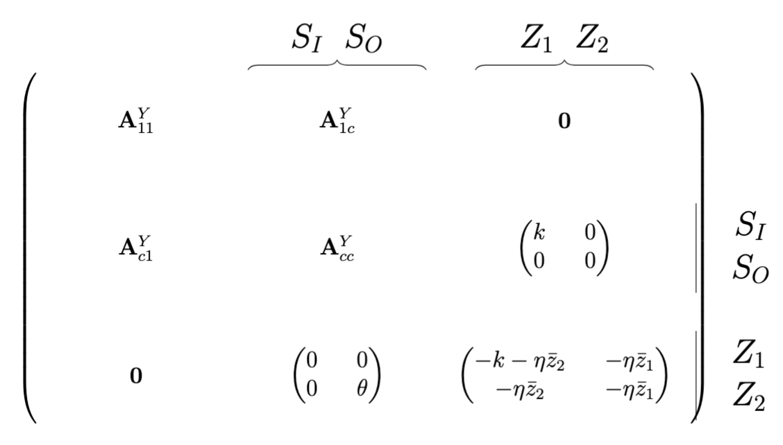
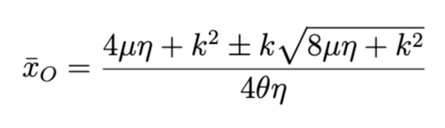
Antithetic Proportional Control
S_{I}
S_{O}
The steady state concentration of S_{O} (x_{O}) is independent of the force inputs.

Slide 15
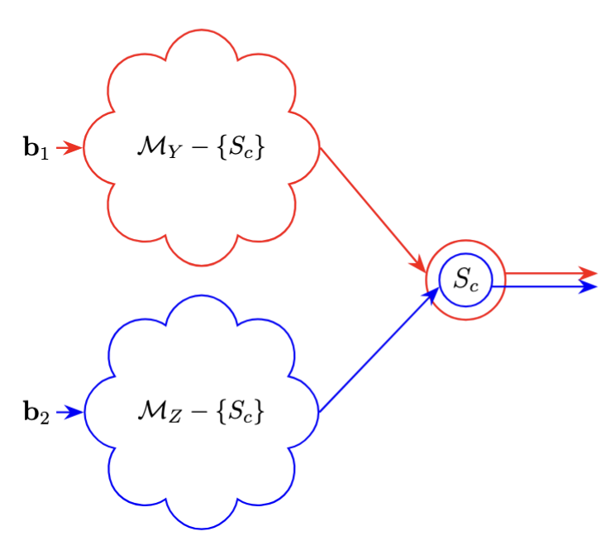
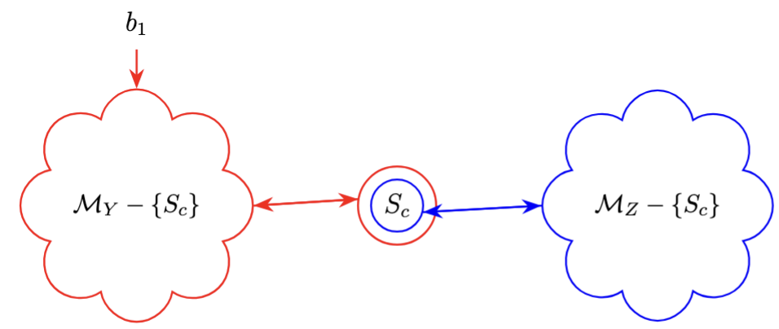
Other Structures
Bi-directional Interactions
Join

Slide 16
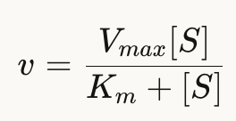
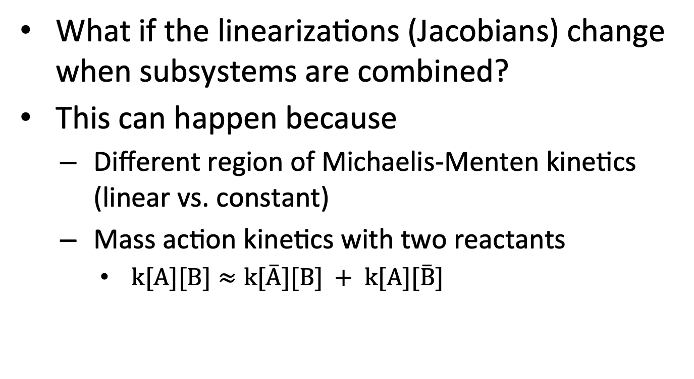
But …
What if the linearizations (Jacobians) change when subsystems are combined?
This can happen because
Different region of Michaelis-Menten kinetics (linear vs. constant)
Mass action kinetics with two reactants
$k[A][B]≈k[A̅][B] + k[A][B̅]$

Slide 17
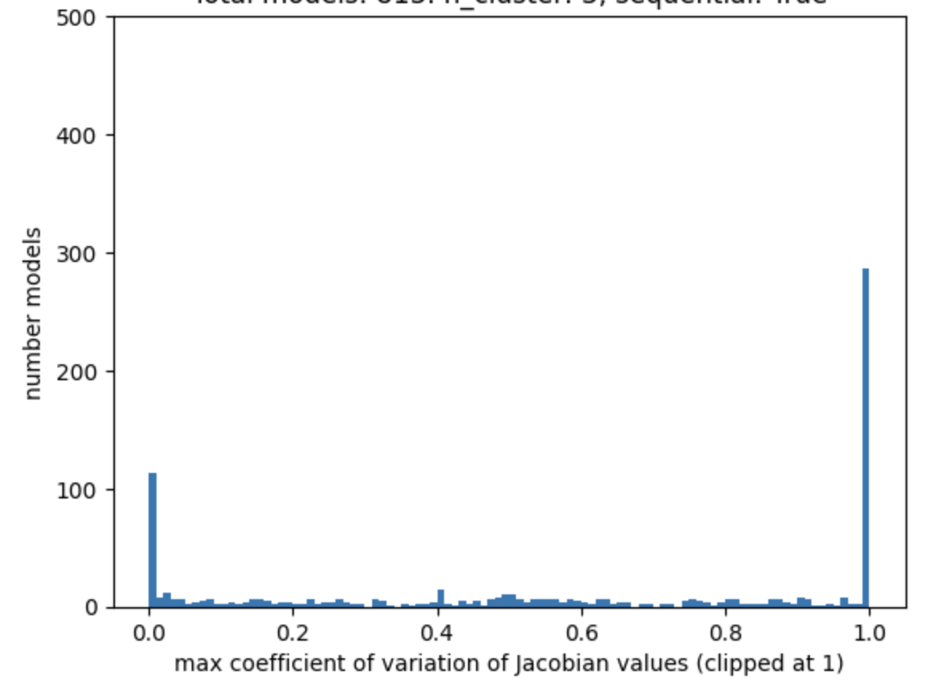
How Good are Linear Approximations in BioModels?
Linear model is a good approximation if the Jacobian does not change over time.
Calculated the maximum coefficient of variant of entries in Jacobians over 100 time points for ~800 models in BioModels
Linear approximation likely works well for ~100 models.

Slide 18
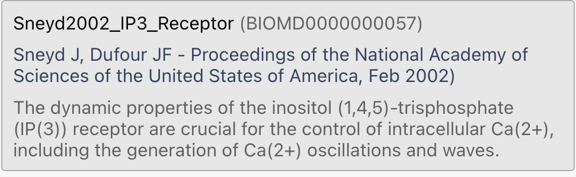
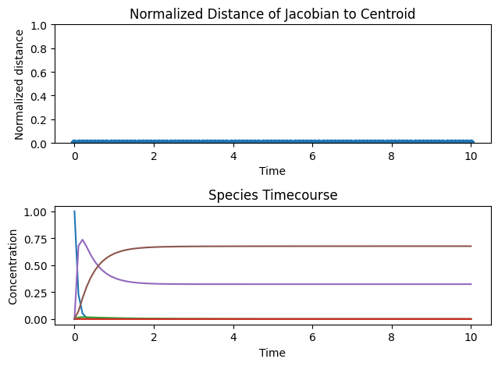
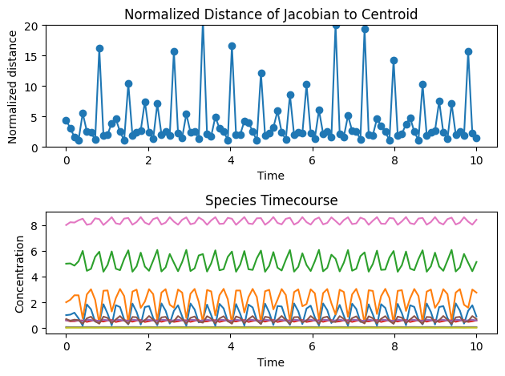
Example: BioModels 57
Jch: CaER => Ca_Cyt; Jch_Fch_0*p1*p2*p3;
Jleak: CaER => Ca_Cyt; Jleak_Fleak;
Jpump: Ca_Cyt => CaER; Jpump_Fpump_0*Ca_Cyt/(Jpump_Kpump + Ca_Cyt);
Wolf Model Counter example

Slide 19
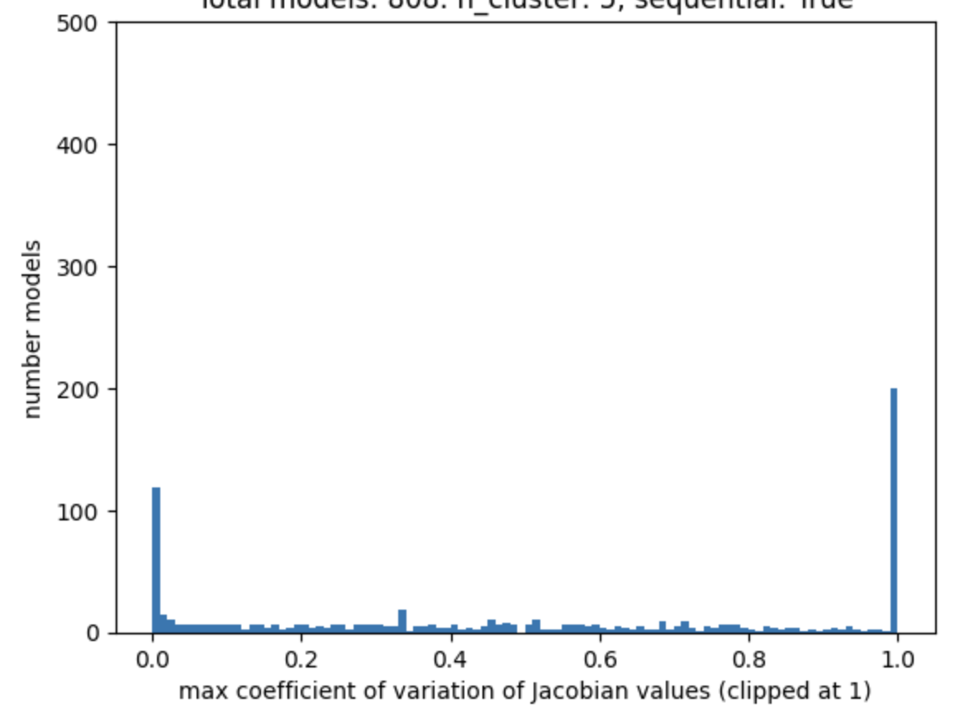
Approximating BioModels With Multiple Jacobians
Linear model is a good approximation if the Jacobian does not change over time.
Calculated the maximum coefficient of variant of entries in Jacobians over 100 time points for ~800 models in BioModels
1 Jacobian
3 Jacobians

Slide 20
Assessing Effect of Combining Subsystems
Consider multiple Jacobians for a subsystem
Jacobians reflect different operating regions
Do stability and step response analysis for the combinations that best reflect the expected operating region
Evaluate on BioModels
Find model pairs with overlapping species
Find Jacobians for models in isolation
Predict stability and step response using multi-Jacobian analysis
Compare predictions with simulations of the combined models

Slide 21
BACKUP

Slide 22
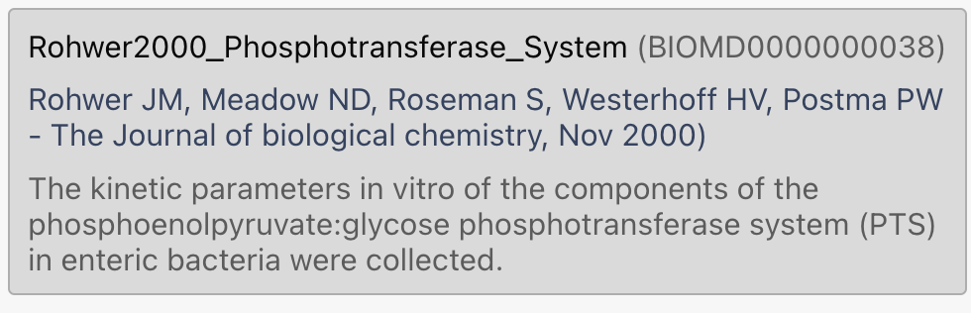
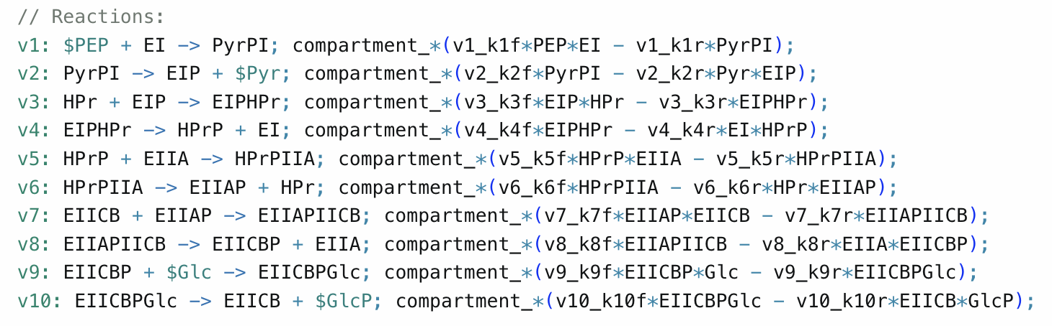
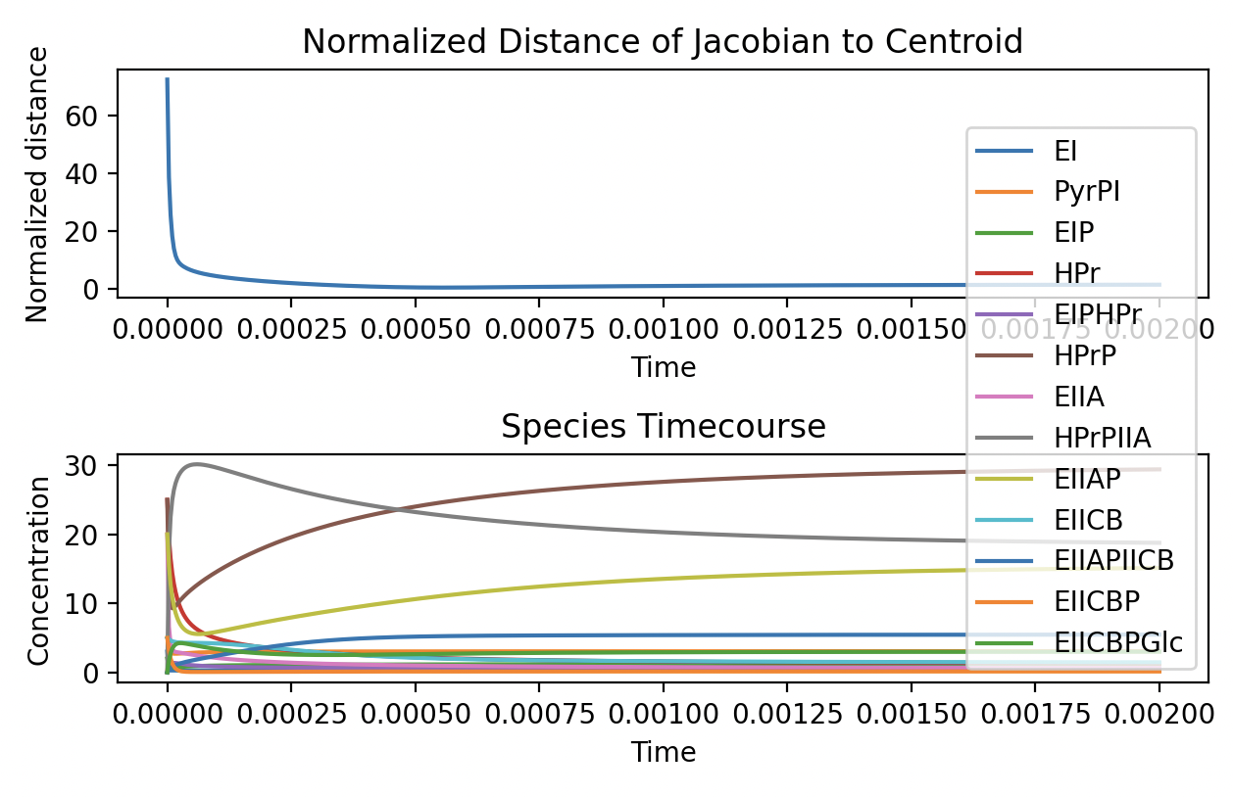
BioModels 38
Lots of nonlinear rate laws: 2 reactants, MM kinetics
Seems like two Jacobians provide a good approximation

Slide 23
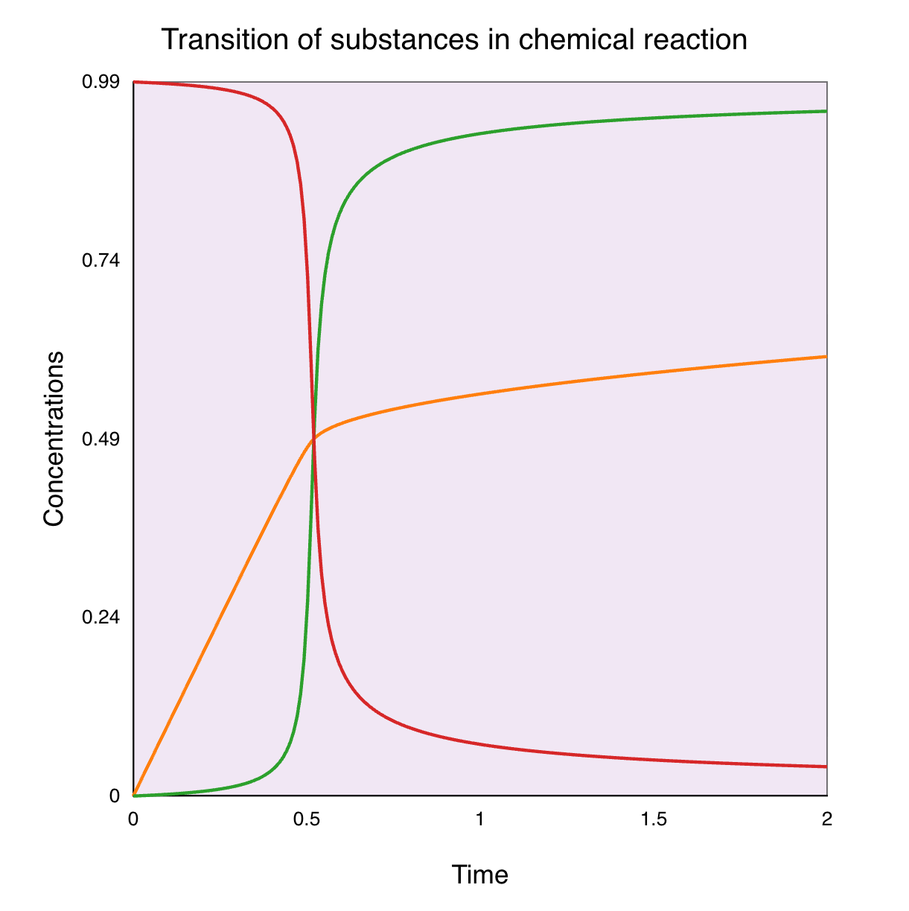
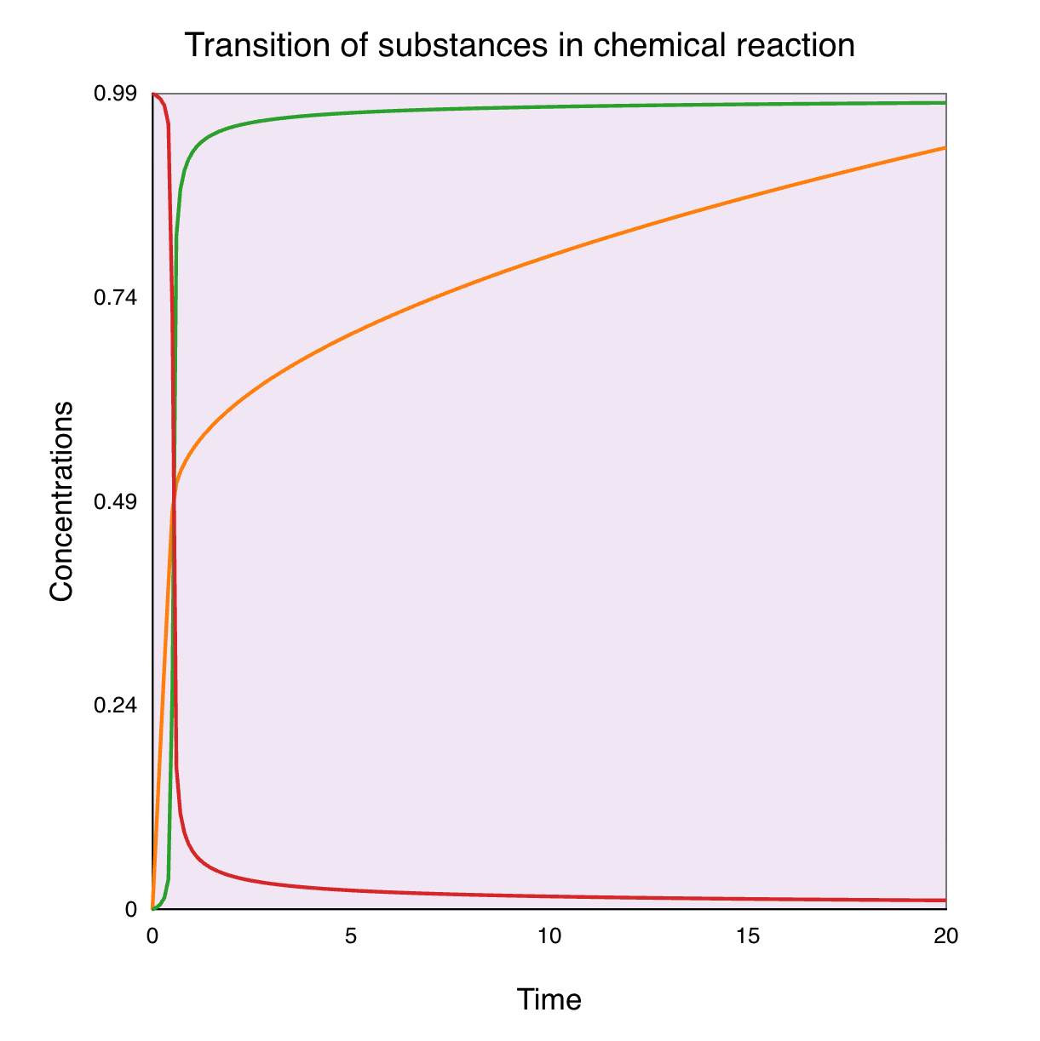
Example of Polylinear Model (BioM 309)
model *Tyson2003_NegFB_Homeostasis()
Ep := Et - E;
E := Et*(2*k3*J4/((k4*R - k3)
+ J3*(k4*R) + J4*k3 + (((k4*R - k3)
+ J3*(k4*R) + J4*k3)^2 –
4*(k4*R - k3)*k3*J4)^(1/2)));
Km3 := J3*Et;
Km4 := J4*Et;
r0: => R; env*k0*E;
r2: R => ; env*k2*R*S;
r3: $Ep => $E; env*k3*Ep/(Km3 + Ep);
r4: $E => $Ep; env*k4*R*E/(Km4 + E);
2
20

