Slide 1
Network Approximations Figures

Slide 2
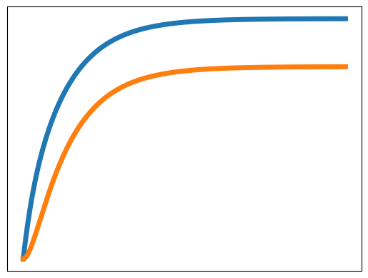
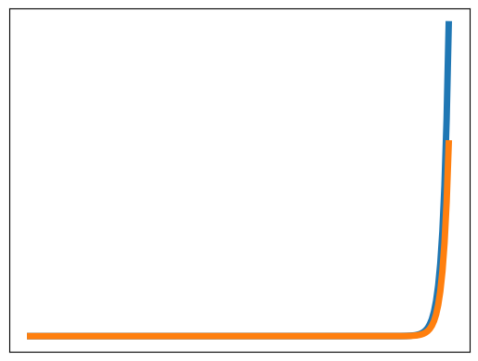
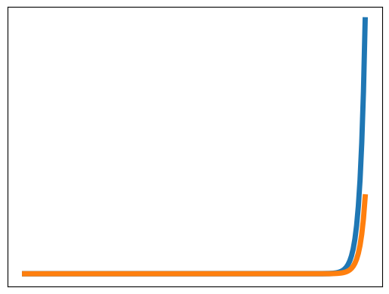
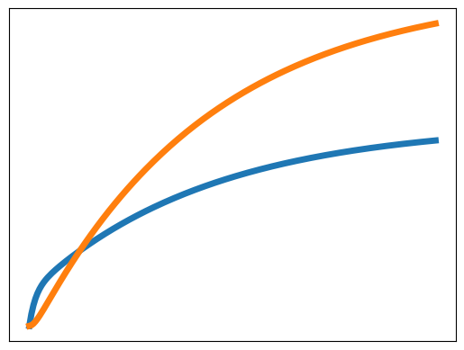
















(a)
(b)
(c)
(d)
-> S1; 1
S1 -> S2; S1
S2 -> S1; 0.5*S2
S2 -> ; 0.75*S2
-> S1; 1
S1 -> S1 + S2; S1
S1 -> ; 3*S1
S2 -> S1 + 2 S2; 1.4*S2
S2 -> ; 2*S2
-> S1; 1
S1 -> 4 S1 + S2; S1
S2 -> S1 + 3 S2; S2
-> S1; 1
S1 -> 4 S1 + S2; S1
S2 -> S1 + S2; S2
Model
Time course
Jacobian
$$\left(\begin{matrix}-1 & 0.5 \\ 1 & -1.25\end{matrix}\right)$$
$$\left(\begin{matrix}3 & 1 \\ 1 & 2\end{matrix}\right)$$
$$\left(\begin{matrix}3 & 1 \\ 1 & 0\end{matrix}\right)$$
$$\left(\begin{matrix}-3 & 1.4 \\ 1 & -0.6\end{matrix}\right)$$
Eigenvalues
-0.4, -1.8
3.6, 1.4
3.3, -0.3
-3.5, -0.1
G. disks
$$[-1.5, -0.5], [-2.25, -0.25]$$
$$[2,4], [1, 3]$$
$$[2,4], [-1, 1]$$
$$[-4.4,-1.6], [-0.4, 0.4]$$
Stability margin
$$-Max(-0.5, -0.25)=0.25$$
$$-Max(4, 3)=-4$$
$$-Max(4, 1)=-4$$
$$-Max(-1.6, 0.4)=-0.4$$
Instability margin
$$Min(-1.5, -2.25)=-2.25$$
$$Min(2, 1)=1$$
$$Min(2, -1)=-1$$
$$Min(-4.4, -0.4)=-4.4$$
Prediction
definitely stable
definitely unstable
indeterminate
indeterminate

Slide 3
(a)
(b)
(c)
(d)
-> S1; 1
S1 -> S2; S1
S2 -> S1; 0.5*S2
S2 -> ; 0.75*S2
-> S1; 1
S1 -> S1 + S2; S1
S1 -> ; 3*S1
S2 -> S1 + 2 S2; 1.4*S2
S2 -> ; 2*S2
-> S1; 1
S1 -> 4 S1 + S2; S1
S2 -> S1 + 3 S2; S2
-> S1; 1
S1 -> 4 S1 + S2; S1
S2 -> S1 + S2; S2
Model
Time course
Jacobian
$$\left(\begin{matrix}-1 & 0.5 \\ 1 & -1.25\end{matrix}\right)$$
$$\left(\begin{matrix}3 & 1 \\ 1 & 2\end{matrix}\right)$$
$$\left(\begin{matrix}3 & 1 \\ 1 & 0\end{matrix}\right)$$
$$\left(\begin{matrix}-3 & 1.4 \\ 1 & -0.6\end{matrix}\right)$$
Eigenvalues
-0.4, -1.8
3.6, 1.4
3.3, -0.3
-3.5, -0.1
G. disks
$$[-1.5, -0.5], [-2.25, -0.25]$$
$$[2,4], [1, 3]$$
$$[2,4], [-1, 1]$$
$$[-4.4,-1.6], [-0.4, 0.4]$$

Slide 4










(a)
(b)
(c)
(d)
Time course
G. disks
$$[-1.5, -0.5], [-2.25, -0.25]$$
$$[2,4], [1, 3]$$
$$[2,4], [-1, 1]$$
$$[-4.4,-1.6], [-0.4, 0.4]$$
Stability margin
$$-Max(-0.5, -0.25)=0.25$$
$$-Max(4, 3)=-4$$
$$-Max(4, 1)=-4$$
$$-Max(-1.6, 0.4)=-0.4$$
Instability margin
$$Min(-1.5, -2.25)=-2.25$$
$$Min(2, 1)=1$$
$$Min(2, -1)=-1$$
$$Min(-4.4, -0.4)=-4.4$$
Prediction
definitely stable
definitely unstable
indeterminate
indeterminate

Slide 5
















(a)
(b)
(c)
(d)
Time course
G. disks
$$[-1.5, -0.5], [-2.25, -0.25]$$
$$[2,4], [1, 3]$$
$$[2,4], [-1, 1]$$
$$[-4.4,-1.6], [-0.4, 0.4]$$
Sets
$$S=\{1, 2\}$$
$$S= ∅$$
$$S= ∅$$
$$S= \{1\}$$
$$U= ∅$$
$$U=\{1, 2\}$$
$$U=\{1\}$$
$$U=∅$$
$$I= ∅$$
$$I= ∅$$
$$I= \{2\}$$
$$I= \{2\}$$
Prediction
Stable
Unstable
Indeterminate
Indeterminate

Slide 7














Branchjoin
$$GA(s)$$
$$k_{1}^{A}$$
$$S_{I}^{A}$$
$$S_{O}^{A}$$
$$k_{2}^{A}$$
$$S_{I}$$
$$S_{O}$$
$$k_{3}$$
$$k_{1}^{B}$$
$$G^{B}(s)$$
$$k_{2}^{B}$$
$$∅$$
$$S_{I}^{B}$$
$$S_{O}^{B}$$

Slide 8






Herbert’s Network 1
Module 1
Module 2
$$X_{0}→^{k_{1}}S_{1}$$
$$S_{1}↔_{k_{2}b}^{k_{2f}}S_{2}$$
$$→^{k_{1d}}$$
$$→^{k_{3}}$$
$$∅$$
$$∅$$

Slide 9


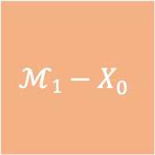
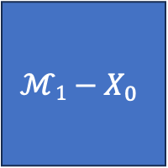


Branch Jacobian
$$X_{0}$$
$$X_{0}$$
0
1
$$ℳ1−X_{0}$$
1
$$ℳ1−X_{0}$$

Slide 10

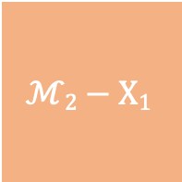
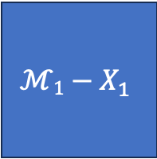



Join Jacobian
$$X_{1}$$
$$ℳ1−X_{1}$$
$$ℳ2−X1$$
0
$$X_{1}$$
$$ℳ1−X_{1}$$
$$ℳ2−X1$$

Slide 11

















Sequential Pathway
$$k_{0}$$
$$k_{1}$$
$$G(s)$$
$$k_{N−1}$$
$$k_{2}$$
$$S_{0}$$
$$S_{1}$$
$${N.S}_{I}$$
$$S_{2}$$
$${N.S}_{O}$$
$$S_{N}$$
$$k_{1}^{′}$$
$$k_{2}^{′}$$
$$k_{N}^{′}$$
$$∅$$
$$∅$$
$$∅$$

Slide 12










Loop
$$k_{1}$$
$$k_{2}$$
$$G(s)$$
$$k_{3}$$
$$k_{4}$$
$$S_{I}$$
$$X_{I}$$
$${N.S}_{I}$$
$${N.S}_{O}$$
$$X_{O}$$
$$S_{O}$$
$$k_{6}$$
$$∅$$
$$k_{5}$$

Slide 13
BACKUP

Slide 14


















Fork-Join
$$GA(s)$$
$${NA.S}_{I}$$
$${NA.S}_{O}$$
$$k_{3}^{A}$$
$$k_{2}^{A}$$
$$k_{1}$$
$$k_{4}$$
$$S_{I}$$
$$X_{I}$$
$$X_{O}$$
$$S_{O}$$
$$k_{6}$$
$$GB(s)$$
$$k_{2}^{B}$$
$${NB.S}_{I}$$
$${NB.S}_{O}$$
$$k_{3}^{B}$$
$$∅$$

