Slide 1
A Mathematical Framework for Modular Biological Networks
JL Hellerstein
Feb 16, 2024

Slide 2
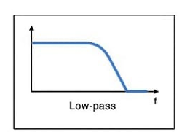
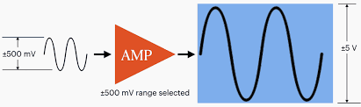
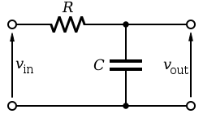
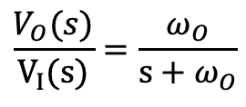
Motivation From Electrical Engineering
Design reaction networks based on desired input/output relationships
Inputs & outputs are “signals” (species concentrations)
Modules (subnetworks) transform signals in known ways
Given a desired output signal, design the reaction network by properly assembling modules
Examples from electrical engineering
Amplifier
Low pass filter
$$\frac{V_{O}(s)}{V_{I}(s)}=\frac{ω_{O}}{s+ω_{O}}$$
frequency

Slide 3
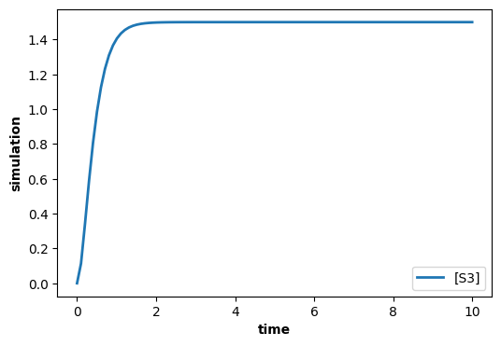
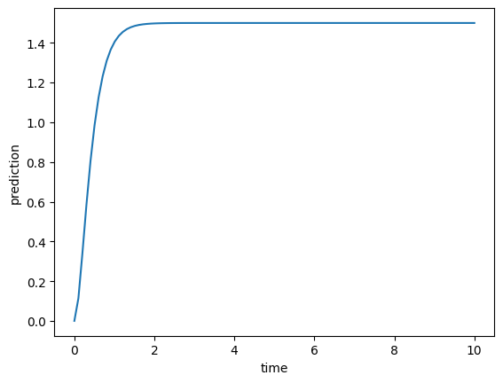
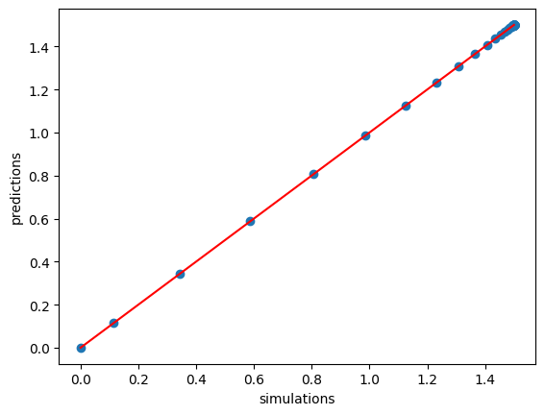





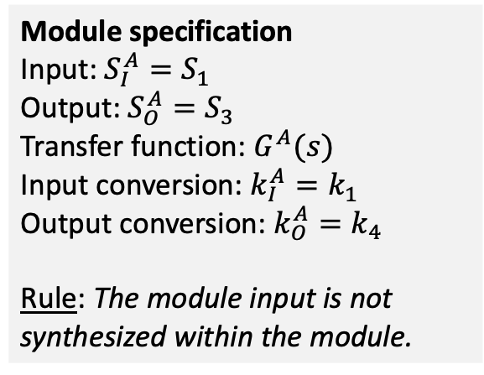



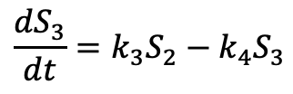

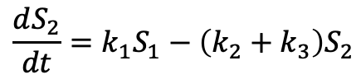
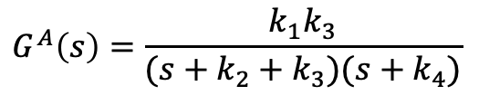
Specifying Modules
Transfer function: $G^{A}\left(s\right)=\frac{S_{3}(s)}{S_{1}(s)}$
System equations
$$\frac{dS_{2}}{dt}=k_{1}S_{1}−\left(k_{2}+k_{3}\right)S_{2}$$
$${sS}_{2}\left(s\right)=k_{1}S_{1}\left(s\right)−\left(k_{2}+k_{3}\right)S_{2}(s)$$
Network A
output
$$\frac{dS_{3}}{dt}=k_{3}S_{2}−k_{4}S_{3}$$
$${sS}_{3}\left(s\right)=k_{3}S_{2}\left(s\right)−k_{4}S_{3}(s)$$
input
S1
$$k_{1}S_{1}$$
S2
$$k_{3}S_{2}$$
S3
$$G^{A}\left(s\right)=\frac{k_{1}k_{3}}{(s+k_{2}+k_{3})(s+k_{4})}$$
$$k_{2}S_{2}$$
$$k_{4}S_{3}$$
$$∅$$
$$∅$$
Antimony & control.TransferFunction
Simulation vs. Prediction
Module specification
Input: ${S_{I}^{A}=S}_{1}$
Output: ${S_{O}^{A}=S}_{3}$
Transfer function: $G^{A}(s)$
Input conversion: $k_{I}^{A}=k_{1}$
Output conversion: $k_{O}^{A}=k_{4}$
Rule: The module input is not synthesized within the module.
$S1 -> S2; kA1*S1
S2 -> ; kA2*S2
S2 -> S3; kA3*S2
S3 -> ; kA4*S3
kA1=1; kA2=2; kA3=3; kA4=4
S1=10; S2=0; S3=0
s = control.TransferFunction.s
tf = kA1*kA3/((s + kA2 + kA3)*(s + kA4))
_, PREDICTIONS_A = control.forced_response(tf,
T=TIMES, U=SAI)

Slide 4
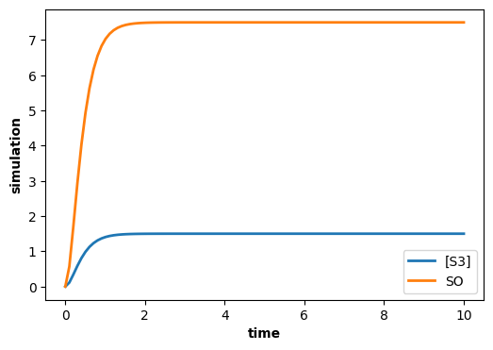






Example of a module: Scale Operator
Network A
output
input
Scale Network
output
input
?
S1
$$k_{1}S_{1}$$
S2
$$k_{1}S_{2}$$
S3
S3
S4
ScaleNetwork
$$k_{2}S_{2}$$
$$k_{3}S_{3}$$
$$∅$$
$$∅$$
Objective:
Construct a network such that the output of the concatenation of A with the scale network creates an output that is m times the output of network A is isolation.
The input species to the ScaleNetwork for network A must be the output species of network A – S3
# Desired behavior using
# an assignment rule.
S1 -> S2; kA1*S1
S2 -> ; kA2*S2
S2 -> S3; kA3*S2
S3 -> ; kA4*S3
S4 ->; SO
kA1=1; kA2=2; kA3=3; kA4=4
$S1=10; S2=0; S3=0; S4=10
# Output of the scale network
m = 5
SO = 0
SO := m*S3

Slide 5
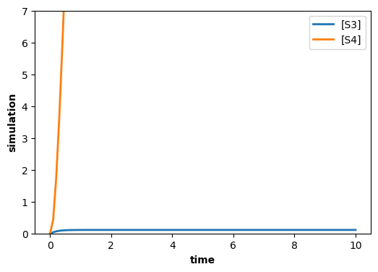


Failed Attempt at ScaleNetwork
Network A
input
output
input
Scale Network
output
$$k_{1}^{S}S_{3}$$
S1
$$k_{1}S_{1}$$
S2
$$k_{1}S_{2}$$
S3
S3
$$S_{3}→ {m S}_{4}$$
S4
ScaleNetwork
$$k_{2}S_{2}$$
$$k_{3}S_{3}$$
$$∅$$
$$∅$$
Problems:
Did not get the desired output
Affected the input (retroactivity)
Output is unstable
# Failed attempt at scale network.
S1 -> S2; kA1*S1
S2 -> ; kA2*S2
S2 -> S3; kA3*S2
S3 -> ; kA4*S3
S3 -> m S4; kS1*S3 // Scale network
kA1=1; kA2=2; kA3=3; kA4=4; kS1=50
$S1=10; S2=0; S3=0; S4=0
m = 5
Solutions:
ScaleNetwork adjusts for retroactivity
ScaleNetwork degrades the output to ensure stability

Slide 6
Objective
Develop a methodology for constructing modular reaction networks with predictable behaviors
Behaviors are time courses of species concentrations
Initial scope
Single Input Single Output (SISO) networks
Networks have linear dynamics and so can be described by transfer functions

Slide 7
Example: Scale Operation

Slide 8
Modular SISO Reaction Network
A module has a single input species and a single output species
Modules only interact through their input and output species
Modules expose sufficient information so that we can predict the time course of combinations of modules

Slide 9













Branchjoin
$$GA(s)$$
$$k_{1}^{A}$$
$$S_{I}^{A}$$
$$S_{O}^{A}$$
$$k_{2}^{A}$$
$$S_{I}$$
$$S_{O}$$
$$k_{3}$$
$$k_{1}^{B}$$
$$G^{B}(s)$$
$$k_{2}^{B}$$
$$∅$$
$$S_{I}^{B}$$
$$S_{O}^{B}$$

Slide 10
















Sequential Pathway
$$k_{0}$$
$$k_{1}$$
$$G(s)$$
$$k_{N−1}$$
$$k_{2}$$
$$S_{0}$$
$$S_{1}$$
$${N.S}_{I}$$
$$S_{2}$$
$${N.S}_{O}$$
$$S_{N}$$
$$k_{1}^{′}$$
$$k_{2}^{′}$$
$$k_{N}^{′}$$
$$∅$$
$$∅$$
$$∅$$

Slide 11










Loop
$$k_{1}$$
$$k_{2}$$
$$G(s)$$
$$k_{3}$$
$$k_{4}$$
$$S_{I}$$
$$X_{I}$$
$${N.S}_{I}$$
$${N.S}_{O}$$
$$X_{O}$$
$$S_{O}$$
$$k_{6}$$
$$∅$$
$$k_{5}$$

Slide 12
BACKUP

Slide 13


















Fork-Join
$$GA(s)$$
$${NA.S}_{I}$$
$${NA.S}_{O}$$
$$k_{3}^{A}$$
$$k_{2}^{A}$$
$$k_{1}$$
$$k_{4}$$
$$S_{I}$$
$$X_{I}$$
$$X_{O}$$
$$S_{O}$$
$$k_{6}$$
$$GB(s)$$
$$k_{2}^{B}$$
$${NB.S}_{I}$$
$${NB.S}_{O}$$
$$k_{3}^{B}$$
$$∅$$

