Slide 1
Modular Chemical Networks
JL Hellerstein
Mar, 2024

Slide 2
What’s a Module?
Oxford dictionary: “a set of standardized parts or independent units that can be used to construct a more complex structure, such as an item of furniture or a building.”
Parnas, 1972 “The specification must provide to the intended user all the information that he will need to use the program correctly…”
Defining properties
Modules only interact through well-defined inputs and outputs.
Modules have clearly defined behaviors.
Modules can be (recursively) composed of other modules.

Slide 3
Why are modules important?
Testing
Testing can be done on modules in isolation (e.g., unit tests)
Design
Design is simplified by having modules that perform “big” functions.
Reuse
Modules are sharable and easy to incorporate (although this can be complicated by dependencies).

Slide 4
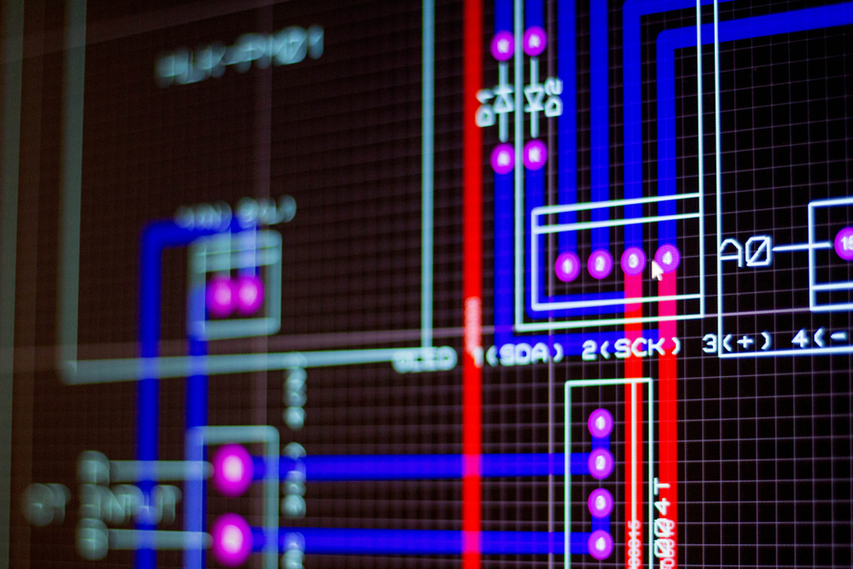
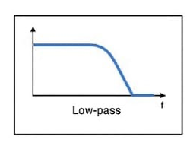
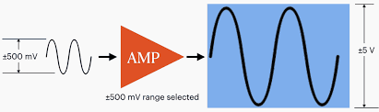
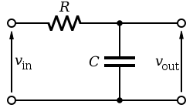
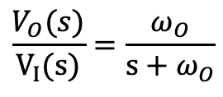
Motivation From Electrical Engineering
SPICE Design System
Vision: Design reaction networks based on desired input/output relationships
Inputs & outputs are species concentrations (signals)
Modules (subnetworks) transform signals in known ways
Given a desired output signal, automatically design the reaction network
Amplifier
Low pass filter
$$\frac{V_{O}(s)}{V_{I}(s)}=\frac{ω_{O}}{s+ω_{O}}$$
frequency

Slide 5
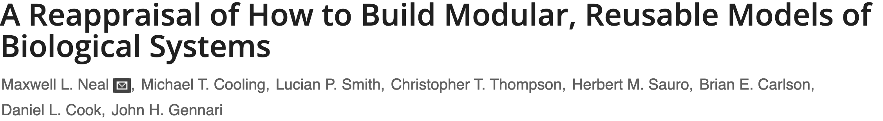
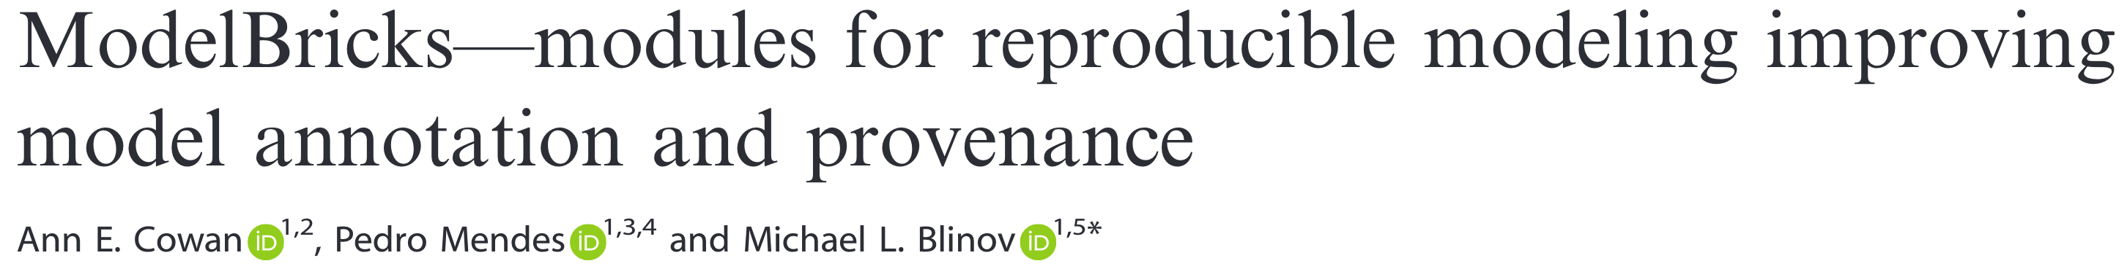
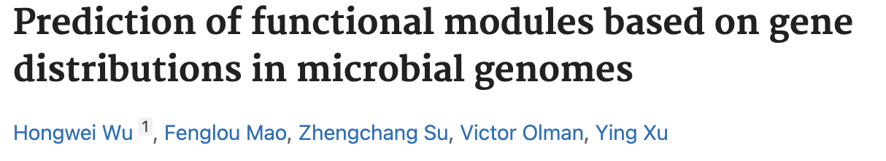
Related Work on Biochemical Modules: 1
Alternatives to information hiding.
Standardized biological parts.
Predicting Gene Ontology annotations.
No formalization of the time course behavior of modules as is needed in a design system.

Slide 6
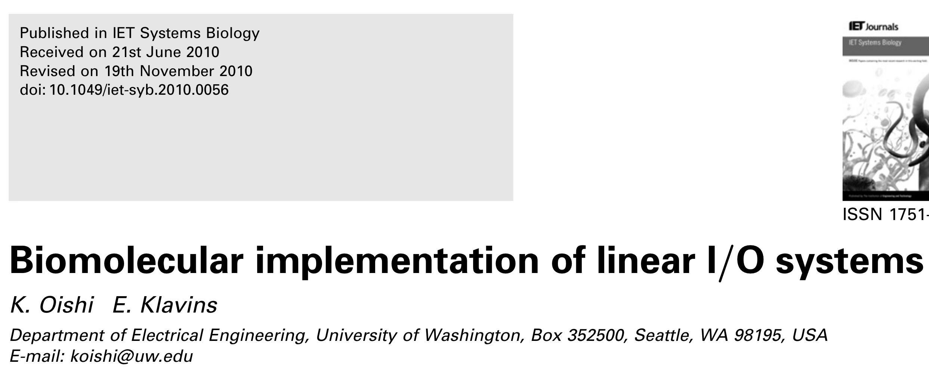

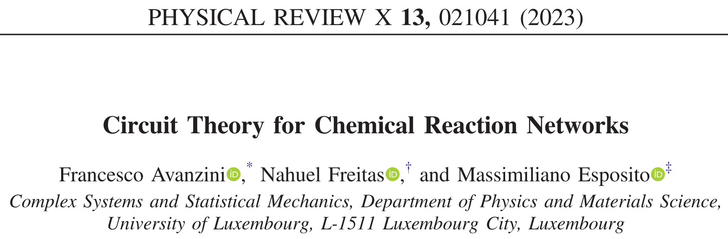
Related Work on Biochemical Modules: 2
Avoids retroactivity by using catalysts as signals.
Compensating for retroactivity.
Calculating fluxes and concentrations as an analog to I-V analysis in EE.
No definition of modules that addresses retroactivity. No concept of operations on modules.

Slide 7
BACKGROUND

Slide 8
Scope
Demonstrate
Formal specification of a chemical module that describes its time course behavior
Recursive creation of modules by operations such as: scale, branch-join, concatenate, negative feedback, positive feedback
Automatic creation of a chemical network from a module specification
Limitations: SISO Linear Modules
Single input single output (SISO) modules
Dynamics are described by a system of linear differential equations (e.g., mass action kinetics with at most one reactant)
Time course behavior is described by a transfer function

Slide 9
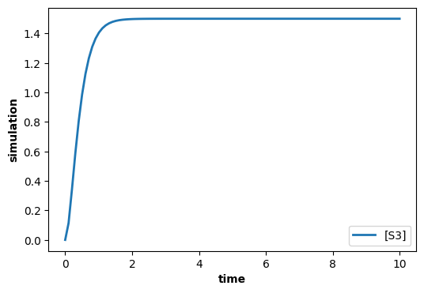
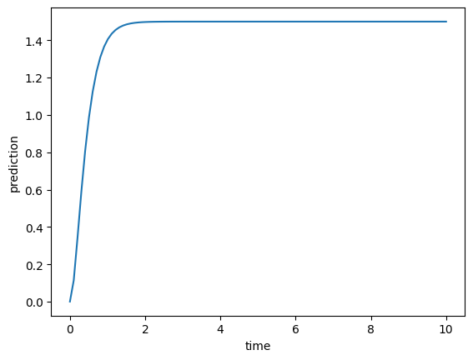
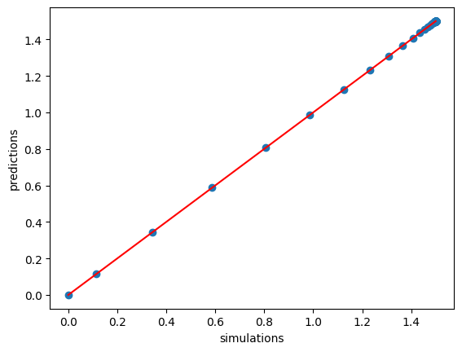





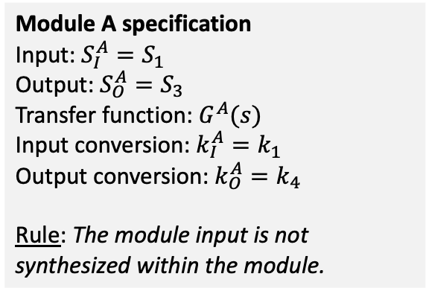



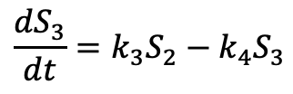

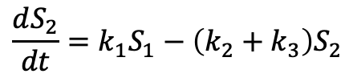
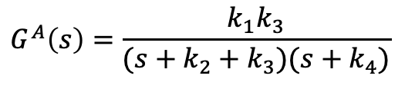
Modules
Transfer function: $G^{A}\left(s\right)=\frac{S_{3}(s)}{S_{1}(s)}$
System equations
$$\frac{dS_{2}}{dt}=k_{1}S_{1}−\left(k_{2}+k_{3}\right)S_{2}$$
$${sS}_{2}\left(s\right)=k_{1}S_{1}\left(s\right)−\left(k_{2}+k_{3}\right)S_{2}(s)$$
Module A
output
$$\frac{dS_{3}}{dt}=k_{3}S_{2}−k_{4}S_{3}$$
$${sS}_{3}\left(s\right)=k_{3}S_{2}\left(s\right)−k_{4}S_{3}(s)$$
input
S1
$$k_{1}S_{1}$$
S2
$$k_{3}S_{2}$$
S3
$$G^{A}\left(s\right)=\frac{k_{1}k_{3}}{(s+k_{2}+k_{3})(s+k_{4})}$$
$$k_{2}S_{2}$$
$$k_{4}S_{3}$$
$$∅$$
$$∅$$
Antimony & control.TransferFunction
Simulation vs. Prediction
Module A specification
Input: ${S_{I}^{A}=S}_{1}$
Output: ${S_{O}^{A}=S}_{3}$
Transfer function: $G^{A}(s)$
Input conversion: $k_{I}^{A}=k_{1}$
Output conversion: $k_{O}^{A}=k_{4}$
Rule: The module input is not synthesized within the module.
$S1 -> S2; kA1*S1
S2 -> ; kA2*S2
S2 -> S3; kA3*S2
S3 -> ; kA4*S3
kA1=1; kA2=2; kA3=3; kA4=4
S1=10; S2=0; S3=0
s = control.TransferFunction.s
tf = kA1*kA3/((s + kA2 + kA3)*(s + kA4))
_, PREDICTIONS_A = control.forced_response(tf,
T=TIMES, U=S1)

Slide 10
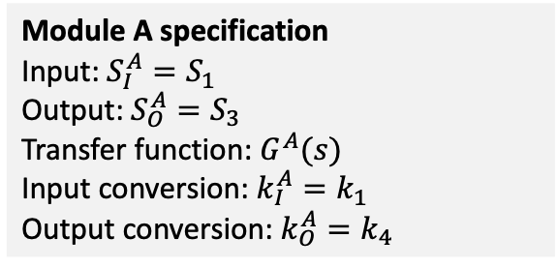
Operations on Modules
Module A specification
Input: ${S_{I}^{A}=S}_{1}$
Output: ${S_{O}^{A}=S}_{3}$
Transfer function: $G^{A}(s)$
Input conversion: $k_{I}^{A}=k_{1}$
Output conversion: $k_{O}^{A}=k_{4}$
The input to an operation is one or more modules and parameter values for the construction of a new module.
The output of an operation is a module.
Non-interacting modules have distinct species.
The concatenation of module A with module B means that the output of A is the same species as the input to B.

Slide 11
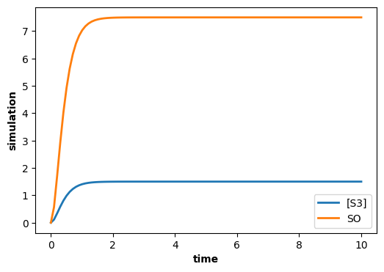






Example of a unary module operation: scale
Module A
output
input
Scale Network
output
input
?
S1
$$k_{1}S_{1}$$
S2
$$k_{3}S_{2}$$
S3
S3
S4
Scale Module
$$k_{2}S_{2}$$
$$k_{4}S_{3}$$
$$∅$$
Module AS
$$∅$$
Objective of the scale operator:
Given module A, construct Module AS whose output is m times the output of module A in isolation.
# Desired behavior using
# an assignment rule.
S1 -> S2; kA1*S1
S2 -> ; kA2*S2
S2 -> S3; kA3*S2
S3 -> ; kA4*S3
S4 ->; SO
kA1=1; kA2=2; kA3=3; kA4=4
$S1=10; S2=0; S3=0; S4=10
# Output of the scale network
m = 5
SO = 0
SO := m*S3
Approach
Create a new module, Scale Module, that scales its input.
Module AS is a new module constructed by concatenating Module A with the Scale Module.

Slide 12
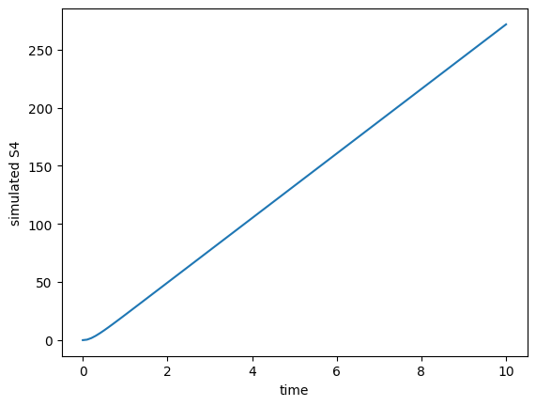








Failed Attempt at Scale Module
Desired behavior
Network A
input
output
input
Scale Network
output
$$k_{1}^{S}S_{3}$$
S1
$$k_{1}S_{1}$$
S2
$$k_{3}S_{2}$$
S3
S3
$$S_{3}→ {m S}_{4}$$
S4
Scale Module
$$k_{2}S_{2}$$
$$k_{4}S_{3}$$
$$∅$$
$$∅$$
Observations:
Did not get the desired output
Output is unstable
Affected the input (retroactivity)
# Failed attempt at scale module.
S1 -> S2; kA1*S1
S2 -> ; kA2*S2
S2 -> S3; kA3*S2
S3 -> ; kA4*S3
S3 -> m S4; kS1*S3 // Scale network
kA1=1; kA2=2; kA3=3; kA4=4; kS1=50
$S1=10; S2=0; S3=0; S4=0
m = 5
Solutions:
Scale Module adjusts for retroactivity
Scale Module degrades the output to ensure stability
$S_{4}$ is not equal to desired.

Slide 13








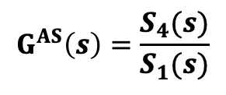





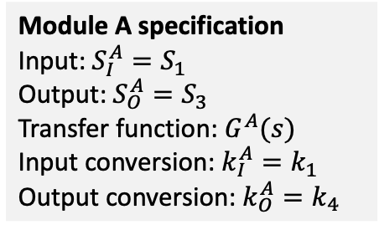


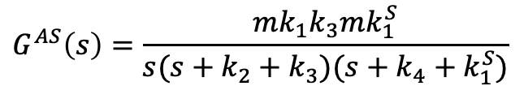


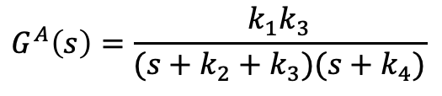
Transfer Function of Scale Module?
Desired behavior
Network A
input
output
input
Scale Network
output
$$k_{1}^{S}S_{3}$$
S1
$$k_{1}S_{1}$$
S2
$$k_{3}S_{2}$$
S3
S3
$$S_{3}→ {m S}_{4}$$
S4
Module A specification
Input: ${S_{I}^{A}=S}_{1}$
Output: ${S_{O}^{A}=S}_{3}$
Transfer function: $G^{A}(s)$
Input conversion: $k_{I}^{A}=k_{1}$
Output conversion: $k_{O}^{A}=k_{4}$
Scale Module
$$k_{2}S_{2}$$
$$k_{4}S_{3}$$
$$∅$$
$$∅$$
Transfer function: $G^{A}\left(s\right)=\frac{S_{3}(s)}{S_{1}(s)}$
$$G^{AS}\left(s\right)=\frac{S_{4}(s)}{S_{1}(s)}$$
$${sS}_{2}\left(s\right)=k_{1}S_{1}\left(s\right)−\left(k_{2}+k_{3}\right)S_{2}(s)$$
$${sS}_{3}\left(s\right)=k_{3}S_{2}\left(s\right)−k_{4}S_{3}(s)$$
$${sS}_{2}\left(s\right)=k_{1}S_{1}\left(s\right)−\left(k_{2}+k_{3}\right)S_{2}(s)$$
$$simulation$$
$${sS}_{3}\left(s\right)=k_{3}S_{2}\left(s\right)−{(k}_{4}+k_{1}^{S})S_{3}(s)$$
$$G^{A}\left(s\right)=\frac{k_{1}k_{3}}{(s+k_{2}+k_{3})(s+k_{4})}$$
$${sS}_{4}\left(s\right)={mk}_{1}^{S}S_{3}\left(s\right)$$
$$G^{AS}\left(s\right)=\frac{mk_{1}k_{3}mk_{1}^{S}}{s(s+k_{2}+k_{3})(s+k_{4}+k_{1}^{S})}$$
$G^{AS}\left(s\right)=G^{A}\left(s\right)\frac{s+k_{O}^{A}}{s+k_{O}^{A}+k_{1}^{S}}$ $\frac{1}{s}mk_{1}^{S}$
$$prediction$$

Slide 14
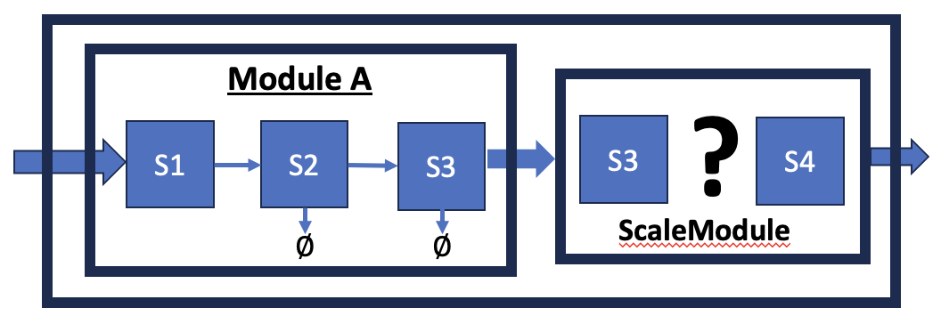
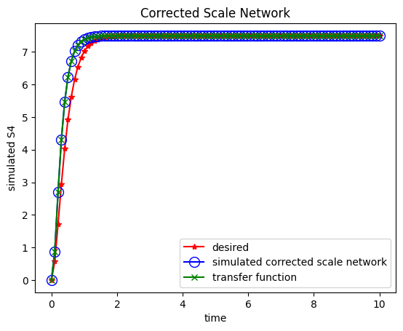


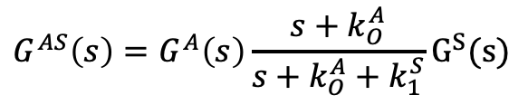



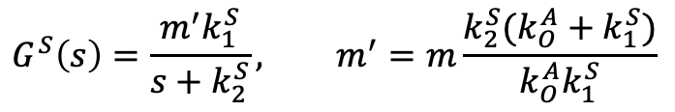


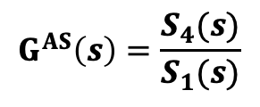
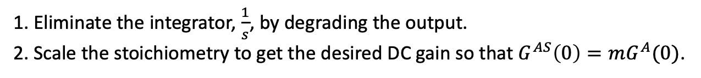




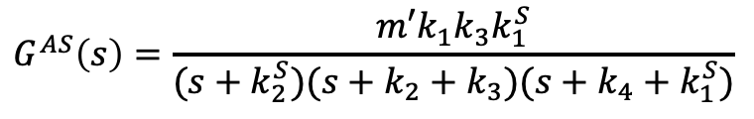
Corrected Scale Module: DC Gain
1. Eliminate the integrator, $\frac{1}{s}$, by degrading the output.
2. Scale the stoichiometry to get the desired DC gain so that $G^{AS}\left(0\right)=mG^{A}(0)$.
input
Scale Network
output
input
Scale Network
output
$$k_{1}^{S}S_{3}$$
$$k_{1}^{S}S_{3}$$
S3
$$S_{3}→ {m S}_{4}$$
S4
S3
$$S_{3}→ {m′ S}_{4}$$
S4
Desired behavior
Old Scale Module
$$k_{2}^{S}S_{4}$$
New Scale Module
$$∅$$
$$G^{AS}\left(s\right)=\frac{S_{4}(s)}{S_{1}(s)}$$
$${sS}_{2}\left(s\right)=k_{1}S_{1}\left(s\right)−\left(k_{2}+k_{3}\right)S_{2}(s)$$
$$G^{S}\left(s\right)=\frac{m^{′}k_{1}^{S}}{s+k_{2}^{S}}, m^{′}=m\frac{k_{2}^{S}(k_{O}^{A}+k_{1}^{S})}{k_{O}^{A}k_{1}^{S}}$$
$${sS}_{3}\left(s\right)=k_{3}S_{2}\left(s\right)−{(k}_{4}+k_{1}^{S})S_{3}(s)$$
${sS}_{4}\left(s\right)={m′k}_{1}^{S}S_{3}\left(s\right)−k_{2}^{S}S_{4}(s)$
$$G^{AS}\left(s\right)=G^{A}\left(s\right)\frac{s+k_{O}^{A}}{s+k_{O}^{A}+k_{1}^{S}}G^{S}(s)$$
$$G^{AS}\left(s\right)=\frac{m′k_{1}k_{3}k_{1}^{S}}{(s+k_{2}^{S})(s+k_{2}+k_{3})(s+k_{4}+k_{1}^{S})}$$
$G^{AS}\left(s\right)=G^{A}\left(s\right)\frac{s+k_{O}^{A}}{s+k_{O}^{A}+k_{1}^{S}}$ $\frac{{m′k}_{1}^{S}}{s+k_{2}^{S}}$
$$G^{AS}\left(0\right)=mG^{A}(0)$$
Notes:
1. The rise time of the scale network is faster than the “desired” network because the dominant pole has a smaller (more negative) value.

Slide 15


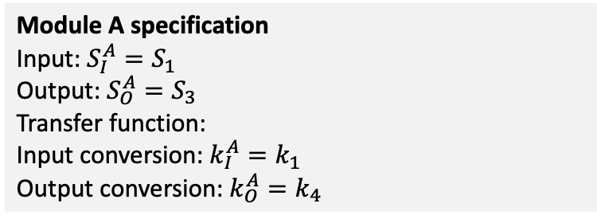


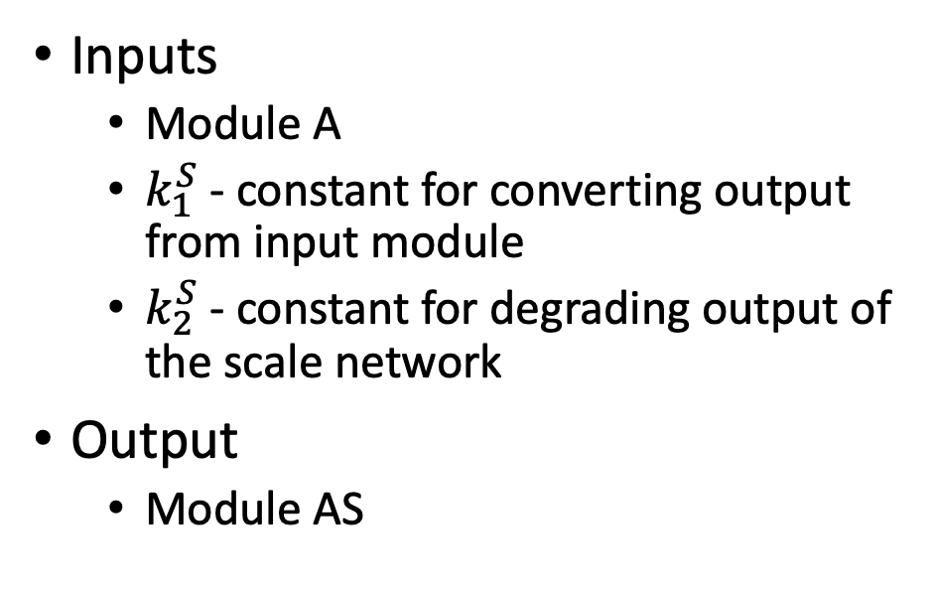



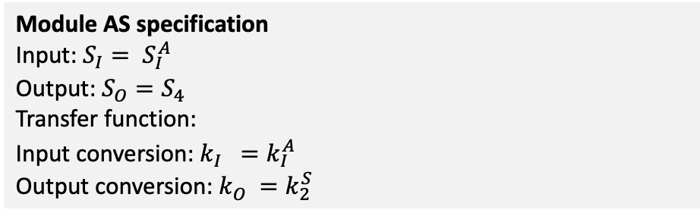



Scale Operator
input
output
input
Scale Network
output
$$k_{1}^{S}S_{3}$$
S1
$$k_{1}S_{1}$$
S2
$$k_{3}S_{2}$$
S3
S3
$$S_{3}→ {m′ S}_{4}$$
S4
$$k_{2}S_{2}$$
$$k_{4}S_{3}$$
$$k_{2}^{S}S_{4}$$
Scale Module
$$∅$$
Module A
$$∅$$
$$∅$$
Module AS
Inputs
Module A
$k_{1}^{S}$ - constant for converting output from input module
$k_{2}^{S}$ - constant for degrading output of the scale network
Output
Module AS
Module A specification
Input: ${S_{I}^{A}=S}_{1}$
Output: ${S_{O}^{A}=S}_{3}$
Transfer function:
Input conversion: $k_{I}^{A}=k_{1}$
Output conversion: $k_{O}^{A}=k_{4}$
$$\frac{k_{1}k_{3}}{(s+k_{2}+k_{3})(s+k_{4})}$$
Module AS specification
Input: ${{S_{I}= S}_{I}^{A}}_{}$
Output: ${S_{O}=S}_{4}$
Transfer function:
Input conversion: $k_{I}^{}=k_{I}^{A}$
Output conversion: $k_{O}^{}=k_{2}^{S}$
$$G^{A}\left(s\right)\frac{s+k_{O}^{A}}{s+k_{O}^{A}+k_{1}^{S}}\frac{m^{′}k_{1}^{S}}{s+k_{2}^{S}}$$
$$m^{′}=m\frac{k_{2}^{S}(k_{O}^{A}+k_{1}^{S})}{k_{O}^{A}k_{1}^{S}}$$

Slide 16














































Operators on Network Modules (A and B)
concatenate
scale
positive feedback
$$GA(s)$$
$$G^{B}(s)$$
$$GA(s)$$
$${k_{1}S}_{O}^{A}$$
$$k_{1}S_{I}$$
$$k_{2}X_{I}$$
$$G(s)$$
$$k_{3}S_{O}^{A}$$
$$S_{I}^{A}$$
$${=S}_{I}^{B}$$
$$S_{O}^{B}$$
$$S_{I}=$$
$$S_{I}^{A}$$
$$S_{O}^{A}=$$
$${m′S}_{O}$$
$$S_{I}$$
$$X_{I}$$
$$S_{I}^{A}$$
$$S_{O}^{A}$$
$$S_{O}$$
$$S_{O}^{A}=$$
$$k_{2}S_{O}$$
$$k_{4}S_{O}$$
$$∅$$
$$k_{5}S_{O}$$
$$∅$$
branchjoin
negative feedback
$$k_{1a}^{}S_{I}$$
$$GA(s)$$
$$S_{I}^{A}$$
$$S_{O}^{A}$$
$$k_{2a}^{}S_{O}^{A}$$
$$k_{1}S_{I}$$
$$k_{2}X_{I}$$
$$G(s)$$
$$k_{3}S_{O}^{A}$$
$$S_{I}$$
$$X_{I}$$
$$S_{I}^{A}$$
$$S_{O}^{A}$$
$$S_{O}$$
$$S_{I}$$
$$S_{O}$$
$$k_{5}S_{O}$$
$$k_{4}S_{O}$$
$$k_{1b }^{}S_{I}$$
$$G^{B}(s)$$
$$k_{2b}^{}S_{O}^{B}$$
$$k_{3}S_{O}$$
$$S_{I}^{B}$$
$$∅$$
$$∅$$
$$∅$$
$$S_{O}^{B}$$

Slide 17
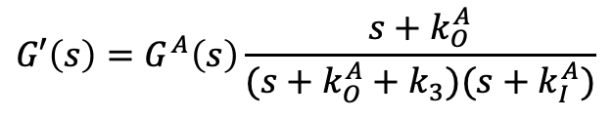
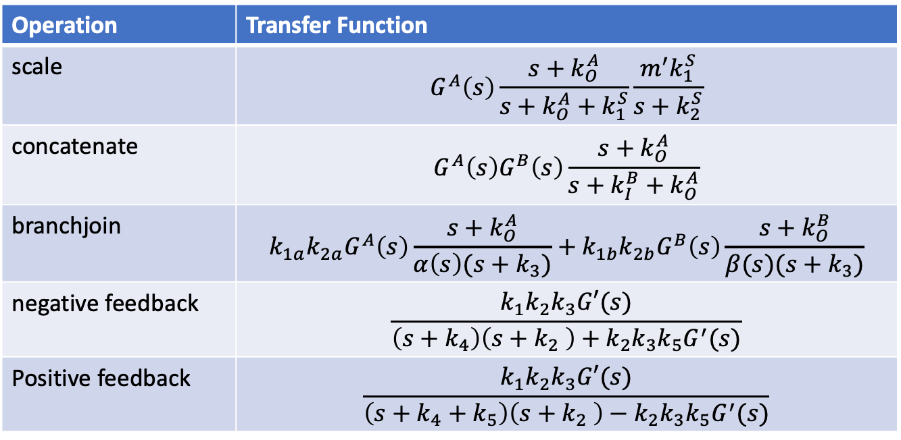
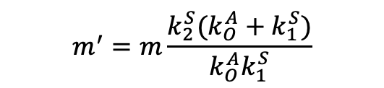


Transfer Functions of Modules Created by Operators
Operation | Transfer Function
scale | $$G^{A}\left(s\right)\frac{s+k_{O}^{A}}{s+k_{O}^{A}+k_{1}^{S}}\frac{m^{′}k_{1}^{S}}{s+k_{2}^{S}}$$
concatenate | $$G^{A}\left(s\right)G^{B}\left(s\right)\frac{s+k_{O}^{A}}{s+k_{I}^{B}+k_{O}^{A}}$$
branchjoin | $$k_{1a}k_{2a}G^{A}\left(s\right)\frac{s+k_{O}^{A}}{α\left(s\right)(s+k_{3})}+k_{1b}k_{2b}G^{B}\left(s\right)\frac{s+k_{O}^{B}}{β(s)(s+k_{3})}$$
negative feedback | $$\frac{k_{1}k_{2}k_{3}G′(s)}{\left(s+k_{4}\right)\left(s+k_{2} \right)+k_{2}k_{3}k_{5}G^{′}(s)}$$
Positive feedback | $$\frac{k_{1}k_{2}k_{3}G′(s)}{\left(s+k_{4}+k_{5}\right)\left(s+k_{2} \right)−k_{2}k_{3}k_{5}G^{′}(s)}$$
$$G′\left(s\right)=G^{A}\left(s\right)\frac{s+k_{O}^{A}}{(s+k_{O}^{A}+k_{3})(s+k_{I}^{A})}$$
$$α\left(s\right)=(s+k_{I}^{A})(s+k_{O}^{A}+k_{2a})$$
$$m^{′}=m\frac{k_{2}^{S}(k_{O}^{A}+k_{1}^{S})}{k_{O}^{A}k_{1}^{S}}$$
$$β\left(s\right)=(s+k_{I}^{B})(s+k_{O}^{B}+k_{2b})$$

Slide 18
Next Steps
Verify operator transfer functions
Do arbitrary operations on network modules
Compare simulation results with transfer functions
Construct design algorithm
Given a transfer function, construct a reaction network with that transfer function
Challenges
Imaginary poles require using negative feedback
Zeroes (non-zero powers of s in the numerator) require branchjoin

Slide 19


Example of a unary module operation: scale
Module A
Scale Network
?
S1
S2
S3
S3
S4
ScaleModule
$$∅$$
$$∅$$

