Slide 1
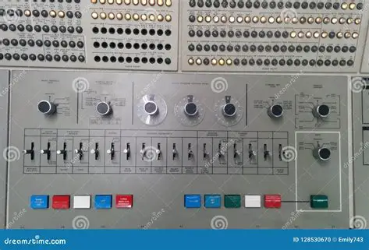
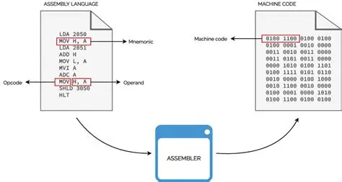
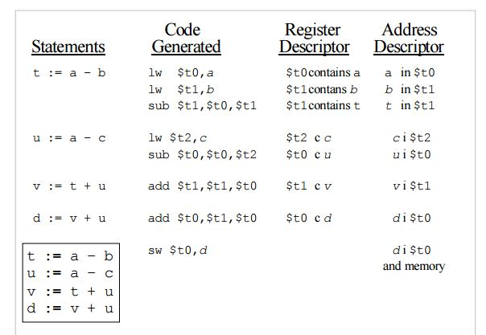
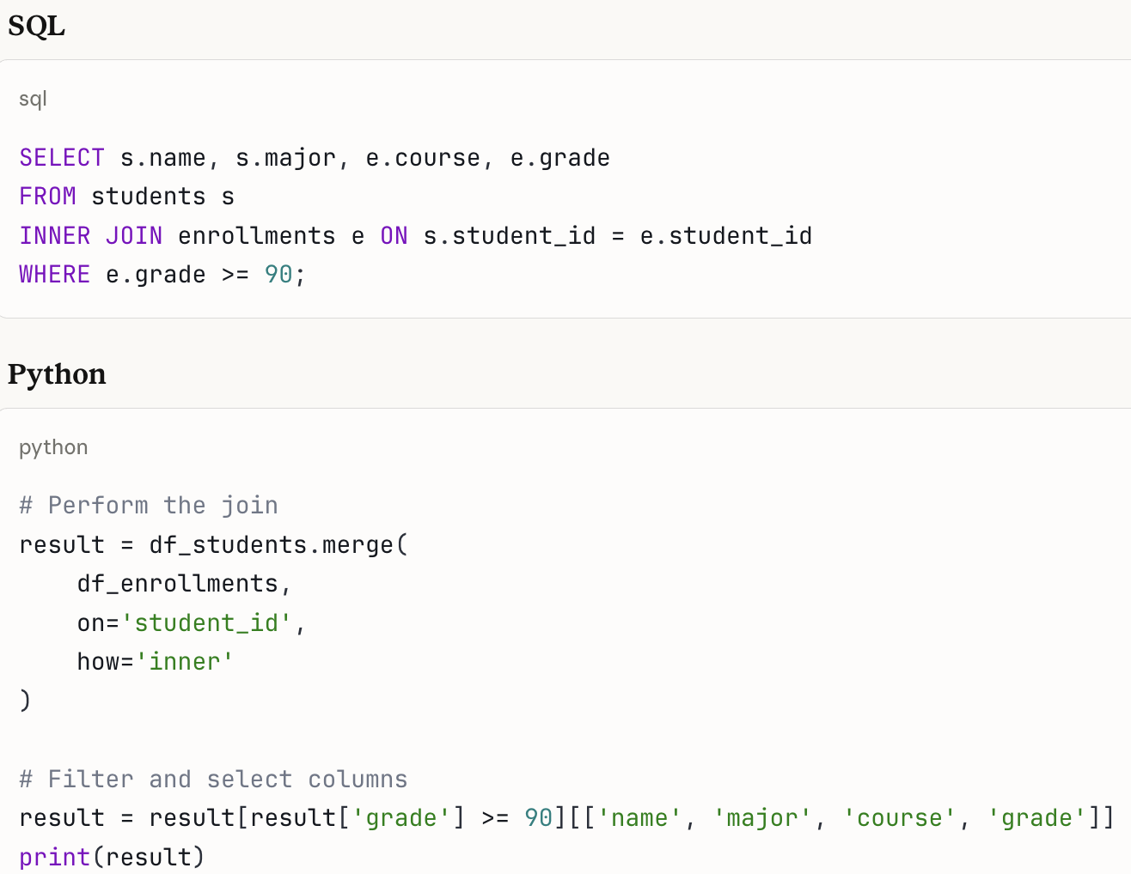
Programming with toggle switches (1940-50s)
Assembly language programming (1950s-)
Third generation languages (1960s-)
Structured query language (1970s-)

Slide 2

