Slide 1
CCE Progress
Team membership & Structure

Slide 2


CCE Formation and Readiness
D2: Cloud Capabilities Engineer (CCE) Team Formation
Operating norms and practices
Skill requirements and timelines to address gaps
Role definition, responsibilities, and RACI
Document current state “Requirements to Deploy” value stream
High-level findings and pain points
High-level improvement opportunities
Delivered
8 May 2020
Delivered
22 June 2020
D3: CCE Intake and Delivery
Future state cloud project onboarding mechanism
FfC, PtB, PtO templates and checklists
Realized Value Stream improvements
D1: Value Stream Mapping Discovery and Assessment
Delivered
25 June 2020
D4: CCE Day 2 BAU Operating Readiness
Critical Day 2 cloud operational management practices required
CCE readiness to engage
Prioritized recommendations
Delivered
30 June 2020

Slide 3
Team Structure
Cloud Platform Product Owner
Scrum Master
Cloud Platform Architect
Cloud Platform Engineer x2
Cloud Technical and Tools Engineer (automation)
Business Analyst / resouce analyst
Cloud Technical and Tools Engineer (tools) x2
Network Engineer
Cloud Security Designer

Slide 4
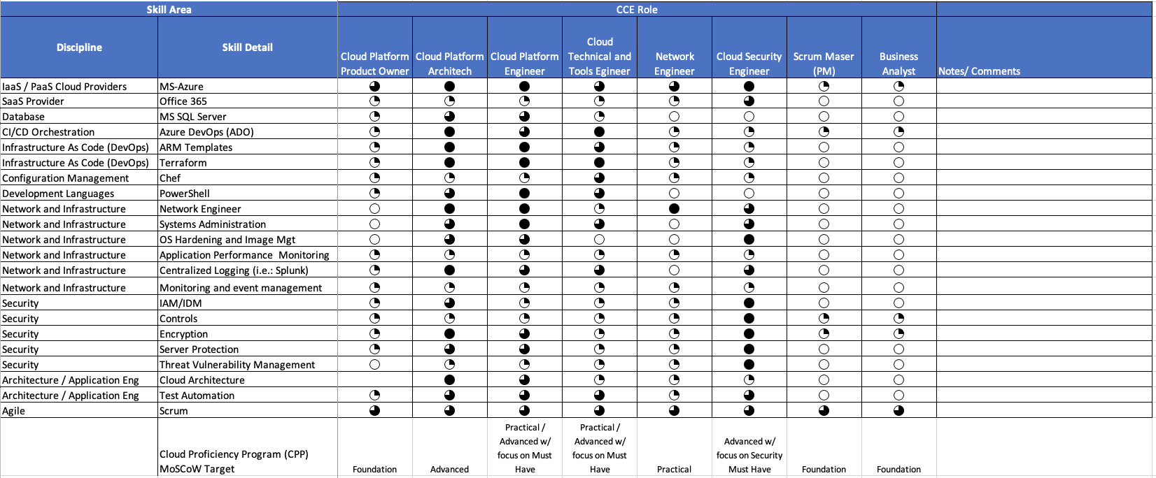
End State Skill Requirements
Legend:
NA
Foundational
Practical
Advanced

Slide 5
Working Cadence
Meeting Name | Purpose | Frequency | Attendees | Facilitator
Sprint Review | Sprint Review and demonstrate completed work in sprint; gain agreement to close stories | Last day of Sprint | Scrum Team, Solution Owner, Resolvers Groups (As needed) & Service Owner (As needed) | Scrum Master
Sprint Retrospective | Assess Sprint and discuss opportunities for Improvement | Last day of Sprint | Scrum Team | Scrum Master
Sprint Planning | Break User Stories into Tasks. Provide Hour Estimate | First day of Sprint | Scrum Team | Scrum Master
Backlog Grooming | Refine user stories and Priority | As Needed. At Least Monthly. | Product Owner, Scrum Master, Stakeholders as needed | Product Owner
Stand Up | Status of Sprint, Impediments or Risks | Daily (Recommended) | Scrum Team | Scrum Master

