Slide 1
Exploratory Data Analysis

Slide 2
Summary Statistics by Treatment
 | A | B | C | Overall
 | (N=32) | (N=28) | (N=38) | (N=98)
AF
Mean (SD) | 37.5 (6.37) | 76.4 (11.1) | 68.7 (12.7) | 60.7 (19.6)
Median [Min, Max] | 36.4 [26.0, 48.0] | 77.6 [53.9, 96.0] | 64.0 [52.8, 95.4] | 60.7 [26.0, 96.0]
age
Mean (SD) | 34.3 (6.12) | 36.3 (5.68) | 32.4 (6.34) | 34.2 (6.23)
Median [Min, Max] | 33.5 [25.0, 45.0] | 37.0 [25.0, 45.0] | 30.0 [25.0, 45.0] | 34.5 [25.0, 45.0]
PR
no | 15 (46.9%) | 10 (35.7%) | 23 (60.5%) | 48 (49.0%)
yes | 17 (53.1%) | 18 (64.3%) | 15 (39.5%) | 50 (51.0%)

Slide 3
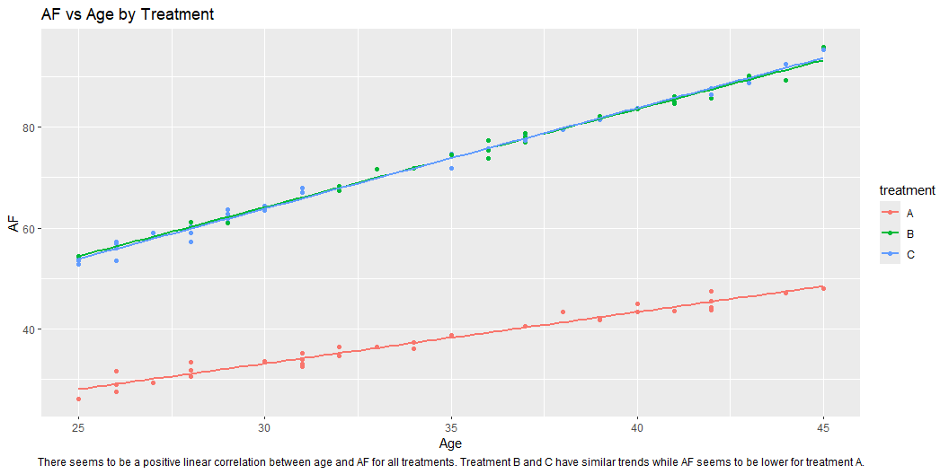
AF vs Age

Slide 4
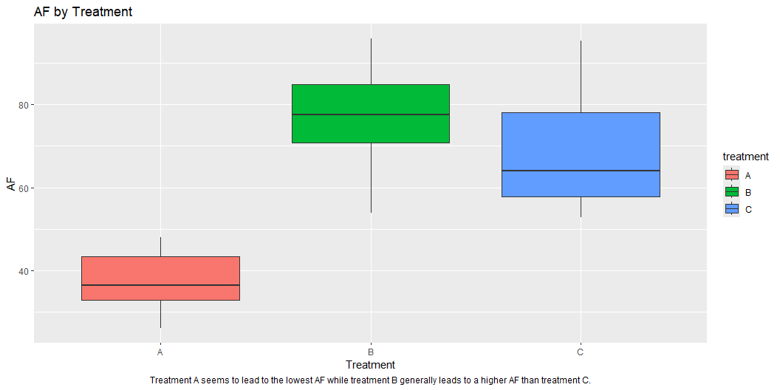
AF vs Treatment

Slide 5
Positive Responses by Treatment Count
treatment | PR | n
A | no | 15
A | yes | 17
B | no | 10
B | yes | 18
C | no | 23
C | yes | 15

Slide 6
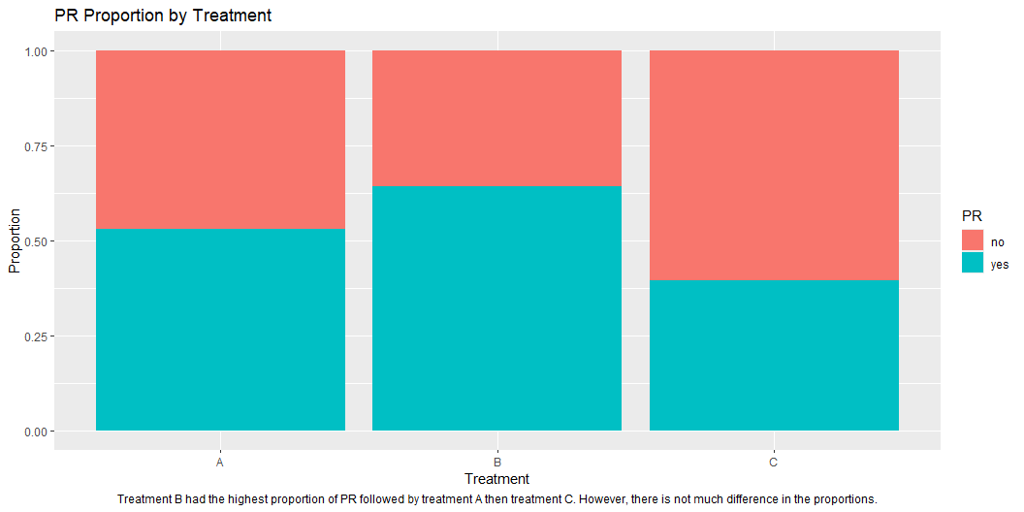
Positive Responses by Treatment Proportions

Slide 7
Key Predictors (AF)
term | pv | adj_p
treatment | 0.000 | 0.000
age | 0.000 | 0.000
PR | 0.001 | 0.022
rs57179 | 0.011 | 0.152
rs19486 | 0.035 | 0.379
rs59798 | 0.050 | 0.449
rs31247 | 0.117 | 0.619
First 7 rows by adjusted p value. After adjustment none of the SNPs have a statistically significant effect by themselves. Treatment is the strongest predictor of AF.

Slide 8
Key Predictors (PR)
term | pv | adj_p
age | 0.000 | 0.000
AF | 0.002 | 0.044
rs91154 | 0.021 | 0.381
rs56579 | 0.037 | 0.505
treatment | 0.129 | 0.554
rs57179 | 0.081 | 0.554
rs69792 | 0.154 | 0.554
First 7 rows by adjusted p value. After adjustment none of the SNPs have a statistically significant effect by themselves. Age is the strongest predictor of PR. Notably by itself treatment is not a statistically significant predictior of PR.

Slide 9
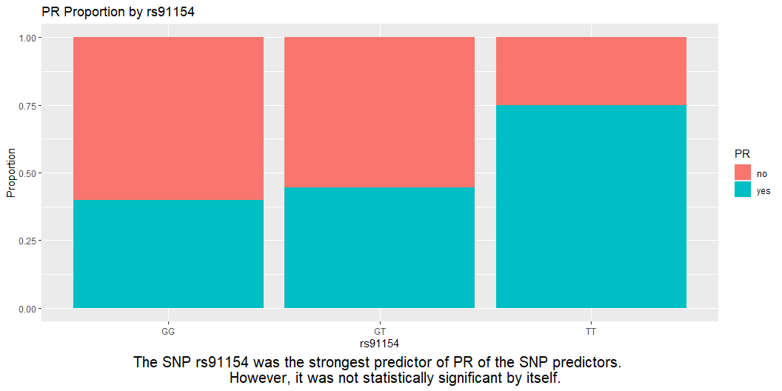
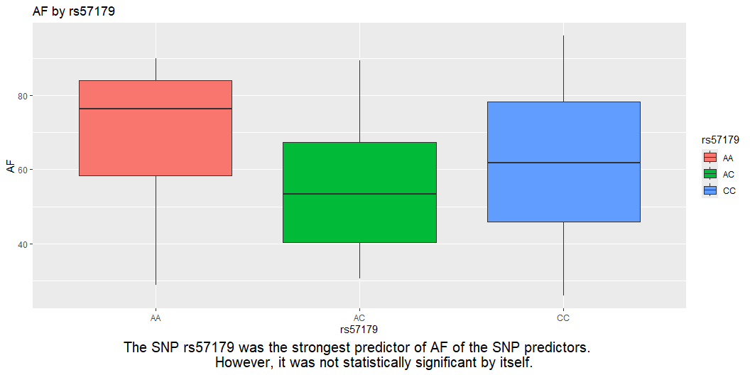
SNPs vs AF and PR

