Slide 1
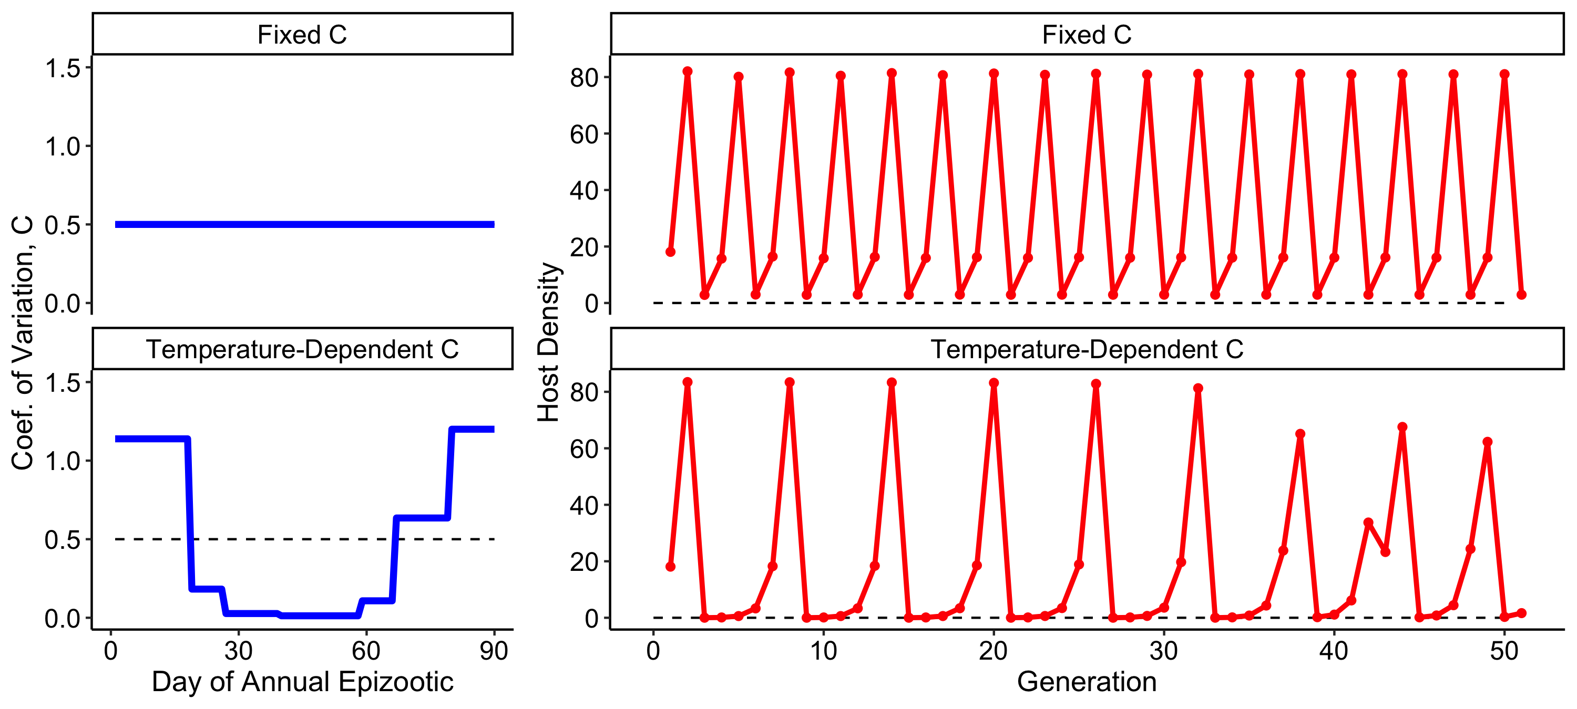
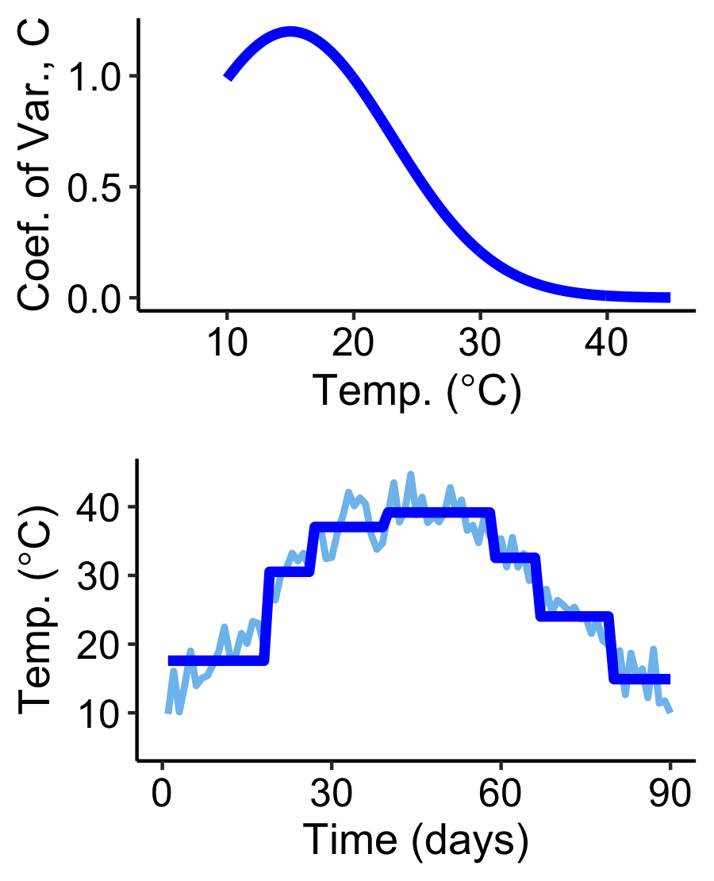
Preliminary epizootic model with variation in susceptibility linked to temperature
Simulate whether temperature affects variation during outbreaks
Simulate host-pathogen dynamics across host generations: Host population cycles
Single epizootic
(c)
(e)
Seasonal temperature
affects variation
Variation in Host Susceptibility
(a)
(d)
(f)
Host demography &
Pathogen overwintering
(b)
Lower CV during some parts of the epizootic leads to larger outbreaks
(fewer high-resistance hosts)
Lower host densities over successive generations
Destabilized
population cycles
Higher extinction risk?

