Slide 1
CORPSEC INVESTIGATIONS LIMITED | GUARDING SERVICES DIVISION
Enterprise Payroll & Guard
Workforce Management System
Comprehensive End-to-End Operational Manual & Step-by-Step System Guide for Company Users
• Version 2026.1 Enterprise Edition • 100% Kenyan Statutory & PSRA Compliant • Real-Time Geofence Operations
Approved by: Moses Alango, Director | Headquarters: Upper Hill, Nairobi, Kenya | Trust But Verify

Slide 2
SYSTEM ARCHITECTURE
Platform Ecosystem & User Access Roles
High-level structural breakdown of the CorpSec platform, user responsibilities, and data synchronization.
ROLE 1
Managing Director & System Admin
Full administrative authority over payroll approvals, official letterhead invoices, bank EFT disbursement schedules, system settings, and immutable audit trails.
Primary Access: admin@corpsec.co.ke
ROLE 2
HR & Payroll Specialist
Manages active & historical guard personnel files, PSRA compliance certifications, mid-month salary advance disbursements, and guided Kenyan statutory payroll runs.
Primary Access: Payroll & HR Hub
ROLE 3
Operations Manager & Supervisors
Supervises client sites, configures 200m GPS geofencing radius, schedules day/night shift rosters, manages asset & uniform custody, and reviews incident occurrence books.
Primary Access: Operations Hub
ROLE 4
Super Guards & Site Commanders
Armed with mobile shift portal to clock in/out their shift and mandated to clock in/out field guards who do not own smartphones directly at client premises within 200m.
Primary Access: Mobile PWA Portal

Slide 3
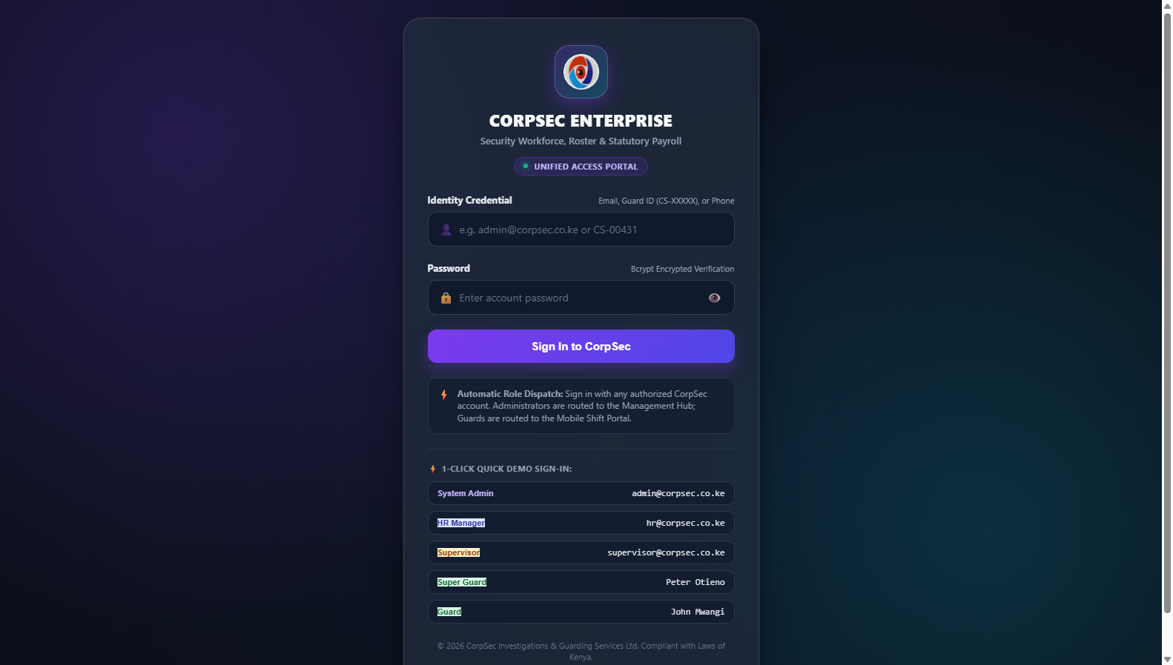
MODULE 01 | AUTHENTICATION
Unified Login Portal & Role-Based Quick Dispatch
Secure multi-factor entrance with role detection and 1-click credential switching for administrators and guards.
👤 AUTHORIZED ROLE: ALL COMPANY PERSONNEL (ADMINISTRATORS, HR, FIELD SUPERVISORS, GUARDS)
Step 1 — Launch System & Enter Credentials: Navigate to the CorpSec URL. Enter your corporate email (or employee badge ID) and password.
Step 2 — Role-Based Auto Dispatch: The security engine verifies bcrypt password hash and automatically routes Admins to the Management Hub, and Guards to the Mobile Portal.
Step 3 — 1-Click Quick Fill Demo: For testing or shift handovers, use the pre-configured quick buttons: 'Admin / HR', 'Super Guard', or 'Guard'.
Step 4 — Session Persistence: Authorized JWT token is safely cached in session storage, preserving state across browser restarts.
💡 Operational Tip / Compliance Rule: Passwords must be at least 8 characters. Any failed login attempt is recorded in the immutable audit trail with originating IP.
📸 Live System Screenshot: Unified login portal displaying bcrypt encrypted authentication, automatic role dispatch, and 1-click quick-fill buttons.

Slide 4
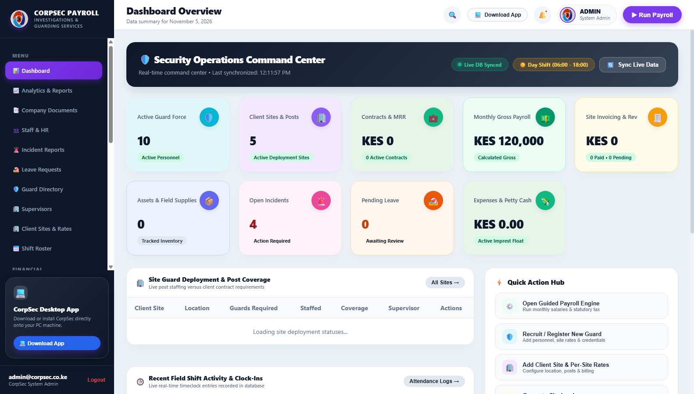
MODULE 02 | OPERATIONS HUB
Executive Operations Command Center & Live KPIs
Real-time visibility into workforce metrics, active guarding shifts, imprest float, and monthly financial summaries.
👤 AUTHORIZED ROLE: MANAGING DIRECTOR, OPERATIONS DIRECTOR & HR MANAGEMENT
Step 1 — Review 8 Real-Time KPI Cards: Inspect total active guards, current site deployments, active day/night shifts, and live attendance metrics at a single glance.
Step 2 — Monitor Petty Cash Imprest Health: Track YTD operational outflows and verify the current petty cash float against the KES 25,000 regulatory cap.
Step 3 — Track Active Billing & Invoices: View issued commercial invoices, collected receivables, and pending client settlements.
Step 4 — Execute 1-Click Operations: Use top-right quick action buttons to instantly run monthly payroll or access the mobile app download portal.
💡 Operational Tip / Compliance Rule: KPI cards update dynamically upon database changes without requiring manual full-page browser reloads.
📸 Live System Screenshot: Executive Operations Dashboard featuring 8 pastel KPI cards, live shift metrics, and KES 211,850 YTD expenditure summary.

Slide 5
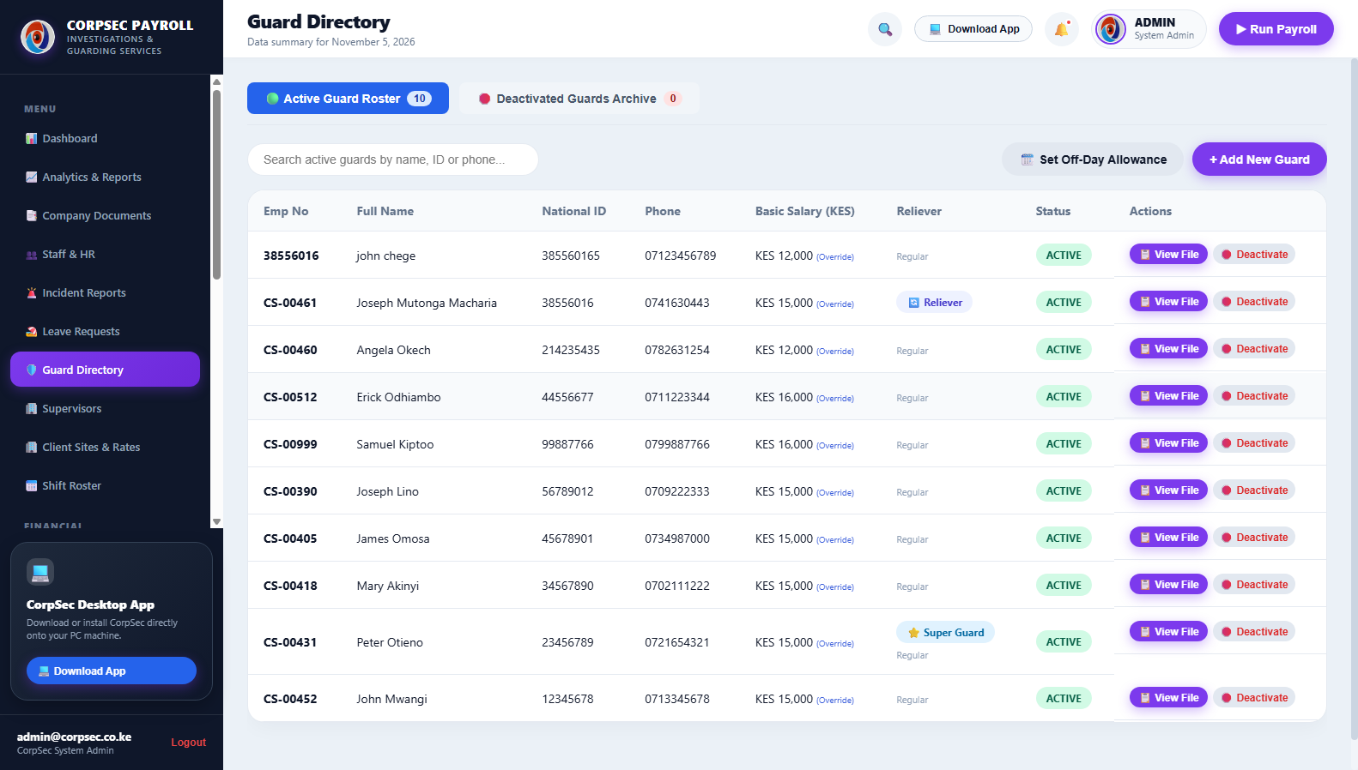
MODULE 03 | PERSONNEL MGMT
Active Guard Directory & Personnel Roster
Central registry of all security personnel with badges, contact numbers, PSRA credentials, and operational status.
👤 AUTHORIZED ROLE: HR MANAGER, RECRUITMENT OFFICER & CHIEF OPERATIONS SUPERVISOR
Step 1 — Search & Filter Roster: Filter guards by operational status (Active vs Inactive) or use the live search bar to find guards by name or badge ID CS-XXXXX.
Step 2 — Identify Relievers & Super Guards: Look for the amber 'SUPER GUARD' badge and 'RELIEVER' indicators indicating mobile site mandate authority.
Step 3 — Open Personnel File: Click 'View File' on any guard row to inspect full personal records, qualifications, and banking information.
Step 4 — Deactivate or Relocate Guard: Use the 1-click 'Deactivate' action to safely transfer guards to inactive archives without deleting historical payroll records.
💡 Operational Tip / Compliance Rule: Never delete a guard profile with past attendance or payroll records; use 'Deactivate' to preserve tax compliance history.
📸 Live System Screenshot: Guard Directory showing active guard roster, employee badges, phone numbers, and direct access to personal files.

Slide 6
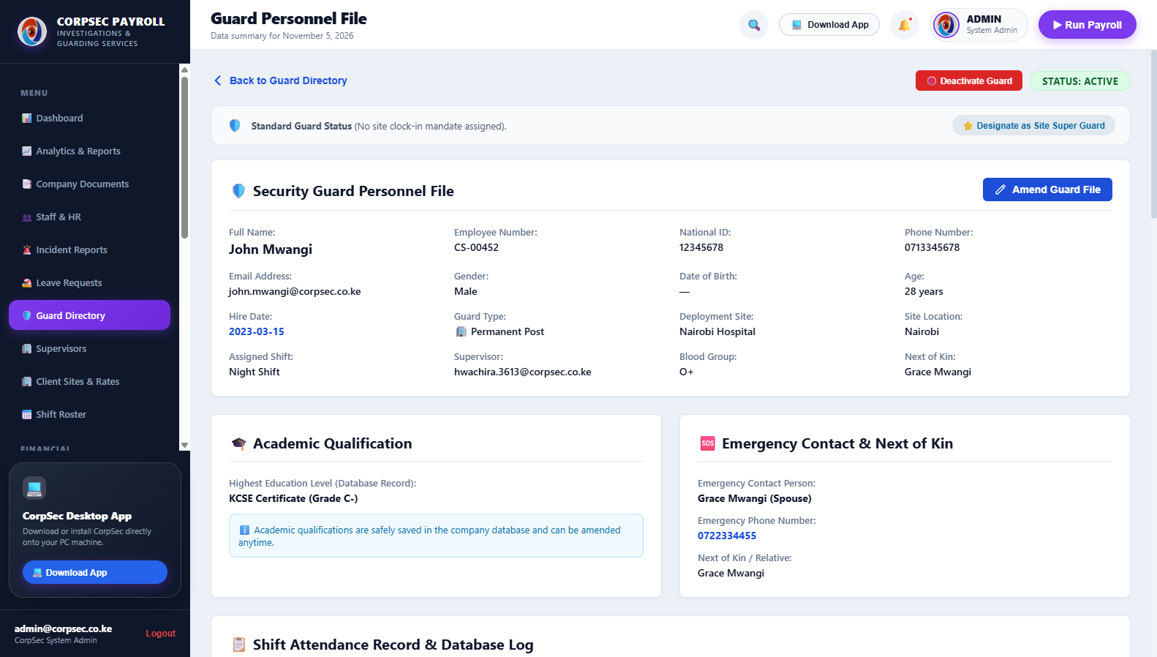
MODULE 04 | GUARD DOSSIER
Full Guard Personnel Dossier & Super Guard Mandate
In-depth digital personnel file containing academic qualifications, emergency contacts, bank details, and mandate status.
👤 AUTHORIZED ROLE: HR DIRECTOR, PERSONNEL AUDITOR & SYSTEM ADMINISTRATOR
Step 1 — Examine Statutory Credentials: Verify Guard National ID, KRA PIN, PSRA registration certificate number, and valid date of enlistment.
Step 2 — Review Next of Kin & Contacts: Inspect verified emergency contact names, primary phone numbers, and residential location for rapid field dispatch.
Step 3 — Inspect Banking & M-Pesa Setup: Ensure guard bank name, account number, or Safaricom M-Pesa registered name are validated for bulk payroll disbursement.
Step 4 — Toggle Super Guard Status: Grant or revoke Super Guard site command authority with a single click. When revoked, site mandates are instantly cleared.
💡 Operational Tip / Compliance Rule: Revoking a Super Guard from their profile automatically strips their authority from any assigned client site geofence.
📸 Live System Screenshot: Personnel file view detailing national ID, PSRA license, emergency contacts, academic history, and Super Guard mandate controls.

Slide 7
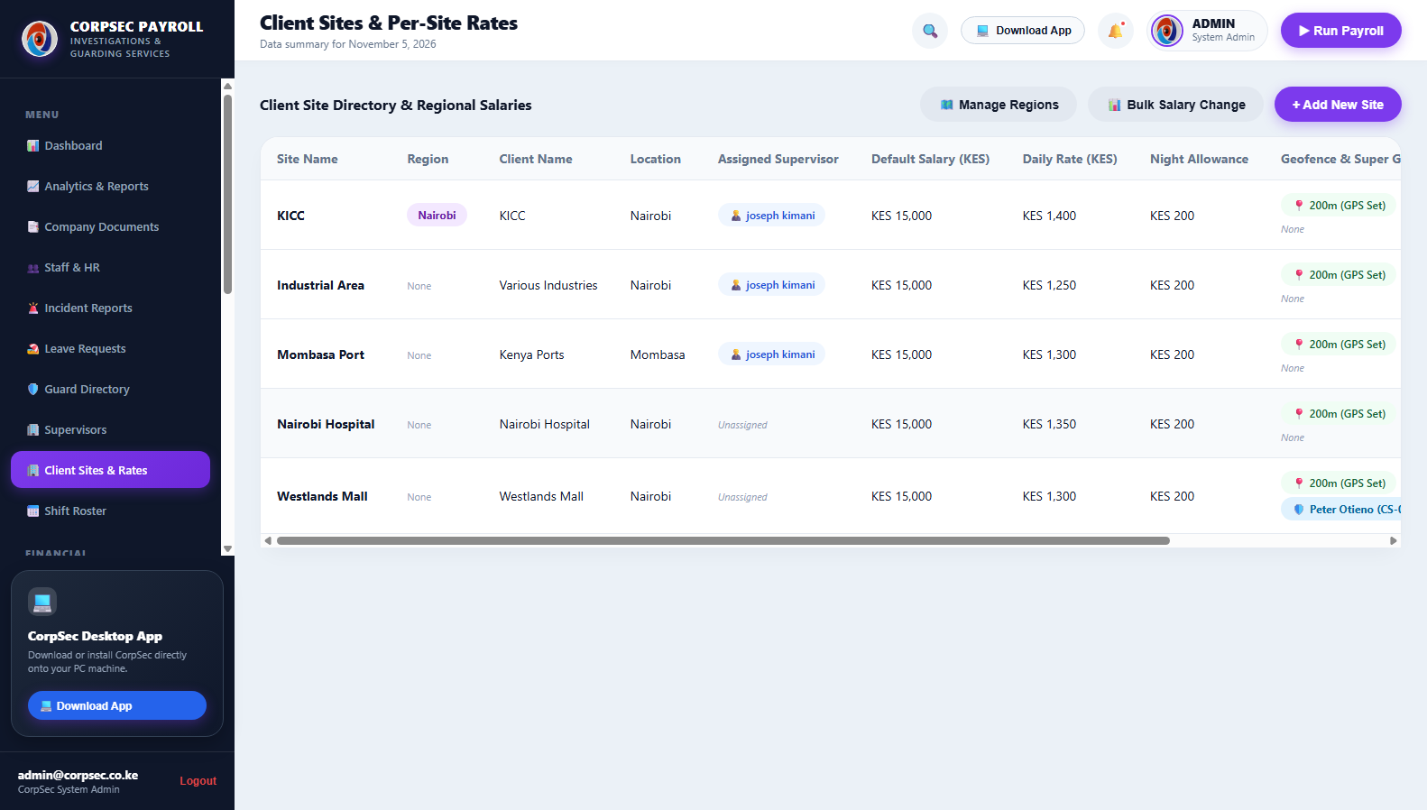
MODULE 05 | CLIENT SITES
Client Sites & Guard Billing Deployment Rates
Site registry tracking commercial guarding contracts, required guard strength, day/night shifts, and daily billing rates.
👤 AUTHORIZED ROLE: BUSINESS DEVELOPMENT MANAGER, OPERATIONS DIRECTOR & COMMERCIAL BILLING OFFICER
Step 1 — Review Client Deployments: View all contracted client facilities (e.g. Westlands Mall, Karen Residence, Upper Hill Commercial Hub).
Step 2 — Check Deployment Strength: Verify required day guards, night guards, and contracted daily billing rate per deployed security officer.
Step 3 — Confirm Assigned Super Guard: See which Super Guard holds operational site command for clocking in non-smartphone field guards.
Step 4 — Access 1-Click Billing & Editing: Click 'Site' to adjust coordinates and radius, or click 'Bill' to instantly generate a monthly tax invoice.
💡 Operational Tip / Compliance Rule: Daily rates automatically populate invoice line items when generating commercial billings for that client site.
📸 Live System Screenshot: Client Sites directory displaying deployed guard counts, contracted daily rates, and assigned Super Guard commanders.

Slide 8
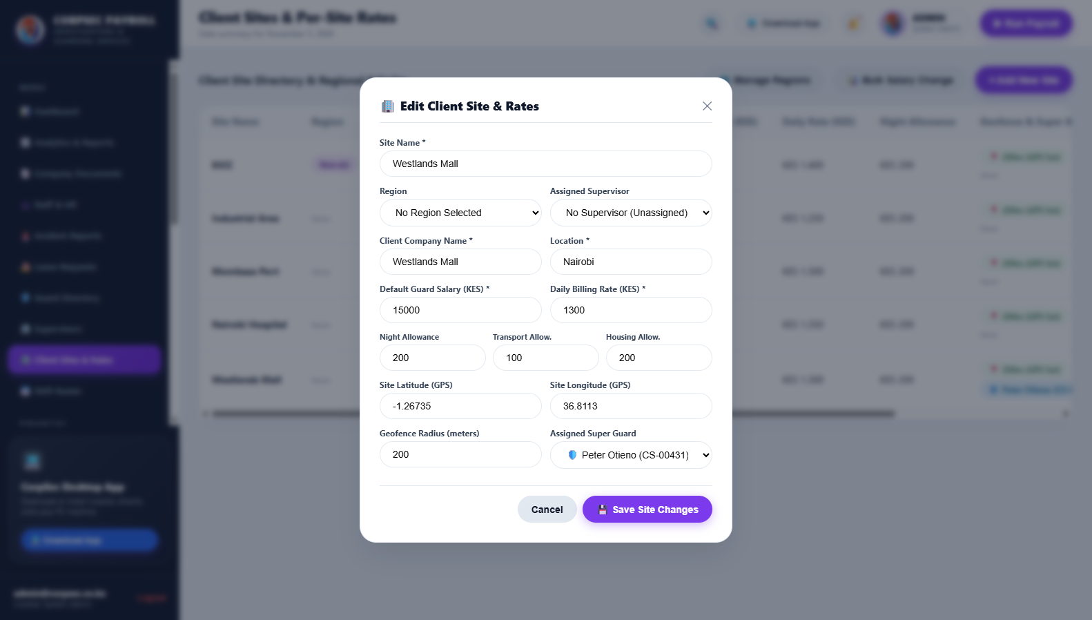
MODULE 06 | GEOFENCE MGMT
Site GPS Geofence & Super Guard Mandate Setup
Interactive site editor to configure precision GPS coordinates, 200m circular geofence boundary, and site supervisors.
👤 AUTHORIZED ROLE: CHIEF OPERATIONS OFFICER, FIELD SYSTEMS ENGINEER & OPERATIONS MANAGER
Step 1 — Input GPS Coordinates: Enter the exact decimal Latitude and Longitude of the client site (e.g., -1.2675, 36.8045 for Westlands Mall).
Step 2 — Configure Geofence Radius: Standardize geofence boundary to 200 meters to ensure guards can only clock in when physically on the client perimeter.
Step 3 — Assign Site Super Guard: Select an authorized Super Guard from the dropdown to grant them proxy clock-in mandates for that location.
Step 4 — Save & Broadcast to Mobile: Click 'Save Amendments'. Geofence parameters immediately sync to field guards' mobile devices via PWA.
💡 Operational Tip / Compliance Rule: Setting radius below 50m may trigger false rejections due to civilian GPS device drift; 200m is the industry gold standard.
📸 Live System Screenshot: Site configuration modal showing GPS latitude/longitude inputs, 200-meter radius threshold, and Super Guard mandate binding.

Slide 9
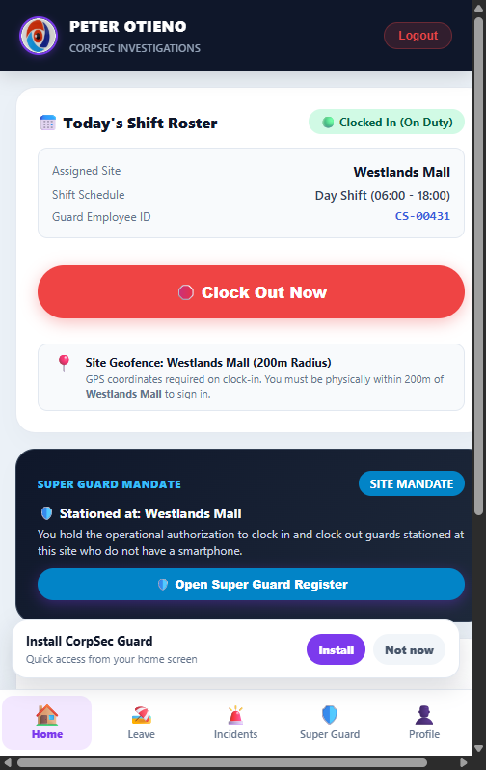
MODULE 07 | MOBILE SHIFT PORTAL
Mobile Super Guard Shift Portal & Mandate Clocking
Mobile-first PWA interface enabling site commanders to clock their shift and record attendance for smartphone-less guards.
👤 AUTHORIZED ROLE: SUPER GUARDS, FIELD SHIFT LEADERS & SITE SECURITY COMMANDERS
Step 1 — Access Mobile Portal on Phone: Open the mobile web portal on any smartphone. The system prompts to install as a native home-screen app.
Step 2 — Personal GPS Clock In/Out: Tap 'Clock In Shift'. The device fetches current GPS coordinates; if inside 200m of assigned site, check-in succeeds.
Step 3 — Open Super Guard Register: Tap the blue 'Open Super Guard Register' button to access the authorized roster for non-smartphone guards.
Step 4 — Execute Proxy Clocking: Select the guard on duty, select their shift (Day/Night), and tap 'Clock In on Behalf' with GPS tamper-proofing.
💡 Operational Tip / Compliance Rule: If a guard is outside the 200m boundary, the system displays exact distance away and blocks attendance recording.
📸 Live System Screenshot: Mobile Guard Portal showing active shift status, GPS coordinate tracking, and 1-click Super Guard mandate register access.

Slide 10
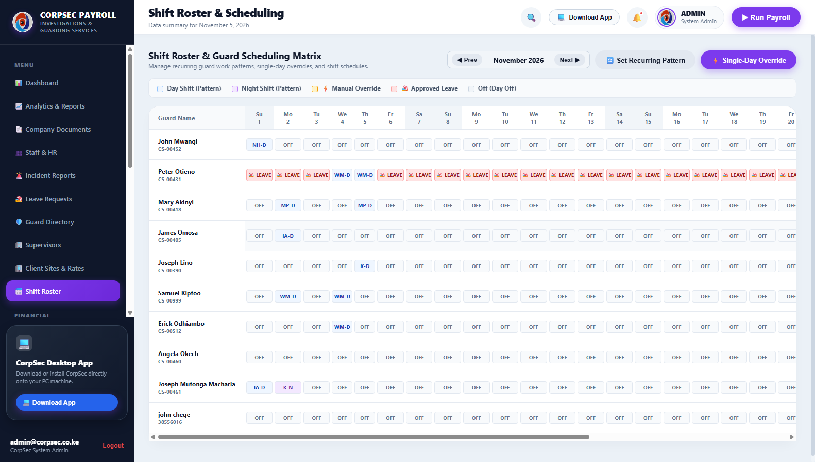
MODULE 08 | SHIFT ROSTERING
Monthly Shift Roster & Tactical Deployments
Interactive calendar deployment matrix managing day shifts, night shifts, relief coverage, and mandatory rest days.
👤 AUTHORIZED ROLE: OPERATIONS ROSTER MANAGER & FIELD DUTY DISPATCHER
Step 1 — Select Deployment Month: Choose target calendar month and year to view or populate guard deployment schedules.
Step 2 — Assign Guard to Site & Shift: Select guard, designate Day Shift (06:00 - 18:00) or Night Shift (18:00 - 06:00), and assign client post.
Step 3 — Allocate Relievers for Rest Days: Ensure guards receive statutory rest days without leaving client sites unmanned by slotting in floating relievers.
Step 4 — Publish & Sync to Roster: Click 'Publish Shift Roster'. Shifts immediately reflect on mobile portals and attendance monitoring dashboards.
💡 Operational Tip / Compliance Rule: CorpSec system flags fatigue warnings if a guard is scheduled for back-to-back night and day shifts without 12-hour rest.
📸 Live System Screenshot: Shift roster view displaying scheduled guard deployments across client sites with day and night rotation indicators.

Slide 11
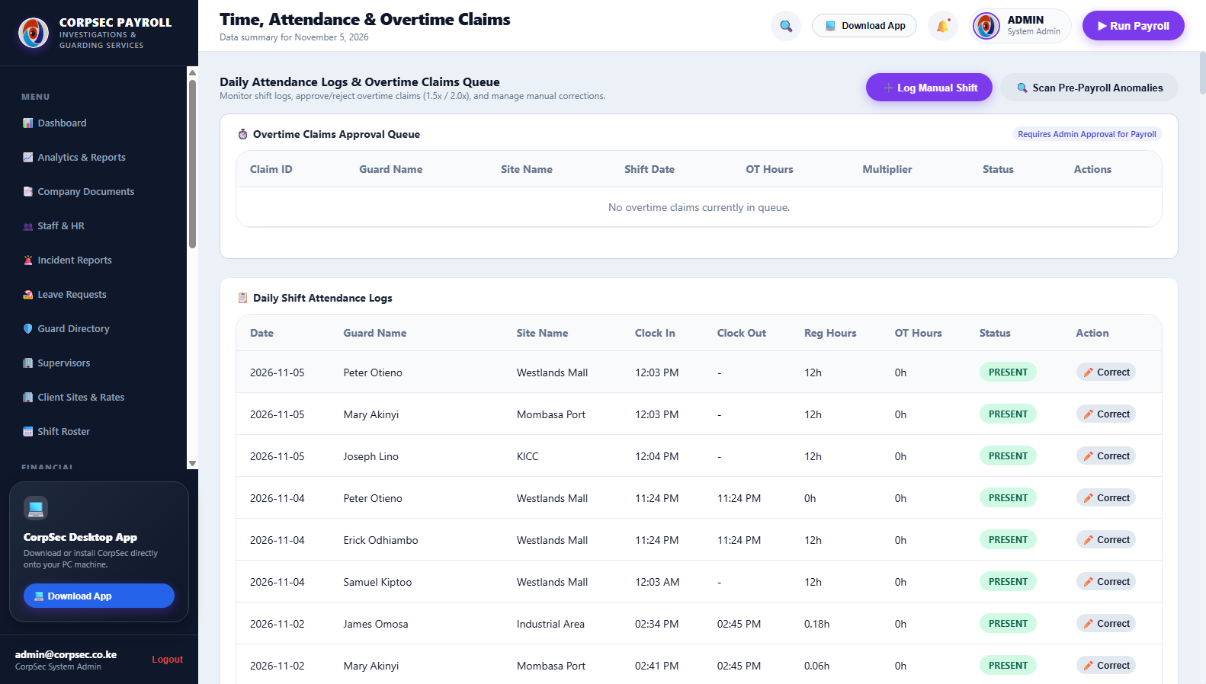
MODULE 09 | ATTENDANCE ENGINE
Real-Time Attendance Engine & 200m Geofence Audit
Live shift verification logging exact GPS coordinates, geofence status (Inside/Outside/Flagged), and overtime hours.
👤 AUTHORIZED ROLE: OPERATIONS CONTROLLER, HR AUDITOR & SHIFT SUPERVISOR
Step 1 — Review Daily Roll Call: Inspect clock-ins across all client sites in real time, with exact clock-in timestamp and site matching.
Step 2 — Audit Geofence Badges: Green 'INSIDE (200m)' indicates verified perimeter attendance; Red 'OUTSIDE GEOFENCE' flags potential proxy fraud.
Step 3 — Inspect Overtime Hours: Guards serving beyond scheduled 12-hour shifts automatically accrue overtime hours logged for payroll computation.
Step 4 — Export Attendance Register: Click 'Export Attendance' to download tamper-proof attendance registers for client SLA reporting.
💡 Operational Tip / Compliance Rule: Every attendance record stores device latitude, longitude, and device user-agent for forensic proof during client billing audits.
📸 Live System Screenshot: Attendance logs showing GPS geofence compliance within 200m, clock-in timestamps, and automated overtime tracking.

Slide 12
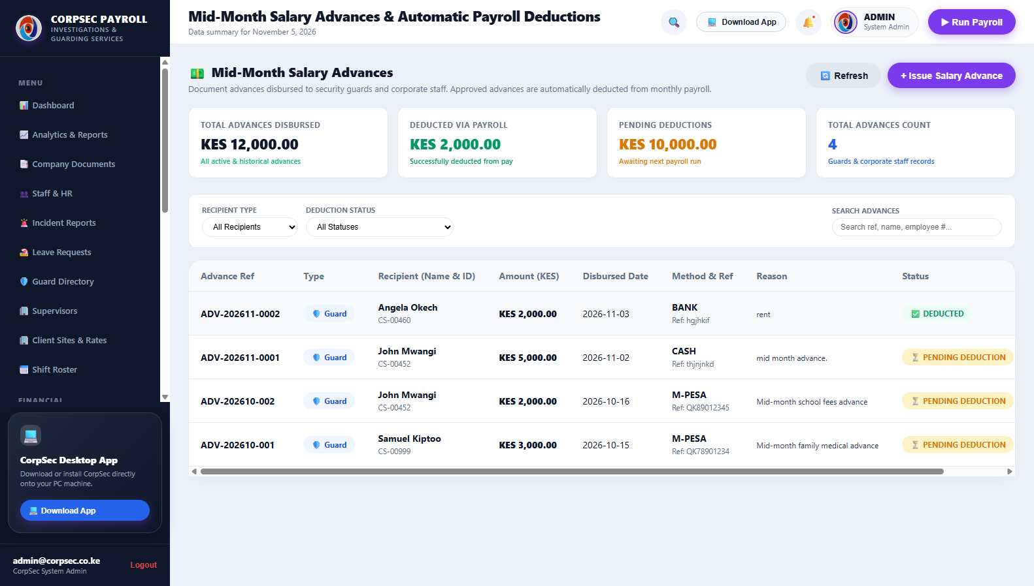
MODULE 10 | SALARY ADVANCES
Mid-Month Salary Advance Management
Controlled advance request workflow with eligibility checking, supervisor approvals, and automatic payroll deduction linking.
👤 AUTHORIZED ROLE: HR MANAGER, FINANCIAL CONTROLLER & MANAGING DIRECTOR
Step 1 — Record Advance Application: Select guard or staff member, enter requested advance amount, and document reason (e.g. medical, school fees).
Step 2 — Automated Eligibility Check: System checks current accrued monthly earnings to ensure advance does not exceed statutory 50% cap.
Step 3 — Approve & Disburse via M-Pesa: Authorized manager approves request; advance status transitions to 'DISBURSED' with reference code.
Step 4 — Automated Payroll Sync: Approved advances automatically lock and feed into the upcoming month's payroll deductions column.
💡 Operational Tip / Compliance Rule: Once disbursed, advances cannot be deleted and automatically reduce final net pay, preventing accidental double disbursement.
📸 Live System Screenshot: Salary Advance portal showing advance requests, remaining balances, approval statuses, and direct links to payroll deduction.

Slide 13
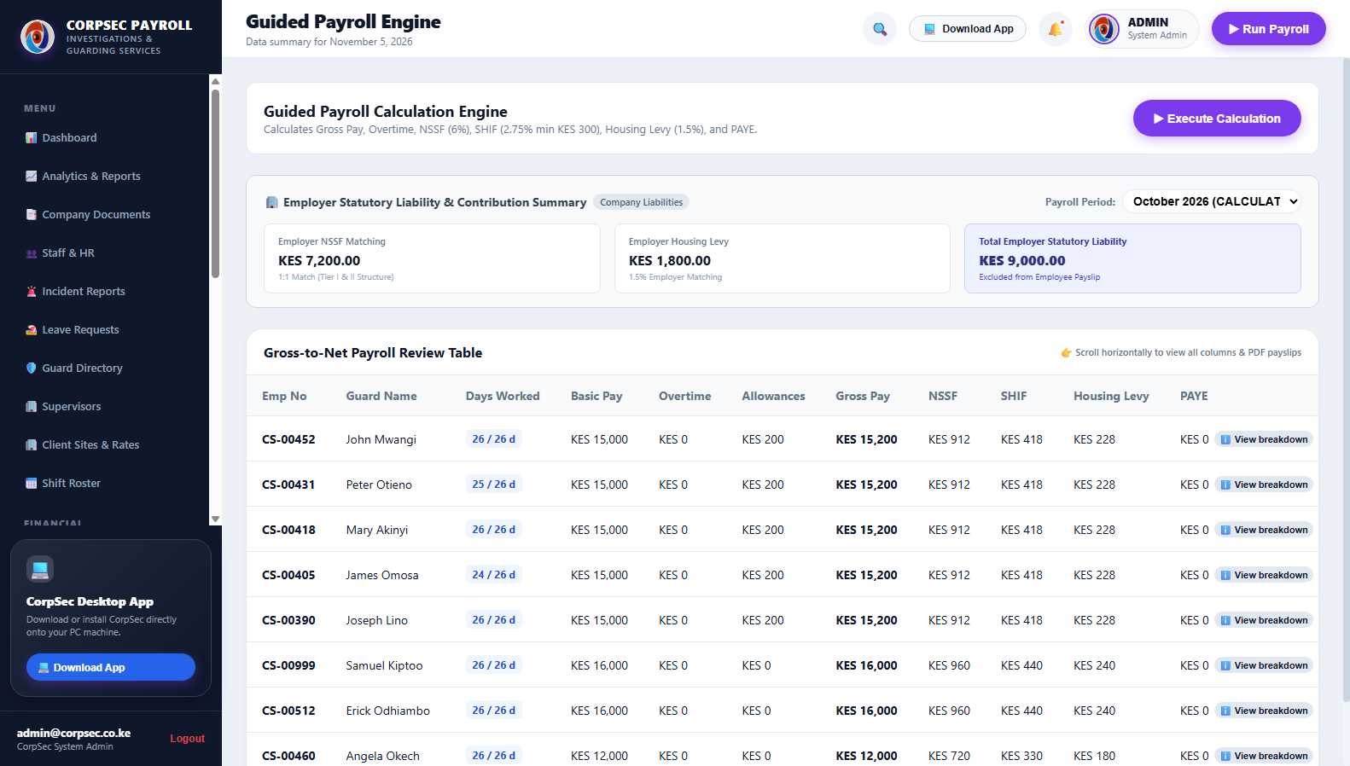
MODULE 11 | PAYROLL ENGINE
Guided Kenyan Statutory Payroll Engine
Fully compliant calculation engine executing KRA PAYE bands, NSSF Tier I & II, SHIF 2.75%, and Housing Levy 1.5%.
👤 AUTHORIZED ROLE: HEAD OF PAYROLL, SENIOR ACCOUNTANT & MANAGING DIRECTOR
Step 1 — Select Billing Period: Choose the active payroll cycle (e.g. November 2026) and click 'Calculate Monthly Payroll'.
Step 2 — Inspect Statutory Deductions: Verify automated computations: NSSF (Tier I KES 420 + Tier II), SHIF (2.75% of gross), Housing Levy (1.5%), and PAYE.
Step 3 — Apply Personal Relief: Kenya standard monthly personal relief of KES 2,400 is automatically credited against gross tax payable.
Step 4 — Review Net Pay & Commit: Audit net salaries after factoring in mid-month salary advances and unexcused absent days before final commitment.
💡 Operational Tip / Compliance Rule: Calculations comply strictly with Kenya Finance Act 2023/2024 regulations, preventing KRA non-compliance penalties.
📸 Live System Screenshot: Payroll engine interface detailing gross pay, NSSF Tier I/II, SHIF 2.75%, Housing Levy 1.5%, PAYE bands, and net disbursements.

Slide 14
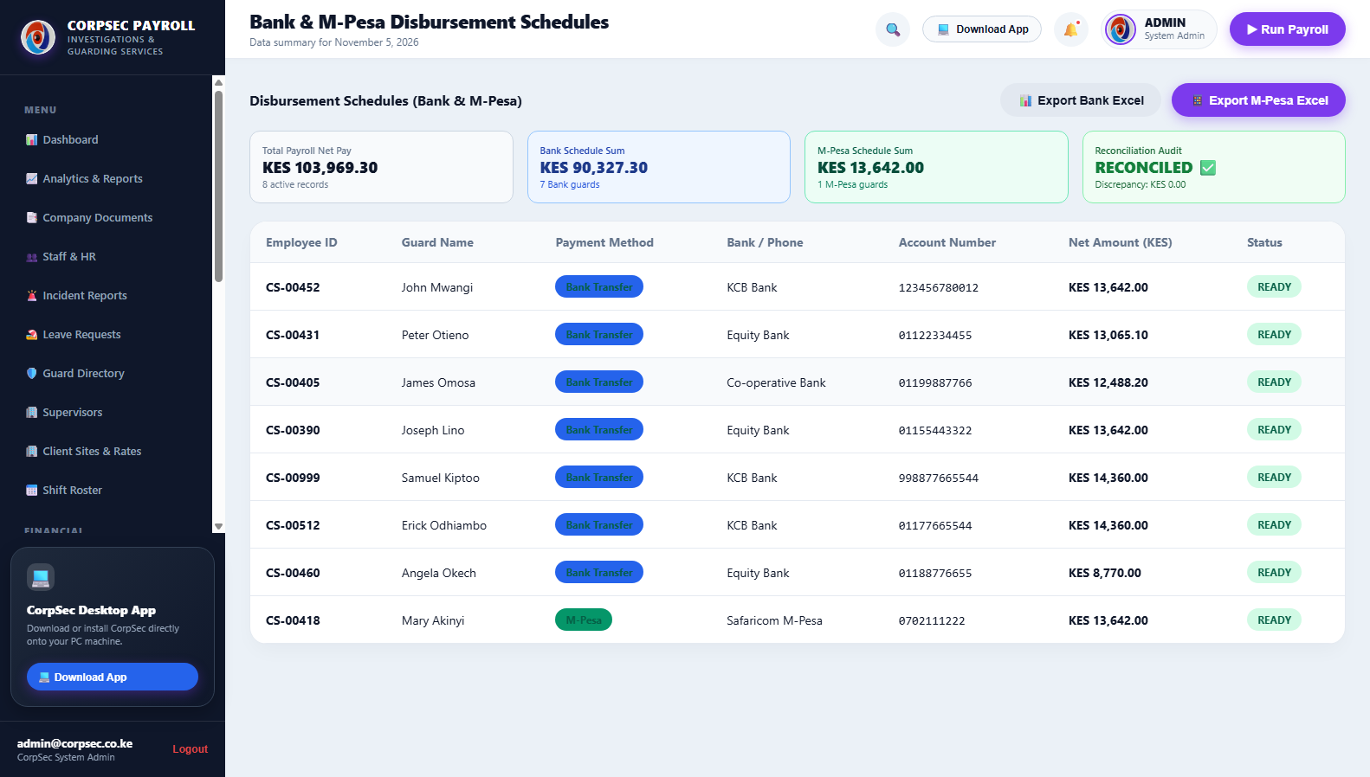
MODULE 12 | PAYMENT DISBURSEMENT
Bank EFT & Safaricom M-Pesa Bulk Payment Schedules
Automated disbursement batch generator formatting standard bank EFT spreadsheets and Safaricom B2C bulk payment files.
👤 AUTHORIZED ROLE: FINANCE DIRECTOR, TREASURY MANAGER & MANAGING DIRECTOR
Step 1 — Select Committed Payroll Run: Select the finalized payroll period to generate dual disbursement channels (Bank vs M-Pesa).
Step 2 — Generate Bank EFT Schedule: Click 'Export Bank EFT File' to produce standardized CSV containing Account Name, Bank Code, Account Number, and Net Pay.
Step 3 — Generate Safaricom M-Pesa B2C File: Click 'Export M-Pesa Bulk File' to produce bulk payout sheets formatted for direct upload to Safaricom Daraja/Portal.
Step 4 — Mark Disbursed & Archive: Upon bank execution, toggle batch status to 'PAID' to lock records and trigger automated digital payslips.
💡 Operational Tip / Compliance Rule: M-Pesa numbers are pre-validated to ensure 2547XXXXXXXX Kenyan Safaricom format, preventing transaction rejections.
📸 Live System Screenshot: Payment schedules view showing bank account details, M-Pesa mobile numbers, net amounts, and 1-click batch export buttons.

Slide 15
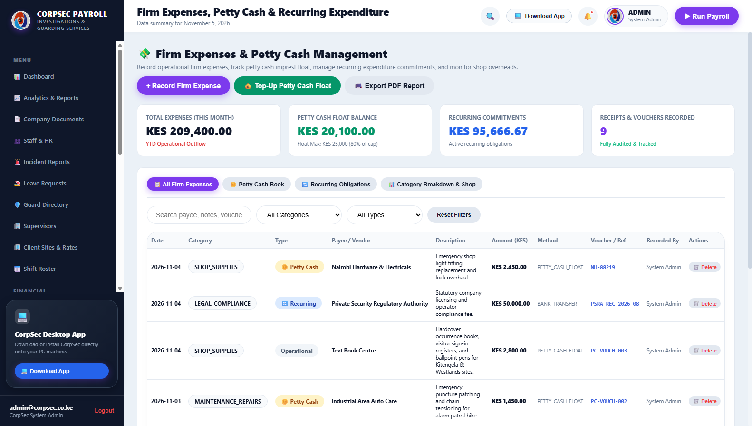
MODULE 13 | EXPENSES & FLOAT
Firm Operational Expenses & Petty Cash Float
Comprehensive ledger tracking company expenditures, recurring obligations, and KES 25,000 petty cash imprest health.
👤 AUTHORIZED ROLE: PETTY CASH CUSTODIAN, FINANCE OFFICER & MANAGING DIRECTOR
Step 1 — Log Expenditure Voucher: Click 'Record Expense', select category (Shop Supplies, Fuel, Compliance), payee/vendor, and amount.
Step 2 — Enforce 30-Second Duplicate Guard: System features built-in protection blocking duplicate submissions within 30 seconds to prevent accidental double entries.
Step 3 — Monitor KES 25,000 Float Cap: The visual float tracker flags warnings if petty cash float exceeds KES 25,000 ceiling, prompting reconciliation.
Step 4 — Track Recurring Obligations: Review standing monthly costs such as PSRA operator fees, radio license renewals, and office rent.
💡 Operational Tip / Compliance Rule: Always enter vendor voucher receipt numbers for audit traceability; petty cash vouchers link directly to accounting ledgers.
📸 Live System Screenshot: Expenses view displaying KES 211,850 YTD outflow, KES 27,850 float tracking, vendor vouchers, and duplicate safeguards.

Slide 16
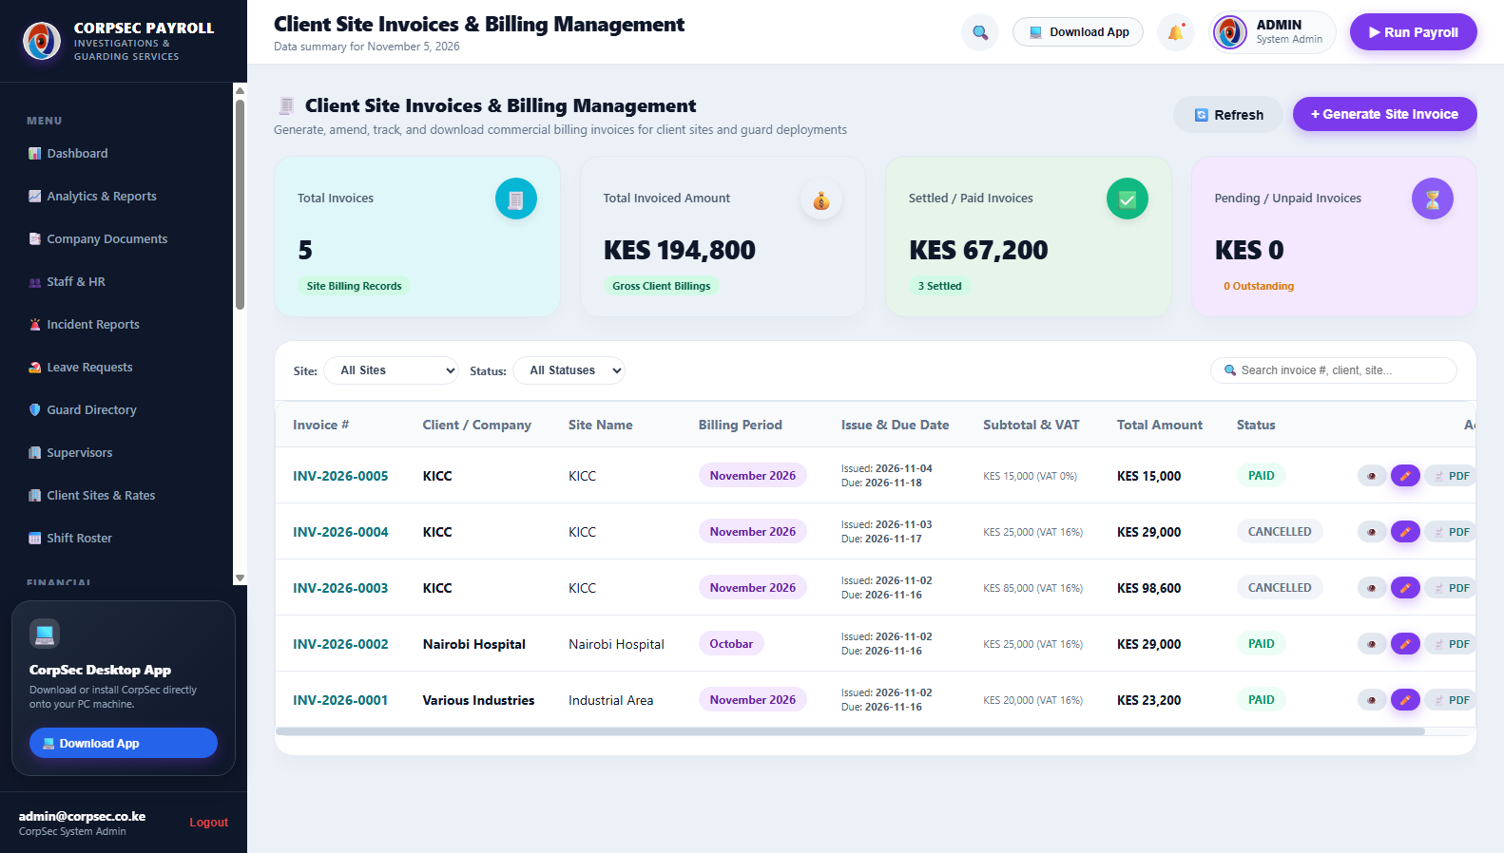
MODULE 14 | SITE INVOICING
Commercial Site Invoicing & Accounts Receivable
Commercial billing hub generating monthly client invoices with 16% VAT, payment terms, and settlement tracking.
👤 AUTHORIZED ROLE: COMMERCIAL BILLING MANAGER, FINANCE ACCOUNTANT & MANAGING DIRECTOR
Step 1 — Generate Monthly Invoice: Click 'Create Site Invoice', select client site, and choose billing period. Guard deployment counts pre-populate automatically.
Step 2 — Review Subtotal & 16% VAT: The system calculates contracted guard subtotal and applies mandatory 16% Value Added Tax in accordance with KRA guidelines.
Step 3 — Track Payment Statuses: Monitor live status badges: 'DRAFT', 'ISSUED', 'PARTIALLY PAID', and 'SETTLED' with due date aging alerts.
Step 4 — Open Official Letterhead Preview: Click 'View Invoice' to open the scrollable official CorpSec Investigations letterhead preview modal.
💡 Operational Tip / Compliance Rule: Invoices generate a unique sequential tax reference (e.g. CSIL/INV/2026-0001) that matches the M-Pesa Paybill account number.
📸 Live System Screenshot: Commercial site invoices table displaying client names, subtotal, 16% VAT, total amounts, and payment settlement badges.

Slide 17
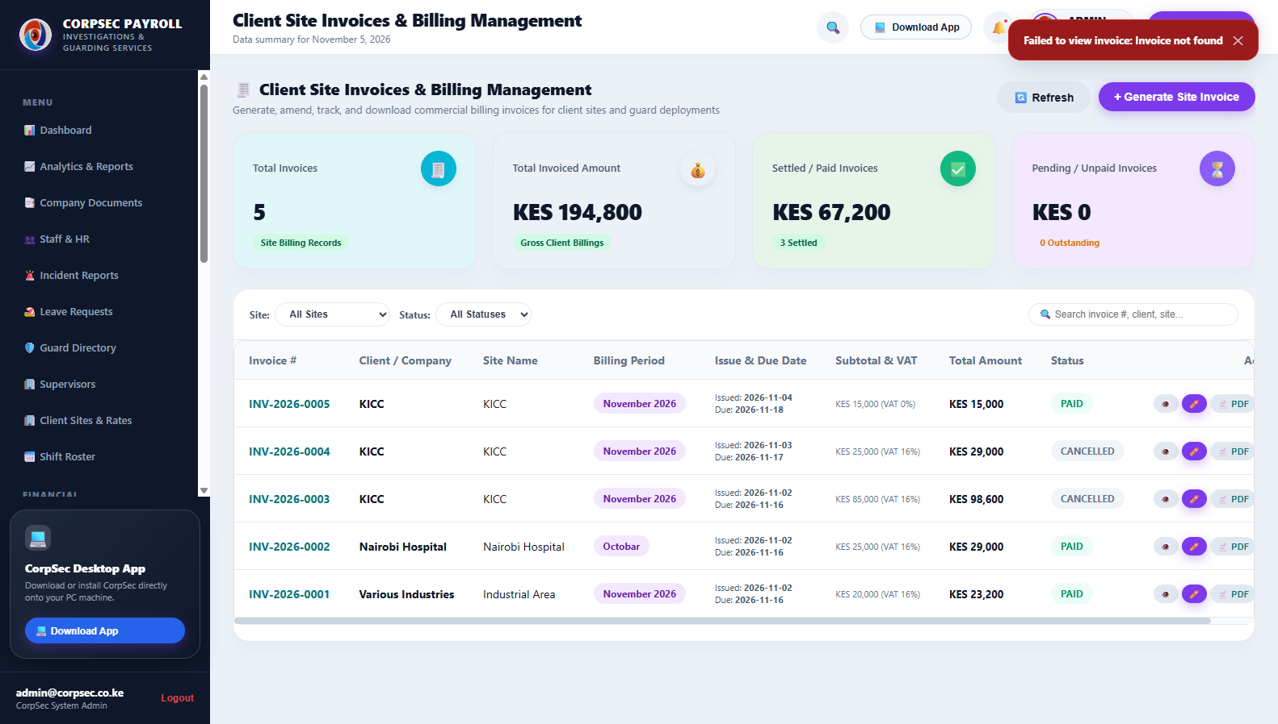
MODULE 15 | OFFICIAL INVOICE
Official CorpSec Letterhead Invoice & PDF Export
High-fidelity corporate billing document featuring dual curved brand ribbons, Moses Alango signature, and banking details.
👤 AUTHORIZED ROLE: MANAGING DIRECTOR, ACCOUNTS RECEIVABLE & CLIENT RELATIONS
Step 1 — Inspect Letterhead Ribbons: Verify top curved brand banner, high-resolution CorpSec logo, and PSRA licensed credentials in the header.
Step 2 — Confirm Database-Driven Data: Client KRA PIN, company PIN (P051234567Z), and banking instructions are pulled live from the database.
Step 3 — Review Scrollable Modal Layout: Scroll smoothly through the document using the dedicated scroll body, with action buttons pinned at the bottom.
Step 4 — Print or Download Official PDF: Click '🖨️ Print Invoice' for direct browser printing or '📄 Download Official PDF' to dispatch to corporate clients.
💡 Operational Tip / Compliance Rule: The invoice features an authorized digital signature by Director Moses Alango and official KCB Bank Upper Hill bank details.
📸 Live System Screenshot: Official CorpSec letterhead invoice modal with dual-tier brand ribbons, KCB bank details, Paybill 522522, and Director signature.

Slide 18
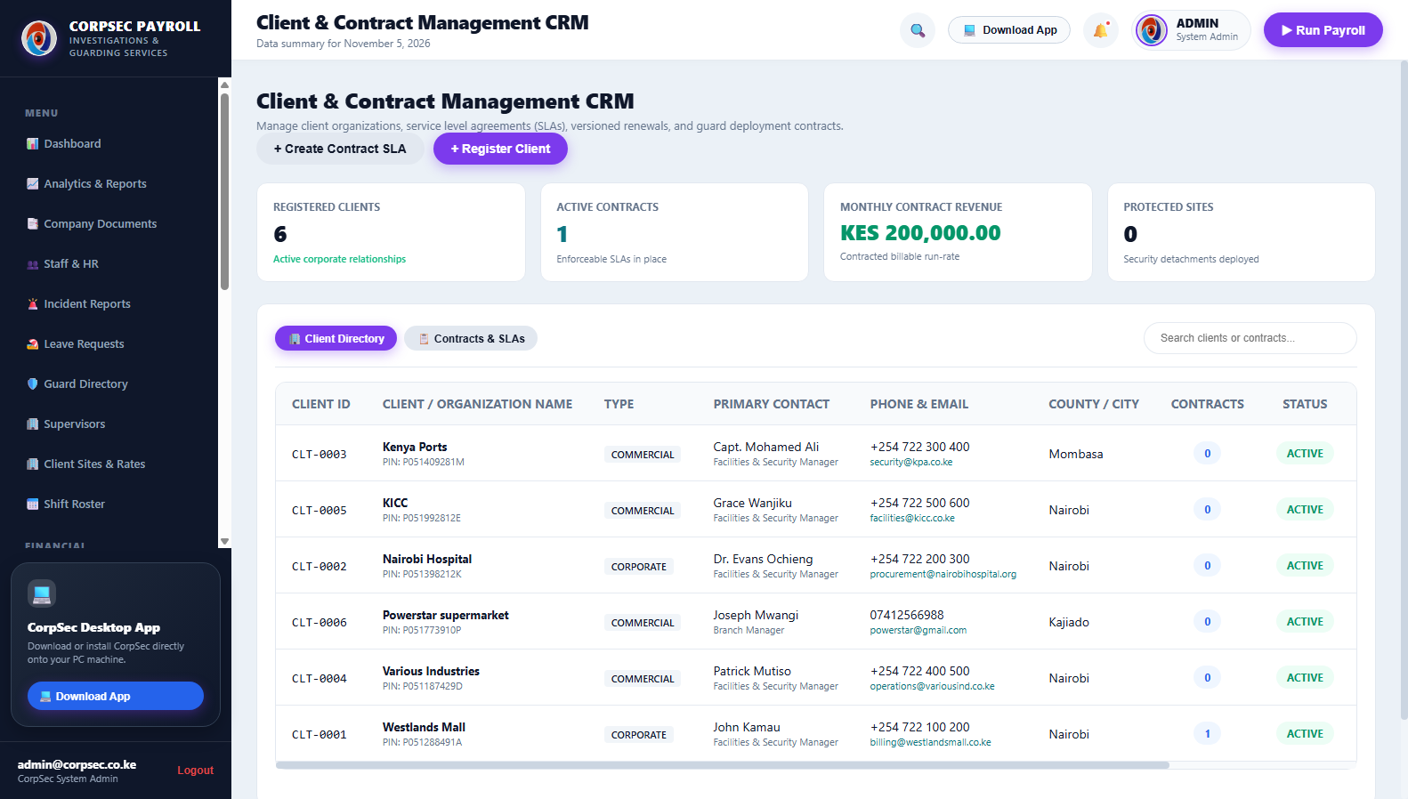
MODULE 16 | CLIENT CRM
Corporate Clients & Security Contracts CRM
Comprehensive customer relationship registry tracking corporate client accounts, primary contacts, and multi-site contracts.
👤 AUTHORIZED ROLE: CLIENT RELATIONS MANAGER, BUSINESS DEVELOPMENT & LEGAL COUNSEL
Step 1 — Register New Client Entity: Click 'Add Client'. Enter corporate name, KRA PIN, billing address, and designated primary contact person.
Step 2 — Attach Security Contracts: Define contract commencement date, annual renewal terms, notice periods, and agreed service level agreements (SLAs).
Step 3 — Link Guarded Sites: Associate multiple physical sites under a single corporate parent account for unified billing and consolidated reporting.
Step 4 — Review Account Health: Track total guards deployed per client, monthly contracted revenue, and contract compliance history.
💡 Operational Tip / Compliance Rule: A single client can have 10+ distinct guarding sites with different guard counts and shift billing rates under one unified profile.
📸 Live System Screenshot: Clients & Contracts CRM view displaying corporate entities, registered KRA PINs, contact persons, and multi-site bindings.

Slide 19
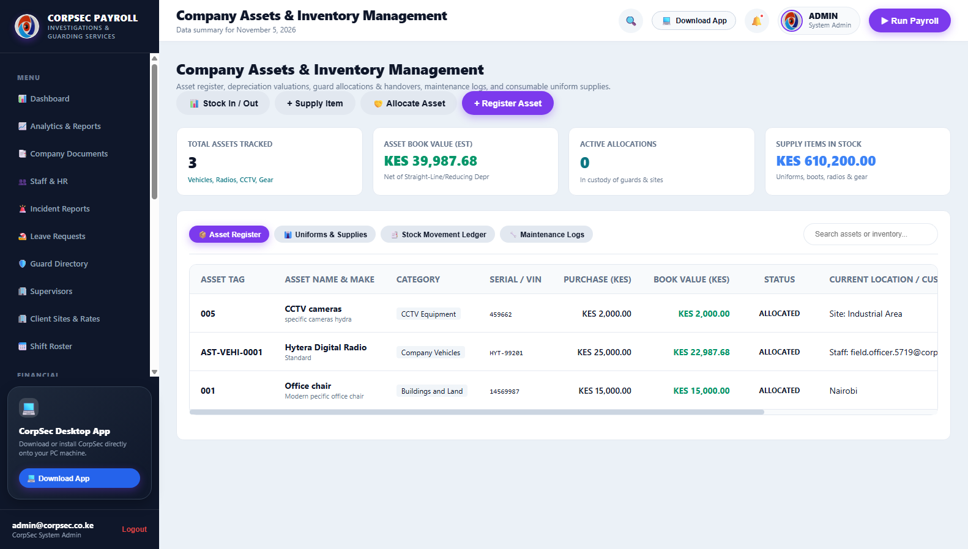
MODULE 17 | ASSET INVENTORY
Security Assets, Tactical Gear & Uniform Custody
Equipment tracking system monitoring batons, hand-held radios, metal detectors, torches, and uniform issuances.
👤 AUTHORIZED ROLE: QUARTERMASTER, LOGISTICS OFFICER & FIELD EQUIPMENT SUPERVISOR
Step 1 — Catalog Security Assets: Register equipment serial numbers, asset categories (Uniforms, Patrol Radios, Tactical Gear), and acquisition values.
Step 2 — Issue Gear to Guards: Assign assets to specific guards with digital custody logs documenting date of issuance and condition at handover.
Step 3 — Track Return & Maintenance: Log equipment returns, report damaged or lost gear, and automatically link replacement costs to payroll if negligent.
Step 4 — Audit Inventory Stock Levels: View real-time stock balances across headquarters stores and client site security armories.
💡 Operational Tip / Compliance Rule: Guards must clear all issued equipment with the Quartermaster before final dues are disbursed upon contract termination.
📸 Live System Screenshot: Assets & Inventory register tracking patrol equipment, tactical gear, uniform allocations, and guard custody status.

Slide 20
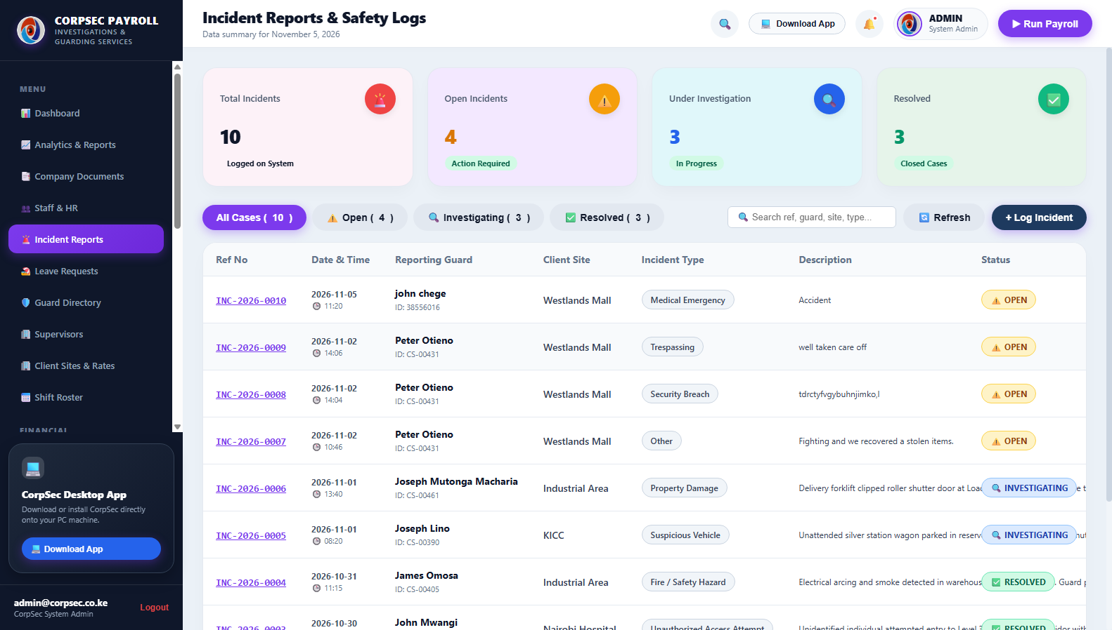
MODULE 18 | INCIDENT LOGGING
Digital Occurrence Book (OB) & Incident Reporting
PSRA-compliant incident management logging security breaches, emergency responses, and investigation resolution notes.
👤 AUTHORIZED ROLE: FIELD DUTY OFFICER, INVESTIGATIONS SPECIALIST & CHIEF SECURITY OFFICER
Step 1 — Record Incident Occurrence: Field guards or supervisors log incidents specifying Date/Time, Client Site, Incident Type, and OB Number.
Step 2 — Assign Severity & Priority: Categorize severity (Minor Infraction, Trespass, Forced Entry, Fire Alarm, Medical Emergency).
Step 3 — Document Witness Statements: Record statements, officer actions taken, police involvement, and evidence collected at the scene.
Step 4 — Track Resolution & Sign-Off: Investigations team updates status to 'INVESTIGATING' or 'RESOLVED' with director-level closing remarks.
💡 Operational Tip / Compliance Rule: Digital OB entries cannot be altered retroactively; all edits append timestamped revision notes preserving evidentiary integrity.
📸 Live System Screenshot: Incident Reports and digital Occurrence Book (OB) logging security events, site locations, priority levels, and action logs.

Slide 21
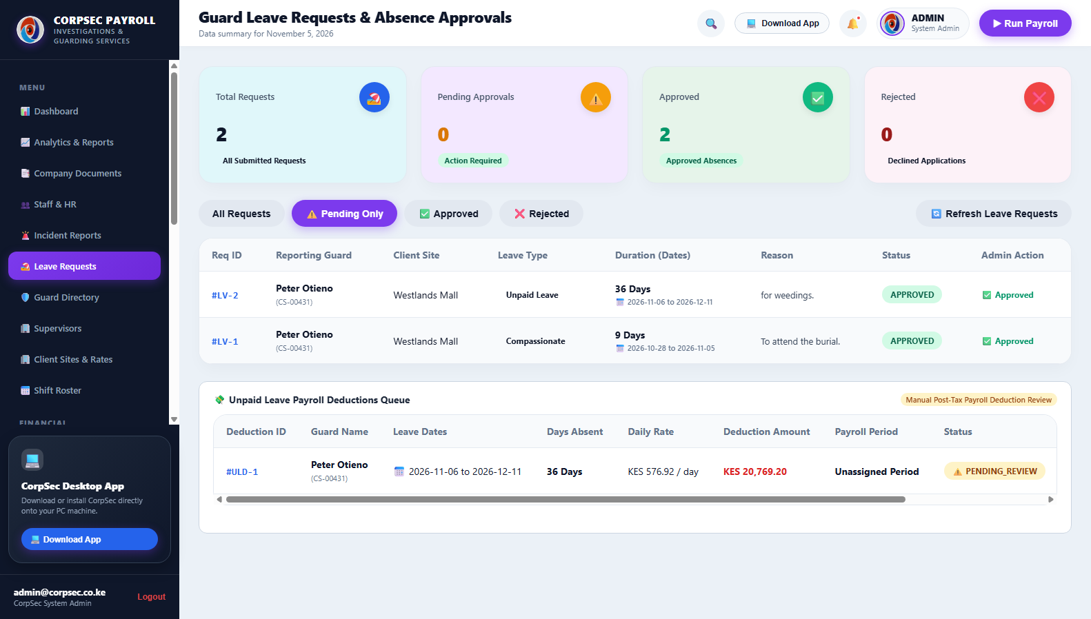
MODULE 19 | LEAVE MANAGEMENT
Guard Leave Requests & Rest Day Allocation
Leave workflow regulating annual leave quotas, sick off authorizations, compassionate days, and shift coverage.
👤 AUTHORIZED ROLE: HR LEAVE OFFICER & OPERATIONS ROSTER COORDINATOR
Step 1 — Submit Leave Application: Guard submits request via mobile portal or supervisor logs request in management hub with start/end dates.
Step 2 — Verify Leave Entitlement: System verifies available annual leave balance (standard 21 statutory days per annum) and past absence records.
Step 3 — Assign Reliever Coverage: Operations assigns a qualified relief guard to cover the post during the leave period to maintain contract SLA.
Step 4 — Approve & Update Roster: Supervisor approves leave. The shift roster automatically reflects the leave badge and prevents double scheduling.
💡 Operational Tip / Compliance Rule: Approved sick leave requires uploading medical certificate documentation to maintain compliance during labor audits.
📸 Live System Screenshot: Leave management pipeline displaying guard leave applications, leave categories, date ranges, and approval controls.

Slide 22
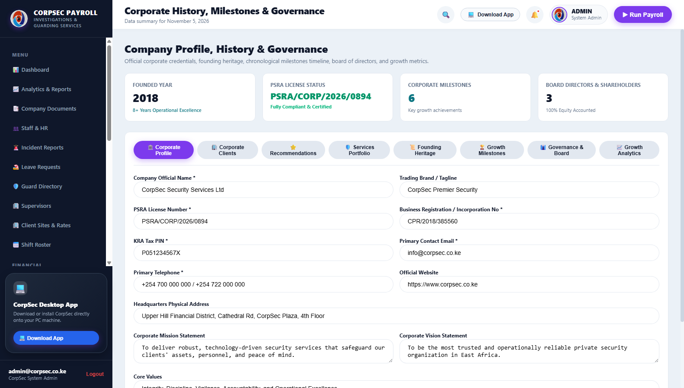
MODULE 20 | COMPANY GOVERNANCE
Corporate Profile, History & PSRA Compliance Standing
Institutional credentials repository displaying corporate governance, PSRA licensing records, and founding milestones.
👤 AUTHORIZED ROLE: MANAGING DIRECTOR, COMPLIANCE AUDITOR & GENERAL PUBLIC/CLIENTS
Step 1 — Inspect PSRA Licensing Details: Review official Private Security Regulatory Authority operator license number, validity, and regulatory status.
Step 2 — Examine Leadership Structure: Review board governance, executive leadership under Director Moses Alango, and divisional management tiers.
Step 3 — Review Company Milestones: Access historical records detailing CorpSec's expansion across Nairobi, Kiambu, and national guarding operations.
Step 4 — Generate Compliance Summary: Export corporate profile dossier for inclusion in public and private commercial security tenders.
💡 Operational Tip / Compliance Rule: Maintaining up-to-date PSRA credentials on the platform ensures automated watermarks on commercial invoices remain fully valid.
📸 Live System Screenshot: Company Profile and History view displaying corporate milestones, leadership credentials, and PSRA regulatory standing.

Slide 23
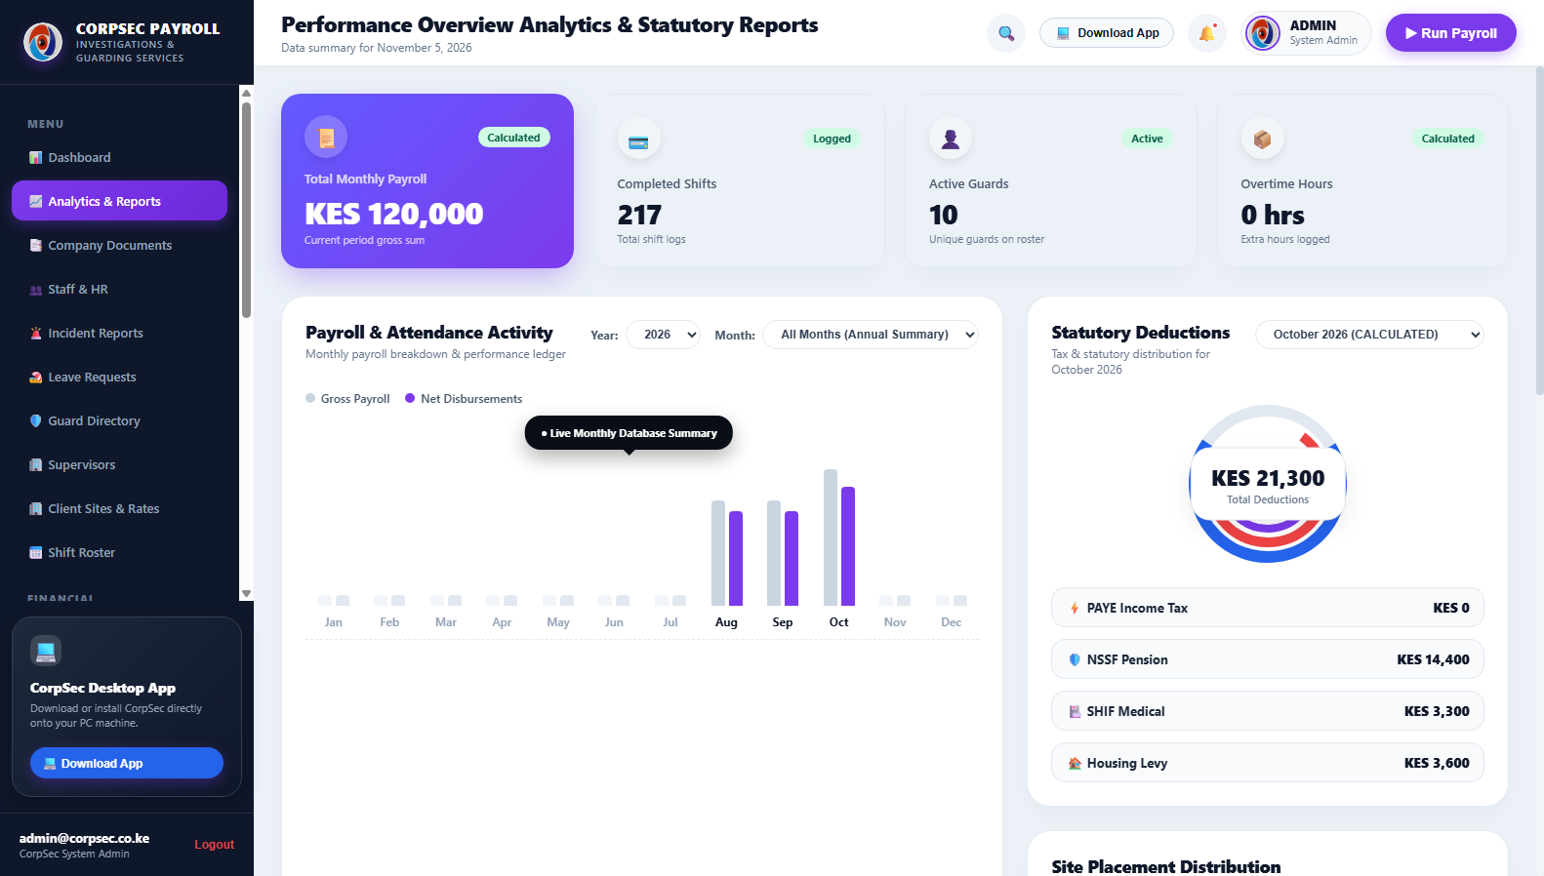
MODULE 21 | EXECUTIVE ANALYTICS
Operations Analytics & Executive Reporting
High-level visual reporting on workforce attendance rates, overtime expenditure distributions, and client profitability.
👤 AUTHORIZED ROLE: EXECUTIVE BOARD, FINANCIAL ANALYST & CHIEF OPERATIONS OFFICER
Step 1 — Analyze Attendance Reliability: Evaluate percentage of shifts manned on time vs tardy clock-ins across all client installations.
Step 2 — Audit Overtime Cost Trends: Identify client sites generating disproportionate overtime expenses to optimize guard roster rotations.
Step 3 — Review Gross Profit Margins: Compare monthly client billing revenues against deployed guard payroll costs to measure account profitability.
Step 4 — Export Executive Summaries: Generate presentation-ready PDF/Excel summaries for quarterly board meetings and client business reviews.
💡 Operational Tip / Compliance Rule: Target an attendance reliability rate above 98.5% to exceed corporate client SLA contractual benchmarks.
📸 Live System Screenshot: Analytics & Reporting center featuring visual charts, overtime trend lines, attendance breakdowns, and operational metrics.

Slide 24
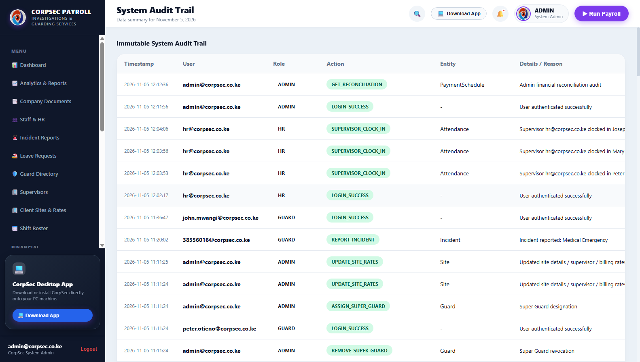
MODULE 22 | AUDIT TRAIL
Immutable System Audit Trail & Tamper Detection
Cryptographically sequenced log recording every administrative modification, payroll edit, and authorization event.
👤 AUTHORIZED ROLE: SYSTEM ADMINISTRATOR, INTERNAL AUDITOR & LEGAL COMPLIANCE
Step 1 — Track Every User Action: Every click resulting in data creation, amendment, or deletion is recorded with millisecond precision.
Step 2 — Inspect Originating IP & Timestamp: Review user email, action category, originating IP address, and browser agent string for forensic audit.
Step 3 — Filter by Audit Category: Filter logs by 'PAYROLL', 'INVOICE', 'GEOFENCE', 'SUPER_GUARD', or 'SECURITY' for focused investigations.
Step 4 — Immutable Architecture: Logs cannot be deleted or modified even by System Administrators, satisfying international ISO security audits.
💡 Operational Tip / Compliance Rule: Audit logs serve as admissible legal evidence in labor dispute tribunals and client contractual arbitration proceedings.
📸 Live System Screenshot: Audit Trail table displaying immutable event logs, timestamps, user email accounts, IP addresses, and detailed actions taken.

Slide 25
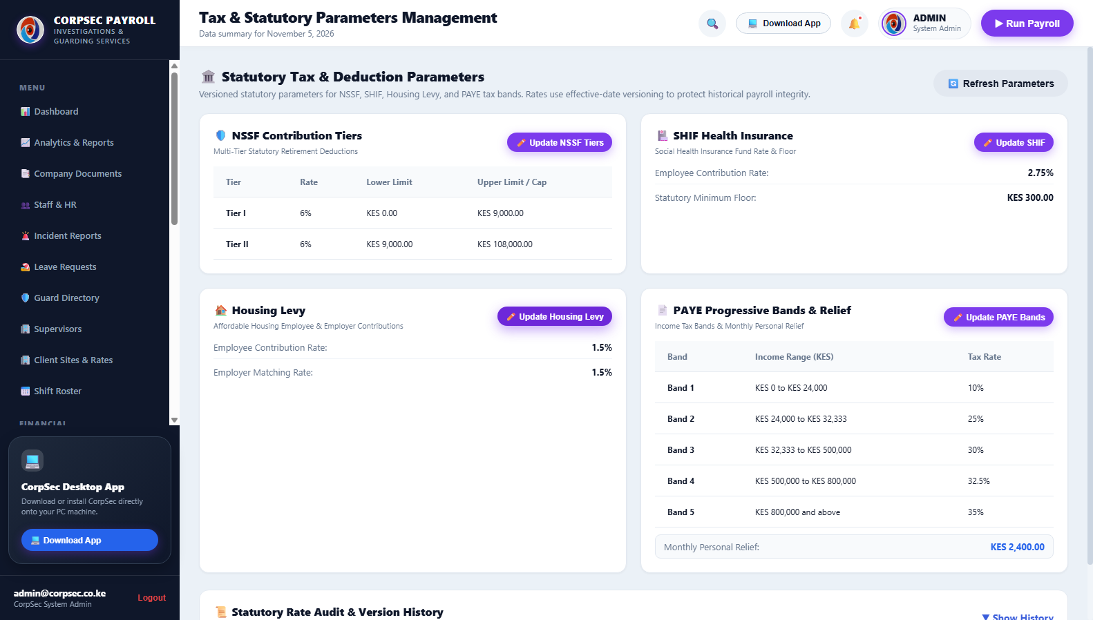
MODULE 23 | STATUTORY CONFIG
Kenyan Statutory Tax Configuration Engine
Centralized parameter engine managing KRA PAYE brackets, NSSF contribution limits, SHIF rates, and Housing Levy rules.
👤 AUTHORIZED ROLE: CHIEF FINANCIAL OFFICER, LEAD TAX CONSULTANT & SYSTEM ADMINISTRATOR
Step 1 — Review PAYE Tax Brackets: Inspect current KRA graduated tax brackets: 10% (first KES 24,000), 25% (next KES 8,333), 30%, 32.5%, and 35%.
Step 2 — Verify NSSF Tier I & Tier II Limits: Confirm Lower Earnings Limit (LEL KES 7,000) and Upper Earnings Limit (UEL KES 36,000) contribution formulas.
Step 3 — Confirm SHIF 2.75% & Housing Levy 1.5%: Verify Social Health Insurance Fund (SHIF 2.75%) and Affordable Housing Levy (1.5% employee + 1.5% employer).
Step 4 — Update Rates for New Finance Acts: When Kenyan Parliament enacts new Finance legislation, update tax thresholds here without modifying source code.
💡 Operational Tip / Compliance Rule: Changes to statutory rates apply dynamically to all subsequent payroll calculations while preserving historical payroll runs unchanged.
📸 Live System Screenshot: Statutory rates configuration showing KRA PAYE tax bands, NSSF Tier I/II ceilings, SHIF 2.75%, and Housing Levy percentages.

Slide 26
OPERATIONAL LIFECYCLE
End-to-End Monthly Operations & Payroll Workflow
Chronological workflow connecting daily guard attendance, mid-month advances, payroll computation, and client invoicing.
PHASE 1 (Day 1)
Deployment & Geofencing
• Finalize client site contracts
• Configure 200m GPS geofence
• Assign authorized Super Guards
• Publish monthly shift roster
PHASE 2 (Days 1–30)
Attendance & Guarding
• Daily 200m GPS clock-in
• Super Guard mandate clocking
• Live overtime hours tracking
• Digital OB incident logging
PHASE 3 (Day 15)
Salary Advances Window
• Receive guard advance requests
• Verify 50% accrued pay cap
• Disburse via Safaricom M-Pesa
• Lock deductions to payroll
PHASE 4 (Days 25–28)
Statutory Payroll Execution
• Calculate NSSF, SHIF, Housing Levy
• Apply KRA PAYE & KES 2,400 relief
• Generate Bank EFT CSV
• Generate M-Pesa B2C file
PHASE 5 (Day 30)
Client Invoicing & Close
• Generate commercial invoices
• Apply 16% VAT & payment terms
• Issue Moses Alango letterhead
• Review immutable audit trail

Slide 27
REGULATORY COMPLIANCE
Statutory Compliance, Security & Data Integrity Framework
How the CorpSec system guarantees 100% legal compliance, fraud elimination, and operational security.
🛡️ PSRA Kenya Certified
PSRA Regulatory Alignment
Strict adherence to Private Security Regulatory Authority mandates: standardized guard ID numbers, mandatory minimum wage compliance, background vetting records, and transparent occurrence book logging.
⚖️ 100% KRA & Labor Compliant
Kenyan Tax & Labor Laws
Automated compliance with KRA Finance Act 2024: NSSF Tier I & Tier II, SHIF 2.75%, Affordable Housing Levy 1.5%, PAYE brackets, and monthly KES 2,400 personal tax relief with zero manual spreadsheet errors.
📍 Precision GPS Perimeter
200m GPS Geofence Anti-Spoofing
Eliminates phantom guard deployments through dual-tier satellite coordinate verification. Attendance is strictly restricted to a 200m perimeter around client installations with spoofing detection.
🔒 Bank-Grade Security
Immutable Audit Trail & Cryptography
Bcrypt password encryption, JWT bearer session verification, and tamper-proof immutable audit logging. Every financial adjustment and status change is forever archived with user ID and IP address.

Slide 28
THE STRATEGIC CONVERSATION | EXECUTIVE VALUE PROPOSITION
The Ultimate Sales & Operations Closing Question:
"In a security market where corporate clients demand bulletproof accountability and zero regulatory liability, what is it worth to your clients to know—with 100% mathematical certainty—that every single guard on their perimeter is GPS-verified within 200 meters, fully compensated without dispute, and backed by instantaneous, immutable audit records?"
"When you present a commercial security proposal, are you offering mere promises—or are you delivering an airtight, PSRA-compliant digital fortress that makes choosing CorpSec Investigations the only defensible decision for their board?"
✨ CorpSec Investigations Limited — Precision Technology. Proven Integrity. Trust But Verify.
Moses Alango, Director | Upper Hill, Nairobi, Kenya
Phone: 0726 058 358 / 0739 058 358 | Email: info@corpsecinvestigations.com | Web: www.corpsecinvestigations.com

