Slide 1
SwiftLog Logistics
How the supply chain performed, 1 January to 8 September 2026
Business review for management
Okoro Joseph Ifeanyichukwu | AnalystLab Africa Experience Lab, Week 5
Notes:
Welcome. This review explains, in plain terms, how SwiftLog performed this year, where it is losing money and time, and what to do about it.

Slide 2
SwiftLog sells well, but delivers poorly
₦14.44M
1 in 3
37%
of sales from orders that were not cancelled
orders delivered so far (33%)
of deliveries arrive on time
Customers are loyal: almost 9 in 10 buyers come back
1 in 3 orders was cancelled, and 1 in 3 is still waiting
About 1 in 10 delivered orders is sent back
Two warehouses are nearly full while most stock sits unsold
SwiftLog Logistics | Business Review
2
Notes:
Headline: demand is healthy, but the business loses a lot between order placed and order delivered.

Slide 3
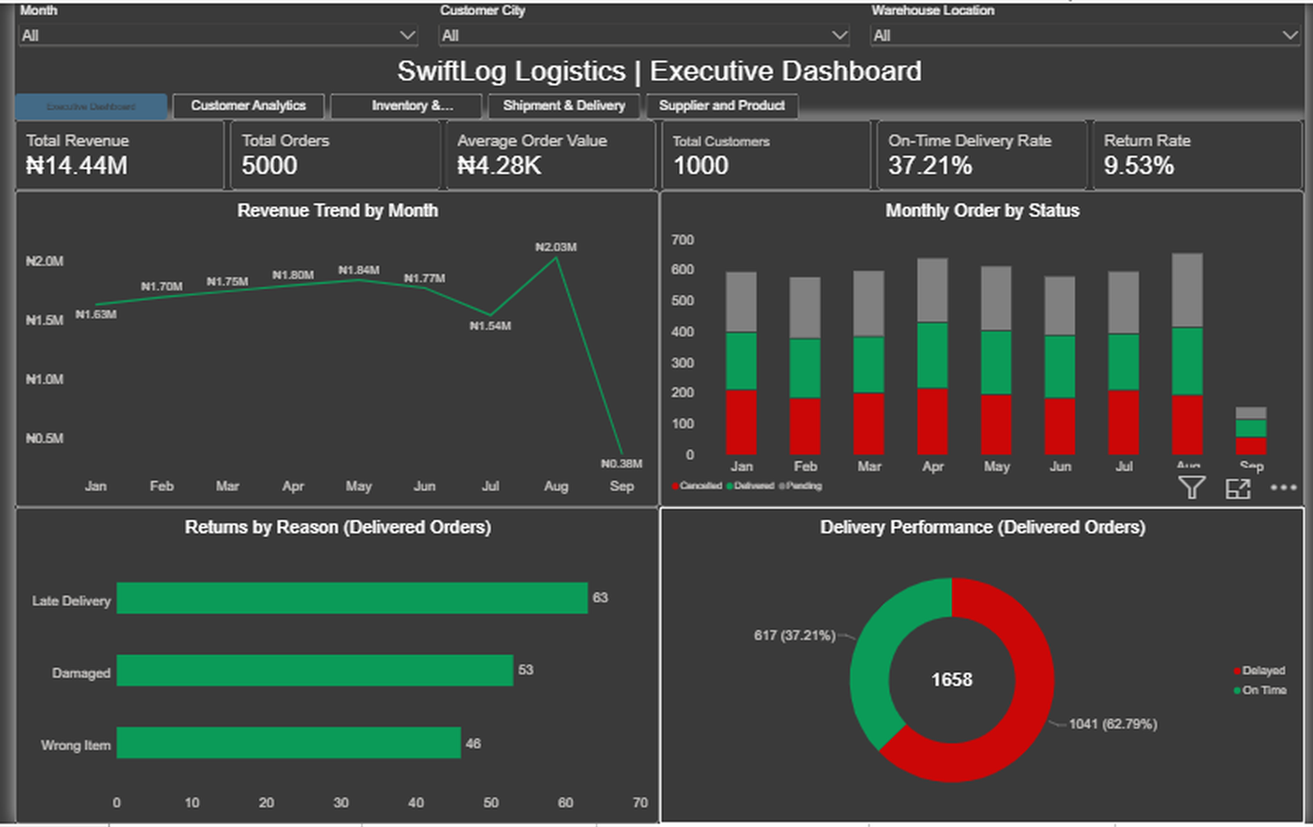
One dashboard, five pages
Executive: the whole business
Customers: who buys and how often
Inventory: stock and warehouses
Deliveries: speed and delays
Products: what sells, plus returns
Filter by month, city or warehouse.
SwiftLog Logistics | Business Review
3
Notes:
The dashboard is interactive. Everything in this review comes from these five pages.

Slide 4
Sales grew steadily and peaked in August
₦14.44M in total
August was the best month: ₦2.03M, about 16% above the early-year average
July dipped to ₦1.54M
*September is low only because our data stops on 8 September
SwiftLog Logistics | Business Review
4
Notes:
Sales are growing. August is the peak, so plan stock and delivery capacity before busy months.

Slide 5
Only 1 in 3 orders is delivered
Delivered: 1,658 orders, about ₦7.1M
Pending: 1,716 orders, about ₦7.3M still waiting
Cancelled: 1,626 orders, about ₦7.2M lost
Only half of the ₦14.44M in sales has actually been delivered
SwiftLog Logistics | Business Review
5
Notes:
This is the biggest finding. A third of orders are cancelled and a third are still waiting.

Slide 6
Customers come back, but new ones are drying up
88%
of buyers order more than once
841 of 959 buyers ordered at least twice
The 10 biggest customers make up only 3.3% of sales, so no single customer is critical
New customers fell from 307 in January to about 30 a month by August
SwiftLog Logistics | Business Review
6
Notes:
Loyalty is a strength. Acquiring new customers is the weak spot.

Slide 7
Fashion leads, and no single product dominates
Fashion brings in 37.5% of sales
The 10 best products together make up only 8% of sales
Best seller by quantity: P132 (347 units)
Biggest earner: P085 (₦143K)
Top city: Kano (₦3.87M), but all four cities are close
SwiftLog Logistics | Business Review
7
Notes:
Sales are well spread across products and cities, which reduces risk.

Slide 8
Only 37 in 100 deliveries arrive on time
3.5 days
average lateness of a late delivery
617 of 1,658 delivered orders were on time
Lateness is spread evenly from 3 to 7 days, so it is a regular problem
Customers should expect about 6 to 7 days, not 3
SwiftLog Logistics | Business Review
8
Notes:
On time means delivered within 2 days of the promised date, as defined in the data.

Slide 9
Kano is the slowest city for deliveries
Kano: only 33% on time (292 of 435 deliveries late)
Ibadan is best at 41%
Slowest warehouses: W13, W06 and W08 (about 30% on time)
Best warehouse: W15 (42%)
SwiftLog Logistics | Business Review
9
Notes:
Every city is below half, but Kano and three warehouses stand out as the weakest.

Slide 10
About 1 in 10 delivered orders comes back
158 delivered orders were returned: 9.5%
Late delivery is the most common reason given (63)
Yet late orders are not returned more often than on-time ones (about 9.5% each)
Abuja has the highest return rate: 11.5%
SwiftLog Logistics | Business Review
10
Notes:
An order can have more than one reason, so reasons add to slightly more than the number of orders.

Slide 11
Two warehouses are almost full while most stock sits unsold
W12 is 97% full and W02 is 91% full
The company holds 1.01M units but sold only 55,390
142 product lines are almost out (under 50 units); 3 are completely out
SwiftLog Logistics | Business Review
11
Notes:
The 80,000-unit capacity is an assumption, because the data does not include warehouse size. It can be changed in the dashboard.

Slide 12
We could not judge suppliers: the data does not say who supplies what
Supplier link
Stock dates
The 150 suppliers are not linked to any product, so supplier performance cannot be measured
Stock has no date, so we cannot see whether stock is growing or shrinking
Delivery dates
Returned products
We only know how many days late, not when goods left or arrived
Returns do not say which product came back, or what it cost
SwiftLog Logistics | Business Review
12
Notes:
We chose to say what we cannot measure instead of guessing. Collecting these four items would unlock supplier scoring and better stock analysis.

Slide 13
Six things to do first
1
Cut cancellations
2
Clear waiting orders
3
Deliver on time
1 in 3 orders is cancelled. Aim for under 20%.
1,716 orders are pending. Ship within 48 hours.
37% on time today. Aim for 60%.
4
Fix Kano
5
Refill almost-empty items
6
Balance the stock
Only 33% on time. Add couriers or a pickup point.
142 lines under 50 units. Refill at 50.
Move stock from W12 and W02 to W01 and W15.
SwiftLog Logistics | Business Review
13
Notes:
These six are the highest priority because they address the biggest losses: cancellations, waiting orders, late deliveries and stock-outs.

Slide 14
Also recommended, and what happens next
Also recommended
Next steps
Fix the three slowest warehouses (W13, W06, W08)
Promise realistic delivery dates: 6 to 7 days
Buy less of what does not sell
Reduce returns, starting with Abuja
Win new customers with referral offers
Prepare for busy months such as August
Collect the missing data (suppliers, dates)
Approve the six priority actions
Give each action an owner and a date
Review the dashboard every week
Re-check these numbers in 90 days
Note: capacity (80,000 units per warehouse) and the 3-day delivery window are assumptions. Data ends on 8 September 2026.
Notes:
Close by asking for approval of the six priority actions and agreeing owners.

