Slide 1
Advanced Causal Inference for Product Analytics in R
By Joanne Rodrigues

Slide 2
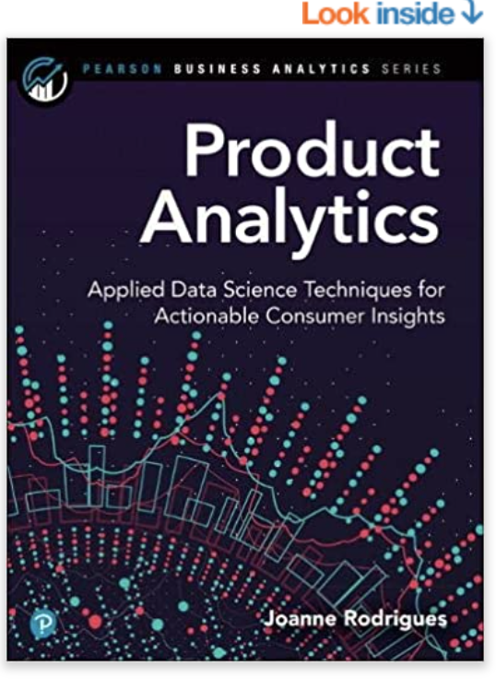
About me
Master’s degrees in Mathematics, Political Science and Demography
Enterprise Data Scientist and Manager
Author of Product Analytics: Applied Data Science Techniques for Actionable Consumer Insights
Founder of ClinicPriceCheck.com and SlidingScaleHealth.org
R developer for over 10+ years

Slide 3
Outline of Talk
Introduction
Translating Raw Data into “Actionable” Insights
Causal Inference from Observational Data
Causal Inference V. Prediction
Conceptualization, Operationalization and Metrics
Advanced Techniques
Regression Discontinuity
Statistical Matching
Observable Patterns?
Heuristics for Causal Inference
Questions?

Slide 4
Translating Raw Data into Actionable Insights
First observe and describe the social processes that exist in your ‘web’ product (How, Why, When, Where, What and Who?)
Generalize and conceptualize those processes
Build a theory around those generalizations with testable hypothesis
Create metrics by operationalizing your concepts (understand what concepts/parts of concepts you can cover with quantitative metrics and what you cannot)
Predicting behavior V. Understanding the causes of behavior

Slide 5
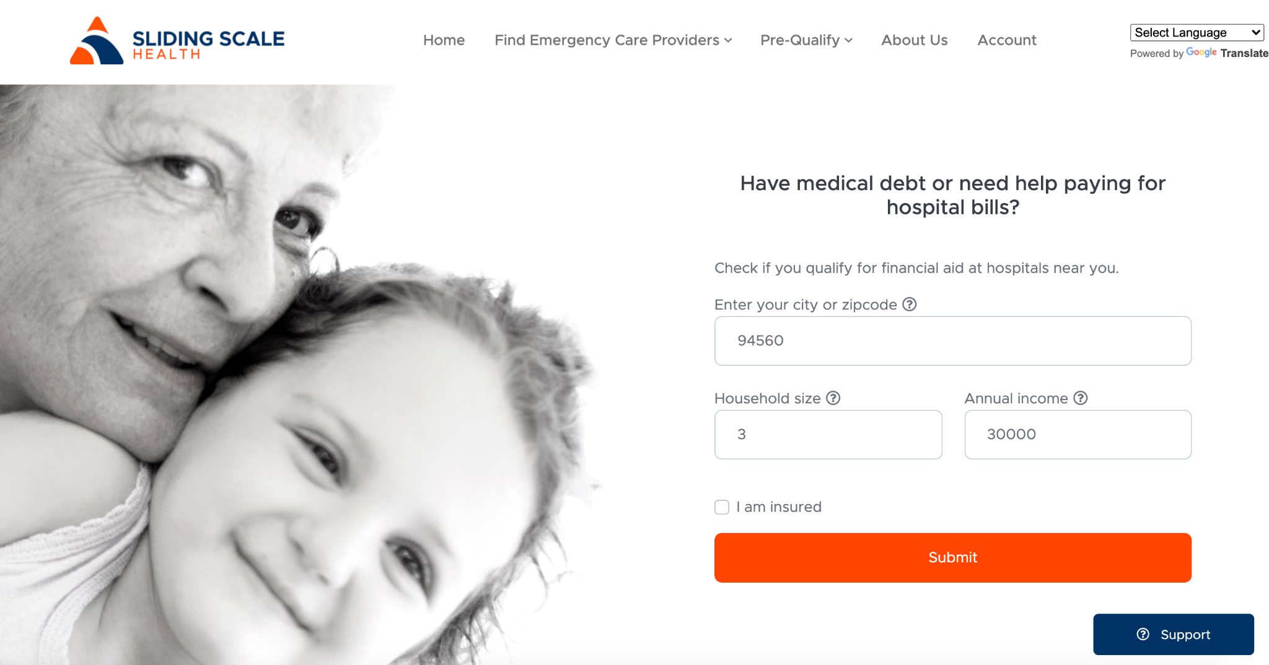

Slide 6
Causal inference from observational data
Causal inference is when we use randomization to isolate and quantify the impact of treatment on an outcome or multiple outcomes
The gold standard of causal inference is experimentation
Observational data is essentially mired in selection bias, or non-random selection into certain behavioral pattern or groups
Can we infer causation from observational data?
Maybe, and if ever only with a well-thought out design
Very few out-of-the-box solutions

Slide 7
Causal Inference V. Prediction
 | Prediction | Causal Inference
Internal/ External Validity | Internal: Not Granted External: Validation on Test Sets | Internal: Granted by Design External: Possible, Much Harder
More Data | Improves with data | Generally does not improve
Generalizable | More, dependant on representativeness/size of the sample | Less, dependant on representativeness/size of the sample
Core Application | Predicting human behavior | Causes of human behavior
Discriminatory | Can be discriminatory; black box; confusing results for non-predictive results | Not easily discriminatory
When does it fail? | Failure to predict aberrant behavior; limits to prediction of human behavior | Failure to quantify the treatment effect for outliers
Product Applications | Future resources, recommendations, risk or fraud | Triggering behavior; behavior change; motivation; product creation/strategy

Slide 8
Conceptualization, Operationalization, and Metrics
Concept: Abstract ideas used to explain phenomenon.
Operationalization: Taking a concept and determining how it can be measured
Metrics: Aggregated measure representing one data point or value, generally masking the distribution.
More important with causal inference; Force us to cover the feature space
How can we operationalize our concepts?
Step 1: Concept - Definition/Multiple Definitions, with all its parts
Step 2: List ‘perfect’ variables to cover or measure every part of definition, note what is immeasurable
Step 3: List all variables that currently exist in our product, could in any way be related these concepts
Step 4: Find the overlapping variables and note what is not covered.

Slide 9

How do we apply causal inference techniques to web products?
Acquisition, Engagement,
Retention, & Revenue
Notes:
https://www.shutterstock.com/image-illustration/people-direction-large-group-shape-arrow-200804189

Slide 10
II. Regression Discontinuity
A causal inference technique to operationalize a break in the treatment variable (relatively common in real-life given time or geographic break points)
The idea is that as you get closer and closer to the break point, those observations at the cut point could randomly be on either side, mimicking the randomness of an experiment
LATE (Local Average Treatment Effects) - RD is only defined in the limit at the break point
Pitfall: Selection at the cut point, i.e. richer students more likely to pass national exam; richer candidates more likely to win elections

Slide 11
RD Example Design
Scenario: We want to incentivize users to ‘crowdsource’ information on hospital pricing, quality and wait times. We decide to use a badge system where a certain number of reviews, likes and upvoting of prices leads to a gaining a ‘expert member’ badge.
The points needed are 50. User cannot see points and the points.

Slide 12
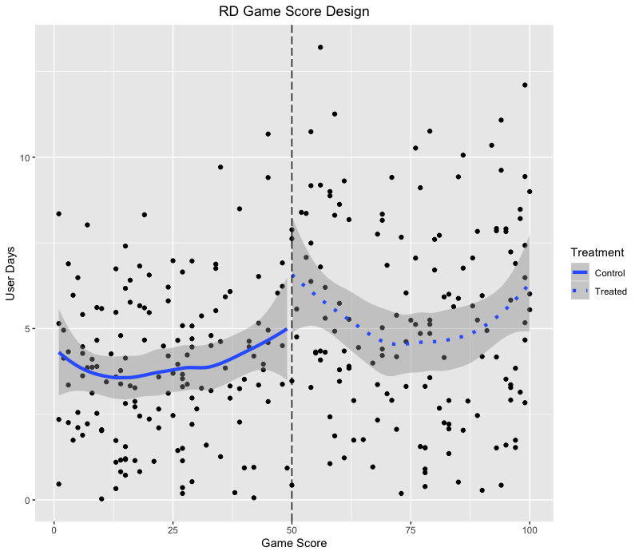
Retention (outcome)
Score (treatment)

Slide 13
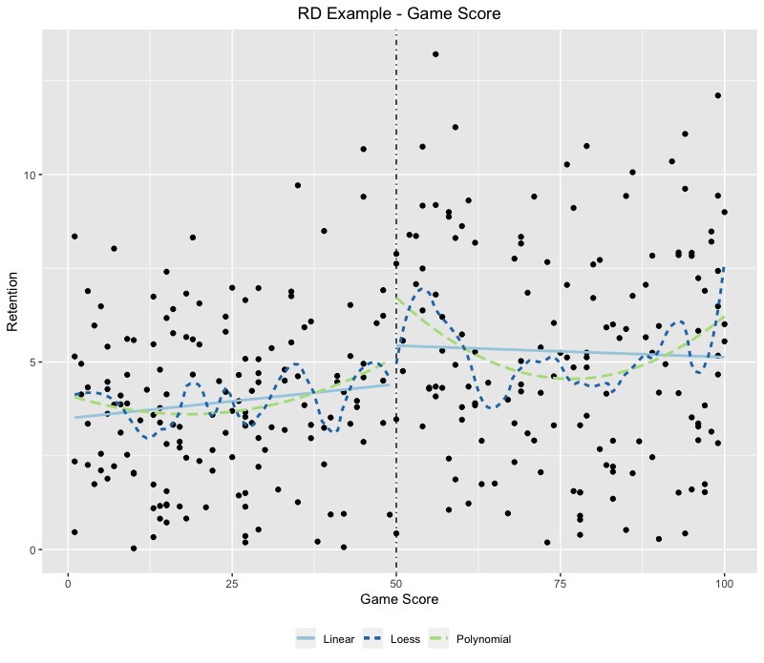
R Code - RD Design
Model | LATE Estimate
OLS model | 0.98 user days
Quadratic model | 1.65 user days
Loess model | .58 user days

Slide 14
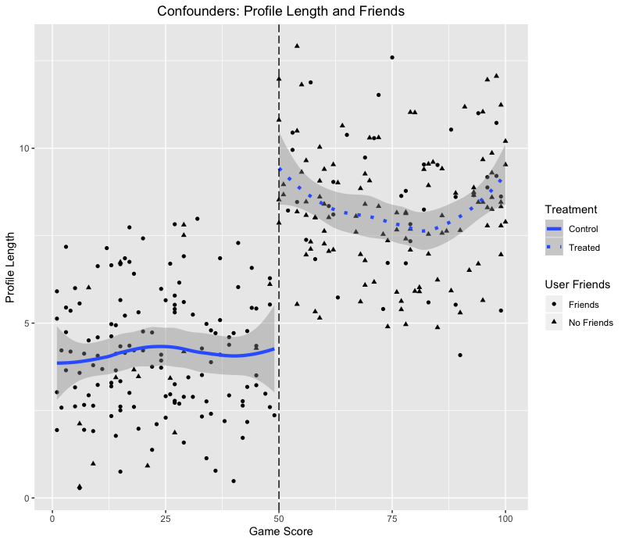
Selection at the cut point

Slide 15
III. Statistical Matching
Match user that look similar on other features to create a treatment and control sets that look ‘alike’ on confounder variables
ATE (Average Treatment Effect), ATC (Average Treatment Effect on the Controls), ATT (Average Treatment Effect on the Treated)
ATT - ATC = ATE
How ‘alike’ are the groups? Achieve match balance, where the confounders are statistically non-differentiable in treatment and control.
Pitfalls: No match balance and we have not achieved coverage of the confounders.
Algorithms: Propensity Score, GenMatch

Slide 16
Matching Example
Scenario: We have a user funnel where we are trying to get users to fill out and submit their hospital financial assistance applications. We’re seeing a large amount of drop-off at Step 4. What types of treatments should we be testing to lower drop-off?
Demo Web Example
User Funnel:
Calculator > 2. Advanced Calculator > 3. Sign-up > 4. Print and Complete Application > 5. Upload Documents > 6. Payment

Slide 17
Matching - Visualization
Feature Space
Treated
Controls
Treated
Controls
Average Matching Situation
Matching Fails!

Slide 18
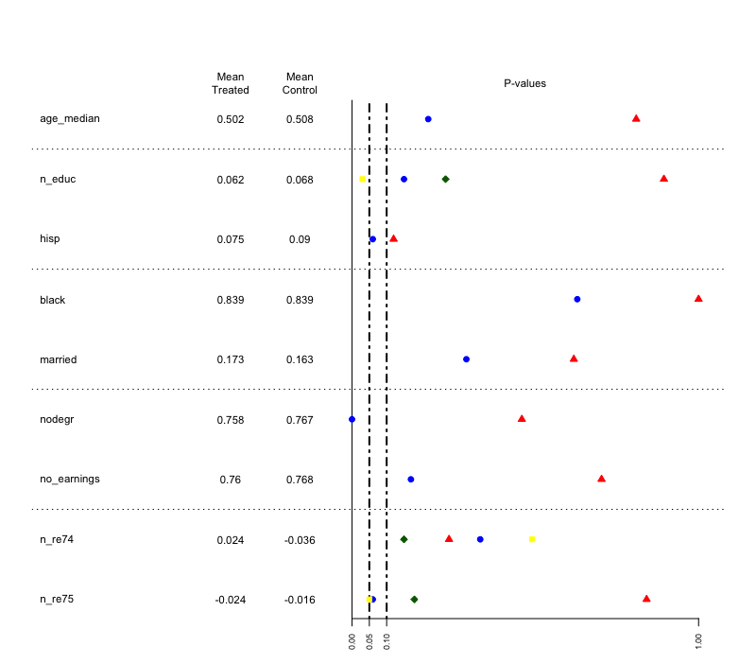
Match Balance

Slide 19

Observable Patterns?

Slide 20
Nine Heuristics for Causal Inference
Strength of the Effect: Large proportional effects (odds ratio)
Consistency: High correlations in different places
Specificity of the Association: Linkages in the association
Temporality: Lagged effects
Dosage Effects: Strength of effect increase (dosage models)
Plausality: The smell test
Coherence: Does it mesh with your theory
Experiment: Use an experiment
Analogy: Similar comparison

Slide 21
Take Home Exercise
Link to Google Document:
https://docs.google.com/document/d/1c8WH6ZI340VIE7aluWFq1KdsutI-twLVMq2P6AixZCk/edit?usp=sharing

Slide 22

Contact me
joannecrodrigues@gmail.com
www.ActionDataScience.com
www.ClinicPriceCheck.com
www.SlidingScaleHealth.org

