Slide 1

Reducing Cost with R in IBM Storage Products Manufacturing
Elaine Jones
Integrated Supply Chain Engineering

Slide 2
The Challenge
Reduce cost of software tools used by Tape Head/Drive Engineering for data acquisition, analysis, and reporting.
We had reduced the SAS license cost for the team to $54k/year.
  Dropped modules
  Cut the number of seats
Can we eliminate this cost completely?
ISC Engineering

Slide 3
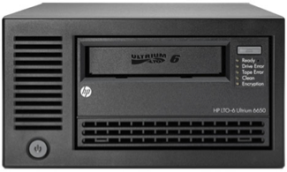
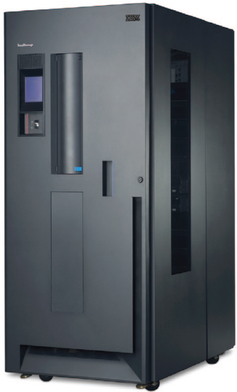
How we used SAS
Started in 1997
Supporting tape head and drive manufacturing: from wafers to completed tape drives
  Electrical, magnetic and mechanical testing – over 1300 parameters
  Shop floor control: tracking by component and assembly serial numbers
SAS provided a means to:
  Query DB2 databases and perform data exploration
  Combine and manipulate data from different databases
  Statistical Analysis: GRR, Regression, Process Capability Analysis
  Populate the data warehouse for automated Statistical Process Control (SPC) and on-demand SPC charts

Slide 4

Alternatives to SAS
Solution from IBM Global Services
  Our organization would be charged
  Added dependency outside our control
R Software
  NY Times article about R Software on IBM’s internal homepage
  Identified two engineers in IBM Mainz, Germany who were using R.
    They also had previously had used SAS

Slide 5
Exploring R Software as a Potential Replacement for SAS
Demonstrated required capabilities:
  Query six different DB2 servers using IBM SQL
  “Last” or “First” record selection from a group (usually timestamp)
  Transpose data from wide to long, and from long to wide
  Export a file to be opened in Excel or JMP
  Run a script automatically
  Execute a batch file to FTP an output file to a remote server
  Load database connection details automatically when R is launched

Slide 6
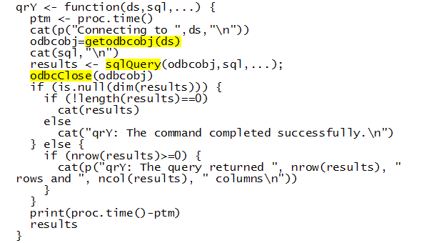
Easing the Transition for end users
Created connections file that is loaded when R is launched. Added to the .First function in the Rprofile.site file:
Created qrY function to simplify RODBC functions:

Slide 7
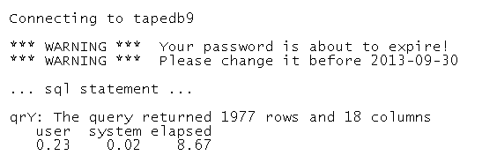
Easing the Transition for end users
qrY function handles the database connections, and returns helpful information to the user:
Created DB2LIST function to run a query using the values of a data.frame column as an input condition
  handy when list is from one database and data you want to pull is in another

Slide 8

Data Flow for SPC Control Charts
Purpose: load summary data into data warehouse for SPC to support on-demand chart display and efficient automated detection of out-of-control conditions.
Tape
Parametric Data
DB2
Programs
Web-based
SPC
SPC
Data
Warehouse
DB2
Run daily
Extract data
Transform data
Export/Load
SPC charts
on-demand and scheduled runs

Slide 9
Data Flow for SPC Control Charts
Tape
Parametric Data
DB2
Could R handle this?
Programs
Web-based
SPC
SPC
Data
Warehouse
DB2
3 different servers in Singapore
Run daily
Extract data
Transform data
Export/Load
30 SAS Programs
SPC charts
on-demand and scheduled runs
~ 40 custom DB2 tables
Over 3000 SPC charts

Slide 10
Data Flow for SPC Control Charts
Tape
Parametric Data
DB2
Scripts
Web-based
SPC
SPC
Data
Warehouse
DB2
Run daily
Extract data
Transform data
Export/Load
SPC charts
on-demand and scheduled runs
ISC Engineering

Slide 11
Benefits
Realized annual savings by dropping our SAS group license
Retained control over the SPC process – no reliance on outside organizations
Fewer lines of code in R scripts
Access to all R packages
Support through R-help support and stackoverflow.com
Developed our own custom training program and R resource portal
ISC Engineering

Slide 12





Acknowledgments
John Schexnayder
Hans-Jüergen Eickelmann
Thorsten Müehge
Peter Golcher
Darren Ellenburg
Questions: Contact Elaine Jones (jones2@us.ibm.com)

