Slide 1


Impact of US government interventions during COVID19 pandemic: seen through mobility
Kenneth Lee
UC Davis
Delphi Research Group

Slide 2
Disclaimer
This project is not meant to compare different causal inference methodologies, but to show a use case for a R package named “covidcast”

Slide 3

Source: https://europeanpharmaceuticalreview.com

Slide 4

Source: https://techcrunch.com/

Slide 5


Slide 6

Source: https://www.pnas.org/content/117/44/27087

Slide 7
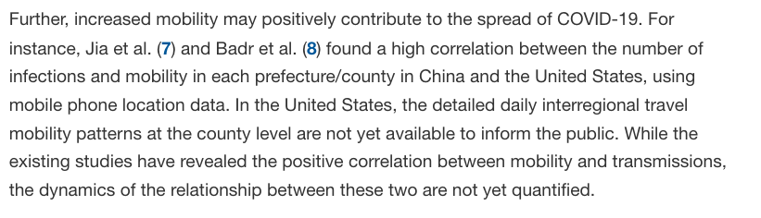
Source: https://www.pnas.org/content/117/44/27087

Slide 8
Government Interventions
Mobility

Slide 9
Government Interventions
Mobility

Slide 10
Government Interventions
Mobility
How can we measure the effect of a government intervention?

Slide 11
Government Interventions
Mobility
How can we measure the effect of a government intervention?
Can we find common characteristics of the areas based on different effects of the government interventions on mobility?

Slide 12
Government Interventions
Mobility
How can we measure the effect of a government intervention?
Can we find common characteristics of the areas based on different effects of the government interventions on mobility?
Does mobility decrease because of the government interventions or public reaction to case counts?

Slide 13
Government Interventions
Mobility
How can we measure the effect of a government intervention?
Can we find common characteristics of the areas based on different effects of the government interventions on mobility?
Does mobility decrease because of the government interventions or public reaction to case counts?
Can we possibly rank the effectiveness of the interventions?

Slide 14
Background
Full_time_work_prop
Notes:
This data source uses data reported by SafeGraph using anonymized location data from mobile phones.

Slide 15
Background
Full_time_work_prop
An average of the fractions of mobile devices over some census block groups that spent more than 6 hours at a location other than their home during the daytime 8am-6pm
Notes:
This data source uses data reported by SafeGraph using anonymized location data from mobile phones.

Slide 16
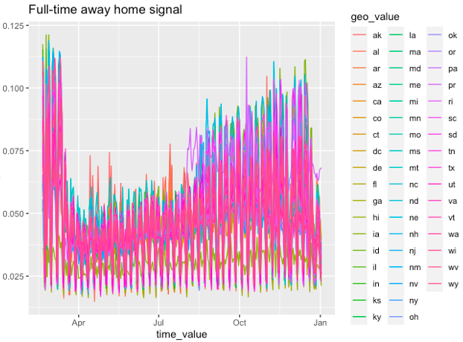

Slide 17
Background
Full_time_work_prop
An average of the fractions of mobile devices over some census block groups that spent more than 6 hours at a location other than their home during the daytime 8am-6pm
Notes:
This data source uses data reported by SafeGraph using anonymized location data from mobile phones.

Slide 18
Background
Full_time_work_prop
An average of the fractions of mobile devices over some census block groups that spent more than 6 hours at a location other than their home during the daytime 8am-6pm
Source: Delphi Epidata API
Notes:
This data source uses data reported by SafeGraph using anonymized location data from mobile phones.

Slide 19
Background
Full_time_work_prop
An average of the fractions of mobile devices over some census block groups that spent more than 6 hours at a location other than their home during the daytime 8am-6pm
Source: Delphi Epidata API
Intervention
A non-pharmaceutical policy enacted on a date by the state
E.g. emergency declaration, business closure etc
Notes:
This data source uses data reported by SafeGraph using anonymized location data from mobile phones.

Slide 20
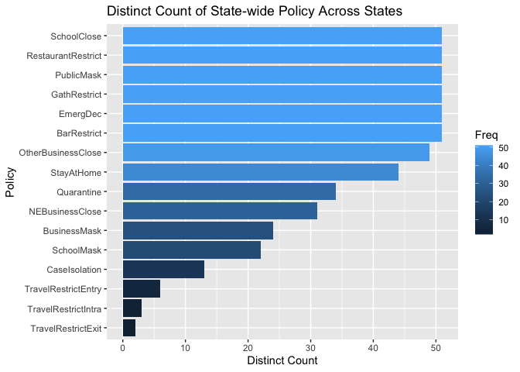
Data Source: https://github.com/COVID19StatePolicy/SocialDistancing
Notes:
When I say government interventions, what I mean is a list of policies that is aggregated by a group at University of Washington. Here is a bar plot that shows the distinct count of the policies that have been implemented by various states.

Slide 21
How can we measure the effect of a government intervention?

Slide 22




Problem Formulation
$$Y_{t}\left(0\right) \text{if} W_{t}=0$$
$$Y_{t}=\left(1−W_{t}\right)Y_{t}\left(0\right)+W_{t}Y_{t}\left(1\right)=$$
$$Y_{t}\left(1\right) \text{if} W_{t}=1$$
$Y_{t}$:
Full_time_work_prop at time t
Indicator whether an intervention happens
$W_{t}$:

Slide 23

Problem Formulation
$$Y_{t}\left(0\right) \text{if} W_{t}=0$$
$$Y_{t}=\left(1−W_{t}\right)Y_{t}\left(0\right)+W_{t}Y_{t}\left(1\right)=$$
$$Y_{t}\left(1\right) \text{if} W_{t}=1$$
$Y_{t}$:
Full_time_work_prop at time t
Indicator whether an intervention happens
$W_{t}$:
$$Y_{t}\left(1\right)−Y_{t}\left(0\right)$$

Slide 24

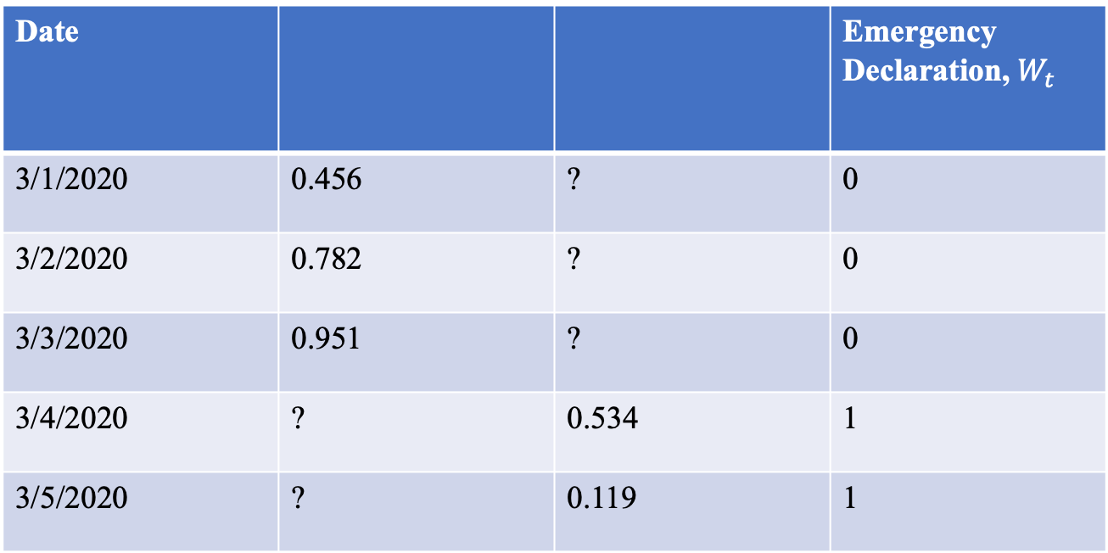

Date |  |  | Emergency Declaration, $W_{t}$
3/1/2020 | 0.456 | ? | 0
3/2/2020 | 0.782 | ? | 0
3/3/2020 | 0.951 | ? | 0
3/4/2020 | ? | 0.534 | 1
3/5/2020 | ? | 0.119 | 1
$$Y_{t}\left(0\right)$$
$$Y_{t}\left(1\right)$$

Slide 25

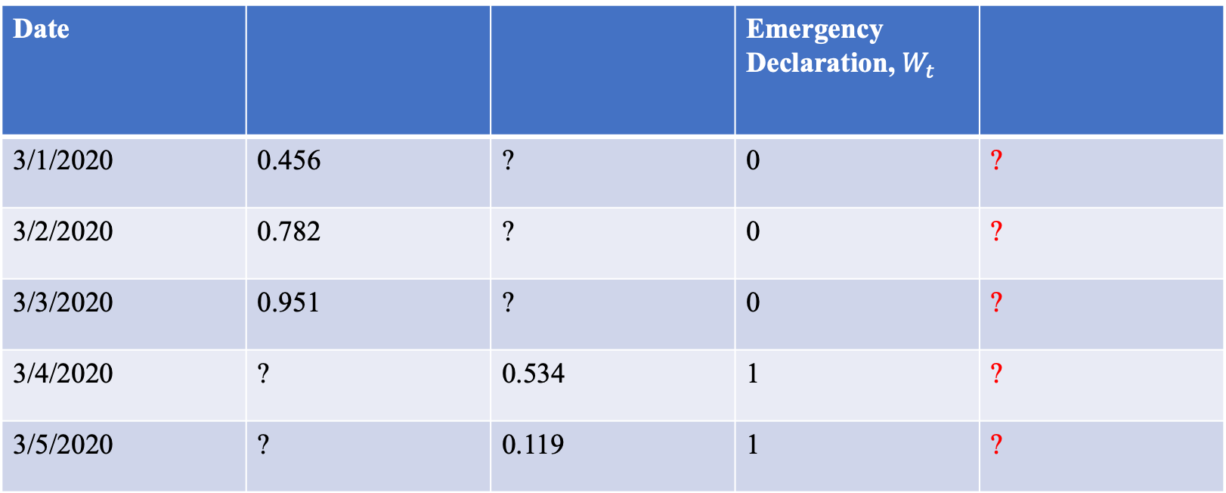



Date |  |  | Emergency Declaration, $W_{t}$
3/1/2020 | 0.456 | ? | 0 | ?
3/2/2020 | 0.782 | ? | 0 | ?
3/3/2020 | 0.951 | ? | 0 | ?
3/4/2020 | ? | 0.534 | 1 | ?
3/5/2020 | ? | 0.119 | 1 | ?
$$Y_{t}\left(0\right)$$
$$Y_{t}\left(1\right)$$
$Y_{t}\left(1\right)$-
$$Y_{t}\left(0\right)$$

Slide 26
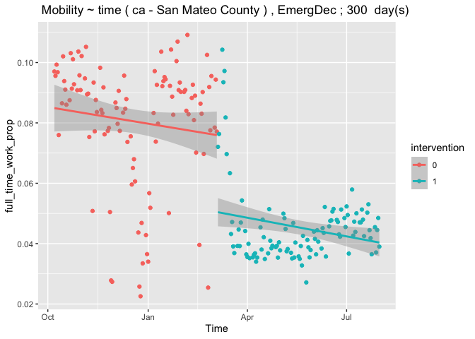

Slide 27
Notes:
But there are multiple interventions in reality

Slide 28
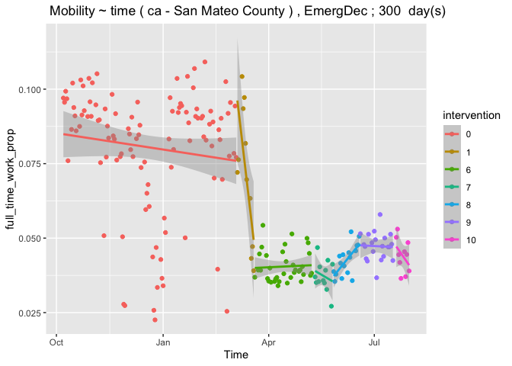
# of

Slide 29
March
May
June
July
"OtherBusinessClose"
"2020-05-09"
"EmergDec"
"2020-03-05"
"PublicMask"
"2020-06-19"
"SchoolMask"
"2020-07-18"
"BarRestrict"
"2020-03-20"
"GathRestrict"
"2020-03-20"
"RestaurantRestrict"
"2020-03-20"
"StayAtHome"
"2020-03-20"
"NEBusinessClose"
"2020-03-20"
"BusinessMask"
"2020-05-27"

Slide 30
# of

Slide 31
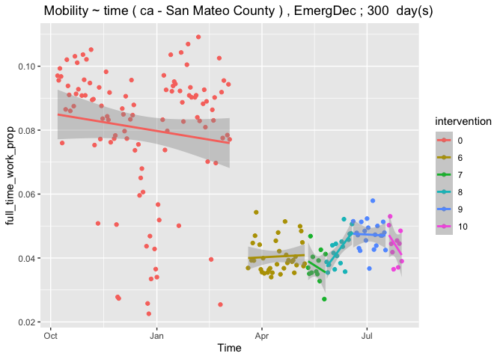
# of

Slide 32
# of

Slide 33
# of

Slide 34
# of

Slide 35
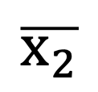
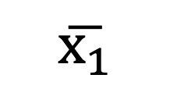
# of
$$\overline{x_{1}}$$
$$\overline{x_{2}}$$

Slide 36
Summary
How can we measure the effect of a government intervention?

Slide 37
Summary
How can we measure the effect of a government intervention?
Regression discontinuity design.

Slide 38
Summary
How can we measure the effect of a government intervention?
Regression discontinuity design.
Can we find common characteristics of the areas based on different effects of the government interventions on mobility?

Slide 39
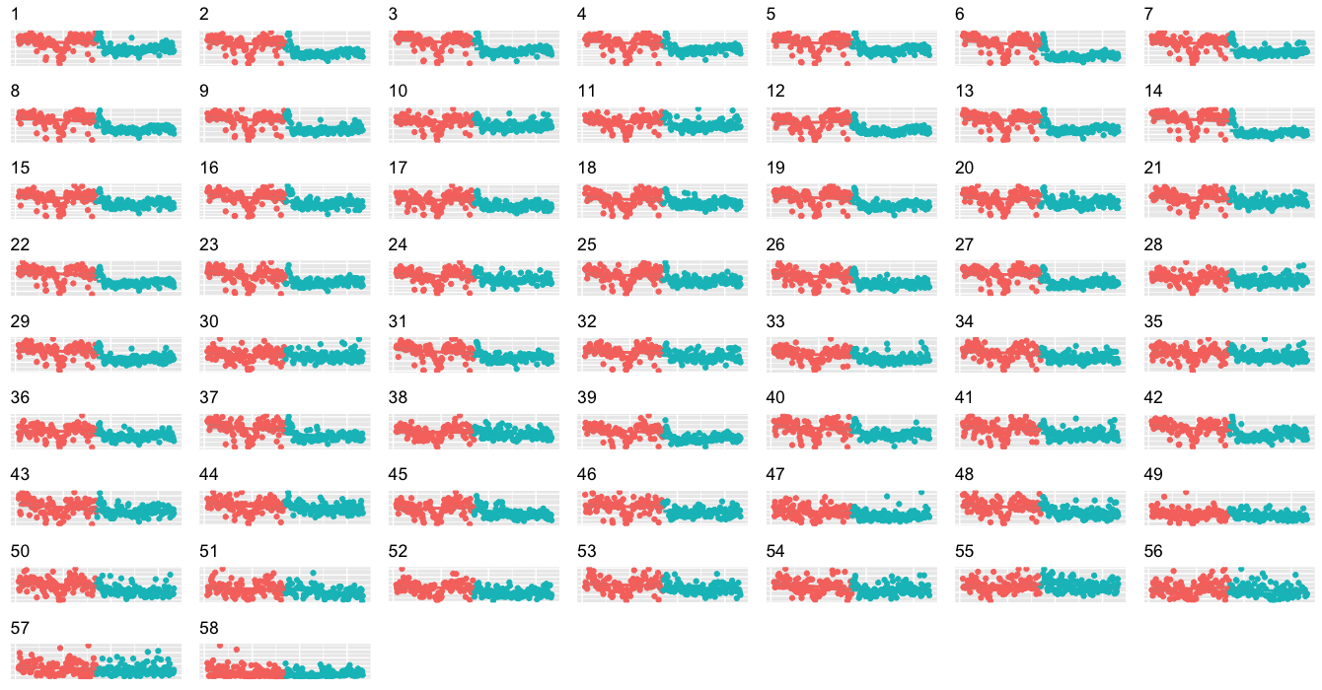

Slide 40
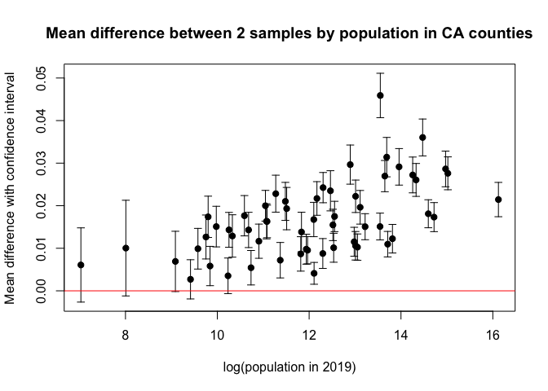
Demographic Data Source: https://www.ers.usda.gov/data-products/county-level-data-sets/

Slide 41
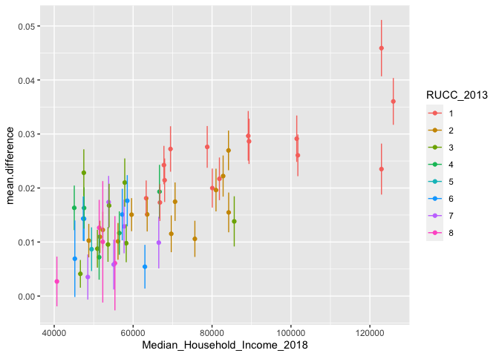

Slide 42
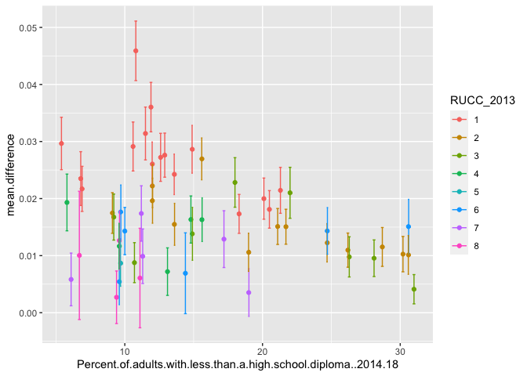
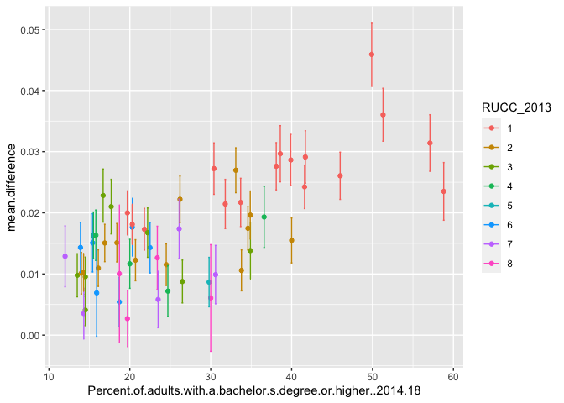

Slide 43
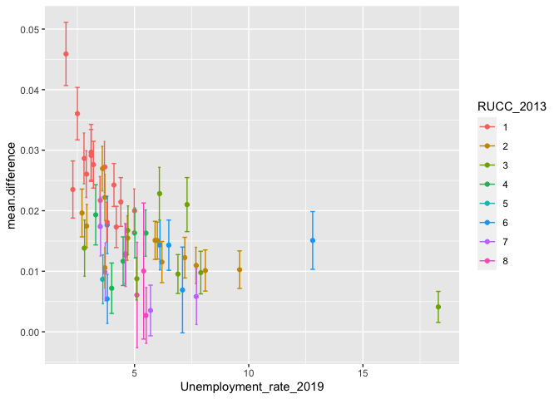

Slide 44
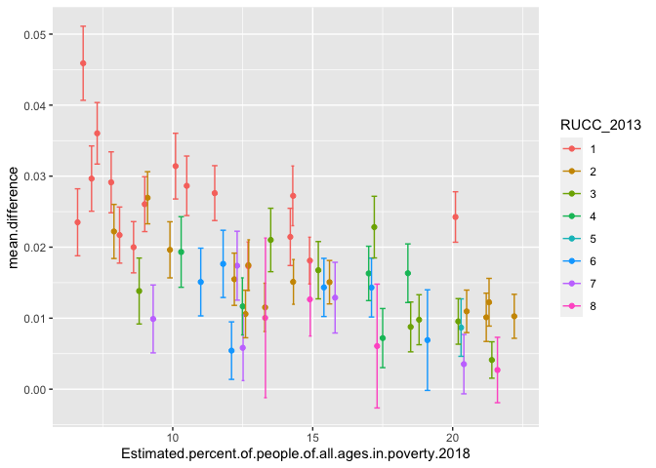

Slide 45
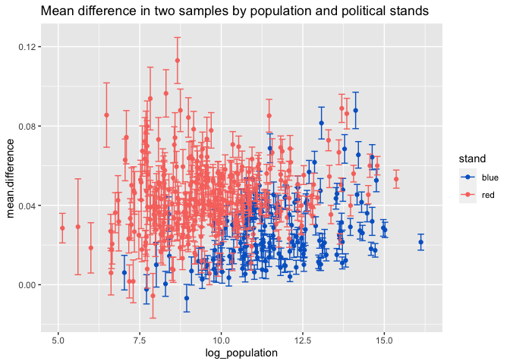
Blue:
CA, WA, NY
Red:
TX, UT, ND

Slide 46
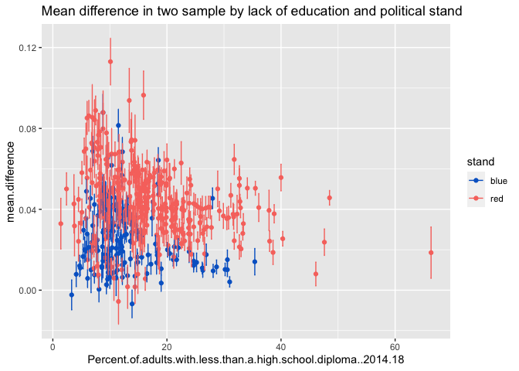
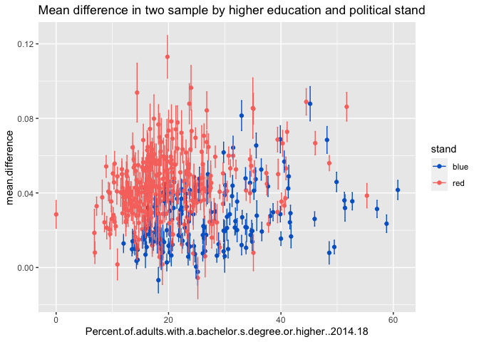

Slide 47
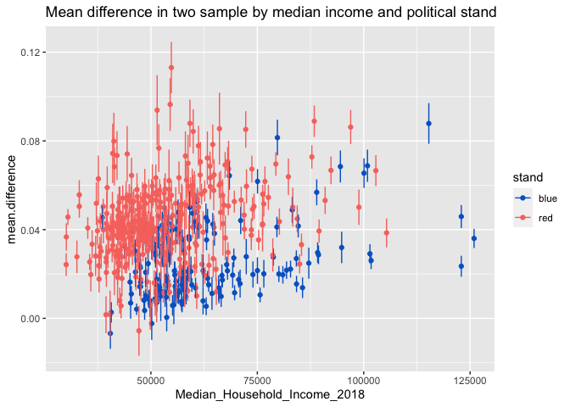
Blue:
CA, WA, NY
Red:
TX, UT, ND

Slide 48
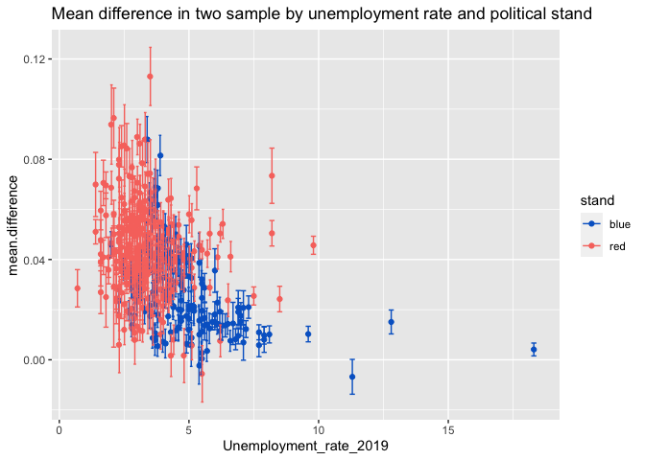
Blue:
CA, WA, NY
Red:
TX, UT, ND

Slide 49
Summary
How can we measure the effect of a government intervention?
Regression discontinuity design.
Can we find common characteristics of the areas based on different effects of the government interventions on mobility?

Slide 50
Summary
How can we measure the effect of a government intervention?
Regression discontinuity design.
Can we find common characteristics of the areas based on different effects of the government interventions on mobility?
Yes, through demographic data.

Slide 51
Summary
How can we measure the effect of a government intervention?
Regression discontinuity design.
Can we find common characteristics of the areas based on different effects of the government interventions on mobility?
Yes, through demographic data.
Does mobility decrease because of the government interventions or public reaction to case counts?

Slide 52

$$Y_{t}=β_{0}+\sum_{i}{β_{i}}C_{i_{t}}+\sum_{k}{β_{k}}I_{k_{t}}$$

Slide 53


$$Y_{t}=β_{0}+\sum_{i}{β_{i}}C_{i_{t}}+\sum_{k}{β_{k}}I_{k_{t}}$$
$$Y_{t}$$
: Completely stay at home proportion at time t
$$C_{i_{t}}$$
: i-th case count signal and other potential confounders at time t
$$I_{k_{t}}$$
: k-th intervention (indicator variable) at time t

Slide 54
Variables [San Mateo County] | Estimate | Std. Error | t-value | P-value
Intercept | 2.155e-01 | 7.559e-03 | 28.506 | < 2e-16
Cumulative number of confirmed COVID-19 cases per 100,000 population | 5.075e-05 | 1.728e-05 | 2.938 | 0.00358
Number of new confirmed COVID-19 cases per 100,000 population, daily | 1.143e-03 | 4.336e-04 | 2.636 | 0.00885
Cumulative number of confirmed due to COVID-19, per 100,000 population | -1.200e-02 | 2.157e-03 | -5.560 | 6.23e-08
Number of new confirmed deaths due to COVID-19 per 100,000 population, daily | 1.102e-02 | 3.89e-02 | 0.287 | 0.77423
Emergency Declaration | 3.384e-03 | 1.297e-02 | 0.261 | 0.79438
Gathering Restriction | 2.052e-02 | 2.249e-02 | 0.912 | 0.36239
School Closure | 1.717e-01 | 2.292e-02 | 7.492 | 8.65e-13
Bar Restriction | 7.026e-2 | 1.398e-02 | 5.025 | 8.91e-07
Public Masks | 4.969e-02 | 1.178e-02 | 4.217 | 3.34e-05
Other Business Closure | 1.245e-02 | 1.177e-02 | 1.058 | 0.29114
Business Masks | -2.782e-02 | 1.100e-02 | -2.529 | 0.01199
School Masks | -1.116e-02 | 7.821e-03 | -1.427 | 0.15456
Quarantine | -4.306e-04 | 9.793e-03 | -0.044 | 0.96496
Weekend | -1.906e-03 | 3.612e-03 | -0.528 | 0.59818
Holiday | -5.244e-03 | 1.024e-02 | -0.512 | 0.60888

Slide 55
Variables [San Mateo County] | Estimate | Std. Error | t-value | P-value
Intercept | 2.155e-01 | 7.559e-03 | 28.506 | < 2e-16
Cumulative number of confirmed COVID-19 cases per 100,000 population | 5.075e-05 | 1.728e-05 | 2.938 | 0.00358
Number of new confirmed COVID-19 cases per 100,000 population, daily | 1.143e-03 | 4.336e-04 | 2.636 | 0.00885
Cumulative number of confirmed due to COVID-19, per 100,000 population | -1.200e-02 | 2.157e-03 | -5.560 | 6.23e-08
Number of new confirmed deaths due to COVID-19 per 100,000 population, daily | 1.102e-02 | 3.89e-02 | 0.287 | 0.77423
Emergency Declaration | 3.384e-03 | 1.297e-02 | 0.261 | 0.79438
Gathering Restriction | 2.052e-02 | 2.249e-02 | 0.912 | 0.36239
School Closure | 1.717e-01 | 2.292e-02 | 7.492 | 8.65e-13
Bar Restriction | 7.026e-2 | 1.398e-02 | 5.025 | 8.91e-07
Public Masks | 4.969e-02 | 1.178e-02 | 4.217 | 3.34e-05
Other Business Closure | 1.245e-02 | 1.177e-02 | 1.058 | 0.29114
Business Masks | -2.782e-02 | 1.100e-02 | -2.529 | 0.01199
School Masks | -1.116e-02 | 7.821e-03 | -1.427 | 0.15456
Quarantine | -4.306e-04 | 9.793e-03 | -0.044 | 0.96496
Weekend | -1.906e-03 | 3.612e-03 | -0.528 | 0.59818
Holiday | -5.244e-03 | 1.024e-02 | -0.512 | 0.60888

Slide 56
Summary
How can we measure the effect of a government intervention?
Regression discontinuity design.
Can we find common characteristics of the areas based on different effects of the government interventions on mobility?
Yes, through demographic data.
Does mobility decrease because of the government interventions or public reaction to case counts?

Slide 57
Summary
How can we measure the effect of a government intervention?
Regression discontinuity design.
Can we find common characteristics of the areas based on different effects of the government interventions on mobility?
Yes, through demographic data.
Does mobility decrease because of the government interventions or public reaction to case counts?
Depends on the county, for some, daily confirmed death case can have a greater effect on mobility.

Slide 58
Summary
How can we measure the effect of a government intervention?
Regression discontinuity design.
Can we find common characteristics of the areas based on different effects of the government interventions on mobility?
Yes, through demographic data.
Does mobility decrease because of the government interventions or public reaction to case counts?
Depends on the county, for some, daily confirmed death case can have a greater effect on mobility.
Can we possibly rank the effectiveness of the interventions?

Slide 59
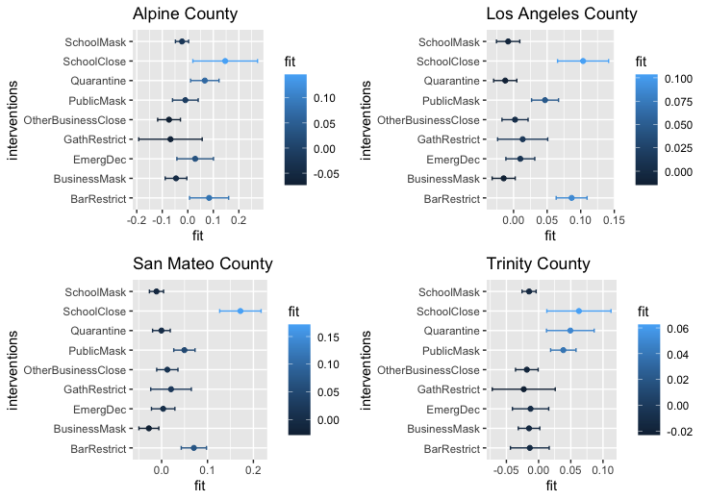

Slide 61
Summary
How can we measure the effect of a government intervention?

Slide 62
Summary
How can we measure the effect of a government intervention?
Regression discontinuity design.

Slide 63
Summary
How can we measure the effect of a government intervention?
Regression discontinuity design.
Can we find common characteristics of the areas based on different effects of the government interventions on mobility?

Slide 64
Summary
How can we measure the effect of a government intervention?
Regression discontinuity design.
Can we find common characteristics of the areas based on different effects of the government interventions on mobility?
Yes, through demographic data.

Slide 65
Summary
How can we measure the effect of a government intervention?
Regression discontinuity design.
Can we find common characteristics of the areas based on different effects of the government interventions on mobility?
Yes, through demographic data.
Does mobility decrease because of the government interventions or public reaction to case counts?

Slide 66
Summary
How can we measure the effect of a government intervention?
Regression discontinuity design.
Can we find common characteristics of the areas based on different effects of the government interventions on mobility?
Yes, through demographic data.
Does mobility decrease because of the government interventions or public reaction to case counts?
Depends on the county, for some, daily confirmed death case count can have a greater effect on mobility.

Slide 67
Summary
How can we measure the effect of a government intervention?
Regression discontinuity design.
Can we find common characteristics of the areas based on different effects of the government interventions on mobility?
Yes, through demographic data.
Does mobility decrease because of the government interventions or public reaction to case counts?
Depends on the county, for some, daily confirmed death case count can have a greater effect on mobility.
Can we possibly rank the effectiveness of the interventions?

Slide 68
Summary
How can we measure the effect of a government intervention?
Regression discontinuity design.
Can we find common characteristics of the areas based on different effects of the government interventions on mobility?
Yes, through demographic data.
Does mobility decrease because of the government interventions or public reaction to case counts?
Depends on the county, for some, daily confirmed death case count can have a greater effect on mobility.
Can we possibly rank the effectiveness of the interventions?
Yes, we can rank the intervention based on regression coefficient.

Slide 69
Summary
How can we measure the effect of a government intervention?
Regression discontinuity design.
Can we find common characteristics of the areas based on different effects of the government interventions on mobility?
Yes, through demographic data.
Does mobility decrease because of the government interventions or public reaction to case counts?
Depends on the county, for some, daily confirmed death case count can have a greater effect on mobility.
Can we possibly rank the effectiveness of the interventions?
Yes, we can rank the intervention based on regression coefficient.

Slide 70
Future work
To collect more data about county-level intervention to measure the start dates and end dates of the policies more accurately.
To include many more potential confounders.
To examine other mobility signals available in the Dephi API.
To try using non-parametric regression methods.

Slide 71
Reference Links
Regression discontinuity designs: A guide to practice
https://www.sciencedirect.com/science/article/pii/S0304407607001091
Delphi Epi Data
https://cmu-delphi.github.io/delphi-epidata/
Project Github repo
https://github.com/cmu-delphi/covidcast-modeling/tree/master/intervention_mobility
County-level Datasets USDA-ERS
https://www.ers.usda.gov/data-products/county-level-data-sets/
State-level social distancing policies in response to COVID-19
https://github.com/COVID19StatePolicy/SocialDistancing

Slide 72
Thanks

