Slide 1

Using R and Alteryx to Uncover the Dimensions of Movie Ratings
Dan Putler, Chief Scientist, Alteryx
Bay Area R Users Group, September 1, 2015

Slide 2


My Partners in Crime
Joseph Lombardi
Ramnath Vaidyanathan

Slide 3
The Roadmap of the Talk
The question we are investigating
What we do
What we find
How we do it (aka, the demo)
How this could be used

Slide 4
The Questions We Address and Some Background
The two basic types of recommendation systems
Collaborative filtering: Recommendations are based on using past choices or judgments of individuals as well as similar choices or judgments made by others
Content-based filtering: Recommendations are based on using information on the attributes of objects (e.g., movies), and determining individuals’ preferences for those attributes
Our research questions
Are there latent, but identifiable, (perceptual) attributes underlying collaborative filtering data in the case of movies?
Can these attributes be used to predict average movie ratings made by others?
Do the relative importance of the latent attributes differ for the general public versus professional reviewers?

Slide 5
What We Do
We use the MovieLens dataset of the ratings of “citizen” movie reviewers and create a dissimilarity matrix between the 200 most frequently rated movies in the MovieLens data
The dissimilarity matrix is then used as input to a non-metric multi-dimensional scaling (MDS) algorithm
The “important” dimensions from the MDS analysis are extracted and used to build multiple predictive models (with hold out samples) for three different target variables
The average IMDB user (general public) ratings for the 200 movies
The Rotten Tomatoes’ “Tomatometer” score for the 200 movies based on all professional critics
The Rotten Tomatoes’ “Tomatometer” score for the 200 movies based on “top” professional critics

Slide 6
Our Maintained Hypotheses
There is a fairly common structure to latent attributes of movies across individuals
Preferences for these perceived attributes can very across individuals
Some of the important perceived attributes are of the “more is better variety” as opposed to being of the “ideal point” variety
Both of these maintained hypotheses are needed into order for the perceived attributes to be predictive of the ratings made my other individuals

Slide 7
Constructing the Dissimilarity Matrix
What is the MovieLens data?
The dataset is being collected by the GroupLens research lab in the Department of Computer Science and Engineering at the University of Minnesota, Twin Cities
The original data contains 20,000,263 ratings across 27,278 movies, and was created by 138,493 users between January 9, 1995 and March 31, 2015
The steps used to create the dissimilarity matrix
The ratings for the top 200 hundred most highly rated movies are extracted from the original data (resulting in final data set of 132,999 reviewers and 5,641,119 reviews)
The extracted data was subject to a z-score transformation for the ratings from each respondent, this is done to address biases due to systematically high or low reviews on the part of a reviewer
The reviewer level z-score transformed data is then used in a cosine dissimilarity algorithm

Slide 8
The MDS Analysis of the Dissimilarity Matrix
The goal of multidimensional scaling is to find a set of meaningful underlying dimensions that "explain" observed measures of distances or dissimilarities between the investigated objects
The approach was developed in the fields of psychometrics and psychophysics
We use a Kruskal’s non-metric MDS method (R's MASS package) since the magnitude of the dissimilarities is unknown
The problem with this approach is that there is no way to obtain measures of the percentage of the variance explained by each dimension of the solution, so a metric MDS method is employed to provide an approximate answer

Slide 9
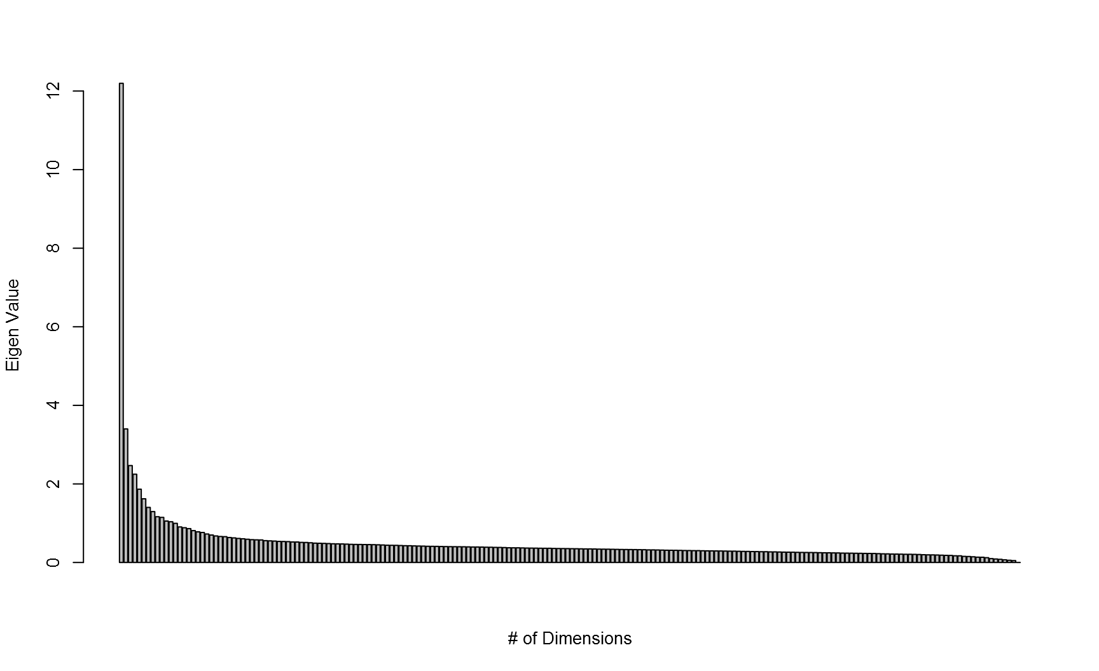
The Scree Plot of the Dimensions

Slide 10
The Extreme Movies on Dimension 1
High
Batman Forever
Twister
Armageddon
Waterworld
Ace Ventura: When Nature Calls
Low
The Godfather
The Usual Suspects
Pulp Fiction
The Shawshank Redemption
The Godfather: Part II

Slide 11
Critics’ Quotes on the High End of Dimension 1
Director Joel Schumacher (of Batman Forever) submits to the Wagnerian bombast with an overly busy surface, and the script by Lee and Janet Scott Batchler and Akiva Goldsman basically runs through the formula as if it's a checklist.
Effects apart, this (Twister) is dire: predictable, clichéd, sloppily written, pitifully performed and surprisingly short of real shocks and suspense.
So predictable it (Armageddon) could have been written by a chimp who's watched too much TV, the huge movie is as dumb as it is loud, and it's way too loud.
It (Waterworld) lacks the coherent fantasy of truly enveloping science fiction, preferring to concentrate on flashy, isolated stunts that say more about expense than expertise. Its storytelling, remarkably crude for such an elaborate production, takes a back seat to its enthusiasm for post-apocalyptic rust and rubble.

Slide 12
Critics’ Quotes on the Low End of Dimension 1
Francis Ford Coppola has made (in The Godfather) one of the most brutal and moving chronicles of American life ever designed within the limits of popular entertainment.
A terrific cast (in the movie The Usual Suspects) of exciting actors socks over this absorbingly complicated yarn that's been spun in seductively slick fashion by director Bryan Singer.
Watching Pulp Fiction, you don’t just get engrossed in what’s happening on screen. You get intoxicated by it — high on the rediscovery of how pleasurable a movie can be. I’m not sure I’ve ever encountered a filmmaker who combined discipline and control with sheer wild-ass joy the way that Tarantino does.
Thanks to fine performances and beautiful photography, you get that inspirational jump-start frame after frame (from The Shawshank Redemption).

Slide 13
The Extreme Movies on Dimension 3
High
Babe
E.T.
The Wizard of Oz
Snow White and the Seven Dwarfs
Toy Story 2
Low
The Fifth Element
Snatch
Interview With the Vampire
Gattaca
Kill Bill: Volume 1

Slide 14
Critics’ Quotes on the High End of Dimension 3
For children, the movie (Babe) will play like a storybook come to life. Adults, at first, will marvel at the special effects and puppetry. But ultimately, they'll be won over by the nuances of a story that finds a fresh way to deliver a timeless message.
E.T., the Extra Terrestrial may be the best Disney film Disney never made. Captivating, endearingly optimistic and magical at times, Steven Spielberg's fantasy about a stranded alien from outer space protected by three kids until it can arrange for passage home is certain to capture the imagination of the world's youth in the manner of most of his earlier pics.
Sheer fantasy, delightful, gay, and altogether captivating, touched the screen yesterday when Walt Disney's long-awaited feature-length cartoon of the Grimm fairy tale, Snow White and the Seven Dwarfs, had its local premiere at the Radio City Music Hall. Let your fears be quieted at once: Mr. Disney and his amazing technical crew have outdone themselves. The picture more than matches expectations. It is a classic, as important cinematically as The Birth of a Nation or the birth of Mickey Mouse.

Slide 15
Critics’ Quotes on the Low End of Dimension 3
(The Fifth Element is) A hodgepodge of elements that don't comfortably coalesce.
The movie (Snatch) is not boring, but it doesn't build and it doesn't arrive anywhere.
Passionately anticipated and much ballyhooed, the film (Interview with the Vampire), alas, is little more than a foppish, fang de siecle costume drama. Its pulse barely registers.
(Gattaca is) Chilly, elegant, and a little bloodless.
Structurally and narratively amputated, (Kill Bill:)Volume 1 retains head and guts but loses its heart and gams to the second installment.

Slide 16
Modeling of the External Ratings Measures
The data randomly divided into two samples
An estimation (training) sample of 134 movies
A validation (test) sample of 66 movies
Four different models were estimated for each of three measures
A linear regression model of the six most important dimensions
A reduced linear regression using stepwise selection
A gradient based boosting model (using the R gbm package)
A random forest model (using the R randomForest package)

Slide 17
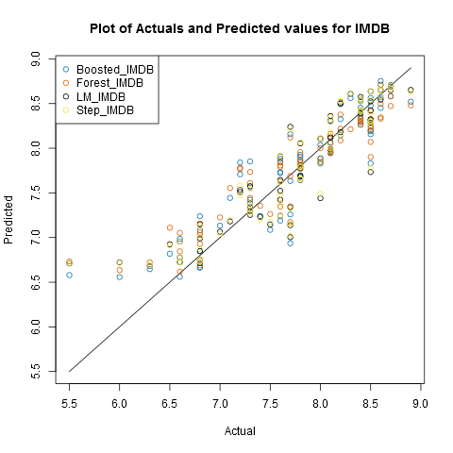
Predictions from the IMDB Ratings Models
Fit and Error Measures:
Model | Correlation | RMSE | MAE | MPE | MAPE
Boosted_IMDB | 0.9125 | 0.3091 | 0.2319 | -0.8061 | 3.1600
Forest_IMDB | 0.9295 | 0.3131 | 0.2309 | -0.9159 | 3.1759
LM_IMDB | 0.9096 | 0.3098 | 0.2190 | -0.7066 | 2.9996
Step_IMDB | 0.9118 | 0.3065 | 0.2192 | -0.7223 | 3.0008

Slide 18
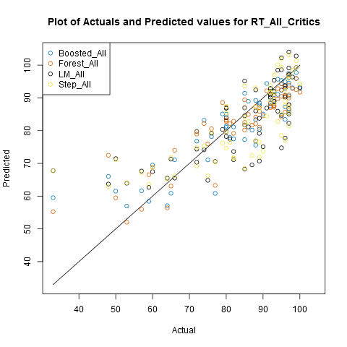
Predictions from the All Critics Tomatometer Models
Fit and Error Measures:
Model | Correlation | RMSE | MAE | MPE | MAPE
Boosted_All | 0.8811 | 7.0583 | 5.2815 | -0.4274 | 7.4685
Forest_All | 0.8936 | 6.9536 | 5.3807 | -0.3884 | 7.4871
LM_All | 0.7616 | 9.4625 | 6.8617 | -0.2499 | 9.5844
Step_All | 0.7610 | 9.4918 | 7.1013 | -0.0946 | 9.8662

Slide 19
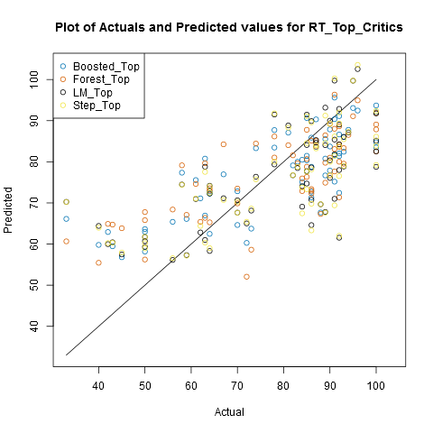
Predictions from the Top Critics Tomatometer Models
Fit and Error Measures:
Model | Correlation | RMSE | MAE | MPE | MAPE
Boosted_Top | 0.7867 | 11.0038 | 9.1647 | -3.2826 | 13.9807
Forest_Top | 0.7381 | 11.8173 | 9.8582 | -2.8166 | 14.8864
LM_Top | 0.6999 | 12.2646 | 9.7081 | -1.6230 | 14.3491
Step_Top | 0.6973 | 12.3260 | 9.7653 | -1.4445 | 14.4109

Slide 20
How This Approach Could be Used in Practice
This approach could be fairly easily implemented using a rotating panel of “citizen” reviewers
Panel members would be asked to rate a set of movies purposely selected to capture both ends of the important perceptual attributes using a minimum number of panel member ratings
As new movies are readied for launch, panel members would view these movies, and provide their ratings
A side benefit of this approach is that it allows the nature of the latent attributes to be identified, potentially enabling the development of more direct measures of those attributes

