Slide 1
Venture Capital Communities
Sanjiv Das
Santa Clara University
Full Paper: http://algo.scu.edu/~sanjivdas/vccomm.pdf
(Joint work with Amit Bubna, Indian School of Business, and N.R. Prabhala, Univ. of Maryland)
R User Group: Dec 2011

Slide 2
Communities: Multi-Disciplinary Applications
Biology
Metabolic networks of cellular organisms (Duch and Arenas, 2005)
Community structure of the human brain (Wu et al, 2011)
Compartmentalization of food chain webs (Dunne, 2006)
Political Science
Political preferences through voting patterns (Porter et al, 2007)
Social interaction
Mobile phone and online networks (Porter et al, 2009)
Collaboration between scientists (Newman, 2001)

Slide 3
Syndication
The VC Market
56,000 deals, $146 billion from 1980-1999
39,002 deals, $316 billion from 2000-2010
Syndication
44% of # deals
66% of amount invested

Slide 4
Choosing Syndication Partners
If partners are chosen at random
Spatially diffuse VC network
If VCs have preferred partners
Spatial clustering of VC networks
We term spatial clusters as VC communities.

Slide 5
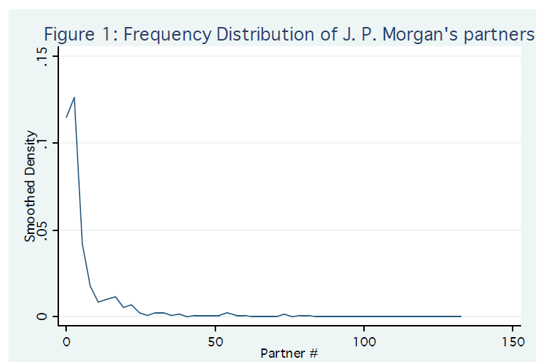
Example: J. P. Morgan

Slide 6
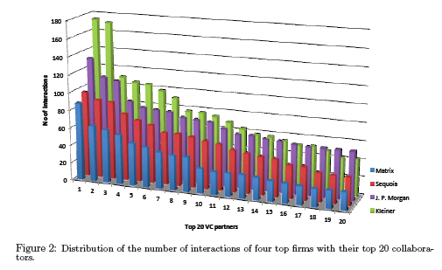

Slide 7
Why are Communities Important?
Syndication: acquiring or improving skills
How does familiarity help?
Familiar norms, processes, and people [Gertler (1995), Porter (2000)]
Flow of informal knowledge
Mitigates incomplete contracting problems, builds trust and enhances reciprocity [Guiso, Sapienza and Zingales (2004); Bottazzi, Da Rin and Hellmann (2011)]
Pure transaction cost effect
Less administrative overheads and paperwork
Behavioral affinity for the familiar
Knowledge spillovers through repeated interactions
Acquiring or improving skills
Learning facilitated through familiar norms, processes, and people
Resource sharing without burden of organizational inflexibility
Economics literature on clustering
Krugman (1991), Porter (1998): new organizational paradigm to capture benefits of externalities.
Lindsey (2007): VCs blur boundaries between portfolio firms. Communities similarly blur lines between VCs.

Slide 8
Detecting Communities
Community identification should
Accommodate large number of players
Not pre-specify the # of communities
Allow for VC communities of varying sizes
Permit fuzzy boundaries between communities
This is a computationally hard clustering problem.
Modularity optimization
Modularity – strength of internal ties compared to ties outside (Girvan and Newman, 2003)
We implement an agglomerative algorithm
“Walktrap” algorithm (Pons and Latapy, 2005)

Slide 9
Community Mathematical Construct
Adjacency matrix of a graph A
A [i,j] = n_{ij}
n_{ij} = # syndicates involving VC i and VC j.
Partition, P, divides A into collections of nodes, P = (P₁, P₂, … P_{n} )
mutually exclusive and collectively exhaustive
The best community structure maximizes in-community deals relative to the predicted in-community deals, or the modularity
where, k_{i} = # syndicates involving VC i and m = # deals in P_{n}

Slide 10
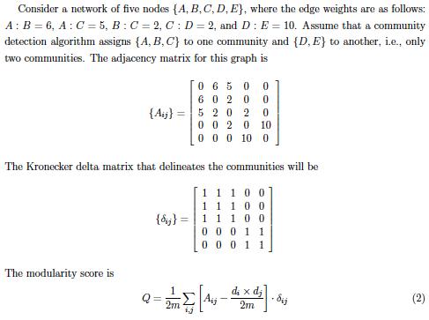
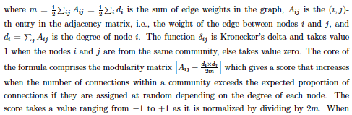
Example

Slide 11




Quick R

Slide 12
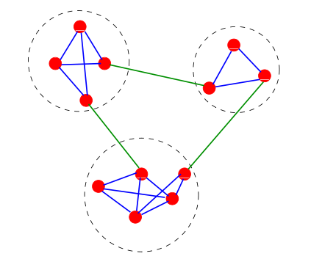
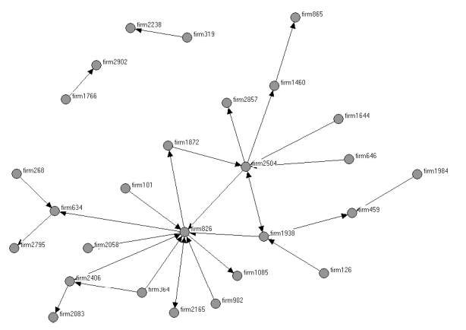
Community v. Centrality
Communities
Group-focused concept
Members learn-by-doing through social interactions.
Centrality
Hub focused concept
Resources and skill of central players.

Slide 13
Data
Sources: SDC
VentureExpert database (VE) - 1980-1999
Exits data - IPO, M&A: 1980-2010
Level of observation in the VE database:
Company × Round × Investor
Community identification using VE database:
Not Individuals, Management or Undisclosed
Filters used in exit analysis:
U.S. investments
Investment is not at "Buyout/Acquisition" stage
Not “Angel or individual” investors

Slide 14
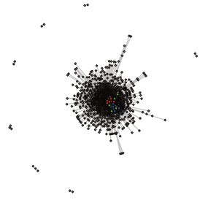
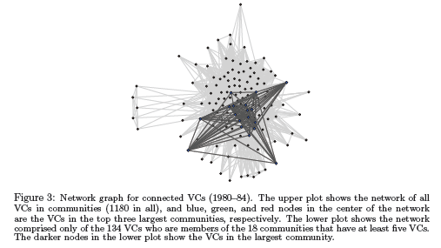

Slide 16
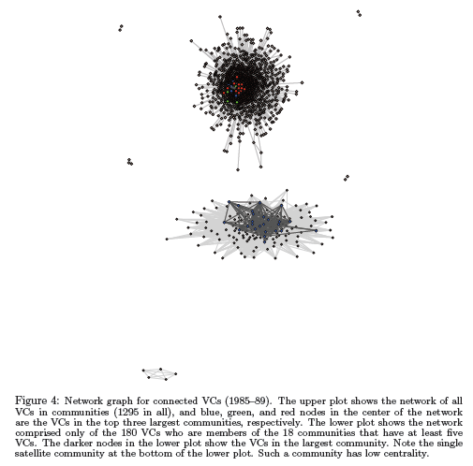

Slide 17
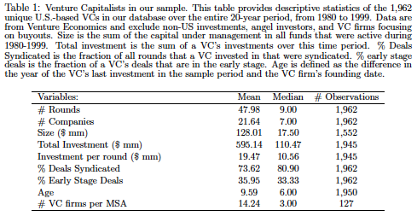

Slide 18
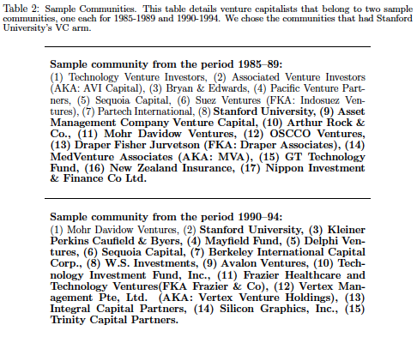

Slide 19
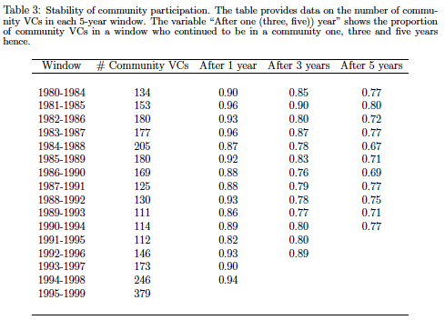

Slide 20
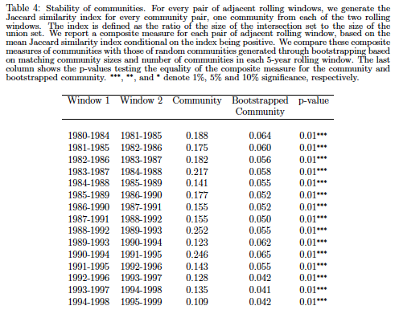

Slide 21
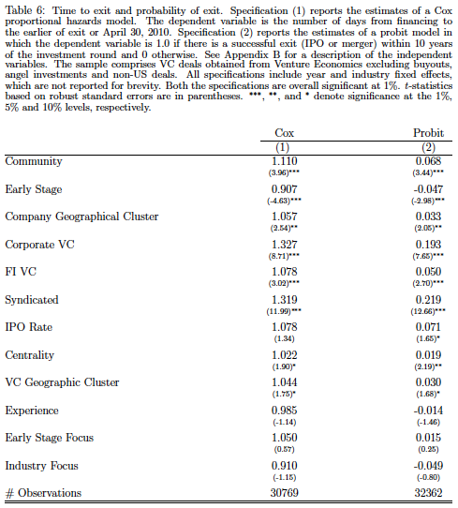

Slide 22
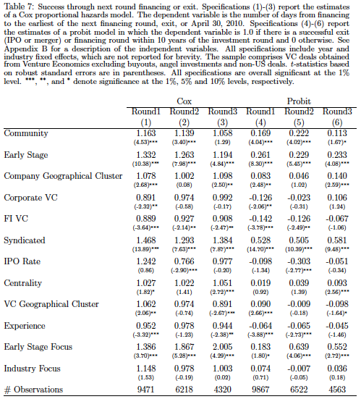

Slide 23
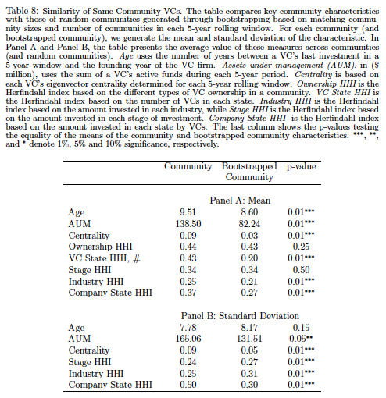

Slide 24
Conclusion
COMMUNITIES: a new way of looking at networks and social interactions in finance.
VCs form communities which tend to be homophilous.
Communities facilitate learning amongst VCs, which have important economic effects for portfolio communities.

