Slide 1
Feature Selection in Classification and R Packages
Houtao Deng
houtao_deng@intuit.com

Slide 2
Agenda
Concept of feature selection
Feature selection methods
The R packages for feature selection

Slide 3
The need of feature selection An illustrative example: online shopping prediction
Features (predictive variables, attributes)
Class
Customer |  | Page 1 | Page 2 | Page 3 | …. | Page 10,000 |  | Buy a Book
1 |  | 1 | 3 | 1 | …. | 1 |  | Yes
2 |  | 2 | 1 | 0 | …. | 2 |  | Yes
3 |  | 2 | 0 | 0 | …. | 0 |  | No
… |  | … | … | … | … | … |  | …
Difficult to understand
Maybe only a small number of pages are needed, e.g. pages related to books and placing orders

Slide 4
Feature selection
Feature
selection
All
features
Feature
subset
Classifier
Accuracy is often used to evaluate the feature election method used
Benefits
Easier to understand
Less overfitting
Save time and space
Applications
Genomic Analysis
Text Classification
Marketing Analysis
Image Classification
…

Slide 5
Feature selection methods
Univariate Filter Methods
Consider one feature’s contribution to the class at a time, e.g.
Information gain, chi-square
Advantages
Computationally efficient and parallelable
Disadvantages
May select low quality feature subsets

Slide 6
Feature selection methods
Multivariate Filter methods
Consider the contribution of a set of features to the class variable, e.g.
CFS (correlation feature selection) [M Hall, 2000]
FCBF (fast correlation-based filter) [Lei Yu, etc. 2003]
Advantages:
Computationally efficient
Select higher-quality feature subsets than univariate filters
Disadvantages:
Not optimized for a given classifier

Slide 7
Feature selection methods
Wrapper methods
Select a feature subset by building classifiers e.g.
LASSO (least absolute shrinkage and selection operator) [R Tibshirani, 1996]
SVM-RFE (SVM with recursive feature elimination) [I Guyon, etc. 2002]
RF-RFE (random forest with recursive feature elimination) [R Uriarte, etc. 2006]
RRF (regularized random forest) [H Deng, etc. 2011]
Advantages:
Select high-quality feature subsets for a particular classifier
Disadvantages:
RFE methods are relatively computationally expensive.

Slide 8
Feature selection methods
Select an appropriate wrapper method for a given classifier
Classifier
Feature selection method
Logistic Regression
LASSO
Tree models such as random forest, boosted trees, C4.5
RRF
RF-RFE
SVM
SVM-RFE

Slide 9
R packages
Rweka package
An R Interface to Weka
A large number of feature selection algorithms
Univariate filters: information gain, chi-square, etc.
Multivarite filters: CFS, etc.
Wrappers: SVM-RFE
Fselector package
Inherits a few feature selection methods from Rweka.

Slide 10
R packages
Glmnet package
LASSO (least absolute shrinkage and selection operator)
Main parameter: penalty parameter ‘lambda’
RRF package
RRF (Regularized random forest)
Main parameter: coefficient of regularization ‘coefReg’
varSelRF package
RF-RFE (Random forest with recursive feature elimination)
Main parameter: number of iterations ‘ntreeIterat’

Slide 11
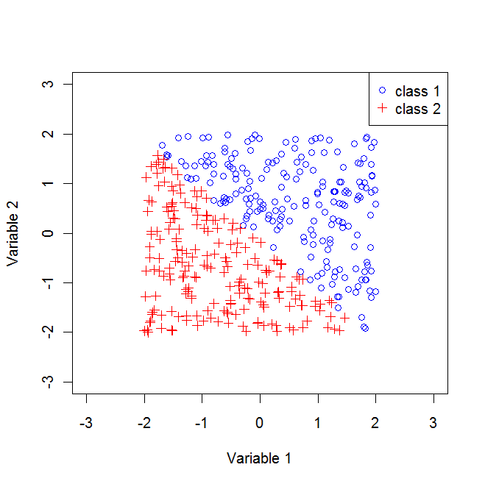
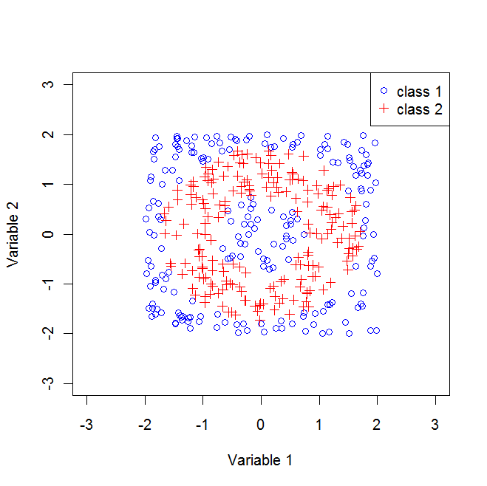
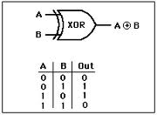
Examples
Consider LASSO, CFS (correlation features selection), RRF (regularized random forest), RF-RFE (random forest with RFE)
In all data sets, only 2 out of 100 features are needed for classification.
Linear Separable
LASSO, CFS, RF-RFE, RRF
Nonlinear
CFS, RF-RFE, RRF
XOR data
RRF, RF-RFE

