Slide 1
Who Acts Like This?
A simple but effective recommendation system for a movie app
Dennis Noren
Feb 9, 2016

Slide 2



UI/UX Design and mobile application development
Impekable
Ideation
Design
Development
www.impekable.com
pek@impekable.com

Slide 3















Our clients
39M users

Slide 4
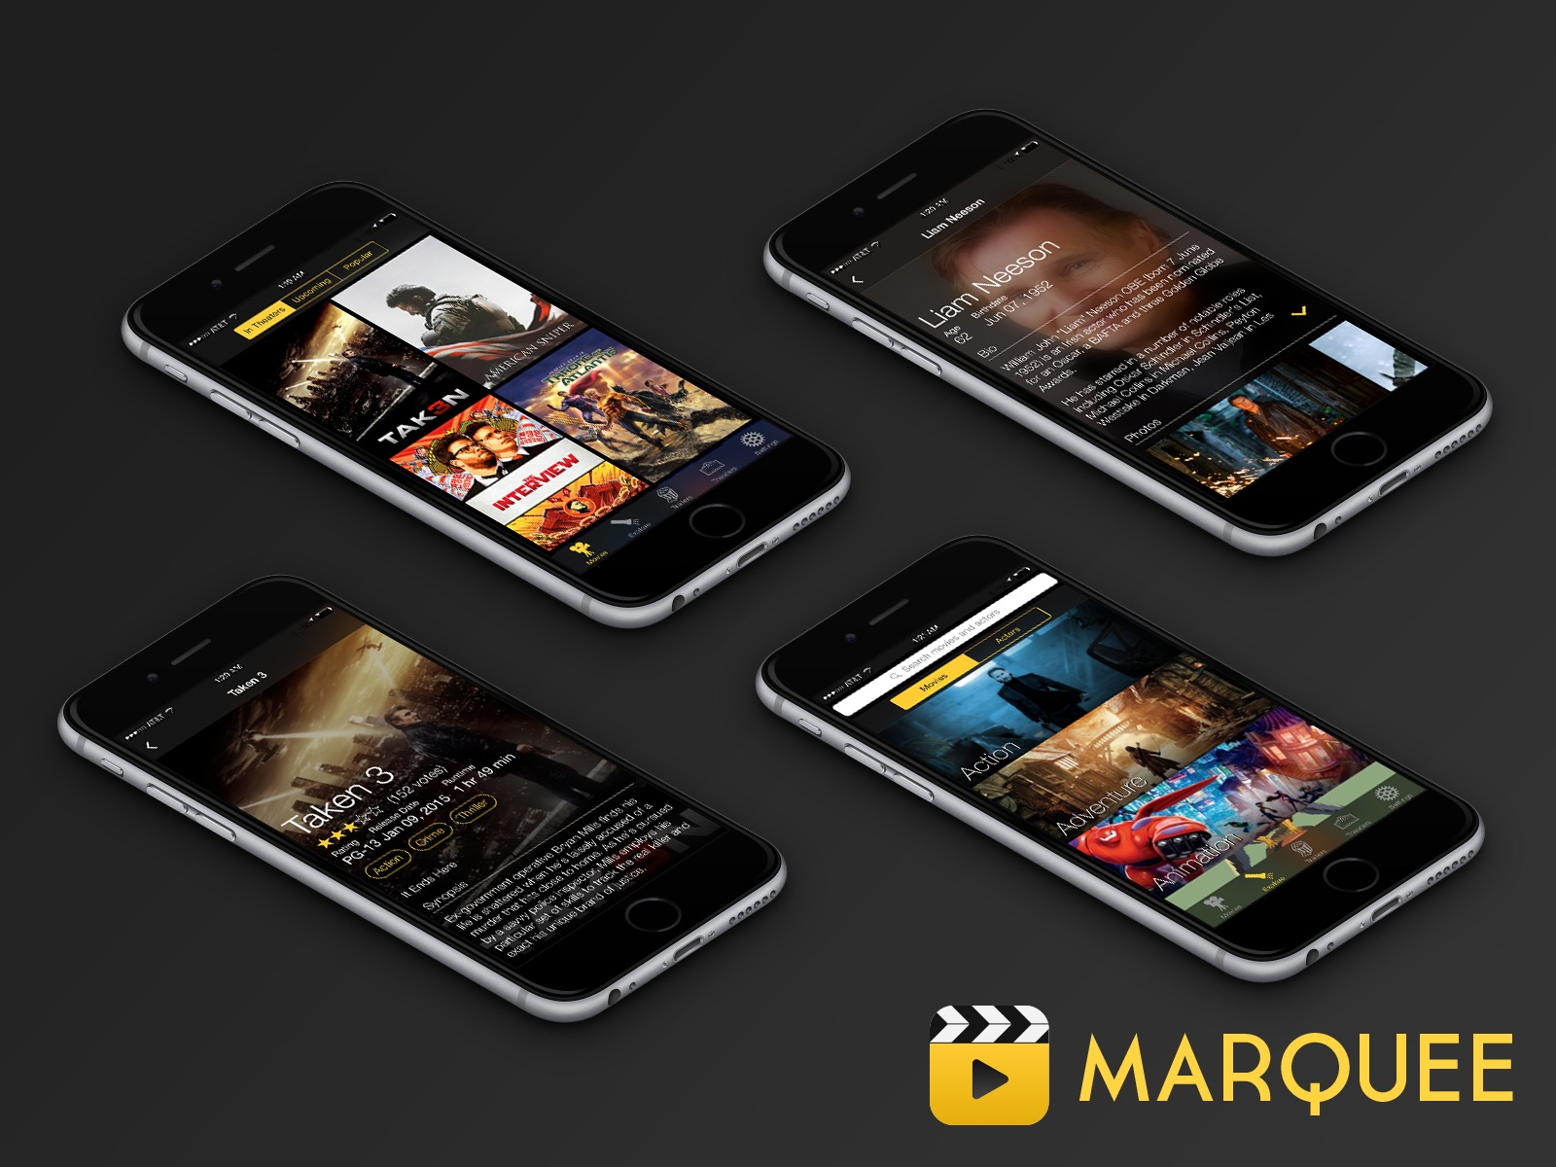

Slide 5
What Marquee Does
Displays data about movies and TV shows
Personalization
Uses: TMDb open source database
Already have recommender for movies

Slide 6
Needed: Actor Recommendations
No direct method available in TMDb API
No click history for user/actor sequences
Use R package ‘TMDb’, which accesses with TMDb API
Build feature set from TMDb and produce similarity measures among actors

Slide 7
Approach
Use genre of movies that actor/actress has appeared in
Use release dates of movies
Use gender association
Normalize to [0, 1]: Hypercube feature space
Find lowest Euclidean distances

Slide 8
Acknowledgements
Impekable LLC
Pek PongPaet
The Movie Database
http://docs.themoviedb.apiary.io
License Artistic – 2.0
R package ‘TMDb’ v 1.0, on CRAN
Developer/Maintainer Andrea Capozio
andreacapozio@gmail.com

Slide 9
Contacts
Dennis Noren
dennisdnoren@gmail.com
www.linkedin.com/in/dennisnoren
Pek Pongpaet
pek@impekable.com
www.impekable.com

Slide 10
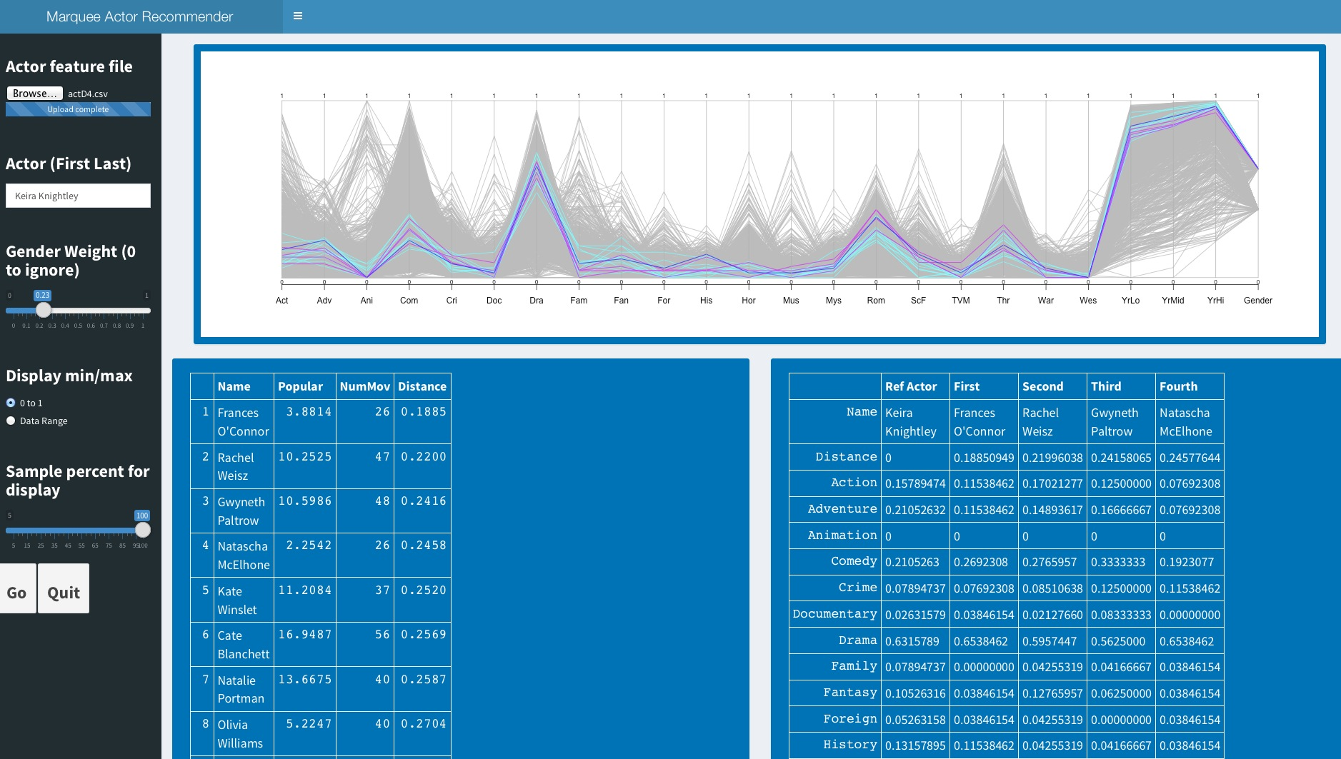
Shiny Dashboard app for exploring model

