Slide 1
Market Timing, Big Data and Machine Learning
BARUG
April 4, 2016
Blair Hull

Slide 2
Market Timing
Robert Merton, 1997 Nobel Prize in Economics
In 1980, calls attempts to estimate the equity premium a “fools errand”

Slide 3
Paul Samuelson, 1970 Nobel Prize in Economics
Said in 1994, “Participation in market timing implies a degree of self-confidence bordering on hubris and self-deception”

Slide 4
Burton Malkiel, author of A Random Walk Down Wall Street
Said in 2013, “Don’t try to time the market. No one can do it. It’s dangerous.”

Slide 5
Nobel Prize Winners:
Can they be wrong?

Slide 6
What has changed:
Data Explosion
Predictive Analytics
Evolution of Academic Literature

Slide 7
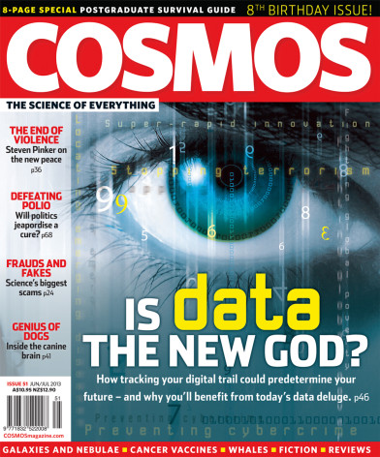
“In God we trust,
all others must bring data.”
-W. Edwards Deming

Slide 8

“Data Deluge”

Slide 9
Machine Learning
“Every part of your business will change based on what I consider predictive analytics of the future.”
Genni Rometty

Slide 10
“Predictive Policing tries to stop violent crime before it happens.”
Business Insider 09/25/2015

Slide 11
Predictive Analytics
Dimension Reduction
Regularization
Ensembles

Slide 12
ACADEMIC HISTORY
1988 – Fama & French, “Dividend Yield”
2000 – Shiller, Cyclically Adjusted Price-to-Earnings Ratio (CAPE)
2008 – Cochrane, says YES
Goyal & Welsh, say NO

Slide 13
CAPE vs Mkt Ret, 1990-2002

Slide 14
CAPE vs Mkt Ret, 2003-2014

Slide 15
Our Contribution
A Practitioner’s Defense of Return Predictability
May 30, 2015
By: Blair Hull – Hull Investments, LLC
Xiao Qiao – University of Chicago
Booth School of Business
SSRN Link: http://ssrn.com/abstract=2609814

Slide 16
A Practitioner’s Defense of Return Predictability:
It is possible to time the market, & beneficial to do so.
Double the return with half the risk
Notes:
It is possible to time the market & beneficial to do so

Slide 17
Procedure: Walk-Forward Simulation
20 variables
Select variables according to correlation screen (.10)
Build regression model every 20 days

Slide 18
What is Different in this Paper
We use daily, weekly, monthly and quarterly data
Overlapping data
Trade everyday on the auction
Replication

Slide 19
Wealth Accumulation and Positions of the Correlation Screening Model

Slide 20
Performance of Market-Timing Strategies, 6/8/2001-5/4/2015
 | CS | RTCS | SPY
Return | 12.11% | 11.66% | 5.79%
Sharpe Ratio | 0.85 | 0.88 | 0.21
Max Drawdown | 21.12% | 21.83% | 55.20%
CS = Correlation Screening Model
RTCS = Real-Time Correlation Screening Model

Slide 21
Annual Returns of Market-Timing Strategies, 6/8/2001-5/4/2015
 | CS | RTCS | SPY
2001 | 1.75% | 4.45% | -8.47%
2002 | 3.72% | 16.30% | -21.59%
2003 | 9.16% | -1.43% | 28.19%
2004 | 5.91% | 0.61% | 10.70%
2005 | 2.13% | -0.22% | 4.83%
2006 | 7.44% | 4.40% | 15.85%
2007 | 8.53% | 2.85% | 5.15%
2008 | 18.96% | 23.85% | -36.69%
2009 | 40.32% | 40.82% | 26.36%
2010 | 2.21% | 3.76% | 15.06%
2011 | 7.69% | 7.99% | 1.90%
2012 | 15.47% | 15.47% | 15.99%
2013 | 34.79% | 34.79% | 32.31%
2014 | 14.64% | 14.64% | 13.47%
2015 | 2.45% | 2.45% | 2.85%

Slide 22
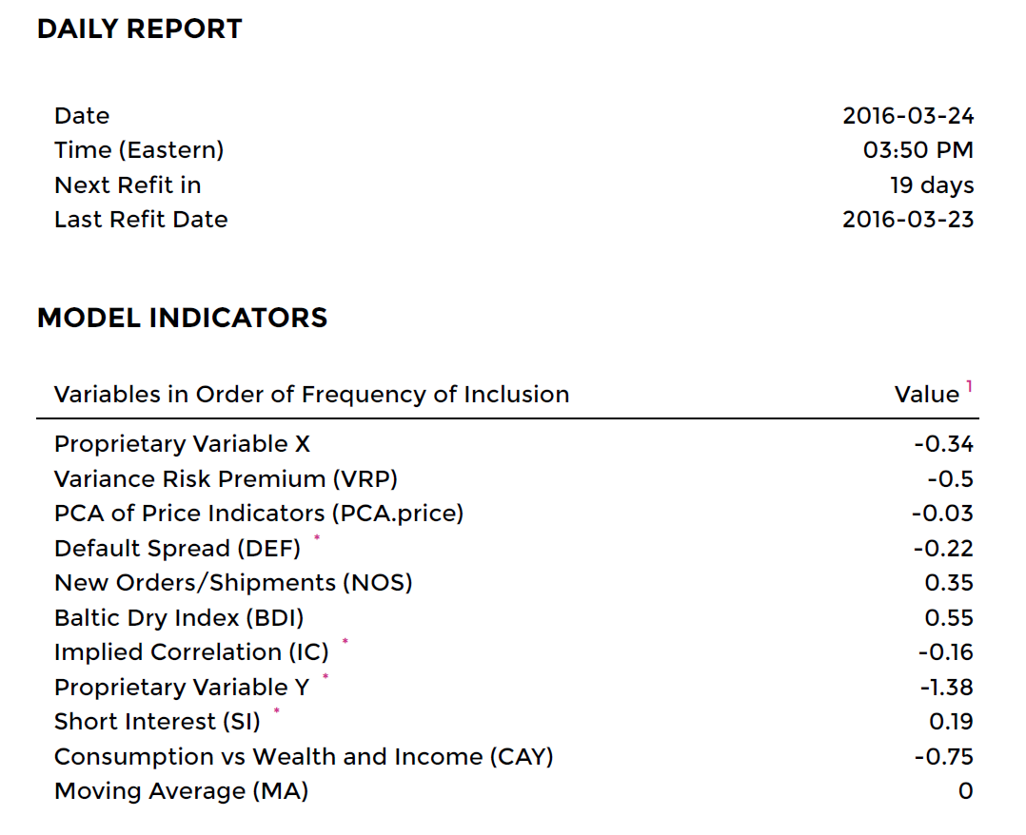
www.hullinvest.com

Slide 23
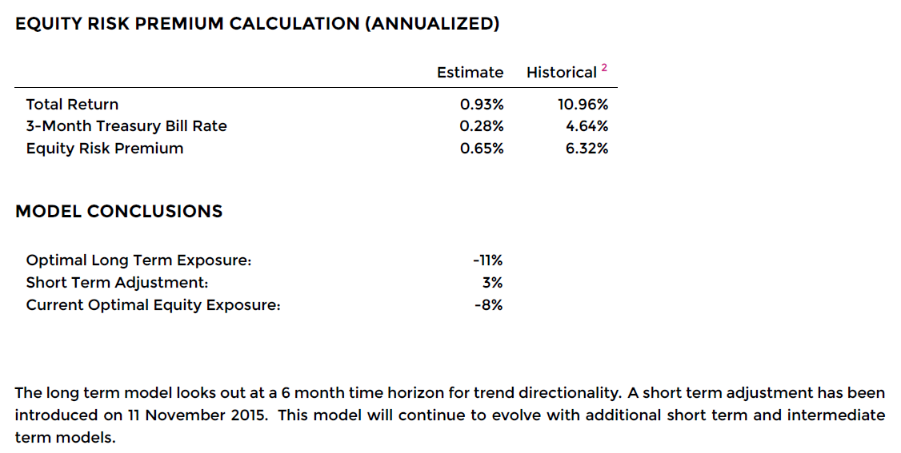

Slide 24
IMPLEMENTATION QUESTIONS
How predictable?
Can we collect the data?
Discipline to follow?

Slide 25
Investor Behavior
Investors do participate in market timing
BUT…
They tend to buy at tops and sell at bottoms.

Slide 26
To use this type of strategy requires a “contrarian spirit”
There can be no emotion, no fear or greed
Result will be a more stable marketplace

Slide 27
Too Good to be True?
Two of the 3 largest drawdowns are in test period
Data set too small

Slide 28
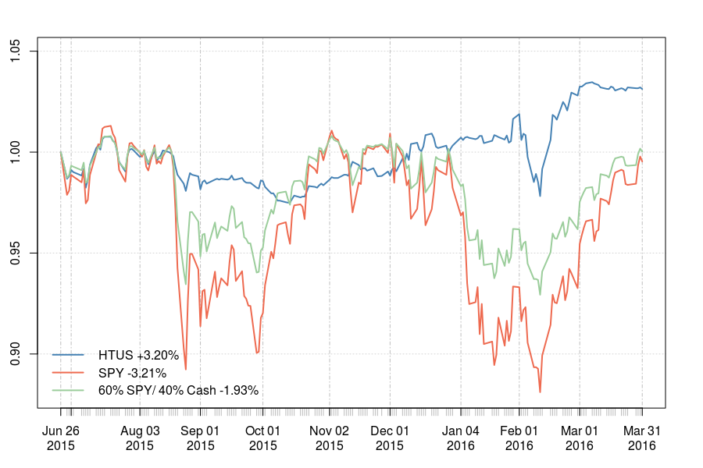
STRATEGY VS MARKET

Slide 29
Ways to Implement
Build your own Model
Hullinvest.com
Managed Accounts
HTUS

Slide 30
Summary
Nobel Prize Winners among others say – No one can time the market
Big Data and New Technology now make it possible
Academic literature has shifted

Slide 31
Final Thought
Just as it was considered irresponsible to time the market in the last 30 years, it will be considered irresponsible NOT to time the market in the next 30 years.

