Slide 1
Forecasting Time Series in R
Dr. Jocelyn Barker
Microsoft

Slide 2
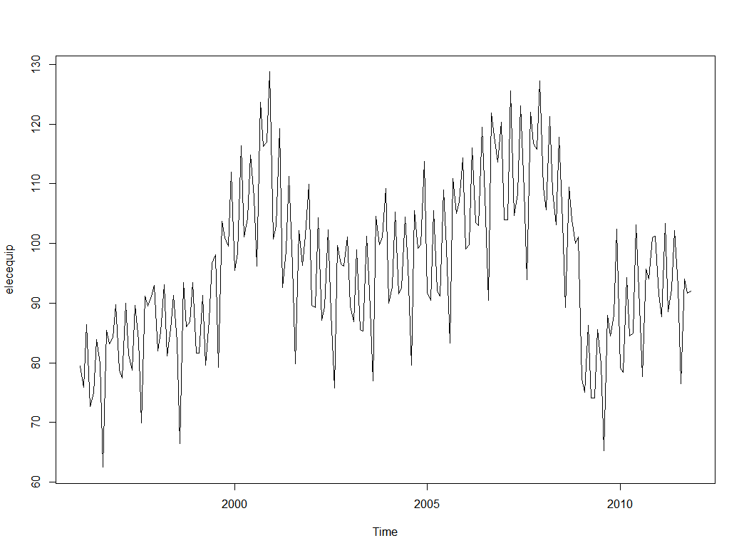
Time Series: Quantitative series of ordered points

Slide 3
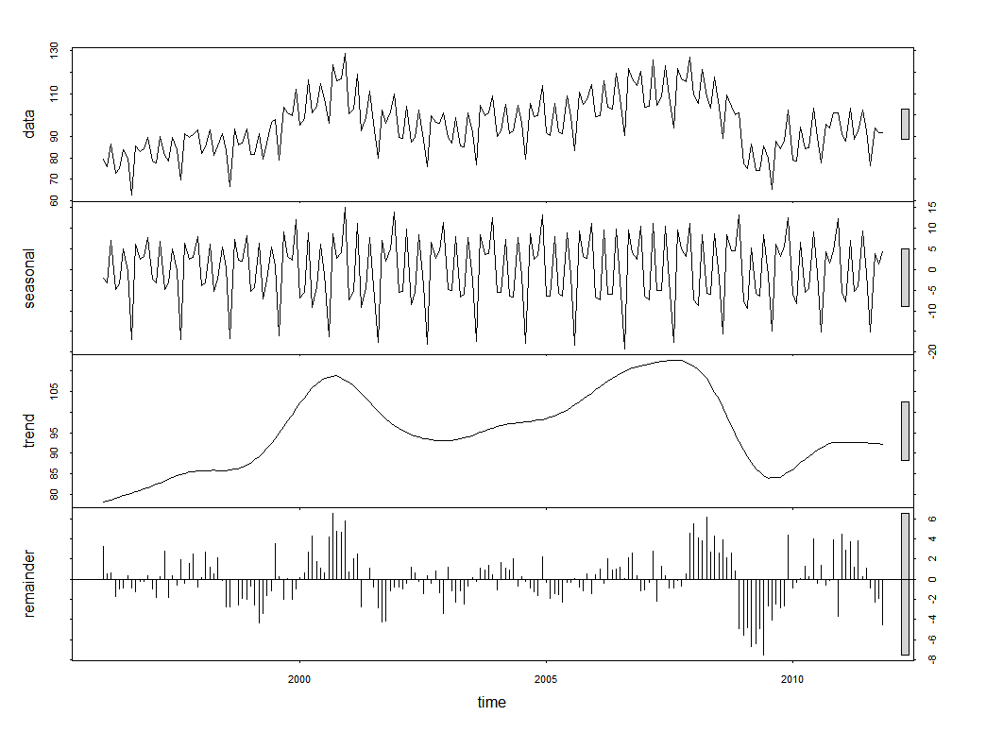

Components of a Time Series
Decomposition:
$$y_{t}=T_{t}+S_{t}+E_{t}$$
$y_{t}$ is the TS we want to forecast, $t$ indexes time period
$T_{t}$ is the trend component
$S_{t}$ is the seasonality component (more than one can be present)
$E_{t}$ is the error, or ‘innovation’, also called ‘irregular component’

Slide 4
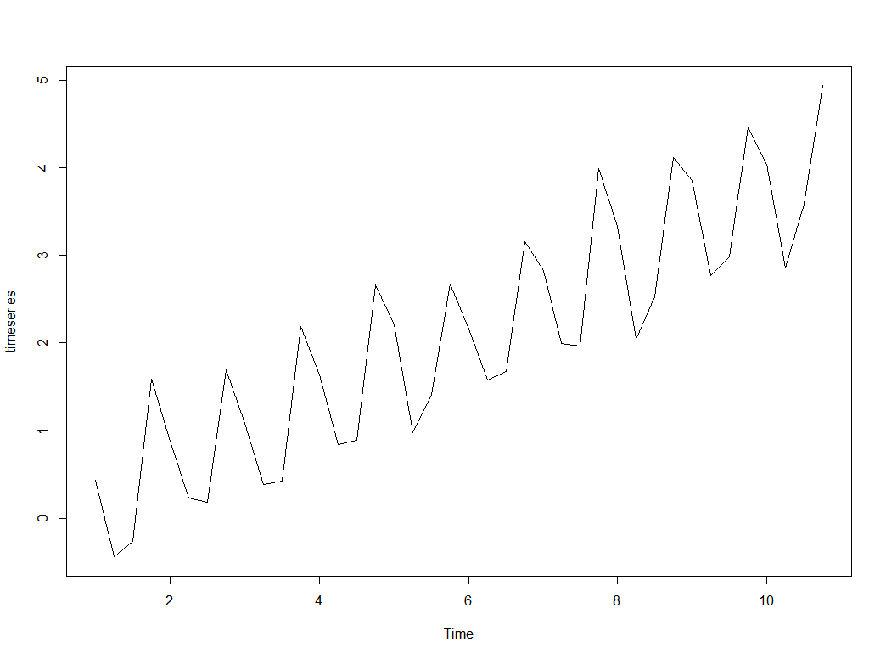
Creating a Time Series in R
#create time series with 3
#components: trend, seasonality and
#error
trend <- seq(0.1, 4, by = 0.1)
seasonality <-
rep(c(0.25,-0.75,-0.5,1),
length.out = 40)
error <- rnorm(40, sd = 0.2)
#create time series object
timeseries <- ts(trend + seasonality + error, frequency = 4)
plot(timeseries)

Slide 5
Exploring Basic Properties
> (tp <- time(timeseries))
Qtr1 Qtr2 Qtr3 Qtr4
1 1.00 1.25 1.50 1.75
2 2.00 2.25 2.50 2.75
3 3.00 3.25 3.50 3.75
4 4.00 4.25 4.50 4.75
5 5.00 5.25 5.50 5.75
6 6.00 6.25 6.50 6.75
7 7.00 7.25 7.50 7.75
8 8.00 8.25 8.50 8.75
9 9.00 9.25 9.50 9.75
10 10.00 10.25 10.50 10.75
> (cyc <- cycle(timeseries))
Qtr1 Qtr2 Qtr3 Qtr4
1 1 2 3 4
2 1 2 3 4
3 1 2 3 4
4 1 2 3 4
5 1 2 3 4
6 1 2 3 4
7 1 2 3 4
8 1 2 3 4
9 1 2 3 4
10 1 2 3 4

Slide 6
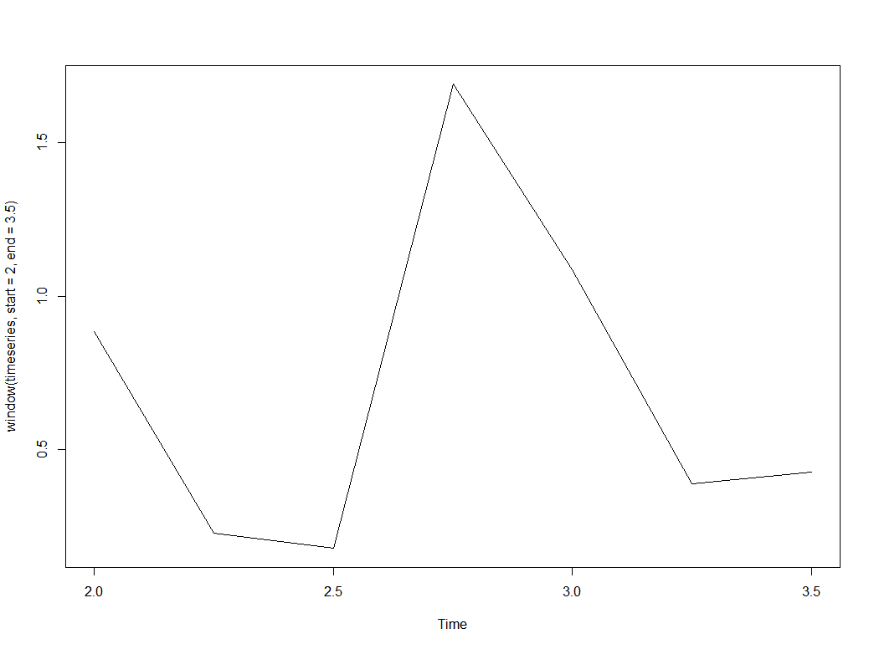
Exploring Basic Properties
> (freq <- frequency(timeseries))
[1] 4
> (delt <- deltat(timeseries))
[1] 0.25
> plot(window(timeseries,
start = 2,
end = 3.5))

Slide 7
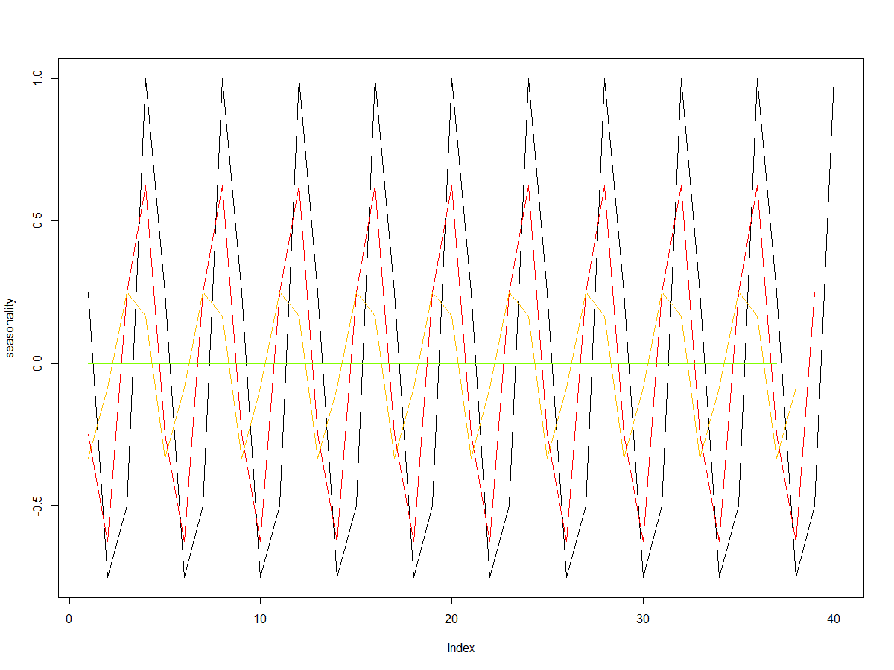
Estimating Components: Trend
#compute mean of one season of data
seasonalMean <- function(timeseries, timepoint,
delt){
mean(window(timeseries, start = timepoint,
end = timepoint + 1 - delt))
}
#compute a rolling seasonal mean to get trend
rollingMean <- function(timeseries){
freq <- frequency(timeseries)
delt <- deltat(timeseries)
tp <- time(timeseries)
timevals <- tp[1:(length(timeseries) - freq)]
rollMean <-
sapply(timevals,
seasonalMean,
timeseries = timeseries,
delt = delt)
rollMean <- ts(rollMean,
start = tp[3],
frequency = freq)
rollMean
}
rollMean <- rollingMean(timeseries)

Slide 8
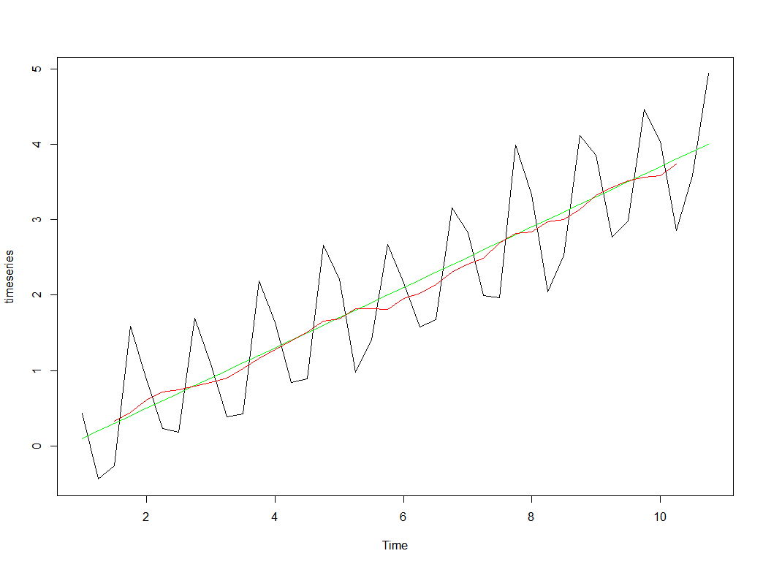
Estimating Components: Trend
#compute mean of one season of data
seasonalMean <- function(timeseries, timepoint,
delt){
mean(window(timeseries, start = timepoint,
end = timepoint + 1 - delt))
}
#compute a rolling seasonal mean to get trend
rollingMean <- function(timeseries){
freq <- frequency(timeseries)
delt <- deltat(timeseries)
tp <- time(timeseries)
timevals <- tp[1:(length(timeseries) - freq)]
rollMean <-
sapply(timevals,
seasonalMean,
timeseries = timeseries,
delt = delt)
rollMean <- ts(rollMean,
start = tp[3],
frequency = freq)
rollMean
}
rollMean <- rollingMean(timeseries)
plot(timeseries)
lines(ts(trend, frequency = freq),
col = "green")
lines(rollMean, col = "red")

Slide 9
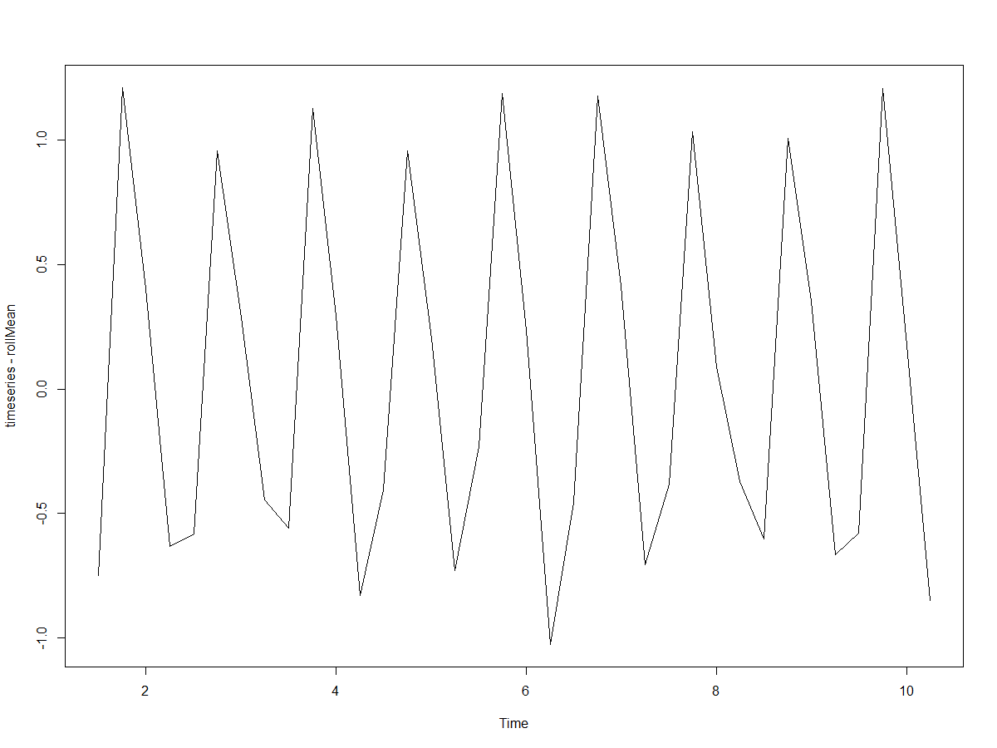
Estimating Components: Seasonality
#subtract estimated trend and average
#across seasons to get seasonality
seasonalEst <- function(timeseries, rollMean){
tsMinusMean <- timeseries - rollMean
season <- rowMeans(matrix(tsMinusMean,
nrow = frequency(timeseries))
season <- rep(season,
length.out = length(tsMinusMean))
season <- ts(season,
start = time(tsMinusMean)[1],
frequency = freq)
}
season <- seasonalEst(timeseries, rollMean)

Slide 10
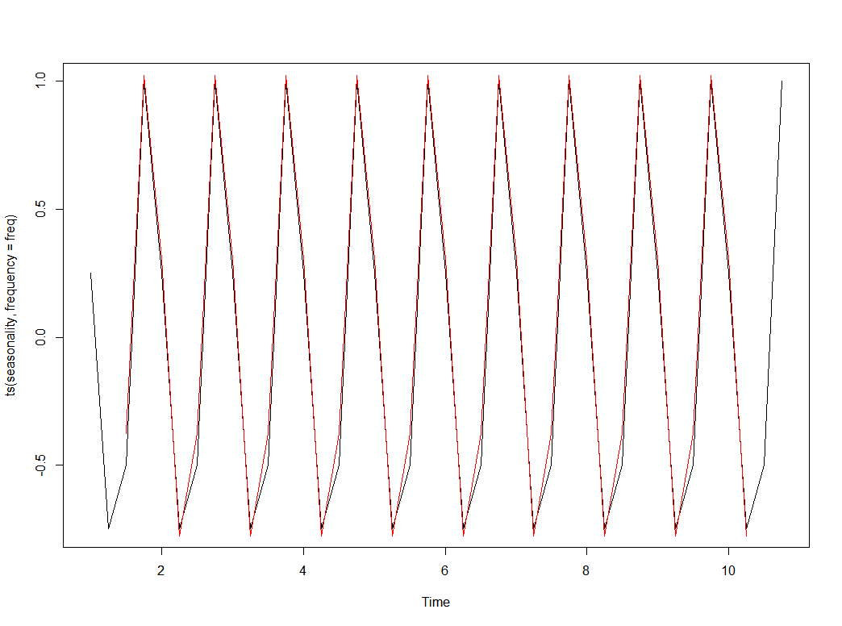
Estimating Components: Seasonality
#subtract estimated trend and average
#across seasons to get seasonality
seasonalEst <- function(timeseries, rollMean){
tsMinusMean <- timeseries - rollMean
season <- rowMeans(matrix(tsMinusMean,
nrow = 4))
season <- rep(season,
length.out = length(tsMinusMean))
season <- ts(season,
start = time(tsMinusMean)[1],
frequency = freq)
}
season <- seasonalEst(timeseries, rollMean)
plot(ts(seasonality,
frequency = freq),
type = "l")
lines(season, col = "red")

Slide 11
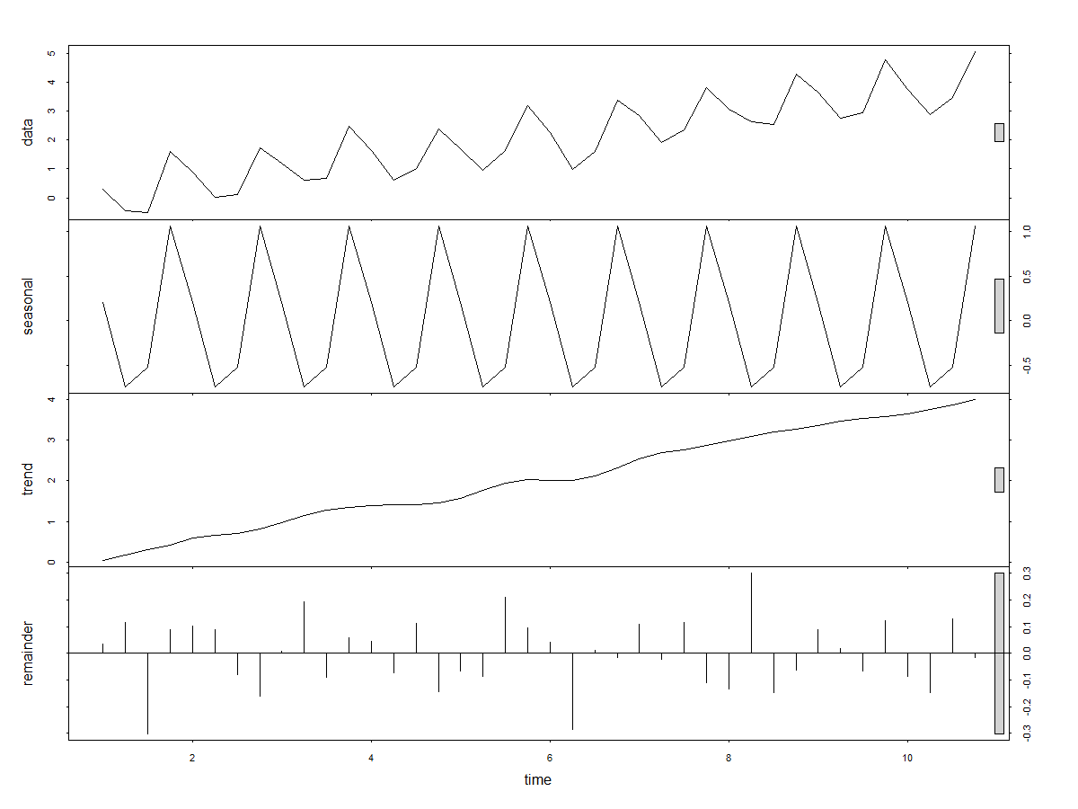
STL: Seasonal Decomposition of Time Series by Loess
> stl(timeseries, s.window = "periodic")
Call:
stl(x = timeseries, s.window = "periodic")
Components
seasonal trend remainder
1 Q1 0.2044770 0.05111526 0.035547473
1 Q2 -0.7438142 0.17277953 0.115875145
1 Q3 -0.5269231 0.30660672 -0.303496653
1 Q4 1.0662608 0.43332521 0.087641013
2 Q1 0.2044770 0.59170728 0.101088352
2 Q2 -0.7438142 0.67551742 0.088503028
2 Q3 -0.5269231 0.71073256 -0.080791766
2 Q4 1.0662608 0.81084948 -0.162239642
3 Q1 0.2044770 0.97687415 0.006276616
3 Q2 -0.7438142 1.15269575 0.192607898

Slide 12
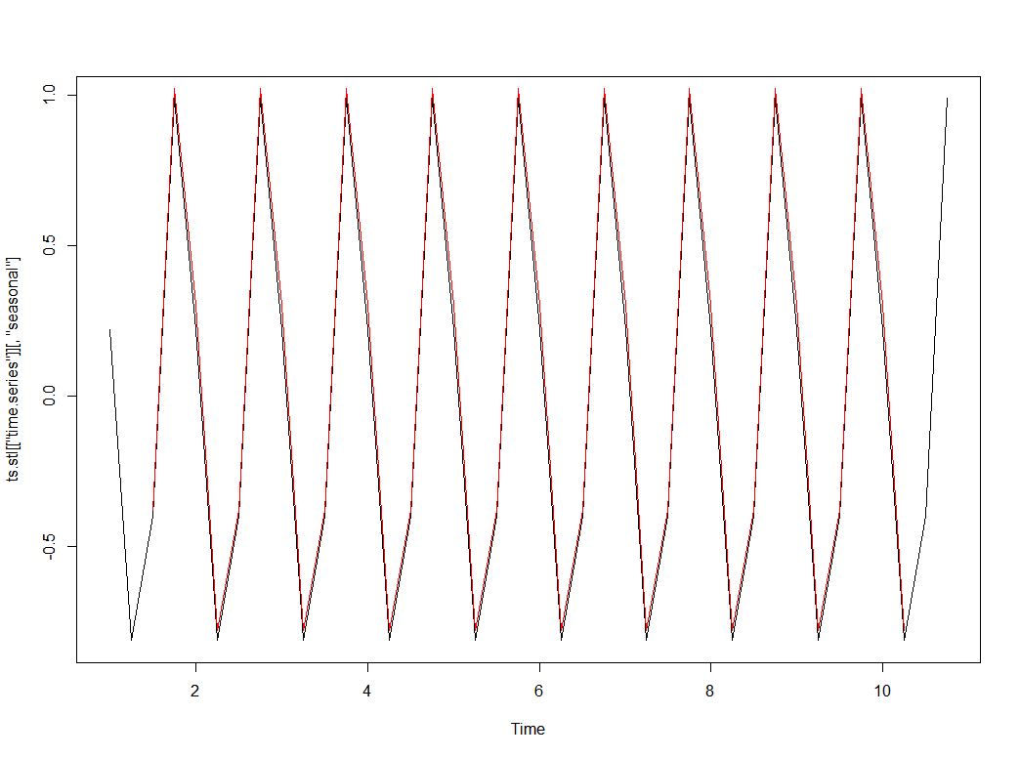
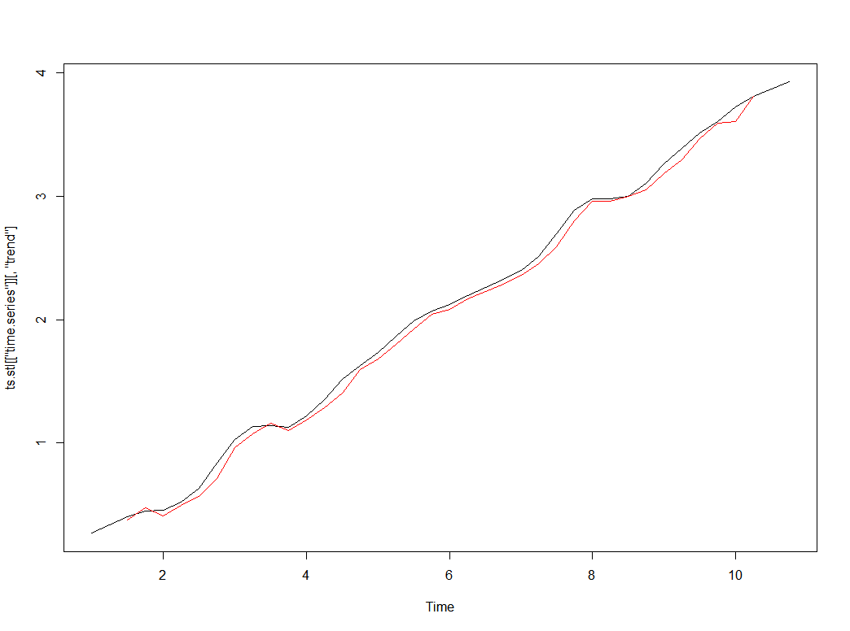
STL Decomposition
tsStl <- stl(timeseries,
s.window = "periodic")
plot(tsStl[["time.series"]][ ,"seasonal"])
lines(season, col = "red")
plot(tsStl[["time.series"]][ ,"trend"])
lines(rollMean, col = "red")

Slide 13
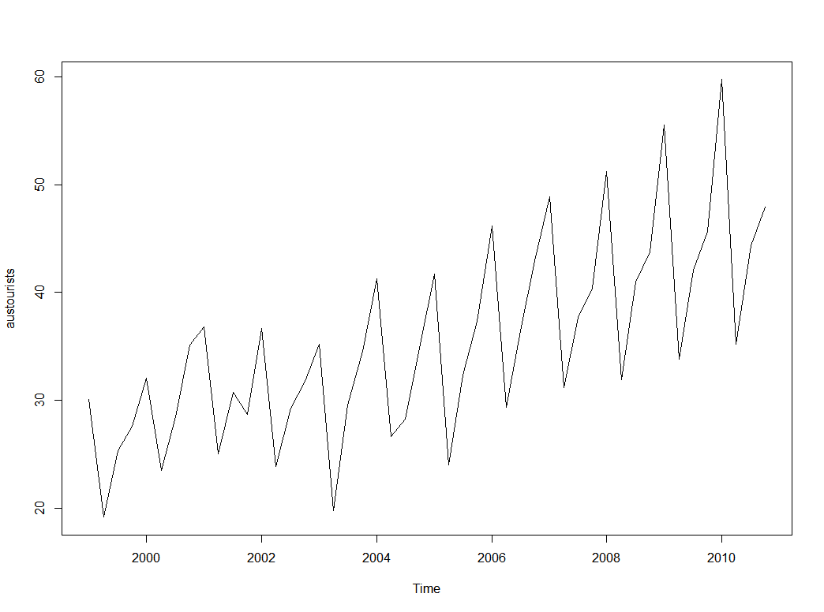
Creating Forecasts
library(fpp)
plot(austourists)
#assign training and testing data
ausTrain <- window(austourists,
end = 2008.75)
ausTest <- window(austourists,
start = 2009)
Forecasting Principles and Practice. Robert J Hyndman and George Athanasopoulos

Slide 14
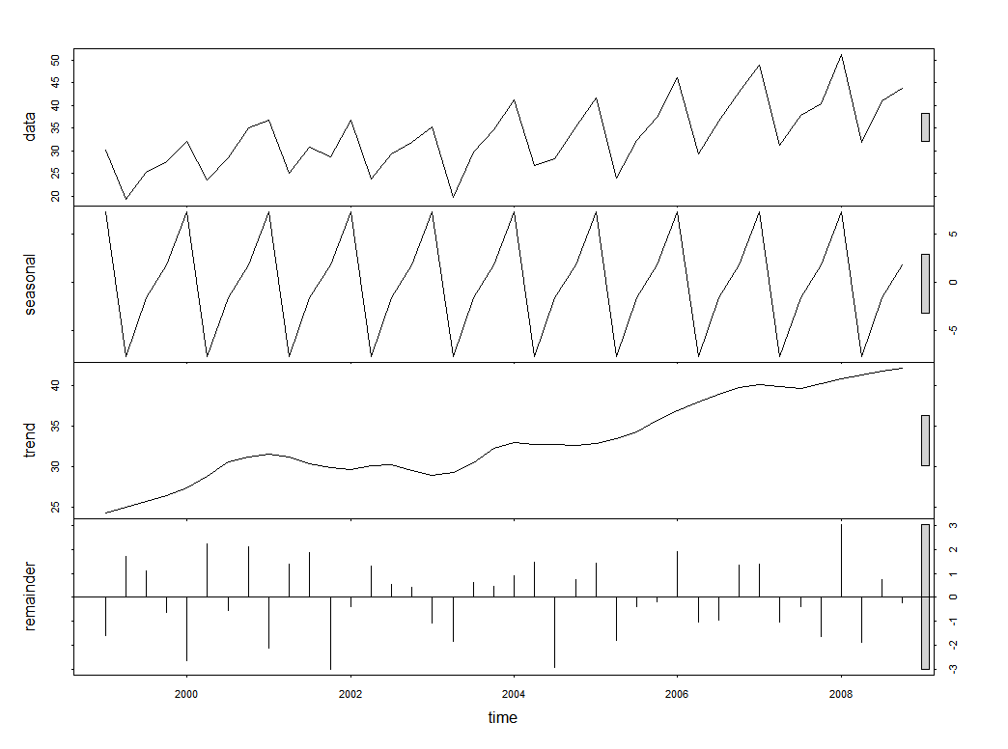
Creating Forecasts
library(fpp)
plot(austourists)
#assign training and testing data
ausTrain <- window(austourists,
end = 2008.75)
ausTest <- window(austourists,
start = 2009)
#create stl models
ausStl <- stl(ausTrain,
s.window = "periodic")
baseStl <- forecast(ausStl, h = 8)

Slide 15
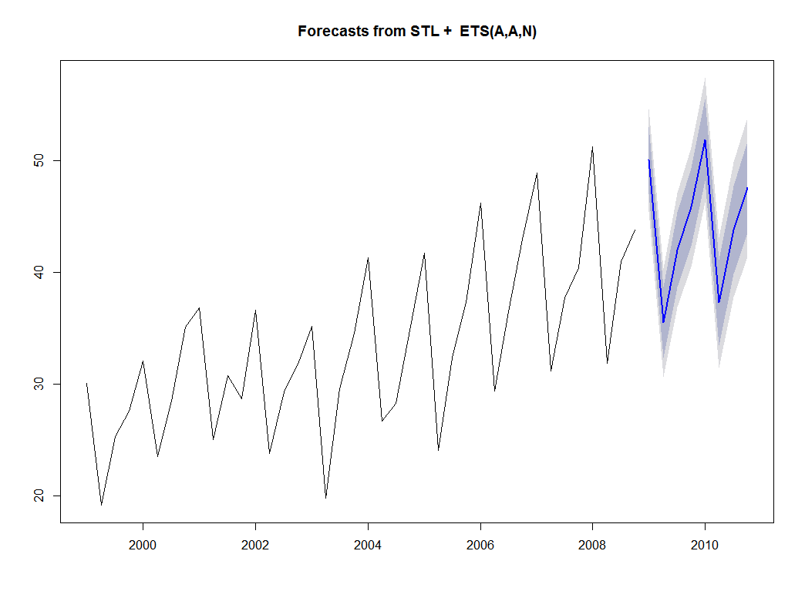
Creating Forecasts
library(fpp)
plot(austourists)
#assign training and testing data
ausTrain <- window(austourists,
end = 2008.75)
ausTest <- window(austourists,
start = 2009)
#create stl models
ausStl <- stl(ausTrain,
s.window = "periodic")
baseStl <- forecast(ausStl, h = 8)
#forecast the stl models
ausForStl <- forecast::stlm(ausTrain)
foreStl <- forecast(ausForStl, h = 8)

Slide 16
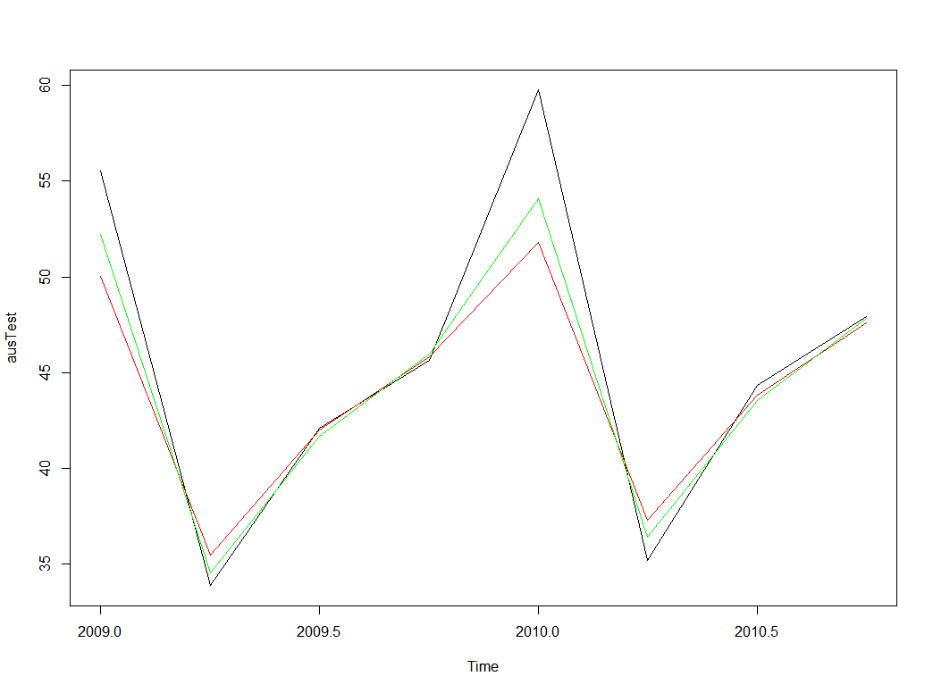
Creating Forecasts
library(fpp)
plot(austourists)
#assign training and testing data
ausTrain <- window(austourists,
end = 2008.75)
ausTest <- window(austourists,
start = 2009)
#create stl models
ausStl <- stl(ausTrain,
s.window = "periodic")
baseStl <- forecast(ausStl, h = 8)
#forecast the stl models
ausForStl <- forecast::stlm(ausTrain)
foreStl <- forecast(ausForStl, h = 8)
#plot model accuracy
plot(ausTest)
lines(baseStl$mean, col = "red")
lines(foreStl$mean, col = "green")
#quantify errors
mape <- function(act, pred){
mean(abs((act-pred)/act)*100)
}
mape(ausTest, baseStl$mean)
[1] 4.545193
mape(ausTest, foreStl$mean)
[1] 3.067948

Slide 17
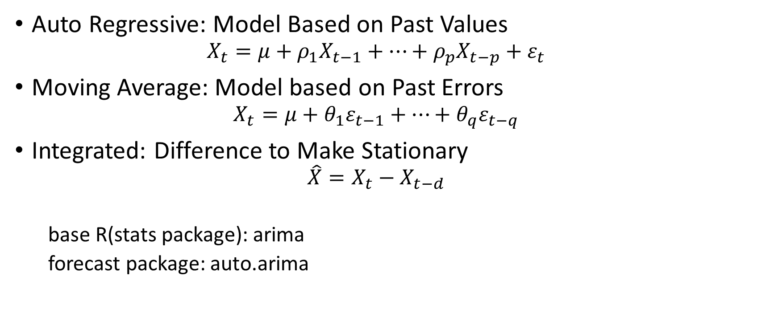
Auto regressive
ARIMA
Moving Average
Integrated
Auto Regressive: Model Based on Past Values
$$X_{t}=μ+{ρ_{1}X}_{t−1}+…+{ρ_{p}X}_{t−p}+ε_{t}$$
Moving Average: Model based on Past Errors
$$X_{t}=μ+{θ_{1}ε}_{t−1}+…+{θ_{q}ε}_{t−q}$$
Integrated: Difference to Make Stationary
$$\hat{X}=X_{t}−X_{t−d}$$
base R(stats package): arima
forecast package: auto.arima

Slide 18
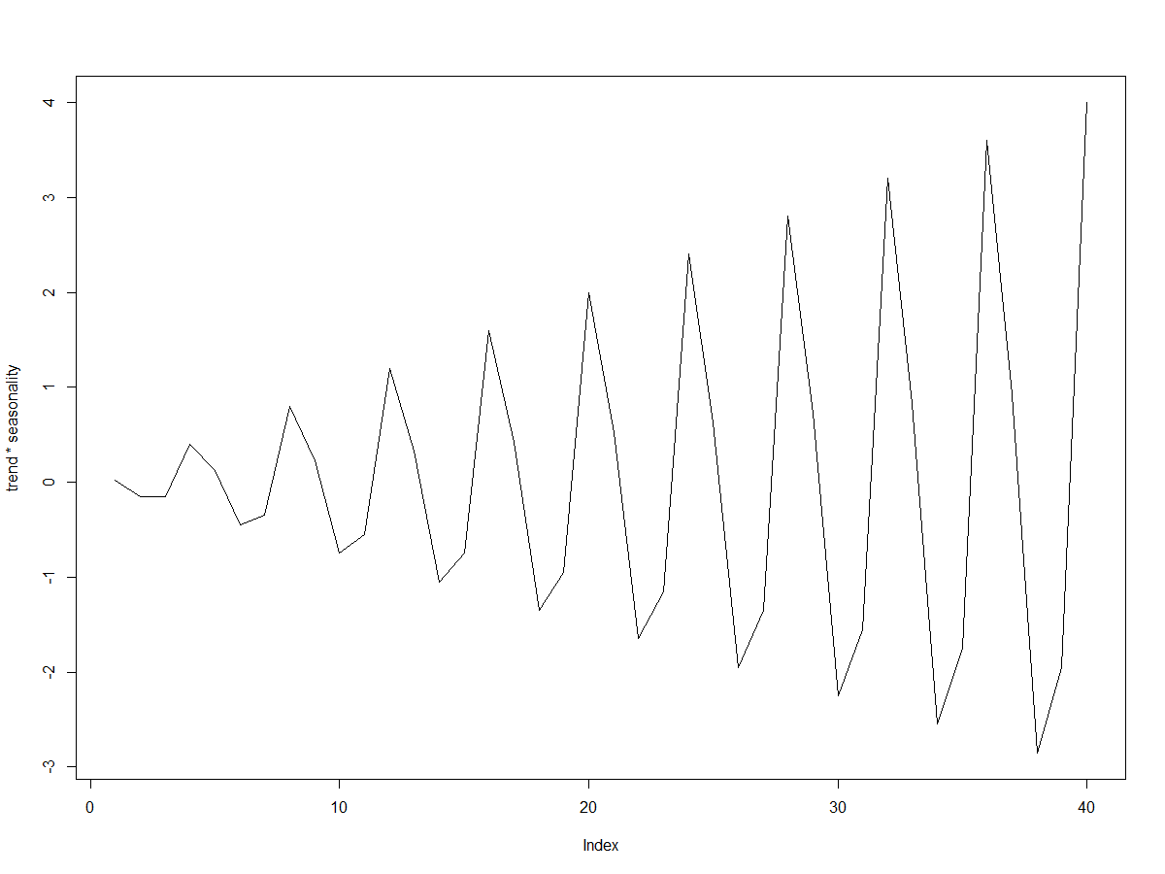
What Makes a Time Series Non-Stationary

Slide 19
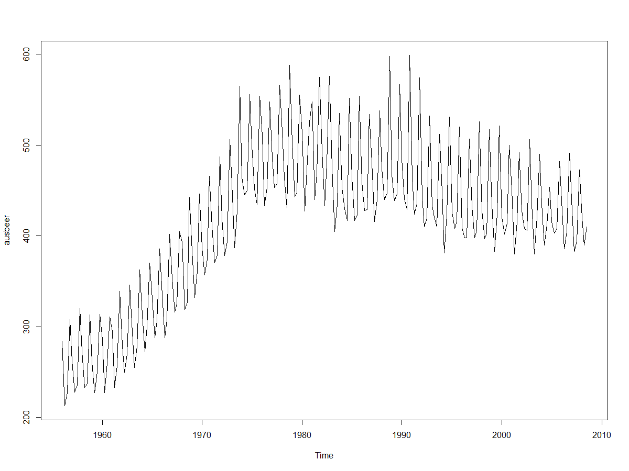
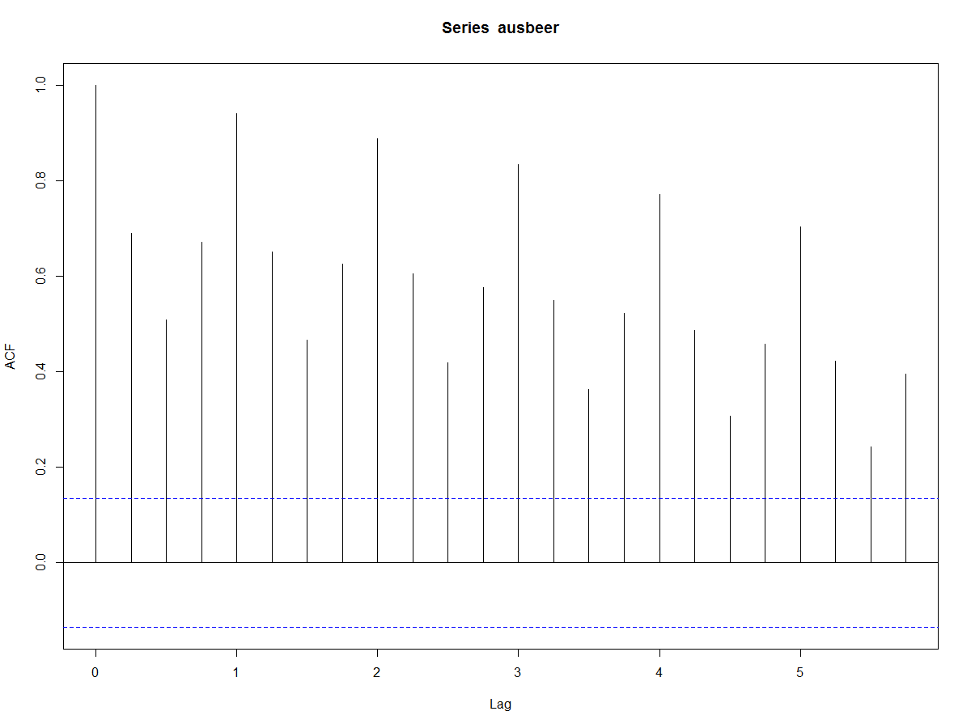
Creating a Stationary Time Series
> plot(ausbeer)
> adf.test(ausbeer, alternative = "stationary")
Augmented Dickey-Fuller Test
data: ausbeer
Dickey-Fuller = -0.9351, Lag order = 5, p-value = 0.9467
alternative hypothesis: stationary
> acf(ausbeer)
> auto.arima(ausbeer)
Series: ausbeer
ARIMA(1,1,2)(0,1,1)[4]
Coefficients:
ar1 ma1 ma2 sma1
0.0274 -0.9963 0.3674 -0.7379
s.e. 0.2012 0.1882 0.1552 0.0508
sigma^2 estimated as 238.6: log likelihood=-858.15
AIC=1726.29 AICc=1726.59 BIC=1742.93

Slide 20
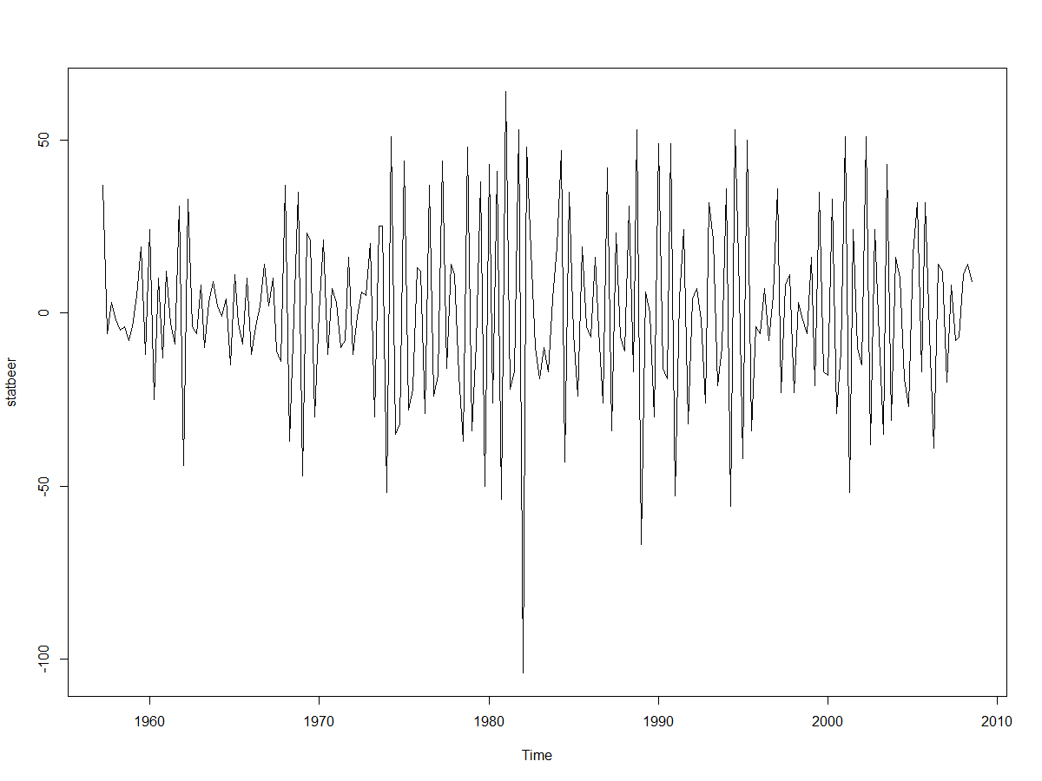
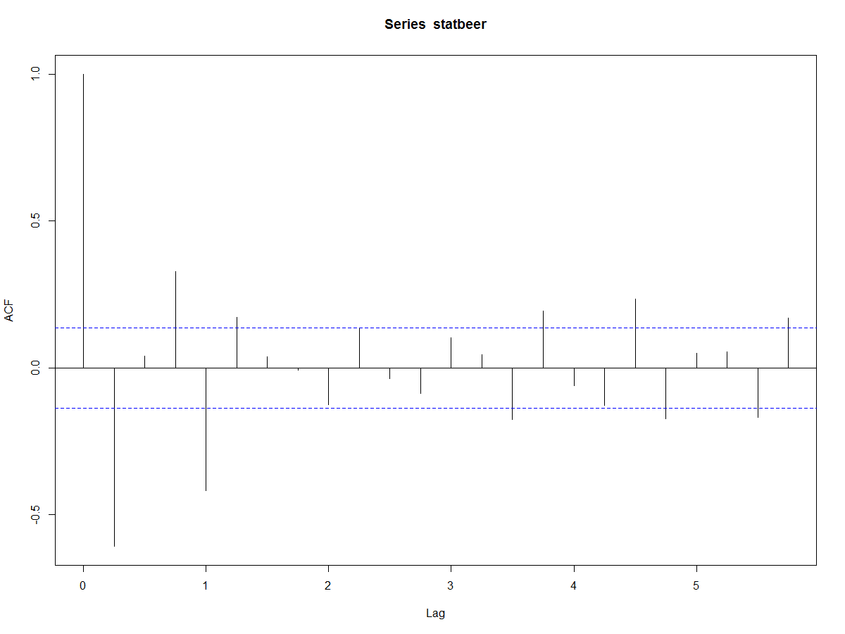
Creating a Stationary Time Series
> plot(ausbeer)
> adf.test(ausbeer, alternative = "stationary")
Augmented Dickey-Fuller Test
data: ausbeer
Dickey-Fuller = -0.9351, Lag order = 5, p-value = 0.9467
alternative hypothesis: stationary
> acf(ausbeer)
> auto.arima(ausbeer)
Series: ausbeer
ARIMA(1,1,2)(0,1,1)[4]
Coefficients:
ar1 ma1 ma2 sma1
0.0274 -0.9963 0.3674 -0.7379
s.e. 0.2012 0.1882 0.1552 0.0508
sigma^2 estimated as 238.6: log likelihood=-858.15
AIC=1726.29 AICc=1726.59 BIC=1742.93
> statbeer <- diff(diff(ausbeer),4)
> plot(statbeer)

Slide 21
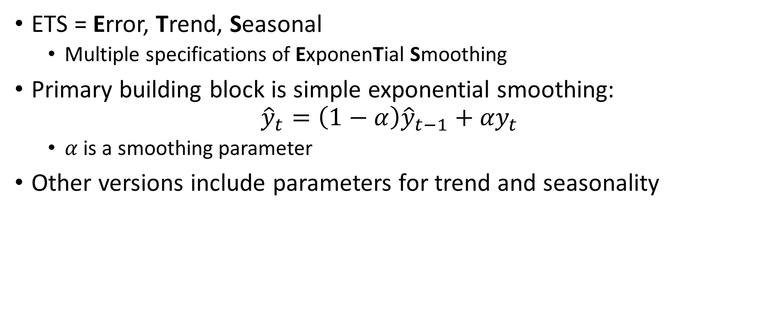
ETS Models
ETS = Error, Trend, Seasonal
Multiple specifications of ExponenTial Smoothing
Primary building block is simple exponential smoothing:
$${\hat{y}}_{t}=\left(1−α\right){\hat{y}}_{t−1}+{αy}_{t}$$
$α$ is a smoothing parameter
Other versions include parameters for trend and seasonality

Slide 22
ETS Models: Exponential Smoothing
 | Seasonal Component
Trend Component | None | Additive | Multiplicative
None | N,N | N,A | N,M
Additive | A,N | A,A | A,M
Additive Damped | Ad,N | Ad,A | Ad,M
Multiplicative | M,N | M,A | M,M
Multiplicative Damped | Md,N | Md,A | Md,M
(N,N) = Simple Exponential Smoothing (ses)
[(A,N),(Ad,N),(M,N),(Md,N)] = Holt’s method (holt)
[(A,A),(Ad,A),(Ad,M),(M,M),Md,M)] = Holt-Winter’s method (hw)
ets() automatically selects the optimal of all options

Slide 23
Time Series Averaging Through Machine Learning
#create rolling forecasts
stlfcasts <- rollapply(austourists, width = 20,
function(x) stlf(ts(x,frequency=4),1)$mean,
align = "right")
arimafcasts <- rollapply(austourists, width = 20,
function(x) forecast(auto.arima(x),1)$mean,
align = "right")
etsfcasts <- rollapply(austourists, width = 20,
function(x) forecast(ets(x),1)$mean,
align = "right")

Slide 24
Time Series Averaging Through Machine Learning
#create rolling forecasts
stlfcasts <- rollapply(austourists, width = 20,
function(x) stlf(ts(x,frequency=4),1)$mean,
align = "right")
arimafcasts <- rollapply(austourists, width = 20,
function(x) forecast(auto.arima(x),1)$mean,
align = "right")
etsfcasts <- rollapply(austourists, width = 20,
function(x) forecast(ets(x),1)$mean,
align = "right")
#create feature matrix from historical forecasts
allfcasts <- cbind(stlfcasts,arimafcasts,etsfcasts)
allfcasts <- ts(allfcasts,
frequency = frequency(allfcasts),
start = time(allfcasts)[2])
features <- cbind(window(allfcasts,end = tail(time(austourists),1)),
window(austourists, start = time(allfcasts)[1]))
features <- as.data.frame(features)
colnames(features) <- c("stl","arima","ets","target")

Slide 25
Time Series Averaging Through Machine Learning
#train a linear regression model using forecasts as features
trainfeat <- features[1:20, ]
testfeat <- features[21:28, ]
model <- lm(target ~ . , trainfeat)
> model
Call:
lm(formula = target ~ ., data = trainfeat)
Coefficients:
(Intercept) stl arima ets
2.01869 1.08229 -0.02261 -0.09846
testforcast <- predict(model, testfeat)
#evaluate results
> mape(testfeat$target, testfeat$stl)
[1] 4.229149
> mape(testfeat$target, testfeat$arima)
[1] 30.38568
> mape(testfeat$target, testfeat$ets)
[1] 23.46801
> mape(testfeat$target, testforcast)
[1] 3.694896

Slide 26
Cross-Validation in Time Series
Time series (TS) ↔ dependent individual observations
Standard machine learning (ML) frameworks assume independent and identically distributed observations (iid)
Benefit of dependence: usually can extract predictable components from TS and forecast them
Drawback of dependence: standard cross-validation (CV) techniques can be deceptive:
Much easier to predict past given future than vice-versa

Slide 27
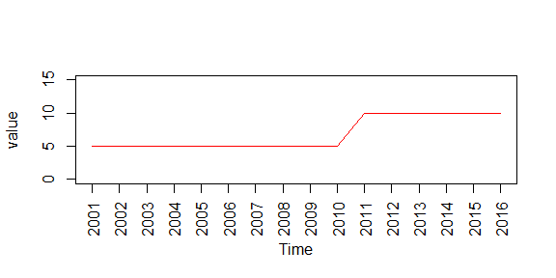
Why Time Series Cross-Validation Matters

Slide 28
Time Series Cross-validation
Normal Cross-Validation
Time Series Cross-Validation
Time point
CV-Fold
Time point
CV-Fold

Slide 29
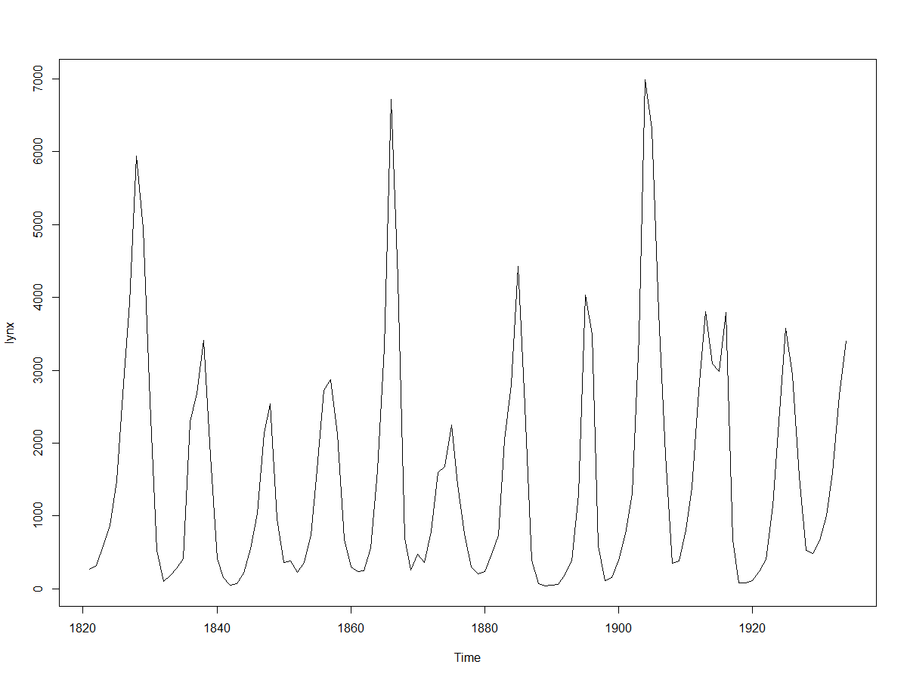
Training a Model
plot(lynx)
#create feature matrix as lags
lags <- rollapply(lynx, 8, "[", align = "right")
lags <- ts(lags,
frequency = frequency(lags),
start = time(lags)[2])
features <- cbind(window(lags,
end = tail(time(lynx),1)),
window(lynx,
start = time(lags)[1]))
features <- as.data.frame(features)
colnames(features) <- c(paste0("lags", 1:8), "target")
#set up training parameters
trainfeat <- features[1:96, ]
testfeat <- features[97:106, ]
#using caret’s “timeseries” crossvalidation
trctrl <- trainControl(method = "timeseries",
horizon = 1,
fixedWindow = FALSE,
initialWindow = 80)
knnModel <- train(form = target ~ . ,
data = trainfeat,
method = "knn",
tuneGrid = data.frame(k = seq(1,50,2)))
testforecast <- predict(knnModel, testfeat)

Slide 30
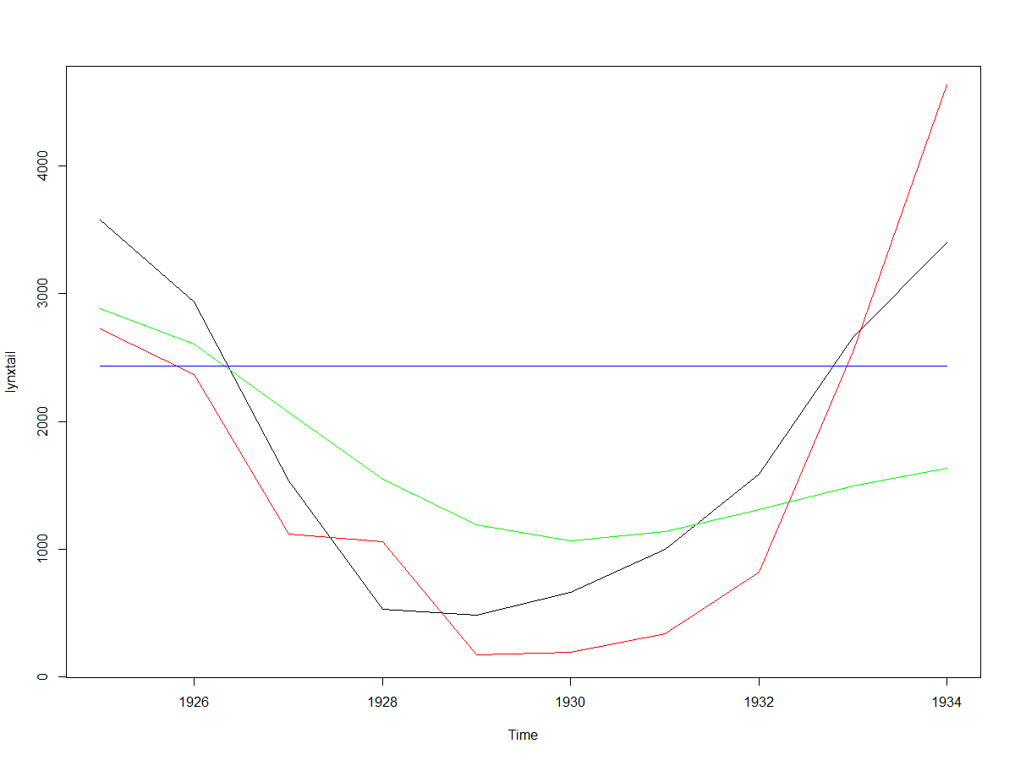
Comparing Results
lynxhead <- window(lynx,end = 1924)
lynxtail <- window(lynx,start = 1925)
arimafcast <-
forecast(auto.arima(lynxhead), 10)
etsfcast <- forecast(ets(lynxhead), 10)
> mape(lynxtail, testforecast)
[1] 46.03539
> mape(lynxtail, arimafcast$mean)
[1] 59.12197
> mape(lynxtail, etsfcast$mean)
[1] 136.8798
plot(lynxtail, ylim = c(175, 4600),
type = "l")
lines(ts(testforcast,start=1925),
col = "red")
lines(arimafcast$mean, col = "green")
lines(etsfcast$mean, col = "blue")

Slide 31
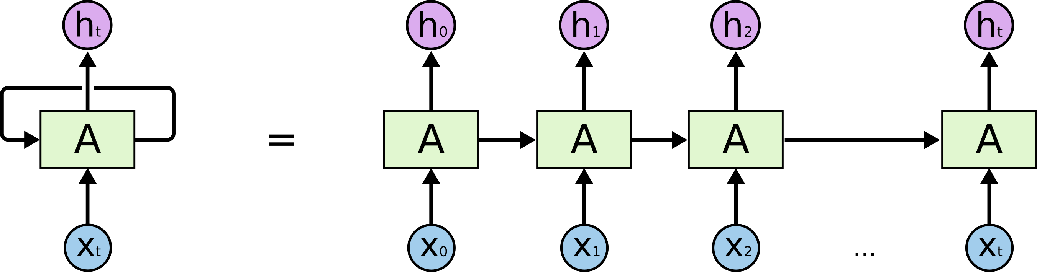
Recurrent Neural Networks

Slide 32

Long Short Term Neural Networks
remember
forget
decide

