Slide 1
Statistics with Big Data: Beyond the Hype
useR 2013
Thursday - 7/11/13 - 11:50
Joseph Rickert

Slide 2

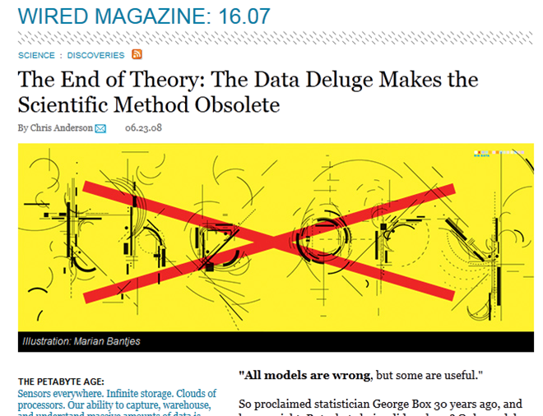
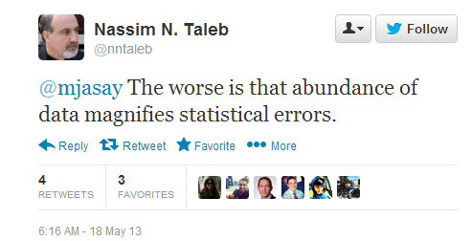
The Hype
2013
2008
Big Data is one of THE biggest buzzwords around at the moment, and I believe big data will change the world.
Bernard Marr: 6/6/13
http://bit.ly/16X59iL
http://www.edge.org/3rd_culture/anderson08/anderson08_index.html
Notes:
Always use all of the data
This is not just a mantra of the uniformed
I worked with a statistician in a prominent insurance company who spoke about the pressure from industry regulators to use all of the data in denying a claim
What is big data to a statistician?
Use Wasserman’s explanation on curse of dimensionality

Slide 3
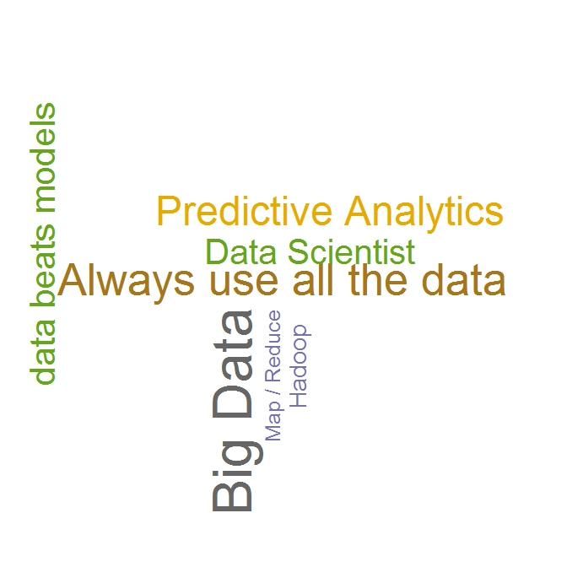
The collision of two cultures
Notes:
Always use all of the data
This is not just a mantra of the uniformed
I worked with a statistician in a prominent insurance company who spoke about the pressure from industry regulators to use all of the data in denying a claim
What is big data to a statistician?
Use Wasserman’s explanation on curse of dimensionality

Slide 4
This Talk
Where would some theory help?
Putting the hype aside:
What tools exist
in R
to meet the challenges
of large data sets?
What are the practical aspects of doing statistics
on large data sets?

Slide 5

The Sweet Spot for “doing” Statistics
Number of rows
as we have come to love it:
Any algorithm you can imagine
“in the flow” work environment
A sense of always moving forward
Quick visualizations
You can get far without much real programming
10⁶
Data
In
Memory

Slide 6

The 3 Realms
Number of rows
The realm of “chunking”
The realm of massive data
>10¹²
Data
in
10¹¹
Data in a File
Multiple
Files
10⁶
Data
In
Memory
Feels like statistics Feels like machine learning

Slide 7
The realm of “chunking”
Number of rows
What’s new here?
External memory algorithms
Distributed computing
Change your way of working
10¹¹
Data in a File

Slide 8
The realm of “chunking”
Number of rows
External Memory Algorithms
Operate on data chunk by chunk
Declare and initialize the variables needed
for( i in 1 to number_of_chunks) { Perform the calculations for that chunk
update the variables being computed}
When all chunks have been processed do the final calculations
10¹¹
Data in a File
You only see a small part of the data at one time – some things e.g. factors are trouble

Slide 9
The realm of “chunking”
Number of rows
# Each record of the data file contains informtion for individual commercial airline flights
# One of the variables collected is the DayOfWeek of the flight
# This function tabulates DayOfWeek
chunkTable <- function(fileName, varsToKeep = NULL, blocksPerRead = 1 )
{
ProcessChunkAndUpdate <- function( dataList){
# Process Data
chunkTable <- table(as.data.frame(dataList))
# Update Results
tableSum <- chunkTable + .rxGet("tableSum")
.rxSet("tableSum", tableSum)
cat("Chunk number: ",.rxChunkNum," tableSum = ",
tableSum, "\n")
return( NULL )
}
updatedObjects <- rxDataStep( inData = fileName,
varsToKeep = varsToKeep, blocksPerRead = blocksPerRead,
transformObjects = list(tableSum = 0),
transformFunc = ProcessChunkAndUpdate,
returnTransformObjects = TRUE,reportProgress = 0)
return(updatedObjects$tableSum)
}
chunkTable(fileName=fileName, varsToKeep="DayOfWeek")
> chunkTable(fileName=fileName, varsToKeep="DayOfWeek")
Chunk number: 1 tableSum = 33137 27267 27942 28141 28184 25646 29683
Chunk number: 2 tableSum = 65544 52874 53857 54247 54395 55596 63487
Chunk number: 3 tableSum = 97975 77725 78875 81304 82987 86159 94975
Monday Tuesday Wednesday Thursday Friday Saturday Sunday
97975 77725 78875 81304 82987 86159 94975
10¹¹
Data in a File

Slide 10
The realm of “chunking”
Number of rows
Distributed Computing
Must deal with cluster management
Data storage and allocation strategies important
10¹¹
Data
Compute node
Data in a File
Data
Compute node
Master node
Data
Compute node

Slide 11
The realm of “chunking”
Number of rows
Change your way of working
Might have to change your usual way of working (e.g. not feasible to “look at” residuals to validate a regression model)
Don’t compute things you are not going to use (e.g. residuals)
Plotting what you want to see may be difficult
Limited number of functions available
Some real programming likely
10¹¹
Data in a File

Slide 12
The realm of massive data
Number of rows
What’s new here?
The cluster is given!!
Restricted to the Map/Reduce paradigm
Basic statistical tasks are difficult
This is batch programming! The “flow” is gone.
The Data Mining Mindset
>10¹²
Data
in
Multiple
Files

Slide 13
The realm of massive data
Number of rows
The cluster is given!!
Parallel computing is necessary
Distribute data parallel computations favors ensemble methods
>10¹²
Data
in
Multiple
Files

Slide 14
The realm of massive data
Number of rows
The Map/Reduce Paradigm
Very limited number of algorithms readily available
Algorithms that need coordination among compute nodes difficult or slow
Serious programming is required
Multiple languages likely
>10¹²
Data
in
Multiple
Files

Slide 15
The realm of massive data
Number of rows
Basic Statistical Tasks are challenging
>10¹²
Getting random samples of exact lengths difficult
Approximate sampling methods common
Independent parallel random number streams required
Data
in
Multiple
Files

Slide 16
The realm of massive data
Number of rows
The Data Mining Mind Set:
>10¹²
Accumulated experience over the last decade has shown that in real-world settings, the size of the dataset is the most important ... Studies have repeatedly shown that simple models trained over enormous quantities of data outperform more sophisticated models trained on less data ....
Lin and Ryaboy
Data
in
Multiple
Files

Slide 17
R Tools for the realm of “chunking”
External Memory Algorithms
bigmemory: massive matrices in memory-mapped files
ff and ffbase offer file-based access to data sets.
SciDB-R: access massive SciDB matrices from R
RevoScaleR
parallel external memory algorithms e.g. rxDTree
Distributed computing infrastructure
Visualization:
bigvis: aggregation and smoothing applied to visualization
tabplot

Slide 18
rxDTree: trees for big data
Based on an algorithm published by Ben-Haim and Yom-Tov in 2010
Avoids sorting the raw data
Builds trees using histogram summaries of the data
Inherently parallel: each compute node sees 1/N of data (all variables)
Compute nodes build histograms for all variables
Master node integrates histograms and builds tree
#Build a tree using rxDTree with a 2,021,019 row version of #the segmentaionData data set
#from the caret package
allvars <- names(segmentationData)
xvars <- allvars[-c(1, 2, 3)]
form <- as.formula(paste("Class", "~",
paste(xvars, collapse = "+")))
#
cp <- 0.01 # Set the complexity parameter
xval <- 0 # Don't do any cross validation
maxdepth <- 5 # Set the maximum tree depth
##-----------------------------------------------
# Build a model with rxDtree
# Looks like rpart() but with a parameter macNumBins to # control accuracy
dtree.model <- rxDTree(form,
data = "segmentationDataBig",
maxNumBinns = NULL,
maxDepth = maxdepth,
cp = cp, xVal = xval,
blocksPerRead = 250)

Slide 19
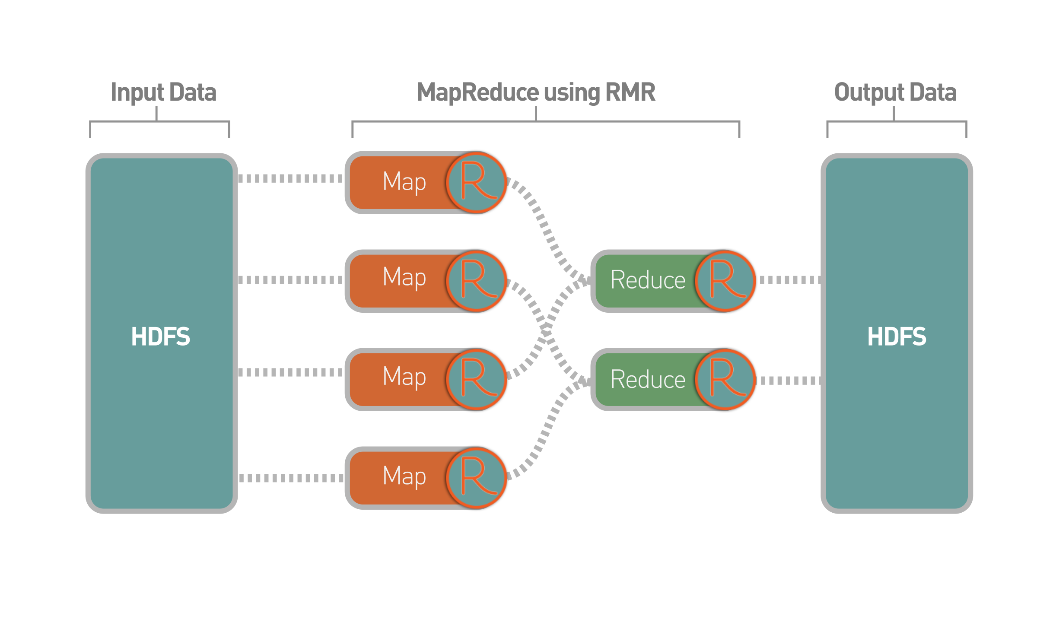
RHadoop: Map-Reduce with R

Slide 20
Theory that could help deflate the hype
Provide a definition of big data that makes statistical sense
Characterize the type of data mining classification problem in which more data does beat sophisticated models
Describe the boundary where rpart type algorithms should yield to rxDTree type approaches

Slide 21
Essential References
Statistics vs. Data Mining
Statistical Modeling: The Two Cultures, Leo Breiman, 2001 http://bit.ly/15gO2oB
Mathematical Formulations of Big Data Issues
On Measuring and Correcting he Effects of Data Mining and Model Selection: Ye ,1998 http://bit.ly/12YpZN7
High-Dimensional Data Analysis: The Curses and Blessings of Dimensionality: Donoho, 2000 http://stanford.io/fbQoQU
Machine Learning in the Hadoop Environment
Large Scale Machine Learning at Twitter: Lin and Kolcz, 2012 http://bit.ly/JMQEhP
Scaling Big Data Mining Infrastructure: The Twitter Experience: Lin and Ryaboy, 2012 http://bit.ly/10kVOca
How-to: Resample from a Large Data Set in parallel (with R on Hadoop): Laserson 2013 http://bit.ly/YRQIDD
Statistical Techniques for Big Data
A Scalable Bootstrap for Massive Data, Kleiner et. al., 2011 http://bit.ly/PfaO75
Big Data Decision Trees
Big Data Decision Trees with R: Cal away, Edlefsen and Gong http://bit.ly/10BtmrW
A streaming parallel decision tree algorithm: Ben-Haim and Yom-Tov, 2010
Short paper http://bit.ly/11BHdK4
Long paper http://bit.ly/11PJ0Kr

