Slide 1
Statistical Marketing Analytics with Big Data
APRIL 15, 2013

Slide 2
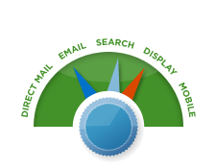


Marketing Analytics Goals
Identify the most profitable channels for every customer and the most profitable customers for every channel.
Target the right customers at the right time with the right message.
Understand what the spend in each marketing
channel contributes to sales.
“Advanced Revenue Attribution”

Slide 3
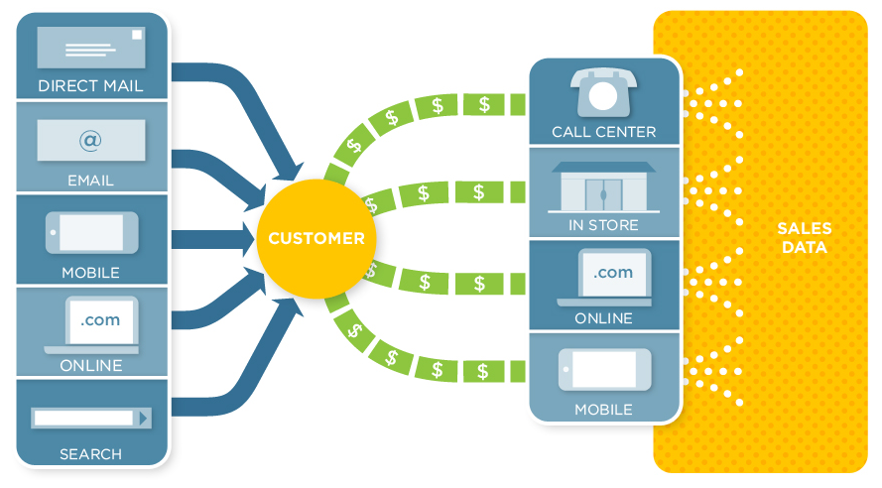
Challenges with Multi-Channel Retail
Multi-channel marketers are unsure where to spend their next dollar.
Messy data with many marketing and order channels, disparate databases, various execution platforms
Don’t understand how spending on marketing affects conversion
No easy way to identify the most profitable channels for every customer

Slide 4
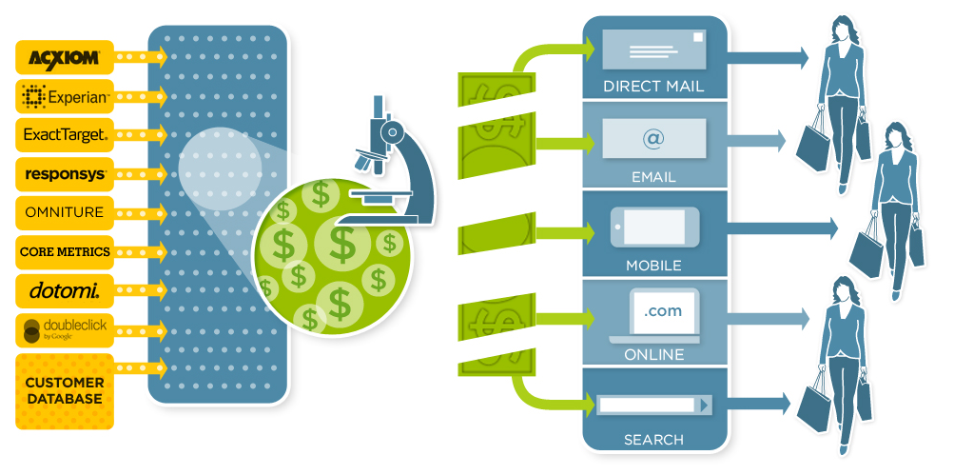
How do you approach the problem?
Enable retailers to conduct customer-level analysis on big data to understand what motivates individuals to buy.
Assemble and standardize all of a marketer’s data into a Hadoop cluster
Apply the rigor of a medical researcher with patented methodology
Identify and attribute the revenue drivers
Know whom to reach

Slide 5
Advanced Revenue Attribution
What is it?
Data-driven time-to-event statistical modeling used to establish an objective and accurate revenue distribution, all done at the individual user level
What are Common Attribution Buckets?
“Big Data” platform that handles and connects
all of a company’s online and offline data (sales, web analytics logs, catalog and email send data, display and search advertising logs, etc.)
supplementary information so we can “fairly” distribute variance across all contributing factors (i.e. Customer Driven (Store Location, Seasonal Factors), Special Cased (Branded Search, Economic Conditions)
How is it different?
Modeling is done at the customer level
facilitates both the micro and macro level analyses in tandem for the most comprehensive insights that a marketer can extract
empowers marketers to customize their strategies at this very same granular level
Focus on modeling time effectively enables the targeting of specific customers with specific treatments at specific times

Slide 6
Attribution Using Time Dependent Models
JANUARY
FEBRUARY
MARCH
APRIL
MAY
JUNE
Customer
Purchase
$100 Purchase
1
catalog
email
catalog
Customer
Purchase
$100 Purchase
2
catalog
email
catalog
email 2
Customer
Purchase
$100 Purchase
3
catalog
search
catalog 1
email
catalog 2
email 2
affiliate
search 1
 |  |  | RECENCY OF TREATMENTS |  |  |  |  | SALES ALLOCATION
customer | sales |  | catalog | email | search | affiliate |  | catalog | email | search | affiliate
#1 | $ 100 |  | 20 | 40 | 0 | 0 |  | $ 99.98 | $ 0.02 | $ - | $ -
#2 | $ 100 |  | 20 | 15 | 0 | 0 |  | $ 81.84 | $ 18.16 | $ - | $ -
#3 | $ 100 |  | 72 | 60 | 10 | 30 |  | $ 40.64 | $ 0.01 | $ 47.03 | $ 12.32

Slide 7
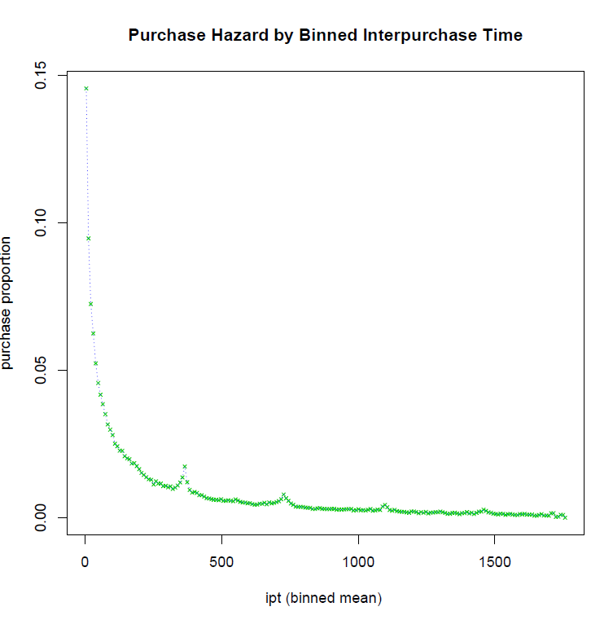
Modeling the Baseline Empirical Hazard
Capture nonlinear trends in baseline, while overlaying marketing treatment variables as well as other customer attributes
RevoR package used:
RevoScaleR
RevoR functions used:
rxImport
rxSummary
rxCube
rxLogit
rxPredict
rxRoc

Slide 8



Partial Residual Modeling
Study the relationship b/w an independent variable and the response, given other independent variables also exist in the model
$\hat{y}$ = $b_{0}+b_{1}x_{1}+b_{2}x_{2}+…+b_{N}x_{N}$
$$e=y−\hat{y}$$
$$r_{N}=e+b_{N}x_{N}$$
Plot partial residuals against the covariate in question and apply appropriate transformation to explain remaining trends

Slide 9
Partial Residual Modeling (RevoR and R Code)
### Append the fitted values to the dataset
rxPredict(model_all, data=outXFile, predVarNames = " prob1 ")
### Explore decay transforms, loop through model variables one at a time
vars <- names(model_all[[1]])
TreatmentList <-names(model_all[[1]])[which(substr(vars,1,2) == "mt")]
pow = 1
for (GRi in 1:length(TreatmentList )){
var=TreatmentList[GRi]
data<-rxReadXdf(file=outXFile, varsToKeep = c(var, "purchase","prob1"))
…
…
…
xBeta1 <- model_all$coefficients[[var]]*data[,var]
parres <- elogit - log(p_purchase1$prob1/(1-p_purchase1$prob1)) + f$xBeta1
vartemp1<-as.data.frame(as.matrix(cbind(tot, m$purchase, actuals, p_purchase1$prob1,var1$var1,t,f$xBeta1,elogit,parres)))
colnames(vartemp1) = c("bin","count","purchase", "actuals","fitted","var1","t","xB","elogit","parres")
nlsfit<- try(nls(parres~b*var1^pow + c ,start=list(b=4, pow=1, c=1), data=vartemp1,trace = TRUE))
if (class(nlsfit) == "try-error") next
pdf(paste(paste(paste("/home/data/K12001/Attribution/data/Modelset_20130311/output/decay_", channel, sep=""), var, sep="_"),".pdf", sep=""))
par(mfrow=c(2,2))
plot(var1$var1, parres,xlab="Binned Ght",ylab="parres", col=3, main="Untransformed Fit ")
lines(var1$var1, f$xBeta1, col=2)
plot(var1$var1, parres,xlab="Binned Ght ",ylab="parres", col=3)
lines(var1$var1, coef(nlsfit)[["b"]]*var1$var1^coef(nlsfit)[["pow"]] + coef(nlsfit)[["c"]], col=2)
title("Transformed Fit ")
.
.
.
dev.off()
###once the power transformations are determined, rebuild the base model with them
assign(paste(channel, "_lev1",sep=""), rxLogit(as.formula(formula1), initialValues=NA, data=outXFile, verbose=3))

Slide 10
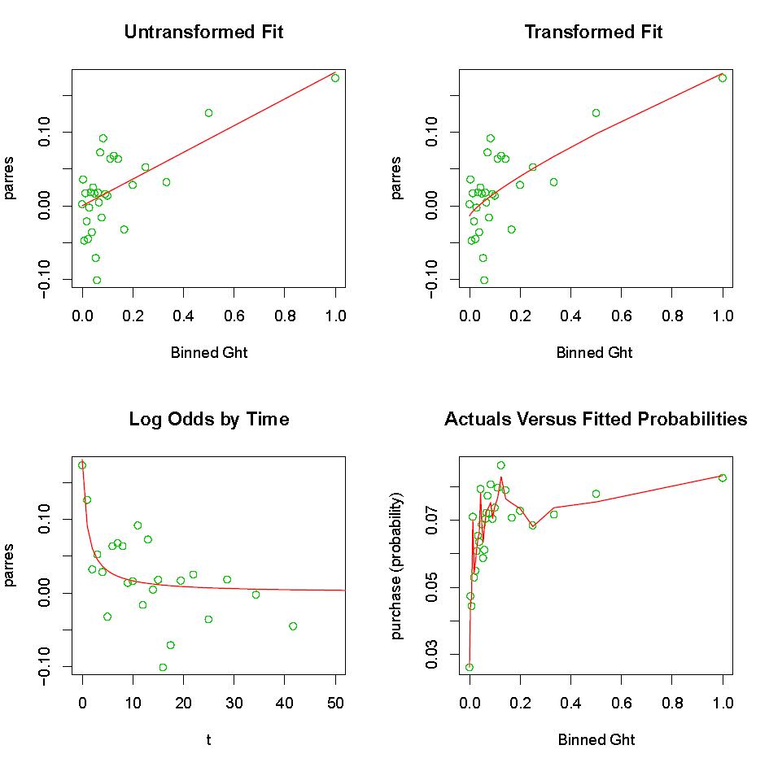
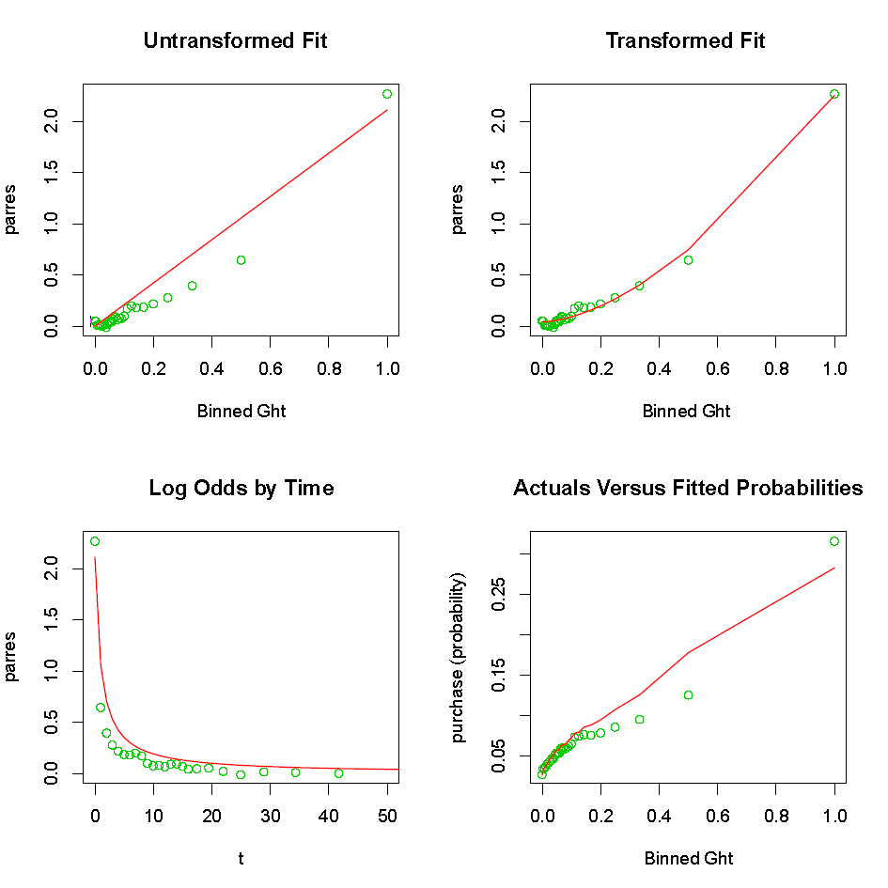
Transformations (Catalog vs Email)
Catalog
Email

Slide 11
The Data World is Changing
Data is getting bigger (Terabytes)
Computing that scales is critical
Statistical relevancy is still critical to framing and solving the problem
→ A combination of Hadoop, RevoR, and R is our current solution

Slide 12
Appendix

Slide 13
Who we are
Company Overview
Experienced team with a proven history of solving difficult analytics problems for Fortune 500 companies
Cloud-based software to manage marketing’s big data problems: customer level revenue attribution and multi-channel optimization, triggered marketing, and planning and reporting
Locations San Francisco, Seattle, and Hyderabad

Slide 14
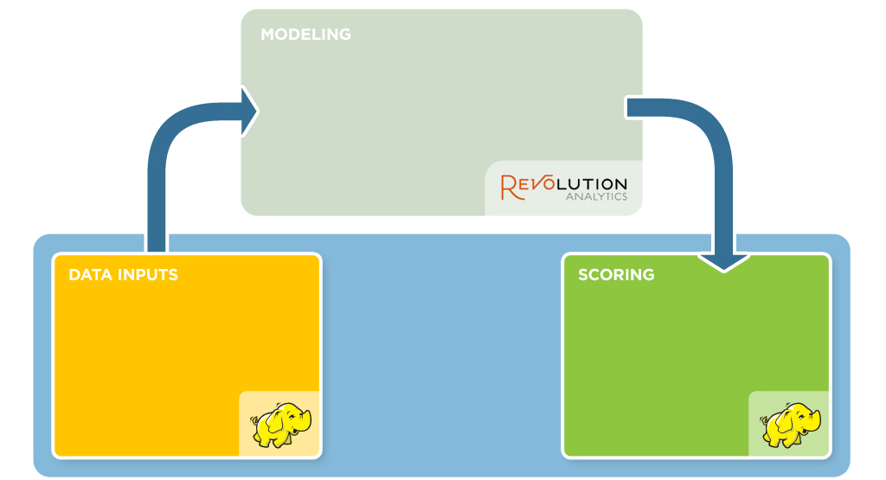
Architecture: Hadoop – Revolution Integration
Current State: Revo v6
Functions to read Hadoop output; xdf creation
Exploratory data analysis
GAM survival models
UpStream Data Format (UDF)
Custom Variables (PMML)
ETL
N marketing channels
Behavioral variables
Promotional data
Overlay data
Scoring for inference
Scoring for prediction
5 billion scores per day per customer

Slide 15
Case Study: Top Multi-Channel Retailer
Attribution
Impact
Presented results that were contrary to company’s expectation; client validated results internally
Within 3 months, reallocated $5MM marketing budget to another channel with more changes to follow
Insights
Marketing is responsible for ~50% of overall sales (offline and online). The other half account for the customer’s buying habit and store trade area.
Ecommerce significantly more influenced by marketing than retail or call-center channels
Direct Load: UpStream credits marketing activities that drove user “navigation” to website.

Slide 16
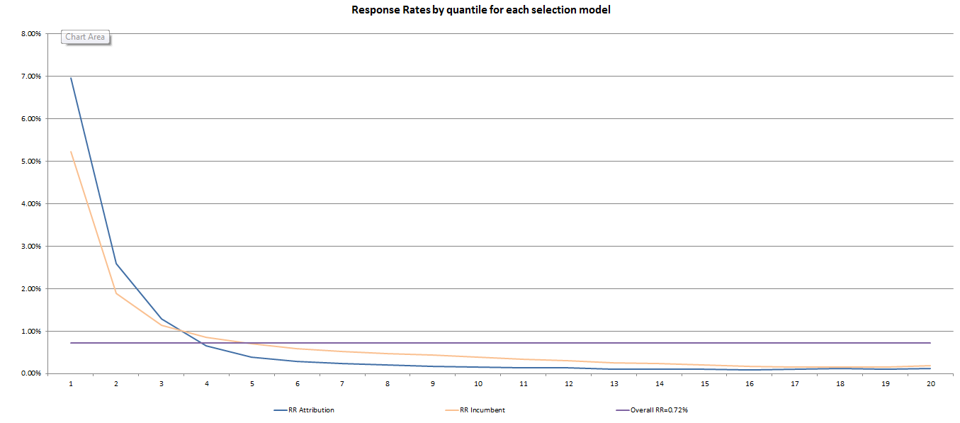
Case Study: Top Multi-Channel Retailer
Optimization
Impact
Already field tested head-to-head against industry leading model
+14% lift in response rate
+$270K in new revenue in a single campaign
Reallocated marketing circulation: identified best prospects to not mail that were likely to purchase without receiving catalog
Scored 22MM households with 9 models all in the cloud

Slide 17
Example Findings
Google keywords often perform worse than you think
In many cases 20-40% worse
Display Advertising performs better than you think
Certain types of display, such as retargeting, performs better than you think and can have strong influence especially at retail stores, which most attribution tools fail to pick up
Custom loyalty has the most impact at the retail store
Often retail sales are due to habit and loyalty, but the same trend doesn’t hold online
Retail sales are influenced by the presence of a store near home
Unfortunately the inverse is also true, web purchases are not typically driven by having a store nearby
Seasonal is much stronger at Internet than Retail or Call Center
The impact of season purchasing is almost double that of retail
Tenure of customers show significant differences
Newer customers are more sensitive to marketing, seasonal factors, and store area than established customers (based on tenure).

