Slide 1
rterra
Writing R Extensions using Terra
saptarshi guha, july,2013

Slide 2
The Case for R Extensions
Take advantage of libraries written in other languages e.g. C,C++, and Fortran
Performance of algorithms written in R is not often the speediest, especially for scalar manipulations
... users recode the 'hot-spots' in C,C++, and/or Fortran
And sometimes users switch to other languages (which may be for reasons other than speed)

Slide 3
Writing R Extensions
R has a well documented C API
which has boilerplate though is 'fairly straightforward' to use
Rcpp is a C++ wrapper around the C API making the latter a pleasure to use
Rcpp also has an inline feature: the user need not compile code, Rcpp handles it automatically

Slide 4
Writing R Extensions
R's C API
SEXP mymethod(SEXP in){
SEXP ab;
PROTECT(ab = allocVector(STRSXP, 2));
SET_STRING_ELT( ab, 0, mkChar("foo") );
SET_STRING_ELT( ab, 1, mkChar("bar") );
UNPROTECT(1);
return(ab);
}
Rcpp API
SEXP mymethod(SEXP in){
Rcpp::CharacterVector ab(2);
ab[0] = "foo";
ab[1] = "bar";
return(ab);
}

Slide 5
Why Lua (and Terra)
Not everyone is very comfortable in C (or C++)
Yet would like their code to be 'reasonably performant'
Why not write extensions in another language that is dynamic, small and fast?
and integrates nicely with C (e.g. call C libraries)

Slide 6
Terra
Research project by Zach Devito, from the website
low-level system programming language that is designed to interoperate seamlessly with the Lua programming language
statically-typed, compiled language(via Clang) with manual memory management.
Use Terra for
Write extension code in Lua, switch to Terra functions for predictable performance (C performance) when needed
Terra uses LuaJIT as the Lua engine. Can be as fast as C
Extend the syntax(build your own DSL): Terra can switch to different parsing engines

Slide 7
Very Quick Introduction to Lua
15 minute introduction: http://tylerneylon.com/a/learn-lua/
A short example
Dog = {} -- 1.function Dog:new() -- 2. newObj = {sound = 'woof'} -- 3. self.__index = self -- 4. self.__eq = DogsEqualFunction(a,b) --
return setmetatable(newObj, self) -- 5.
end -- function Dog:makeSound() -- 6. print('I say ' .. self.sound)
end mrDog = Dog:new() -- same as Dog.new(Dog)
mrDog:makeSound() -- 'I say woof' (same as mrDog.makeSound(mrDog))
Lua is dynamic, garbage collected, has closures, lacks any form of classes (though Javascript style prototypes or C++ style classes can be implemented) and has modules (R libraries)

Slide 8
Very Quick Introduction to Lua
-- __add(a, b) for a + b -- __sub(a, b) for a - b -- __mul(a, b) for a * b -- __div(a, b) for a / b -- __mod(a, b) for a % b -- __pow(a, b) for a ^ b -- __unm(a) for -a -- __concat(a, b) for a .. b -- __len(a) for #a -- __eq(a, b) for a == b -- __lt(a, b) for a < b -- __le(a, b) for a <= b -- __index(a, b) <fn or a table> for a.b -- __newindex(a, b, c) for a.b = c -- __call(a, ...) for a(...)
The above functions can be implemented for sugar e.g. a+b , ,a==b, a/b , a[i]

Slide 9
Using rterra

Slide 10
rterra: Examples
Load the rterra library and 'source' the Terra file
Terra functions are JIT compiled (via Clang).
Lua functions are passed through LuaJIT
library(rterra)
tinit(clang="/opt/clang3.3/bin/clang")
terraFile(system.file("examples","tests.t",package="rterra"))
In addition to terraFile:
terraStr and terra (equivalent of .Call)
and terraAddIncludePaths (like -I/usr/include in gcc), terraLinkLibrary (like gcc's -l or dyn.load), and terraAddRequirePaths (to locate custom modules)

Slide 11
rterra: Environments
ttests = {}
function ttests.testNameSpace(p)
local myNS = R.Robj(p)
local globalenv = R.Robj(R.constants.GlobalEnv)
R.print(globalenv["foo"])
myNS["foo"] = "alpha-gamma"
end
…
return ttests
myNS <-new.env()
myNS$foo <- 1.234
foo <- 2.45
terra("testNameSpace",myNS,table="ttests")
print(list(myNS$foo, foo))
Lua
R
[1] 2.45
NULL
> print(list(myNS$foo, foo))
[[1]]
[1] "alpha-gamma"
[[2]]
[1] 2.45

Slide 12
rterra: Vectors
function ttests.makeIntegerVector()
local z = R.Robj{type="int",with = {0,21,3,R.constants.NaINTEGER}}
z[0] = 31 + z[1]
z['whoami'] = "integer vector"
return z
end
terra("makeIntegerVector",table="ttests")
Lua
R
[1] 52 21 3 NA
attr(,"whoami")
[1] "integer vector"

Slide 13
rterra: Vectors with Attributes
stdio = terralib.includec("stdio.h")
function ttests.intVectorWithAttr(p,n)
local z = R.Robj(p)
stdio.printf("Printing the attribute ... ")
R.print(z['foo'])
local w = R.Robj(n)
local g = R.Robj{type='str',with={ w[1] }}
-- z['listattr'] = R.Robj{type='list',with={w,w}}
z['dooey'] = g
end
x <- structure(1:5,foo="stuff")
y <- as.character(1:4)
terra("intVectorWithAttr",x,y,table="ttests")
Lua
Printing the attribute ... [1] "stuff"
NULL
> print(x)
[1] 1 2 3 4 5
attr(,"foo")
[1] "stuff"
attr(,"doeey")
[1] "3"
R

Slide 14
rterra: Matrices
require("io")
function ttests.matrixTest(s)
local m = R.Robj(s)
local mview = R.asMatrix(m)
for j=0, mview.ncols - 1 do
for i = 0, mview.nrows -1 do
io.write( mview[{i,j}],"\t" )
end
io.write("\n")
end
end
y <- matrix(as.numeric(1:10),ncol=2)
print(y)
terra("matrixTest",y,table="ttests")
Lua
> print(y)
[,1] [,2]
[1,] 1 6
[2,] 2 7
[3,] 3 8
[4,] 4 9
[5,] 5 10
> terra("matrixTest",y,table="ttests")
1 2 3 4 5
6 7 8 9 10
R

Slide 15
rterra: Lists and Calling R Functions
function ttests.createVector()
local runif=R.makeRFunction("runif",3,R.getNamespace("stats"))
local m = R.Robj{type="list",length = 4}
m[0] = R.Robj{type='real',with = {1,2}}
m[1] = R.Robj{type='real',with = {2,2}}
m[2] = R.Robj{type='real',with = {3,2}}
m[3] = R.Robj(runif(R.Robj{type='real',with= {10}}.sexp,
R.Robj{type='real',with = {-1}}.sexp,
R.Robj{type='real',with = {1}}.sexp))
return m
end
terra("createVector",table="ttests")
Lua
[[1]]
[1] 1 2
[[2]]
[1] 2 2
[[3]]
[1] 3 2
[[4]]
[1] 0.6907007 0.2870886 0.8696195 0.7024621 0.5748302 0.6567022 0.4824151
[8] 0.5233279 0.4983562 0.5210542
R

Slide 16
rterra: How is Terra Involed?
Use Lua to construct Terra functions.
These Terra functions are inlined when used in other Terra functions
for a,b in pairs({ {"NilValue"},{"NaSTRING"},{"GlobalEnv"},{"EmptyEnv"},{"BaseEnv"},{"UnboundValue"},
{"NaN",double},{"PosInf",double},{"NegInf",double}, {"NaREAL",double},
{"NaINTEGER",int}, {"NaLOGICAL", int}}) do
local fn = b[1]
local s
s = symbol(b[2] or R.SEXP, "argument")
R[ "is" .. fn] = terra([s])
return([s] == R.constants.[fn])
end
end

Slide 17
Performance of rterra

Slide 18
rterra: Performance - Gibbs Sampler
Gibbs Sampler did the rounds for speed issues
Terra can import C header files with some caveats
e.g. not all #defines are imported
gsl = terralib.includecstring [[
#include <gsl/gsl_rng.h>
#include <gsl/gsl_randist.h>
const gsl_rng_type* get_mt19937(){
return gsl_rng_mt19937;
}
]]
terralib.linklibrary "libgsl.so"
terralib.linklibrary("libgslcblas.so")
terralib.linklibrary("gibstest.so")
Notes:
comment on single parameters can be passed to Lua without parens. [[ is a multiline string

Slide 19
rterra: Performance - Gibbs Sampler
Lua version
function doGibbsJIT(p)
local p1 = R.Robj(p)
local N,thin = p1[0], p1[1]
local r = R.Robj{type='real',length = N*2}
local mr = R.asMatrix(r, {N,2})
local rng = gsl.initgsl_rng()
local x,y = 0.0,0.0
for i=0,N-1 do
for j=0, thin-1 do
x=gsl_ran_gamma(rng,3.0,1.0/(y*y+4));
y=1.0/(x+1)+gsl.gsl_ran_gaussian(rng,1.0/cmath.sqrt(2*x+2))
mr[{i,0}],mr[{i,1}] = x,y
end
end
freegsl_rng(rng)
return r
end

Slide 20
rterra: Performance - Gibbs Sampler
Terra version
GSL_RNG_INIT = function(rng)
return( quote
rng = gsl.gsl_rng_alloc([&gsl.gsl_rng_type] (gsl.get_mt19937()))
ffi.gc(rng,gsl.gsl_rng_free)
end)
end
terra _doGibbsTerra(r:&double, N:int, thin:int )
var rng : &gsl.gsl_rng = nil
[GSL_RNG_INIT(rng)] -- splicing (like a macro)
for i=0,N do
for j=0, thin do
var x,y = 0.0,0.0
x=gsl.gsl_ran_gamma(rng,3.0,1.0/(y*y+4));
y=1.0/(x+1)+gsl.gsl_ran_gaussian(rng,1.0/cmath.sqrt(2*x+2))
r[i ],r[i+N] = x,y
end
end
end
function doGibbsTerra(p) -- call this from R
local p1 = R.Robj(p)
local N,thin = p1[0], p1[1]
local r = R.Robj{type='real',length = N*2}
_doGibbsTerra( r.ptr, N,thin)
return r
end

Slide 21
rterra: Performance - Gibbs Sampler
Terra Multi-threaded version
local struct A {
N: int;
thin: int;
r:&double;
}
terra _doGibbsTerra1(r:&double, N:int, thin:int ,numthreads:int)
var p = { N = N, thin=thin, r=r} -- anonymous struct
var threadpool = glib.g_thread_pool_new(_driver,&p,numthreads,0,nil)
var integers = [&int](stdlib.malloc(sizeof(int)*N))
for i=0,N do
integers[i] = i
glib.g_thread_pool_push(threadpool,integers+i,nil)
end
glib.g_thread_pool_free (threadpool,0,1)
stdlib.free(integers)
end
Structs can have methods attached to them , similar to Lua's metatables

Slide 22
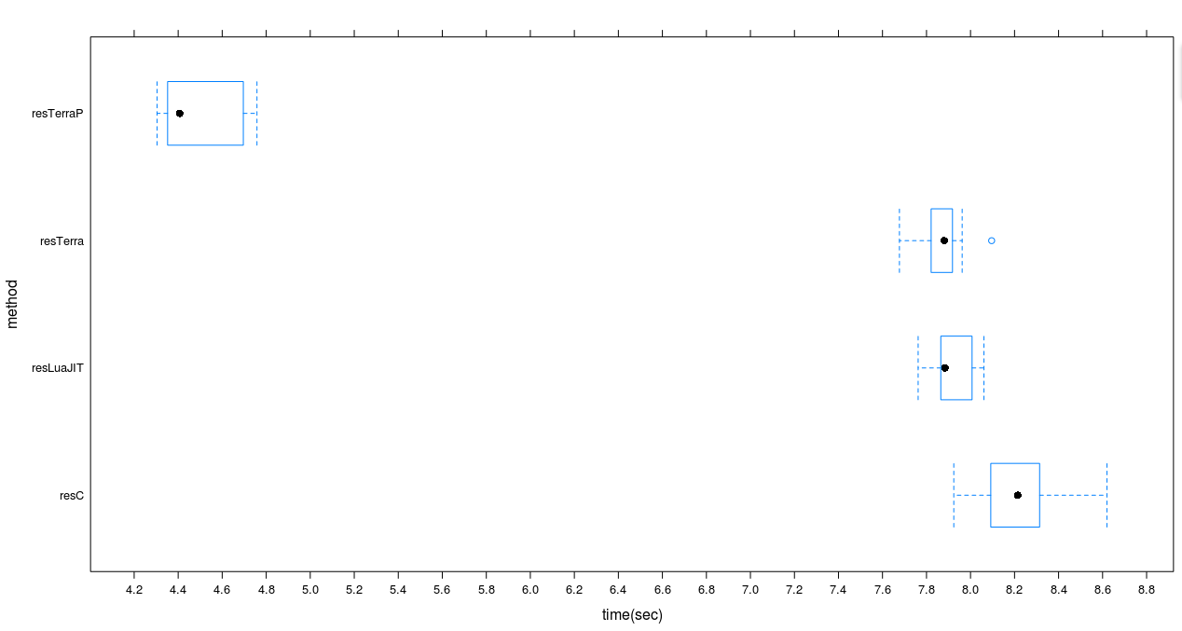
rterra: Performance - Gibbs Sampler
N = 50,000 thin = 300

Slide 23
rterra: Performance - Vector Ops
Weighted Mean: Write this in terra (same as C) or LuaJIT (close to C)
For very large vector size or repeated computations we can use vector ops (SSE)

Slide 24
rterra: Performance - Vector Ops
terra uvwsum(a : R.SEXP,w:R.SEXP)
var a1 = Rt.newReal(a,false)
var w1 = Rt.newReal(w,false)
var s,ws = 0.0,0.0
for i=0,w1.length do
ws = ws + w1:get(i)
s = s + w1:get(i)*a1:get(i)
end
return Rt.newScalarReal(s/ws)
end
terra wsum(a : R.SEXP,w:R.SEXP)
var a1 = Rt.newReal(a,false)
var w1 = Rt.newReal(w,false)
var regular = w1.length and (- [vecsizel])
var wacc : vector(double, vecsizel) = 0.0
var sacc : vector(double, vecsizel) = 0.0
for index =0, regular,[vecsizel] do
var t1 = terralib.attrload([&vector(double,vecsizel)]( w1.ptr + index),{ align = 8 })
var t2 = terralib.attrload([&vector(double,vecsizel)]( a1.ptr + index),{ align = 8 })
wacc = wacc + t1
sacc = sacc + t1*t2
end
var wrest ,srest = 0.0,0.0
for i=regular, w1.length do
wrest = wrest + w1:get(i)
srest = srest + w1:get(i)*a1:get(i)
end
for i =0, [vecsizel] do
wrest = wrest + wacc[i]
srest = srest + sacc[i]
end
return Rt.newScalarReal(srest/wrest)
end

Slide 25
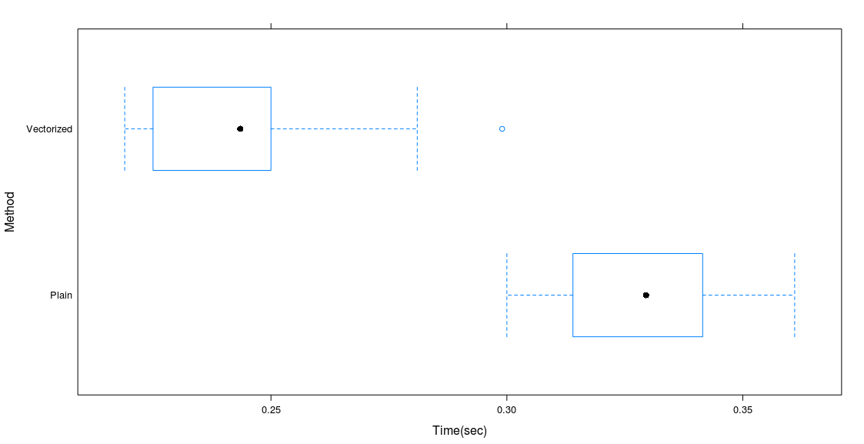
rterra: Performance - Vector Ops
N = 70MM

Slide 26
rterra: Performance - Cosine Distance
LuaJIT need not be always C speed - 2x-3x quite possible (with nested loops)
function doCosineL(mat0) -- unoptimized
local mat = R.asMatrix(R.newReal{fromSexp = mat0})
local retval = R.Robj{type=’numeric’,length = mat.nrows*mat.nrows}
retval["dim"] = R.Roj{type=’int’,with = {mat.nrows, mat.nrows}}
local rm = R.asMatrix(retval)
for row1 = 0, mat.nrows-1 do
for row2=0, mat.nrows-1 do
local s,a1,a2 = 0.0, 0.0,0.0
for i=0, mat.ncols-1 do
s = s + mat[ {row1,i} ] * mat[ {row2,i} ]
a1 = a1 + mat[ {row1,i} ]^2
a2 = a2 + mat[ {row2,i} ]^2
end
rm[ {row1,row2} ] = s / (cmath.sqrt(a1*a2))
end
end
return retval
end

Slide 27
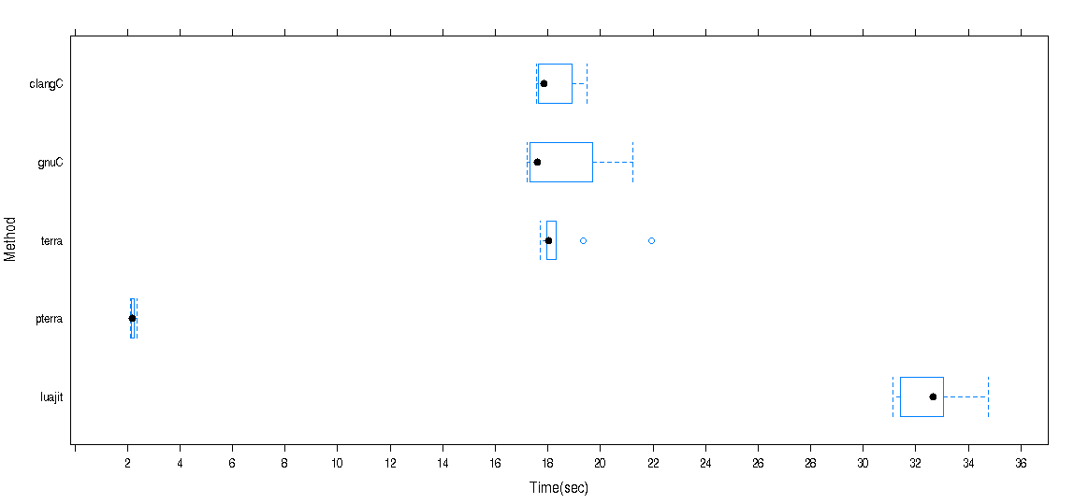
rterra: Performance - Cosine Distance
N=1500;m <- matrix(as.numeric(1:N^2),ncol=N)

Slide 28
rterra: Lua + QT
require 'qtcore'
require 'qtgui'
function plotData3(a)
local scene = QGraphicsScene.new()
local aa = R.Robj(a)
for i = 0,#aa-1 do
local plotElement = aa[i]
local plotType = ffi.string(plotElement[0][0])
if plotType == "circle" then
local x,y, radius = plotElement[1][0],plotElement[2][0],plotElement[3][0]*5
scene:addEllipse(x,y,radius,radius,pen, brush)
elseif plotType == "line" then
local x1,y1= plotElement[1][0], plotElement[2][0]
local x2,y2=plotElement[3][0],plotElement[4][0]
scene:addLine(x1,y1,x2,y2,pen)
elseif plotType == "text" then
local x,y= plotElement[2][0], plotElement[3][0]
local rot = plotElement[4][0]
local txt = ffi.string(plotElement[1][0])
local m = scene:addText(txt, font)
m:setPos(x,y)
m:setRotation(-rot)
end
end
window:setScene(scene)
window:show()
end

Slide 29
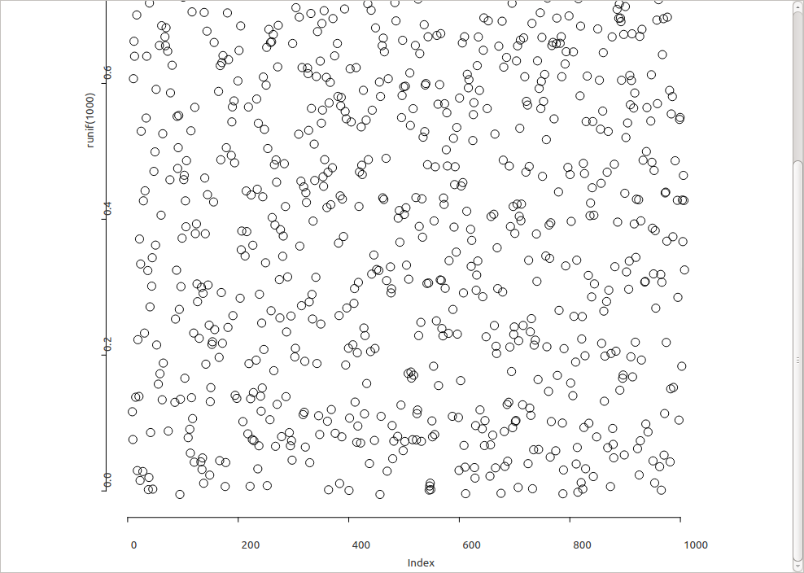
rterra: Lua + QT
library(RGraphicsDevice)
dev <- myDevice()
plot(runif(1000))
ctl <- dev$plots()
terraFile(system.file("examples","rqt.t",package="rterra"))
terra("qtinit",table="rqt")
terraFile(system.file("device","runner.t",package="rterra"))
terra("plotData3",ctl[[1]])
Works nicely with R's eventloop

Slide 30
terra: Language Extensions
Terra can change to a custom parser mid way e.g.
print(sum 1,2,3 done)
let lp = optimize begin
minimize productSum(xs,ys) subject to {
0 <= sum(xs[1:2]) == 1,
sum(xs) <= 1,
sum(xs[1:100]) <= 100,
}
end
One could use this to create a custom DSL
Bugs
Stan

Slide 31
rterra: Summary
Terra is low level and still in research but very usable
Knowing Terra does not mean you can forget C
Segfaults can happen - you are close to the 'metal'
rterra
still in development
Iterative style of development is a pleasure
modify code in terra file
source it and run again - no compile stage
If required, I code in Lua. When performance is not good enough, switch to Terra
all in the same file: seamless
Not the equivalent of rJava!

Slide 32
Appendix: Tracing LuaJIT
LuaJIT can trace the steps involved in JIT compile stage. See
http://luajit.org/running.html
http://stackoverflow.com/questions/7167566/luajit-2-optimization-guide
require'jit.dump'
require'jit.v'
jit.v.start()
jit.dump.start()
function moo()
local x=0; for i=1,1e6 do x=x+i end; print(x)
end
moo()

Slide 34
rterra: How is Terra Involed?
Example: Calling R functions from Lua/Terra
function R.makeRFunction(fname, len,namespace)
local nspace
if not namespace == nil then
local z1 = Rbase.Rf_ScalarString(Rinternals.Rf_mkChar(namespace))
local z2 = Rbase.Rf_lang2(Rinternals.Rf_install("getNamespace"),z1)
nspace = Rbase.Rf_eval(z2,R.constants.GlobalEnv)
else
nspace = R.constants.GlobalEnv
end
local langcall = Rbase["Rf_lang" .. (len+1)]
local fncall
if type(fname)=="string" then
fncall = Rbase.Rf_install(fname)
elseif Rbase.TYPE(fname) == R.types.FUNSXP then
fncall = fname
else
Rbase.Rf_error("What type of function did you give me?")
end
local params = {}
for i = 1,len do
params[i] = symbol(R.SEXP,"argument" ..i)
end
return
terra([params])
var result = Rbase.Rf_eval( langcall( fncall, [params]), nspace)
return result
end
end

