Slide 1
The “PCA Trick”: Separating normal and abnormal timeseries components
John-Mark Agosta
John-mark.agosta@microsoft.com
Microsoft Azure
15 Dec 2020
With thanks to Avinash Sridharan, Alex Yang, Anshul Agarwal, & Sankalp Soni

Slide 2
Abstract
Principal Component Analysis (PCA) is best known for it’s feature generation ability, to find a subspace where most of the feature variance lives. Alternately, when applied to concurrent time-series, it is capable of segregating data into common periodic versus occasional anomalous components. This was demonstrated on network traffic in a seminal paper*.
We show how this applies to detection of anomalies in VM performance time-series, increasing the probability of detection while decreasing spurious alerts two orders of magnitude better than current naïve thresholding methods. We demonstrate this on data of incidents of known VM degradation, using conventional hold-out validation to optimize true positive and false positive rates.
* A. Lakhina, M. Crovella, C. Diot, “Diagnosing Network-Wide Traffic Anomalies”
SIGCOMM’04, Aug. 30–Sept. 3, 2004, Portland, Oregon, USA.

Slide 3
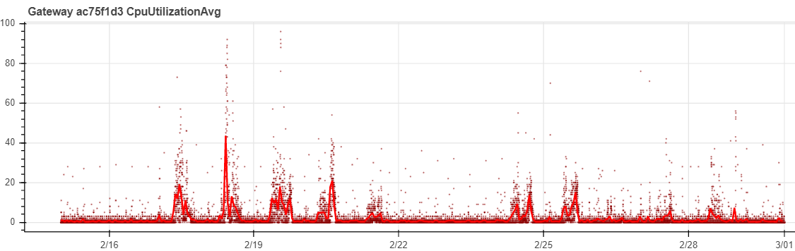
“What is the problem we are trying to solve?”
Setting anomaly thresholds is a moving target. Daily and weekly traffic patterns, and constant load changes make the sensitivity / spurious detection tradeoff hard.
Too many details – each system generates upwards of 100s of measurements a minute
More systems than there are eyes to monitor – which alerts are more extreme/ critical?

Slide 4
Outline
Why this works – Periodic components form their own subspace
“Fourier analysis for free” – easier than transforming the data into frequency space, then filtering.
The data: A known case of multiple timeseries from multiple machines.
The example: extracting anomalies: Thresholding of erratic, periodic metrics

Slide 5
Filtering periodic data with PCA

Slide 6

Fourier functions (sine & cosine) are a translation invariant orthonormal basis.
Fourier functions (e.g. from the family $e^{ix}$) are the eigenfunctions of translation. Since
$e^{(x+h)}=e^{x}e^{h}, −∞<x<∞$
for any displacement h, where $e^{x}=\cos{x+i\sin{x }}$
This means they are a replica of themselves for any h.
Fourier functions also provide a complete orthogonal basis for any periodic function. The combination of these properties means a reduction of a complicated periodic signal can be done as a Fourier expansion.
PCA transformations of stationary time-series recover combinations of Fourier components.

Slide 7
The “PCA-Trick”: To extract an anomaly from noisy periodic time-series
We apply PCA to transform vectors and retrieve principal components of these vectors, then look at the variation present in each of the components. The top PCA components absorb all the periodic variation, and all that remains in the subsequent ones is the anomalous variation.
Essentially obtain a Fourier decomposition “for free”.
Periodic time-series
PCA
reduction
Separate periodic
and anomalous components
Lakhina, A., Crovella, M., & Diot, C. (2004). Diagnosing network-wide traffic anomalies. ACM SIGCOMM computer communication review, 34(4), 219-230.

Slide 8
PCA transformation of signals with common periods
Despite the signals’ phase differences, the first two PCA components form a basis for the cyclic variation
for all 5 signals, leaving the remaining components with just random noise.
PCA

Slide 9
Adding a step anomaly to the 5 cyclic signals
The first two PCA components “soak up” the periodic variation from all signals, leaving the 3rd PCA
component with the common anomaly that was hidden in the signals.
Anomaly
Anomaly
PCA

Slide 10
Anomaly Detection with PCA

Slide 11
How is this done?
Did a change (upgrade, config) lead to an anomaly?
Look back over previous week from the change for a ‘normal’ sample.
Use the “PCA trick” on the set of performance statistics to eliminate periodic components
Detect extreme values by looking at bin frequencies (e.g. histograms) of the reduced anomaly signal.

Slide 12
Data pipeline
The pipeline runs first over “pre-event” interval, then the resulting model runs periodically over hourly data.
Minute by minute
signals
Hourly
Averaging
Merge
Into
common
dataframe
Metric
statistics
PCA
reduction
Anomaly
histograms
signal
Standard
-ize
Threshold
Size and dimensionality of the data
Decreases over stages
Anomaly detection model

Slide 13
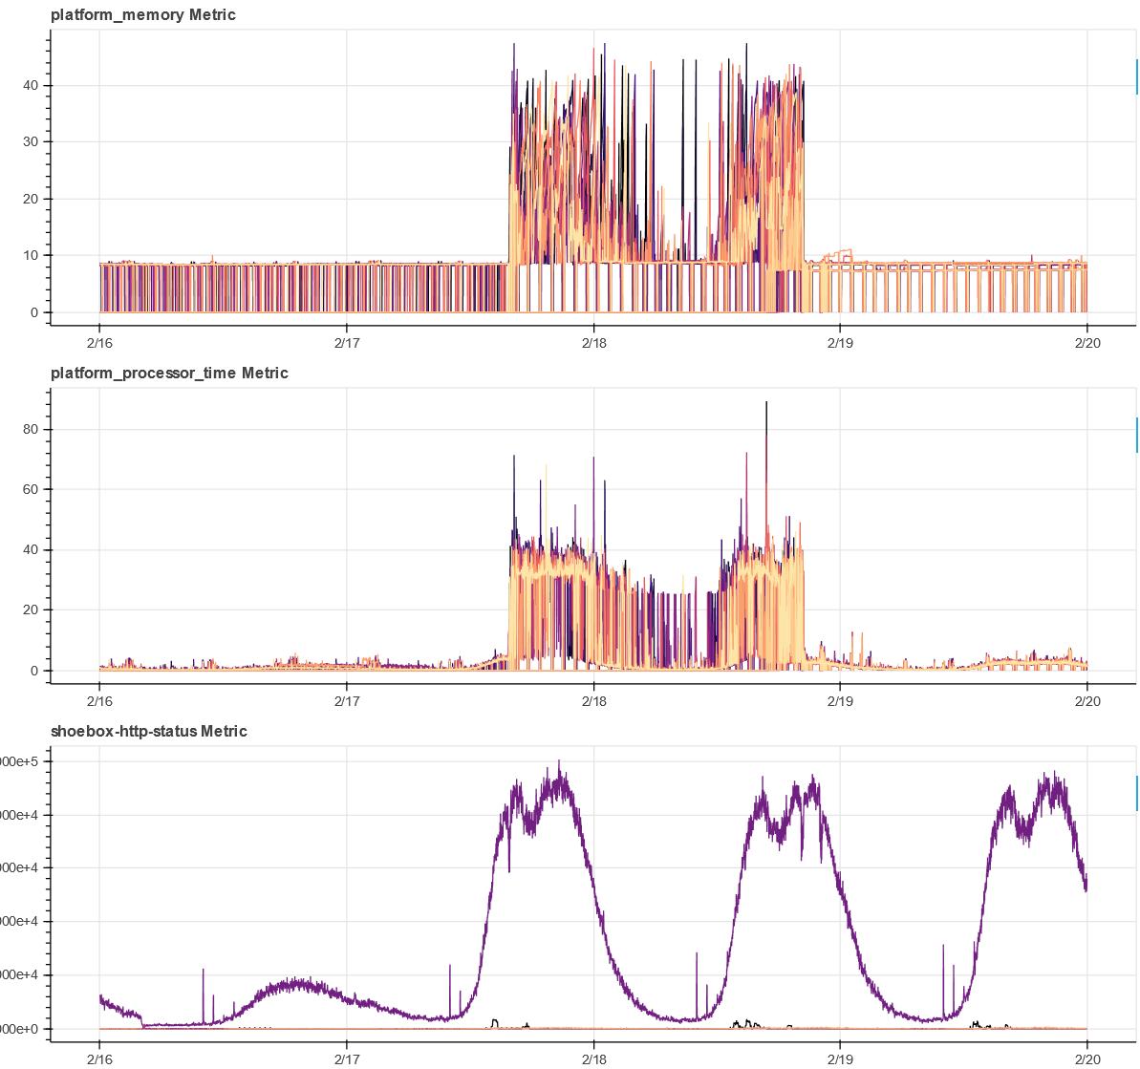
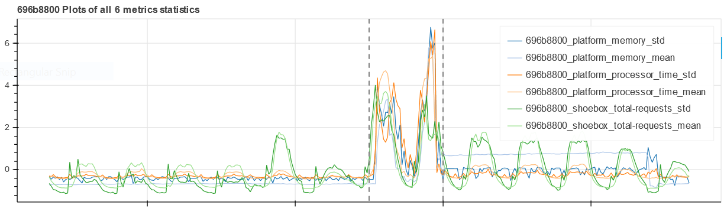
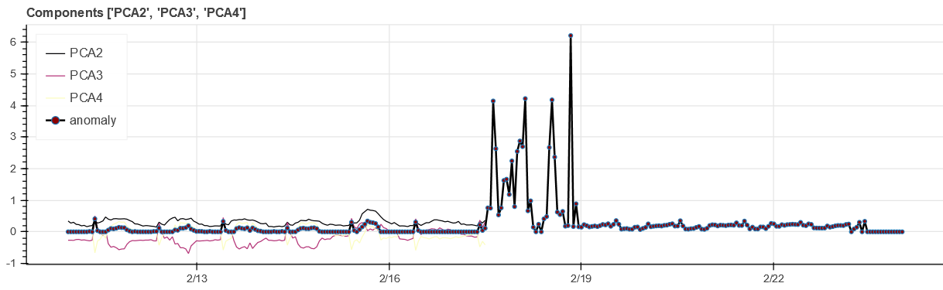
Extracting anomalies from erratic, periodic metrics
Raw metrics
timeseries
Metrics statistics
timeseries
Anomaly signal
derived from
PCA components

Slide 14
Some results on distributed clusters

Slide 15
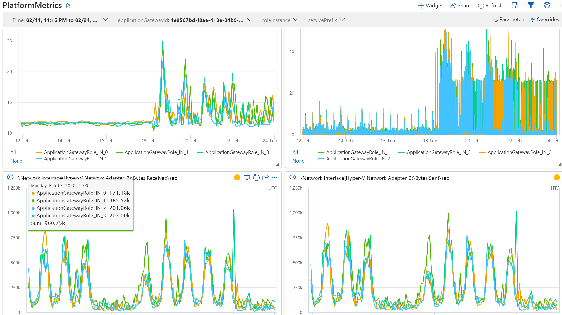
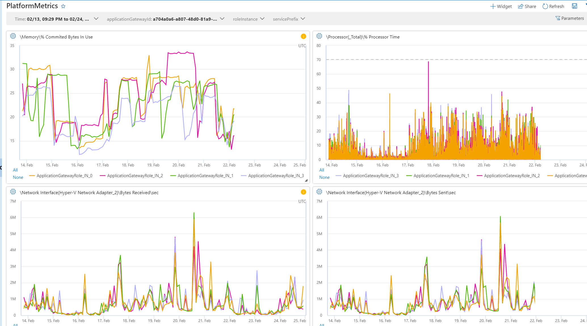
Examples of an anomaly in noisy, periodic data.
Despite evident anomalies in some cases, random periodic traffic without anomalies do not alarm.
High anomaly detection ranking score example
Low anomaly detection ranking score example
Perhaps 100 gws were affected for each ICM reported!

Slide 16
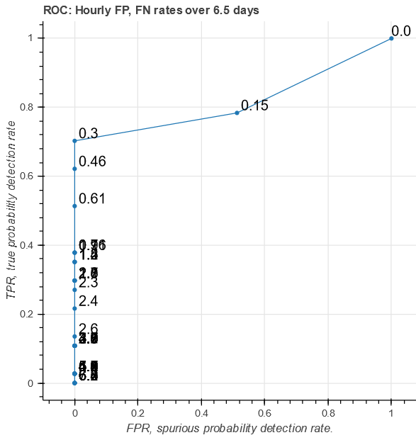
ROC curves for known anomalies
ROC curves show the TP/ FP tradeoffs as the detection threshold varies. Threshold values annotate the curve, increasing as the curve approaches the origin.
The detector is trained on the previous traffic before the known anomaly.
The TP rate is measured on the known anomaly and the FP rate on the subsequent period after the anomaly
The detector is optimized for vanishingly small FP rates.
This demonstrates that the anomaly detector generates no measurable spurious detections for most of the anomaly detection threshold range.

Slide 17
Summary of findings
The PCA-Trick is practical for segregating anomalous common effects in strongly cyclic daily customer traffic.
Thresholds can be tuned on data samples using standard “hold-out” validation methods to decrease FP/TP rates substantially.
Retrospective anomaly detection analysis on a known event demonstrated high (50%) hourly anomaly detection rates at zero measurable FP rates.
Similar analysis of 400 clusters for the same episode demonstrate the ability to strongly distinguish anomalous gateways from normal.

Slide 18
In Summary
We can exploit this peculiar property of a PCA basis on time-series data.
John-mark.agosta@microsoft.com
Look for the writeup on medium.com

